Slide 1
Using Jupyter to Take Your Data Science Workflow to the Next Level
Hunter Glanz
California Polytechnic State University
San Luis Obispo, CA
https://github.com/hglanz/WUSS2019-GlanzTalk

Slide 2
Biography
Hunter Glanz is an Assistant Professor of Statistics and Data Science at California Polytechnic State University (Cal Poly), San Luis Obispo, California. He regularly teaches courses in Statistical Computing with SAS, R, and Python. He enjoys helping organize networking opportunities and hackathon events for students interested in Statistics and Data Science.

Slide 3
Aims/Themes of This Talk
Reproducibility
And
Integration of SAS with open source tools like Jupyter

Slide 4
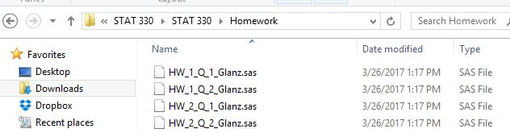
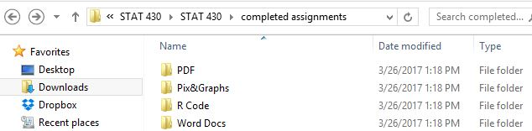
Historical Collaboration on Projects
Organized, but fragmented

Slide 5

Story is Similar between Academia and Industry
Clean, wrangle, mana data
Summarize and visualize data
Analyze and model
Synthesize and report
“Some” assembly required

Slide 6

Historical Deficiencies
Fragmented collection of files:
Code, text, images, data…
Communication, readability, reproducibility suffer
Unnecessarily large distance between data and story

Slide 7
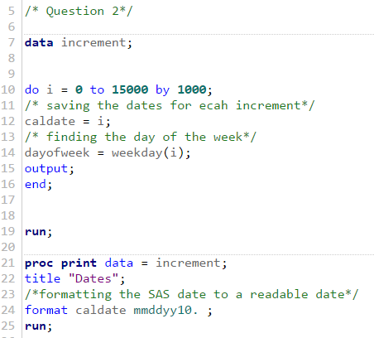
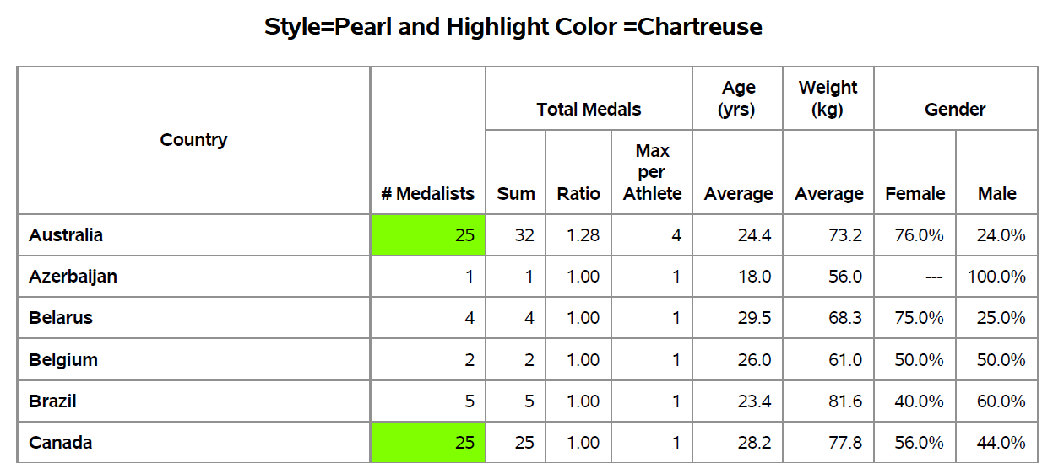
Does Anything Out There Work?
Making computing easier:
IDEs and editors (Emacs, Notebook++, Vim, SAS Studio, Rstudio, etc.)
Make report-writing easier:
SAS*, Rstudio, LaTeX

Slide 8

Nothing Addresses Our Needs
IDEs/Editors
SAS Studio and Rstudio
Built-in documentation
Color coding, formatting, etc.
Documenting
Rmarkdown & Report-Writing Interface
Highly customizable LaTeX
None of these integrate coding and documentation!

Slide 9

Capabilities of Ideal Tool
Color coding, formatting, organization of existing tools
Documentation and report writing organically coexist with coding
Streamline the process of:
Exploratory data analysis
Data science
Research
Analytics
And more!

Slide 10

Cue the Jupyter Project
Supports over 40 software languages!

Slide 11
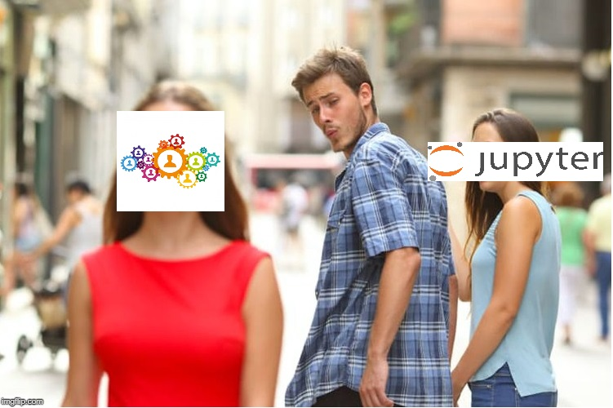

You May Be…

Slide 12

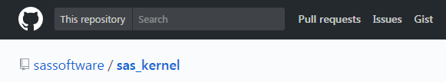
Getting Started with Jupyter Notebooks

Slide 13
Live Demo of Jupyter via SAS University Edition!
Live Demo!

Slide 14
Project Jupyter Summary Part I
Web application enabling creation of documents that contain live code, equations, visualizations and explanatory text.
Over 40 languages are supported including SAS, Python, and R.
Code within the notebook can produce rich output such as images, videos, LaTeX and JavaScript.
Interactive widgets can be used to manipulate and visualize data in real time.

Slide 15
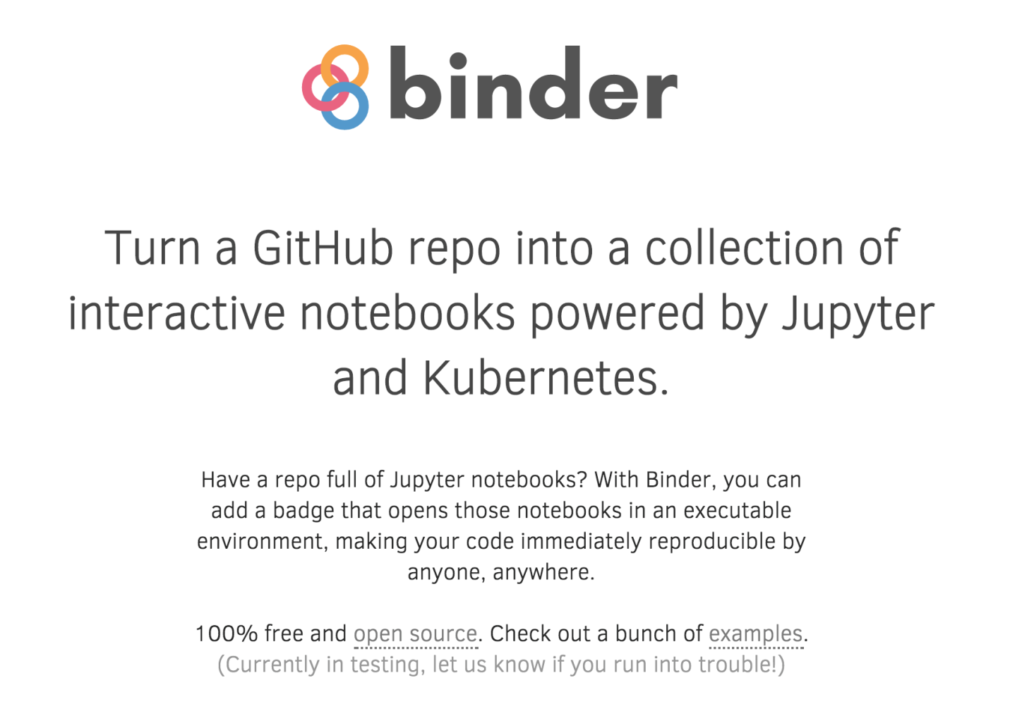
Project Jupyter Summary Part II
Nbviewer
GitHub
Binder
JupyterHub (for organizations)

Slide 16
Conclusions: Ease of Use
From personal use to JupyterHub for organizations, Jupyter Notebooks make statistical computing easier to do AND share than ever before!
“The need to minimize thought-to-execution friction is probably the single biggest productivity requirement in corporate America.”
Jupyter Notebooks let us take a GIANT leap toward achieving this when it comes to data science and statistical computing.

Slide 17
Conclusions: The Tool We Need and Deserve
Jupyter Notebooks
A single vehicle for live code, text and images.
Dynamic documents that enhance statistical computing and statistical communication.
Streamline the analytics process
The color coding, formatting and organization of your favorite editor
Report writing capabilities
The integration and synthesis of these things into a single environment

Slide 18
Thank You! Questions?
Slides and Live Demo at https://github.com/hglanz/WUSS2019-GlanzTalk

Slide 19
Contact Information
Name: Hunter Glanz
Company: California Polytechnic State University
City/State: San Luis Obispo, CA
Phone: 805-756-2792
Email: hglanz@calpoly.edu

