Slide 1
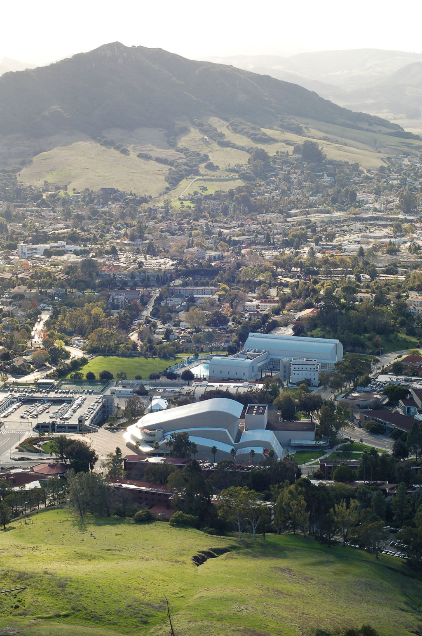
Cross-Disciplinary Studies Program
in Data Science
Hunter Glanz Statistics
Alex Dekhtyar Computer Science
Dennis Sun Statistics
And Many More!
https://github.com/hglanz/mc2_series_2021_GlanzDS
Notes:
About me:
Professor of Statistics for 18 years
Restored Statistical computing (non-SAS) in 1997 teaching S-Plus, then R.
Just stepped down as Chair of the Academic Senate Curriculum Committee after a 5 year tenure.
About Alex:
Professor of Computer Science and Graduate Coordinator
The “database” and Knowledge and Discovery with Data guy

Slide 2
Goal
Establish a Data Science Program at Cal Poly
Notes:
2

Slide 3
Limitations
2013-2014
No “data science” faculty
No resources
Limited hiring prospects (1CS + 1 STAT)
Notes:
3

Slide 4
Partnership
Computer Science + Statistics
Home to the only students on campus ready for it
Notes:
4

Slide 5
Step 1
We figured out what we want to teach
Notes:
5

Slide 6
Data Scientist Skills
Background
Computer Science
Linear Algebra
Linear/Numeric Analysis
Gradient Descent
Probability Theory
Databases
Algorithms
Distributed Computations
Data Mining
Specialized Knowledge
Statistics
Linear Regression
Max Likliehood
Expectation Maximization
Multivariate Analysis
Principal Component/
Factor Analysis
Data Acquisition
Data Wrangling
Model Selection
Feature Engineering
Data Visualization
Communication
GIS awareness
Advanced Knowledge
Notes:
6

Slide 7
Step 2
We figured out the classes
Notes:
7

Slide 8
Computer Science | Statistics/Math | Data Science
 |  | Electives
August 12, 2015
BDA EDCON 2015 - Puerto Rico
Notes:
8

Slide 9
Computer Science | Statistics/Math | Data Science
Introduction to Computer Science I, II, III
Discrete Structures
Design and Analysis of Algorithms
 |  | Electives
Intro CS Sequence
August 12, 2015
BDA EDCON 2015 - Puerto Rico
Notes:
9

Slide 10
Computer Science | Statistics/Math | Data Science
Introduction to Computer Science I, II, III | Statistics II / Statistics for Engineers
Discrete Structures | Introduction to Probability and Simulation
Design and Analysis of Algorithms
 | Linear Algebra | Electives
 | Calculus III
Stat and Math Background
August 12, 2015
BDA EDCON 2015 - Puerto Rico
Notes:
10

Slide 11
Computer Science | Statistics/Math | Data Science
Introduction to Computer Science I, II, III | Statistics II / Statistics for Engineers
Discrete Structures | Introduction to Probability and Simulation
Design and Analysis of Algorithms
Introduction to Database Systems
Introduction to Distributed Computing
Knowledge Discovery from Data | Linear Algebra | Electives
 | Calculus III
Relevant CS Coursework
August 12, 2015
BDA EDCON 2015 - Puerto Rico
Notes:
11

Slide 12
Computer Science | Statistics/Math | Data Science
Introduction to Computer Science I, II, III | Statistics II / Statistics for Engineers
Discrete Structures | Introduction to Probability and Simulation
Design and Analysis of Algorithms | Applied Regression Analysis
Introduction to Database Systems | Statistical Computing with R
Introduction to Distributed Computing | Applied Multivariate Statistics
Knowledge Discovery from Data | Linear Algebra | Electives
 | Calculus III
Relevant STAT Coursework
August 12, 2015
BDA EDCON 2015 - Puerto Rico
Notes:
12

Slide 13
Computer Science | Statistics/Math | Data Science
Introduction to Computer Science I, II, III | Statistics II / Statistics for Engineers | Introduction to Data Science
Discrete Structures | Introduction to Probability and Simulation | Data Science
Design and Analysis of Algorithms | Applied Regression Analysis | Data Science Capstone I, II
Introduction to Database Systems | Statistical Computing with R
Introduction to Distributed Computing | Applied Multivariate Statistics
Knowledge Discovery from Data | Linear Algebra / Linear Analysis | Electives
 | Calculus III | STAT or CS (2 courses)
August 12, 2015
BDA EDCON 2015 - Puerto Rico
Notes:
13

Slide 14
Computer Science | Statistics/Math | Data Science
Introduction to Computer Science I, II, III | Statistics II / Statistics for Engineers | Introduction to Data Science
Discrete Structures | Introduction to Probability and Simulation | Data Science
Design and Analysis of Algorithms | Applied Regression Analysis | Data Science Capstone I, II
Introduction to Database Systems | Statistical Computing with R
Introduction to Distributed Computing | Applied Multivariate Statistics
Knowledge Discovery from Data | Linear Algebra / Linear Analysis | Electives
 | Calculus III | STAT or CS (2 courses)
21 courses
80 quarter units

Slide 15
Our Challenge
How in the world can we pull this off?

Slide 16
Finding the vehicle
Minor
Concentration
A coherent group of courses which stands alone and provides a student with broad knowledge of and competency in an area outside the student's major.
24-30 quarter units (6-8 courses)
Not taken in your degree program
A coherent and specialized course of study within a student's major degree program, which presupposes knowledge of the major discipline
A block of at least 5 designated courses included in the major
Notes:
16

Slide 17
Finding the vehicle
What if the knowledge you seek…
Enhances your understanding of your discipline
but
Comes from another discipline???
Notes:
17

Slide 18

Best of both worlds
CROSS-DISCIPLINARY STUDIES MINOR
specificity
MINOR
breadth
CONCENTRATION
depth
http://www.threadless.com/teachers/a-venn-diagram-love-story/
Notes:
18

Slide 19
Cross Disciplinary Studies Minor
Definition
A cross-disciplinary studies minor (CDSM) is the result of a partnership between two or more target major programs. It is defined as a set of curricular requirements comprised of coherent groups of courses tailored for each partner program such that all students from target majors develop
depth in the partner discipline,
focused study in their own discipline, as well as
focused study in the mutual domain of the minor.
Notes:
19

Slide 20
Cross Disciplinary Studies Minor
Curricular requirements are the same for all students.
The total number of units that are not covered by the student’s major shall not exceed 24 units.
At least 12 units beyond the requirements of the student’s major.
At least half of the units must be from upper division courses.
Notes:
CDSM in Interactive Arts
CENG and CLA
Computer Science and Graphic Communications
20

Slide 21
Conclusion
Goal : Offer an in-depth Data Science curriculum
Challenge : 21 classes, 80 units; no proper vehicle
Solution : new type of subprogram
(Cross-Disciplinary Studies Minor)

Slide 22
DATA 401: Data Science
Purpose: Synthesis of knowledge
Prerequisites: High (all other courses from minor)
Content:
“Big Data”
Properties
Computational approaches
Case Studies
directed project-based learning
full data science workflow/lifecycle
Full synthesis of knowledge from prior coursework
Databases/data management
Data acquisition/preparation
Distributed computations
NoSQL (CS tech electives in Databases)
Data Analysis
R and Python

Slide 23
DATA 451/452: Capstone
Purpose: “Real World” Experience
Modeled after Computer Engineering capstone
Two quarters
Teams
Outside customers (Cal Poly faculty; businesses; non-profits; government)
Full-scale data science consulting project
“Big Data”
Analytics
Work with customer
Visualization
Explanation/Presentation
Synthesis and culminating experience

