Slide 1

ChillFlix

Slide 2
Content

Slide 3
Content
What?
Why?
How?
Low Fidelity
High Fidelity
Tools

Slide 4
What?

Slide 5
What is ChillFlix?
ChillFlix provides users to steam movies, TV series and many more other contents seamlessly
Latest Contents
Trending Movies and videos
Preferences

Slide 6
Why?

Slide 7
Personalization is critical in making a mobile User Experience delightful

Slide 8
Continue..
If we look at present-day scenarios, a majority of people like to spend their free time doing nothing but binge-watching their favorite shows
Growth of digital media consumption is growing exponentially over the past few years

Slide 9
Continue..
If we look at present-day scenarios, a majority of people like to spend their free time doing nothing but binge-watching their favorite shows
Growth of digital media consumption is growing exponentially over the past few years

Slide 10

How we started?

Slide 11
How we started?
Brainstorming
Found possible screens for various context
Made low fidelity layout for each screens
Designed user flow of each screens
Identified design patterns and colors for the app
Done Detailing of each pages

Slide 12
Low fidelity?

Slide 13
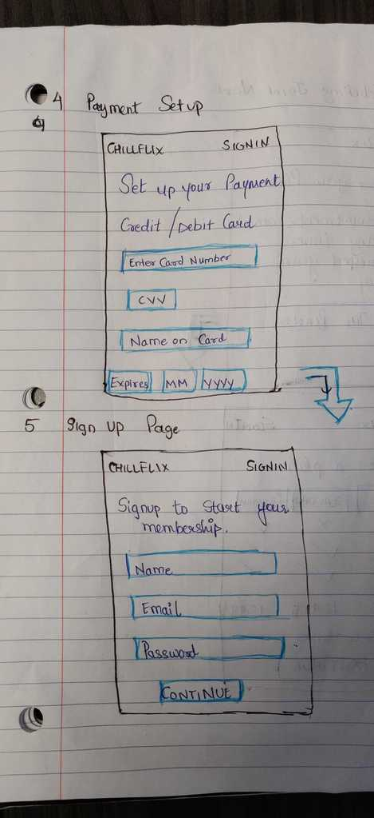
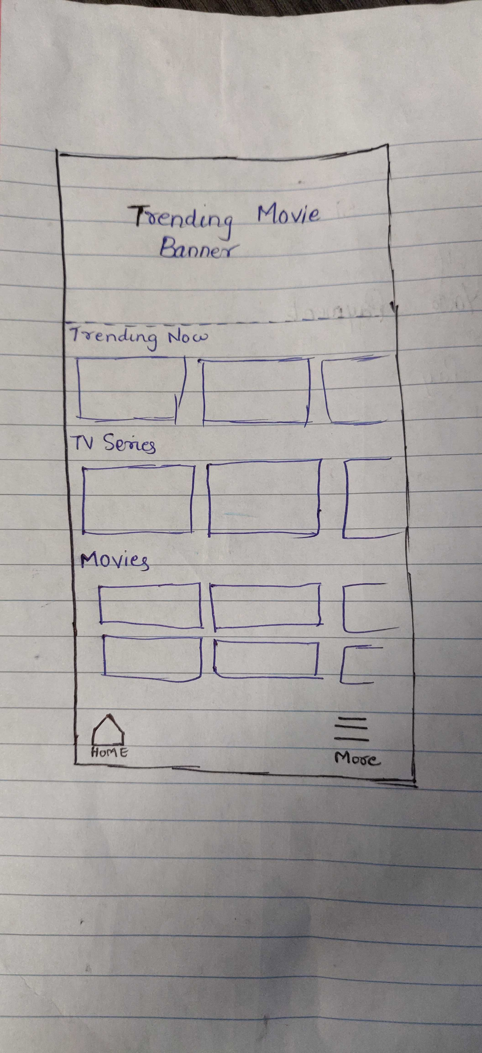
Screens

Slide 14
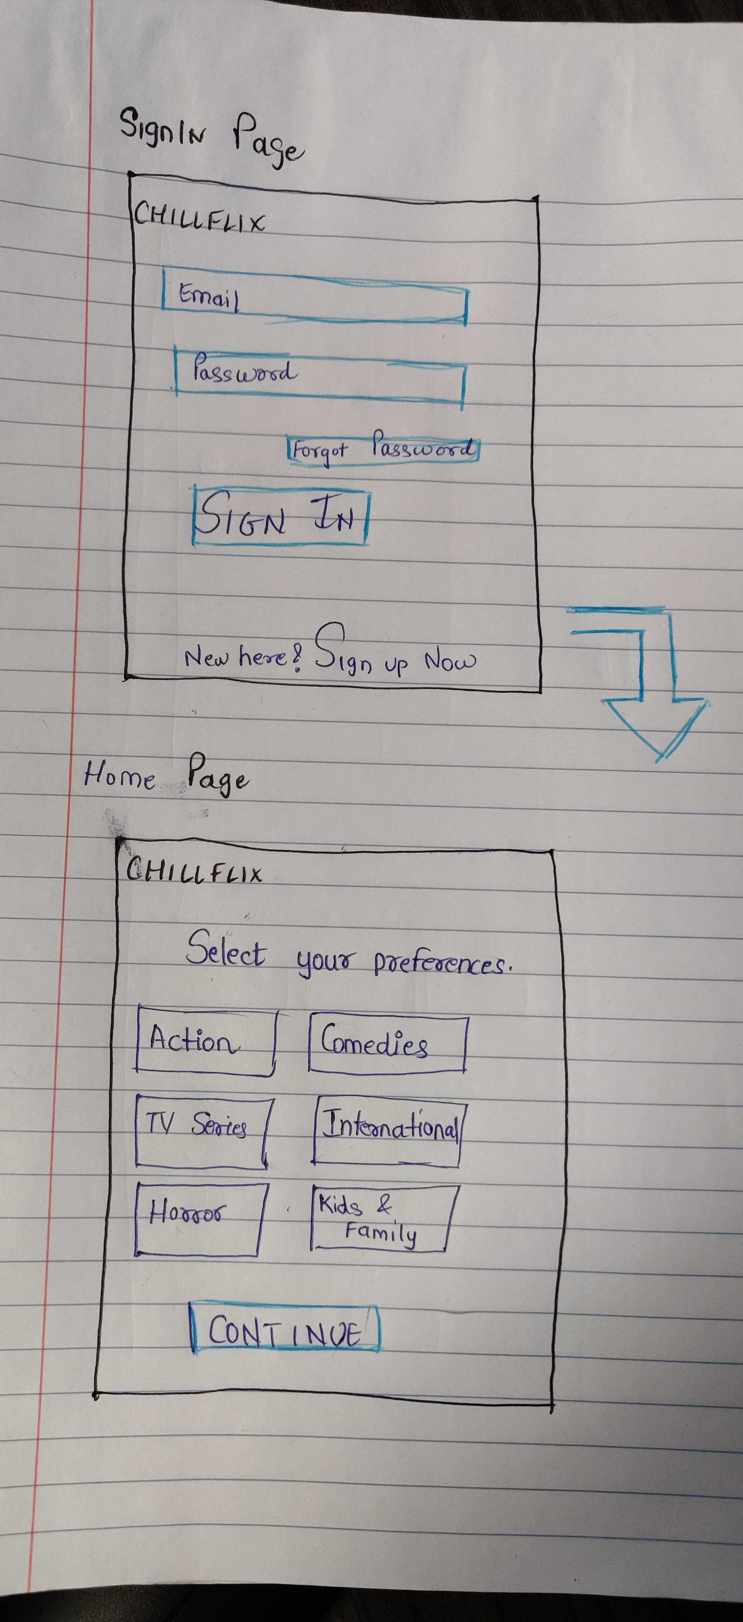
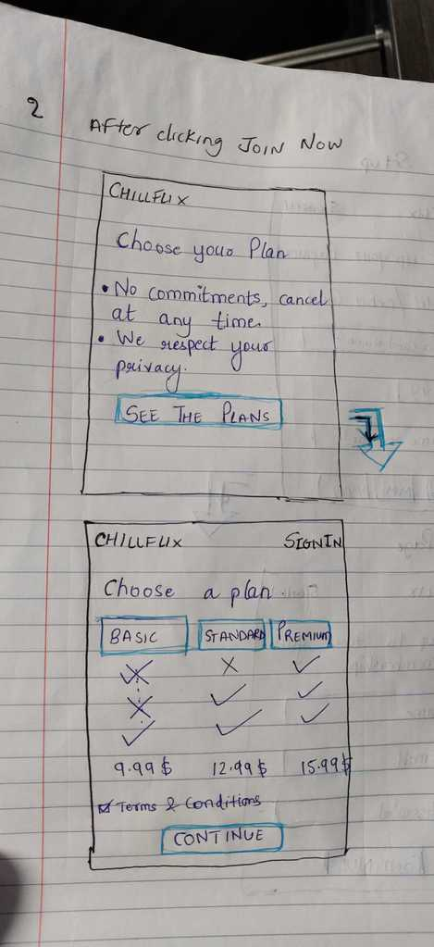
Screens

Slide 15
High fidelity?

Slide 16
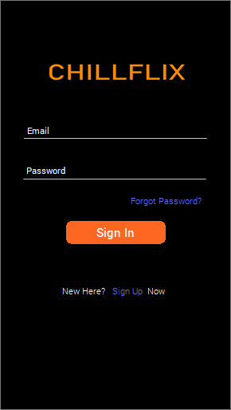
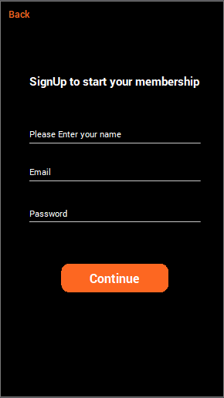
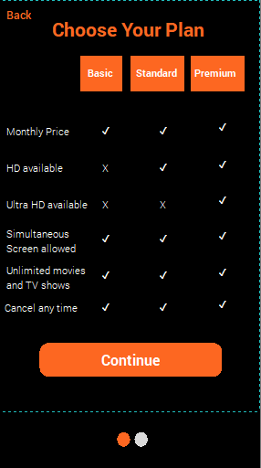
Screens

Slide 17
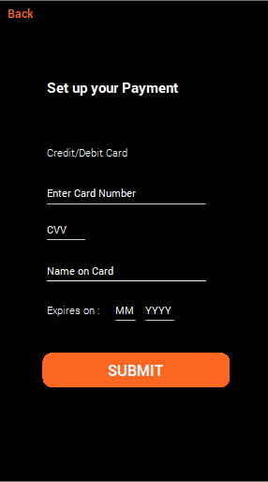
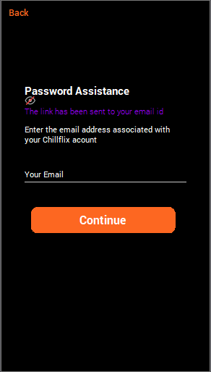
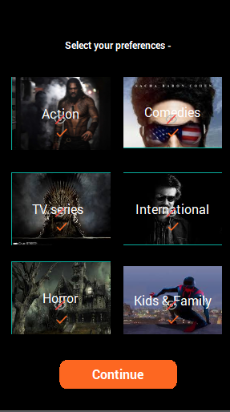
Screens

Slide 18
Tools?

Slide 19
Tools we have used
Communication Tool: Slack
Prototyping Tool: JustInMind
Project Tracking Tool: ZenHub
Version Control: Github

Slide 20
References?

Slide 21
Tools we have used
https://www.justinmind.com/support/
https://www.youtube.com/
NetFlix Mobile App
Amazon Prime App

Slide 22
Questions?

Slide 23
THANKS! Guided By : Prof. Richard Grand'Maison
1896288 - Harsh Mehta
1896362 - Harshil Ramswaroop
1896494 - Urvil shah
1896502 - Himanshu Shah
1896933 - Ruby Ann

