Slide 1
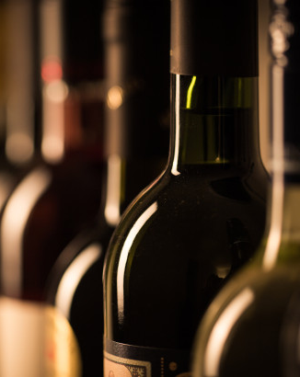
Data “Wine”tists
Kevin Heaney
Howard Mitchell
Rodney Mosquito
Suzanne Polk
John Sachs
Notes:
To change the image on this slide, select the picture and delete it. Then click the Pictures icon in the placeholder to insert your own image.

Slide 2
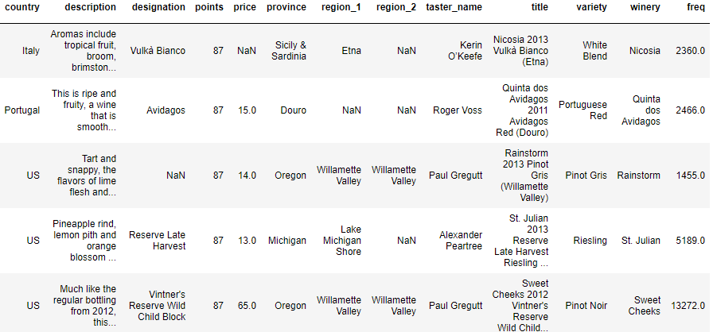
The Data
Dataset located on Kaggle
Wine reviews scraped from WineEnthusiast on 11/24/2017
Variables include country, price, variety, and review score
We explore the dataset in one of the Tableau storyboards
We parse the wine descriptions into their constituent words

Slide 3
Data Transformation
We created categories for the wine, manually categorizing the varietals with above 200 wines in the dataset into red, white, sparkling, or rosé
Description parsed into its constituent words
Categorize the words into flavor profiles distinct for each category
Feed each wine’s list of words into an equation that assigns them a flavor profile
Dropped countries with fewer than 20 wines in the review set

Slide 4
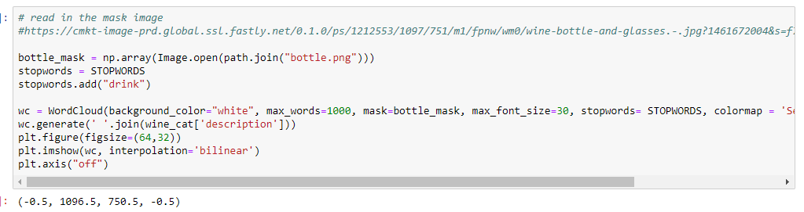
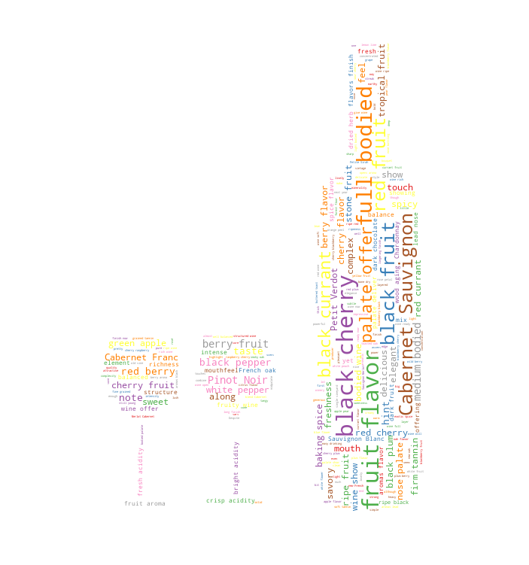
Word Cloud
Parsed common words out of description
Created a word cloud from the most common words
Used additional functionality to map it onto an image

Slide 5
The Machine Learning Model
The predicted value is the review score (0-100)
We train the model on one-hotted country variables, category variables, the reviewer’s name, and the price
The virtual sommelier (“json”-melier) returns an estimated score based on criteria passed into it
[demo the notebook]

Slide 6
Future functionality:
Wine Recommender
By providing fields on which to filter, we hope to be able to provide recommendations from the list of
Get flask working properly
Materialize, the website design we used, interfered with flask server
Call the machine learning model itself via JavaScript & Pickle or use Google Cloud to host the machine learning model & call that way

Slide 7
Website Demo
[demo]

