Slide 1


HiddenGem Media
HOW TO SPEAK OUR ICP'S LANGUAGE
Industry Acumen – Hotel & Resort Terminology
Session 2 of 2: fourteen terms in about 60 minutes
why direct pays · is the marketing working? · the stack · two rounds of practice and a sort
Notes:
NICOLE
Okay, is everybody settled in? Welcome back, everybody in the room and everybody on the call.
Last week you met five owners. They're back. Marisol has a buyer on the line, Walt's promo code is doing suspiciously well, and Theo has decided guest emails are one less thing to manage.
Session 1 was the owner's side of the business: what a room goes for, what the place keeps, and when guests book. Session 2 is our side of it. Why a direct booking is worth more than its price. Whether the marketing is actually working. And the tools a property runs on, which you'll be sorting on your own phone.
Fourteen terms, two rounds of practice and a sort. Same deal as last time: nobody's behind, Kyle and I are learning this alongside you, and if a term doesn't click, stop us. Let's go.
--------
REFERENCE
SAY THIS: “Last week you met five owners. They're back.”
Nicole opens session 2 (Kyle's split, 5 Oct: Nicole has slides 1 to 17, 33 to 39, 44, 45 and 49; Kyle has 18 to 32, 40 to 43 and 46 to 48; the deck's notes carry the names). Looser voice than the rest of the deck, as on session 1's slides 1 and 65. The callback line "Last week you met five owners. They're back." is the one line to keep if the rest is reworded (handoff, 1 Oct); the three cues after it are the owners who appear in the two practice rounds. No agenda slide: slide 2 recaps and slide 3 shows the shape. "On the call": the room is mixed (decisions log, 25 Sep). Nothing here is a correction; session 1 went well and this is the second half of a proactive training (decisions log, 27 Sep).
— slide 1 of 49

Slide 2





01 · WHERE WE LEFT OFF
Where we left off
Session 1 in four lines. Everything today builds on these.
1
The profit ladder
Total revenue, then GOP (gross operating profit), then NOI (net operating income). The buyer prices the bottom rung.
2
Sold, or available?
ADR (average daily rate) is what a sold room went for. RevPAR (revenue per available room) counts the empty ones too.
3
What did they leave out?
The qualifier is the question: “basically full”, “best summer yet”.
4
Ask which number it is before you react to it
The habit that survives any trim.
2 / 48
Notes:
KYLE
Before the new terms, here's session 1 in four lines, because today leans on every one of them.
One: the profit ladder. Total revenue is everything guests spend. Take off the cost of running the place and you get GOP, gross operating profit. Take off the owner's fixed costs and you get NOI, net operating income. NOI is the bottom rung, and it's the number a buyer prices. Hold onto that one: Lakeside Lodge's buyer comes back today.
Two: sold, or available? ADR, average daily rate, is what a sold room actually went for. RevPAR, revenue per available room, counts the empty rooms too. Same month, two different numbers.
Three: what did they leave out? "Basically full." "Best summer yet." The qualifier is usually where the real question is.
And four, the habit underneath all of it: when an owner quotes a number, ask which number it is before you react to it.
If any of those are fuzzy, the dictionary is live on the portal now, and we'll show you where at the end. For today, that's all you need.

Slide 3


02 · WHAT WE'LL COVER
Today in three blocks
Block 4: why direct pays
Block 5: is the marketing working?
Block 6: the stack
01
Metasearch
01
CPM
01
The tools map
02
Cap rate
02
UTM
02
Rate shopping and market intelligence tools
03
First-party data
03
CAPI
03
CRM tools
04
Effective commission
04
Incrementality
04
Guest messaging tools
05
Cannibalization
05
Upsell tools
3 / 48
Notes:
KYLE
Here's how today is laid out. Three blocks again, each a handful of terms and then practice on exactly those terms.
First, why direct pays: what a direct booking is really worth, and what it costs to win one.
Second, is the marketing working: the ad numbers an owner will quote at you.
Third, the stack: the systems a property runs on, which you'll sort on your own phone at the end.

Slide 4




BLOCK 4 · WHY DIRECT PAYS
Block 4: why direct pays
Four terms that put a number on a direct booking: where guests compare your price, what a buyer pays for your profit, what you own when the guest books with you, and what it really cost to win them.
01
02
03
Metasearch
Cap rate
First-party data
Where a guest sees your price next to the OTAs' (online travel agencies).
What a buyer pays for your profit.
What you own when the guest books with you.
04
Effective commission
What it really cost to win them.
4 / 48
Notes:
NICOLE
Block 4: why direct pays. Four terms. Metasearch, where a guest sees your price next to the OTAs'. Cap rate, what a buyer pays for your profit. First-party data, what you own when the guest books with you. Effective commission, what it really cost to win them.
Same client as last week, Lakeside Lodge, 50 rooms. Its owner and every number here are made up.
--------
REFERENCE
SAY THIS: “Lakeside Lodge, its owner and every number in this block are made up.”
Block-intro shape: the terms in one breath, then practice is coming (said at the end of slide 8 instead, so the intro stays short). OTA glossed here, first spoken use in this deck. Dictionary, OTA: "A third-party marketplace selling the room for a cut." Reference term; one breath. The made-up line is said on every block intro and rules slide (house rule, 28 Sep). The four icons are Untitled UI line icons rasterised with `make_icons.py`; if a glyph is missing from the 70 already in the project, add it the same way (search, percent, user-check, receipt).
### The four term slides (8 min, slides 5 to 8)
— slide 4 of 49

Slide 5

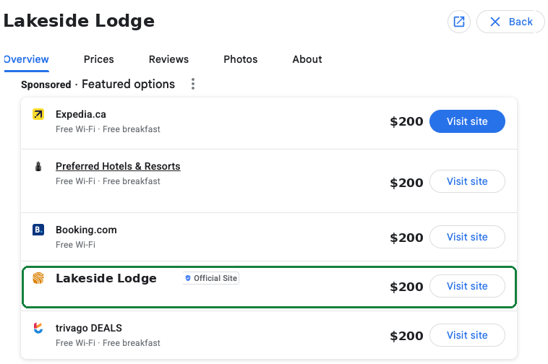


BLOCK 4 · WHY DIRECT PAYS
Metasearch where guests compare your price
Dictionary
Google Hotel Ads, Tripadvisor, Trivago — rate comparison that passes traffic on to a booking channel.
WHAT A GUEST SEES WHEN THEY SEARCH LAKESIDE LODGE ON GOOGLE
Why the owner cares
Their direct price sits next to Booking.com's and Expedia's on the same screen, and the click that lands on their own site is a booking they keep. It is also where last week's rate parity becomes visible to the guest.
Contextual usage
Guests comparing prices on Google or Tripadvisor are on metasearch — are you showing up there with your direct rate?
Same public price everywhere. The official-site line is the click that lands on her site.
5 / 48
Notes:
NICOLE
Metasearch. Say a guest types "Lakeside Lodge" into Google and a panel comes up with the lodge's dates and prices from several places: Expedia, Booking.com, a hotel programme, the lodge's own website, trivago. That panel is metasearch. Google Hotel Ads, Tripadvisor, Trivago: sites that compare prices and then pass the guest on to wherever they click. They don't take the booking. The OTAs do.
[Point to the panel.] This is what the guest sees. Every line says $200, because of rate parity from last week: the public rate stays level everywhere. So the direct listing doesn't win on price. It wins on where the click lands. [Point to the green line.] That one says "Official Site". Click it and the booking lands on Marisol's site, and she keeps it. Click Expedia, and Expedia takes its cut.
Why the owner cares: this is the one place their own price and the OTAs' price sit on the same screen. If the lodge isn't listed there, the guest only sees the OTAs, and the booking goes to Expedia with Expedia's cut on it. Two ways to be there: Google's free booking links, which cost nothing, and Google Hotel Ads, which are paid.
On a call: "Guests comparing prices on Google or Tripadvisor are on metasearch. Are you showing up there with your direct rate?"
The so-what for you: when an owner says "we're on Google now", ask whether it's the free listing or the paid one. Next: what a buyer pays for the place.

Slide 6


BLOCK 4 · WHY DIRECT PAYS
Cap rate capitalization rate: what a buyer pays for NOI
Dictionary
The yield a buyer prices the property at, applied to NOI.
NOI ÷ Purchase price
The buyer is back. Lakeside Lodge made $900,000 of NOI over the last twelve months; the offer is $12,000,000. What cap rate is that?
Cap rate = $900,000 ÷ $12,000,000 = 7.5%
Why the owner cares
Therefore, cap rate = 7.5% (the price is 13.3 × NOI)
It turns NOI into what the place is worth, so every dollar added to NOI adds many dollars to the value of their life's work. Buyers start from the cap rate; the price falls out of it.
HOW A BUYER ARRIVES AT 7.5%, THEN AT THE PRICE
1
Comparable sales: what similar lodges sold for, relative to NOI
2
The return they need: more risk or dearer borrowing, higher cap rate
3
Then the price: NOI ÷ cap rate = $900,000 ÷ 7.5% = $12,000,000
Contextual usage
4
Add $75,000 of NOI and the lodge is worth about $1,000,000 more
A higher NOI at the same cap rate means the property is worth more — that's the long game.
6 / 48
Notes:
NICOLE
Cap rate. A capitalization rate is the expected annual rate of return on a commercial real estate property, calculated by dividing its net operating income by its current market value or purchase price.
Last week Marisol's buyer asked for her NOI. This week the buyer came back with a price. Cap rate is how the two connect. The formula is NOI divided by the price, and it's the return the buyer wants on their money. [Point to the card.] Over the last twelve months, Lakeside Lodge made $900,000 of NOI. The buyer offered $12 million. $900,000 divided by $12 million is 7.5%.
But here's the part the formula hides: in real life the buyer doesn't start from the price. They start from the cap rate, and the price falls out of it. [Point to the list.] How do they pick 7.5%? Two things. Comparable sales: what similar lodges sold for lately, as a share of their NOI. And the return they need: a riskier property, or money that's more expensive to borrow, means they want a higher return, so a higher cap rate, and a lower price. Then they turn the formula around: price equals NOI divided by cap rate. $900,000 divided by 7.5% is $12 million. You'll also hear it as a multiple: $12 million is about thirteen times the NOI. Same deal, said the other way up.
Why the owner cares: at 7.5%, every extra $75,000 of NOI is worth about a million dollars more at sale. So every booking we move direct, every spa package, lifts the number a buyer would pay.
One caution: A buyer prices a full year, not a month
On a call: "A higher NOI at the same cap rate means the property is worth more. That's the long game."

Slide 7


BLOCK 4 · WHY DIRECT PAYS
First-party data the guest data you own
Dictionary
Guest data the property owns outright, which is most of why direct matters.
WHO HOLDS THE GUEST, AND WHAT COMES WITH THEM
Booked via OTA
Booked direct
Booking.com has the guest's email and the stay history.
The guest is Booking.com's to re-market.
Next year's stay pays commission again.
The email: next year's stay, no commission.
The data: retargeting and lookalike audiences start from this list.
The pre-arrival upsell: spa, dinner, a better room.
The review and the referral come to the lodge.
Direct bookings tend to cancel less.
Why the owner cares
Owning the guest relationship means next year's stay without paying commission again. A direct booking is worth its price plus everything that comes with the guest.
Contextual usage
Every direct booking gives you first-party data — the guest's email is yours, not the OTA's.
7 / 48
Notes:
NICOLE
First-party data. Plain words: guest data the property owns outright. Who stayed, when, their email, what they spent. "First-party" just means it's theirs, collected by them, not borrowed from a platform.
[Left, then right.] Two guests at Lakeside Lodge. The first booked through Booking.com. Booking.com has their email, sends the confirmation, sends the reminders, and when that guest wants to come back next summer, Booking.com will happily help them, for another cut. The lodge can see a name on a booking, but the relationship isn't theirs. The second guest booked direct. The lodge has the email, the dates, the spa booking.
Now look at everything that comes with that second booking, beyond the price. The next stay is one email away, with no commission on it. That guest's details seed the retargeting audience and the lookalike audience, so the ads find more people like them. The week before arrival, the lodge can offer dinner, the spa, a better room. The review and the referral land with the lodge, not on an OTA's page. And direct bookings tend to cancel less than OTA ones. A $1,500 direct booking isn't worth $1,500. It's worth that plus every one of those.
Why the owner cares: this is most of why direct matters, and it's what our funnel is built to do. The welcome offer, the landing page, the email list: every one of those is building the owner's own list.
On a call: "Every direct booking gives you first-party data. The guest's email is yours, not the OTA's."
The so-what for you: when an owner says the OTA handles all the guest emails and that's one less thing to manage, you've just heard them give away the most valuable thing a booking produces.

Slide 8
BLOCK 4 · WHY DIRECT PAYS
Effective commission what it really cost to win the booking
Dictionary
The full cost of winning a booking as a percentage of its value, so a direct booking and an OTA booking compare on one line.
Total cost of winning the booking ÷ Gross booking value
A guest booked five nights at Lakeside Lodge direct, a $1,500 stay. The Meta ads that brought them cost $150. Through Booking.com, the same stay would have carried a $225 commission.
Direct: $150 ÷ $1,500 = 10%
Why the owner cares
Booking.com: $225 ÷ $1,500 = 15%
It puts a direct booking and an OTA booking on one line, which is the comparison owners actually make. And unlike an OTA's cut, it is a cost HGM can bring down.
Therefore, effective commission = 10% direct, 15% on Booking.com
THE SAME $1,500 STAY, TWO WAYS
Won by Meta ads
$150 (10%)
Contextual usage
Through Booking.com
$225 (15%)
Once we count ad spend and discounts too, what's your effective commission on a direct booking compared with Booking.com?
Both costs are made up. The point is the one line they sit on.
8 / 48
Notes:
NICOLE
Effective commission. It asks: what did it cost to win this booking, as a percentage of what the booking was worth? Total cost of winning it, divided by the value of the stay.
Why a percentage? Because that's how an OTA charges: a share of the stay, not a flat fee. Put our ad cost on the same footing and the owner can compare the two on one line.
[Point to the card.] Five nights at Lakeside Lodge, a $1,500 stay, booked direct. The Meta ads that brought that guest cost $150. $150 divided by $1,500 is 10%. Through Booking.com, the same stay would have carried a $225 commission, which is 15%. [Bars.] Ten cents on the dollar, against fifteen.
Why the owner cares: this is the comparison they're already making in their head. And there's a difference between the two costs. Booking.com's cut is in a contract. Ours can come down, as the ads get better and as more guests come back on their own.
You might also hear CPB, cost per booking, in dollars. Same idea, but a dollar figure breaks the moment the owner raises their rates; a percentage survives that, which is why HiddenGem Brain governs ad spend on it. *** clarify this.
On a call: "Once we count ad spend and discounts too, what's your effective commission on a direct booking compared with Booking.com?" **
So that's the block: compare, value, own, and what it cost. Now four odd ones out.

Slide 9



PRACTICE · AFTER BLOCK 4
Odd one out
One term, four statements about it. Three are true. One is the common mistake.
Hold up the number of the odd one out.
Three, two, one, vote. Everyone commits at once.
The owners, their properties and every number here are made up.
Notes:
NICOLE
Practice. Four terms from this block, one at a time. For each one you'll see four statements. Three of them are true. One is the mistake people actually make with that term. Find the odd one out and hold up its number.
In the room, fingers up; on the call, fingers up on camera. We count down, everyone commits at once, and then the answer slide. Three, two, one, vote. First one.

Slide 10

ODD ONE OUT · 1 OF 4
Which one is the mistake?
ODD ONE OUT · 1 OF 4
Metasearch
ODD ONE OUT · 1 OF 4
Priya's hotel just showed up on Google next to Booking.com and Expedia. Three of these are true about where she's showing up. One is the common mistake.
Cast your vote
1
Compares, passes on
1
It compares prices and passes the guest on to wherever they click
2
Google, Tripadvisor
2
Google, Tripadvisor and trivago are the big ones
3
Takes the booking
3
It takes the booking, the way an OTA does
4
Her price is listed
4
Her own website's price can be listed there, next to the OTAs'
Vote first. Then the answer.
10 / 48
Notes:
NICOLE
Metasearch. Priya's hotel has just shown up on Google beside Booking.com and Expedia, and she's asked what that is. [Read the four.] Three are true. Which one is the mistake? Three, two, one, vote.

Slide 11
ODD ONE OUT · 1 OF 4
Which one is the mistake?
Metasearch
1
It compares prices and passes the guest on to wherever they click
THE ANSWER
The answer
2
Google, Tripadvisor and trivago are the big ones
3
It takes the booking, the way an OTA does
1
Compares, passes on
4
Her own website's price can be listed there, next to the OTAs'
Google, Tripadvisor
2
Takes the booking
WHY
Statement 3 is the mistake. Metasearch compares and passes the guest on; it doesn't take the booking. The OTAs do that. Click Priya's line and the booking lands on her site; click Expedia and Expedia takes its cut.
4
Her price is listed
“Guests comparing prices on Google or Tripadvisor are on metasearch. Are you showing up there with your direct rate?”
11 / 48
Notes:
NICOLE
Number three. Metasearch doesn't take the booking. It compares prices and passes the guest on to whoever they click, and the OTAs are the ones that take the booking. That's the whole point of being listed there with your own price: click Priya's line and the booking lands on her site. On a call: "Guests comparing prices on Google or Tripadvisor are on metasearch. Are you showing up there with your direct rate?"

Slide 12
ODD ONE OUT · 2 OF 4
Which one isn't first-party?
ODD ONE OUT · 2 OF 4
First-party data
ODD ONE OUT · 2 OF 4
Theo is happy that Booking.com handles the guest emails for his OTA bookings. Three of these are first-party data. One isn't.
Cast your vote
1
The OTA extranet
1
The guest's details on the Booking.com extranet
2
Email his site took
2
A guest's email, collected when they booked on his site
3
His booking history
3
His own booking history, going back years
4
Spa booking, PMS
4
The spa booking the guest added in his PMS
Vote first. Then the answer.
12 / 48
Notes:
NICOLE
First-party data. Theo's pleased that Booking.com handles the guest emails for his OTA bookings: one less thing to manage. [Read the four.] Three of these are first-party data. Which one isn't? Three, two, one, vote.

Slide 13
ODD ONE OUT · 2 OF 4
Which one isn't first-party?
First-party data
1
The guest's details on the Booking.com extranet
THE ANSWER
The answer
2
A guest's email, collected when they booked on his site
3
His own booking history, going back years
The OTA extranet
4
The spa booking the guest added in his PMS
Email his site took
2
3
His booking history
WHY
Statement 1 is the odd one. The data an OTA about his guests isn't first-party, even if he can see some of it. The relationship sits with Booking.com. The other three are his: collected by him, held in his systems.
4
Spa booking, PMS
“Every direct booking gives you first-party data. The guest's email is yours, not the OTA's.”
13 / 48
Notes:
NICOLE
Number one. What Theo can see on the Booking.com extranet is Booking.com's data about his guests, not his. First-party means collected by the property, owned by the property: the email his own site took, his booking history, the spa booking in his PMS. The extranet guest is Booking.com's to email next year, for another cut. On a call: "Every direct booking gives you first-party data. The guest's email is yours, not the OTA's."

Slide 14
ODD ONE OUT · 3 OF 4
Which one is the mistake?
ODD ONE OUT · 3 OF 4
Effective commission
ODD ONE OUT · 3 OF 4
Marisol's business partner says the ads are expensive. Three of these are true about effective commission. One is the mistake.
Cast your vote
1
Counts ad spend
1
It counts the ad spend that won the booking, not just commission
2
One line, both ways
2
It puts a direct booking and an OTA booking on one line
3
Discounts count too
3
A discount given to win the booking counts too
4
Always lower direct
4
It's always lower on a direct booking than on an OTA booking
Vote first. Then the answer.
14 / 48
Notes:
NICOLE
Effective commission. Marisol's business partner thinks the ads are expensive. [Read the four.] Three of these are true. Which one is the mistake? Three, two, one, vote.

Slide 15
ODD ONE OUT · 3 OF 4
Which one is the mistake?
Effective commission
1
It counts the ad spend that won the booking, not just commission
THE ANSWER
The answer
2
It puts a direct booking and an OTA booking on one line
3
A discount given to win the booking counts too
1
Counts ad spend
4
It's always lower on a direct booking than on an OTA booking
One line, both ways
2
3
Discounts count too
WHY
Statement 4 is the mistake. Effective commission is a comparison, not a verdict. A direct booking won with expensive ads and a deep discount can cost more than Booking.com's cut. That's why the number exists.
Always lower direct
“Once we count ad spend and discounts too, what's your effective commission on a direct booking compared with Booking.com?”
15 / 48
Notes:
NICOLE
Number four. Effective commission is the full cost of winning a booking as a share of what it was worth, and it's a comparison, not a promise. Usually direct wins, as on slide 8, 10% against 15%. But a direct booking won with expensive ads and a big discount can cost more than the OTA's cut, and the number exists so you can see that on one line. On a call: "Once we count ad spend and discounts too, what's your effective commission on a direct booking compared with Booking.com?"

Slide 16
ODD ONE OUT · 4 OF 4
Which one is the mistake?
ODD ONE OUT · 4 OF 4
Cap rate
ODD ONE OUT · 4 OF 4
Marisol's buyer is back with a second offer. Three of these are true about cap rate. One is the mistake.
Cast your vote
1
NOI ÷ price
1
It's NOI divided by the price
2
Higher rate, dearer
2
At the same NOI, a higher cap rate means a higher price
3
A full year of NOI
3
Buyers price a full year of NOI, not one good month
4
Also a multiple
4
The same deal can be said as a multiple of NOI
Vote first. Then the answer.
16 / 48
Notes:
NICOLE
Cap rate, and Marisol's buyer is back. [Read the four.] Three true, one mistake. This one catches people. Three, two, one, vote.

Slide 17
ODD ONE OUT · 4 OF 4
Which one is the mistake?
Cap rate
1
It's NOI divided by the price
THE ANSWER
The answer
2
At the same NOI, a higher cap rate means a higher price
3
Buyers price a full year of NOI, not one good month
1
NOI ÷ price
4
The same deal can be said as a multiple of NOI
Higher rate, dearer
3
A full year of NOI
WHY
Statement 2 is the mistake, and it's the one that costs money. At the same NOI, a higher cap rate means a lower price, because the buyer wants more return on every dollar. Price = NOI ÷ cap rate, and dividing by a bigger number gives less.
4
Also a multiple
“A higher NOI at the same cap rate means the property is worth more. That's the long game.”
17 / 48
Notes:
NICOLE
Number two, and it's backwards in a way that matters. At the same NOI, a higher cap rate means a lower price. The cap rate is the return the buyer wants; the more they demand per dollar, the less they'll pay for the same NOI. Price is NOI divided by cap rate, and dividing by a bigger number gives you less. The other three are true. On a call: "A higher NOI at the same cap rate means the property is worth more. That's the long game."
That's block 4. Kyle has block 5.

Slide 18





BLOCK 5 · IS THE MARKETING WORKING?
Block 5: is the marketing working?
Five terms about the ad numbers an owner will quote at you: what attention costs, how a booking gets traced, how it gets counted, and whether the ads created it or just took the credit.
01
02
03
CPM
UTM
CAPI
Cost per mille: the cost per thousand impressions.
Urchin Tracking Module: the tags that make a link traceable.
Conversions API: counting the booking when the browser won't.
04
05
Incrementality
Cannibalization
Did the ad cause the booking?
When the promo moves revenue instead of adding it.
18 / 48
Notes:
KYLE
Block 5: is the marketing working? Our home turf, and where an owner quotes our own numbers back at us.
Five terms. CPM, what attention costs. UTM, how a booking gets traced. CAPI, how it gets counted when the browser won't cooperate. Incrementality, whether the ads created it or took the credit. Cannibalization, when a promotion moves revenue instead of adding it.

Slide 19
BLOCK 5 · IS THE MARKETING WORKING?
CPM cost per mille: the cost per thousand impressions
Dictionary
Cost per thousand impressions — the ad number an owner is most likely to quote at you.
(Ad spend ÷ Impressions) × 1,000
Lakeside Lodge's Meta ads spent $4,500 last month and were shown 500,000 times. What was the CPM?
CPM = ($4,500 ÷ 500,000) × 1,000
Why the owner cares
Therefore, CPM = $9
It is the ad number they are most likely to quote at you, and the one we quote at each other. It is a price set by an auction nobody controls, and on its own it says what attention cost, not whether the ads brought bookings.
WHY CPM MOVES, AND WHY WE CAN'T SET IT
1
Meta is an auction, every second
Every impression is bid for. More advertisers in Q4, over the holidays or near a big launch, and the same budget buys fewer impressions.
2
We don't control the auction
We control the creative, the audience and the timing.
Contextual usage
3
HGM's own launch-condition band, directional
Your CPM went up this month, which usually means we're competing with more advertisers for the same people.
Discovery campaigns at $9 to $11 per thousand. Not a promise.
19 / 48
Notes:
KYLE
CPM. Cost per mille, mille being Latin for a thousand: the cost of showing an ad a thousand times. An impression is one showing, and it counts repeats to the same person, so impressions aren't people.
Lakeside Lodge's ads spent $4,500 last month and were shown 500,000 times. $4,500 divided by 500,000, times a thousand, is $9. Nine dollars per thousand impressions.
Here's the thing to understand about that number.
Meta is an auction, running every second of every day. Every time there's a slot in someone's feed, every advertiser who wants that person bids for it, and the price is whatever it takes to win. We don't set it. When more advertisers want the same people, in the run-up to the holidays, or when a big brand launches nearby, the same dollars buy fewer impressions. When it's quiet, they buy more. We have no control over who else is in the ring. What we do control is the creative, who we aim it at, and when.
So a rising CPM on its own isn't a sign anything's wrong.
Why the owner cares: CPM is a price, and it's the one every report leads with. What it can't tell you is whether anyone booked.
On a call: "Your CPM went up this month, which usually means we're competing with more advertisers for the same people."
When anyone leads with CPM, the next question is always what those impressions turned into. That's the next three terms.

Slide 20


BLOCK 5 · IS THE MARKETING WORKING?
UTM Urchin Tracking Module: the tags that make a link traceable
Dictionary
Link tags that make traffic traceable.
THE SAME TAGS ON AN EMAIL AND ON AN AD
An email link
A Meta ad link
Why the owner cares
lakeside-lodge.example/?utm_source=email&utm_medium=welcome-flow&utm_campaign=email-1
The report reads: email / welcome flow / Email 1.
Sent from GoHighLevel, every link tagged.
lakeside-lodge.example/?utm_source=facebook&utm_medium=paid&utm_campaign=retargeting
The report reads: facebook / paid / retargeting.
On our own sites the tags are written onto the booking record.
It lets us show them which email or ad brought each booking, instead of asking them to take it on trust. At HGM every email link and every ad carries them, and on our own sites they are stamped onto the booking itself.
Contextual usage
We tag every link with a UTM so we can see exactly which post or email brought each booking.
20 / 48
Notes:
KYLE
UTM. It stands for Urchin Tracking Module, after the company that invented it before Google bought them, and nobody says the long version; everyone says UTM.
What it is: a set of tags on the end of a link that says where the link lived.
Five tags exist; these three do most of the work.
Source: where it came from, email or Facebook.
Medium: what kind of thing it was, a Welcome Flow Email or a paid ad.
Campaign: which one, the Welcome Flow email 1, 2 or 3? or, the retargeting campaign
Here's how we use them. Every email we send from GoHighLevel has its links tagged, so when a guest clicks "check availability" in the Welcome Flow email, the report reads email, Welcome Flow, Email 3, Every Meta ad's link is tagged the same way, so a booking from a retargeting ad reads Facebook, paid, retargeting.
Why the owner cares: "we can't track social" is one of the most common things a top resort might tell us. Tags are how we prove which bookings the emails and the ads brought, instead of asking them to trust us.
On a call: "We tag every link with a UTM so we can see exactly which post or email brought each booking."

Slide 21


BLOCK 5 · IS THE MARKETING WORKING?
CAPI conversions API: counting the booking when the browser won't
Dictionary
Server-side event sending, which survives the browser blocking the pixel.
TWO ROUTES TO META
The browser: the pixel
The server: CAPI
Why the owner cares
Code on the booking page tells Meta “a booking happened”.
Blocked by ad blockers and phone privacy settings.
Some bookings never get counted.
The booking engine tells Meta directly.
Nothing in the browser can block it.
A shared event ID, so one booking isn't counted twice.
It keeps bookings visible to the ad platform when a guest's browser blocks the pixel, so their campaigns are judged and tuned on real results.
Contextual usage
With CAPI connected, bookings still get reported even when a guest's browser blocks the pixel.
21 / 48
Notes:
KYLE
CAPI - Conversions API. First the pixel, because CAPI only makes sense next to it. The pixel is a bit of code on the booking page that tells Meta "a booking just happened", so Meta learns which ads lead to bookings.
The catch: it runs in the guest's browser, and browsers block things. Ad blockers, the privacy settings on an iPhone. Then the booking happens and Meta never hears about it.
That's the browser route. CAPI is the server route. The booking engine itself tells Meta about the booking, computer to computer, with nothing in the guest's browser to get in the way. The two run together, and they share an ID for each event so a booking that gets through both ways is counted once, not twice.
Why the owner cares: Meta decides who sees the next ad based on what it saw work. If it only sees half the bookings, the owner's budget is being steered on half the picture. With CAPI connected, the campaigns are judged on real results.
On a call: "With CAPI connected, bookings still get reported even when a guest's browser blocks the pixel."
The so-what: when an owner says their developer set up CAPI, that's good news. The one thing to check is that the pixel and the API share an event ID.

Slide 22
BLOCK 5 · IS THE MARKETING WORKING?
Incrementality did the ad cause the booking?
Dictionary
Whether a booking actually happened because of the advertising, or would have happened anyway.
ONE MONTH, ONE PROPERTY, TWO MATCHED AREAS
Exposed area, ads on
50 bookings
Why the owner cares
Holdout area, ads off
15 bookings
It answers whether their ad money created bookings or only took credit for ones that were coming anyway. The way to know is a holdout: one group sees the campaign, a matched group is kept out of it, and the difference is the lift.
The lift: caused by the ads
35 bookings
Made-up numbers. The lift is the incremental part; Meta's report would have claimed all 50.
Contextual usage
The real test is incrementality — did the ads bring in bookings that wouldn't have happened anyway?
22 / 48
Notes:
KYLE
Incrementality - The word is ugly; the idea is simple. Attribution tells you which ad a booking followed. Incrementality tells you whether the ad caused it.
Start with how Meta counts. If someone sees or clicks an ad and books inside the window, Meta credits that booking to the ad. That's attribution, and it's honest as far as it goes. But some of those people were already coming: they'd stayed before, a friend had told them, and the ad was just the last thing they saw.
How do you measure that? You compare two groups. One group sees the campaign. A controlled group, the holdout, is kept out of it. Whatever the first group does beyond the control is the lift the ads caused.
Say Lakeside Lodge runs ads in two similar areas and switches one off for a month. The area with ads books 50. The holdout, or control group, books 15. The lift is 35. Meta's report would have claimed all 50; the honest number is 35.
Why the owner cares: they paid for 50 and got 35. The gap is the fear every owner has about advertising, and this is the only way to put a number on it. They want to know how much of their advertising dollars brought in new business that they otherwise wouldn’t have had.
On a call: "The real question is incrementality. Did the ads bring in bookings that wouldn't have happened anyway?"
On a call say "attributed", not "caused", when you quote Meta's number.

Slide 23
BLOCK 5 · IS THE MARKETING WORKING?
Cannibalization when the promo moves revenue instead of adding it
Dictionary
When an ad, promotion or channel takes bookings the resort would have gotten anyway, instead of creating new ones. The numbers look like growth, but revenue has only moved around, often at a higher cost.
WHERE A 10% BOOK-DIRECT CODE'S 120 REDEMPTIONS LANDED
Peak Saturdays, would have booked anyway
90
Soft dates, new bookings
30
Why the owner cares
Given away: 10% on 90 stays, to win 30
It makes marketing look like growth when revenue has only moved around, often at a higher cost. It is the same fear as incrementality, seen from the promotion's side. The fix is a fence: conditions on the discount.
The fence: blackout dates for weekends and holidays, soft dates only, owned channels only, a cap on depth and frequency, a real deadline, reset each season.
Contextual usage
Before we celebrate the promo, let's check for cannibalization — were those guests going to book anyway?
23 / 48
Notes:
KYLE
Cannibalization - The last term in the block, and it's incrementality's twin. Incrementality is the question: did the ad create the booking? Cannibalization is what it's called when the answer is no. A promotion, an ad or a channel takes bookings the property would have got anyway. The report shows growth; the revenue has only moved around, and usually it cost something to move it.
Say Lakeside Lodge runs a 10% book-direct code, open to everyone, and the report says 120 bookings used it. Look where they landed. Ninety were peak Saturdays, the nights that sell out every single year at full price. Those guests were coming anyway, and the code handed them 10% off for nothing. Thirty landed on soft dates, dates that were pacing behind and needed help. Those thirty are real. So the offer won thirty bookings and gave away 10% on ninety to do it.
How do you stop that? You put a fence around the discount.
Conditions.
Blackout dates, so it never applies on a weekend or a holiday.
Soft dates only, the dates that actually need help.
Owned channels only, email and SMS and DMs, never the public rate.
A real deadline. And you reset the fence each season, because the dates that need help in March aren't the ones that need help in July.
Why the owner cares: this is what they're quietly afraid of every time they discount: paying for guests they'd have had anyway. A fence is how you discount without teaching your best weekends to wait for a deal.
On a call: "Before we celebrate the promo, let's check for cannibalization. Were those guests going to book anyway?"

Slide 24

PRACTICE · AFTER BLOCK 5
Fill the blank
Five lines you'd say to an owner, each with a blank.
Four ways to fill it. Hold up the number of the right one.
Three, two, one, vote. The finished line is one worth keeping.
The owners, their properties and every number here are made up.
Notes:
KYLE

Slide 25

FILL THE LINE · 1 OF 5
Fill the blank
FILL THE LINE · 1 OF 5
“Your CPM went up this month, which usually means ___.”
FILL THE LINE · 1 OF 5
Cast your vote
Said to Marisol, about Lakeside Lodge's Meta report.
1
the ads stopped working
2
more advertisers, same people
3
Meta raised its fees
4
the pixel is broken
Vote first. Then the answer.
25 / 48
Notes:
KYLE

Slide 26
FILL THE LINE · 1 OF 5
Fill the blank
“Your CPM went up this month, which usually means ___.”
THE ANSWER
The answer
1
the ads stopped working
more advertisers, same people
3
Meta raised its fees
WHY
CPM is the price of attention in an auction. When it rises, more advertisers are bidding for the same people: Q4, the holidays, a big launch nearby. It says nothing on its own about whether the ads worked (that's CPB and the holdout), Meta has no fee to raise, and a broken pixel changes what gets reported, not what an impression costs.
4
the pixel is broken
“Your CPM went up this month, which usually means we're competing with more advertisers for the same people.”
26 / 48
Notes:
KYLE
Number two: we're competing with more advertisers for the same people. CPM is the price of attention in an auction, so when it rises the usual reason is more bidders: Q4, the holidays, a big launch nearby. Not "the ads stopped working", because CPM doesn't measure that; CPB and the holdout do. Not Meta's fees, because there's no fee to raise. And a broken pixel changes what gets reported, not what an impression costs. The full line: "Your CPM went up this month, which usually means we're competing with more advertisers for the same people."

Slide 27
FILL THE LINE · 2 OF 5
Fill the blank
FILL THE LINE · 2 OF 5
“We tag every link with a UTM so we can see ___.”
FILL THE LINE · 2 OF 5
Cast your vote
Said to Priya, who asked what the long links in her emails are for.
1
which post or email brought it
2
how many saw the ad
3
if the pixel was blocked
4
what the OTAs charge
Vote first. Then the answer.
27 / 48
Notes:
KYLE

Slide 28
FILL THE LINE · 2 OF 5
Fill the blank
“We tag every link with a UTM so we can see ___.”
THE ANSWER
The answer
which post or email brought it
2
how many saw the ad
3
if the pixel was blocked
WHY
A UTM tags the link, so the booking engine can say where the click came from. That's the source of each booking: this post, that email. Impressions are Meta's count, not the link's; a blocked pixel is what CAPI is for; the OTAs' prices are rate shopping.
4
what the OTAs charge
“We tag every link with a UTM so we can see exactly which post or email brought each booking.”
28 / 48
Notes:
KYLE
Number one: exactly which post or email brought each booking. The tag rides on the link, the booking engine records it, and the booking comes back labelled with its source. Not impressions, which Meta counts before anyone clicks. Not the pixel, which is CAPI's job. Not the OTAs' prices, which is a rate shopping tool. The full line: "We tag every link with a UTM so we can see exactly which post or email brought each booking."

Slide 29
FILL THE LINE · 3 OF 5
Fill the blank
FILL THE LINE · 3 OF 5
“With CAPI connected, bookings still get reported even when ___.”
FILL THE LINE · 3 OF 5
Cast your vote
Said to Ines, whose developer has just set it up.
1
the owner forgets to tell us
2
the booking engine is down
3
the browser blocks the pixel
4
the guest books by phone
Vote first. Then the answer.
29 / 48
Notes:
KYLE

Slide 30
FILL THE LINE · 3 OF 5
Fill the blank
“With CAPI connected, bookings still get reported even when ___.”
THE ANSWER
The answer
1
the owner forgets to tell us
2
the booking engine is down
the browser blocks the pixel
WHY
CAPI sends the booking from the server, so it doesn't depend on the guest's browser. The pixel is browser-side and can be blocked; the server route survives that. It can't report a booking the engine never took, and it isn't a substitute for the owner telling us anything.
4
the guest books by phone
“With CAPI connected, bookings still get reported even when a guest's browser blocks the pixel.”
30 / 48
Notes:
KYLE
Number three: even when a guest's browser blocks the pixel. The pixel lives in the browser and the browser can say no; CAPI sends the same booking from the server, so it gets through anyway. It doesn't help when the engine is down, because there's no booking to send, and a phone booking never touched the engine in the first place. The full line: "With CAPI connected, bookings still get reported even when a guest's browser blocks the pixel."

Slide 31
FILL THE LINE · 4 OF 5
Fill the blank
FILL THE LINE · 4 OF 5
“The real question is incrementality: did the ads bring in bookings that ___?”
FILL THE LINE · 4 OF 5
Cast your vote
1
cost less than the OTA
Said to Theo, who wants to know if the ads are worth it.
2
came in on a promo code
3
the pixel could see
4
wouldn't have happened anyway
Vote first. Then the answer.
31 / 48
Notes:
KYLE

Slide 32
FILL THE LINE · 4 OF 5
Fill the blank
“The real question is incrementality: did the ads bring in bookings that ___?”
THE ANSWER
The answer
1
cost less than the OTA
2
came in on a promo code
3
the pixel could see
WHY
Incrementality asks what the ads added, not what they touched. A booking can be cheaper than an OTA's cut, carry a promo code and be seen by the pixel, and still be one that was coming anyway. The holdout is how you find out.
wouldn't have happened anyway
“The real question is incrementality: did the ads bring in bookings that wouldn't have happened anyway?”
32 / 48
Notes:
KYLE
Number four: bookings that wouldn't have happened anyway. That's the whole idea. The other three are all things a booking can be, cheaper than the OTA, on a promo code, visible to the pixel, and none of them tells you whether the ad caused it. The holdout does: ads on for one group, off for the matched group, and the gap is what the ads added. The full line: "The real question is incrementality: did the ads bring in bookings that wouldn't have happened anyway?"

Slide 33
FILL THE LINE · 5 OF 5
Fill the blank
FILL THE LINE · 5 OF 5
“Before we celebrate the promo, let's check for cannibalization: were those guests ___?”
FILL THE LINE · 5 OF 5
Cast your vote
1
going to book anyway
Said to Walt, whose 15%-off code did 60 redemptions last month, most of them on Saturdays that sell out anyway.
2
new to the property
3
on the OTAs first
4
staying on a weekend
Vote first. Then the answer.
33 / 48
Notes:
KYLE

Slide 34
FILL THE LINE · 5 OF 5
Fill the blank
“Before we celebrate the promo, let's check for cannibalization: were those guests ___?”
THE ANSWER
The answer
going to book anyway
2
new to the property
3
on the OTAs first
WHY
Cannibalization is a discount given to a booking that was coming anyway. Walt's Saturdays sell out at full rate, so most of those 60 redemptions moved revenue and gave 15% away. Whether the guests were new, on an OTA or on a weekend doesn't settle it; whether they'd have booked without the code does. Point the code at the soft dates.
4
staying on a weekend
“Before we celebrate the promo, let's check for cannibalization: were those guests going to book anyway?”
34 / 48
Notes:
KYLE
Number one: were those guests going to book anyway. Walt's Saturdays sell out at full rate, so a 15% code on those nights doesn't create a booking, it discounts one he already had. Sixty redemptions looks like growth; most of it is revenue moved. "New to the property" sounds right but isn't the question; a new guest who'd have paid full rate is still cannibalized. The fix is the fence: point the code at the soft dates. The full line: "Before we celebrate the promo, let's check for cannibalization: were those guests going to book anyway?"

Slide 35





BLOCK 6 · THE STACK
Block 6: the stack
Five terms about the systems a property runs on, and the names you'll hear.
01
02
03
The tools map
Rate shopping and market intelligence tools
CRM tools
PMS, channel manager, booking engine, dynamic pricing: one slide each.
What the neighbours charge tonight.
Customer relationship management: where the guest list lives.
04
05
Guest messaging tools
Upsell tools
Texts and chats around the stay.
The upgrade sold before the guest arrives.
35 / 48
Notes:
NICOLE
Block 6: the stack. The software a property runs on, and the block where an owner says "we're on Mews" and waits to see if you know what that means.
Five terms, eight slides. The tools map is the four systems that take and price a booking: the PMS, the channel manager, the booking engine and dynamic pricing. The kinds of tools our ICP uses to manage their guests and the changing market: rate shopping and market intelligence, CRM, guest messaging and upsells.
At the end you'll sort those names on your own phone, so this block is about recognising them, not memorising them.

Slide 36








BLOCK 6 · THE STACK
PMS property management system
The front desk's system: every reservation lives in it, guests are checked in from it, and the night's numbers come out of it. Everything else in the stack connects to the PMS.
Mews
Oracle OPERA Cloud
Cloud PMS for independent hotels and resorts, sold with its own booking engine. The name you'll hear most from our ICP.
The big-brand PMS: Hyatt chose it, and IHG approves it. A resort that came from a brand may still be on it.
Cloudbeds
Newbook
One suite for independents: PMS, channel manager and booking engine in one product. Ask what they use it for.
From the campground and holiday-park world, where many glamping stacks start. Also sells channel management.
WebRezPro
RMS Cloud
Cloud PMS aimed at independent hotels, lodges and inns, with its own booking engine.
PMS for parks, resorts and hotels, with channel management and a booking engine in the same suite.
Little Hotelier
Guesty
SiteMinder's all-in-one for small properties: a PMS with the channel manager and booking engine built in.
Vacation-rental software: PMS and channel manager in one, with Hostaway as its closest peer.
Cloudbeds, RMS Cloud, Little Hotelier, Newbook, Guesty and Lodgify also sit in the channel manager and booking engine boxes.
36 / 48
Notes:
NICOLE
The first system: the PMS, property management system. The front desk's computer. Every reservation lives in it, guests get checked in from it, and the night's numbers come out of it. Whatever else a property runs, it plugs into the PMS, so this is the name to get first on a call.
[Left to right.] Mews is the one you'll hear most from independent hotels and resorts. Oracle OPERA Cloud is the big-brand system; Hyatt chose it and IHG approves it, so a resort that came from a chain may be on it. Cloudbeds is sold as one suite that does the PMS, the channel manager and the booking engine, which is why it comes up again in two slides' time. Newbook comes from the campground and holiday-park world, where a lot of glamping stacks start. WebRezPro and RMS Cloud are both independent-property systems. Little Hotelier is SiteMinder's all-in-one for small places. And Guesty, with Hostaway, is the vacation-rental side; you'll hear those from an owner who started with a few cabins.
On a call: "Which PMS are you on? That tells us what we can connect to."
The habit: hear the name, place it in the box. If it's a name you don't know, "which system is that?" is a perfectly good question.

Slide 37






BLOCK 6 · THE STACK
Channel manager one feed of rates and rooms to every OTA
Sends the property's rates and availability out to every OTA at once, and brings their bookings back, so a room sold on Booking.com disappears from Expedia before it is sold twice.
SiteMinder
Cloudbeds
The name you'll hear most. A channel manager first, with a booking engine; its small-property PMS is a separate product, Little Hotelier.
The channel manager inside the Cloudbeds suite, feeding the OTAs straight from its own PMS.
STAAH
DerbySoft
Channel manager for independent properties, with its own booking engine and website tools.
Connectivity for larger hotels and chains: links the property's systems to the OTAs and to Google.
RateGain
Guesty
Distribution and rate tools for hotels; it also sells the rate-shopping tools on slide 40.
Vacation rentals: PMS and channel manager in one product, pushing listings to Airbnb, Vrbo and Booking.com.
Hostaway
Lodgify
A vacation-rental PMS first, with channel manager, booking engine, pricing, messaging & upsells, for managers with many units.
Vacation rentals: a website with the booking engine built in, plus a channel manager to the OTAs.
SiteMinder, Cloudbeds and STAAH also sell a booking engine; Guesty, Hostaway and Lodgify are rental suites.
37 / 48
Notes:
NICOLE
The second system: the channel manager. Think of it as the switchboard between the property and the OTAs. It pushes the property's rates and availability out to Booking.com, Expedia, Airbnb and the rest, all at once, and pulls their bookings back in. So when a room sells on Booking.com, it disappears from Expedia before anyone can sell it twice.
[Left to right.] SiteMinder is the name you'll hear most; it also sells a booking engine. Cloudbeds again, inside its suite. STAAH is aimed at independent properties. DerbySoft is connectivity for bigger hotels and chains, so you'll hear it less from our ICP. RateGain sells distribution tools alongside its rate tools, which is why it turns up again in the market-intelligence box. And the vacation-rental side: Guesty and Hostaway are all-in-ones, a PMS first with the channel manager built in, and Lodgify is a website with the engine built in that also feeds the OTAs.
Why the owner cares: without a channel manager, somebody updates every OTA by hand, and the first double booking is the day they go looking for one.
On a call: "Which channel manager sends your rates to the OTAs? When we move a rate, that's what has to carry it everywhere within the hour."

Slide 38
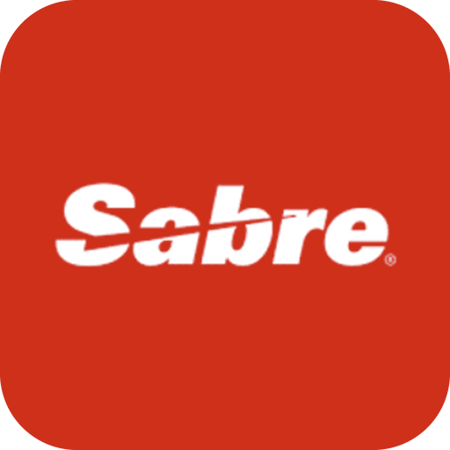

BLOCK 6 · THE STACK
Booking engine the Book now page on the owner's own site
The “Book now” page on the property's own website: it takes the direct booking, charges the card and writes the reservation into the PMS. Direct bookings, first-party data and our tracking all run through it.
Sabre SynXis
Amadeus iHotelier
SynXis's booking engine (sold by Sabre until 2025), on its central reservation system. The larger-hotel end of this box.
Amadeus' booking engine for hotels and resorts, often paired with its central reservation system.
SiteMinder
Cloudbeds
Sold alongside its channel manager, so one vendor covers the OTAs and the direct page.
The booking engine inside the Cloudbeds suite, writing straight into its own PMS.
Mews
STAAH
Sold with its PMS: the direct booking lands in the same system the front desk runs.
Sold with its channel manager, for independent properties.
Lodgify
WebRezPro
A vacation-rental website with the booking engine built in; the owner's site and the engine are one product.
The booking engine that comes with its PMS, for independent hotels and lodges.
Most PMS and channel-manager vendors sell an engine too; ask which one the owner's site actually uses.
38 / 48
Notes:
NICOLE
The third system: the booking engine. The "Book now" page on the property's own website. It shows the dates and prices, takes the credit card, and writes the reservation into the PMS. This is the one we care about most, because every direct booking, every piece of first-party data, and every bit of tracking we talked about in block 5 runs through it.
[Left to right.] SynXis is the engine that Sabre sold until 2025, sitting on the SynXis central reservation system, which is a CRS, the rate-and-inventory brain that bigger hotel groups run above the PMS. iHotelier is the Amadeus(Ah-Mah-Day-Us) equivalent. Almost every PMS and channel-manager vendor sells an engine too: SiteMinder, Cloudbeds, Mews, STAAH, WebRezPro, and Lodgify, on the vacation-rental side, is a website with the engine built in.
Why the owner cares: this is where the guest either books direct or gives up and goes back to Expedia. A slow or clunky engine is regret, from last week, made of software.
On a call: "Which booking engine is on your site? That's where our tracking has to live."

Slide 39

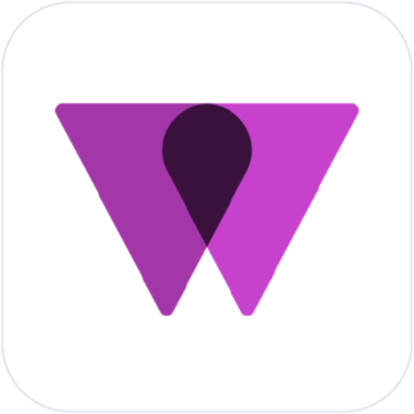
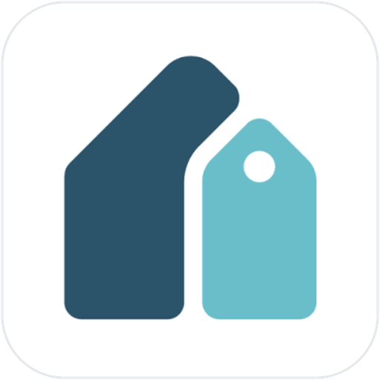

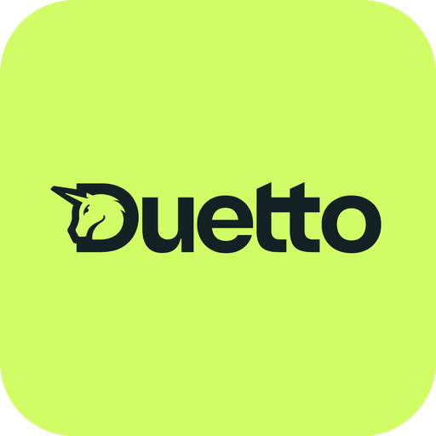


BLOCK 6 · THE STACK
Dynamic pricing prices that move with demand
Rates moving automatically with demand; the category Wheelhouse and PriceLabs sit in.
PriceLabs
Wheelhouse
Pricing for short-term and vacation rentals, increasingly small hotels. Plugs into the PMS and moves the nightly rate.
Dynamic pricing for short-term and vacation rentals; the same job as PriceLabs, from the same world.
Beyond
IDeaS
Vacation-rental pricing and revenue tools; formerly Beyond Pricing, so owners may use the old name.
A hotel revenue-management system: the bigger-hotel end of this box. Forecasts demand, sets rates.
Duetto
Atomize
Hotel revenue-management system; IDeaS' main rival at resorts and groups.
Automated pricing for hotels; now sold as Mews RMS, part of Mews.
RoomPriceGenie
Cloudbeds
Automated pricing for smaller hotels, B&Bs and inns that can't run a revenue manager.
A pricing tool inside the Cloudbeds suite; an owner on Cloudbeds may run that instead of a separate one.
IDeaS, Duetto and Atomize are sold as revenue-management systems; PriceLabs, Wheelhouse and Beyond as dynamic pricing. Same box.
39 / 48
Notes:
NICOLE
The fourth system: dynamic pricing. Software that moves tonight's price up and down with demand, automatically, instead of the owner doing it on Sunday nights. Remember Ines from last week.
[Left to right.] PriceLabs and Wheelhouse grew up in short-term rentals and are the names you'll hear from an owner who started with cabins; Beyond is the third one in that world. IDeaS and Duetto are from the big-hotel space, sold as revenue-management systems rather than pricing tools; Atomize sits with them, and is now sold as Mews RMS. RoomPriceGenie is built for smaller hotels. And Cloudbeds has a pricing tool inside its suite, so an owner on Cloudbeds may be using that. Different labels, same box: all of them set prices from demand.
Why the owner cares: it takes day-to-day rate-setting off their plate.
The catch is these tools price against demand that already exists. They don't create any. HiddenGem Brain prices from the property's own bookings and the demand our marketing sends, so when an owner says "PriceLabs handles our rates", the question is what it's reacting to.
On a call: "Are you using dynamic pricing, or setting rates by hand each season?"

Slide 40




BLOCK 6 · THE STACK
Rate shopping and market intelligence tools the neighbours' prices
Watching comp-set rates automatically; Lighthouse, formerly OTA Insight.
Lighthouse
RateGain
Rate shopping: the comp set's prices, date by date. Formerly OTA Insight; it also sells pricing.
Rate intelligence for hotels, alongside its distribution tools.
STR, part of CoStar
KeyData
Benchmarking: how the comp set performed last month, on occupancy, ADR and RevPAR.
Benchmarking for short-term and vacation rentals, built from managers' own data.
AirDNA
Amadeus Demand360
Vacation-rental market data: what the area's rentals charge and earn.
Forward-looking demand data: what's on the books for the market, not just what was.
Cloudbeds
PriceLabs
A rate-shopping view inside the suite, so a Cloudbeds owner may already have one.
Dynamic pricing first; market data and rate shopping come with its pricing tool.
Rate shopping answers “what are they charging tonight?”; benchmarking answers “how did they do last month?”. Owners lump both together.
40 / 48
Notes:
KYLE
Now the tools around the guest and the market.
First, rate shopping and market intelligence tools. A rate shopping tool watches what the comp set is charging, night by night, automatically. Market intelligence is the wider family: what the neighbours charge, and how they performed.
Lighthouse is the name you'll hear most; it used to be OTA Insight, so some owners still say that.
RateGain sells rate intelligence too.
Then the benchmarking side:
STR, part of CoStar, is the industry's standard report on how a comp set performed.
KeyData does the same for short-term rentals,
AirDNA is vacation-rental market data, and
Amadeus Demand360 looks forward at market demand.
Cloudbeds has one inside its suite.
And PriceLabs, from the pricing slide: its market data and rate shopping come with the pricing tool.
Two questions, one box: "what are they charging tonight?" and "how did they do last month?"
Why the owner cares: they want to know they're not out of line with the lodge across the lake, and that's fair.
On a call: "A rate shopping tool would show you what the resorts around you are charging each night."

Slide 41
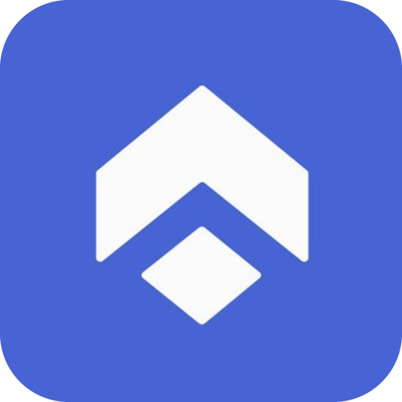






BLOCK 6 · THE STACK
CRM tools customer relationship management: where the guest list lives
Where guest data is held and segmented for marketing; Revinate, Cendyn.
Revinate
Cendyn
Hotel CRM and email marketing: guest profiles, segments and campaigns, with reputation tools alongside.
Hotel CRM, spelled C-e-n-d-y-n. Guest data and marketing automation for independents and groups.
GoHighLevel
HubSpot
HGM's own CRM, with texting and chat built in: the leads and the email list the funnel builds.
A general CRM some owners run, usually for sales enquiries rather than past guests.
Mailchimp
Klaviyo
The email tool a small owner often calls their CRM. A list and campaigns, not guest history.
Email and SMS with more automation than Mailchimp; the same role for a bigger list.
Enso Connect
Cloudbeds
Guest experience platform that also sells guest segments and campaigns.
A CRM inside the suite, as a paid add-on; ask what the owner means by CRM.
Mews keeps guest profiles, but connects to a CRM rather than being one. Two CRMs on every call: the property's, and the GoHighLevel list we build.
41 / 48
Notes:
KYLE
CRM tools - CRM is customer relationship management, which in a hotel means one thing: the system that holds the guest list. Who stayed, how often, what they spent, what they like.
A hotel CRM takes those records from the PMS and sorts them so you can market to them: past guests who came in winter, guests who used the spa.
Revinate and Cendyn are the hotel-specific names
Then ours: GoHighLevel, which holds the leads and the email list our funnel builds, sends the emails, and has texting and chat built in.
Then the general tools an owner may already have: HubSpot, a general CRM; Mailchimp, which a small owner often calls their CRM even though it's an email tool; and Klaviyo, the same role with more automation.
Then Enso Connect and Cloudbeds, which both sell segments and campaigns. When an owner says CRM, ask what they mean.
Why the owner cares: this is first-party data with a home. A guest in the CRM is a relationship; a guest who only exists on a Booking.com confirmation is a one-time sale.
On a call: "Which CRM tool holds your guest list? We could use it to invite past guests back."

Slide 42


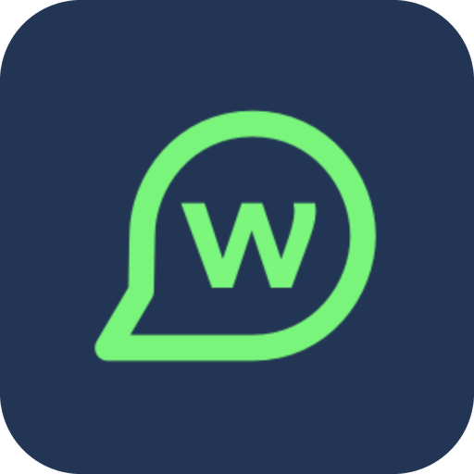


BLOCK 6 · THE STACK
Guest messaging tools the conversation before, during and after the stay
Pre-arrival and in-stay messaging to the guest; Duve, and Whistle (now part of Cloudbeds).
Duve
Canary Technologies
Guest communication hub for hotels and rentals: messages, check-in and a guest app, with upsells built in.
Hotel guest messaging, digital check-in and upsells in one platform.
Whistle
Akia
Guest messaging, now part of Cloudbeds, so a Cloudbeds owner may already have it.
Messaging for hotels and rentals: texts and automated replies around the stay.
Enso Connect
Kipsu
Guest experience platform for vacation rentals and boutique stays: messaging, check-in, upsells.
Hotel guest messaging by text, used by brands and independents.
Mews
Guesty
Messaging add-ons inside the PMS; some properties never buy a separate tool.
Vacation-rental suite with guest messaging built in, so a Guesty owner may never buy a separate tool.
Canary, Duve and Enso Connect sell upsells too, so they come back on the next slide.
42 / 48
Notes:
KYLE
Guest messaging tools - Tools that text or chat with the guest, one to one, around the stay.
This is "your room's ready", "here's the gate code", "would you like to add dinner on Friday?"
Three windows: before arrival, during the stay, and after checkout, when the review gets asked for.
Duve is a guest communication hub, hotels and rentals both. Canary is hotel guest messaging, and it sells upsells too. Whistle is now part of Cloudbeds, so an owner on Cloudbeds may have it without knowing the name.
Akia, Enso Connect and Kipsu are the other three specialists you'll hear: Enso on the vacation-rental and boutique side, Kipsu with hotels.
And two suites that have messaging built in, Mews and Guesty, so an owner on either may never buy a separate tool.
Why the owner cares: at fifty rooms you can't personally text every guest, and this is how the place keeps feeling personal as it grows. And that first window, before arrival, is the moment a guest is most excited and most open to adding something.
On a call: "Your guest messaging tool is a good place to offer upgrades before arrival."

Slide 43

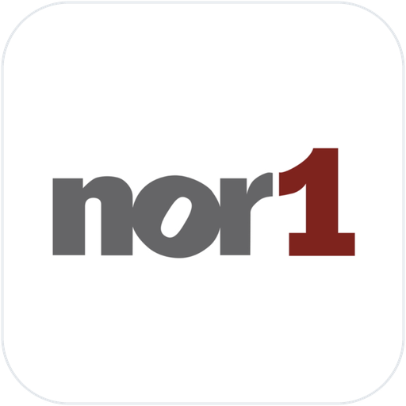
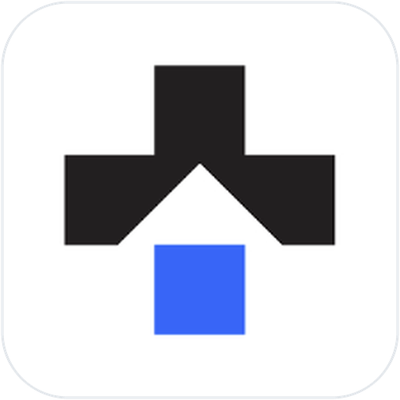

BLOCK 6 · THE STACK
Upsell tools the upgrade sold before, and at, arrival
Paid upgrades before and at arrival; Oaky (part of Plusgrade since 2025).
Oaky
Nor1
Hotel upsells by email and at check-in: the better room, the late checkout. Part of Plusgrade since 2025.
Oracle's upsell product, built to pair with OPERA, so brand-origin resorts may have it.
Plusgrade
UpsellGuru
The group Oaky now belongs to; started in airline upgrades, now hotels too.
Hotel upsells, including letting guests bid for an upgrade before arrival.
Canary Technologies
Duve
Messaging plus upsells, sold as one platform.
Messaging plus upsells, for hotels and rentals.
Enso Connect
Mews
Messaging plus upsells, for rentals and boutique stays.
Extras and upgrades offered in its own booking engine; some owners stop there.
Canary, Duve and Enso Connect are messaging tools that sell upsells too; some platforms do both.
43 / 48
Notes:
KYLE
Last category: upsell tools - An upsell is an extra sold alongside the stay: breakfast, a late checkout, a better room.
An upsell tool sells it automatically. A few days before check-in it emails or texts the guest: "upgrade to the lake view for $40 a night?"
At arrival, it offers a late checkout. The guest taps yes, the charge goes on their bill, and nobody at the front desk had to sell anything.
Oaky is the name you'll hear most; it's part of Plusgrade now, and Plusgrade itself does upgrades for and hotels. Nor1 is Oracle's, so it travels with OPERA. UpsellGuru is the other specialist.
And three names from the last slide, Canary, Duve and Enso Connect, because messaging tools sell upsells too; some platforms do both jobs.
Why the owner cares: this is ancillary revenue from session 1, on autopilot. Guests who've already chosen the place are the easiest people in the world to sell to, and the tool asks every one of them, politely, at the right moment.
On a call: "An upsell tool can offer a room upgrade automatically a few days before check-in."

Slide 44
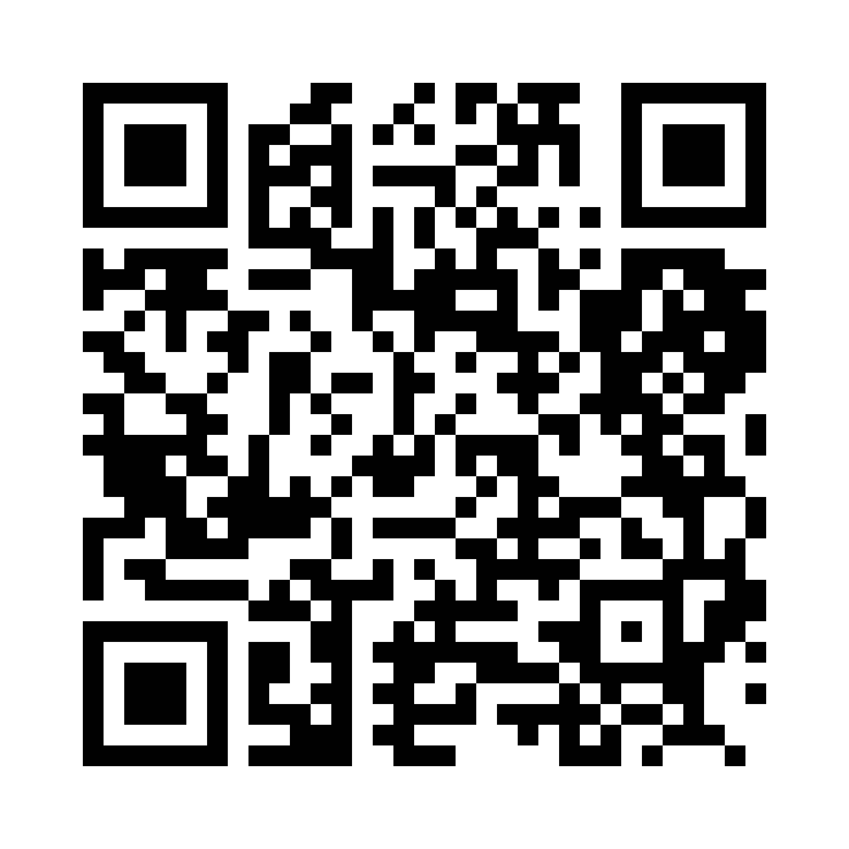



PRACTICE · AFTER BLOCK 6
Sort the stack
Point your phone's camera at the code, then tap the link that appears.
If it asks you to sign in, use your HGM Google account.
On the call? The same link is in the meeting chat.
hgmportal.com/dictionary/tools/review
Notes:
NICOLE
Here's the code. Point your phone's camera at it and tap the link that pops up. If it asks you to sign in, use your HGM Google account. On the call, the same link is in the meeting chat.
I'll leave this up while everyone gets in. Hands up when you can see round one on your screen, and we'll start the clock.

Slide 45


06 · THE RESOURCES
What you have, and where it lives
The HGM portal
Everything below lives at hgmportal.com. Sign in with your HGM Google account.
The dictionary
253 terms in nine sections. Type a few letters and the term opens in full.
Term check and term practice
The check after the sessions, and a practice mode you can run any time, on any term.
Tool check and tool practice
The same two modes for the vendor names in block 6: which box does it go in?
The PDFs
The call cheat sheets and the Client Tech Stack Guide, readable in the portal and sent to you after the session.
46 / 48
Notes:
KYLE
Here's what you have, and where it lives. One address for all of it: hgmportal.com, with your HGM Google account.
The dictionary: Start typing and the term opens in full.
The term check and term practice
Here's how it works. You do the check, closed book, on your own. When you finish, you get a score; you get a list: the terms you need another look at. Each one links to its entry on the portal, and to the practice mode, so you can practise just those. Then you retake just those terms, with fresh questions. The aim is to shrink the list to zero. An empty list means you're ready for the call.
The tool check and a tool practice
Then the PDFs: the call cheat sheet, one page, thirty terms, what it is, why the owner cares, what to say, what to ask;
The Client Tech Stack Guide, every name from today by box, with a question to ask about each one. You'll be able to read them in the portal.
And of course the PDF version of the dictionary
One ask: bookmark the dictionary page where you take calls, so it's one click away.

Slide 46
08 · CLOSE
Where this goes from here
1
Don't know a term? Ask which they mean, then open the dictionary page.
2
Ask one question from these two sessions on your next owner call.
3
Check Kyle's daily update: a term a day, for the foreseeable future.
“Two Wednesdays ago we couldn't have told you what RevPAR was.
Now we can ask an owner how October's pacing, and mean it.”
Notes:
NICOLE
Okay, and that brings us to the end of session two, and of Industry Acumen, Hotel and Resort Terminology. Thirty terms over two Wednesdays.
Three things to take with you. One: don't know a term? Ask which they mean, then open the dictionary page.
Two: ask one question from these two sessions on your next owner call. "Which PMS are you on?" Any one.
KYLE
Three: I'm adding a term a day to my daily update, for the foreseeable future. It's small, it's near the end, and it will keep these terms fresh in your mind.
NICOLE
Two Wednesdays ago most of us couldn't have told you what RevPAR was. Now we can ask an owner how October's pacing, and mean it. We're ready for the calls before they start.
The say-this lines are suggestions, not scripts, and nothing here is a new requirement. Thank you, everybody. Questions, while Nicole and I are both up here.

