Slide 1

Some Problems with Properties
Harry Goldstein, Joseph W. Cutler, Adam Stein, Andrew Head, Benjamin C. Pierce
University of Pennsylvania
HATRA Workshop
December 7, 2022

Slide 2

quickCheck prop_bstOK

Slide 4



Slide 5
High Level Story
What is property-based testing (PBT) ?
Preliminary Interview Study
Ongoing Full-Scale Study
Ideas for the Future

Slide 6

What is Property-Based Testing?
Part 1:

Slide 7
vip :: Input -> Output

Slide 8
vip :: Input -> Output
prop_vipOK in =
pre in ==>
post (in, vip in)

Slide 9
✔︎
✔︎
prop_vipOK
✔︎

Slide 10
✔︎
prop_vipOK
✔︎
✔︎

Slide 11
vip :: Input -> Output

Slide 12
topo :: Graph v -> [v]

Slide 14
[
]

Slide 15
[
]

Slide 16
topo :: Graph v -> [v]

Slide 17
topo :: Graph v -> [v]
prop_topoOK g =
let vs = topo g in
all (λ(v, w) ->
idx v vs < idx w vs)
(edges g)

Slide 18
topo :: Graph v -> [v]
prop_topoOK g =
let vs = topo g in
all (λ(v, w) ->
idx v vs < idx w vs)
(edges g)

Slide 19
topo :: Graph v -> [v]
prop_topoOK g =
let vs = topo g in
all (λ(v, w) ->
idx v vs < idx w vs)
(edges g)

Slide 20
Property-Based Testing
The programmer writes executable properties to describe the (partial) correctness of their program.
They check those properties with lots and lots of random inputs.

Slide 21
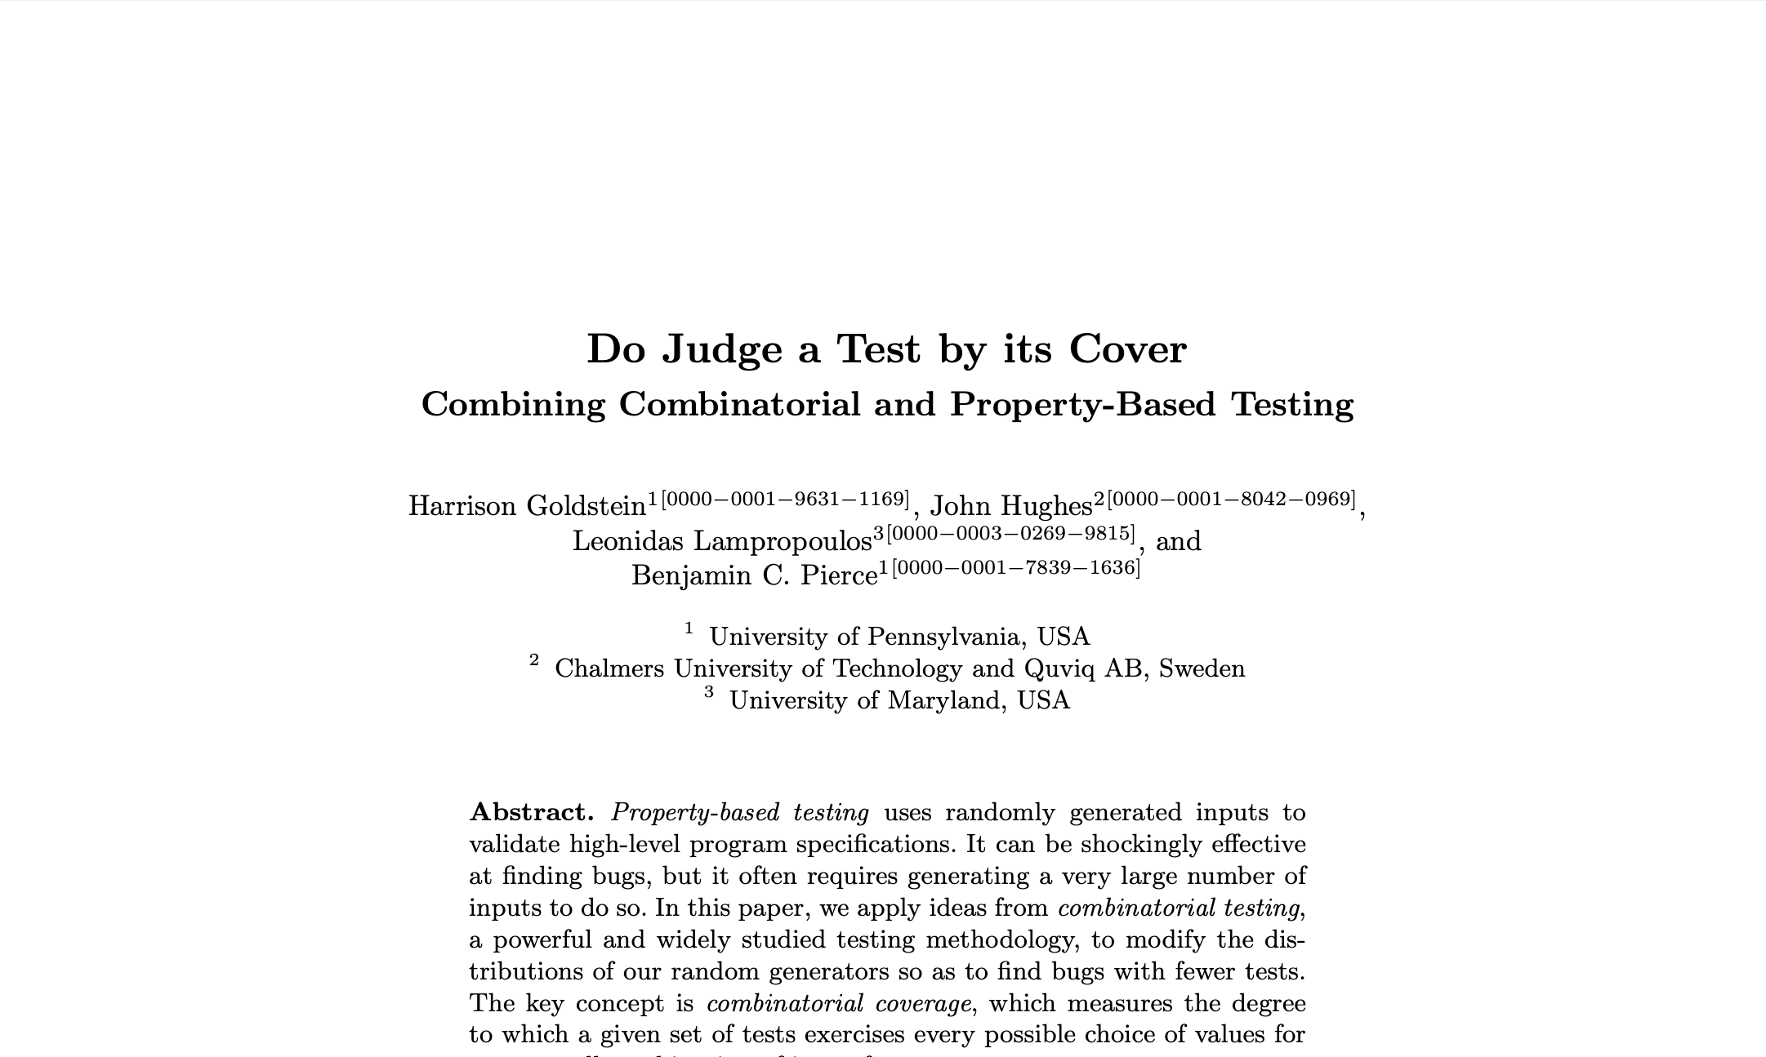
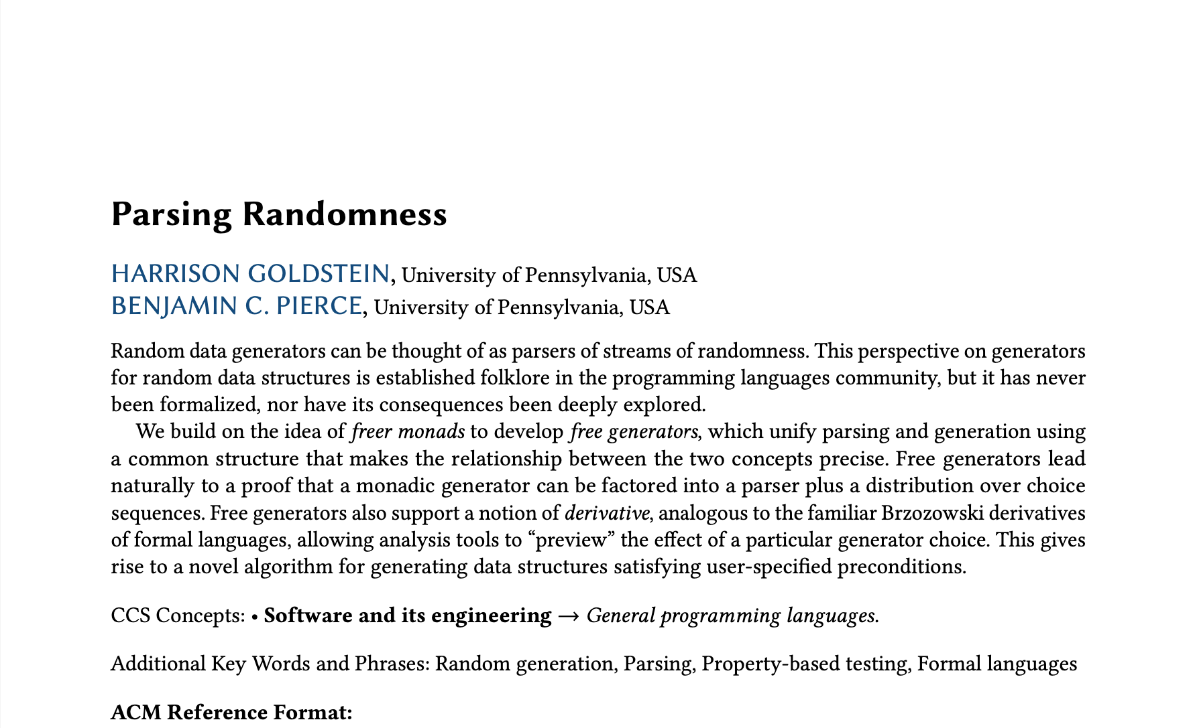
Past Research Focus
How can the research community improve random data generation for property-based testing?

Slide 22
Past Research Focus
How can the research community improve random data generation for property-based testing?
How do I know my work will impact real people?

Slide 23
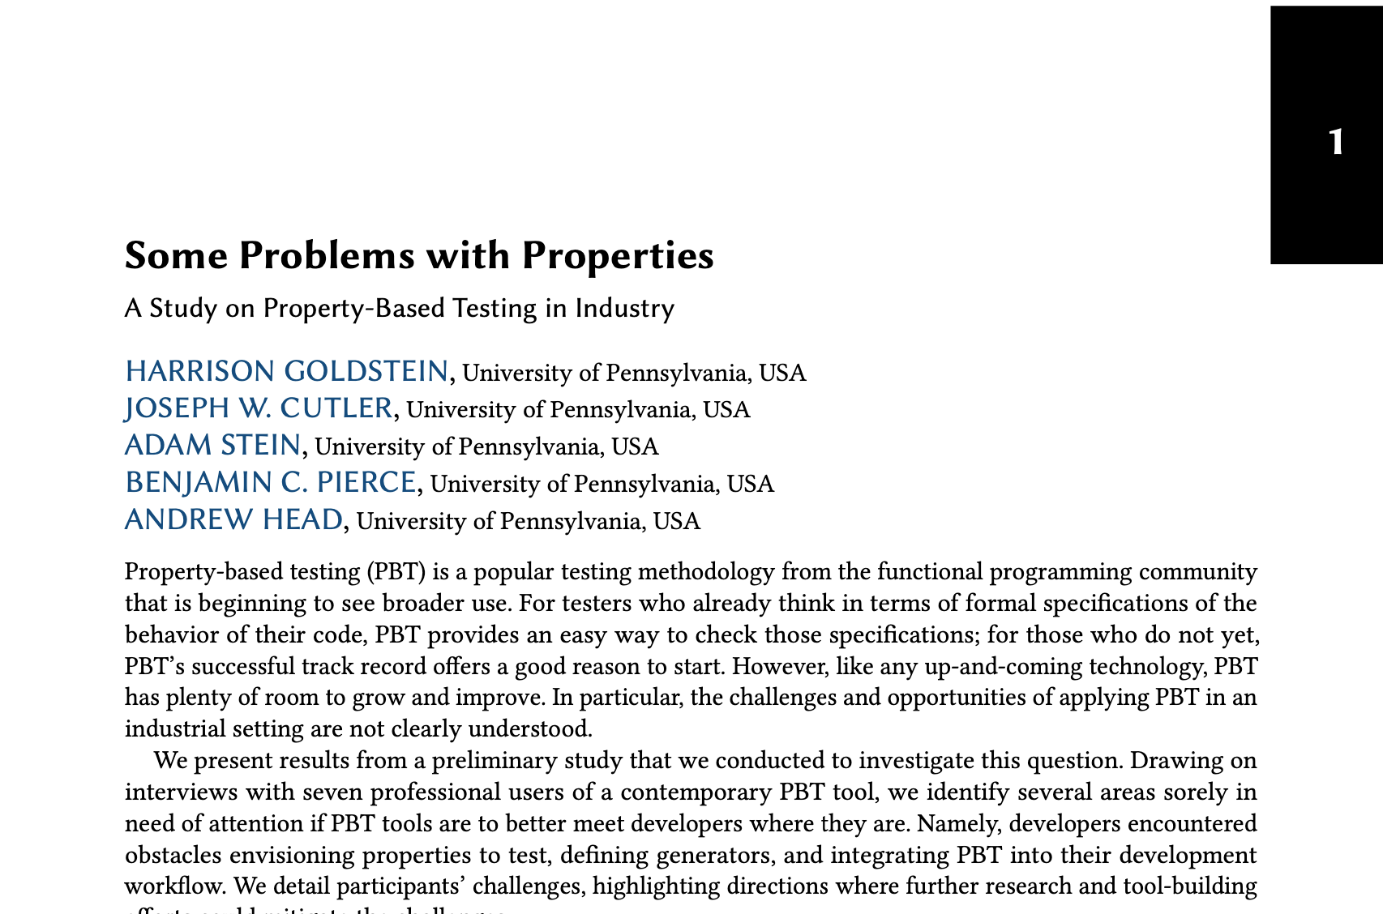
Broader Focus
How can the research community make property-based testing more useful for real-world software developers?

Slide 24
Preliminary Interview Study
Part 2:

Slide 26
Interview Design
3 Interview Prompts
Tell us about a memorable experience applying PBT .
How did you pick the properties you tested?
Did you need to write custom generators?

Slide 27


Slide 28
A
B
C

Slide 29





Problems with Properties
Generator Design
Property Design
Workflow
Missing Education
Bootstrapping

Slide 30


Generator Design
“Sometimes [generators] were missing some useful use cases.”
prop_vipOK in =
pre in ==>
post (in, vip in)
Preconditions
Distributional Issues
Strange Languages

Slide 31


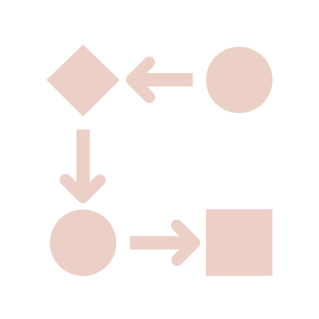

Property Design
It was hard to “formulate the right property in the first place.”
Weak Properties
Poorly Abstracted Code
Model-Based Testing

Slide 32


Workflow
Running PBT can be “a bit like Russian roulette.”
Nondeterminism
Time

Slide 33
Missing Education
Bootstrapping
“I don’t know if when I talk about [PBT] that people are lost.”
“They realize that [PBT is] very important and very useful , but can they find somebody to write those tests and maintain those tests? That’s another question.”

Slide 34
Problems with Properties
Generator Design
Property Design
Workflow
Missing Education
Bootstrapping

Slide 35

Problems with Properties
Generator Design
Property Design
Workflow
Missing Education
Bootstrapping
What else?

Slide 36
Ongoing Full-Scale Study
Part 3:

Slide 37


Slide 38

New Research Questions
What support do developers need to help them imagine properties?
What kinds of generators do testers need to exercise their properties effectively? Do they have specific precondition and/or distributional requirements?
What aspects of the developer workflow around PBT need improvement?
What concrete changes could be made to modern PBT systems to improve effectiveness and usability?

Slide 39
Problems with Properties?
Generator Design
Property Design
Workflow
Missing Education
Bootstrapping
What else?

Slide 40

Problems with Properties?
Generator Design
Property Design Recognition
Workflow
Missing Education
Bootstrapping
What else?

Slide 41
Problems with Properties?
Generator Design
and Automation
Property Design Recognition
Workflow
Missing Education
Bootstrapping
What else?

Slide 42

Problems with Properties?
Generator Design
and Automation
Property Design Recognition
Workflow
Missing Education
Bootstrapping
Evaluation

Slide 43
Ideas for the Future
Part 4:

Slide 44
Survey(s) to validate the results of the Jane Street study?

Slide 45
Survey(s) to validate the results of the Jane Street study?
Other formative research into PBT usage?

Slide 46
Survey(s) to validate the results of the Jane Street study?
Prototypes of tools to help users with these challenges?
Other formative research into PBT usage?

Slide 47
Survey(s) to validate the results of the Jane Street study?
Prototypes of tools to help users with these challenges?
Other formative research into PBT usage?
Better educational curricula around PBT?

Slide 48
Thank you!
We’d love to hear your feedback on:
Study design.
Questions you wish we’d asked.
Ways to make this work more compelling to both PL and HCI audiences.
hgo@seas.upenn.edu (@hgoldstein95 on Twitter)

