Slide 1
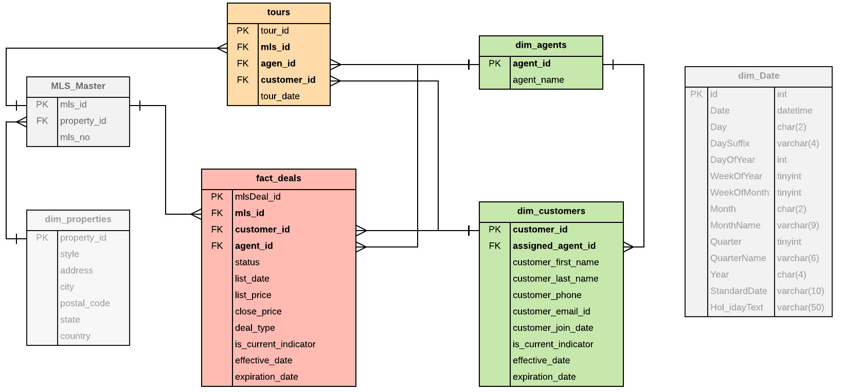
Data Model
Notes:
1st attempt -
relational model.
2nd attempt -
start schema
3rd attempt -
hybrid model;

Slide 2
Sort keys and Distribution Style
Table Name | Sort key | Distribution Style
fact_mlsdeals | agent_id | mls_id
dim_agents | agent_id | ALL
dim_customers | is_current_indicator | EVEN
dim_tours | tour_id | EVEN
mls_master | mls_id | mls_id
Notes:
The distribution keys and sort keys were chosen to optimize the largest join, which is the join between the fact table and the mls_master table. The other dim tables were relatively small, so we chose to use the ALL distribution style for them to avoid unnecessary data redistributions.
Sort Key -
agent_id is the most frequently used attribute in this use case. Helps query optimizer for better plans.
DistStyle -
Optimize the largest join between fact and dimension table. mls_id joins fact and mls_master table.
DistStyle -
agents table is relatively small enough to fit all in each slice of the nodes. To avoid unnecessary data redistributions.
sort
Sort Key-
tour_id is used for this use case. Otherwise, property_id is an alternative as well.
DistStyle -

Slide 3
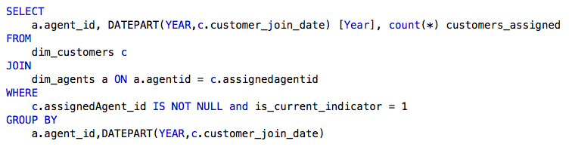
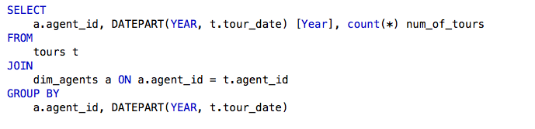
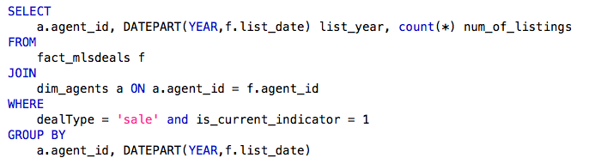
1 - Number of customers agents get assigned by year
2 - Number of tours agents take customers on by year
3 - Number of listing contracts agents sign with customers by year

Slide 4
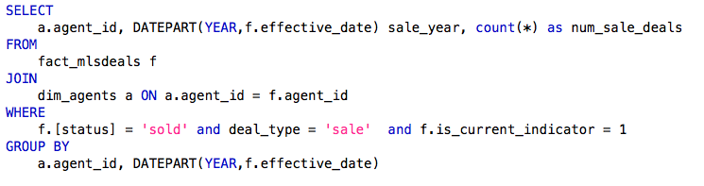
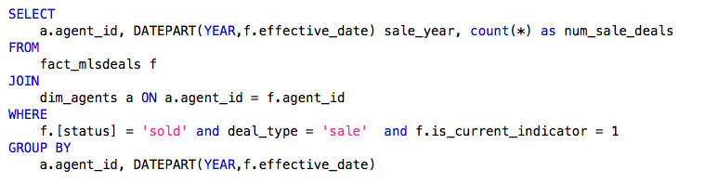
4 - Number of deals agents complete with customers selling homes by year
5 - Number of deals agents complete with customers buying homes by year

Slide 5
Performance Considerations
Designed a hybrid model with relational and dimensional modelling techniques for better scale and usability
Designed for the specific use case
Used one table for customers and agents assignments since each customer is assigned an agent by default
Used one deals table instead of two separate tables for buying and selling with the use of close_price and deal_type attributes
Optimized mls_master table to have only property_id for taking care of one to many relationship
Used agents with Diststyle ALL, although agents_id is queried and joined more frequently due to its relatively small size.
Used agent table column as both the sort and distribution key since it is frequently being joined with other tables. This will avoid the expensive sorting
Compress encoding using analyze compression command.
Redshift do not force enforce Primary and foreign key constraints. For informational purpose only.

