Slide 1

TicTacToe with AI

Slide 2



Agenda
Introduction
Strategy
MiniMax
RL
Introduction - TicTacToe
3 x 3 grid
2 players alternately place marks X and O
3 identical marks in a row, column, or diagonal win the game
Characteristics:
  (m, n, k) game
  zero-sum game
  perfect information

Slide 3
Agenda
Introduction
Strategy
MiniMax
RL
Solution strategy
Place marks with goal to maximize own score and minimize other player’s score
Different solution algorithms
  MiniMax
  Reinforced Learning
  and others

Slide 4
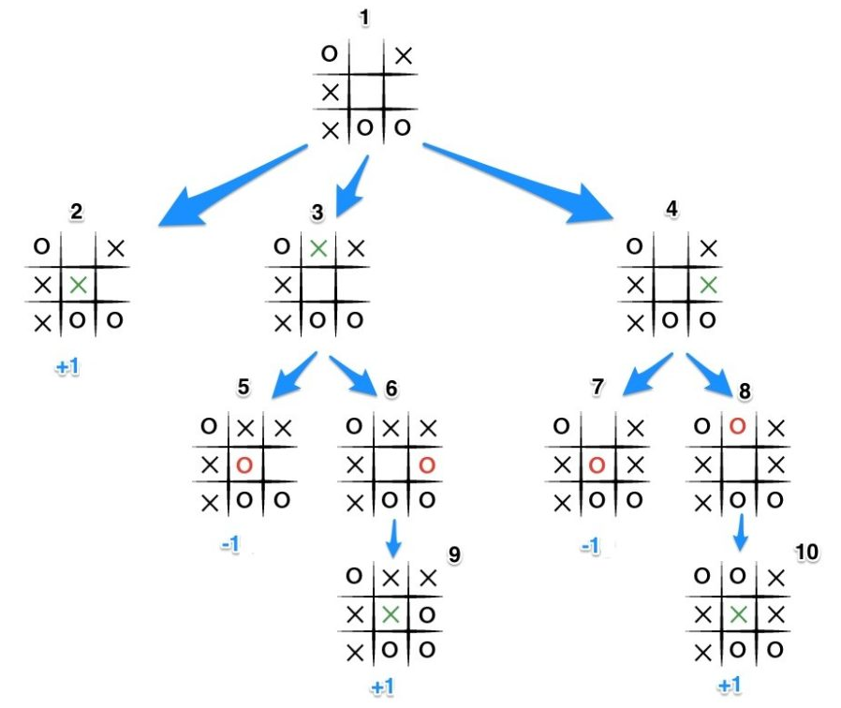
Agenda
Introduction
Strategy
MiniMax
RL
MiniMax algorithm
Recursively compute possible outcomes and return best
Source: https://www.developer.com/java/java-minimax-algorithm-and-ai/

Slide 5

Agenda
Introduction
Strategy
MiniMax
RL
Reinforced Learning
RL is a type of machine learning technique that enables an agent to learn in an interactive environment by trial and error using feedback from its own actions and experiences.
Unlike supervised learning where the feedback provided to the agent is a correct set of actions for performing a task, reinforcement learning uses rewards and punishment as signals for positive and negative behavior.
Source: https://www.kdnuggets.com/2018/03/5-things-reinforcement-learning.html

Slide 6
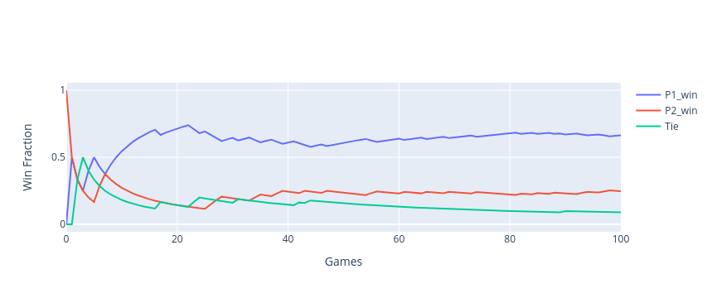
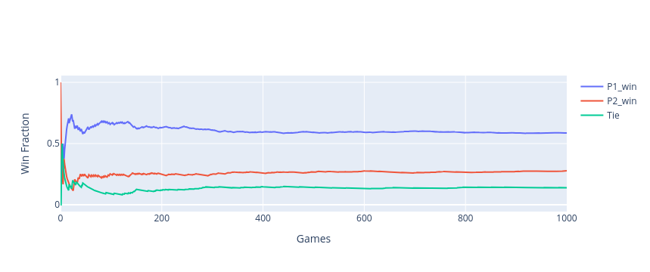
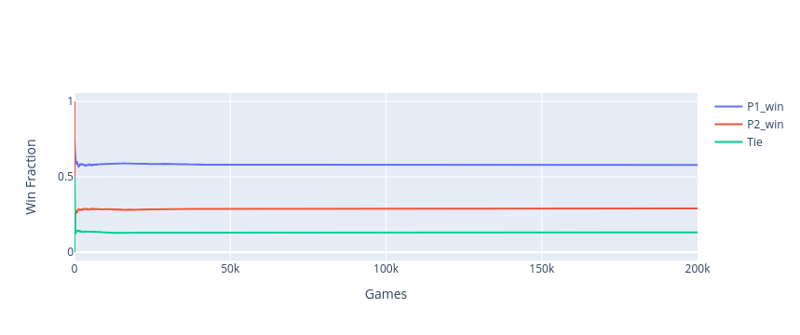
Agenda
Introduction
Strategy
MiniMax
RL
Reinforced Learning
RL with Q learning learn very fast as can be seen from the plots below. Already after about a 400 game iterations, the winning fraction has reached a constant state

