Slide 1
Quick classification (logistic regression) on IMS

Slide 2

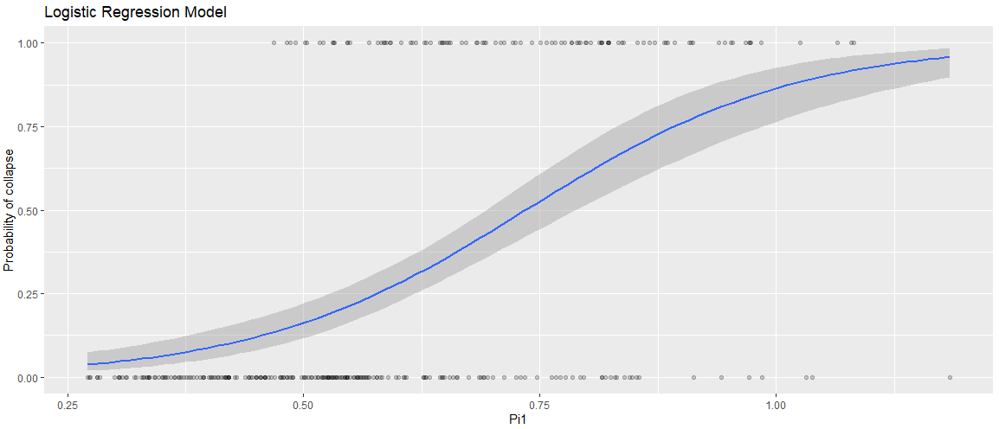
Average spectral (around 3s)
Test set accuracy: 83.1%

Slide 3
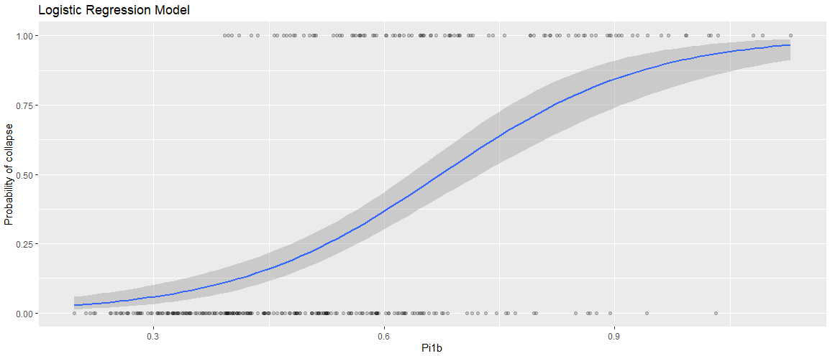
Average spectral (around Tm)
Test set accuracy: 79.2%

Slide 4

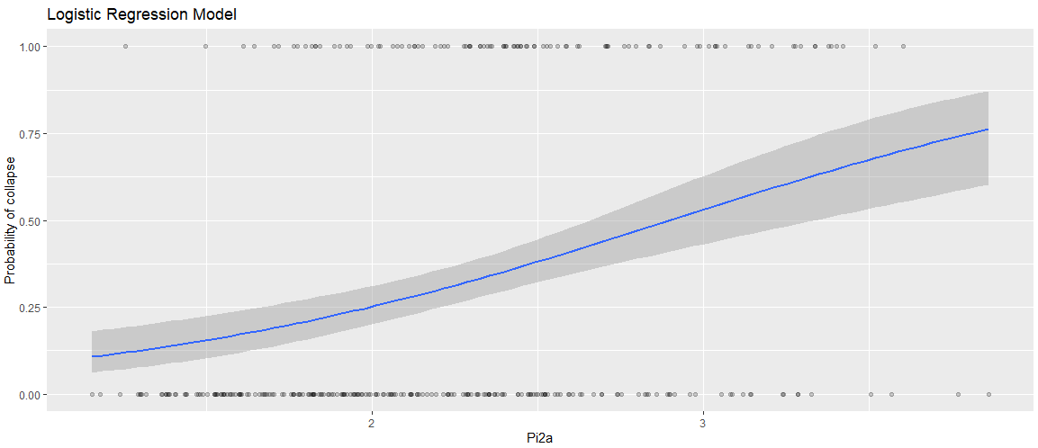
Average spectral (around 3s)
Test set accuracy: 80.5%

Slide 5
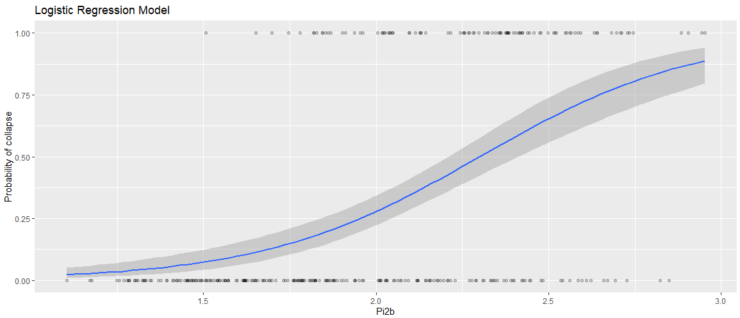
Average spectral (around Tm)
Test set accuracy: 81.8%

Slide 6

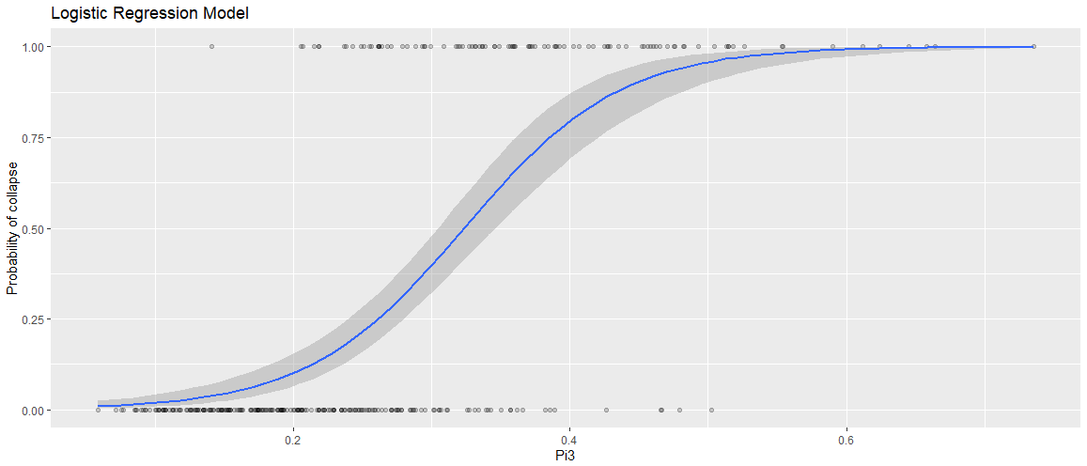
Spectral at T2
Test set accuracy: 83.1%

Slide 7

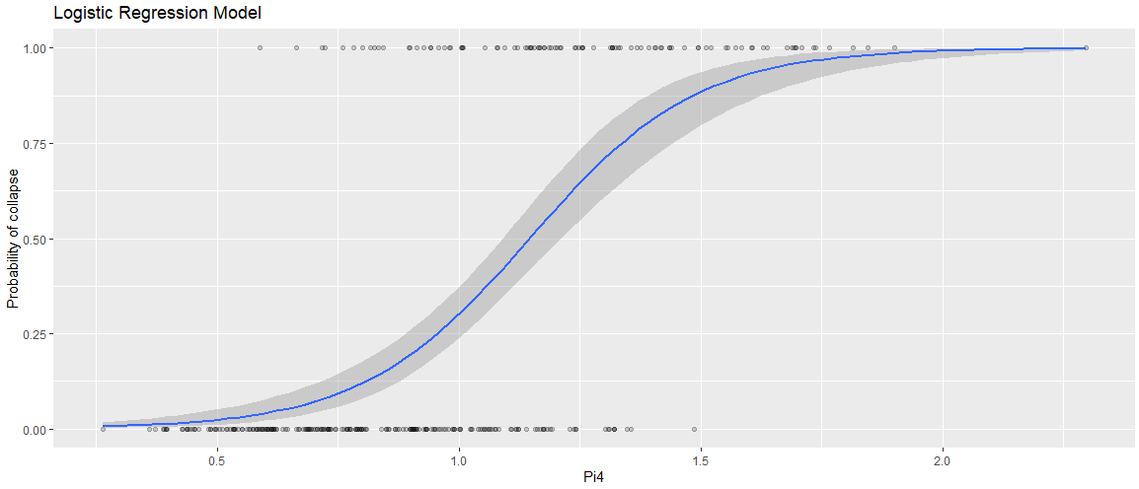
Spectral at T2
Test set accuracy: 85.7%

Slide 8


Spectral at Tm
Test set accuracy: 85.7%

Slide 9

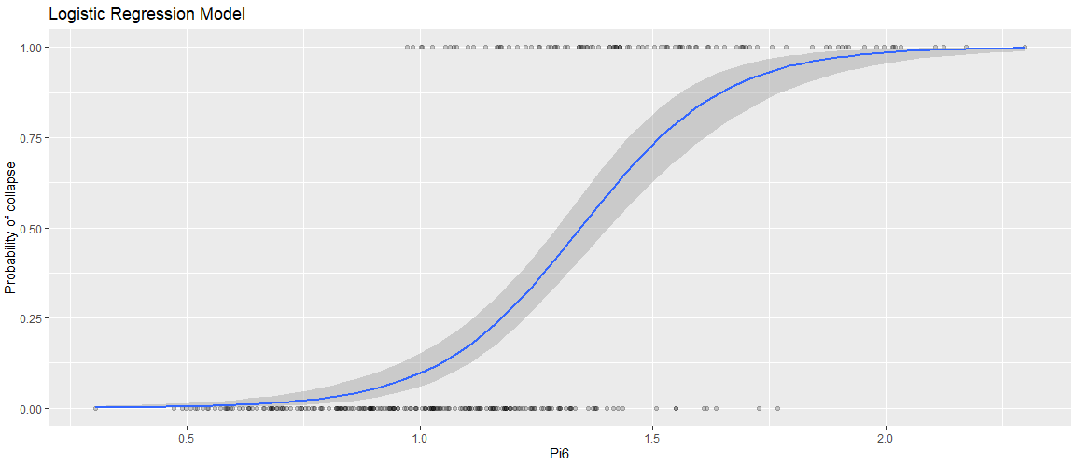
Spectral at Tm
Test set accuracy: 89.6%

Slide 10

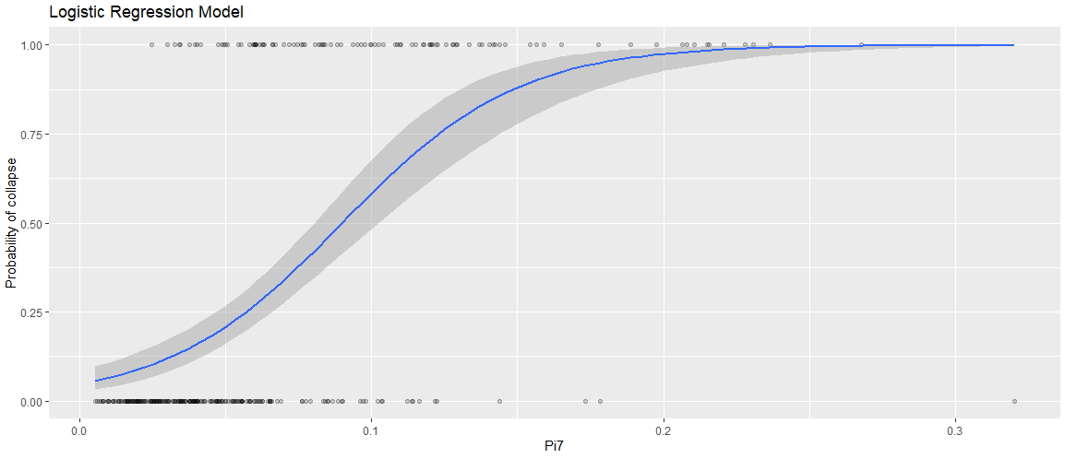
IP
Test set accuracy: 81.8%

Slide 11

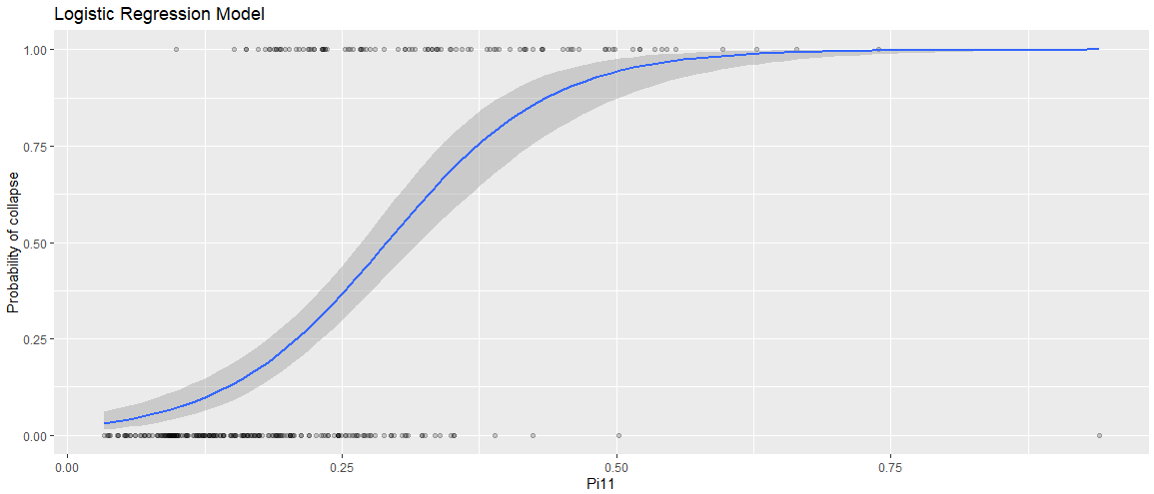
IP
Test set accuracy: 84.4%

Slide 12

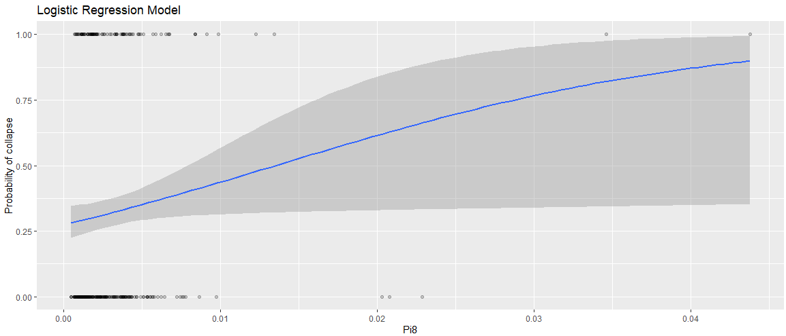
PGA
Test set accuracy: 71.4%

Slide 13

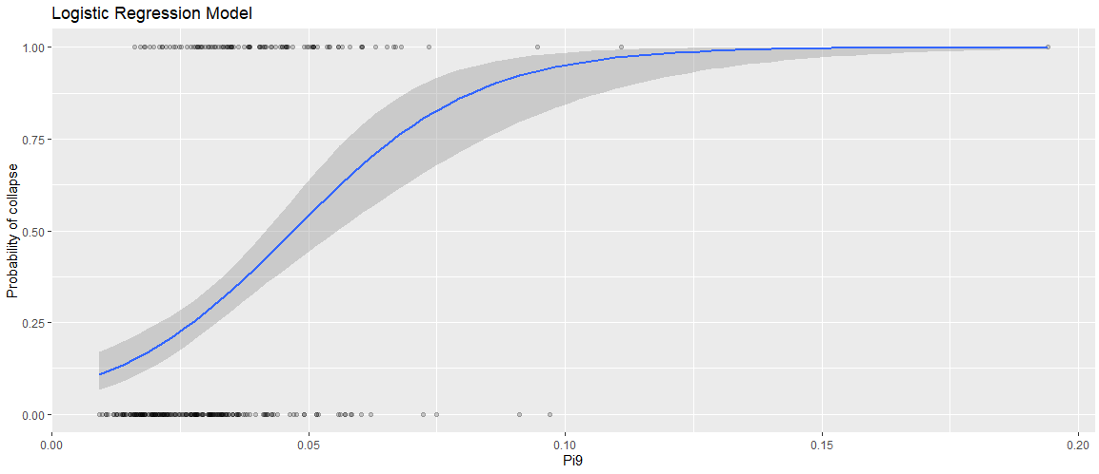
PGV
Test set accuracy: 77.9%

Slide 14

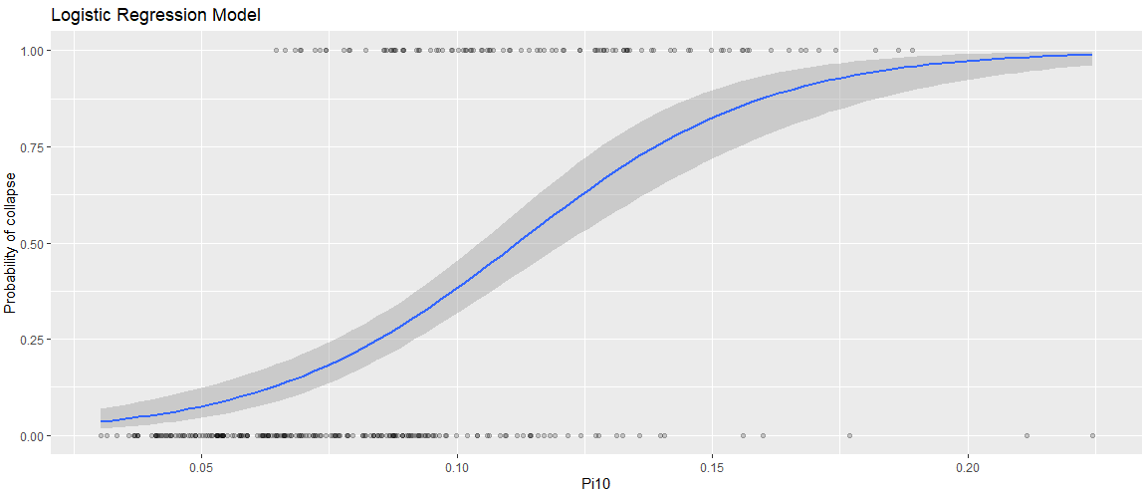
FIV3
Test set accuracy: 80.5%

Slide 15

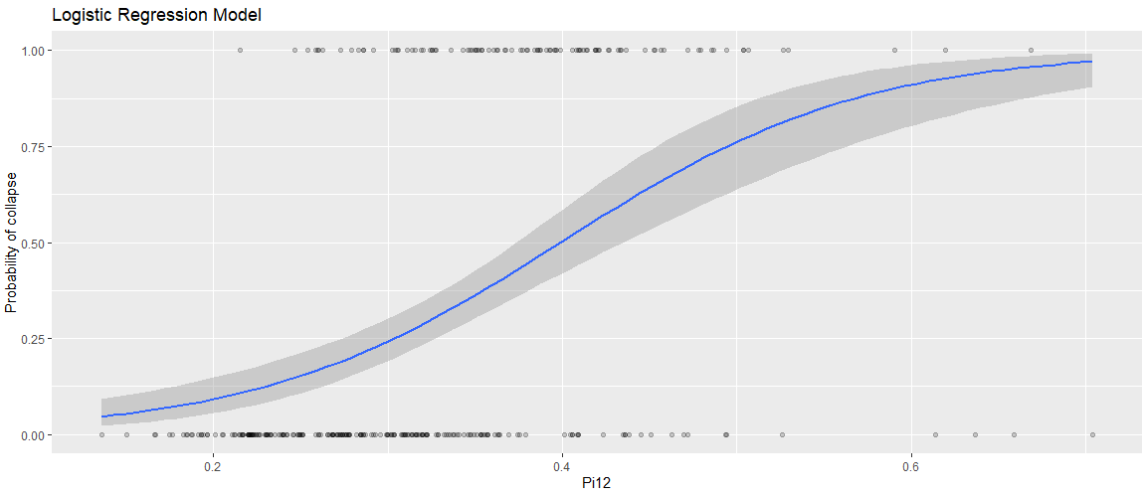
FIV3
Test set accuracy: 87.0%

Slide 16
Questions
Does damping need to be additionally introduced elsewhere?
Are the normalizations for FIV3, PGV, PGA, and IP suitable?

Slide 17
Thanks!
Questions? Comments?

