Slide 1
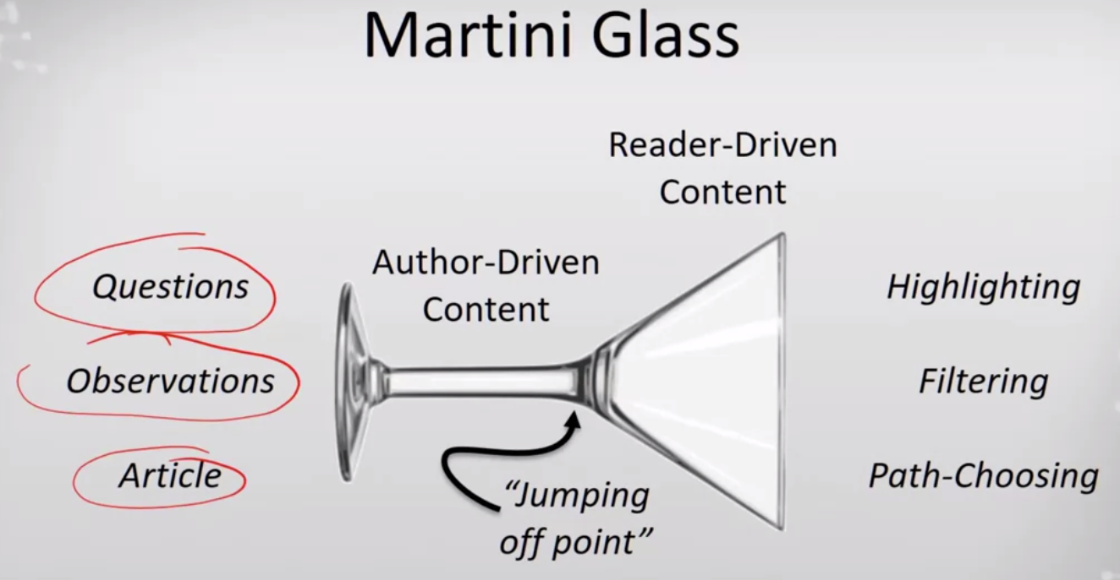
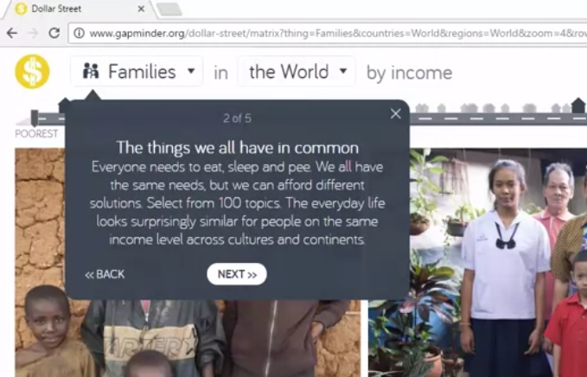
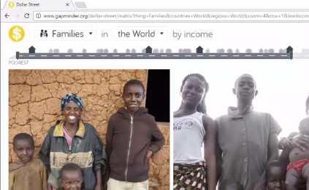
Scenes
5 moving boxes with messaging
Then final ‘dashboard’ as scene 6 for reader-driven content
Parameters
Triggers

