Slide 1
3
1_3
6
1_6
1
1_4_6
10
1_4
4

Slide 2
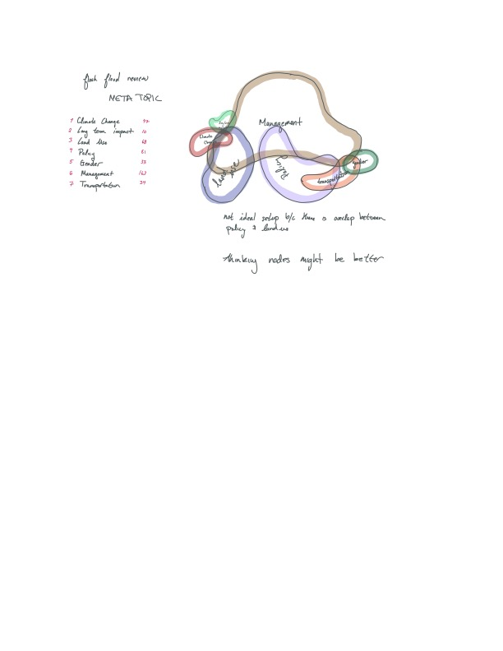
24
Big data
234
1234
Hydrological modelling
23
123
Mapping weather??
[1] water weather data
[3] Mapping/GIS
Mapping flood water
Weather perceptions
[4] Mechanistic modelling
Mapping flood damage
346
35
135
15
1356
1346
46
136
146
[5] Community tools
145
[6] Interviews/qualitative
Community tool interviews
Participatory mapping
356

