Slide 1
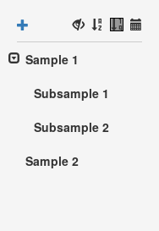
new sample
sorting
expand/collapse

