Slide 1
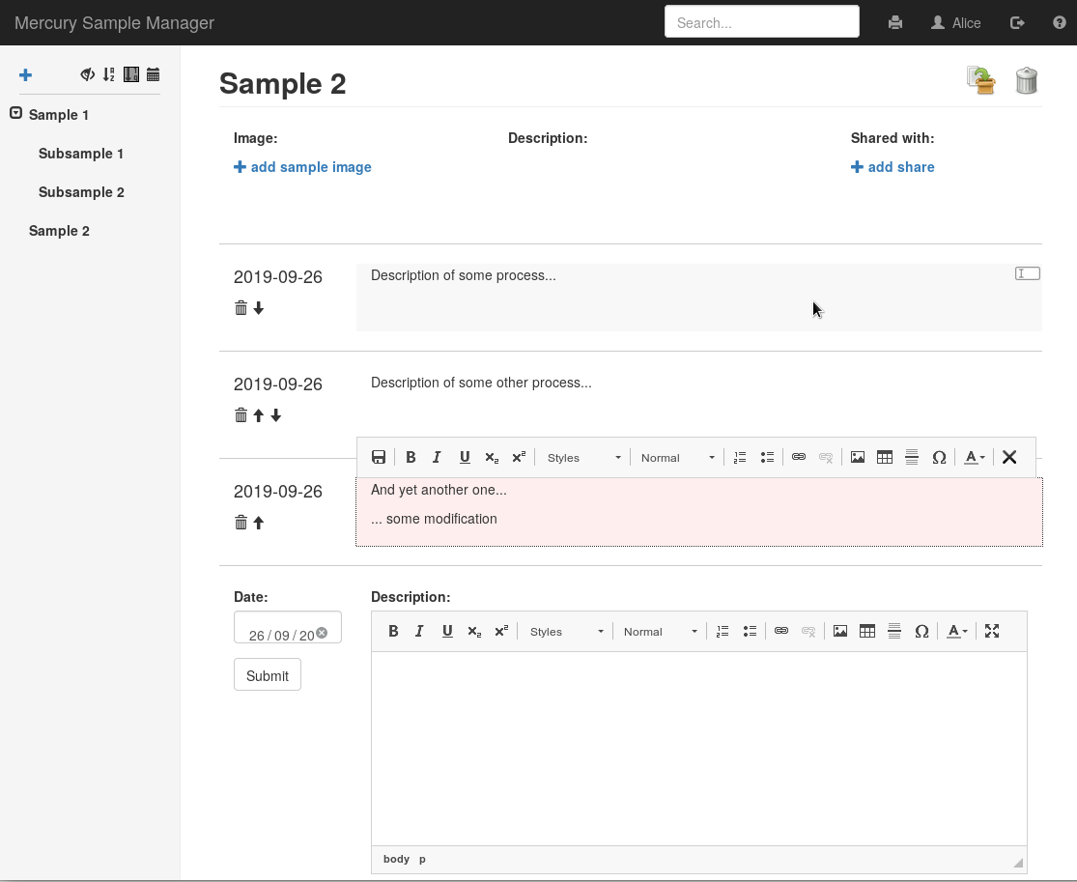
edit an action by double clicking on the text field...
...or by clicking on this icon
modifications are not saved (red background) until you click on the save icon
the order can be changed using the arrow buttons and actions can be removed using the delete button

