Slide 1
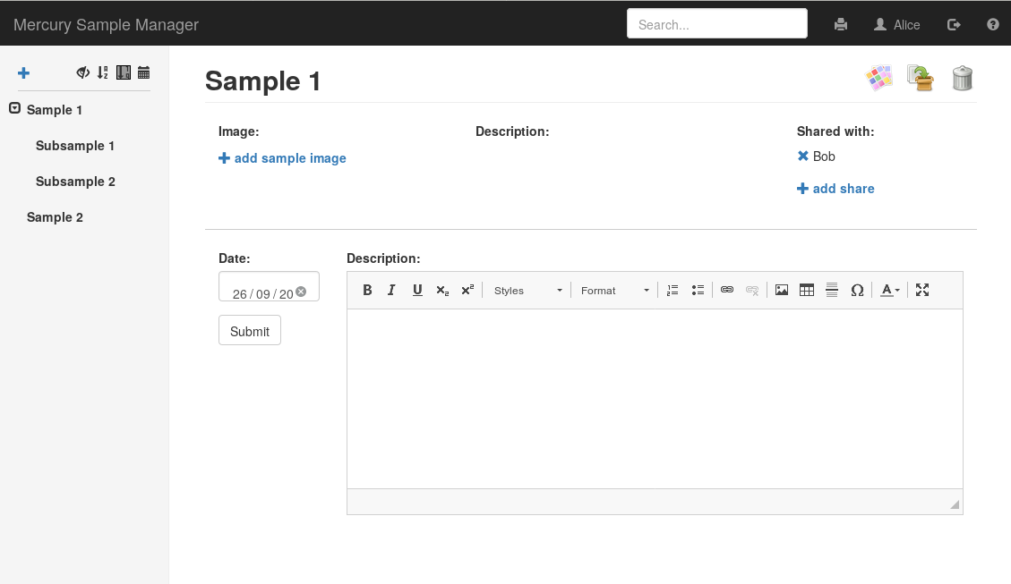
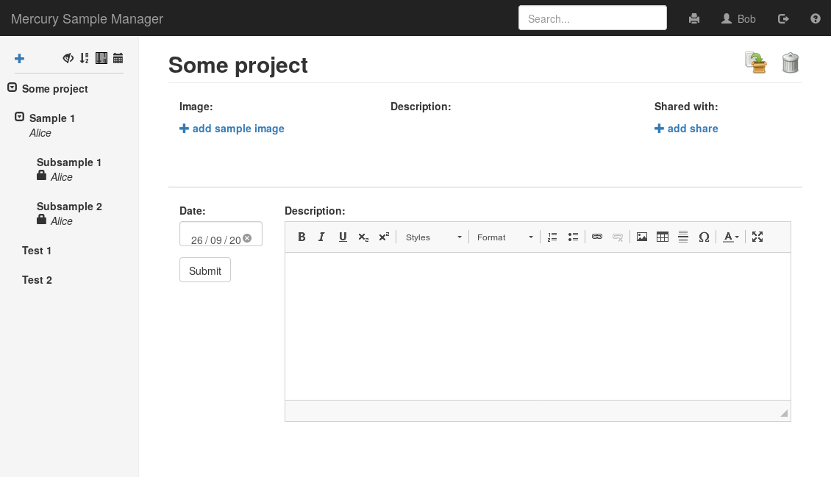
Alice’s Sample 1 has two subsamples and is shared with Bob
Bob can drag the direct share (Sample 1) into his sample “Some project”, but he cannot move the indirect shares (Subsample 1 and 2)

