Slide 1
Comparing ASMR to CMD
Hardy Griesbauer

Slide 2
Methods
Generate historical monthly ASMR values using asmrCalc() function in forestDroughtTool package for several climate stations
Compared to ClimateBC-derived CMD values for climate station locations, using linear regression
Compared over different time periods (full record for each station) and over annual/growing season

Slide 3
Climate stations and corresponding BGC units
stn_name | bgc | Start | End | Length
FORT ST JAMES | SBSdw3 | 1895 | 2018 | 124
GOLDEN A | MSdk2 | 1903 | 2017 | 115
GRAND FORKS | PPxh3 | 1941 | 2007 | 67
LUMBY | IDFxh1 | 1960 | 2008 | 49
PRINCE GEORGE A | SBSmk1 | 1943 | 2008 | 66
QUESNEL A | SBSmh | 1947 | 2006 | 60

Slide 4
Soil Data used for asmrCalc
RSMR | root | CF | AWSC1 | FC | AFC | AWSC | infRate
Xeric | 0.25 | 0.55 | 154.6000 | 217.6 | 24.480 | 17.39250 | 7.5
Subxeric | 0.50 | 0.41 | 192.2957 | 247.0 | 72.865 | 56.72723 | 25.9
Submesic | 0.50 | 0.40 | 290.0455 | 373.0 | 111.900 | 87.01364 | 24.9
Mesic | 0.50 | 0.40 | 362.4811 | 453.0 | 135.900 | 108.74434 | 0.0
Subhygric | 0.30 | 0.20 | 337.5625 | 456.0 | 109.440 | 81.01500 | -28.4

Slide 5
Annual CMD vs Annual ASMR

Slide 6
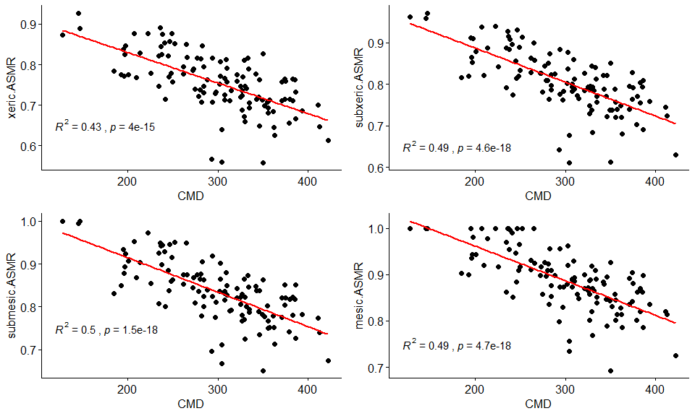
SBSdw3 - Fort St James
These outliers are from recent years (2013-2016

Slide 7
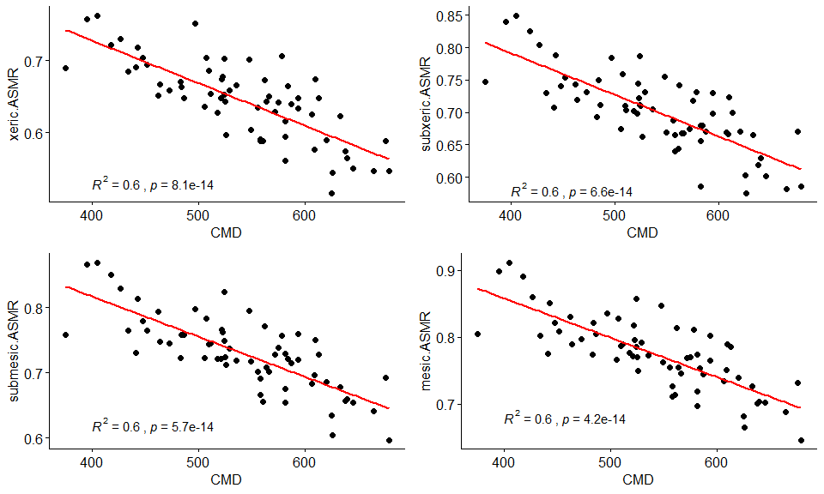
PPxh3 - Grand Forks

Slide 8
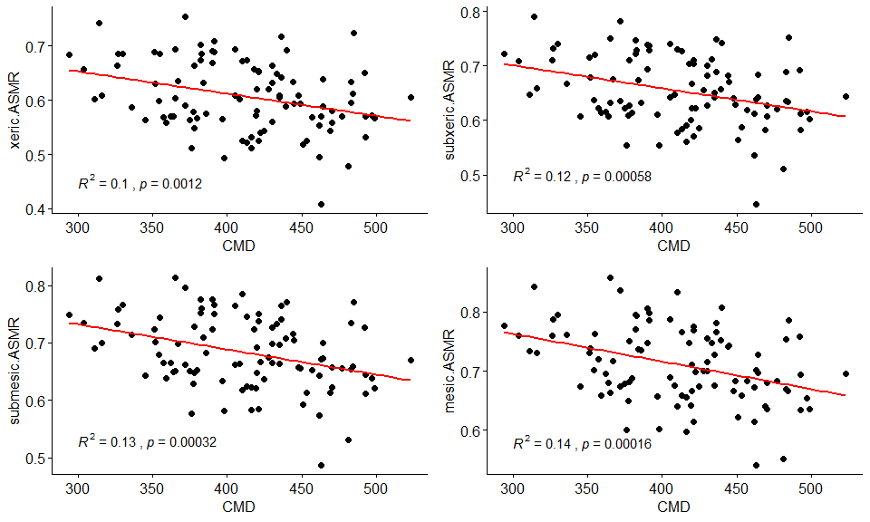
MSdk2 - Golden

Slide 9
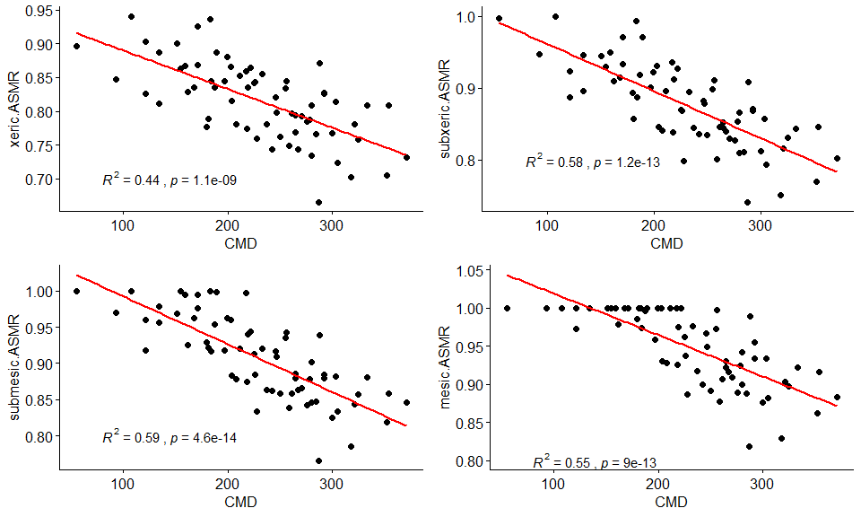
SBSmk1 - Prince George

Slide 10
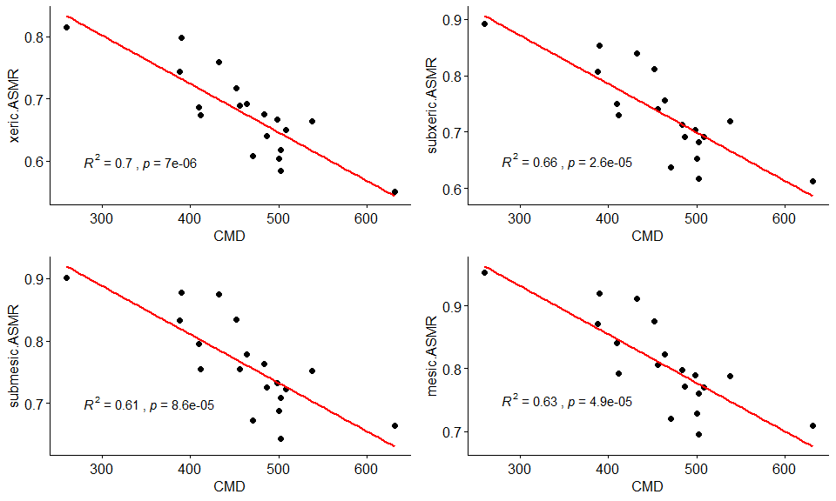
IDFxh1 - Lumby
Note only 19 years of data

Slide 11
Thoughts from annual variables
Correlations between both models are significant in all cases, and strong in 4 of the BGC units shown.
Correlations are highest in hot/dry climates.
Linear regression is not totally appropriate here, because ASMR values are bounded by 1. If we pursue this further, should use beta regression to handle bounded data.
Outlier years might be worth examining further

Slide 12
Growing season ASMR vs growing season CMD
Next, look at relationship between CMD and ASMR over growing season (May to August)

Slide 13
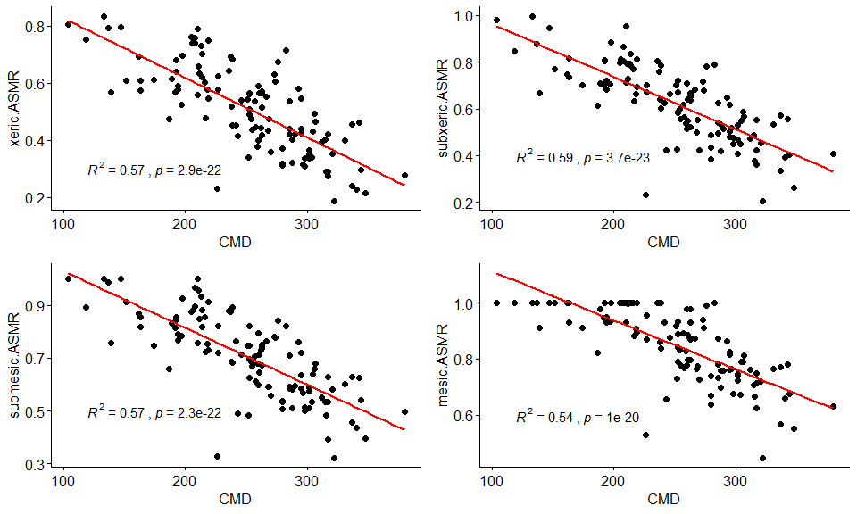
SBSdw3 - Fort St James - growing season

Slide 14
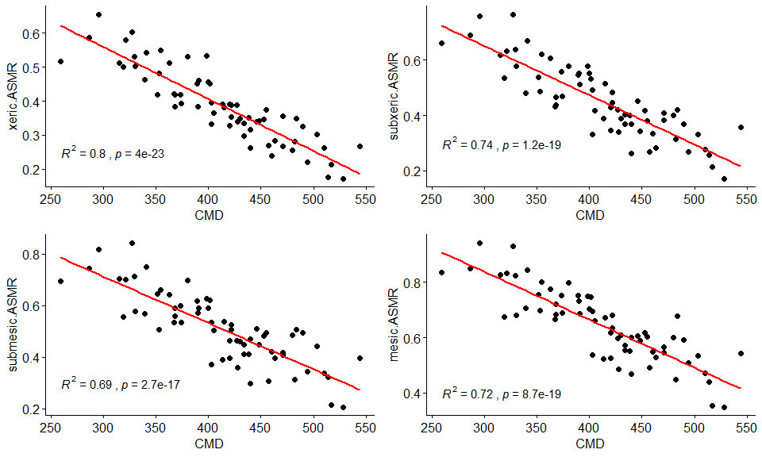
PPxh3 - Grand Forks

Slide 15
Thoughts from growing season variables
Correlations are stronger between growing season compared to annual;
Correlations are again highest in hot/dry climates;
Outlier years might be worth examining further (why do the models disagree on those years?)

Slide 16
Next steps
Replicate with more stations.
Look at 1961-1990 vs recent periods. Do the models agree over both time periods?
If further analysis confirms that both models are in strong agreement for most units, then we can develop a model that predicts the regression slope and coefficient, and apply that to CMD values to estimate ASMR across soil moisture classes.

