Slide 1




Vlad Krotov
A Quick Introduction to R and RStudio
December 11, 2017

Slide 2
Learning Outcomes
LO1: Explain how R language is used for analyzing data
LO2: Add comments to R code
LO3: Use RStudio for entering and running R-code
LO4: Use some utility functions in R, such getwd()
LO5: Retrieve help information for R functions
LO6: Perform simple arithmetic calculations in R
LO7: Declare variables of different data types in R and determine data type of a variable
LO8: Create and access data frames
LO9: Write conditional statements in R
LO10: Write loops in R
LO11: Install R packages from CRAN

Slide 3
Why R?
R is becoming the language of data science
Data Scientist is the “sexiest job of the 21st century”
Harvard Business Review
By 2018 the U.S. alone will face a shortage of
140,000 to 190,000 people with deep analytical skill
McKinsey & Company

Slide 4
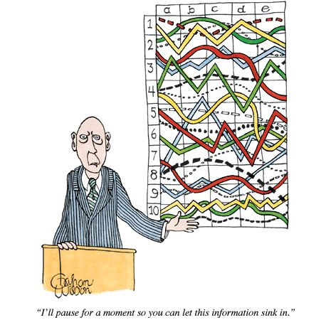
Data Science is not just Stats!

Slide 5

Data Science
Data Science
IT
Programming:
R, Python (Pandas), Java, C++;
Databases;
Data Formats:
HTML, CSS, XML,JSON;
Technologies:
SAS, Hadoop, Spark, etc.
DOMAIN
Marketing
Management
Accounting
Economics
Finance
Networking
Education
Government
Social Media
Biomedicine
English
STATISTICS
Descriptive Statistics: Mean, Median, Mode, etc.;
Inferential Statistics: ANOVA, Regression,
SEM, Clustering, etc.;
Data Visualization;
Machine Learning;
Curiosity

Slide 6
About R
R is a programming language used for:
data manipulations
statistical analysis
data visualization
Like any programming language, it includes:
variables
loops
conditional statements
recursive functions
input/output commands

Slide 7
Data Science Features of R
Numerous functions for data retrieval, manipulation and storage
Built-in operators for calculations using arrays and matrices
Tools for basic and intermediate statistical analysis (e.g. descriptive statistics, regression, SEM, data mining, machine learning, etc.)
Graphics packages for data analysis and visualization
Integration with C, C++, Fortran for improving computational speed
The ability to interface with code written in Python another popular language of data science

Slide 8
R Packages
Of special importance are ~12,000 user-contributed packages available from the Comprehensive R Archive Network (CRAN) https://cran.r-project.org/)
Some examples of R packages:
Package Name | Functionality
dicecrawler | Retrieving data from Dice.com
plyr | Various data manipulations
tm | Text mining
FCNN4R | Machine learning
ggplot2 | Graphics
syuzhet | Plot arc analysis in literary works

Slide 9
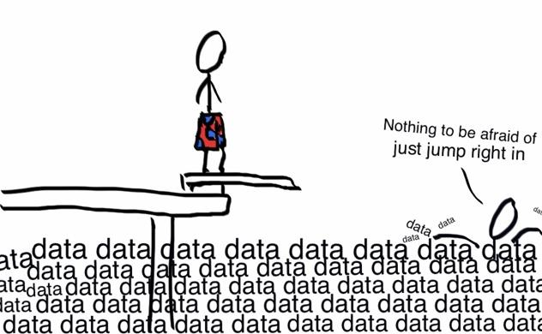
Let’s jump right in!

Slide 10



The Tools We Need
✓
R language installation:
https://cran.r-project.org/mirrors.html
✓
2. RStudio installation
https://www.rstudio.com/products/rstudio/download/
✗
3. My GitHub repository for this tutorial
https://github.com/vladkrotov/RTutorial
✗
4. Please respond to a poll and keep the tab open:
https://pollev.com/vladkrotov187

Slide 11

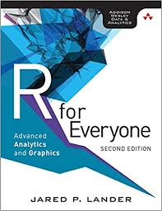
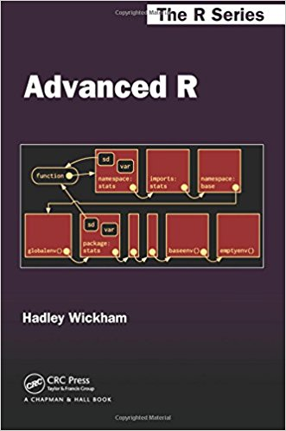
Recommended Resources
http://swirlstats.com

Slide 12
Thank you!
So what do you think?
https://pollev.com/vladkrotov187

