Slide 1




Vlad Krotov
A Quick Introduction to R and RStudio
December 11, 2017

Slide 2
Learning Outcomes
LO1: Explain how R language is used for analyzing data
LO2: Add comments to R code
LO3: Use RStudio for entering and running R-code
LO4: Use some utility functions in R, such getwd()
LO5: Retrieve help information for R functions
LO6: Perform simple arithmetic calculations in R
LO7: Declare variables of different data types in R and determine data type of a variable
LO8: Create and access data frames
LO9: Write conditional statements in R
LO10: Write loops in R
LO11: Install R packages from CRAN

Slide 3
Why R?
R is becoming the language of data science
Data Scientist is the “sexiest job of the 21st century” – says Harvard Business Review
According to McKinsey, “By 2018 the U.S. alone will face a shortage of 140,000 to 190,000 people with deep analytical skills as well as 1.5 million managers and analysts to analyze big data and make decisions”

Slide 4
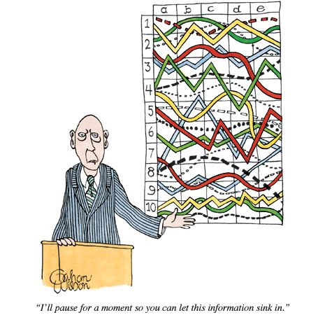
Data Science is not just Stats!

Slide 5

Data Science
Data Science
IT
Programming:
R, Python (Pandas), Java, C++;
Databases;
Data Formats:
HTML, CSS, XML,JSON;
Technologies:
SAS, Hadoop, Spark, etc.
DOMAIN
Marketing
Management
Accounting
Economics
Finance
Networking
Education
Government
Social Media
Biomedicine
English
STATISTICS
Descriptive Statistics: Mean, Median, Mode, etc.;
Inferential Statistics: ANOVA, Regression,
SEM, Clustering, etc.;
Data Visualization;
Machine Learning;
Curiosity

Slide 6
About R
R is a programming language used for:
data manipulations
statistical analysis
data visualization
Like any programming language, it includes:
variables
loops
conditional statements
recursive functions
input/output commands

Slide 7
Data Science Features of R
Numerous functions for data retrieval, manipulation and storage of data
Built-in operators for calculations using arrays and matrices
Built-in collection of tools for basic and intermediate statistical analysis (e.g. descriptive statistics, regression, PLS, data mining, machine learning, etc.)
Graphics packages for data analysis and visualization
Integration with C, C++, Fortran for improving computational speed
The ability to interface with code written in Python another popular language of data science

Slide 8
R Packages
Of special importance are ~12,000 user-contributed packages available from the Comprehensive R Archive Network (CRAN) https://cran.r-project.org/)
Some examples of R packages:
Package Name | Functionality
dicecrawler | Retrieving data from Dice.com
plyr | Various data manipulations
tm | Text mining
FCNN4R | Machine learning
ggplot2 | Graphics
syuzhet | Plot arc analysis in literary works

Slide 9
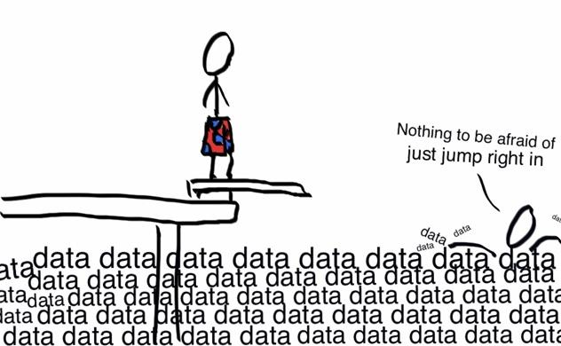
Let’s jump right in!

Slide 10



The Tools We Need
✓
R language installation:
https://cran.r-project.org/mirrors.html
✓
2. RStudio installation
https://www.rstudio.com/products/rstudio/download/
✗
3. My GitHub repository for this tutorial
https://github.com/vladkrotov/RTutorial
✗
4. Please respond to a poll and keep the tab open:
https://pollev.com/vladkrotov187

Slide 11

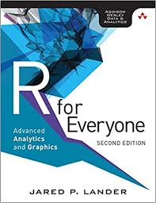
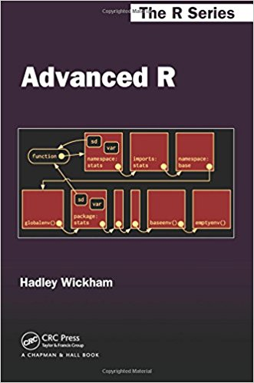
Recommended Resources
http://swirlstats.com

Slide 12
Thank you!
So what do you think?
https://pollev.com/vladkrotov187

