Slide 1
Arl notice list
Jim Chou, Hannah Grounds, Yuanjie Li

Slide 2
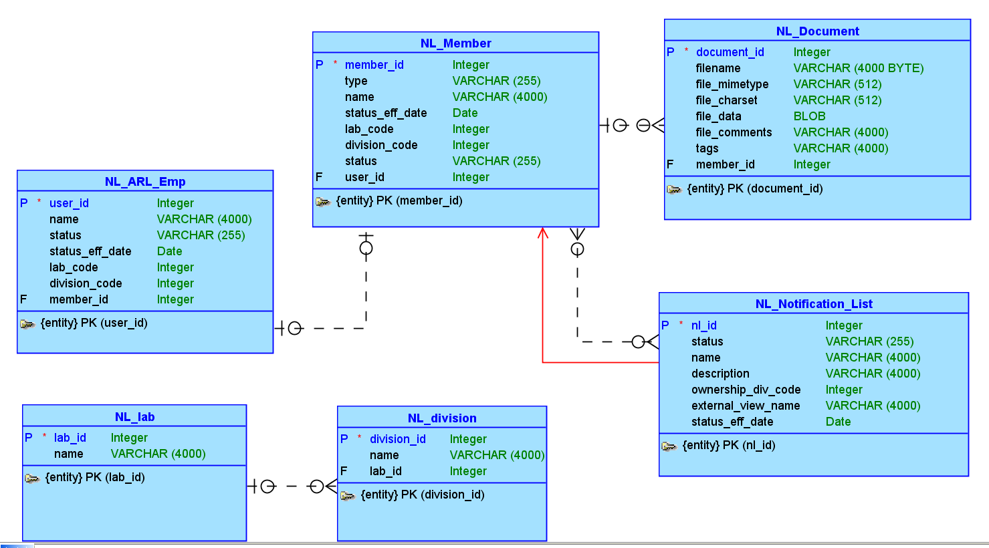
Conceptual Model

Slide 3
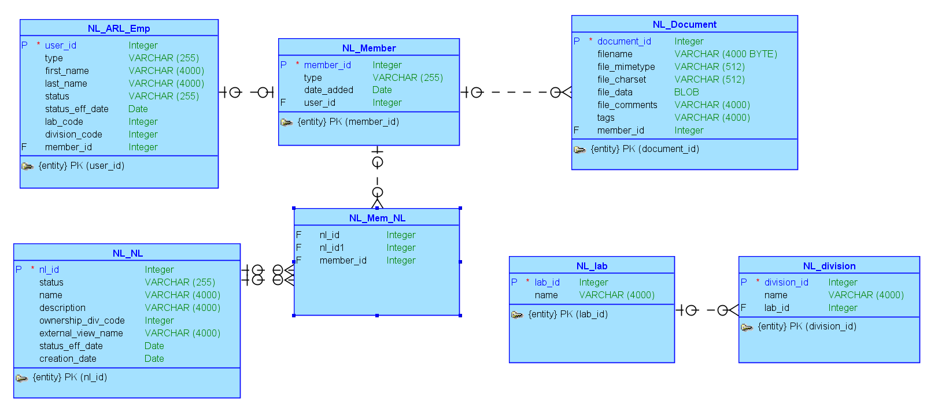
Logical Model

Slide 4
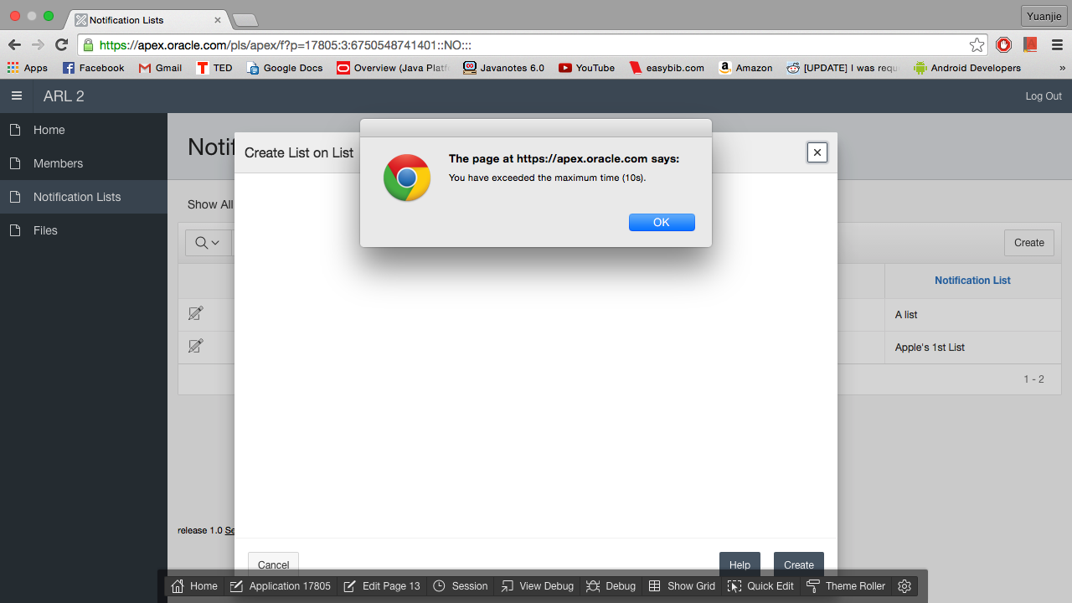
Form Timeout
Notes:
The Form Timeout feature notifies a user when they’ve spent too long on a form. Once the user clicks “OK” the form will be closed. The user can then re-open the form to try again.

Slide 5
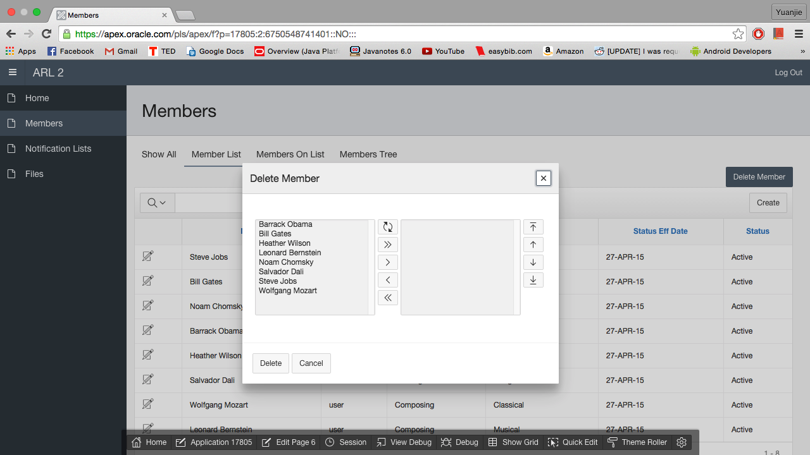
Delete Shuttle
Notes:
We used the Shuttle feature to allow us to delete multiple members from a particular notification list at once instead of having to remove them all individually.

Slide 6
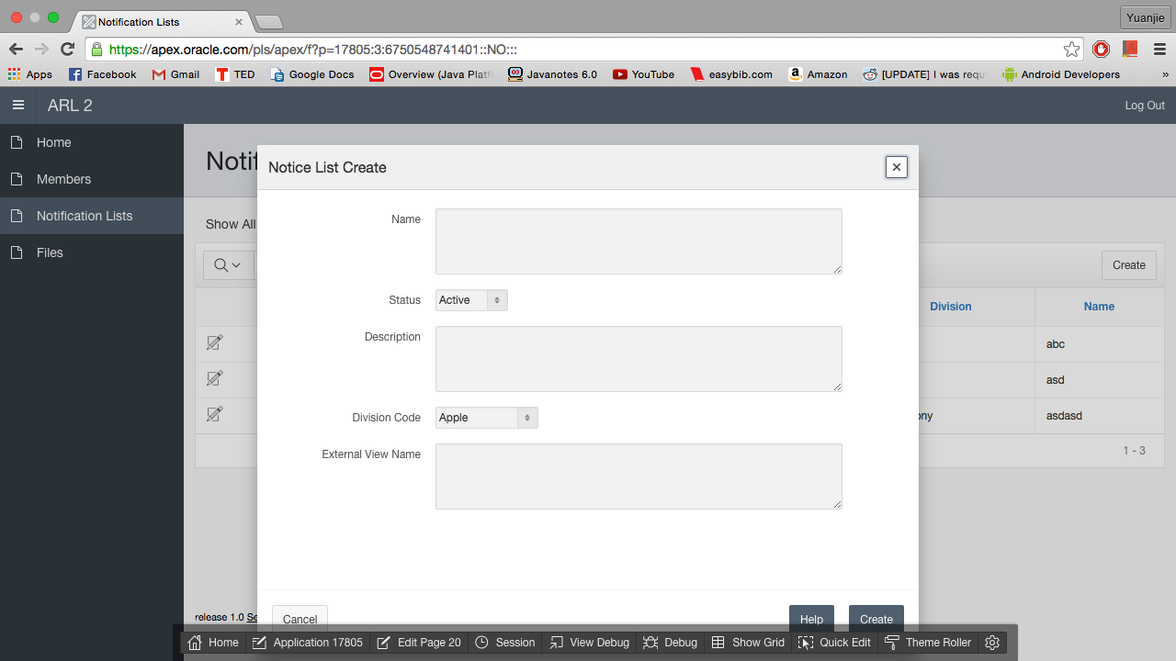
Create a Notification List
Notes:
On the Notice List Create form, we have text fields for a user to input what they want their new list to be called, a description for their list, and a name that will be viewed throughout the rest of the application. There are two select lists, one for a user to select whether a notification list should be active or inactive, and another to select the division that owns the notification list.

Slide 7
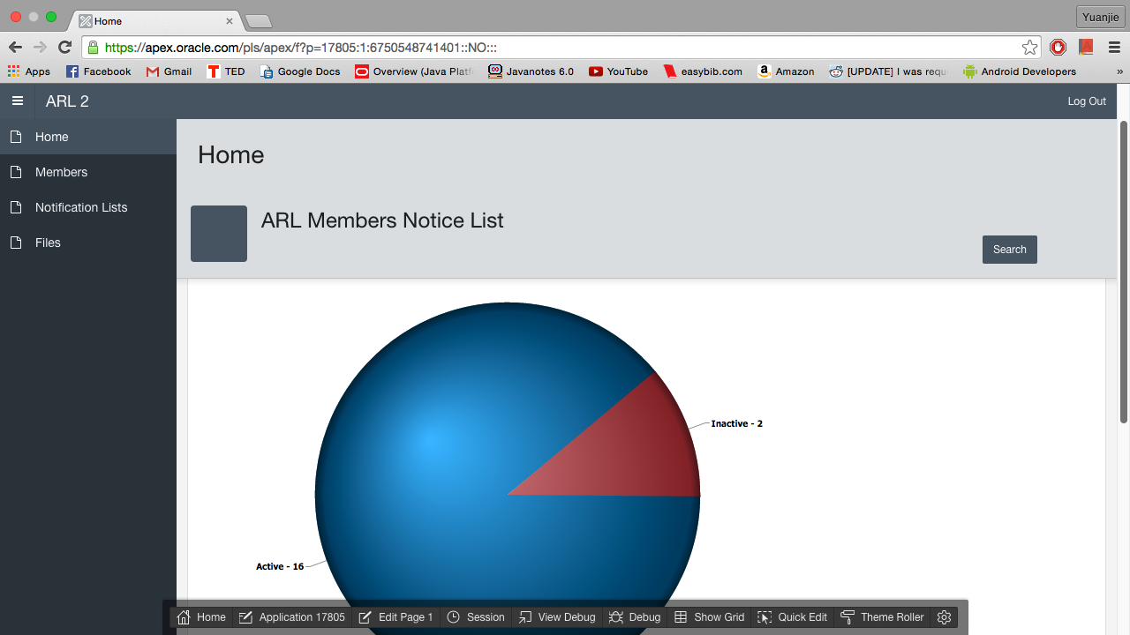
Visual Aids
Notes:
We included a pie chart on the home page of our application to display what percentage of notification lists are active and inactive.

Slide 8
Authorization Scheme
DECLARE
user_type VARCHAR2(255);
user_member_id NUMBER;
user_div_code NUMBER;
BEGIN
user_member_id := USER;
-- Select the user's and his division
SELECT type, division_code
INTO user_type, user_div_code
FROM nl_member m
JOIN nl_arl_emp e ON nl_arl_emp_user_id = user_id
WHERE member_id = user_member_id;
-- If is admin, then allow them to edit everything
IF user_type = 'admin'
THEN
SELECT *
BULK COLLECT INTO edit_lists
FROM nl_nl_view
ORDER BY name;
-- If division matches, then you can see those of
-- the same division
ELSE IF user_div_code = owner_division_code
SELECT *
BULK COLLECT INTO edit_lists
FROM nl_nl_view
WHERE ownership_div_code = user_div_code
ORDER BY name;
END IF;
END;
/

Slide 9
Application
Apex link: https://apex.oracle.com/pls/apex/f?p=17805:1:6750548741401::NO:::

