Slide 1
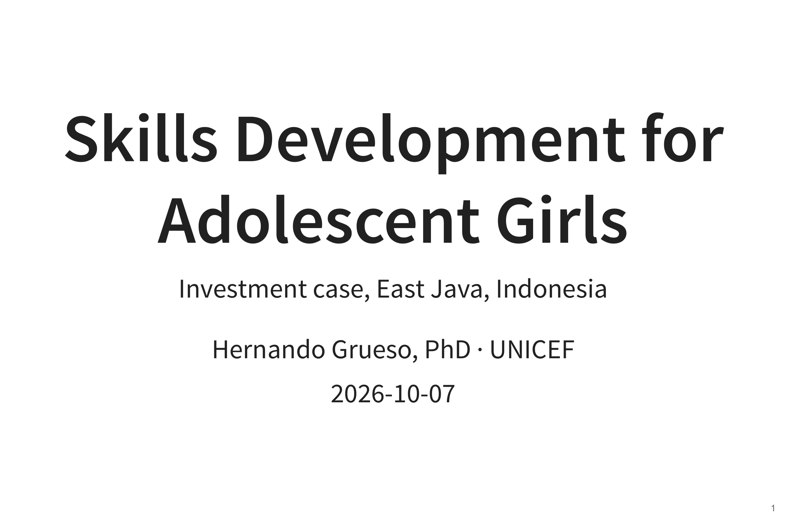

Slide 2
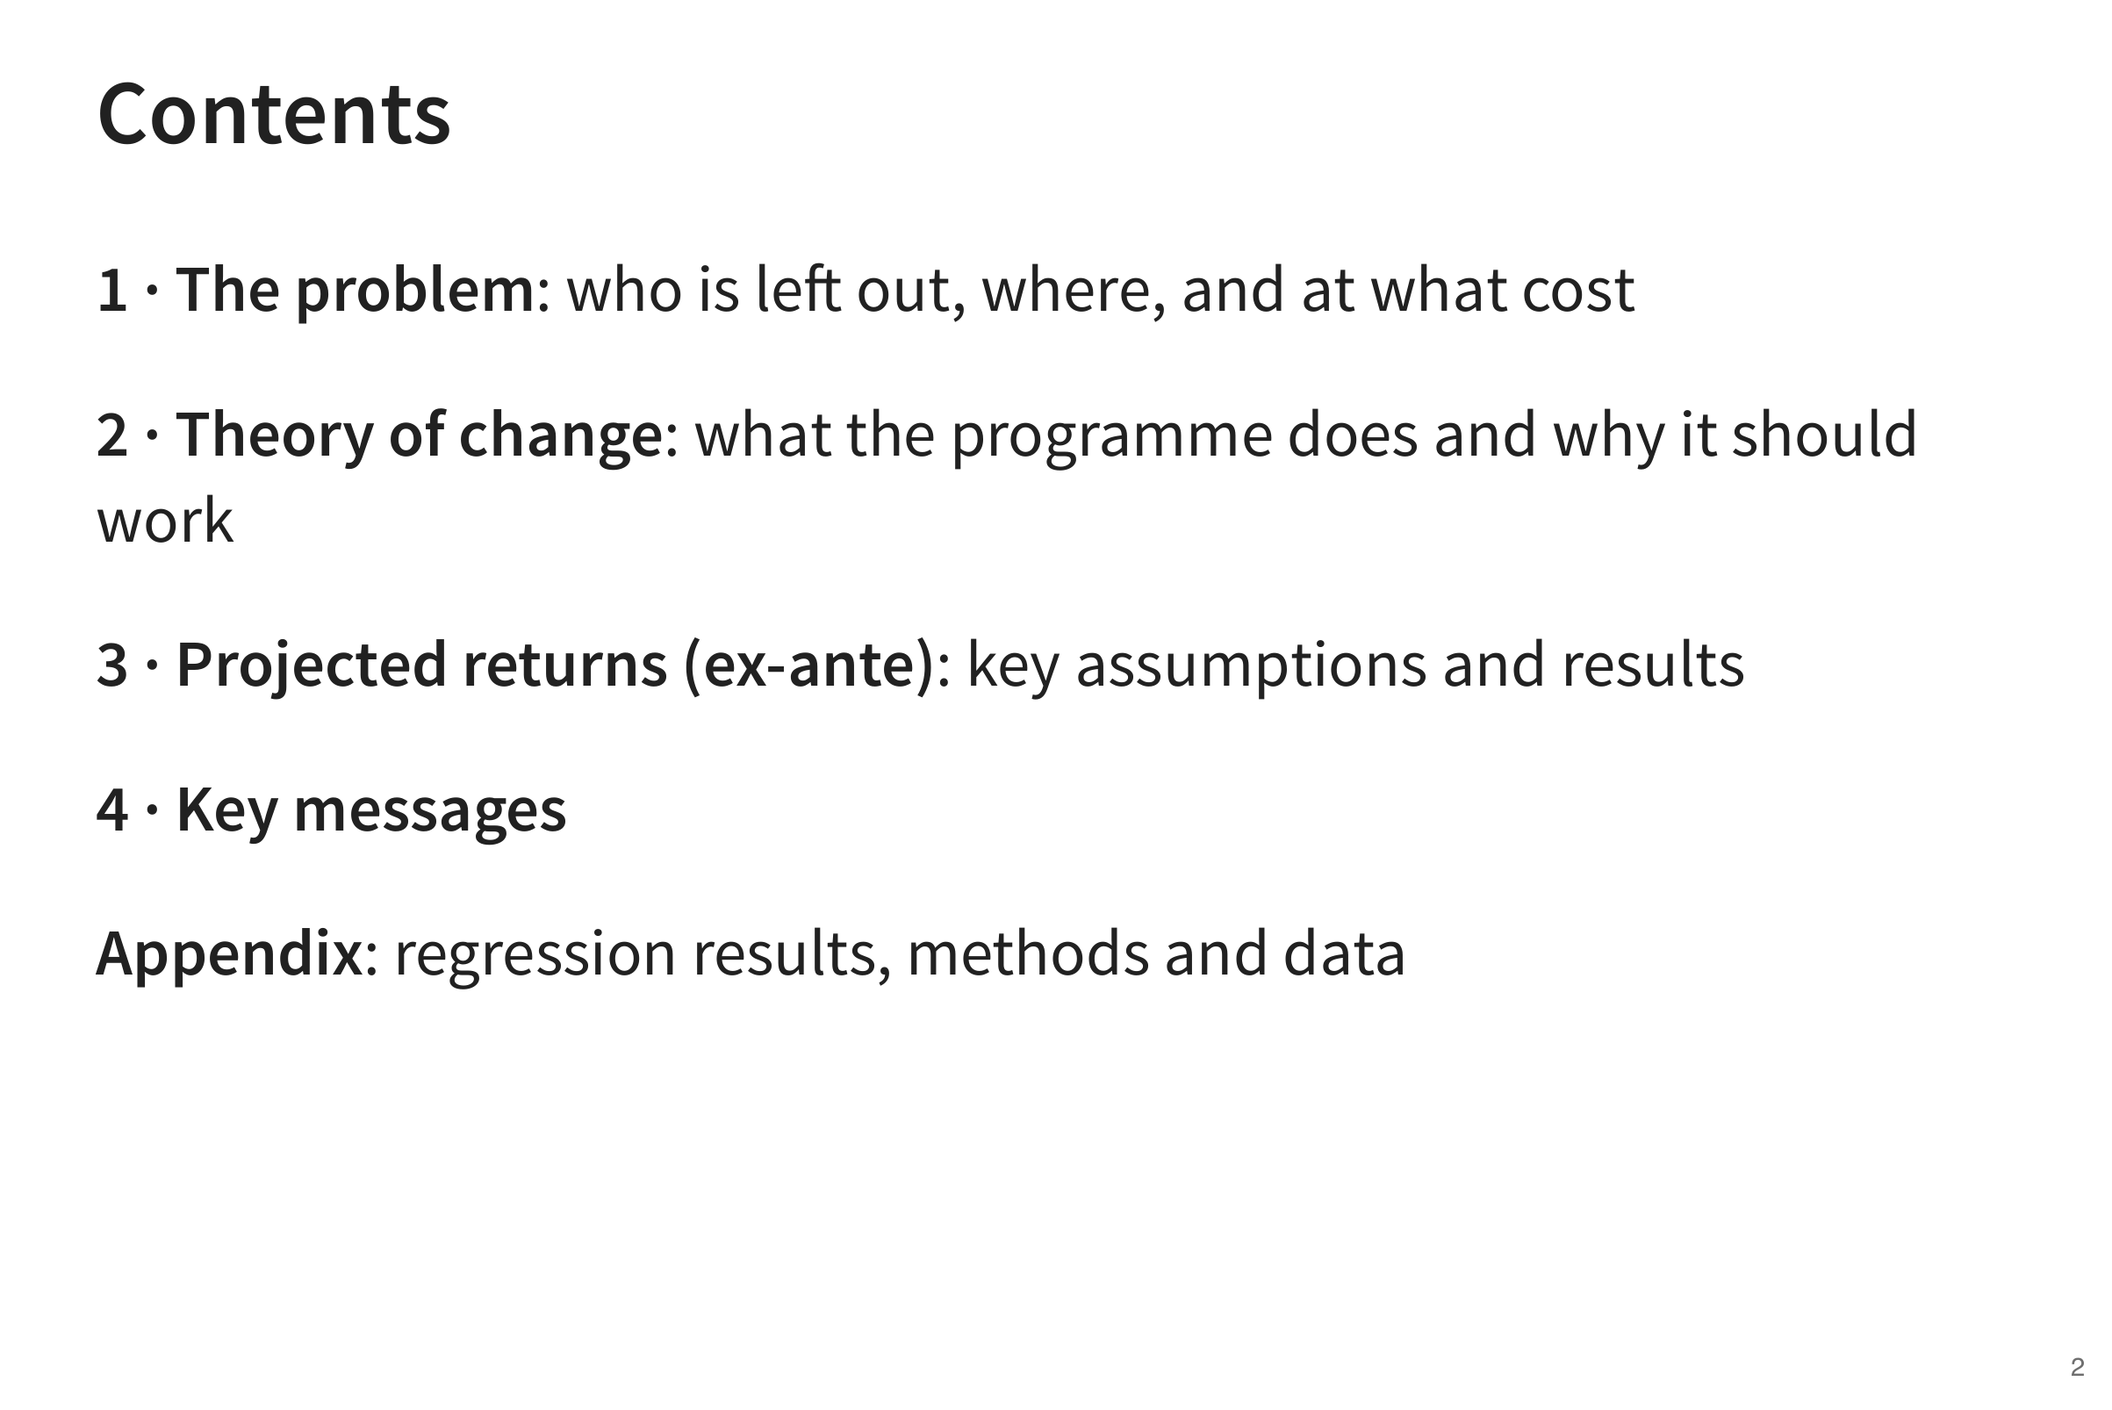
Notes:
The deck moves from the problem, to how the proposed programme is expected to work, to what it could return, and ends with key messages and policy recommendations. Technical detail is in the appendix.

Slide 3


Slide 4
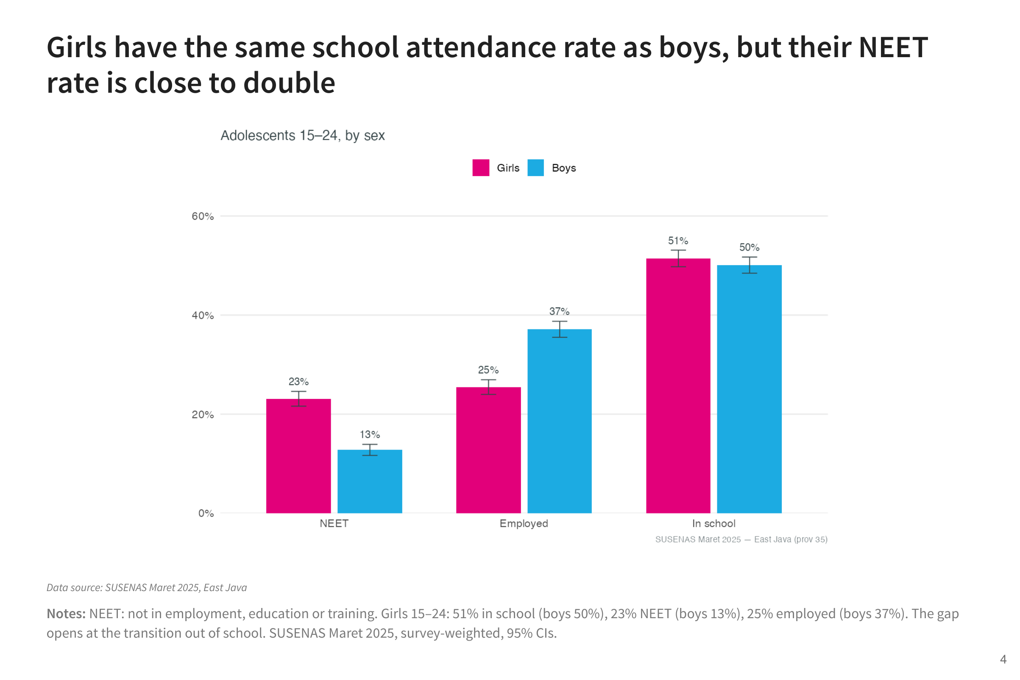
Notes:
Girls aged 15 to 24 in East Java attend school at the same rate as boys. The difference appears after school: close to one in four girls is NEET, meaning not in employment, education or training, against about one in eight boys. This is why the programme focuses on the move from school into work or further study.

Slide 5
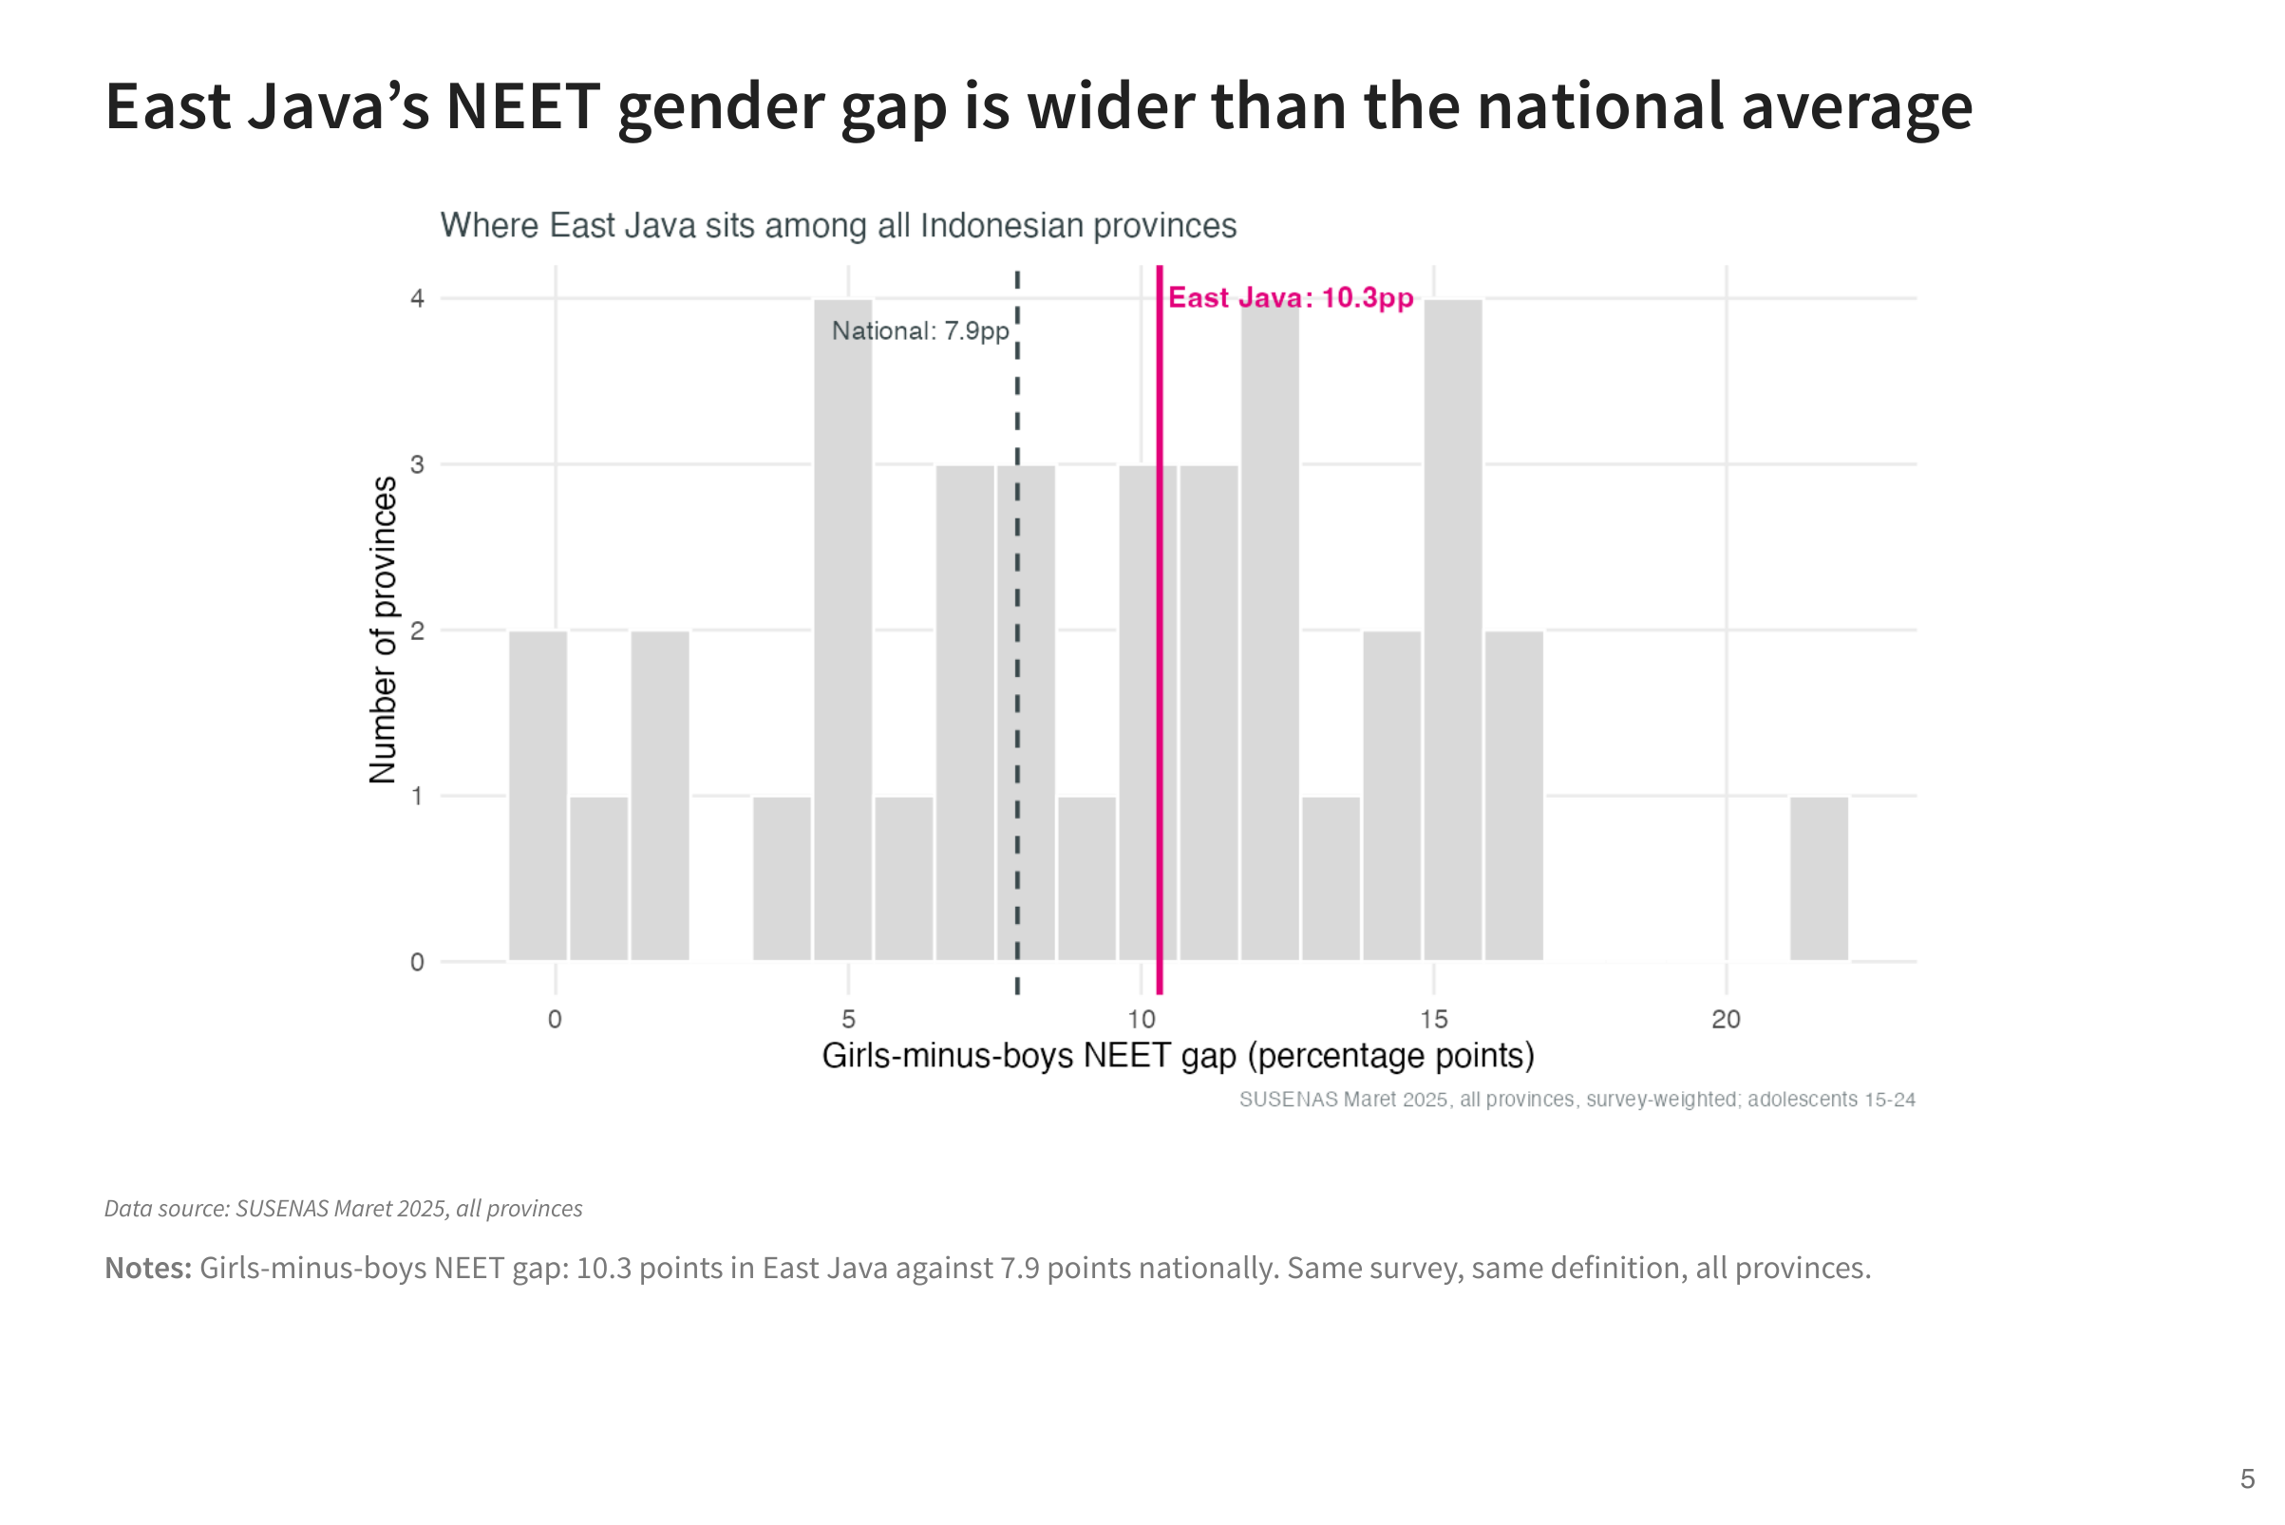
Notes:
The same comparison for every province shows that the gap between girls and boys is wider in East Java than in Indonesia as a whole. This is not only a national pattern.

Slide 6
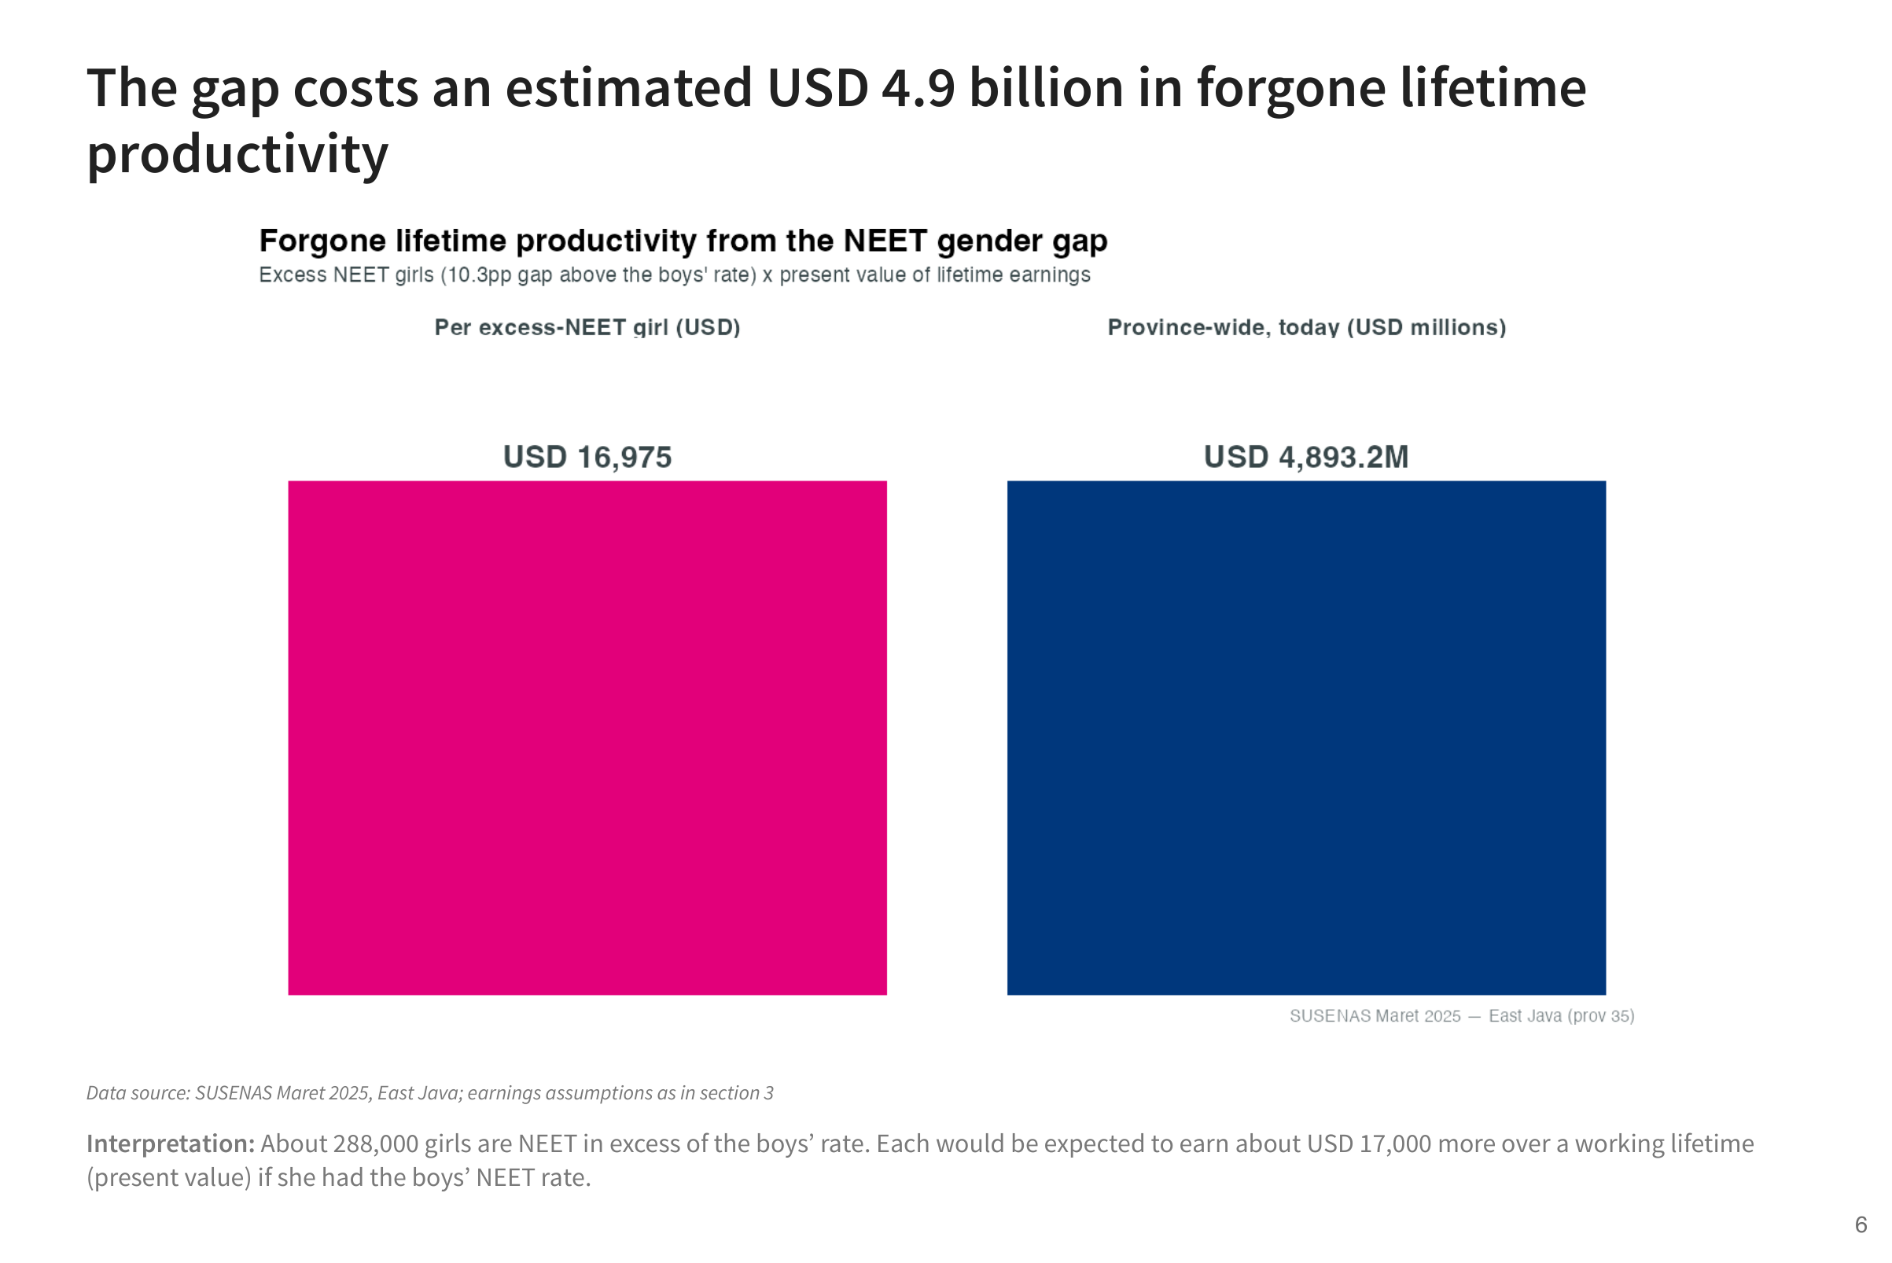
Notes:
This puts a value on the gap. About 288,000 more girls are NEET than would be at the boys’ rate. Each would earn about USD 17,000 over her working life, in today’s money, if she were working. Together that is about USD 4.9 billion. It shows what is at stake, not what the programme would recover.

Slide 7
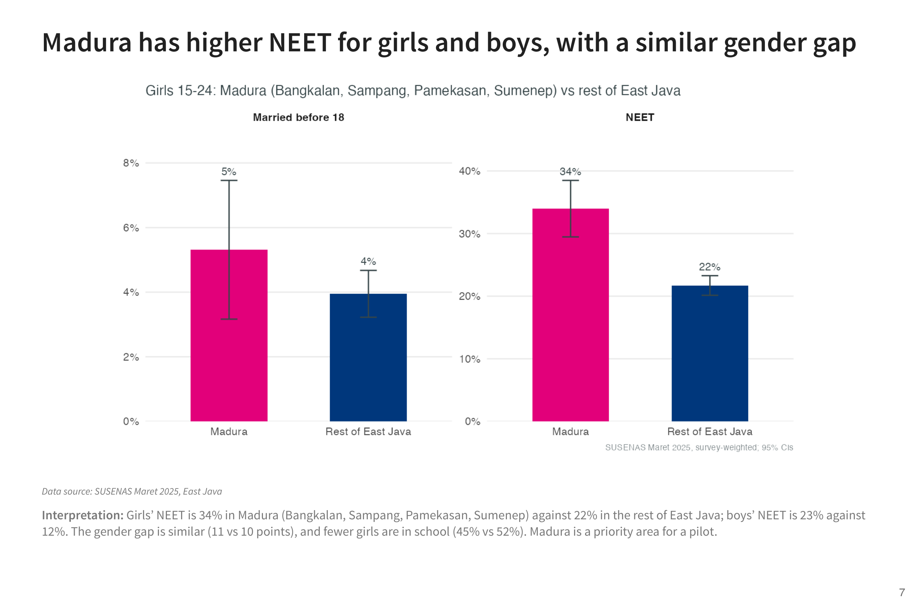
Notes:
Madura stands out: NEET rates are higher for both girls and boys, and fewer girls are in school. The gap between girls and boys is similar to the rest of the province, so Madura needs both general and girl-focused support. This makes it a natural first area for a pilot.

Slide 8
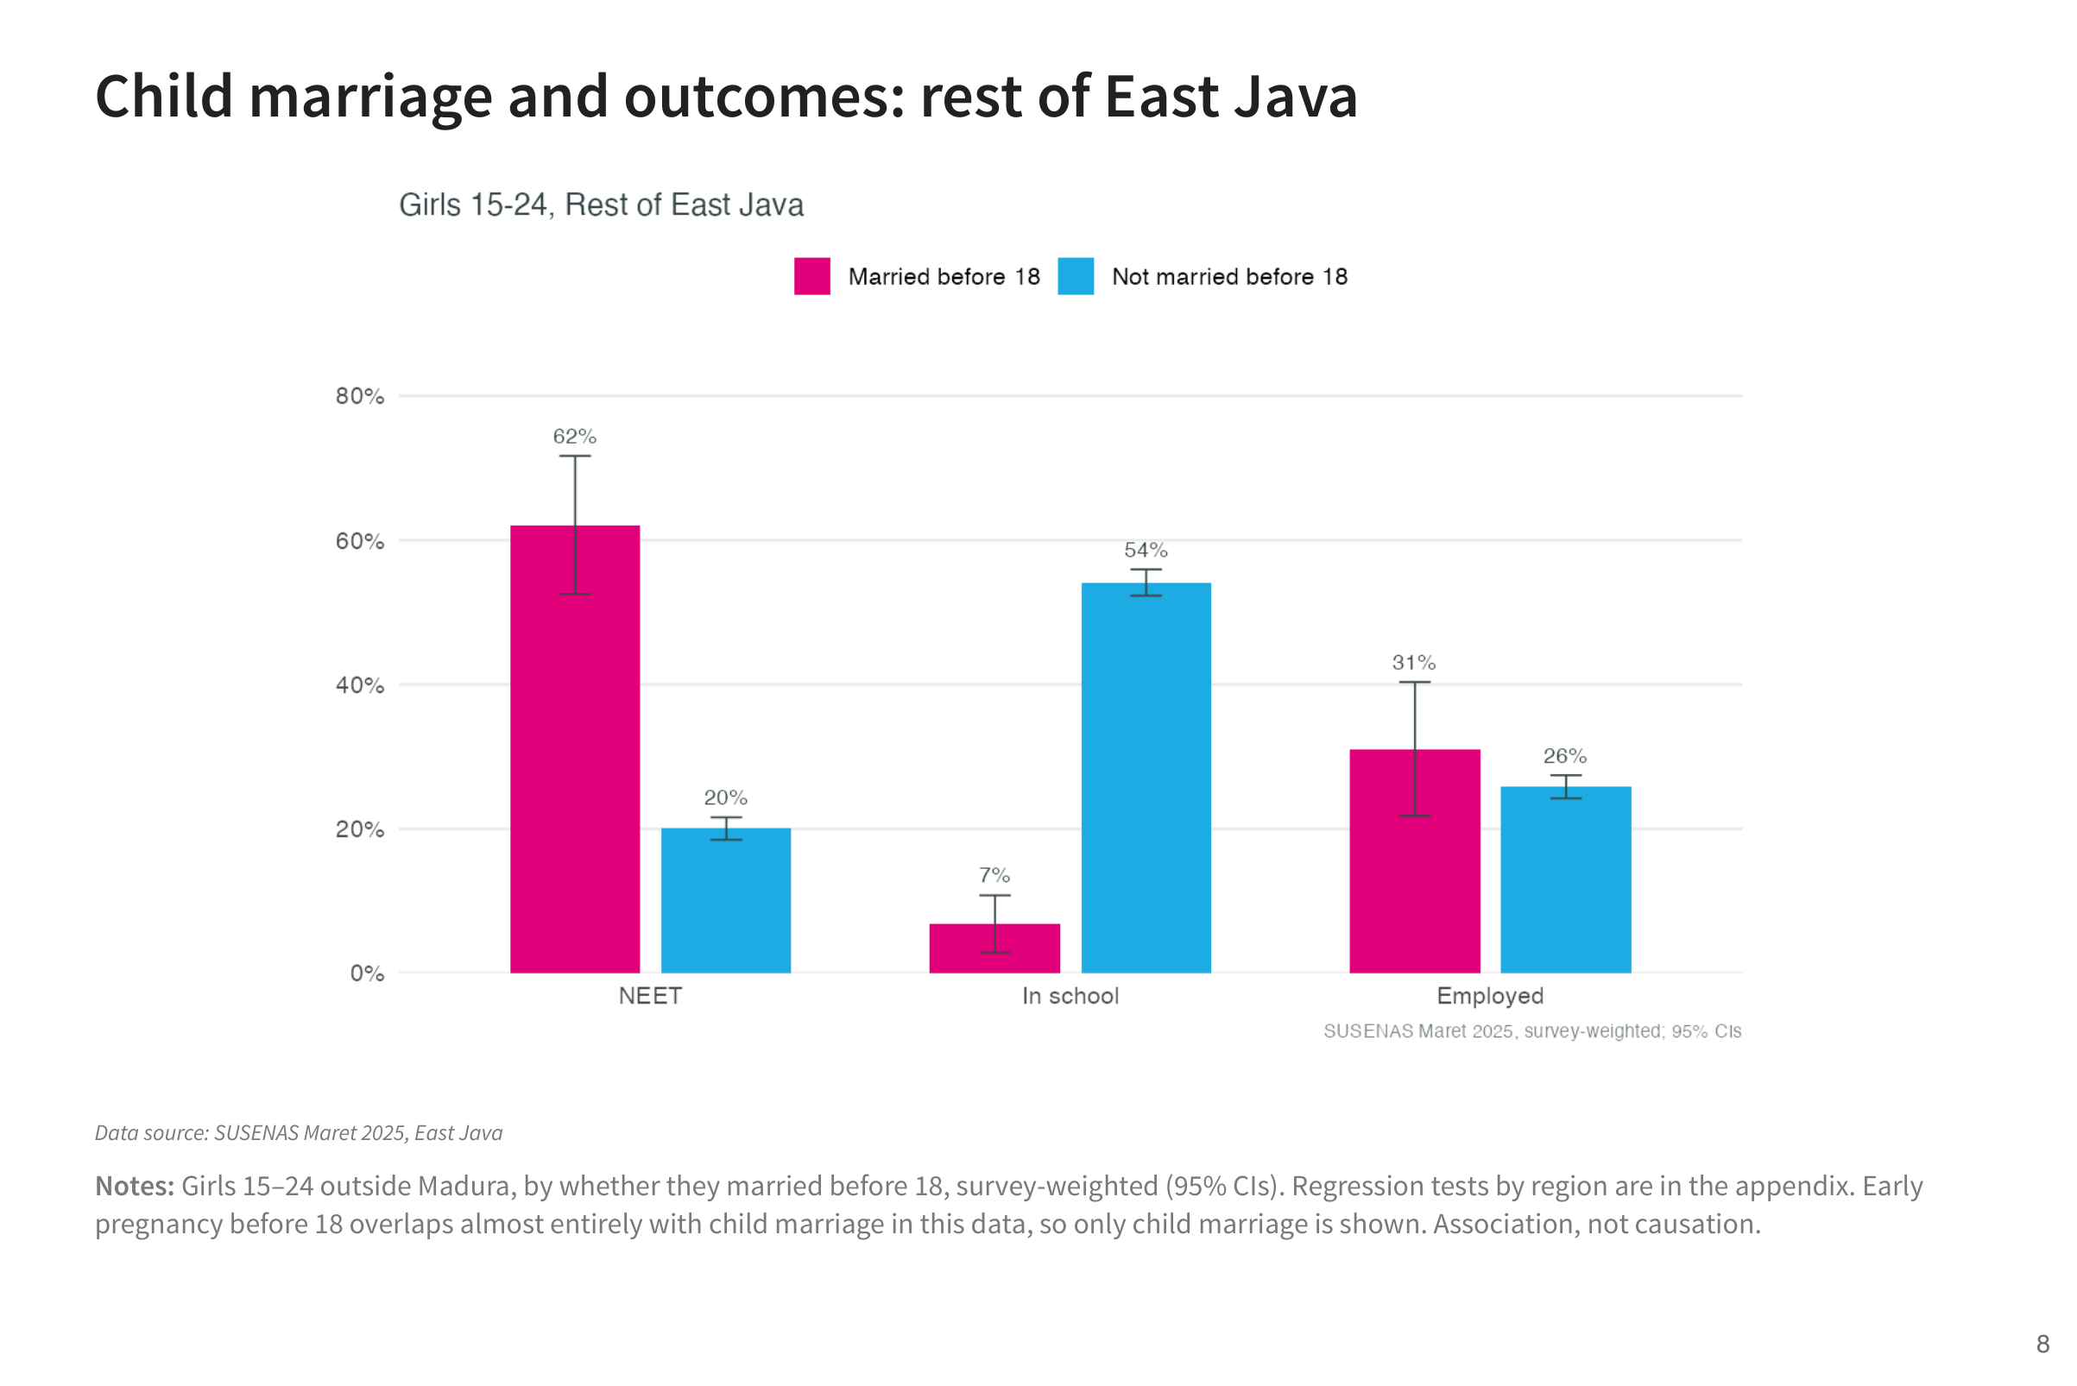
Notes:
Outside Madura, girls who married before 18 are much more likely to be NEET and much less likely to be in school. This is an association: the survey cannot tell whether marriage leads girls to leave school or the other way round.

Slide 9
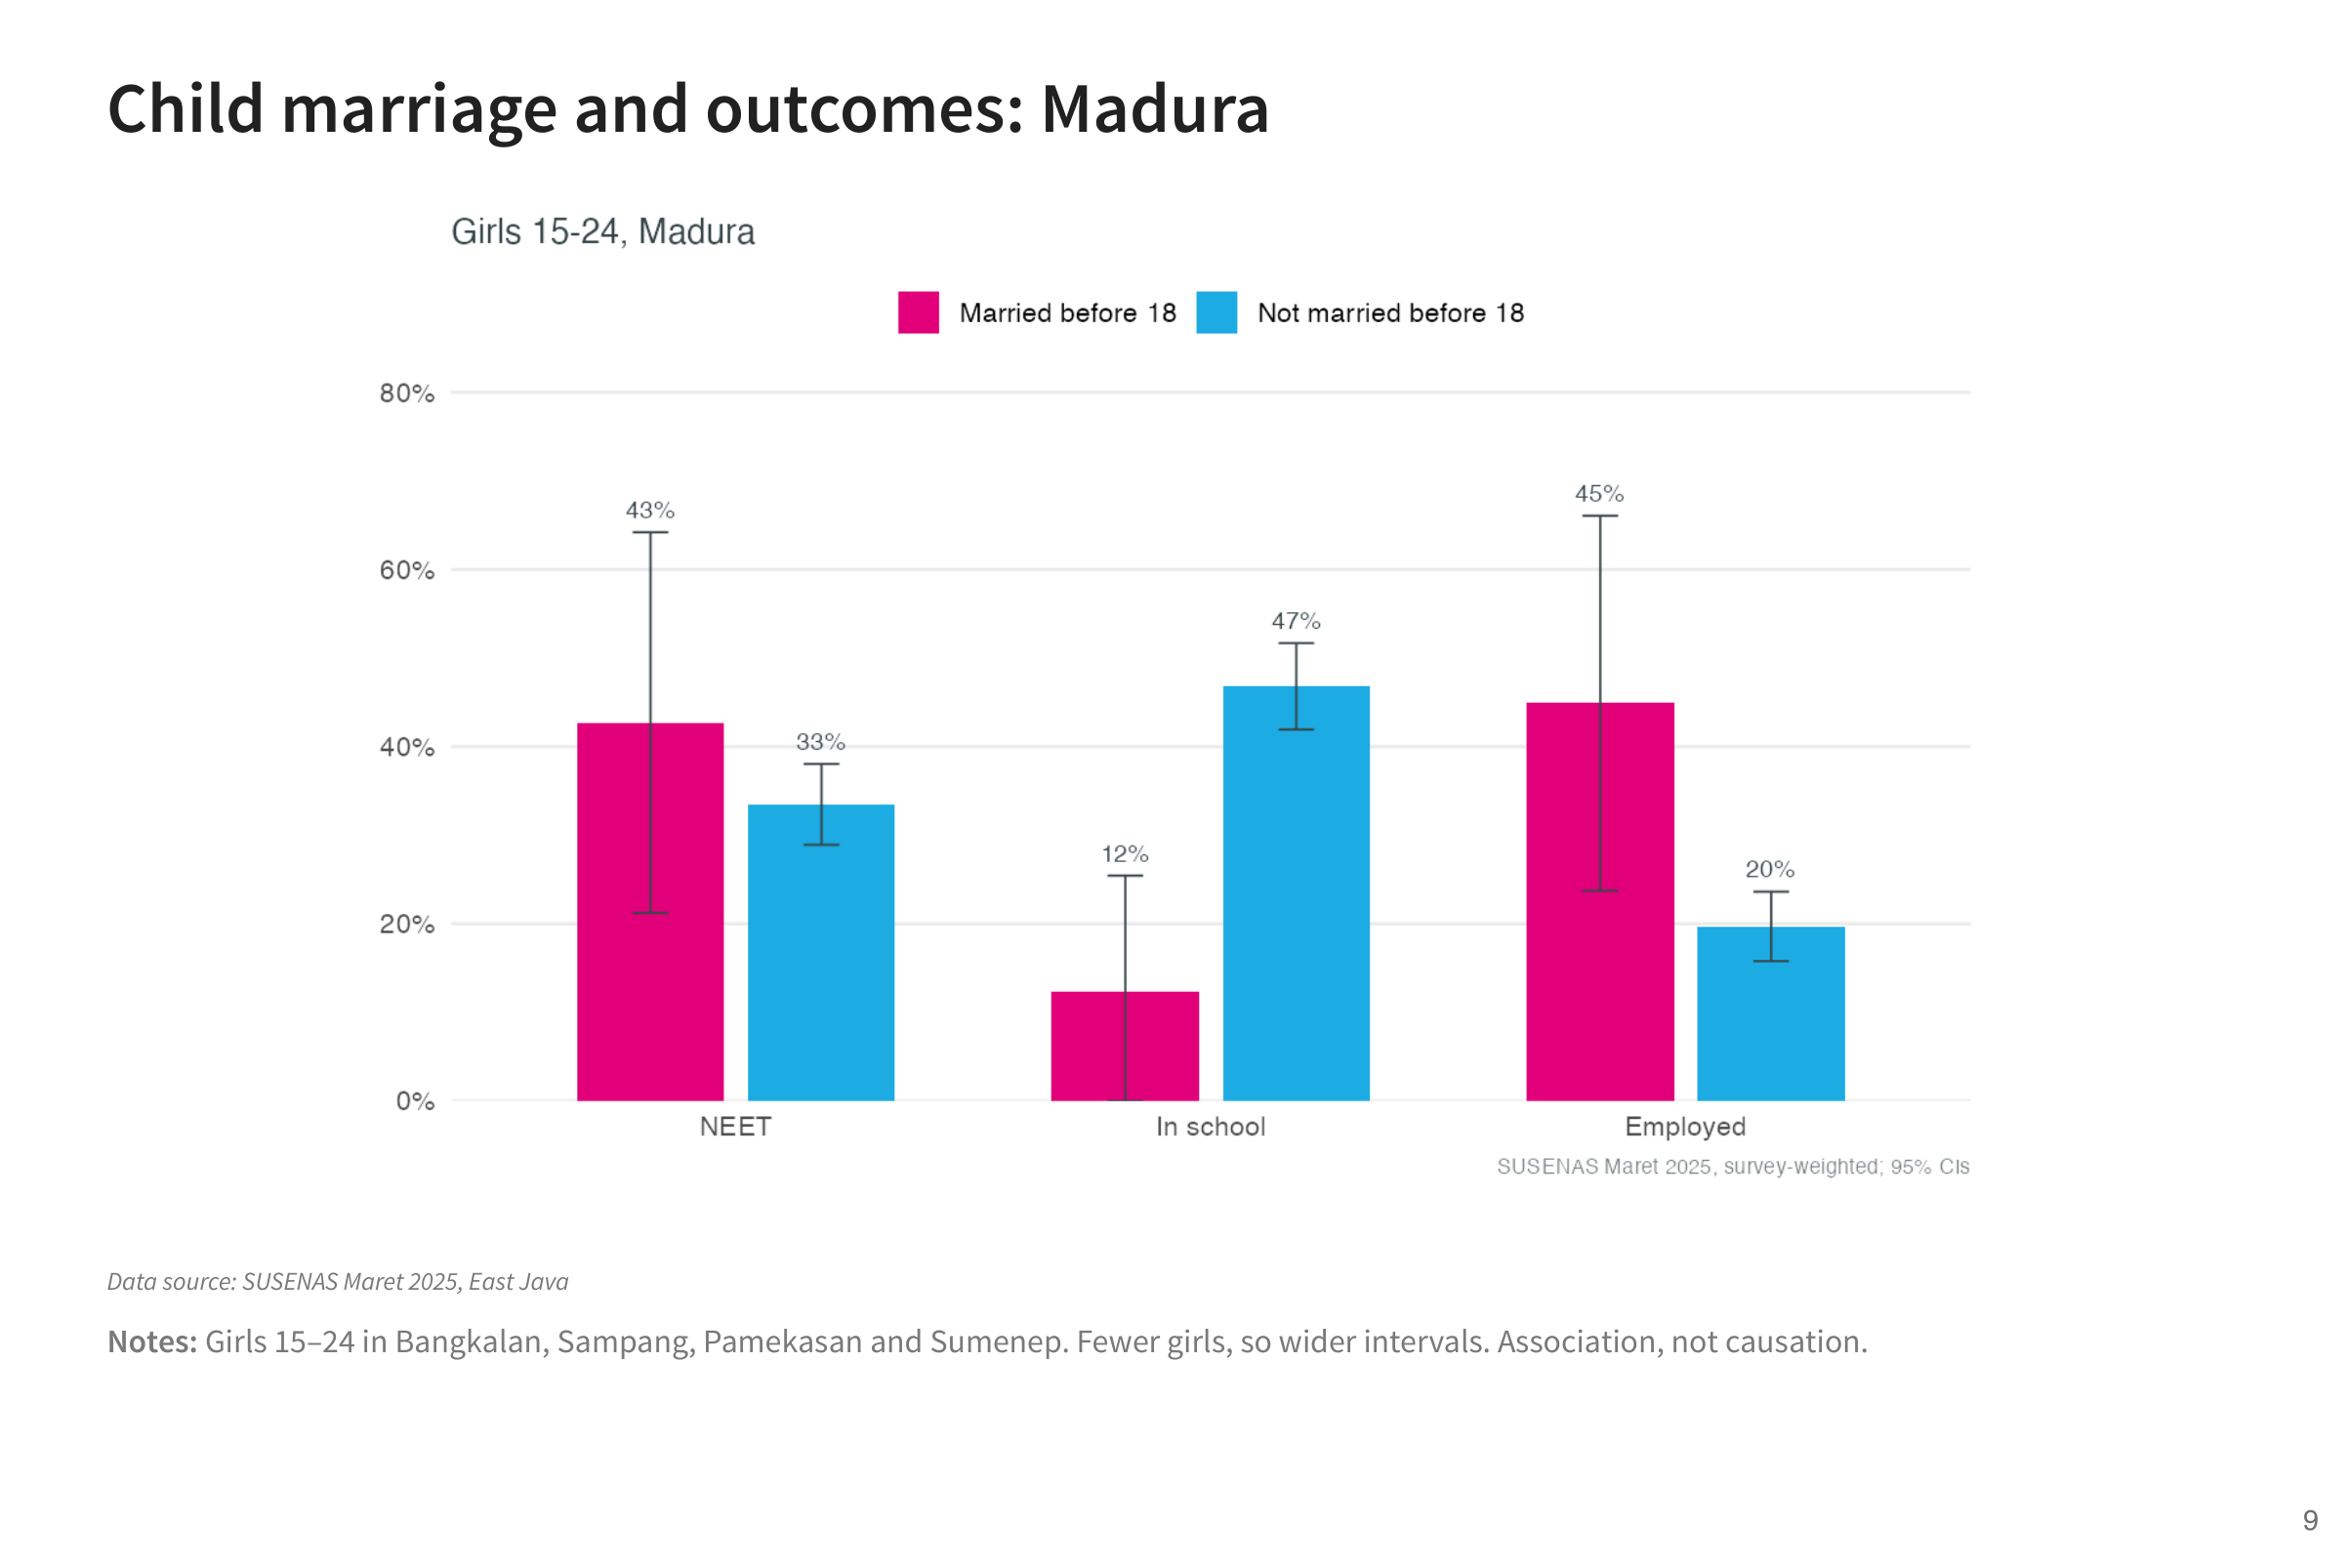
Notes:
In Madura the same pattern appears for school attendance, but few girls in the sample married before 18, so the estimates are less precise.

Slide 10
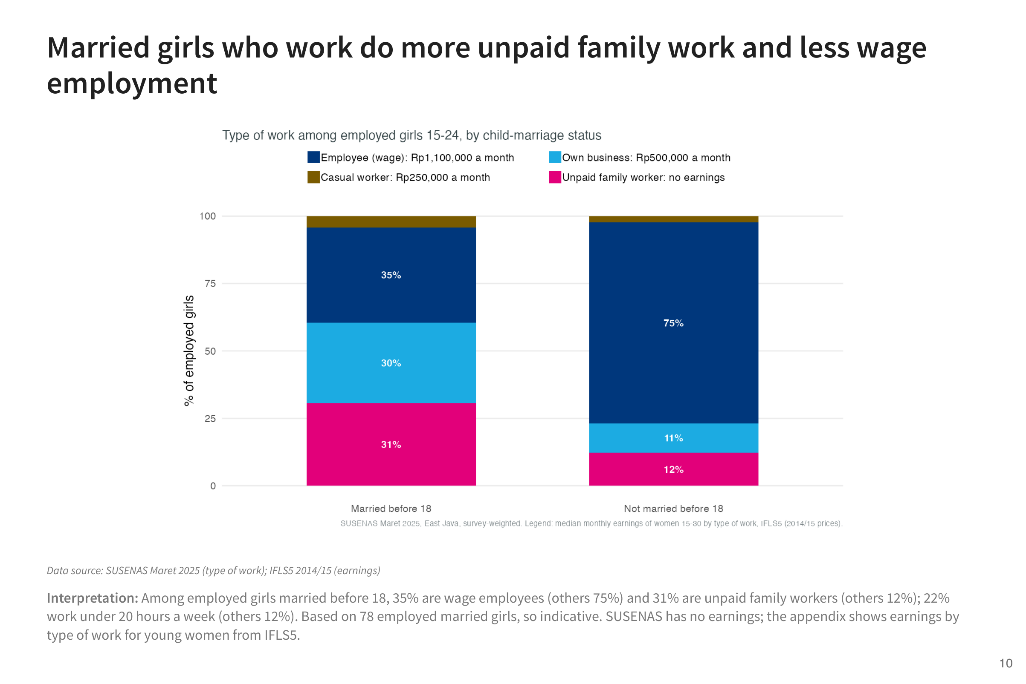
Notes:
Girls married before 18 who work are more often in unpaid family work or small own businesses, and less often in wage jobs. Typical monthly earnings are about Rp1.1 million for employees, Rp0.5 million for own businesses and nothing for unpaid family work, so the type of work matters as much as whether girls work.

Slide 11
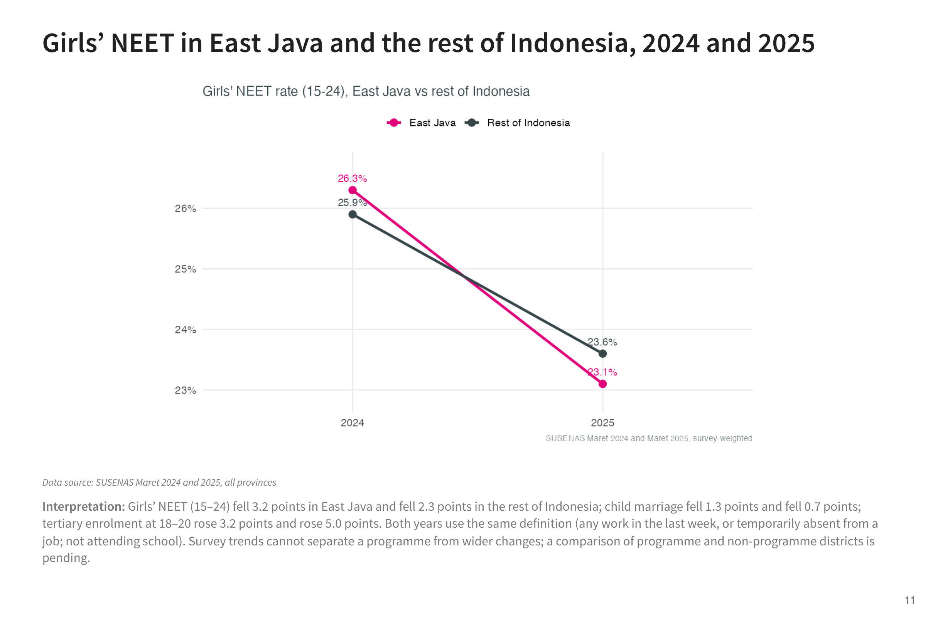
Notes:
Girls’ NEET fell between 2024 and 2025 in East Java and in the rest of Indonesia, using the same definition in both years. Because it fell nationally, the change cannot be attributed to a provincial programme.

Slide 12
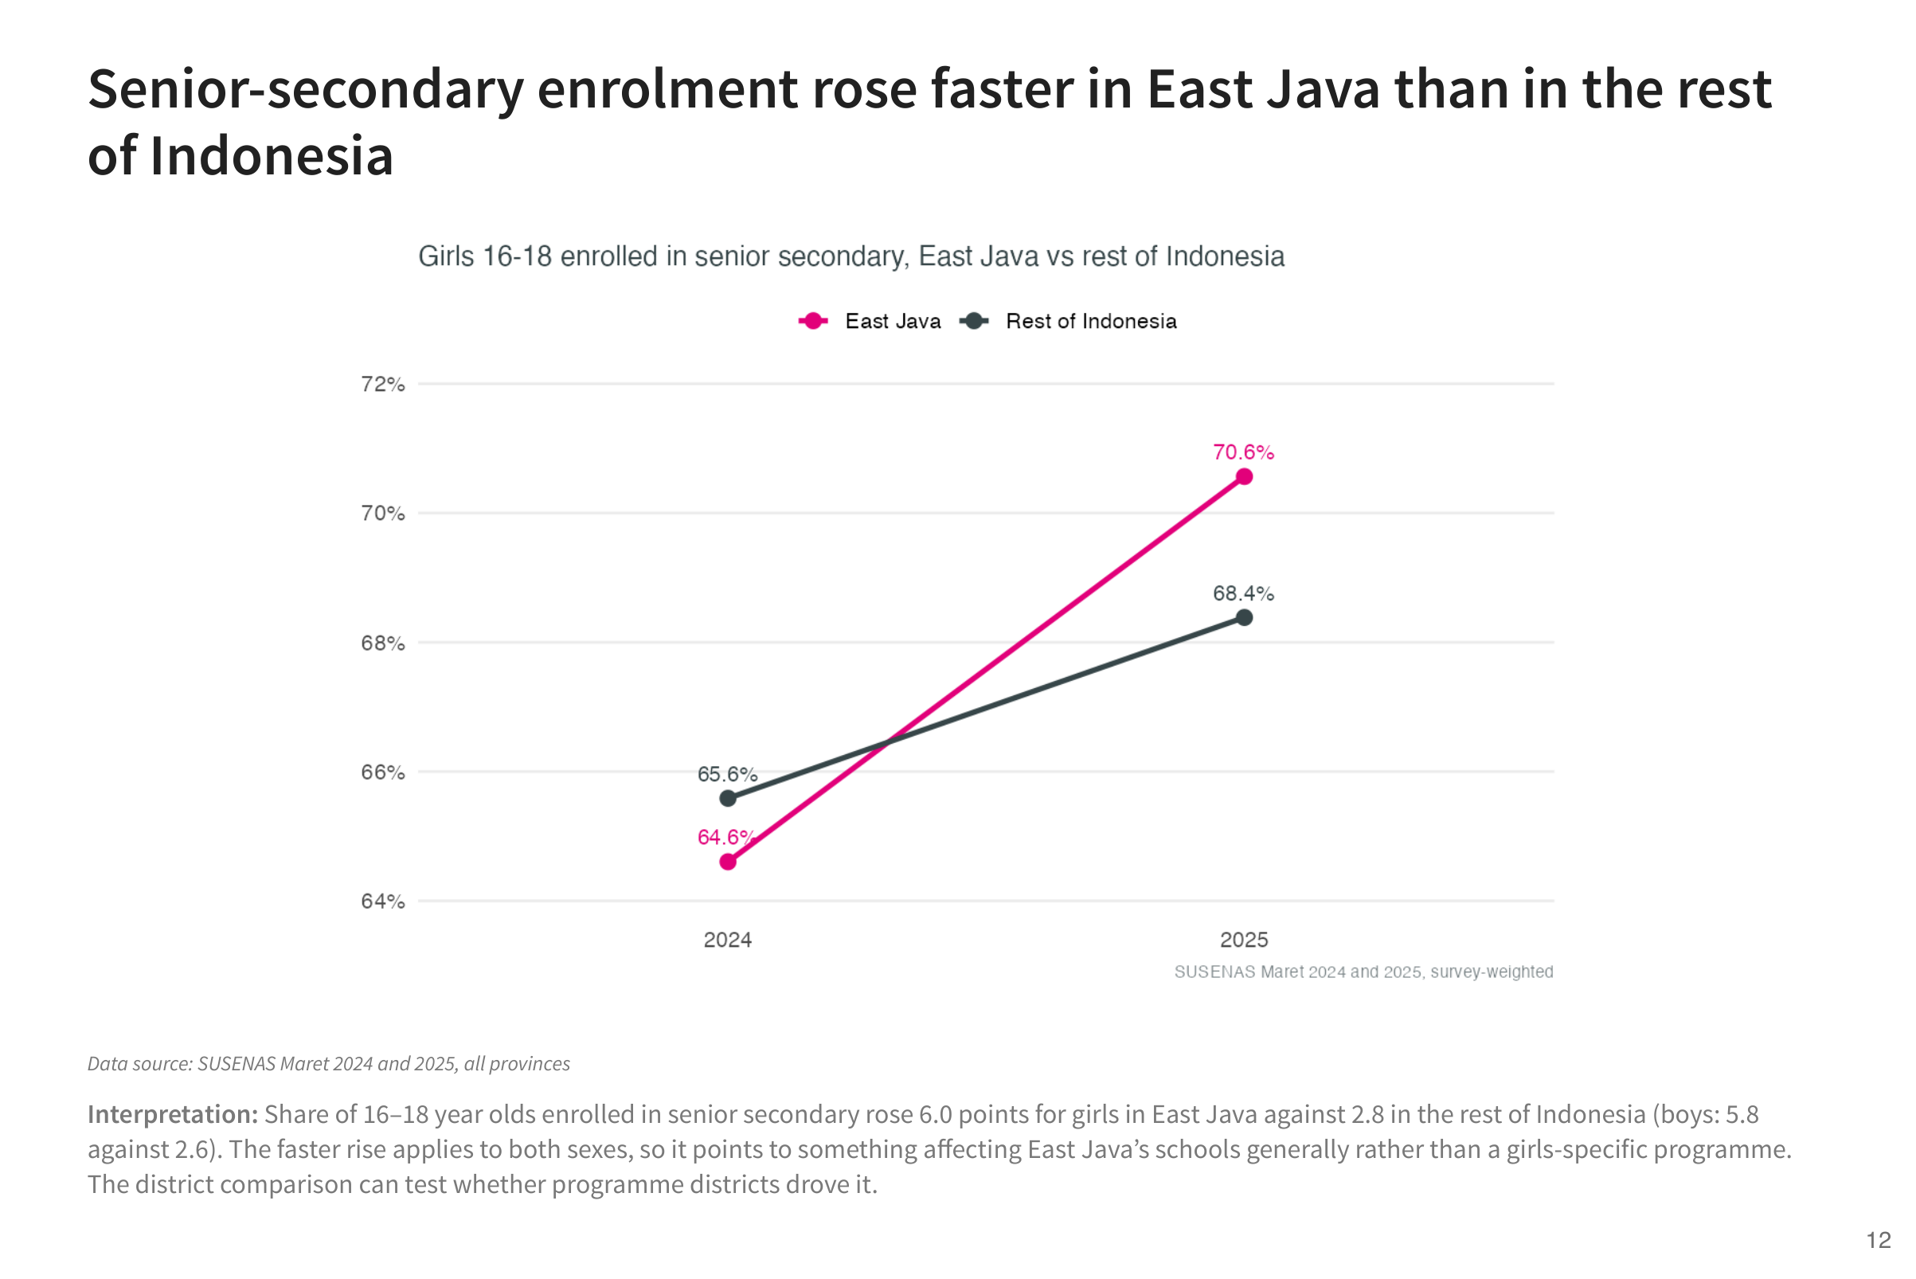
Notes:
The share of 16 to 18 year olds in senior secondary rose faster in East Java than elsewhere, for girls and boys alike. That points to province-wide changes in schooling rather than a girls-specific effect.

Slide 13
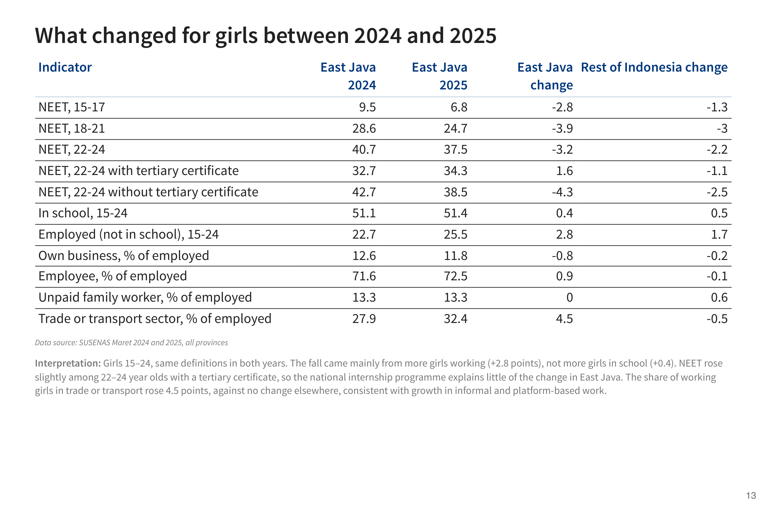
Notes:
This table tests the explanations raised by the team for the fall in NEET. The fall came mostly from more girls working, especially in trade and transport, rather than from more girls in school. NEET did not fall among young women with a university degree, so the national internship programme is unlikely to be the main driver in East Java.

Slide 14
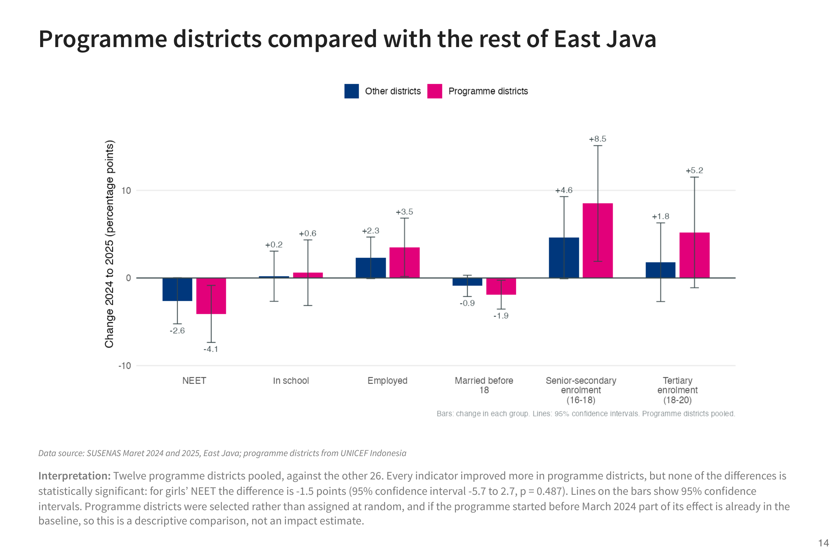
Notes:
This compares the districts where the programme works with the rest of East Java, before and after. Programme districts improved more than the rest on every indicator, which is encouraging, but the differences are small enough that they could be chance. Programme districts were also selected rather than chosen at random, and we only have two years of data, so this is not yet evidence of impact.

Slide 15
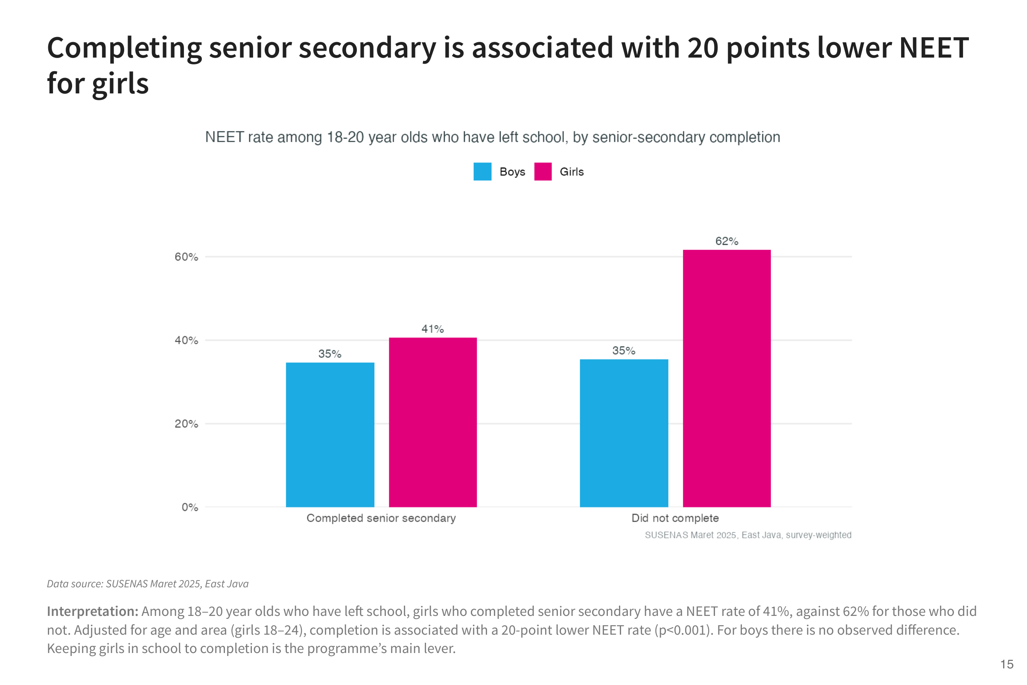
Notes:
Among young women who have left school, those who completed senior secondary are about 20 points less likely to be NEET. For young men there is no observed difference. This is why keeping girls in school to completion is the programme’s main lever.

Slide 16
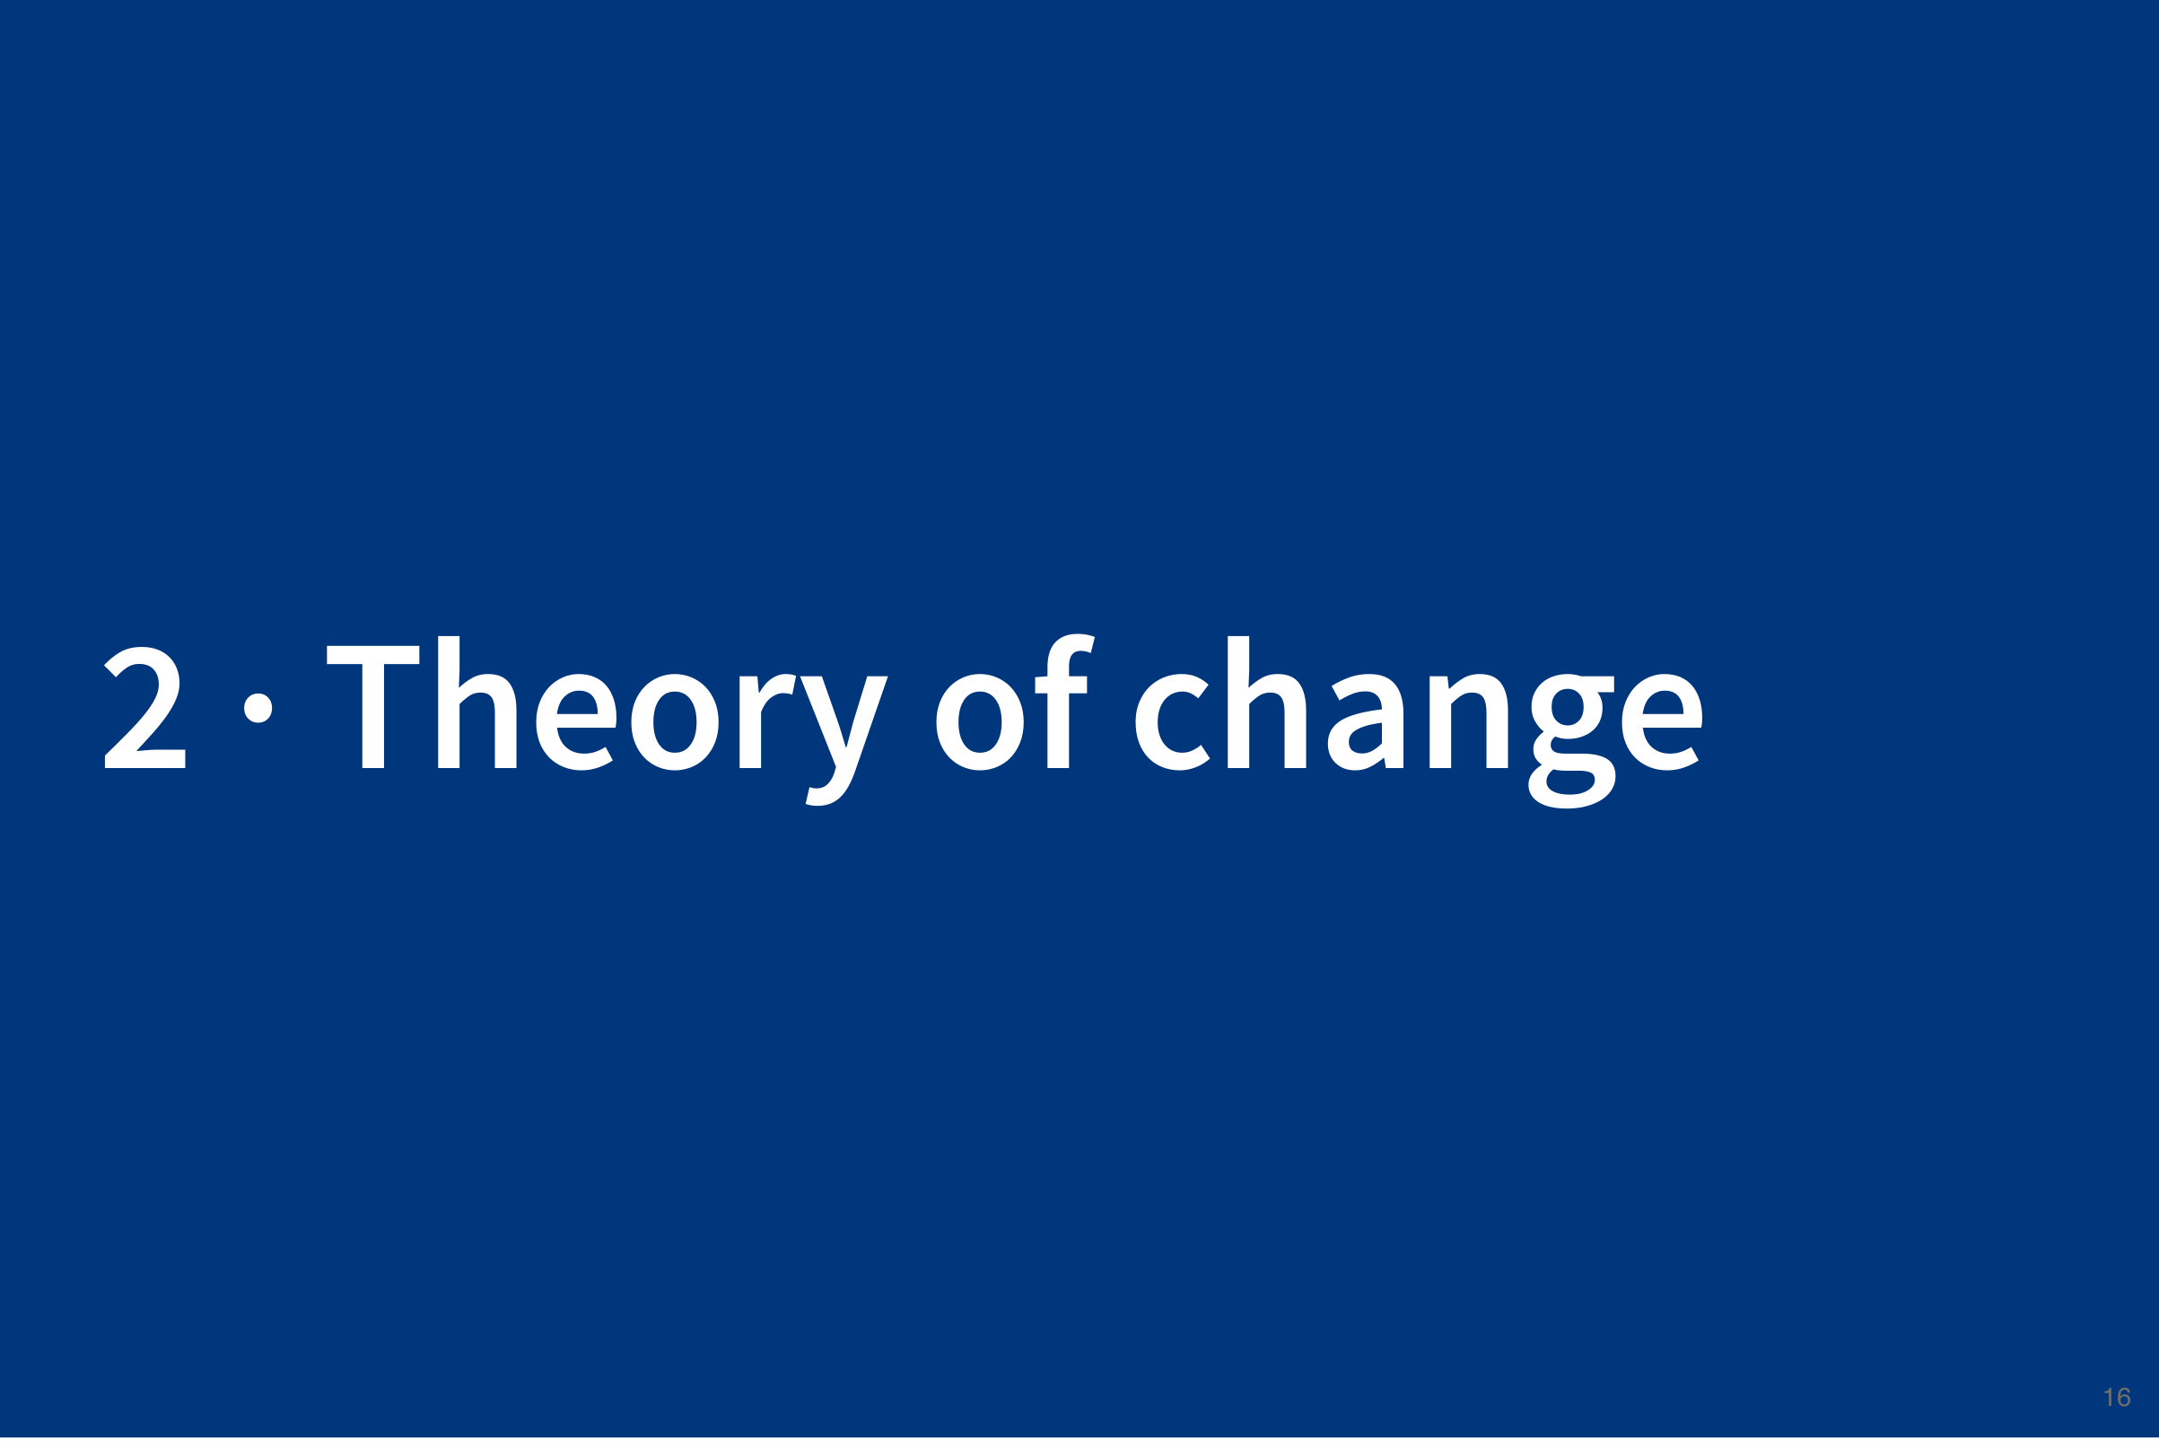

Slide 17
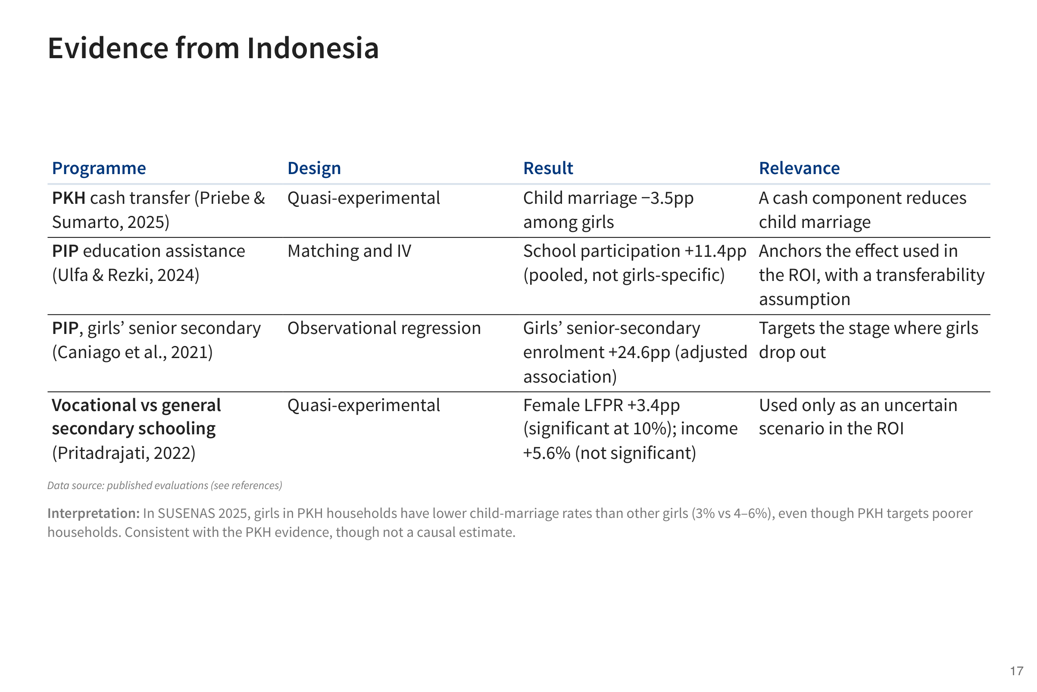
Notes:
These are the Indonesian studies the projection relies on. PKH, the national cash transfer, reduced child marriage among girls. PIP, education assistance, raised school participation, and that effect is the starting point for the projected return.

Slide 18
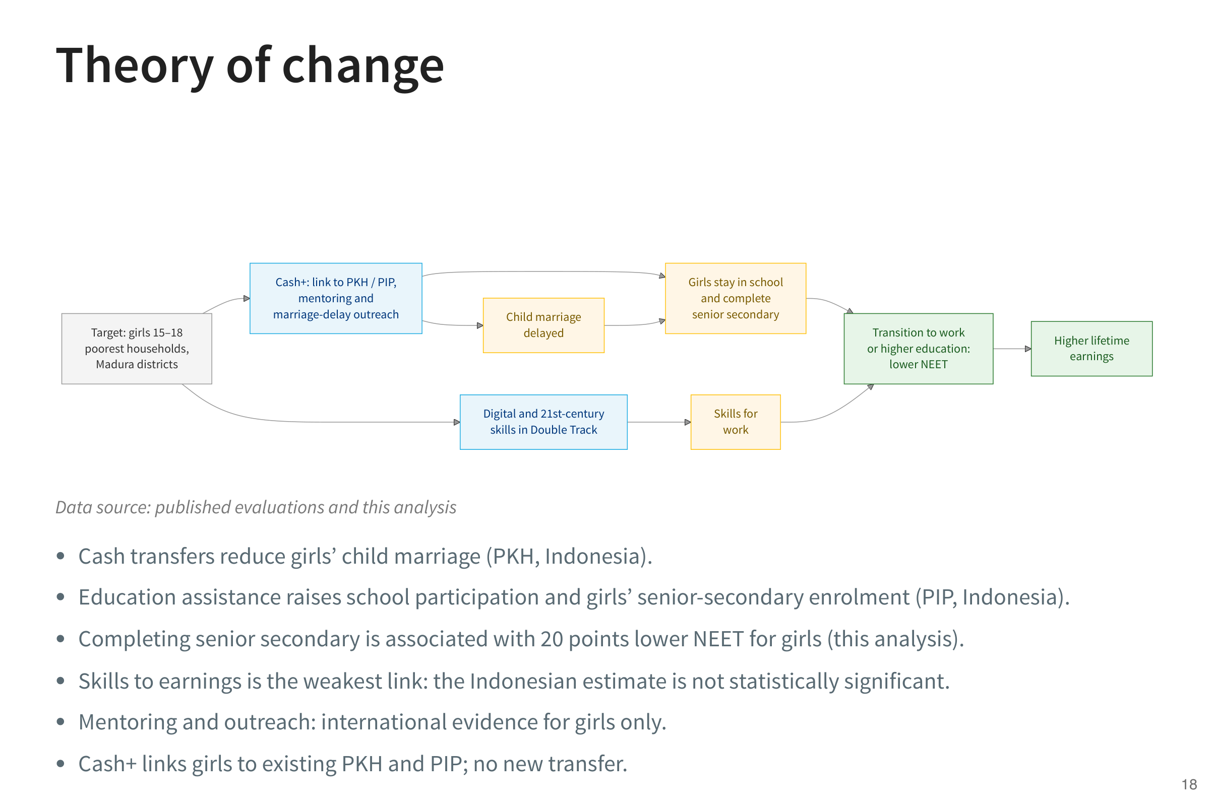
Notes:
The programme has two parts. Cash+ links girls to PKH and PIP and adds mentoring and outreach to delay marriage. The skills component adds digital and 21st-century skills within Double Track. Both aim to keep girls in school to completion and help them move into work or further study.

Slide 19
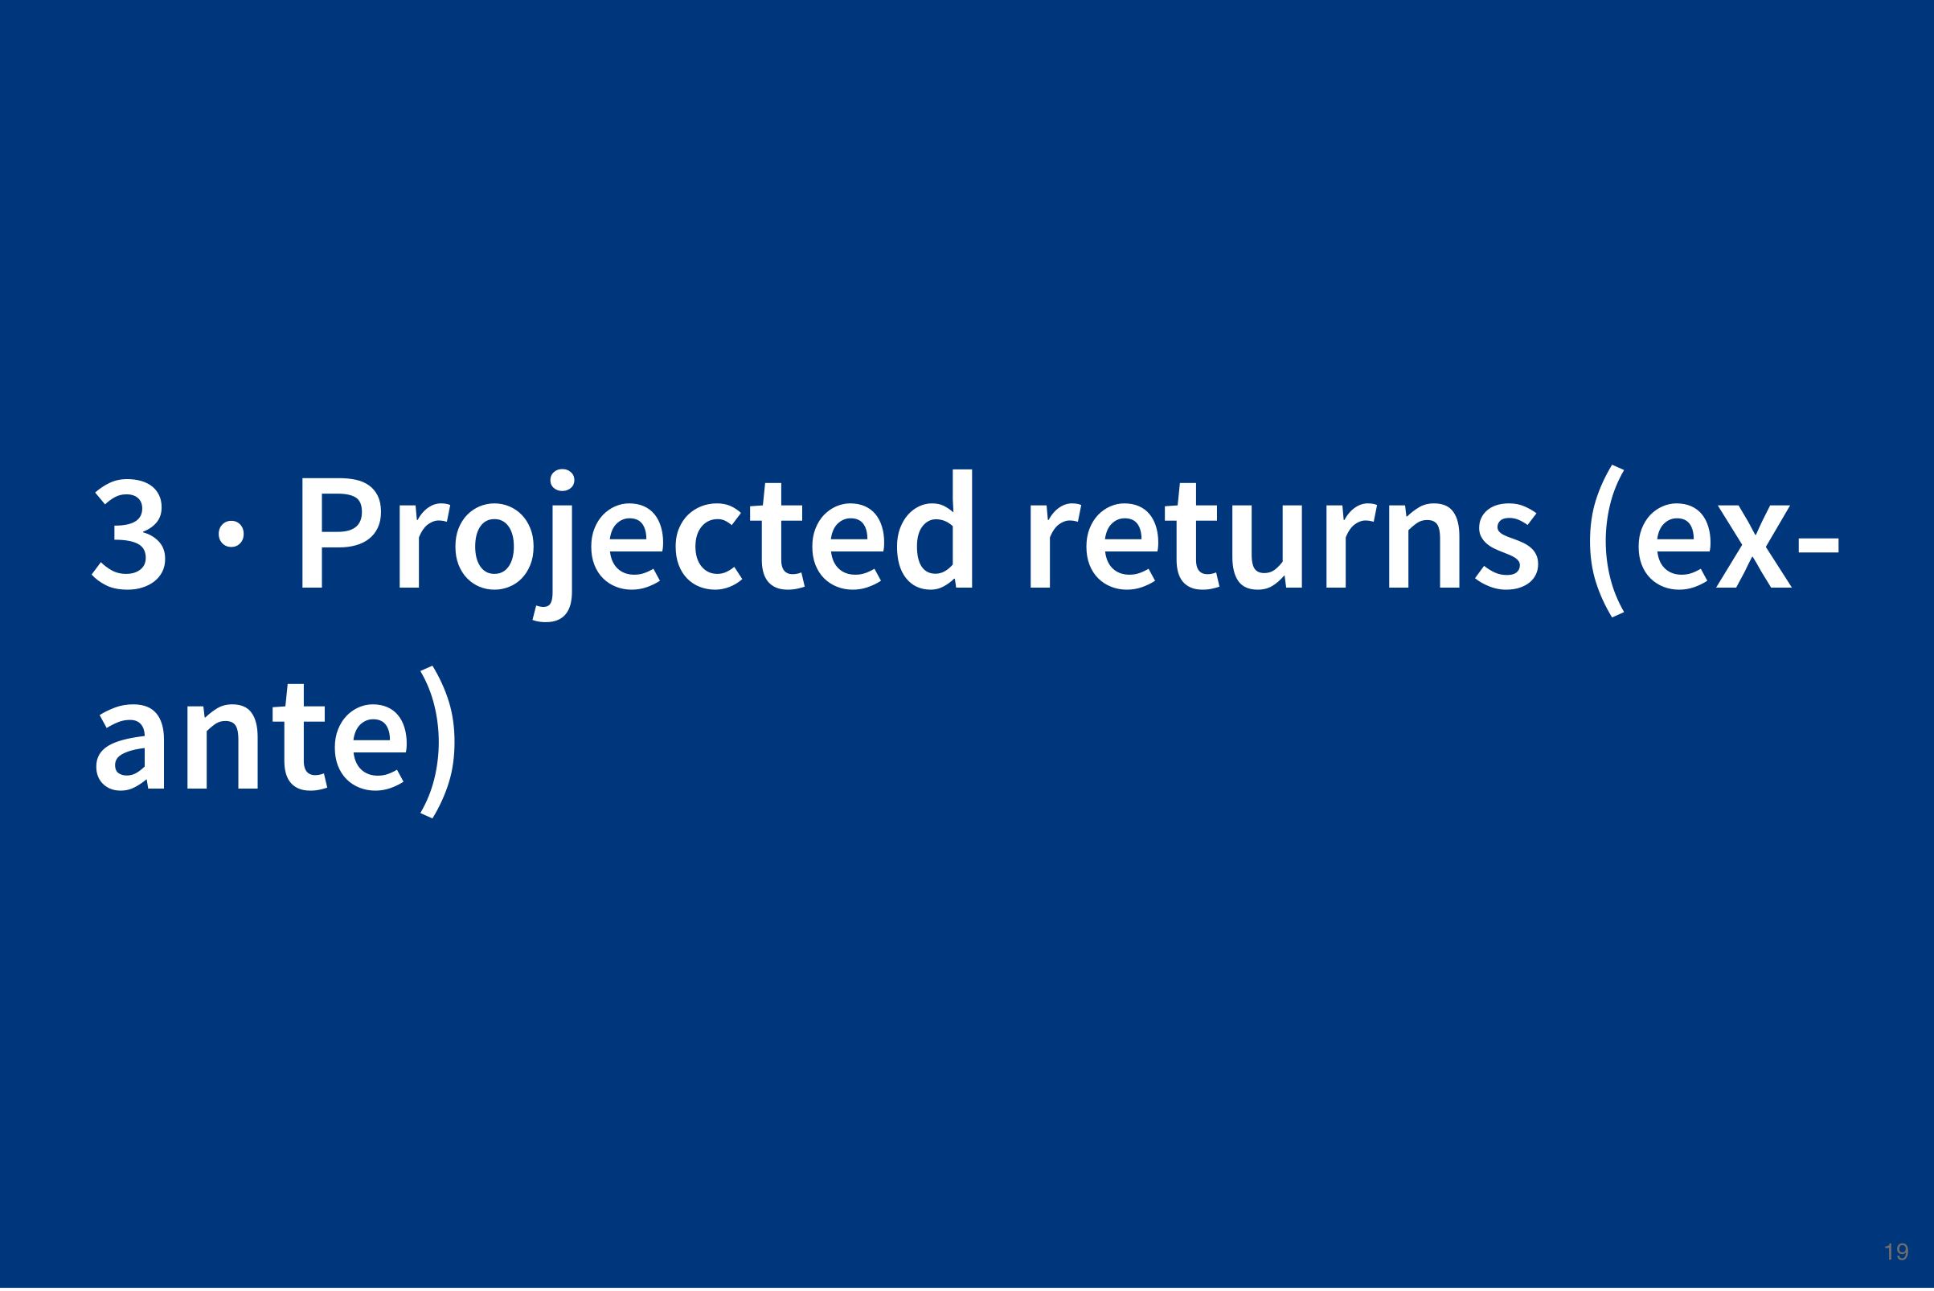

Slide 20
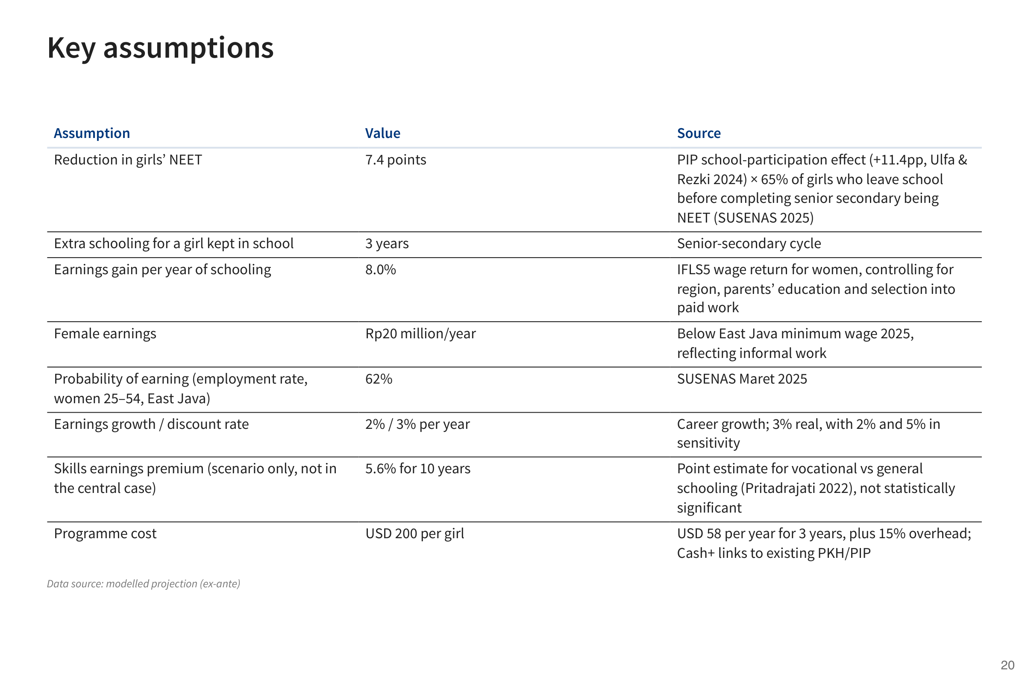
Notes:
From here on the numbers are projections, not measured results. They show what the programme would return if these assumptions hold. Each assumption has a source, and the following slides show how much the result changes when they do not hold.

Slide 21
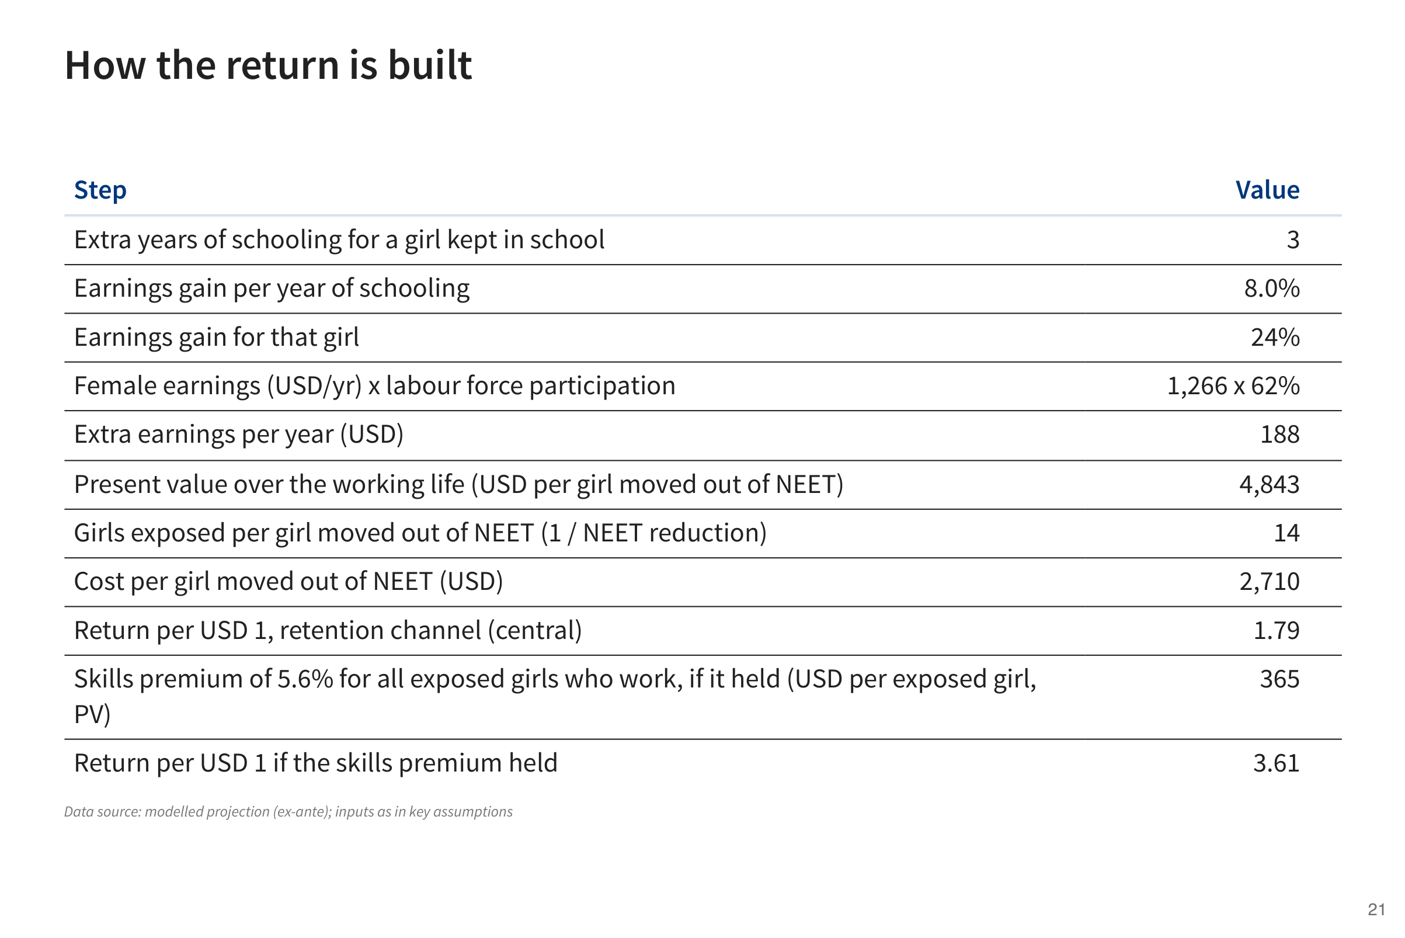
Notes:
The table follows the calculation step by step: how many girls the programme keeps out of NEET, how much more each of them earns over her working life, and how that compares with the cost.

Slide 22
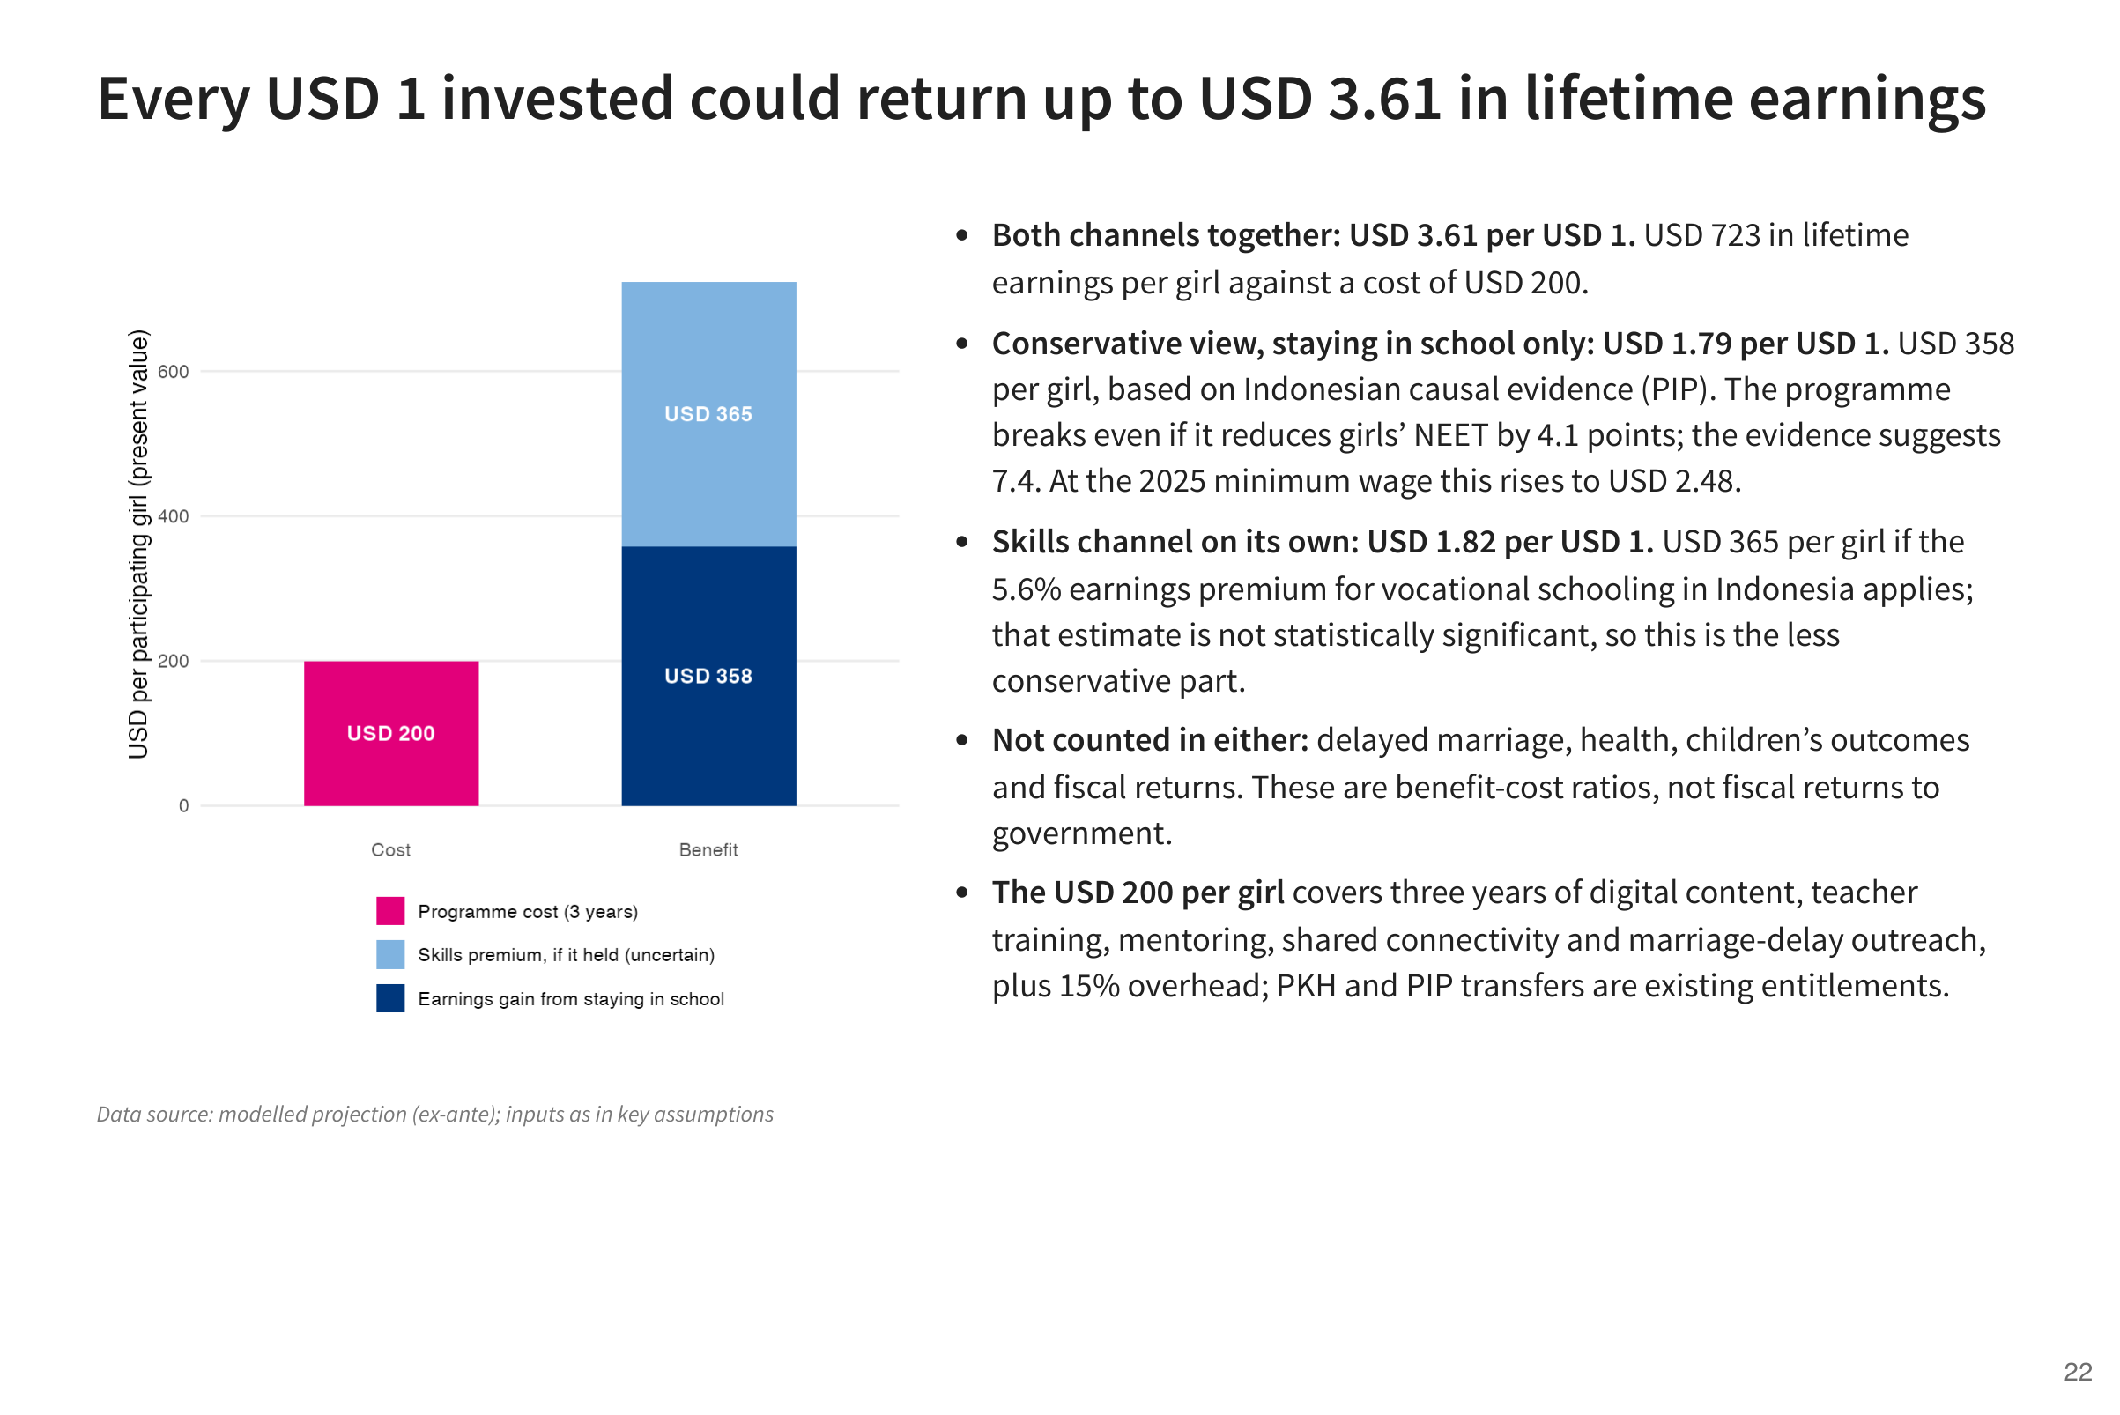
Notes:
Counting only the benefit of keeping girls in school, each dollar returns about USD 1.79. If the skills component also raises earnings, the return could reach USD 3.61, but that part of the evidence is uncertain. Both figures count earnings only, so they leave out benefits such as delayed marriage and better health.

Slide 23
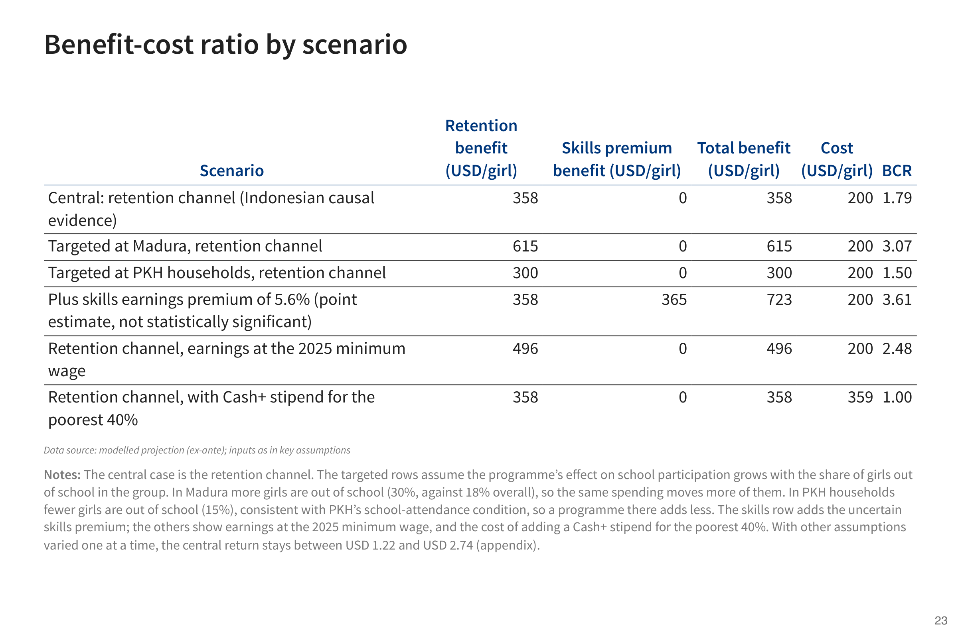
Notes:
The same calculation under different assumptions. The return is higher in Madura, where more girls leave school, because the same spending then changes the path of more girls. It is lower in PKH households, where girls are already more likely to stay in school. It is also higher with the skills effect or at the minimum wage, and lower if a new stipend is added to the cost.

Slide 24
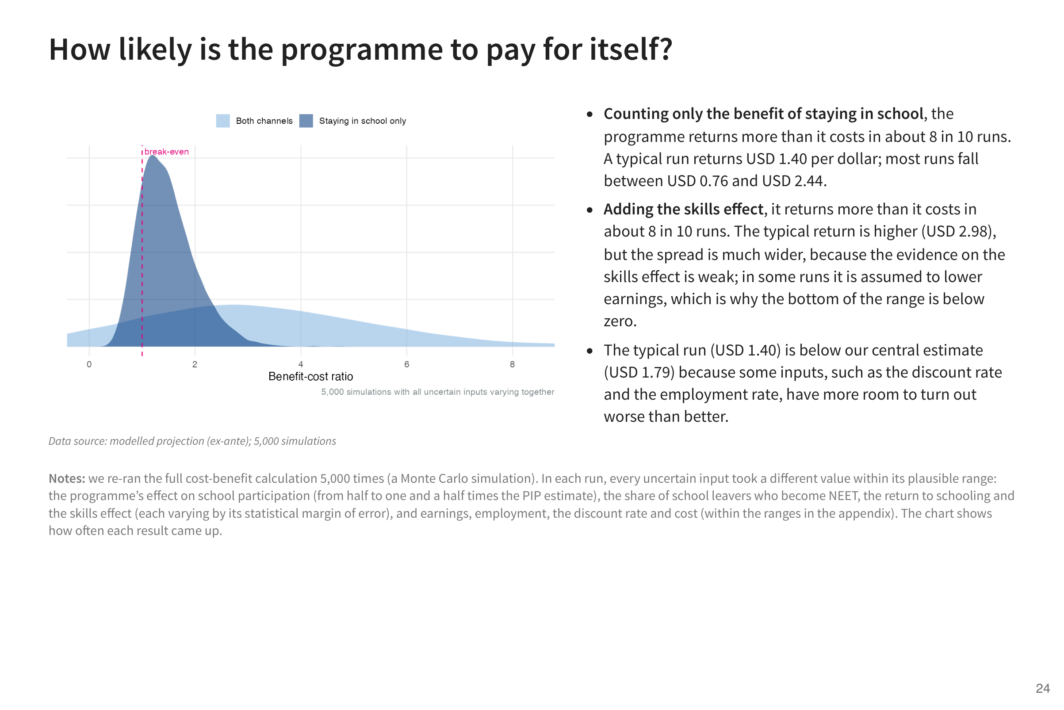
Notes:
To test how much the result depends on our assumptions, we re-ran the calculation 5,000 times, each time with different but plausible values for every uncertain input. Counting only the benefit of staying in school, the programme returned more than it cost in about 8 of every 10 runs.

Slide 25


Slide 26
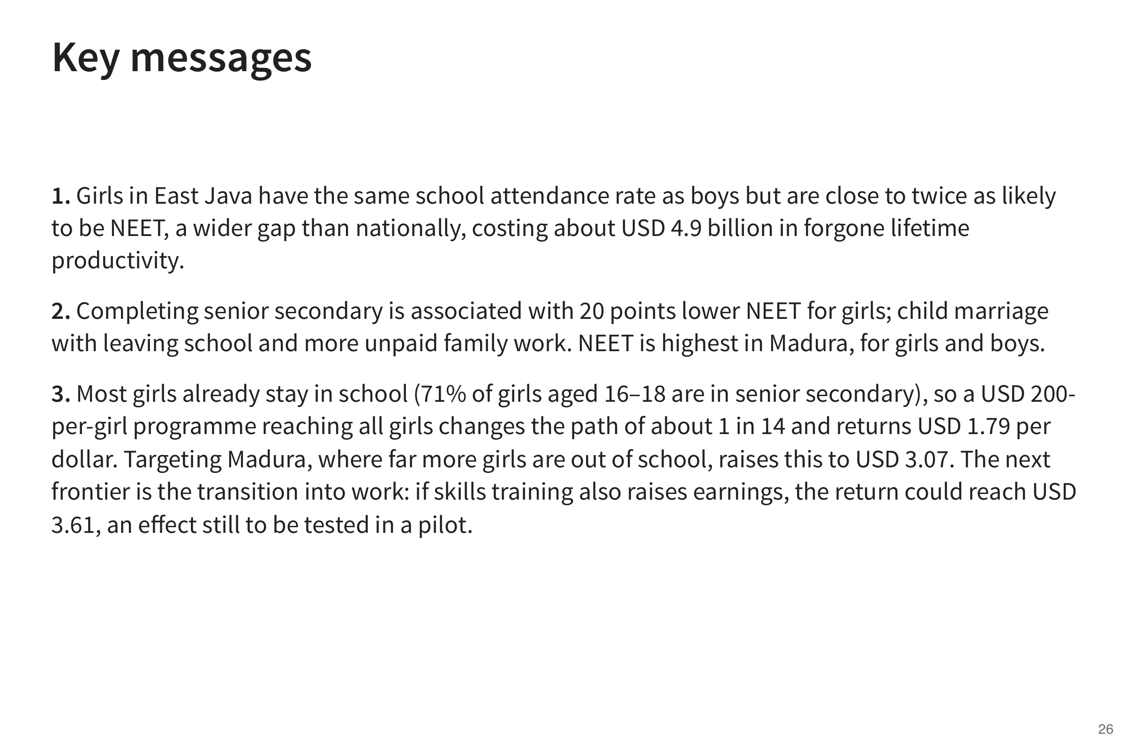
Notes:
Three messages. The gap is at the transition out of school, and it is costly. Completing senior secondary matters, but most girls already stay in school, so a programme reaching everyone changes the path of only a minority. That is why the return is higher when the programme targets places like Madura, where more girls leave school, and why the next step is the transition into work, where skills training could add most, an effect that a pilot should measure.

Slide 27
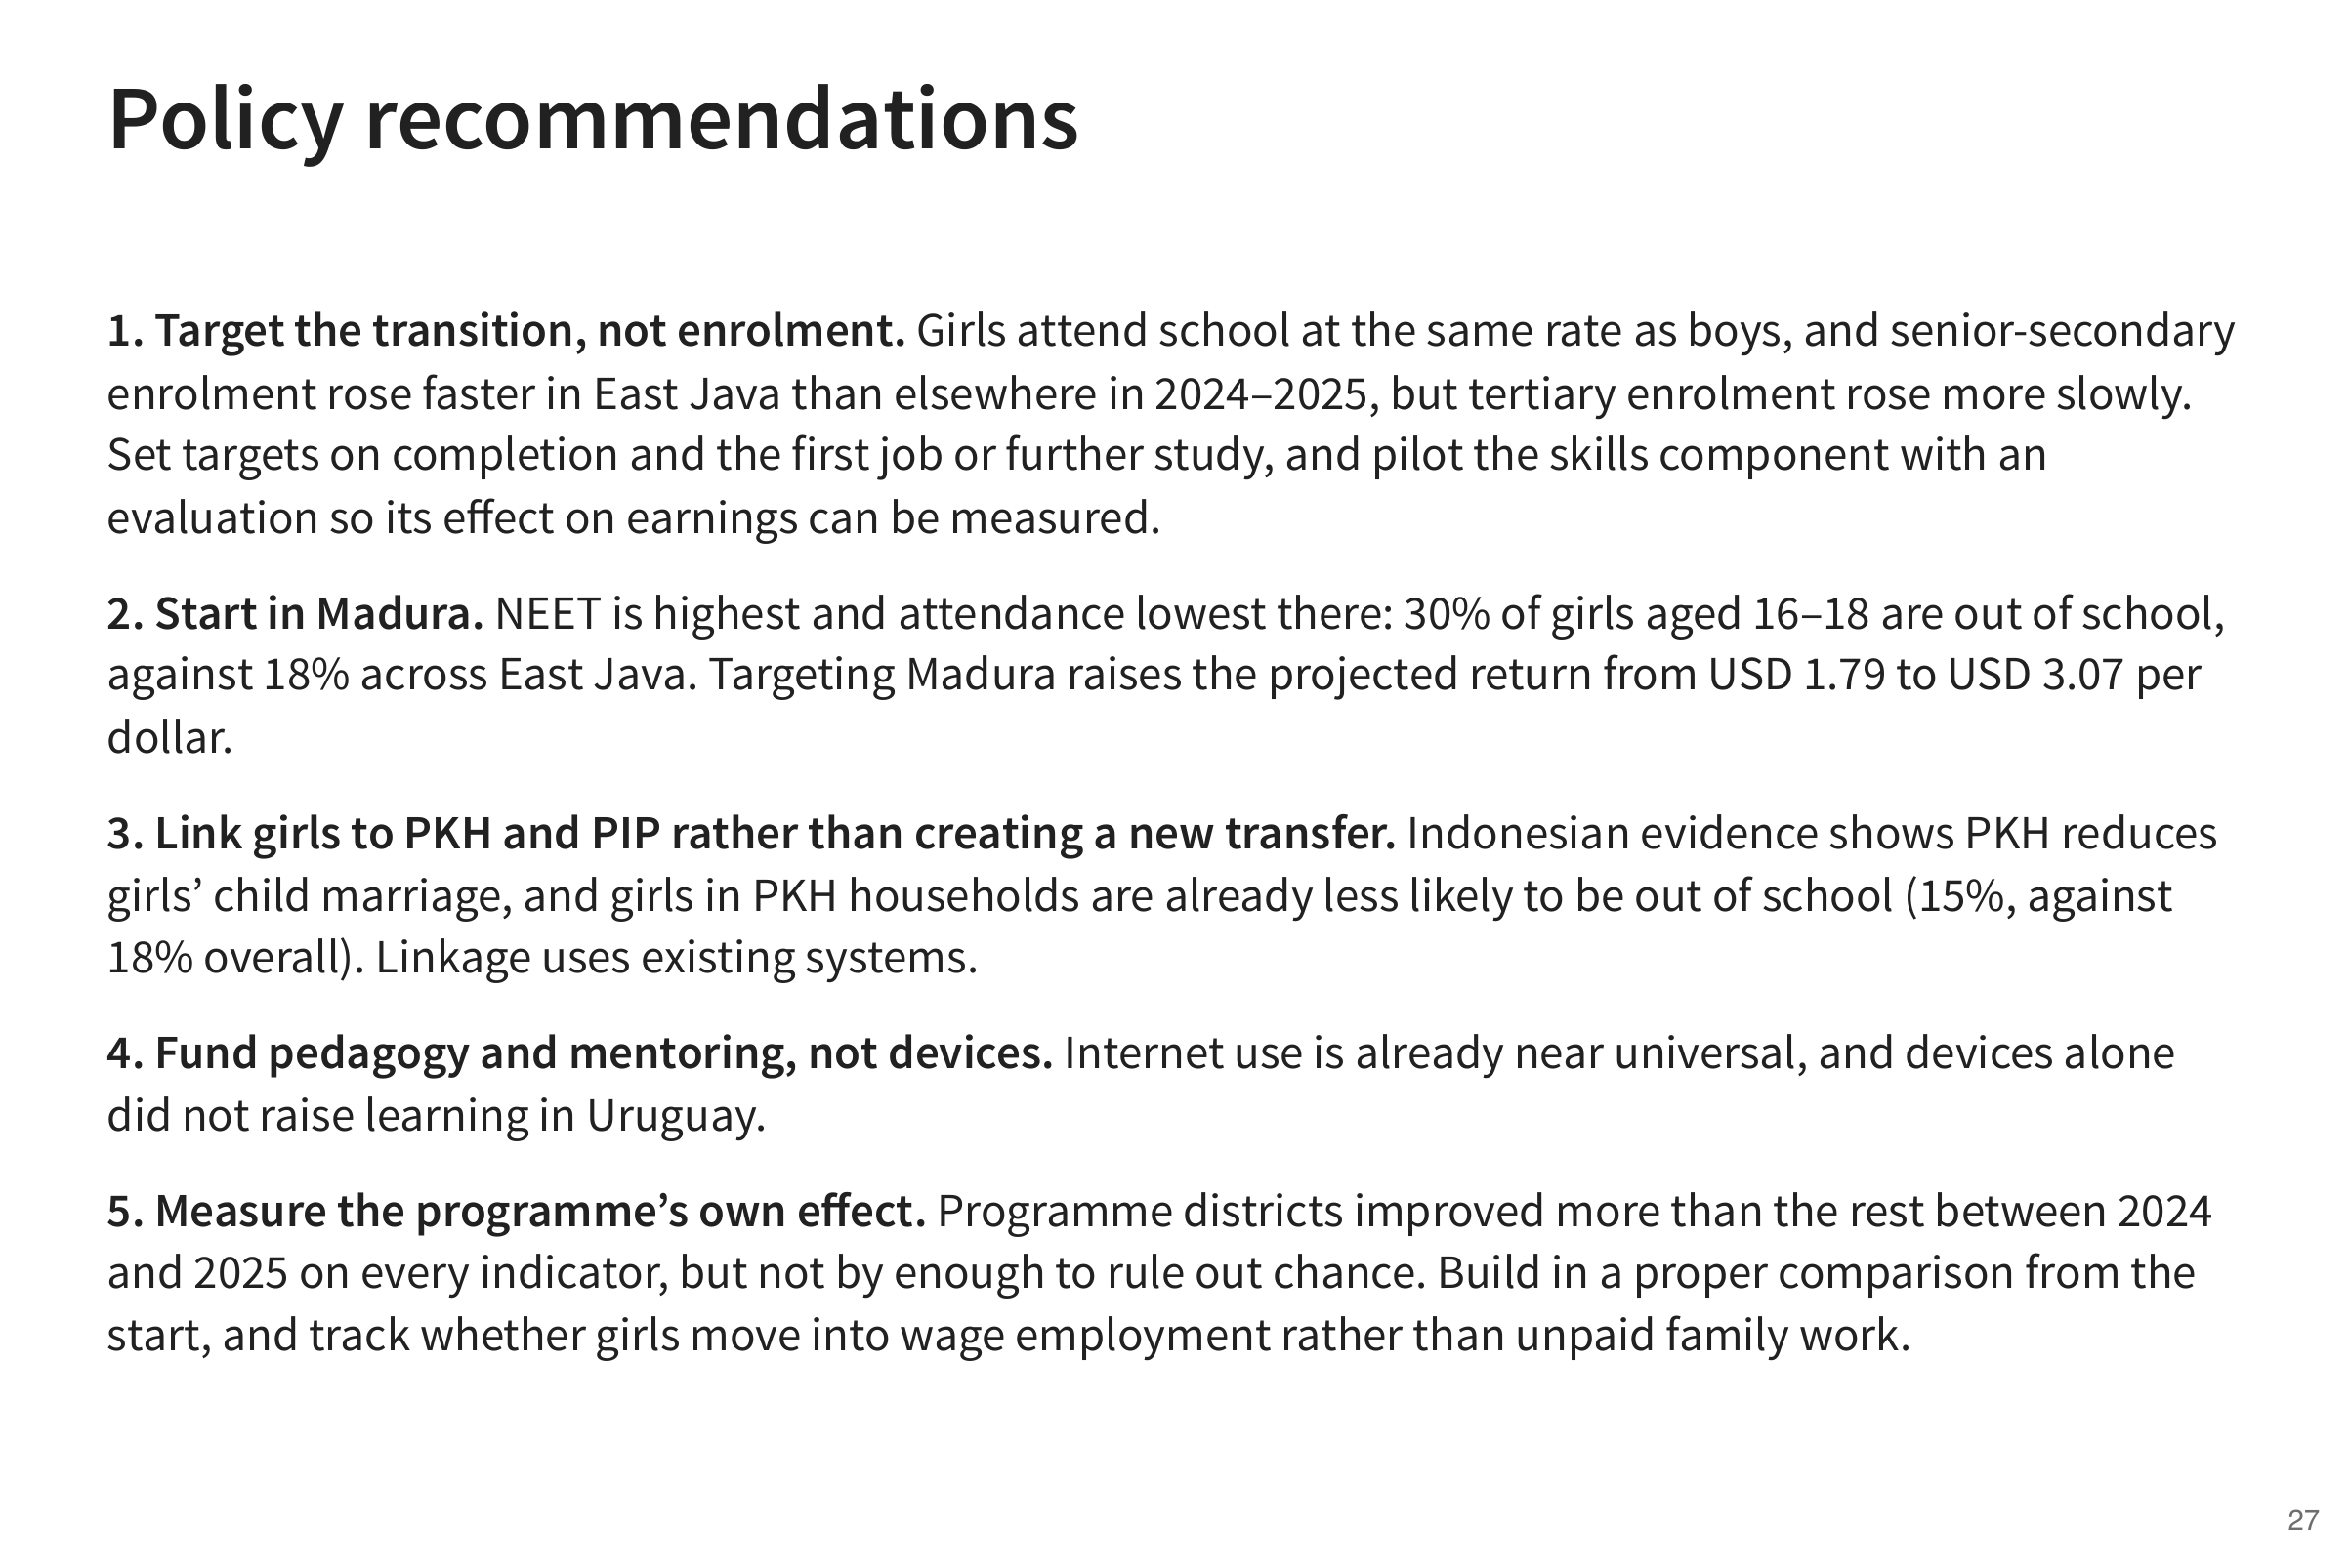
Notes:
Five recommendations that follow from the analysis, from where to target to how to measure the programme’s own effect.

Slide 28


Slide 29
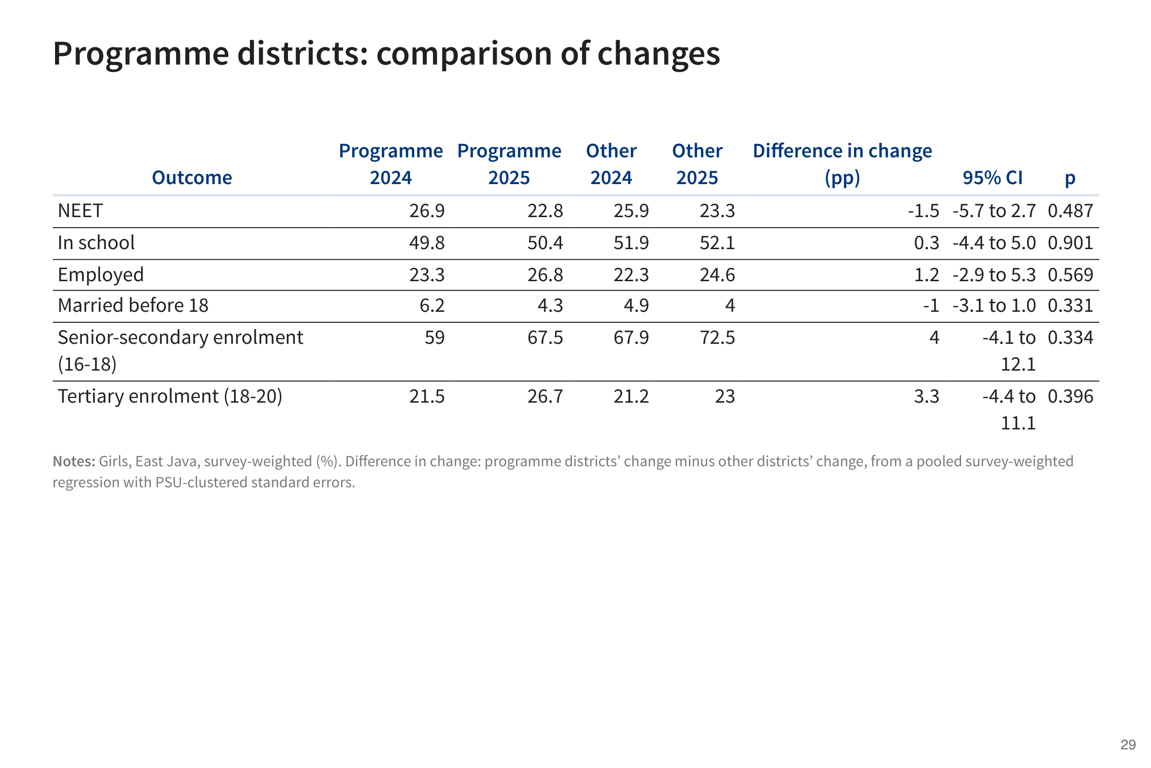

Slide 30
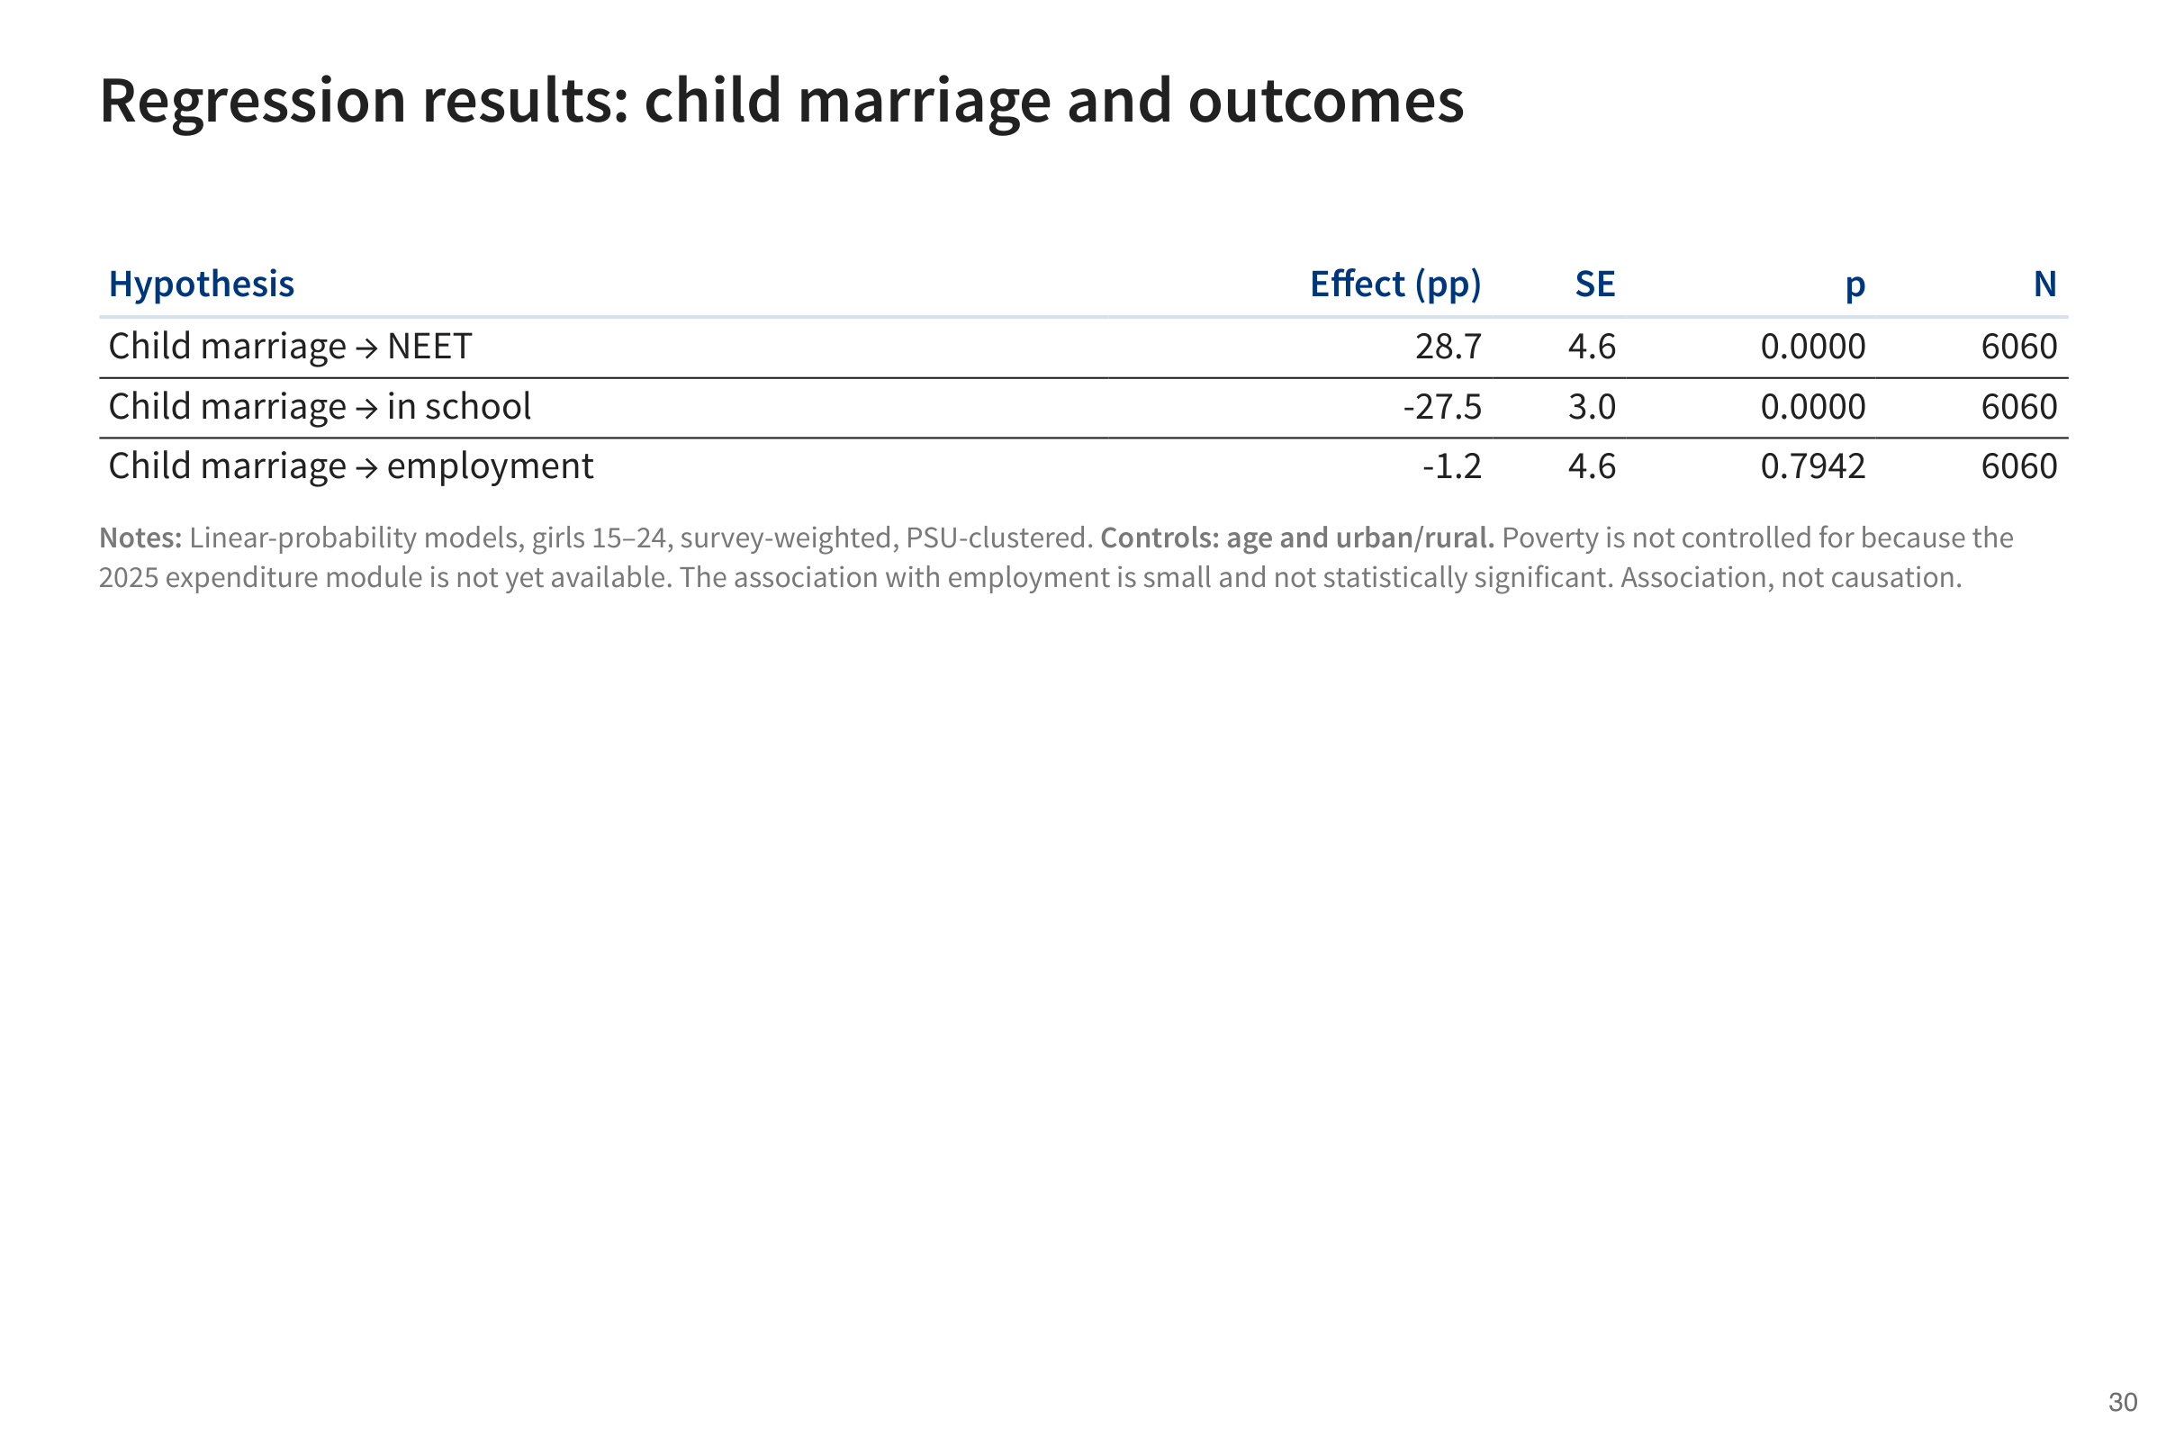

Slide 31
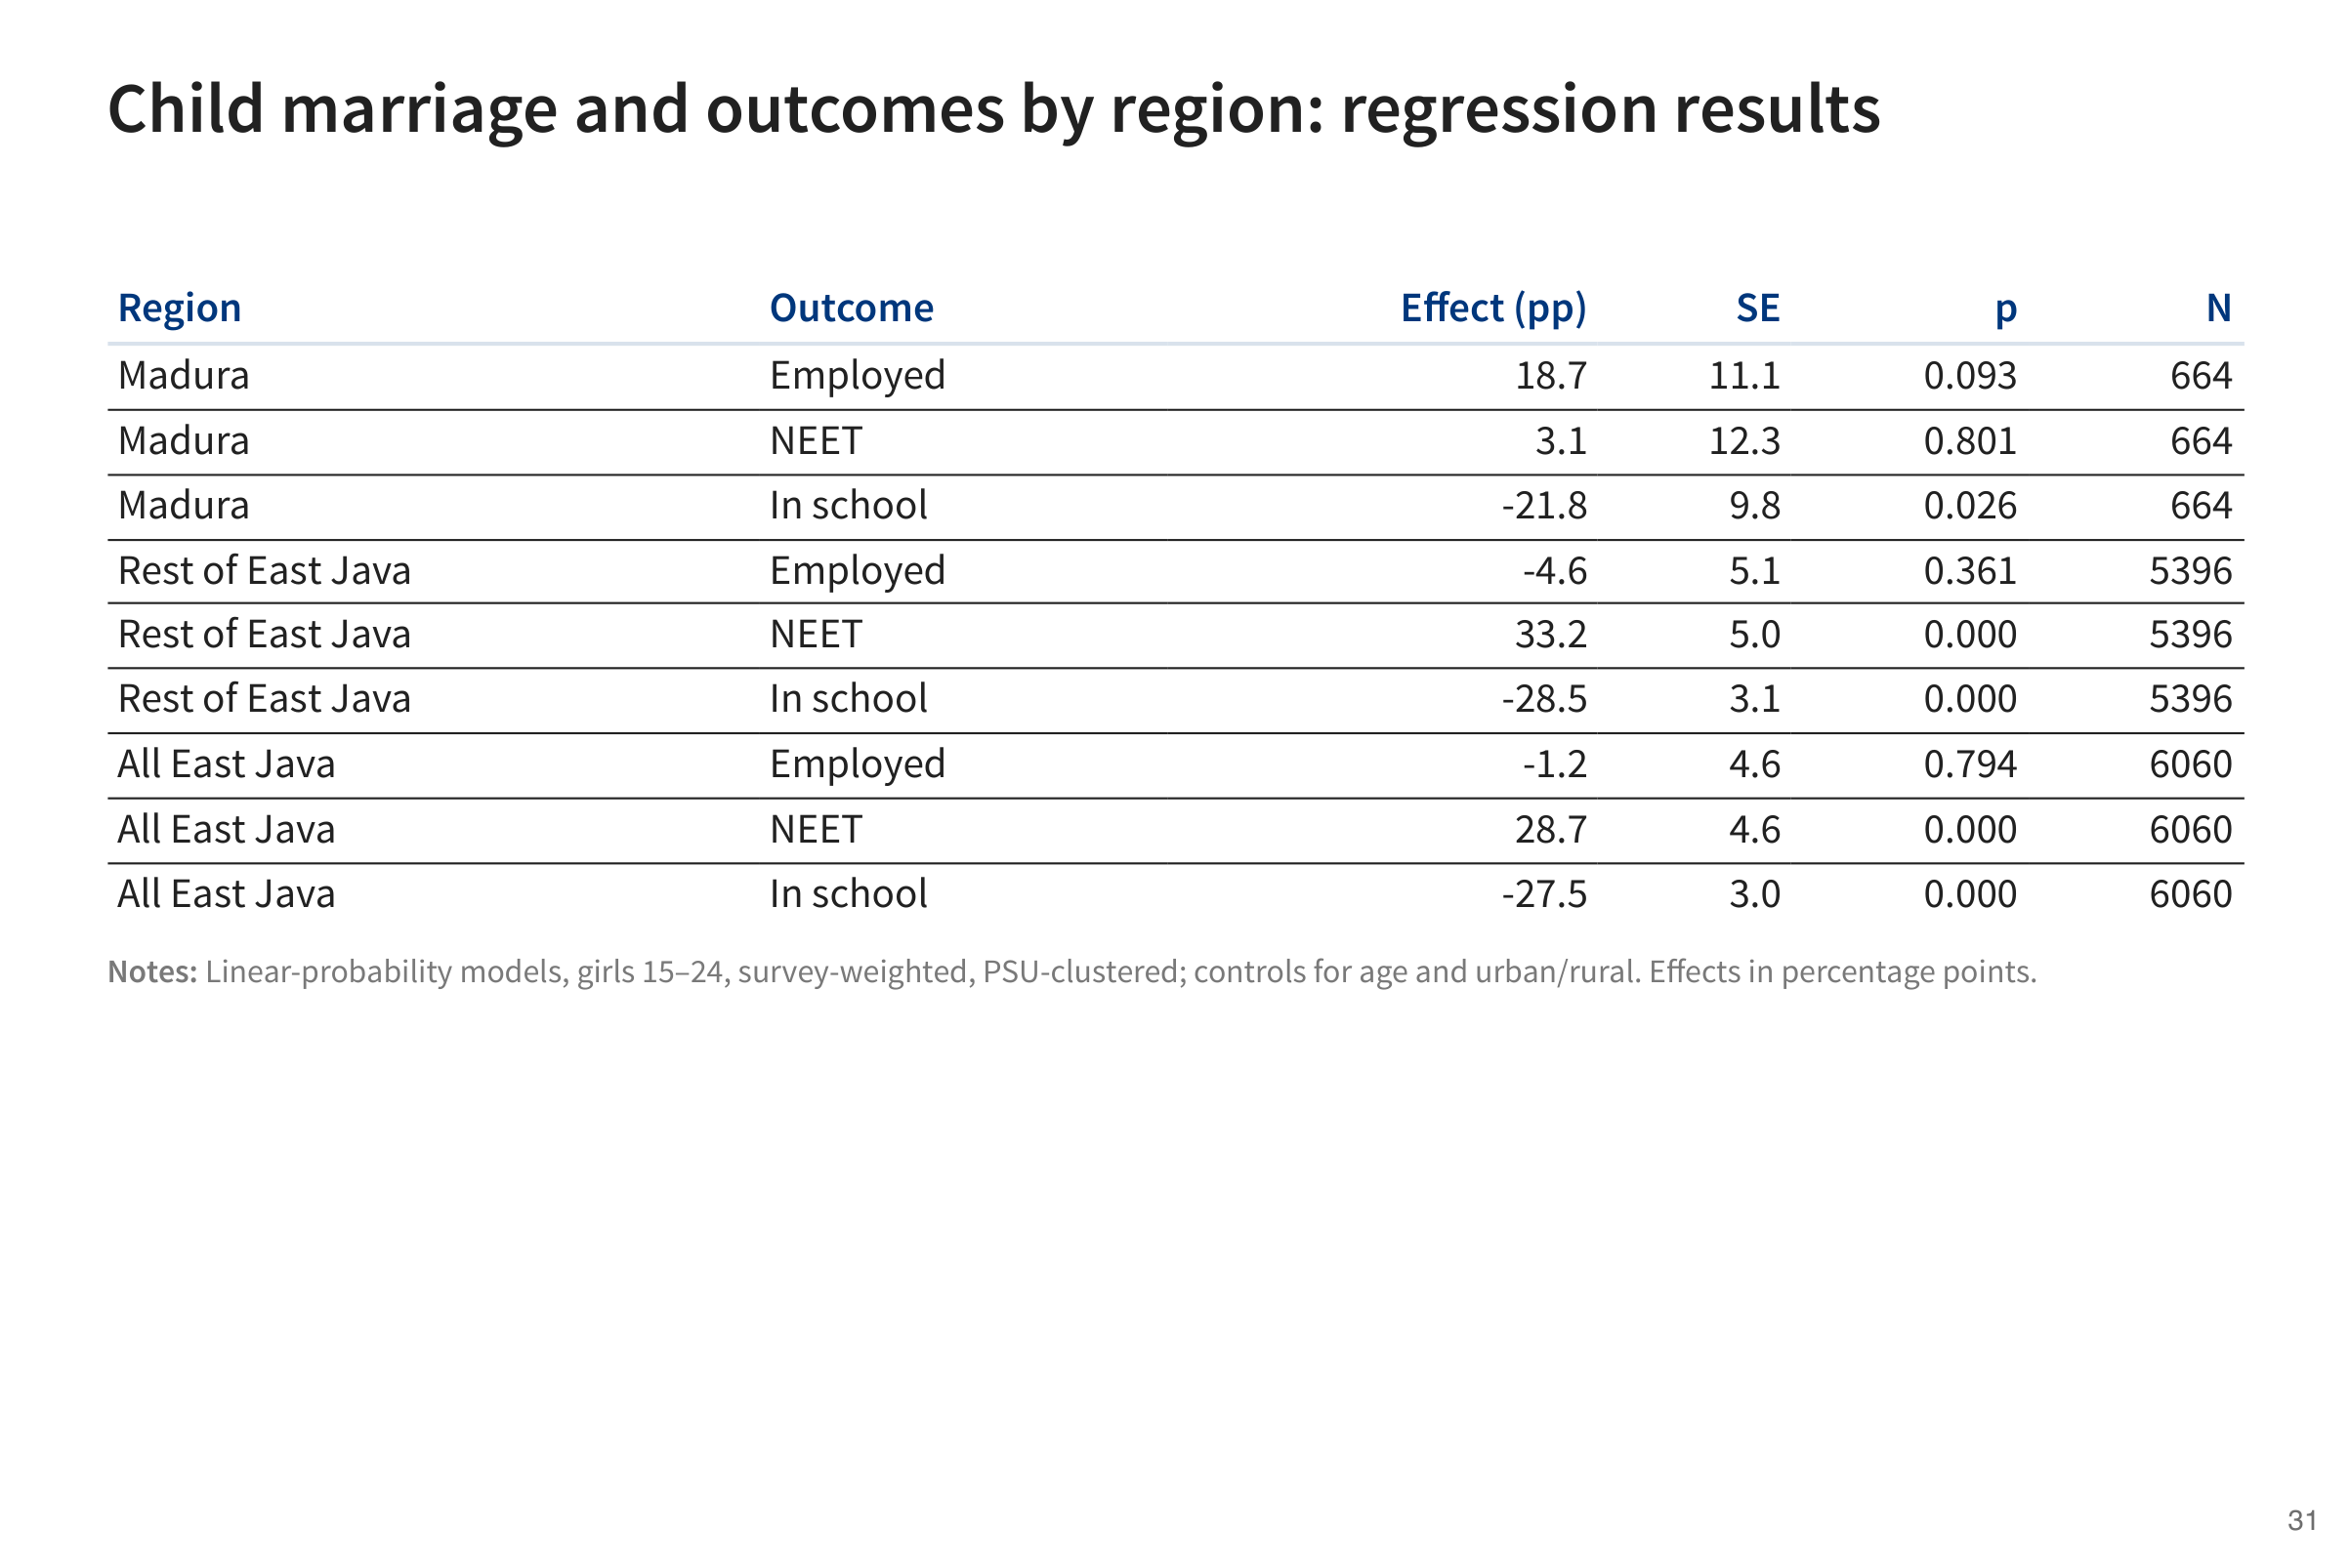

Slide 32
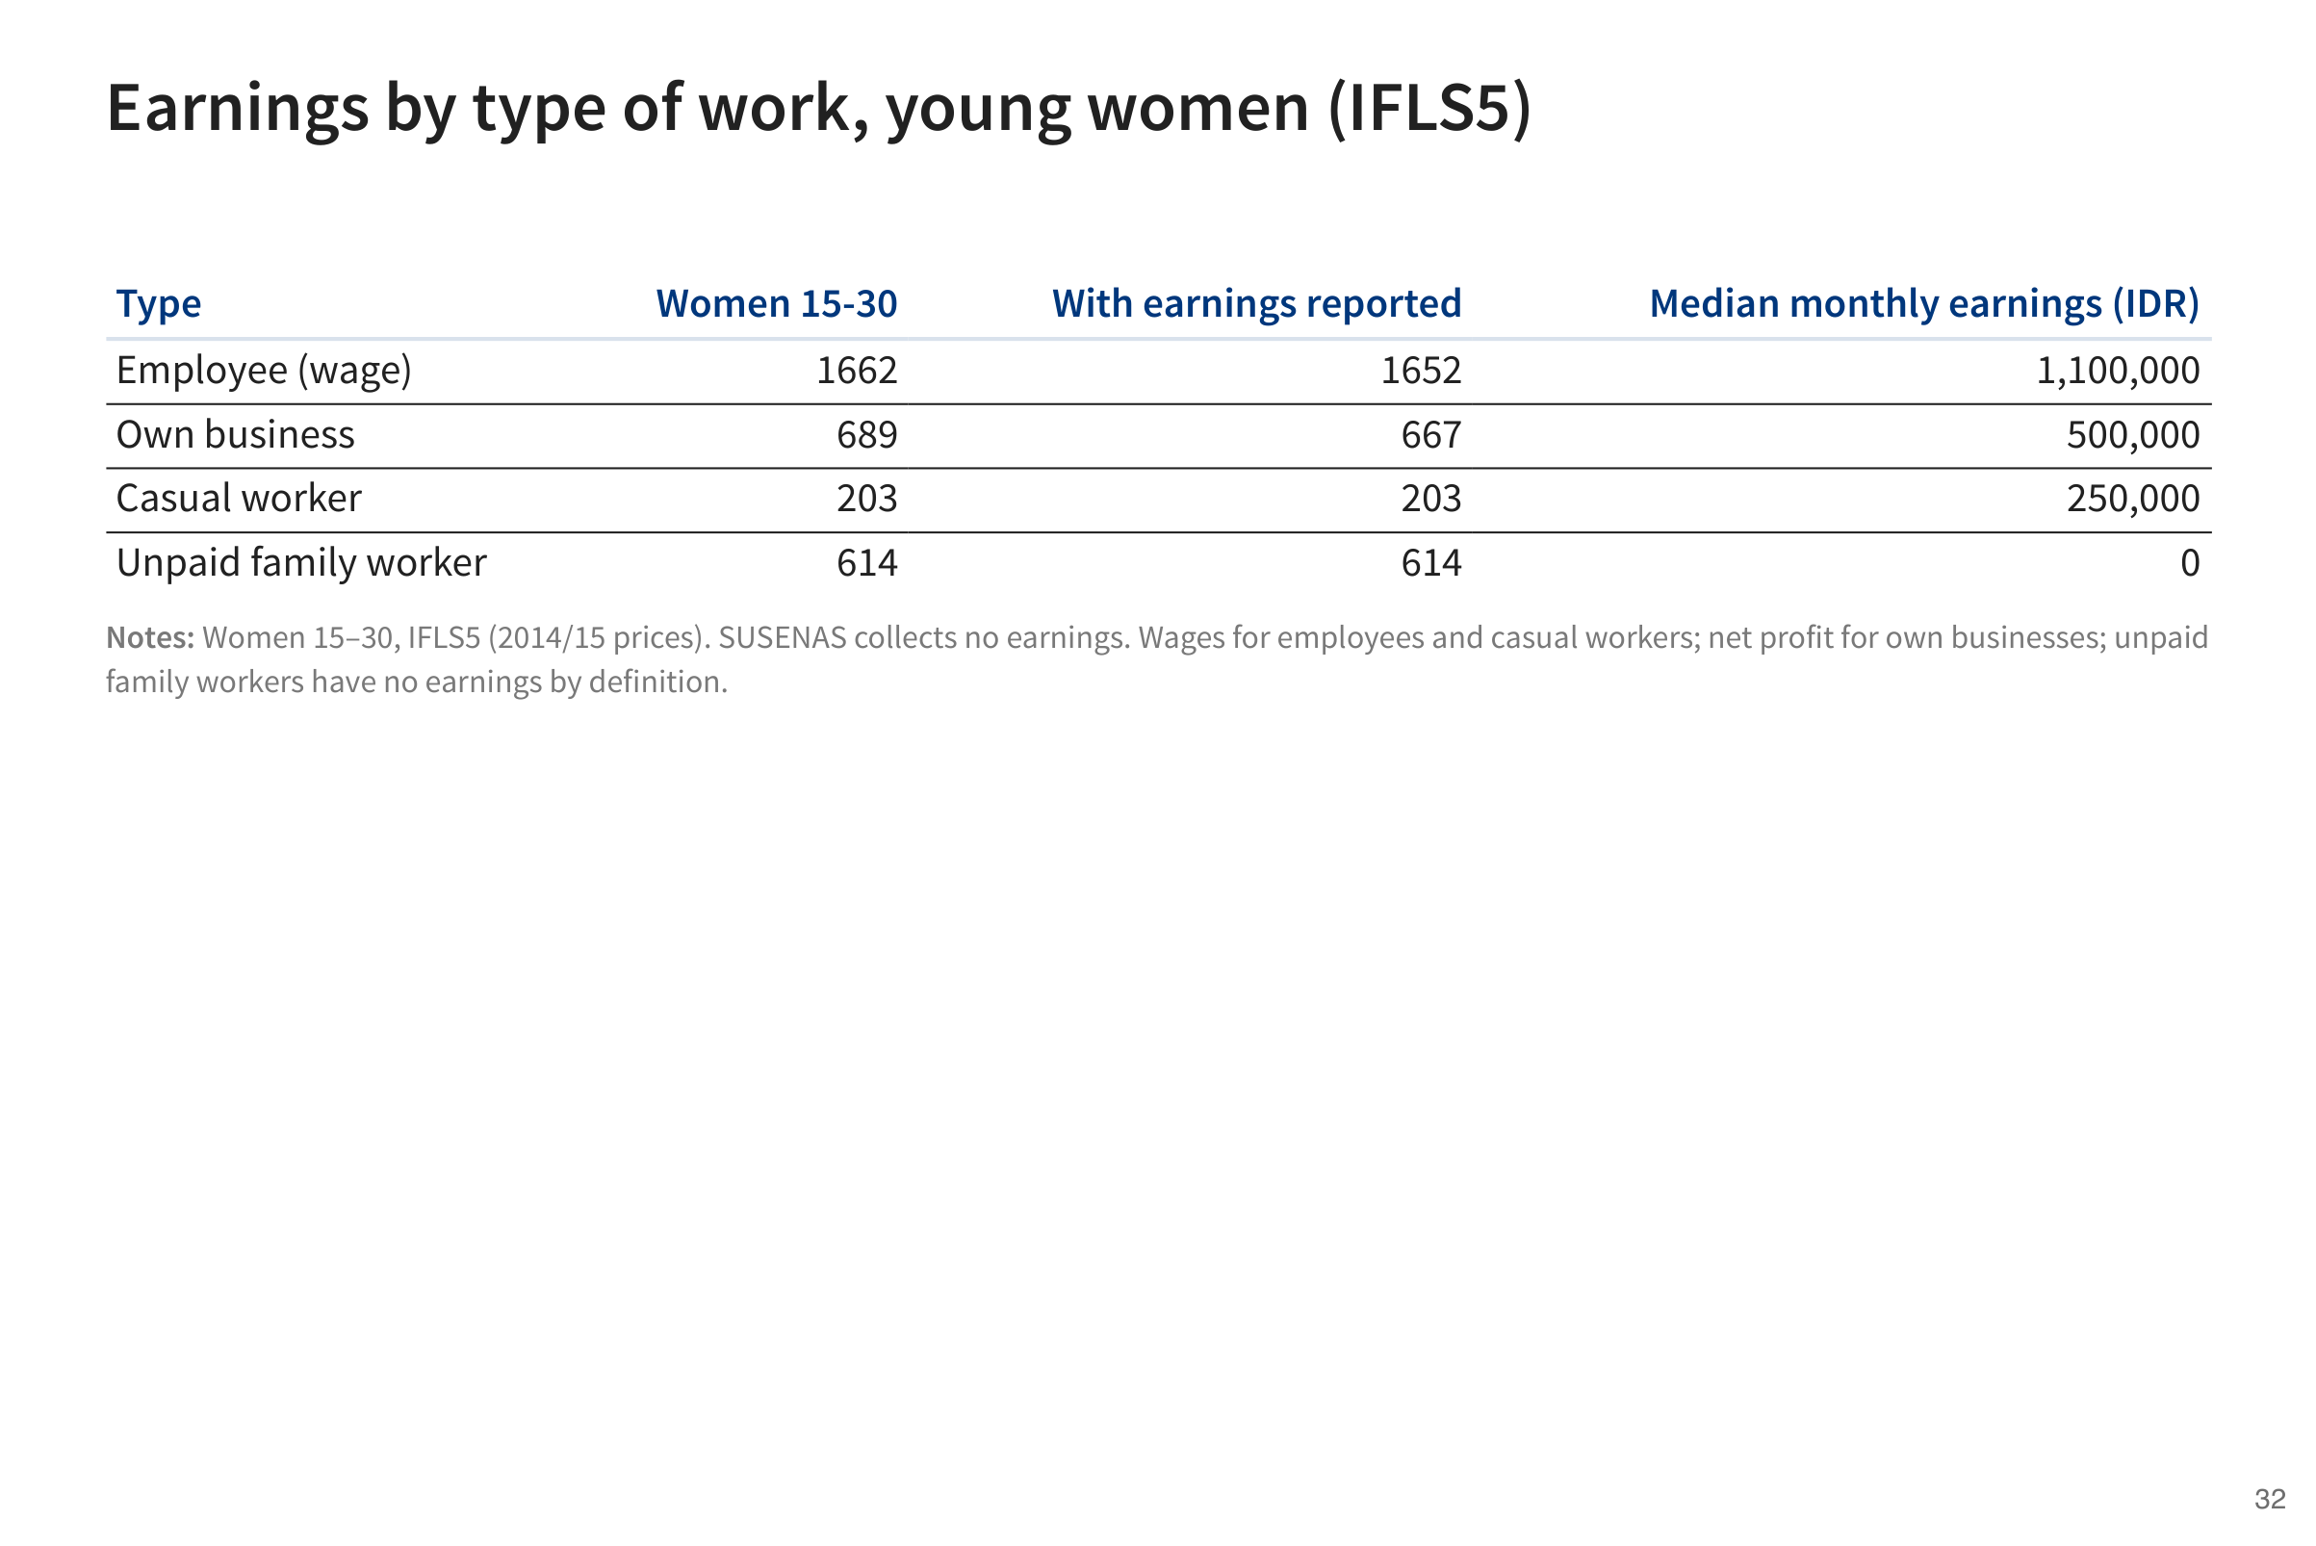

Slide 33
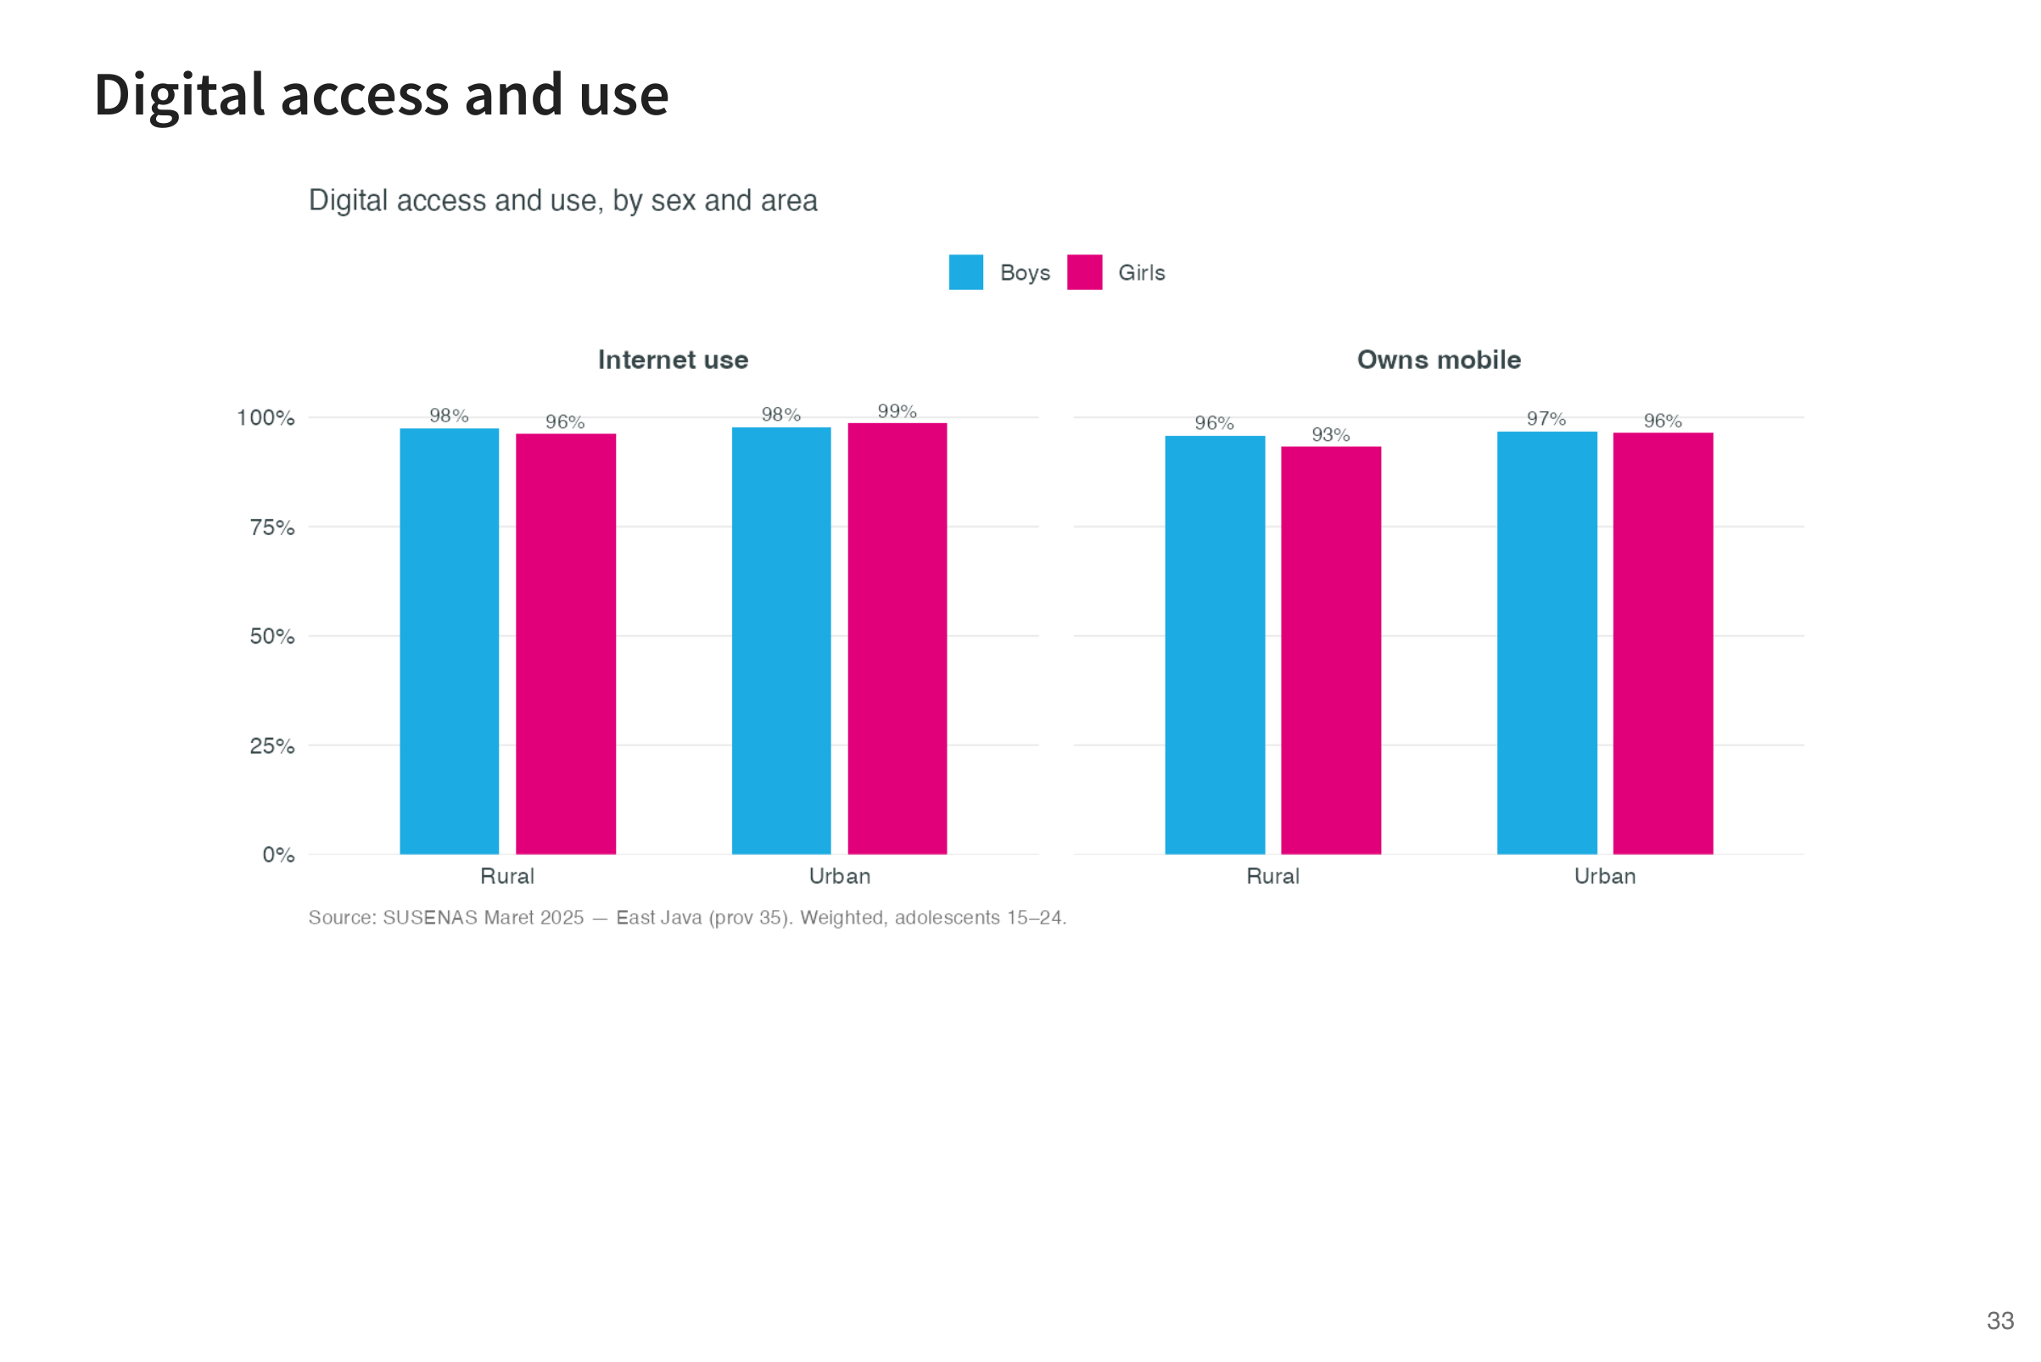

Slide 34
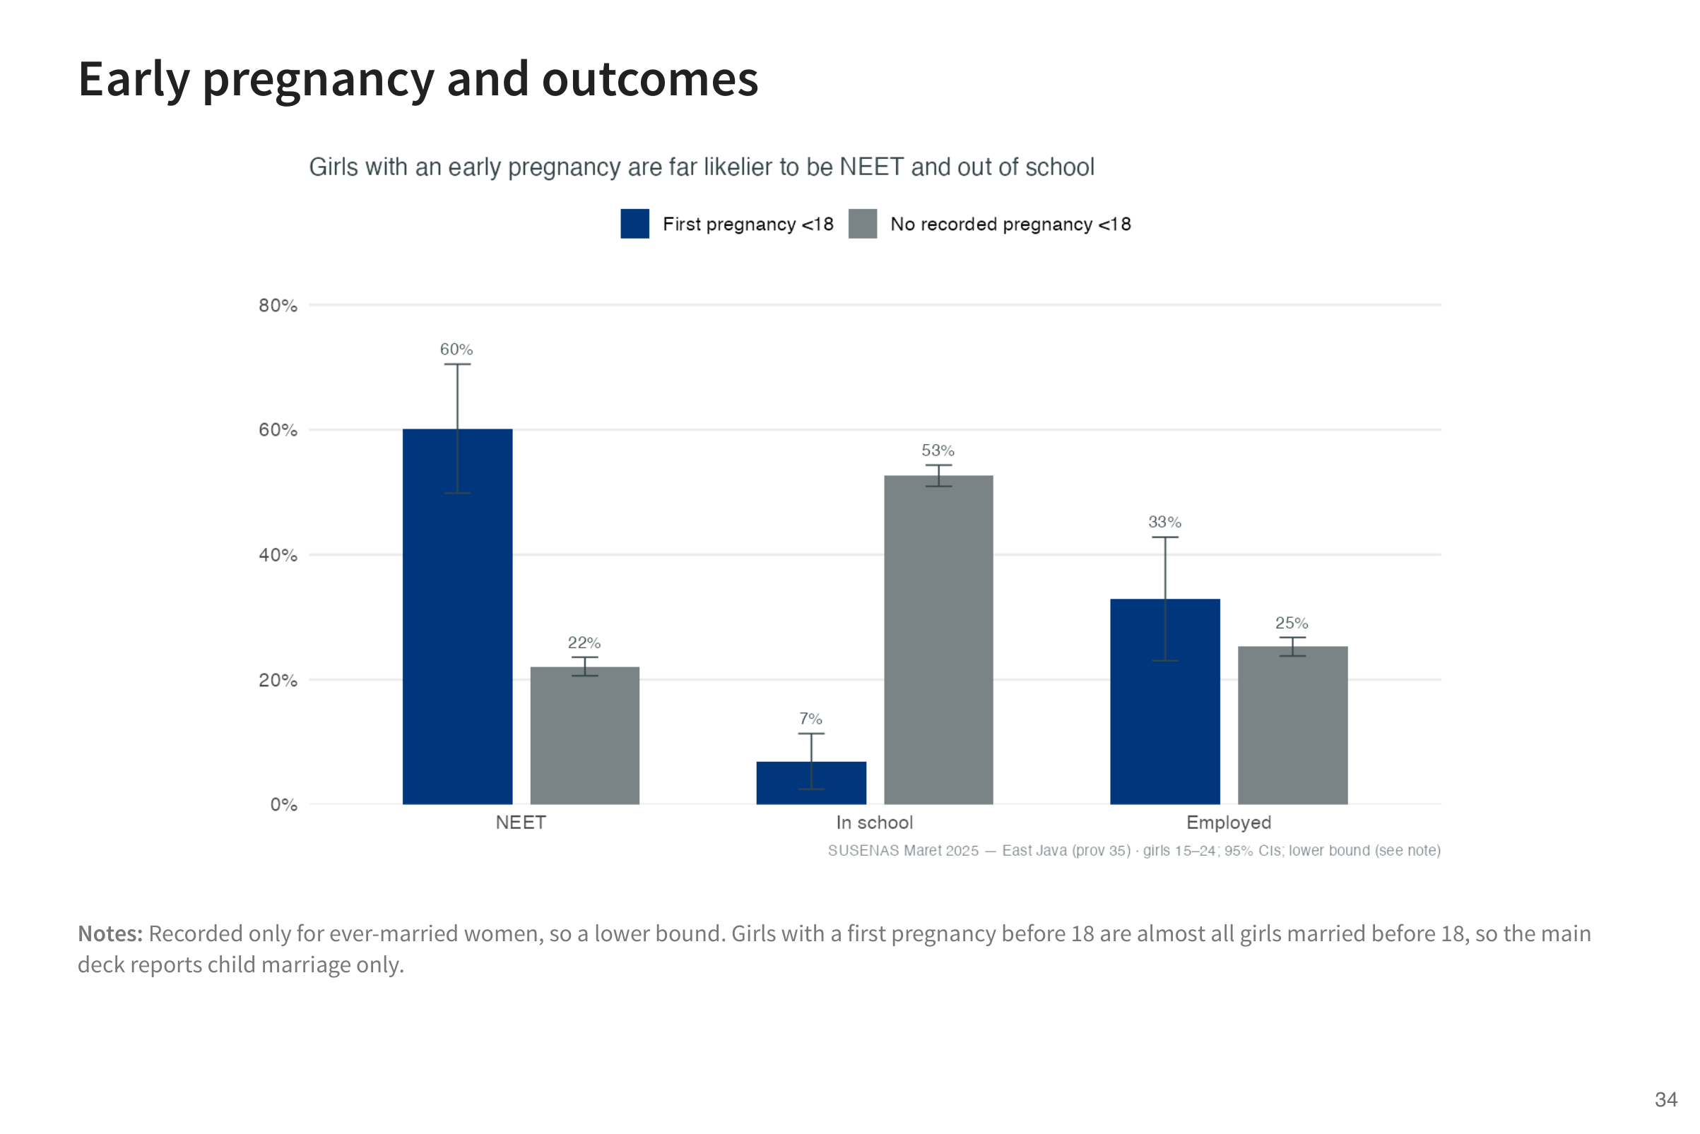

Slide 35
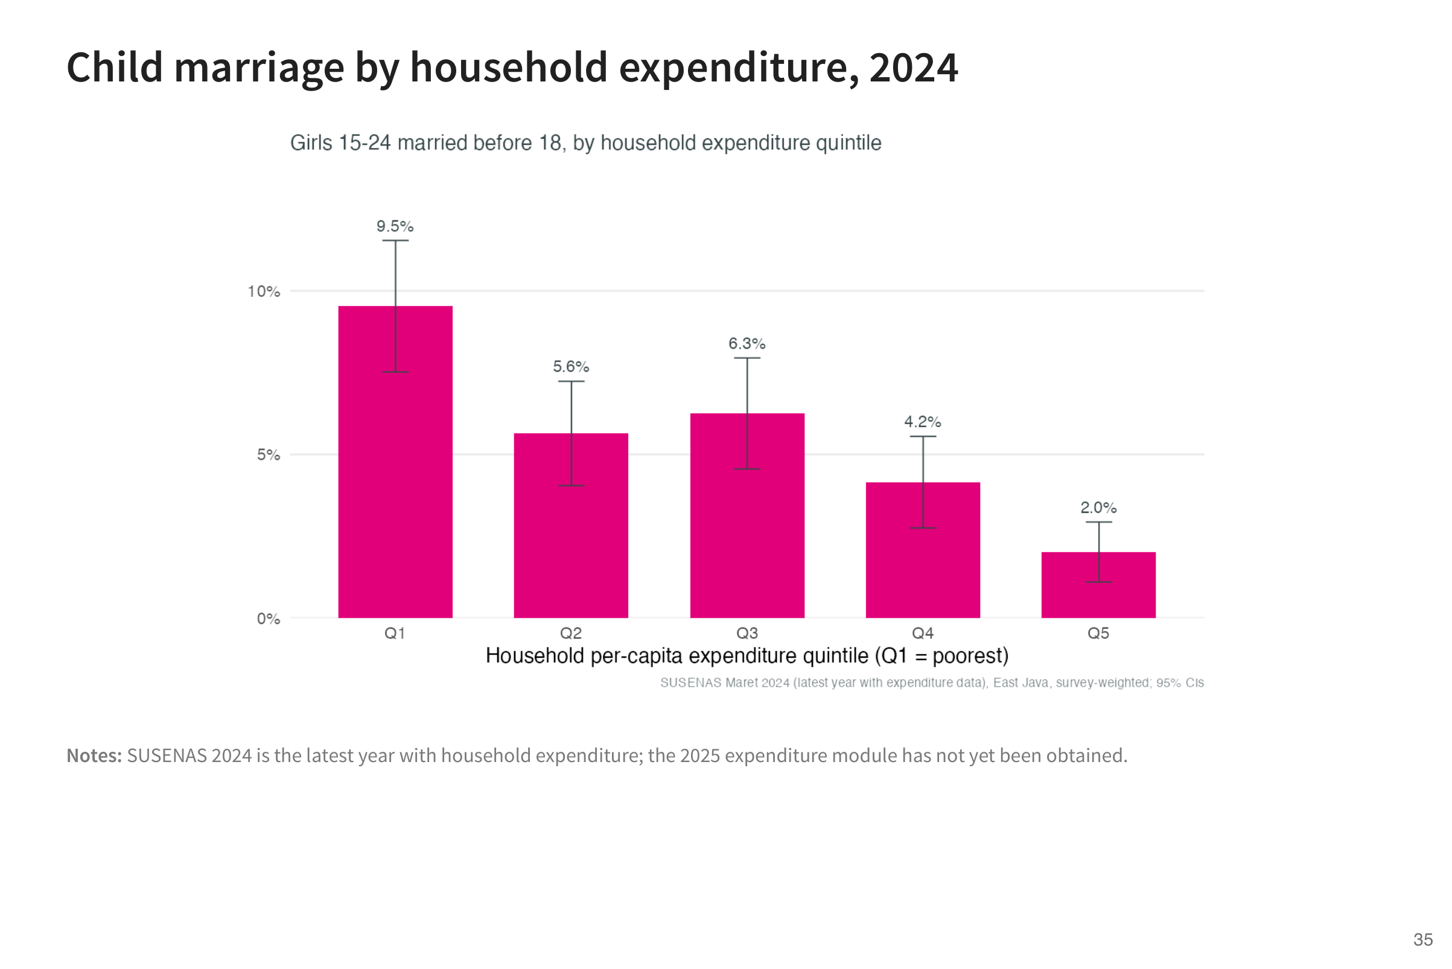

Slide 36
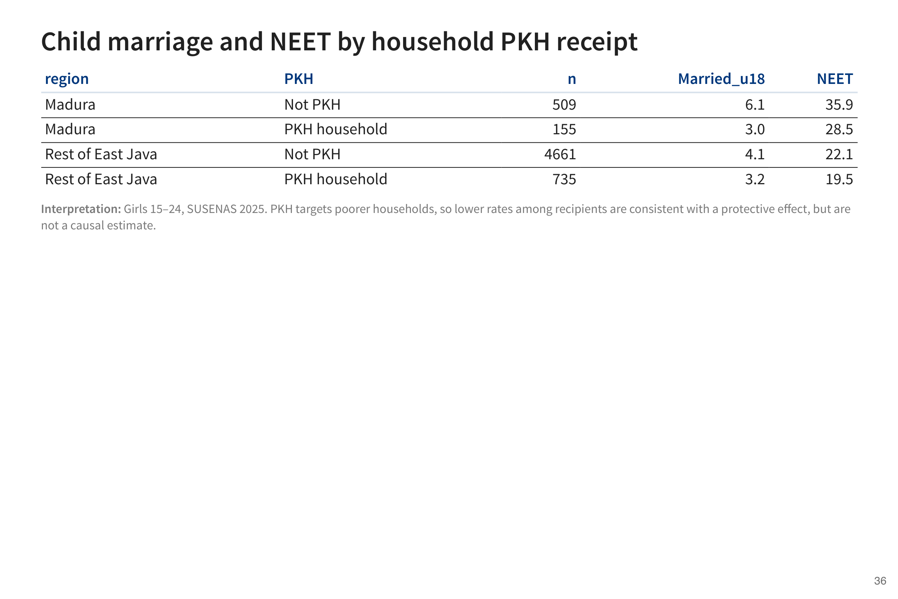

Slide 37
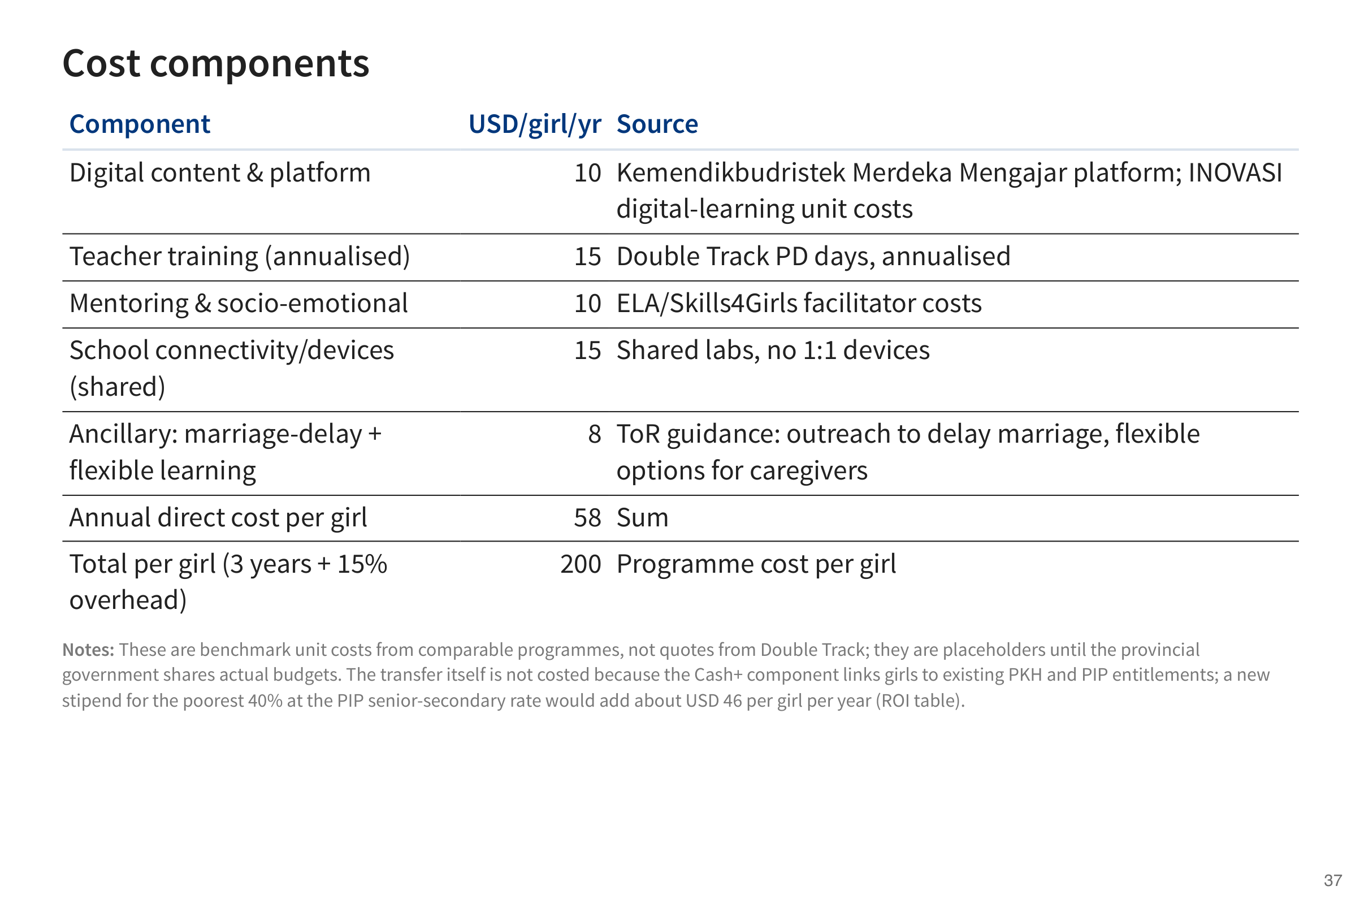

Slide 38
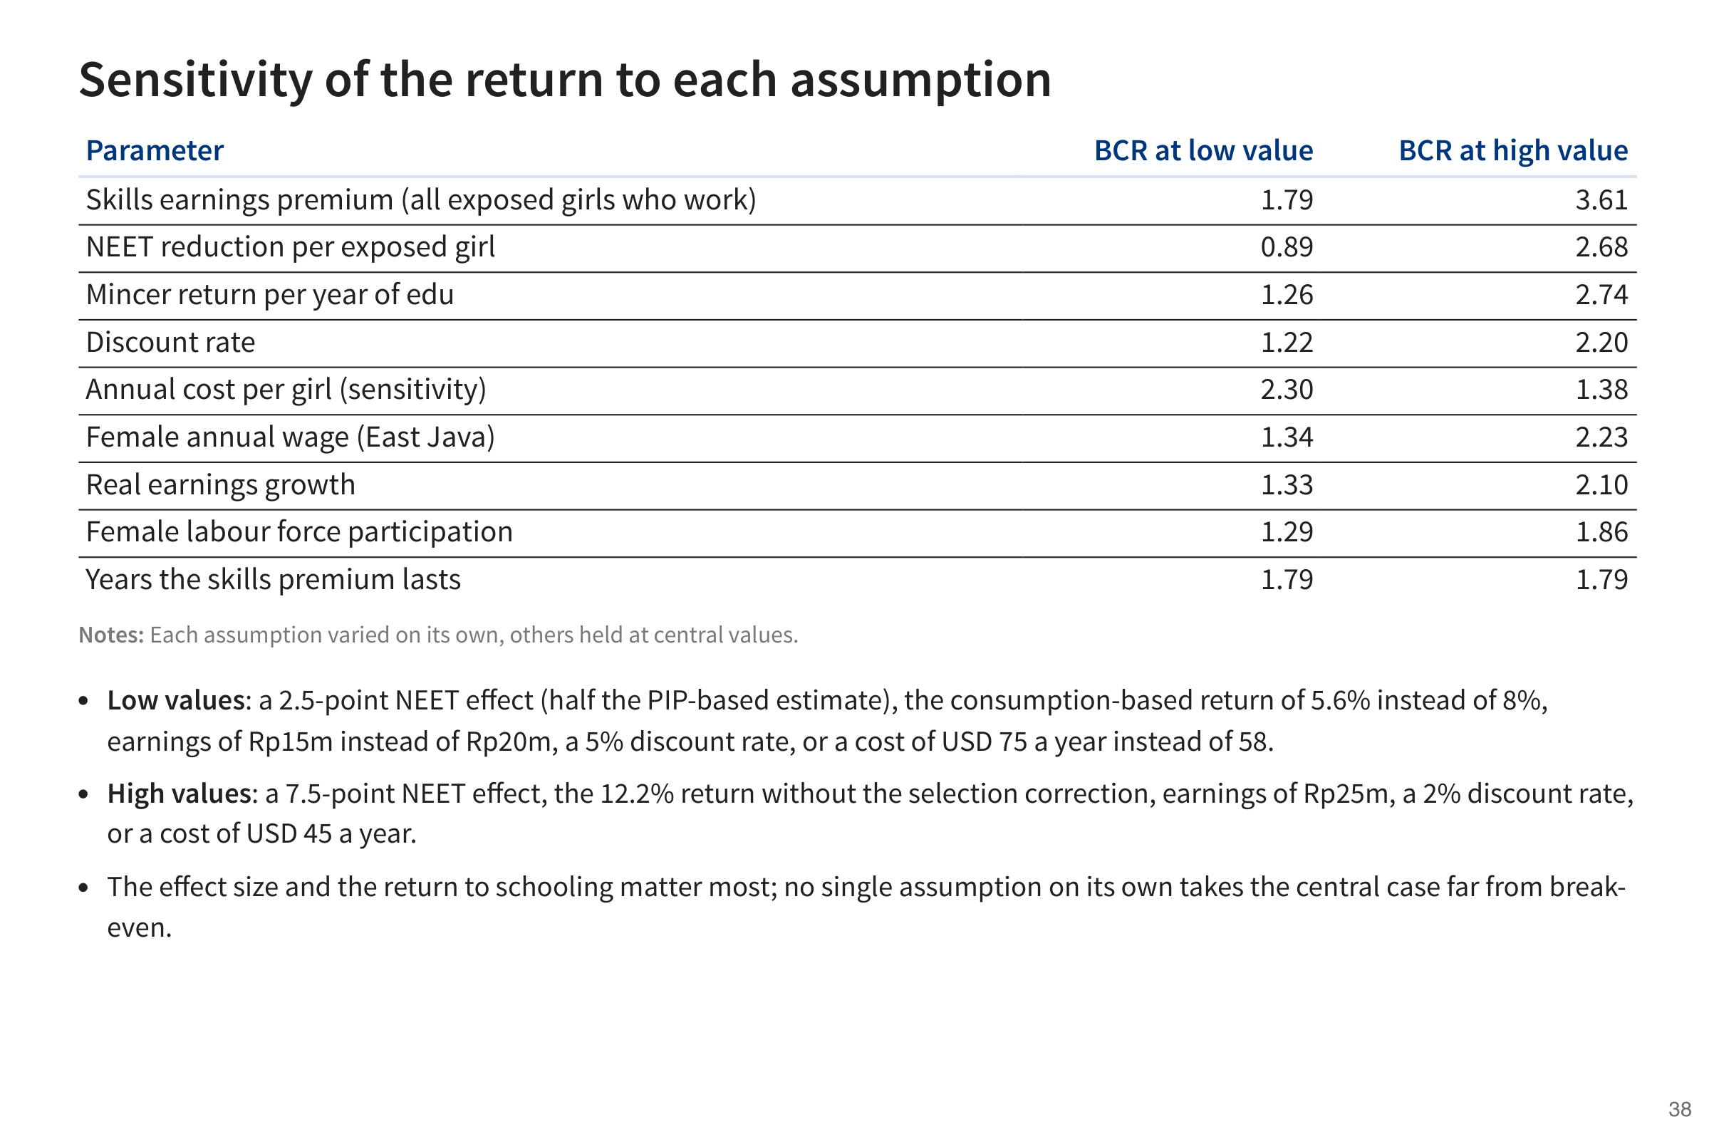

Slide 39
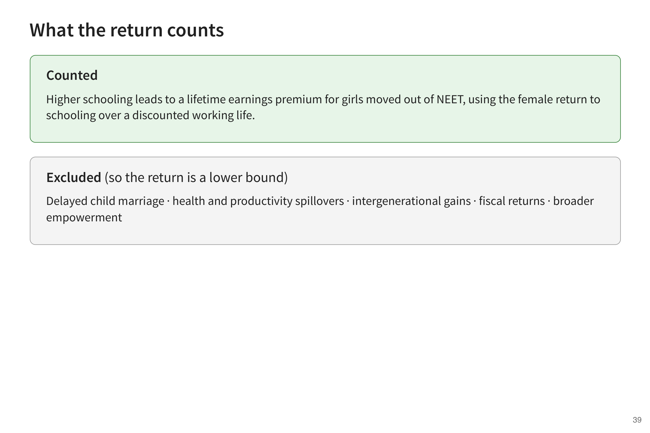

Slide 40
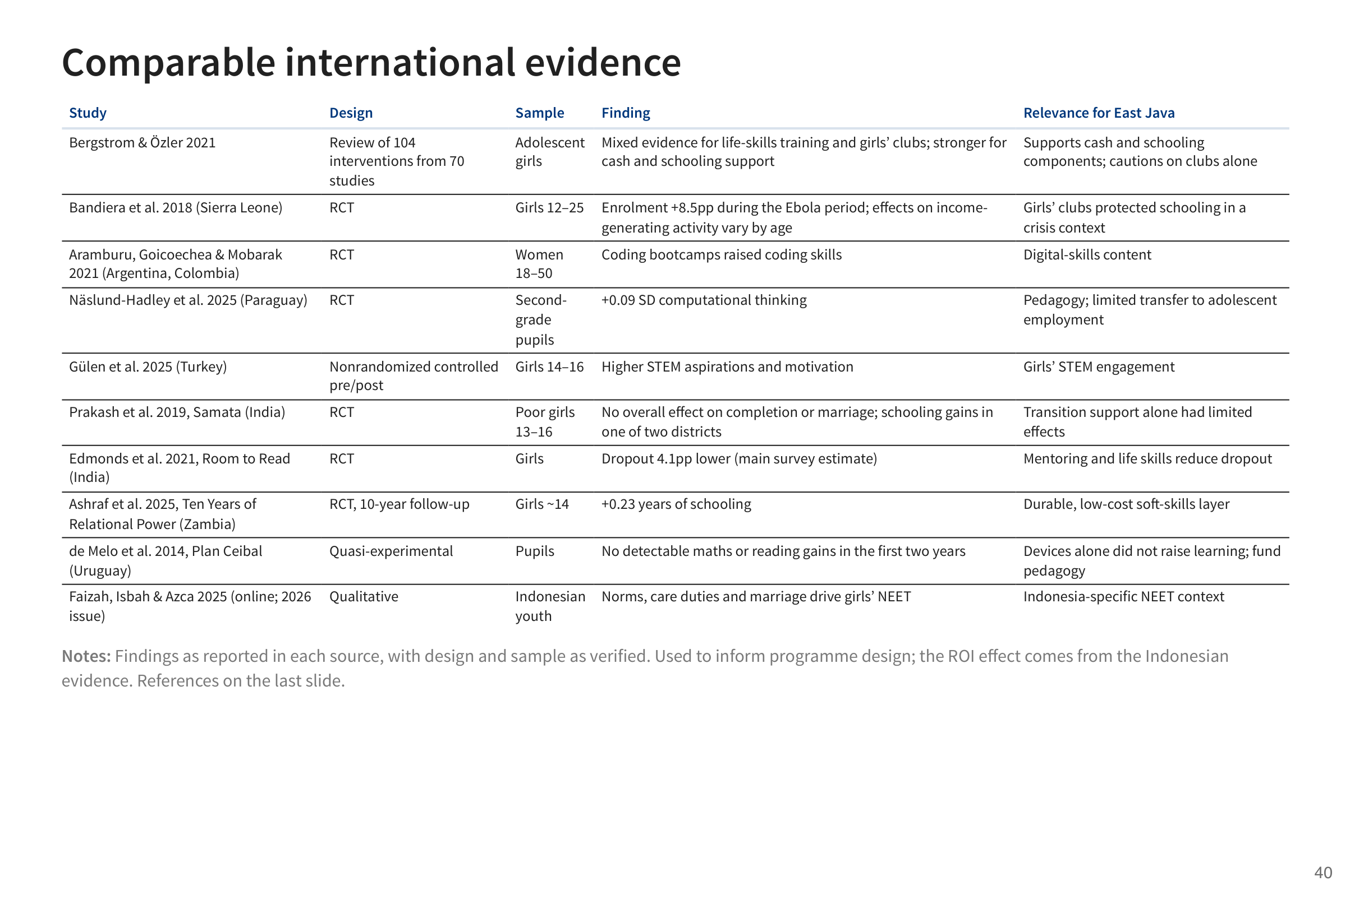

Slide 41
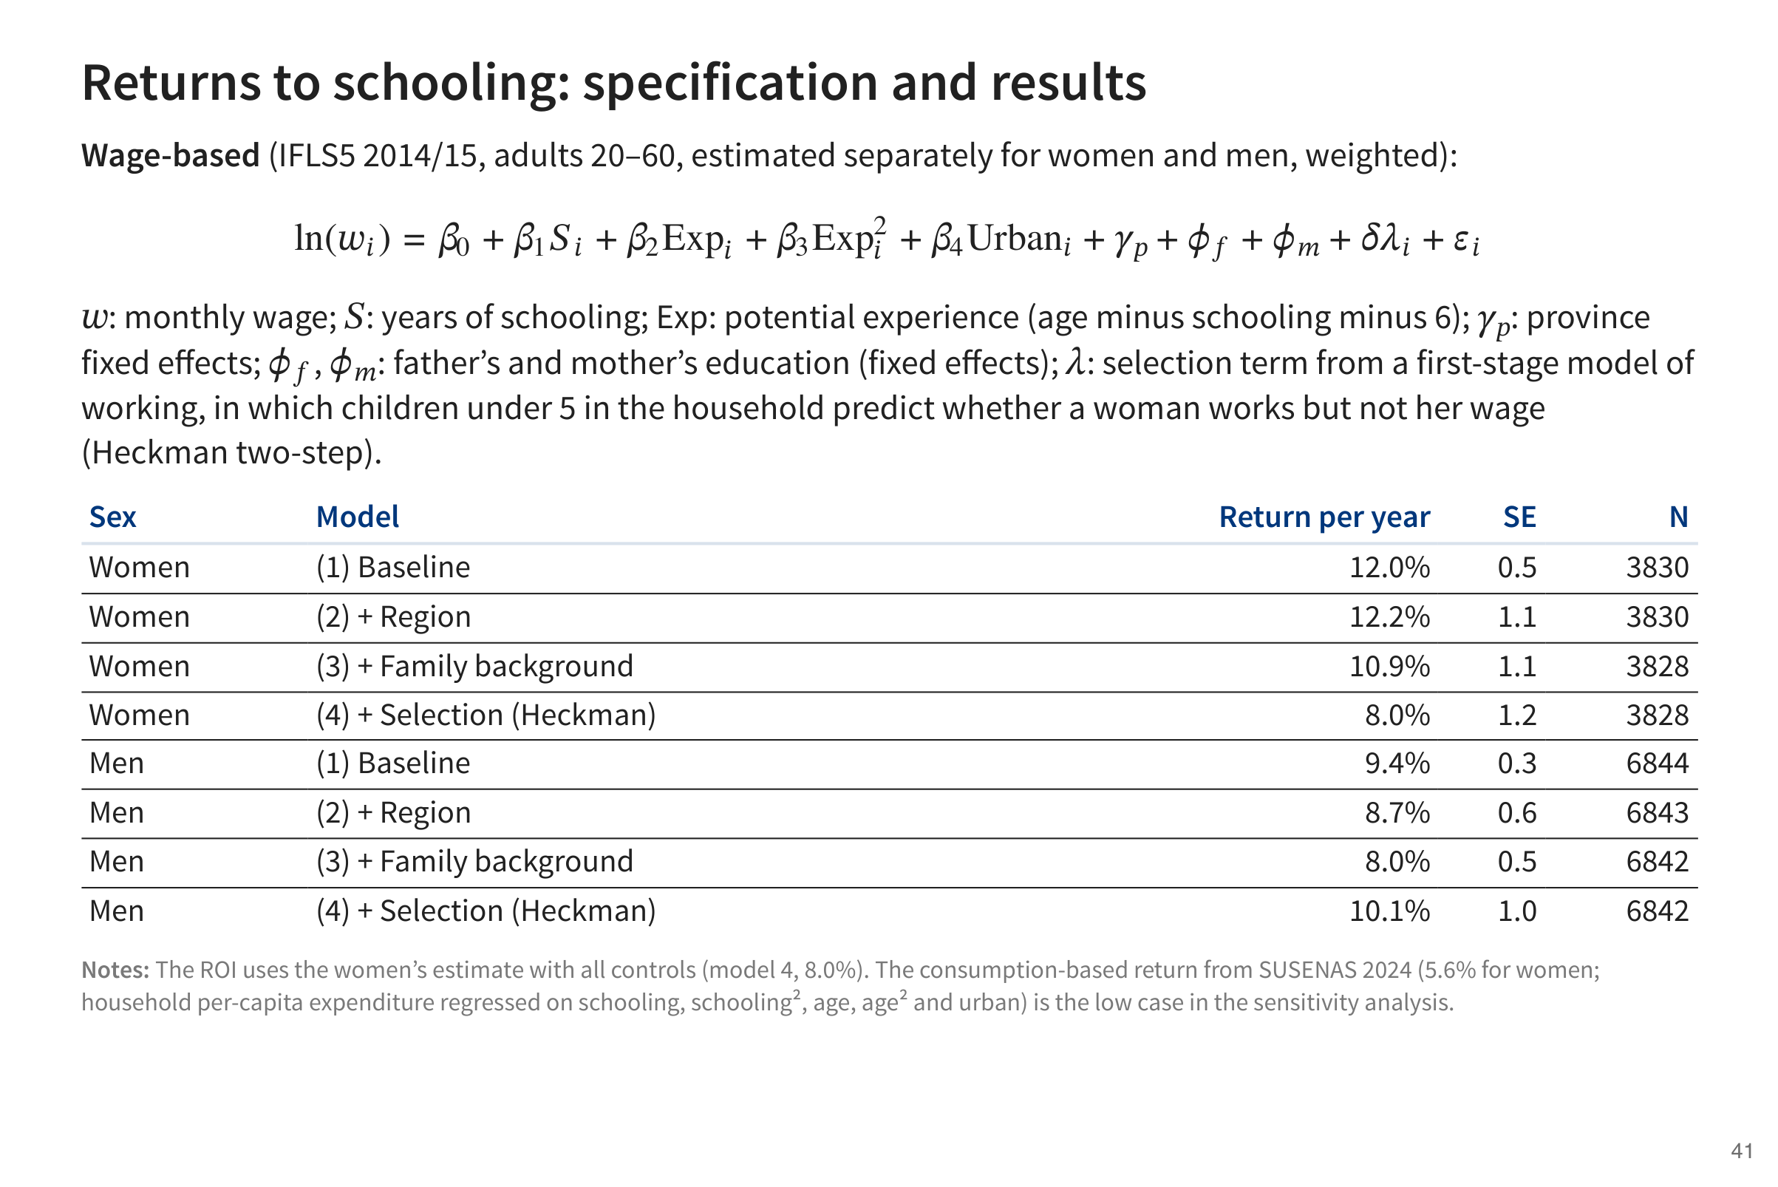

Slide 42
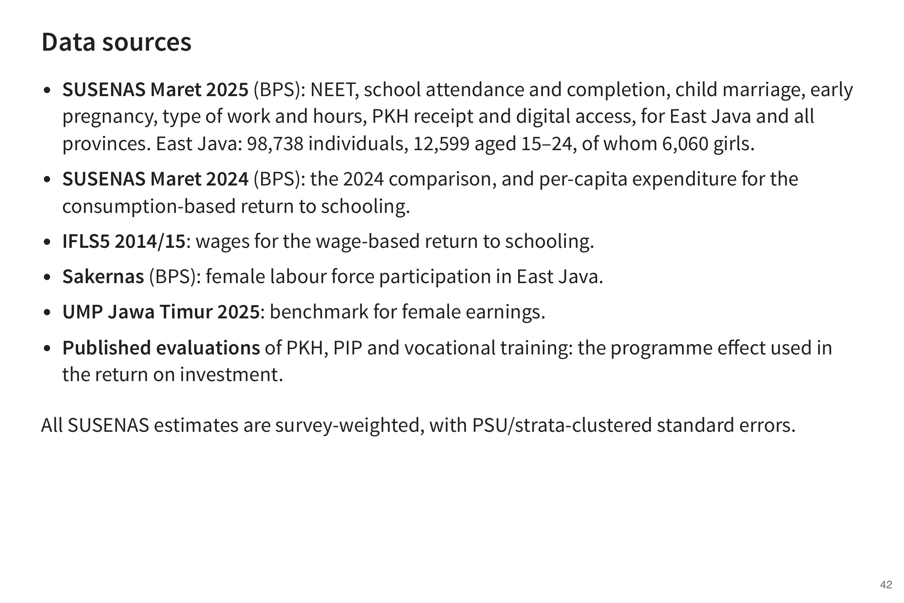

Slide 43
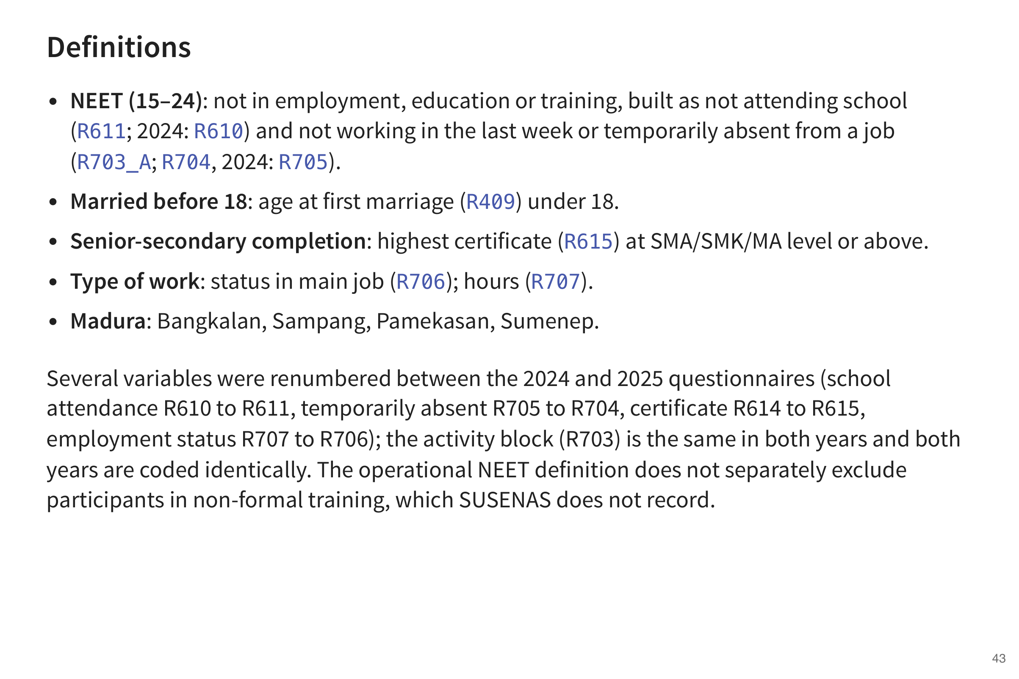

Slide 44
