Slide 1
Cost of Inaction Analysis for Adolescent Girls’ Education and Human Capital in Nepal
Hernando Grueso, PhD
UNICEF

Slide 2
Data and Context

Slide 3
Data Source: Nepal Living Standards Survey IV (NLSS IV) 2022/23
Source: National Statistics Office of Nepal · NLSS IV 2022/23 microdata
Sampling: Nationally representative two-stage stratified design across 7 provinces
Sample size: 46,870 individuals in 9,600 households
Analysis sample: 9,785 youth aged 15–24 (4,919 girls, 4,866 boys); 13,586 women aged 15–64 for the causal forest
Modules used: S01 (roster), S07 (education), S08 (disability, Washington Group), S09 (employment), S10 (wages), poverty file
Survey design: PSU = psu_number, strata = province, weights = ind_wt

Slide 4
Variables and Definitions
Concept | Definition | Source
NEET | Not in education, employment or training | S07 + S09
Enrolled | Currently attending any school level | q07_11
Secondary completed | Completed Class 10 (SLC) or higher | q07_12
Currently married | Self-reported marital status | q01_05
Caste/ethnicity | 8 NLSS groups, recoded to 5 broad categories | q01_07
Wealth quintile | Asset-based, household level | constructed
Below poverty line | Official NSO poverty status | poverty file
Disability | Washington Group 6+ functional difficulty | q08_16–q08_21
Monthly wage | Long-term salaried workers, NPR | q10_07, q10_09

Slide 5
Key Findings at a Glance

Slide 6
Five Headline Findings

Slide 7
Diagnostic: Gender Gaps in Education and Employment

Slide 8
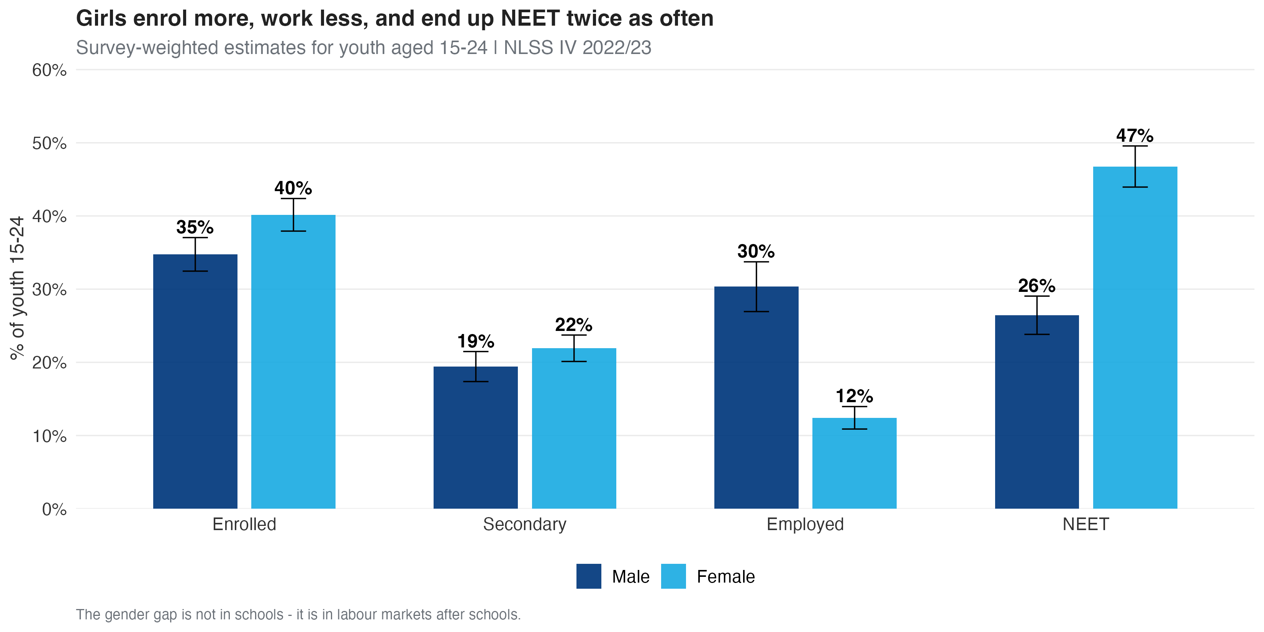
The Gender Gap is Not in Schools — It is in Labour Markets

Slide 9
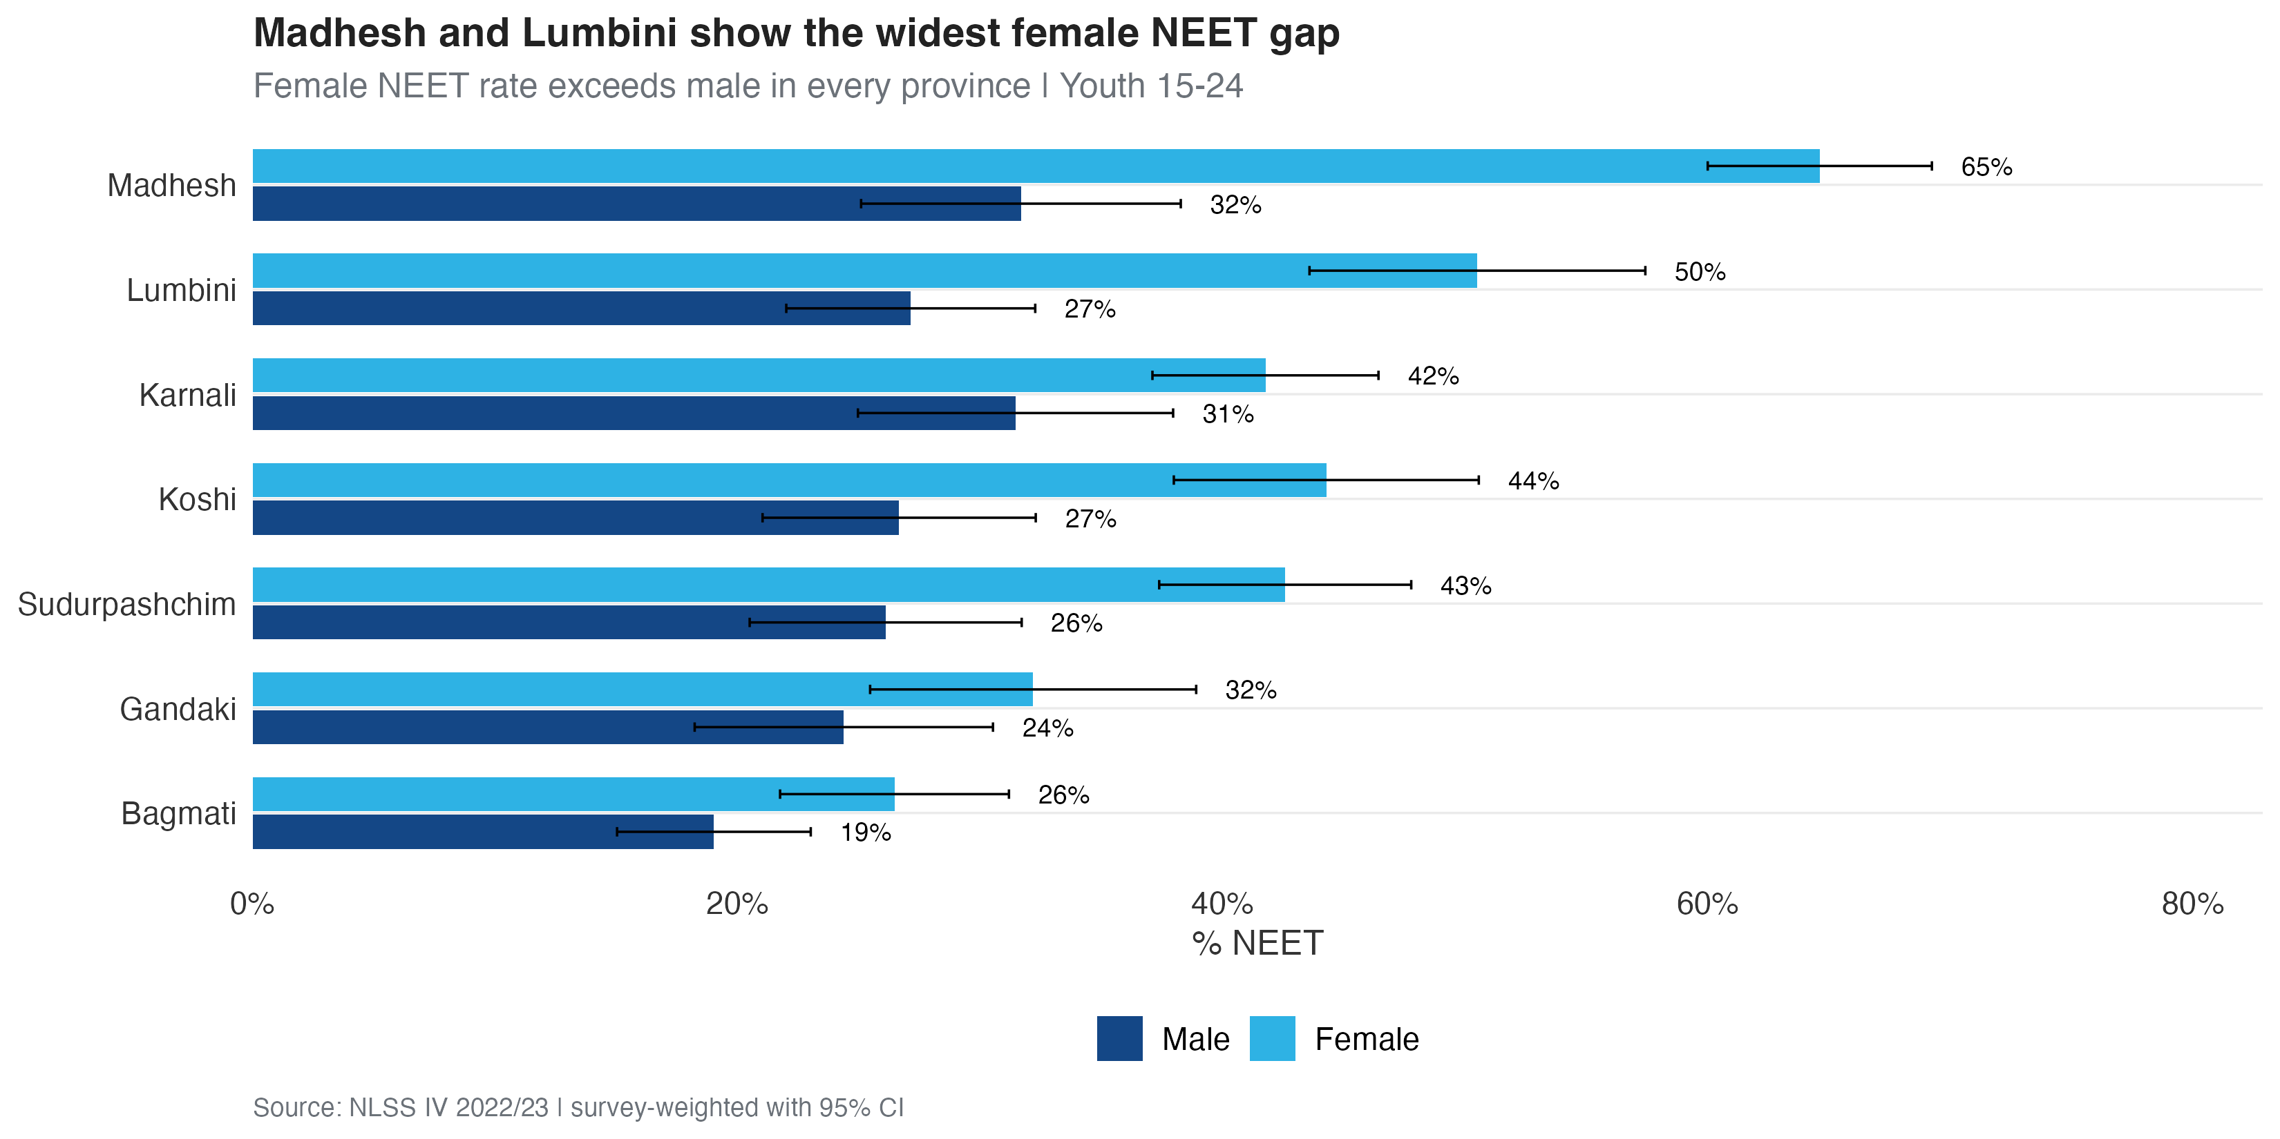
Madhesh and Lumbini: Provinces with the Widest Female NEET Gap

Slide 10
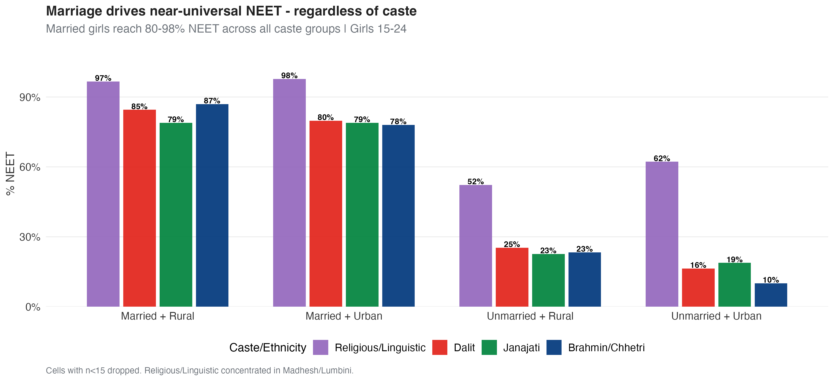
Marriage Drives Near-Universal NEET — Regardless of Caste

Slide 11
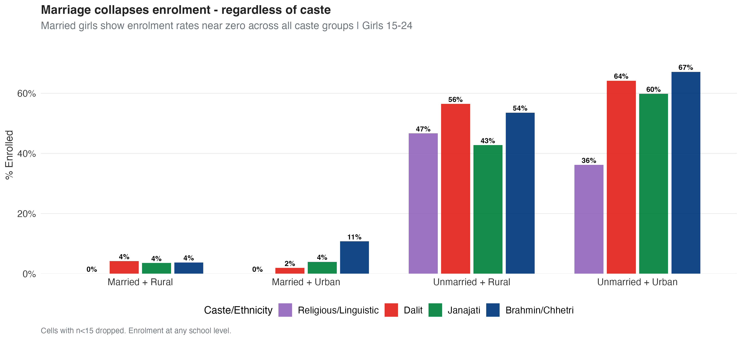
Marriage Also Collapses Enrolment — Across All Castes

Slide 12
Headline Numbers — Where Each Girl Aged 15–24 Is
Status (youth 15–24) | Girls | Boys | Gap (pp)
In school only (not working) | 35.4% | 32.8% | +2.6 pp
In school and working | 4.8% | 2.0% | +2.8 pp
Working only (not in school) | 13.0% | 38.9% | −25.9 pp
NEET (Not in Educ/Employment) | 46.8% | 26.4% | +20.4 pp
Of which: currently married | 37.4% | 17.6% | +19.8 pp

Slide 13
The 46.8% NEET figure reflects girls who are neither in school nor employed under the ILO 7-day definition (which excludes unpaid family work and unsuccessful job search). These four categories are mutually exclusive and sum to 100%.

Slide 14
Multivariate Analysis

Slide 15
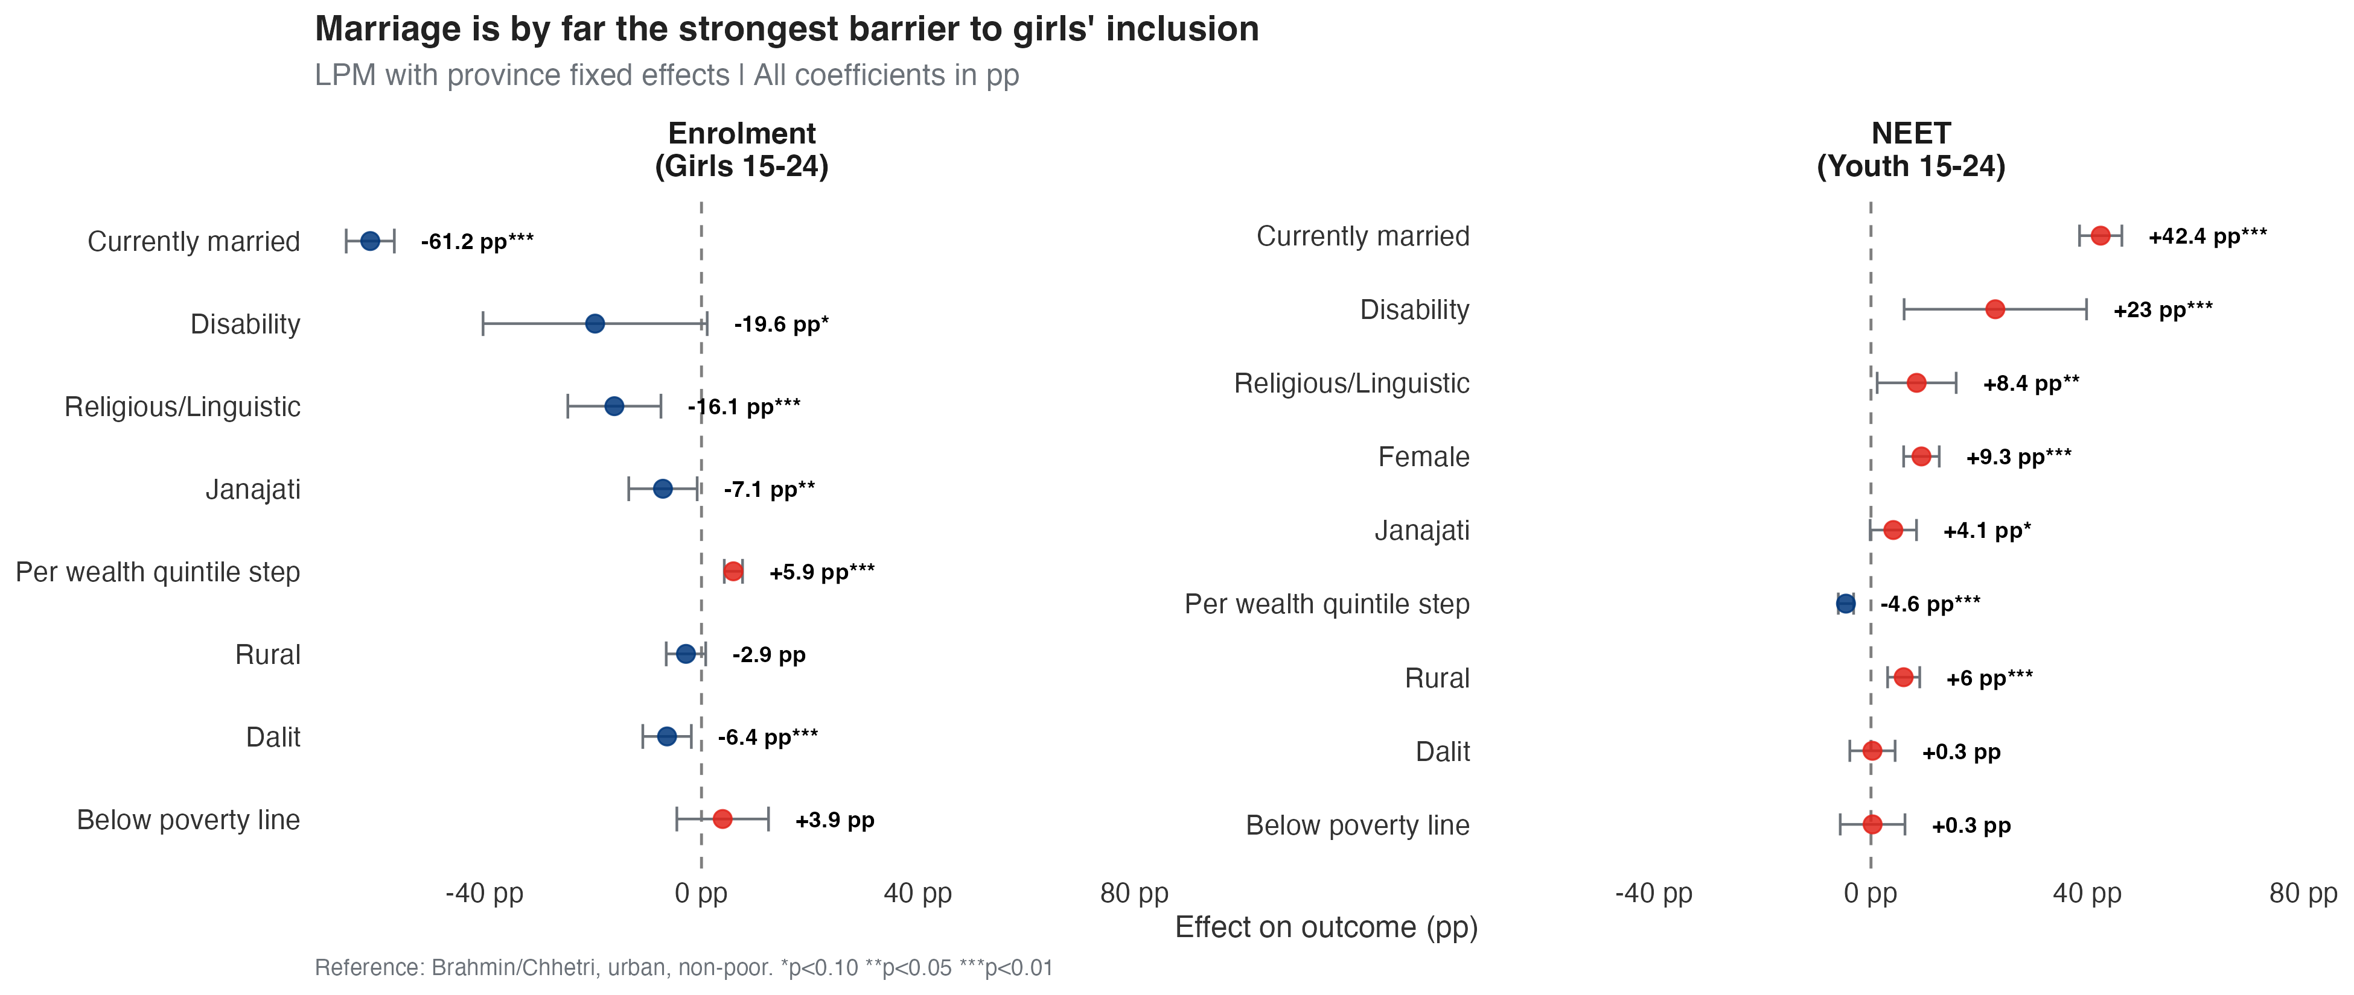
Marriage is by Far the Strongest Barrier — All Factors in Percentage Points

Slide 16
Reading the Coefficient Plot
Marriage is associated with the largest changes. Being currently married is associated with a −61 pp lower enrolment probability and a +42 pp higher NEET probability, after controlling for poverty, caste, geography, and disability.
Caste matters even after wealth. Dalit girls face a −6 pp enrolment gap that does not disappear when we control for wealth quintile. Religious/Linguistic girls face a similar penalty.
Wealth helps incrementally. Each step up in the wealth quintile is associated with +5.9 pp enrolment and −4.6 pp NEET.
The gender coefficient on NEET remains +9.3 pp even after holding everything constant — a residual labour-market gap not explained by observable characteristics.

Slide 17
Estimating Education Returns for Adolescent Girls

Slide 18
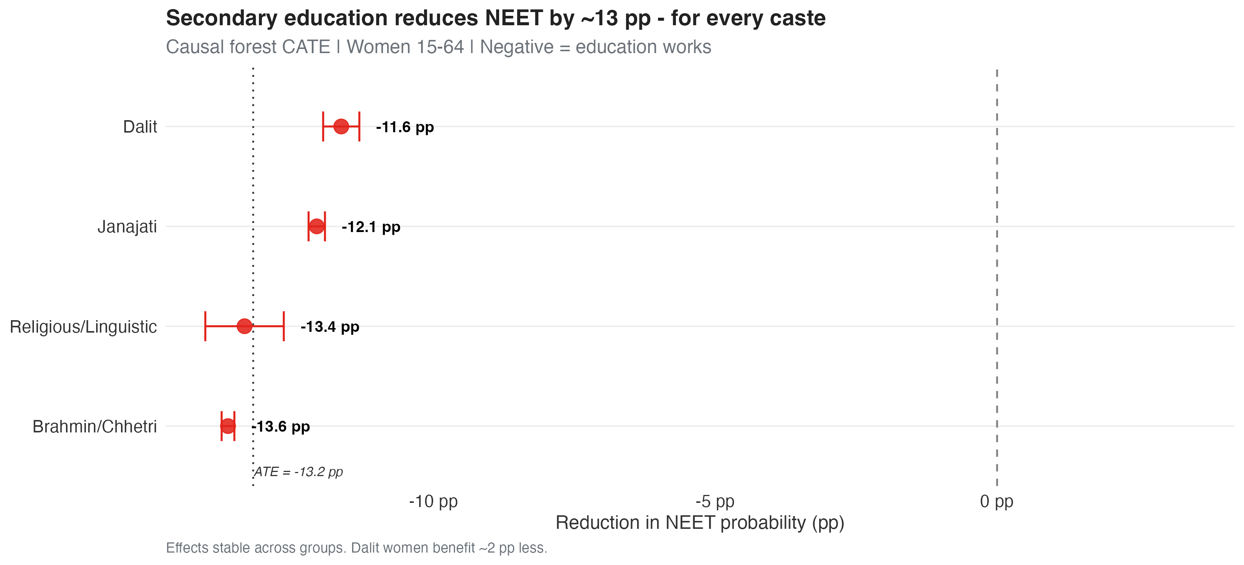
Secondary Education Reduces NEET by ~13 pp — For Every Caste

Slide 19
The −13.2 pp ATE estimate is for women aged 15–64. The parallel estimate for men is smaller (~−7 pp) — boys’ NEET is shaped more by labour-demand conditions than by individual schooling. Causal-forest details and boys’ coefficients in the appendix.

Slide 20
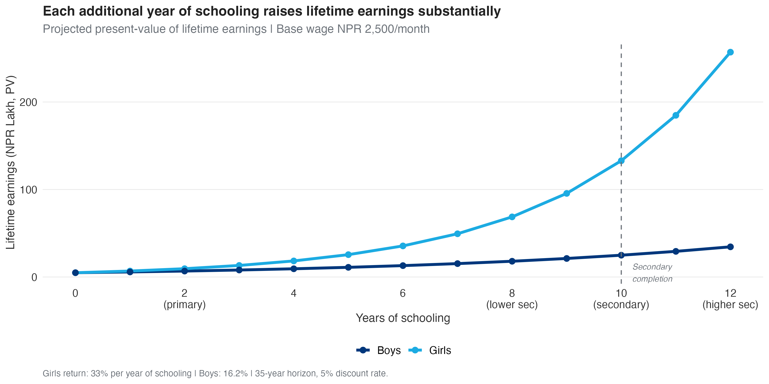
Returns to Schooling are Exponentially Larger for Girls

Slide 21
Average Mincer return: +14.5% per year of schooling for girls vs +12.0% for boys. Beyond secondary (10+ years): each additional year of schooling adds ~+15% to girls’ lifetime earnings vs ~+10% for boys — the gender gap in returns widens with educational attainment. Compounded over 35 working years, this is where the cost of inaction concentrates.

Slide 22
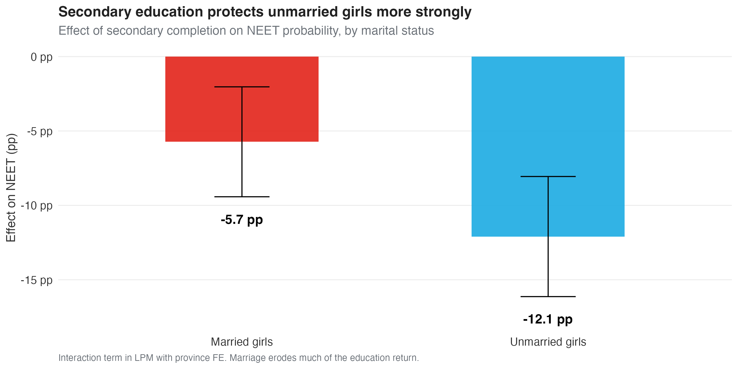
Marriage Erodes the Protective Effect of Education

Slide 23
What the Analyses Tell Us
Education is associated with inclusion everywhere. Completing secondary school is associated with a −13.2 pp lower NEET probability. The estimated effect is stable across all 7 provinces and all caste groups.
The Mincer return per year of schooling is 33% for girls (16.2% for boys). After 10 years of schooling, projected lifetime earnings roughly double relative to no schooling.
Marriage attenuates the protective association. Education is strongly associated with lower NEET for unmarried girls, but the relationship is weaker among married girls — education and marriage prevention act as complements, not substitutes.
OLS and causal forest produce convergent estimates in direction, magnitude, and stability. The investment case rests on triangulated evidence from two independent methods.

Slide 24
The Cost of Inaction

Slide 25
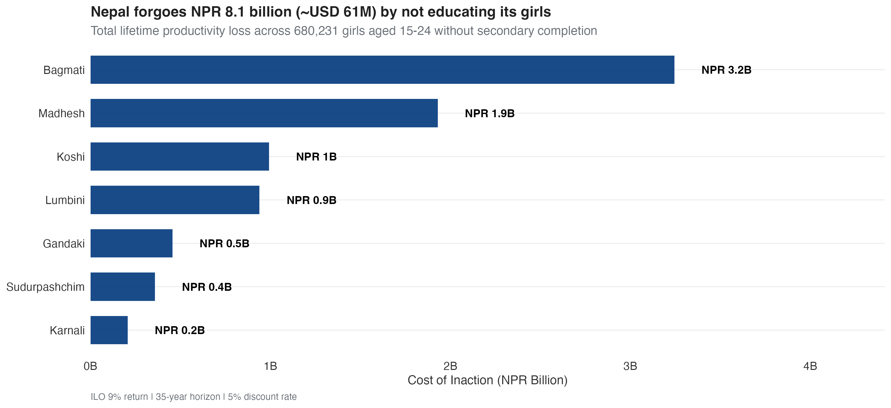
Nepal Forgoes NPR 8 Billion Every Year by Not Educating its Girls

Slide 26
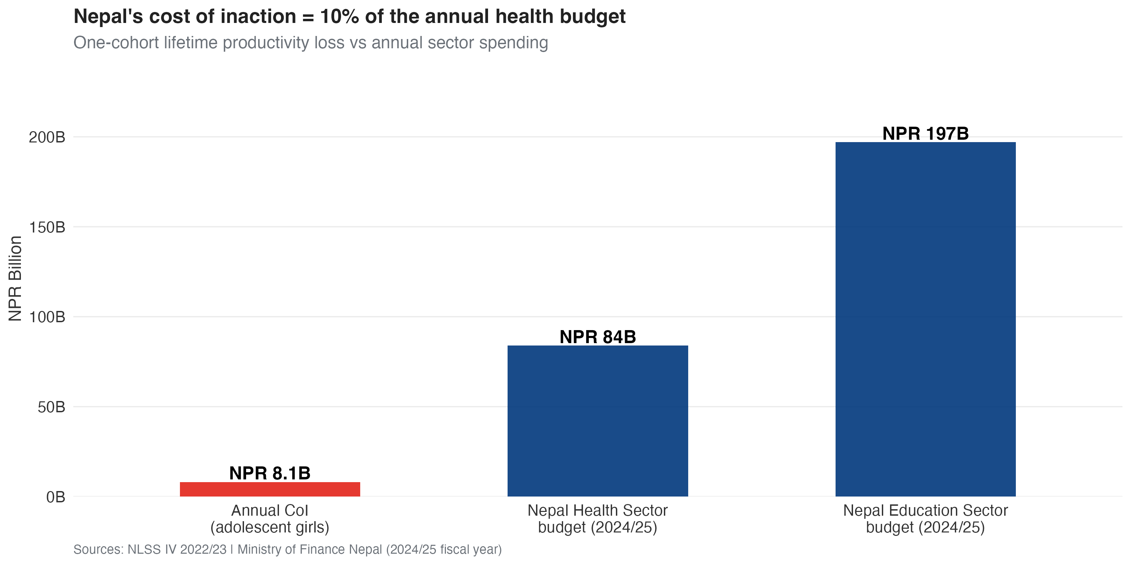
Cost of Inaction is 10% of the Annual Health Budget

Slide 27
What This Means in Concrete Policy Terms
NPR 8.1 billion is the lifetime productivity loss from one cohort of 680,231 adolescent girls who will not complete secondary education in Nepal.
That equals about 10% of the national health-sector budget and 4% of the education-sector budget for fiscal year 2024/25.
Karnali, Sudurpashchim, and Madhesh carry the largest relative burden — per-girl losses are smaller than in Bagmati because wages are lower, but a larger share of the local economy is at stake.
“Per cohort” means the lifetime productivity loss for the current cohort of 680,000 adolescent girls (aged 15–24 today). A new cohort enters this stage every year — so this is a recurring annual loss, not one-off.
Break-even spending per girl. USD 61 million ÷ 680,000 girls ≈ USD 90 per girl in cumulative lifetime social spending. Any secondary-completion programme costing less than USD 90 per beneficiary would yield a positive return on investment in productivity terms alone.

Slide 28
Recommendations

Slide 29
Five Investment Priorities for the New Government
1 · End child marriage as an economic priority. Marriage is associated with more variation in girls’ NEET than poverty, caste, and disability combined. Enforcement of existing legislation in Madhesh and Lumbini would yield the largest single gain.
2 · Universal secondary completion AND year-by-year retention. Each year of schooling is associated with a 14.5% earnings premium for girls. Beyond secondary completion the gender differential in returns widens (~+15% per year for girls vs ~+10% for boys) — programme design should reward every year retained, with the largest gains realised in upper-secondary and tertiary education.
3 · Dalit-specific labour-market measures. Education alone is associated with a 2 pp residual disadvantage for Dalit women. Pair education with apprenticeships and anti-discrimination measures.
4 · Bridge programmes for the 19–24 cohort. The female NEET rate rises sharply after age 18 (+24.7 pp gap). Vocational and second-chance education could capture earnings that current schooling cannot.
5 · Track and report sex-disaggregated NEET by province annually. What is not measured is not managed. Make this the new headline statistic of NLSS V.

Slide 30
Methodological Appendix

Slide 31
How We Estimate the Cost of Inaction
We combine three components:

Slide 32
1 · Causal effect
Generalised Random Forest (Wager & Athey 2018) on women 15–64, treatment = secondary completion, outcome = NEET. ATE = −13.2 pp.
2 · Earnings projection
Mincer wage equation on 952 women in long-term salaried employment. Conservative return = 9% per year of schooling (ILO benchmark, lower than the internal estimate of 14.5%).
3 · Population scaling
Survey weights from NLSS IV scaled to national total of 1.4M girls aged 15–24. Provincial CoI = ATE × N excluded × PV per girl.
Discount rate: 5% | Horizon: 35 working years | GDP source: NSO Nepal 2023/24 provincial accounts.

Slide 33
Assumptions and Limitations

Slide 34
The Mincer Wage Equation: Specification
The Mincer human-capital earnings function is estimated as:
$$log\left({\text{wage}}_{ip}\right)=α+β_{1}⋅{\text{schooling}}_{ip}+β_{2}⋅{\text{exp}}_{ip}+β_{3}⋅{\text{exp}}_{ip}^{2}+β_{4}⋅{\text{rural}}_{ip}+γ_{p}+ε_{ip}$$
$log\left({\text{wage}}_{ip}\right)$ — natural log of monthly wage (NPR) for individual $i$ in province $p$
$β_{1}$ — key parameter: return per additional year of schooling (Mincer return)
$\text{exp}$ — years of potential labour market experience (age − schooling − 6)
${\text{exp}}^{2}$ — captures concavity (returns to experience diminish with age)
$\text{rural}$ — binary indicator for rural residence
$γ_{p}$ — province fixed effects (regional wage differentials)
$ε_{ip}$ — error term, heteroskedasticity-robust SE (HC1)
Specifications tested: (i) Basic — schooling, experience, rural; (ii) +Province FE; (iii) +Caste/ethnicity controls; (iv) Interactions with marital status. The reported estimate ${\hat{β}}_{1}≈0.145$ implies a 14.5% return per year of schooling for women; ILO Nepal benchmark of 9% used for the conservative CoI.

Slide 35
Appendix Table A1: Mincer Wage Equation, Female Salary Workers
Variable | Coefficient | SE | 95% CI | p-value
Years of schooling | 0.3298 | 0.0114 | [0.3074, 0.3521] | <0.001
Experience (years) | 0.1109 | 0.0108 | [0.0898, 0.1320] | <0.001
Experience squared | -0.0014 | 0.0002 | [-0.0019, -0.0009] | <0.001
Rural | -0.4351 | 0.0631 | [-0.5588, -0.3114] | <0.001
N | 2214.0000 | NA | NA | NA
R-squared | 0.3630 | NA | NA | NA

Slide 36
Notes: Dependent variable is log of monthly wage (NPR). Sample: women aged 15–64 in long-term salaried employment (N = 952). Specification includes years of schooling, experience, experience squared, rural indicator, and province fixed effects. Standard errors are heteroskedasticity-robust (HC1). Source: Author’s calculations using NLSS IV 2022/23. *p < 0.10, **p < 0.05, ***p < 0.01.

Slide 37
Appendix Table A2: Mincer Wage Equation, Male Salary Workers
Variable | Coefficient | SE | 95% CI | p-value
Years of schooling | 0.1624 | 0.0065 | [0.1497, 0.1751] | <0.001
Experience (years) | 0.1193 | 0.0063 | [0.1069, 0.1316] | <0.001
Experience squared | -0.0020 | 0.0001 | [-0.0022, -0.0017] | <0.001
Rural | -0.3706 | 0.0359 | [-0.4409, -0.3003] | <0.001
N | 4677.0000 | NA | NA | NA
R-squared | 0.2290 | NA | NA | NA

Slide 38
Notes: Dependent variable is log of monthly wage (NPR). Sample: men aged 15–64 in long-term salaried employment. Specification includes years of schooling, experience, experience squared, rural indicator, and province fixed effects. Standard errors are heteroskedasticity-robust (HC1). Source: Author’s calculations using NLSS IV 2022/23. *p < 0.10, **p < 0.05, ***p < 0.01.

Slide 39
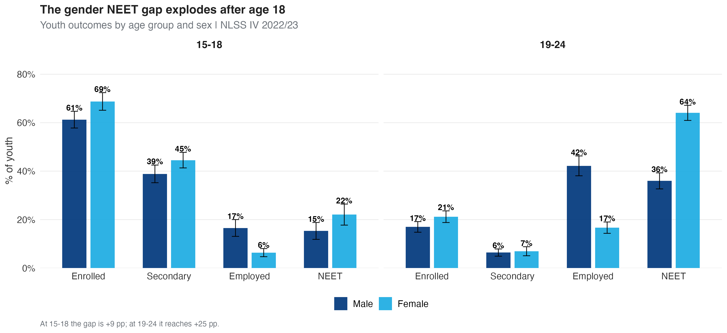
Appendix Figure A1: Gender Gap by Age Group

Slide 40
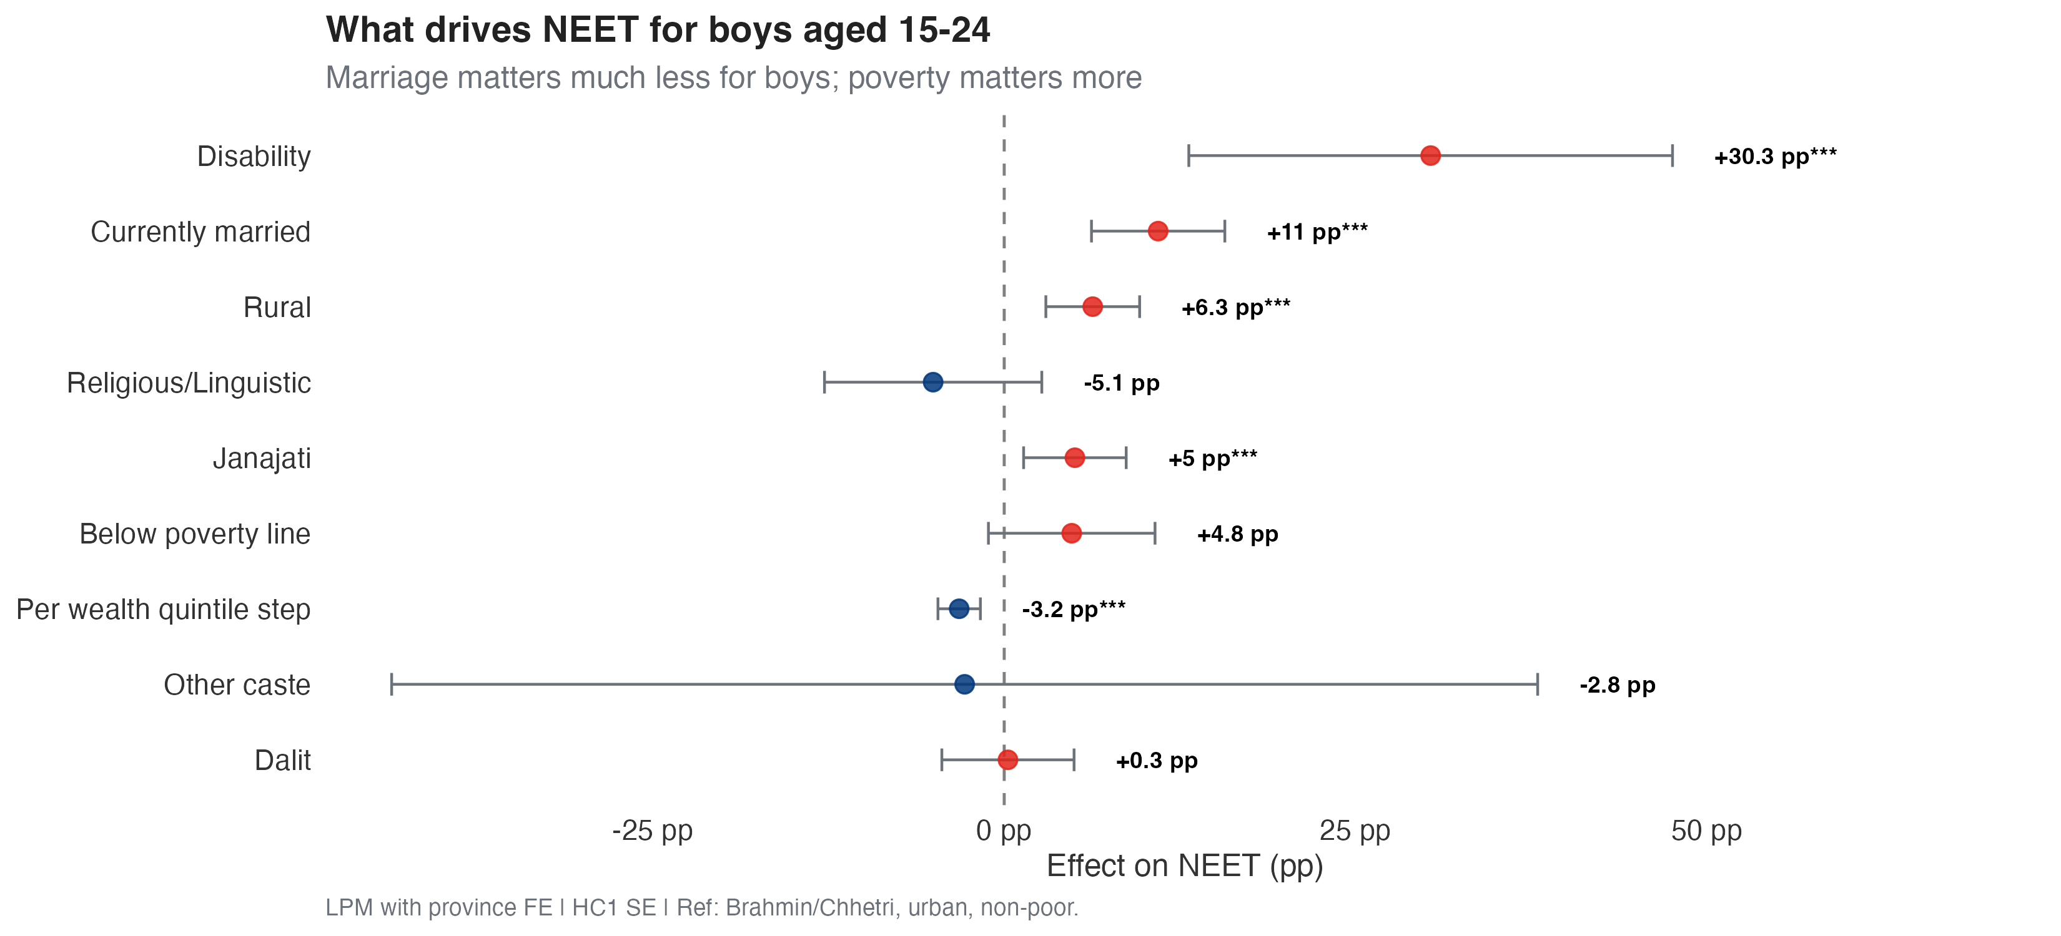
Appendix Figure A2: Boys’ NEET Regression — Coefficient Plot

Slide 41
Appendix Table A3: Boys’ NEET Linear Probability Model
Variable | Coefficient | SE | 95% CI | p-value
Rural | 0.063 | 0.017 | [0.030, 0.096] | <0.001
Below poverty line | 0.048 | 0.030 | [-0.011, 0.107] | 0.112
Per wealth quintile step | -0.032 | 0.008 | [-0.047, -0.017] | <0.001
Currently married | 0.110 | 0.024 | [0.062, 0.157] | <0.001
Disability | 0.303 | 0.088 | [0.131, 0.476] | <0.001
Janajati | 0.050 | 0.019 | [0.014, 0.087] | 0.007
Dalit | 0.003 | 0.024 | [-0.044, 0.050] | 0.911
Religious/Linguistic | -0.051 | 0.039 | [-0.128, 0.027] | 0.200
Other caste | -0.028 | 0.208 | [-0.436, 0.380] | 0.892

Slide 42
Notes: Dependent variable is NEET status. Linear probability model. Sample: boys aged 15–24 (n ≈ 4,300). Controls: rural, poverty status, wealth quintile, marital status, disability (WG 6+), caste/ethnicity. Reference categories: Brahmin/Chhetri, urban, non-poor. Province fixed effects included. Standard errors are heteroskedasticity-robust (HC1). Source: Author’s calculations using NLSS IV 2022/23. *p < 0.10, **p < 0.05, ***p < 0.01.

