Slide 1
Cost of Inaction Analysis for Adolescent Girls’ Education and Human Capital in Nepal
UNICEF

Slide 2
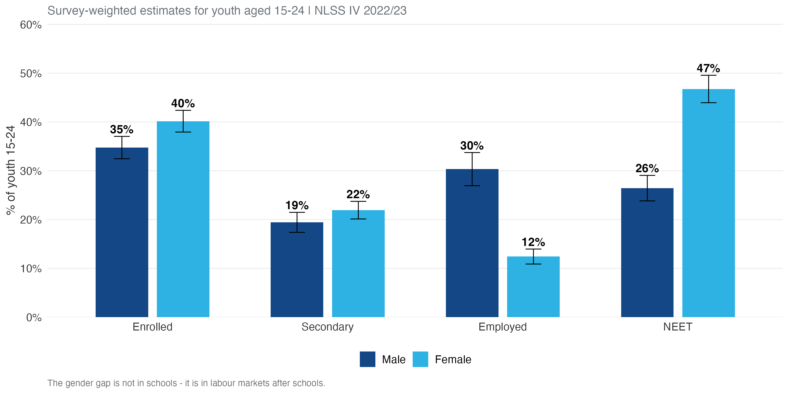
The Problem: Girls Enrol, but Don’t Find Work

Slide 3
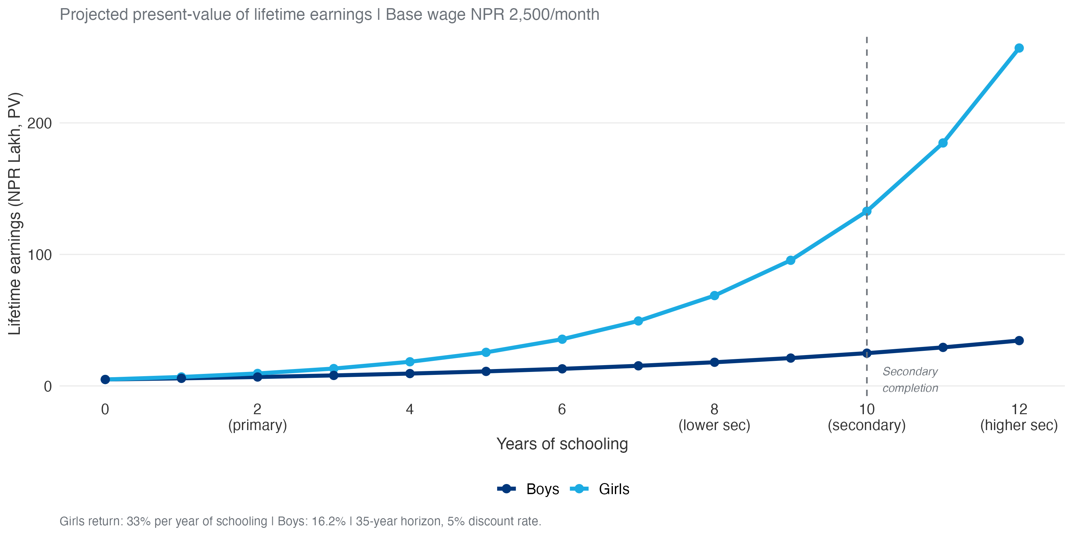
The Evidence: Education Reduces Exclusion

Slide 4
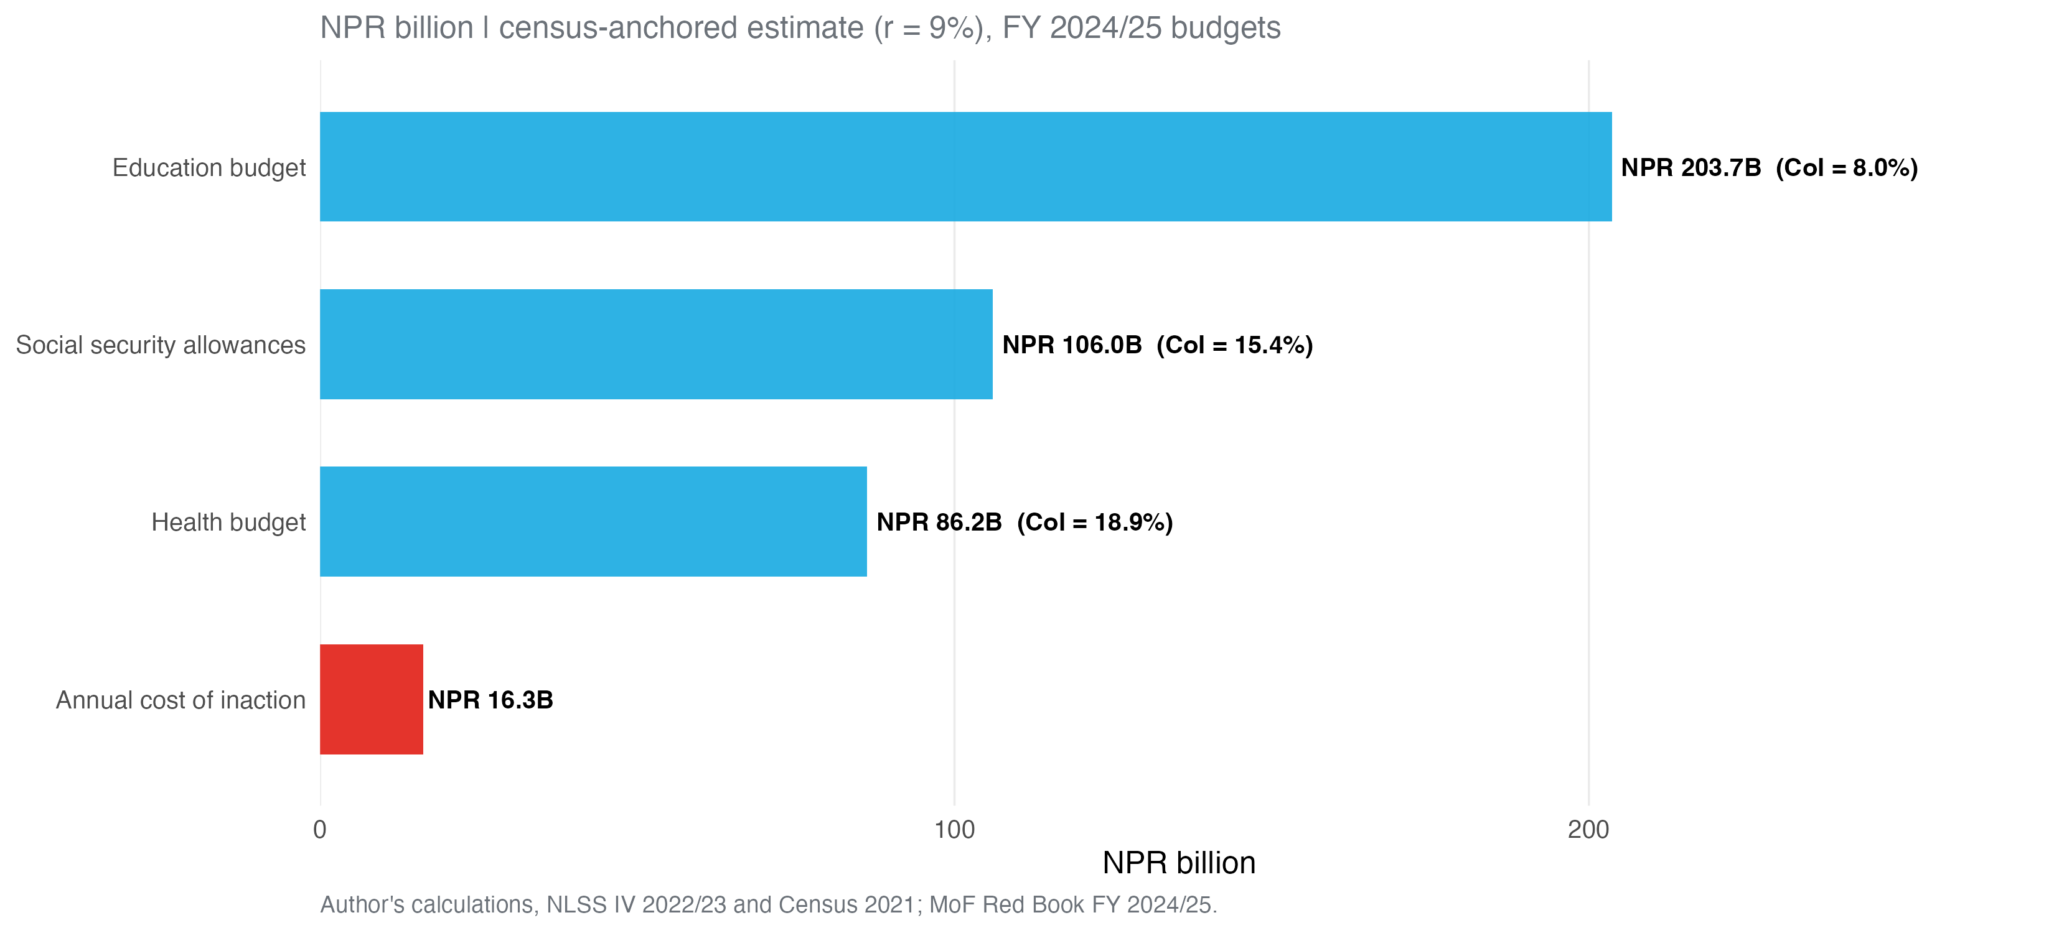
The Cost: NPR 16 Billion per Cohort

Slide 5
The Recommendation: Four Priority Areas, Employment First

Slide 6
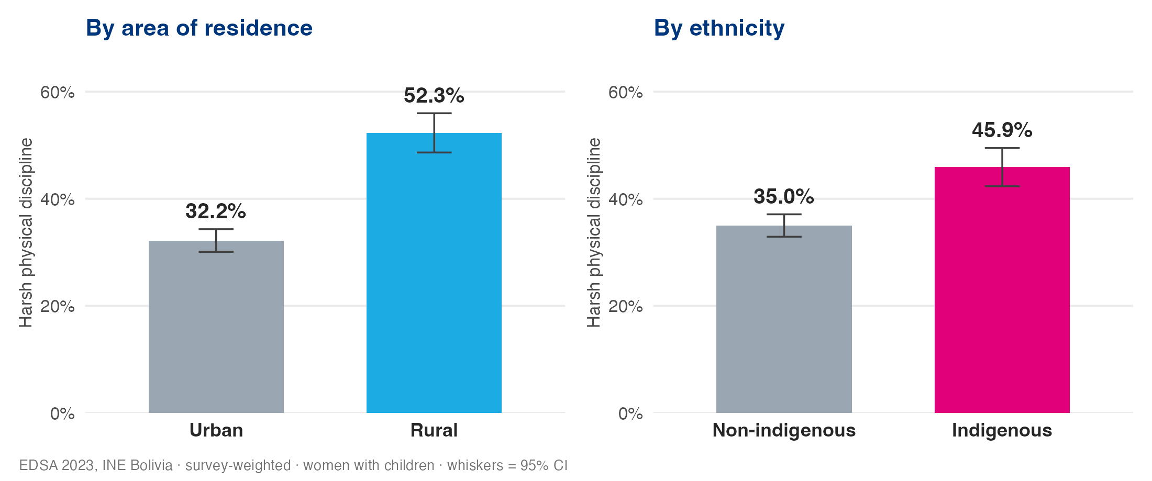
The Same Lens Elsewhere — Bolivia: a Different Diagnosis

Slide 7
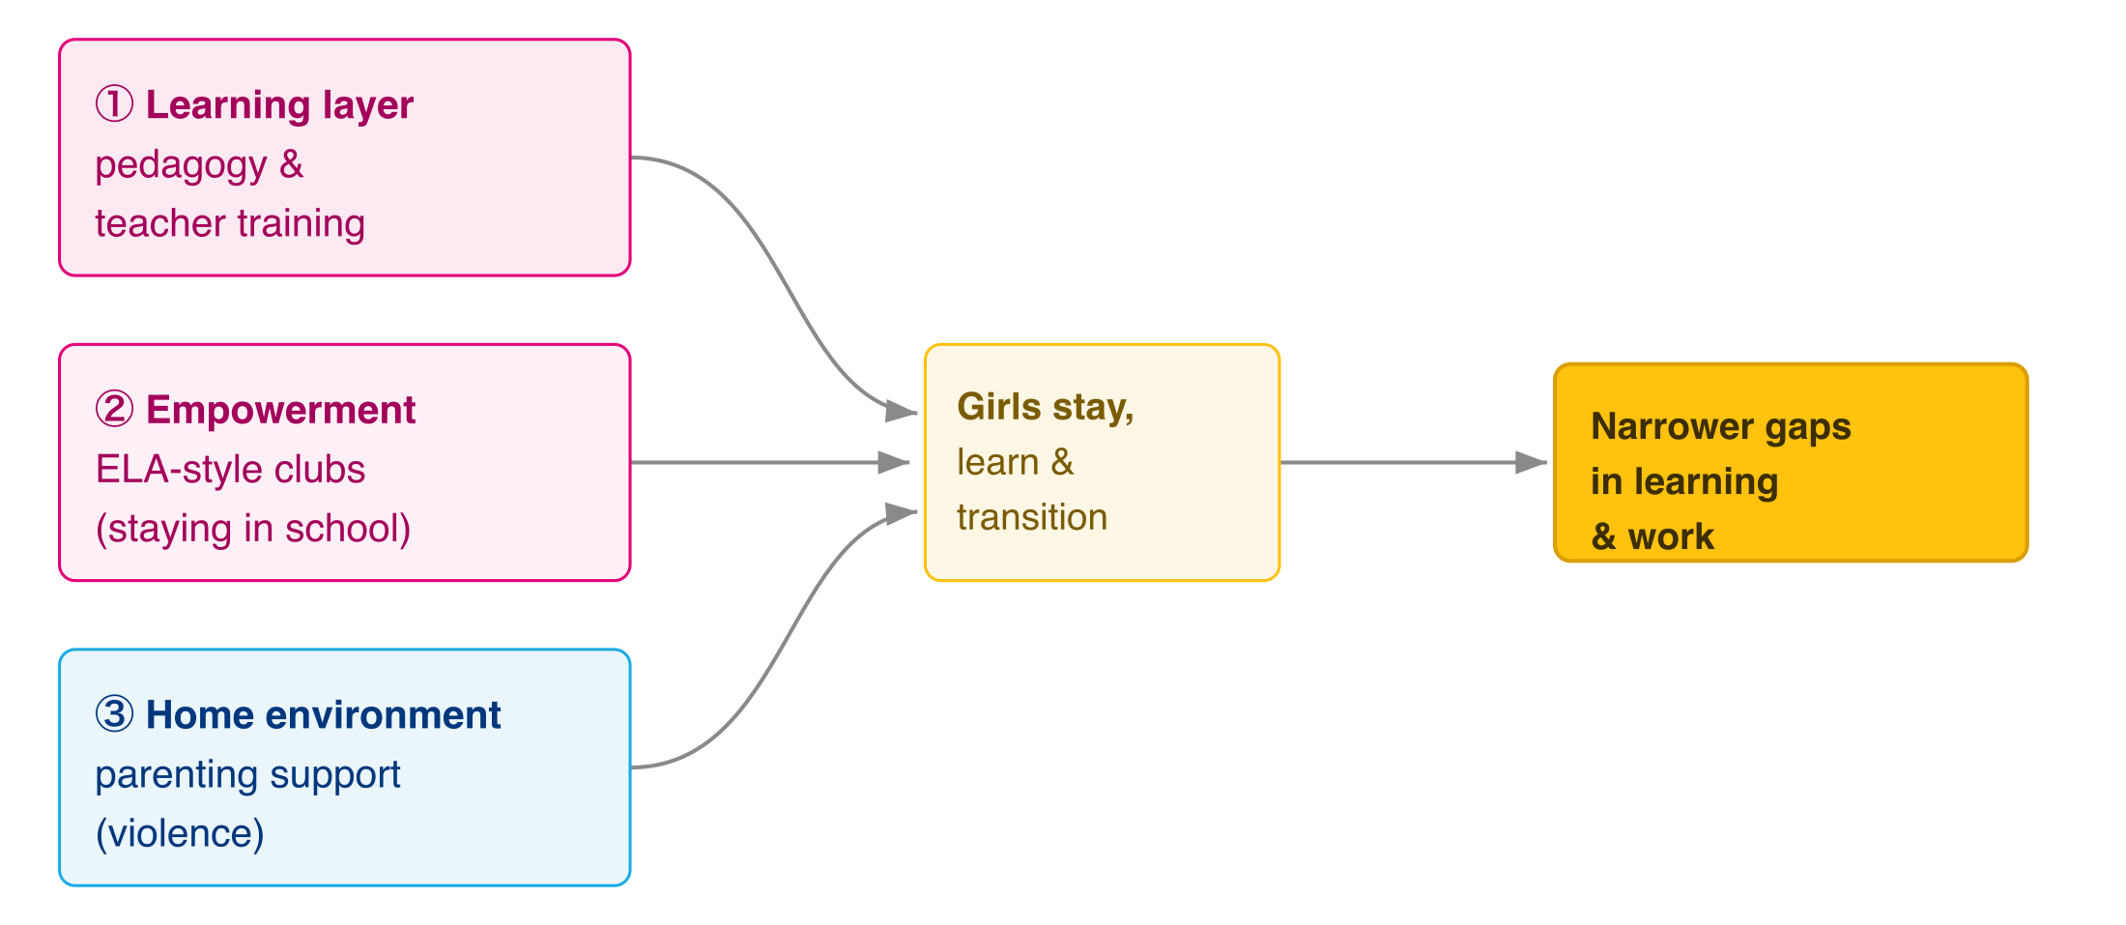
Bolivia: Evidence-Matched Theory of Change — BCR ≈ 4–6

