Slide 1
A Sustainable and Flexible Pipeline for Industrial Object Detection via Active Learning and AAS-Integrated synthetic data generation Hyperparameters
Leveraging Synthetic Data Generated Relying on AAS Metadata for Domain Randomization
Hooman Tavakoli
DFKI
October 8, 2025

Slide 2
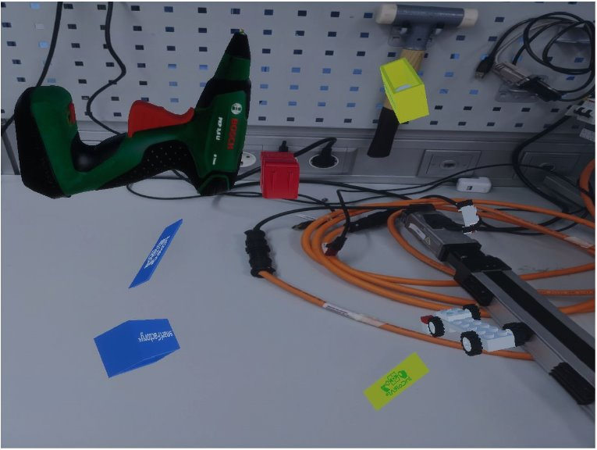
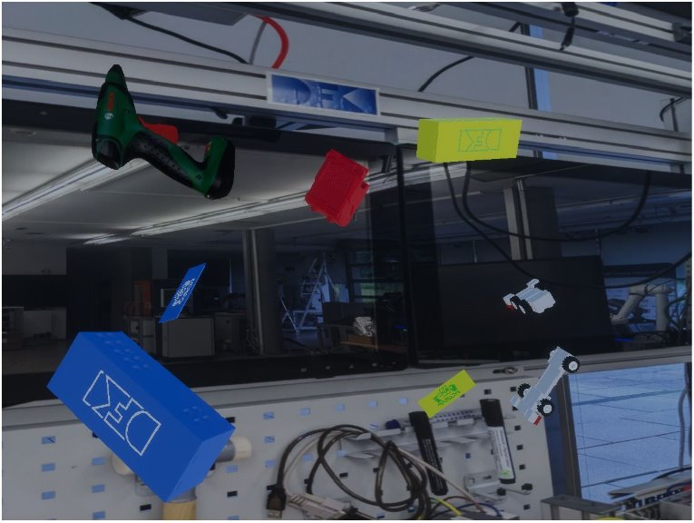
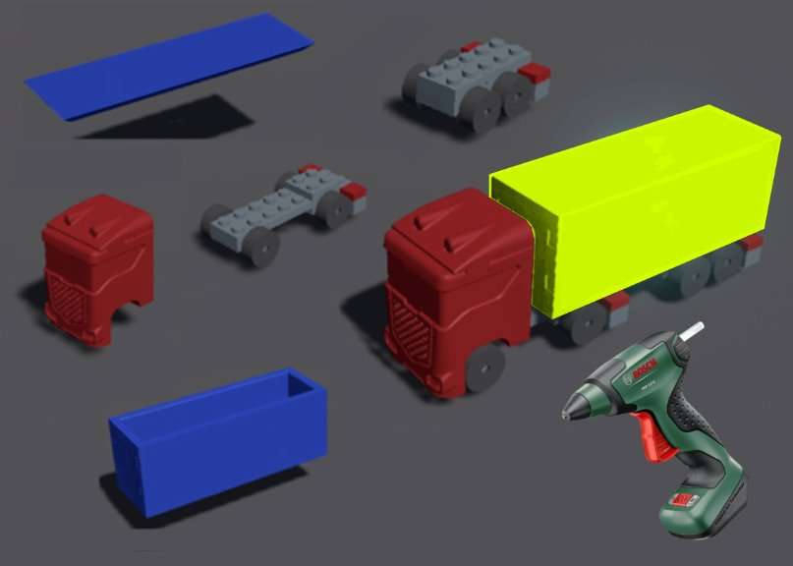
Motivation / Background
Object Detection (OD) is crucial for AR/VR, robotics, and industrial automation.
Large, labeled datasets are costly and energy-intensive.
Training large OD architectures is unsustainable.
Synthetic data offers a sustainable, controllable solution.

Slide 3
Challenges: Real Dataset Acquisition
Labeling is time-consuming and costly.
Scenario diversity is limited in real-world datasets.
Bias across classes can distort model generalization.
Requires expert domain knowledge for accurate annotation.

Slide 4
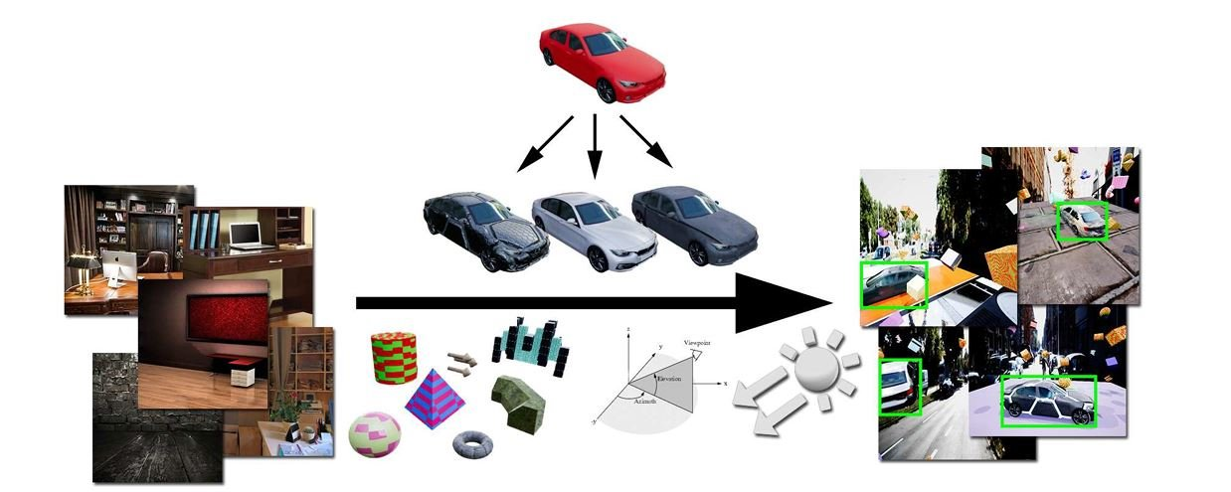
Challenges: Synthetic Datasets
Domain gap between synthetic and real data.
Requires optimization of visual parameters (Lighting, Texture, Occlusion, Background).
High precision in CAD design is needed for realism. (Texture, Color, Material,..)
Goal: close the gap while reducing manual effort.

Slide 5
Research Questions
1. Which synthetic data parameters matter most for domain-specific tasks?
4. How to model the hyperparameters in the specific domain for dynamic environment?
2. How to optimize OD models trained on synthetic data with limited real data?
3. How to make OD models adaptable to reconfigurable industrial domains?

Slide 6
Objectives
Automated updates through structured industrial metadata (AAS).
Adaptive optimization of OD using synthetic data.
Two-phase training: synthetic pretraining + real fine-tuning.
Energy/cost-efficient OD via Active Learning (AL) & Continual Learning (CL) for dynamic use cases.

Slide 7
Novelty / Contributions
Use of structured industrial data (AAS) for synthetic dataset generation.
  Model the SDG hyperparameters.(Light complexity, texture, domain specific parameters like distance and camera positions.)
  Versioning of the OD for specific domain.
Integration of AL and CL for adaptive, elastic OD frameworks.
Updating the OD model for dynamic domain and Production planning.

Slide 8
Methodology Overview
Model the hyperparameters relevant for domain specific use cases.
Combine structured metadata with virtual environments for dataset generation.
Employ AL to select informative real samples for fine-tuning.
Integrate CL for continuous model updates and adaptation.

Slide 9
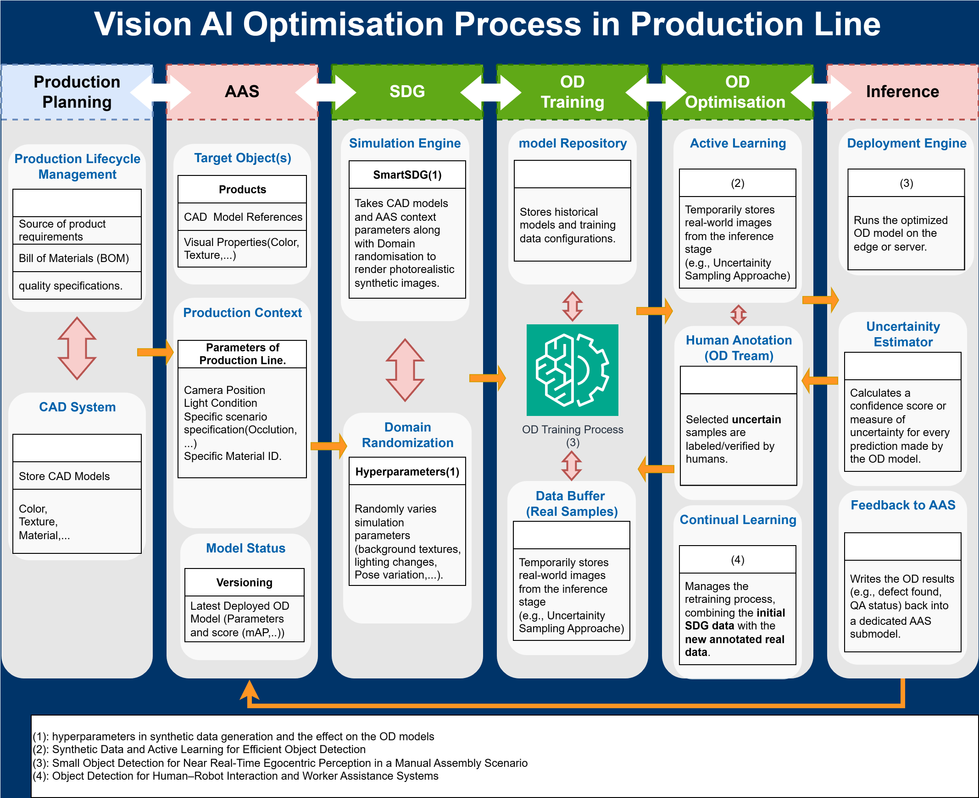

Slide 10
Use Case: SmartFactory
OD in one of the islands, or specific scenario.
  Hand Arbeit Platz.
  CA Module.
  T4T use case.

Slide 11
Expected Outcomes
Automated synthetic dataset generation with AAS integration.
Domain randomization driven by structured metadata.
Sustainable and standardized OD workflows.
Low CO₂ emissions and reduced human labeling effort through AL and CL.

Slide 12
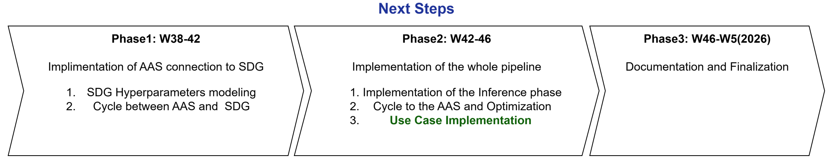
Timeline

