Slide 1



API Automated Testing with RestSharp (NUnit)
NASHTECH
Truong Nguyen
Confidential.

Slide 2

Agenda
What is API Testing
Why we do API tests
API Testing with RestSharp
Steps for building an automation API testing framework
Exercises
Confidential.

Slide 3
What is API Testing?

Slide 4
What is an API?
API stands for “Application Programming Interface.”
API is an interface to an application designed for other computer systems to use.
APIs can be used on web-based systems, operating systems, database systems and computer hardware.

Slide 5
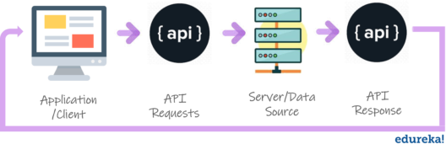
What Is API & API Testing
API enables communication and data exchange between two separate software system.
The purpose of API Testing is to check the functionality, reliability, performance, and security of the programming interfaces.
Confidential.

Slide 6
What is API Testing?
It is a type of software testing that involves testing APIs directly.
It is to check whether the API meets expectations in terms of functionality, reliability, performance, and security of an application
In API Testing our main focus will be on a Business logic layer of the software architecture

Slide 7
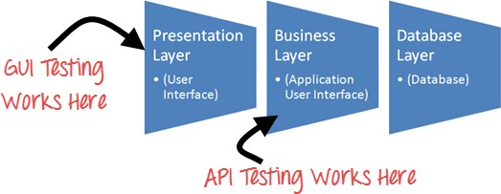
API Testing
Confidential.

Slide 8
2. Why we do API tests?

Slide 9
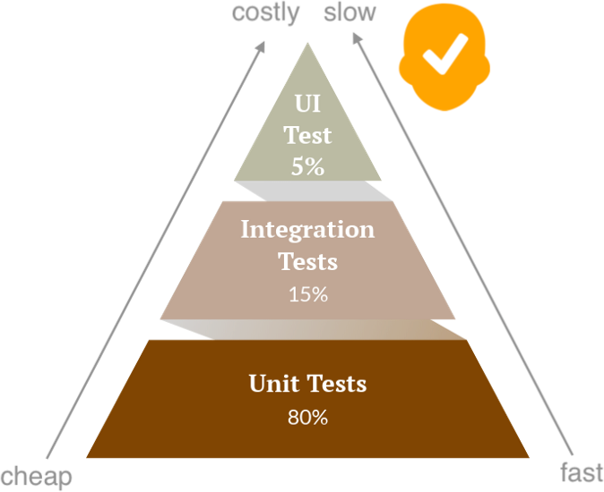
Why We Do API Tests
Identifies bugs before it goes to UI
Effective testing at a lower level over high-level
Reduces future efforts to fix defects
Time-saving
Confidential.

Slide 10
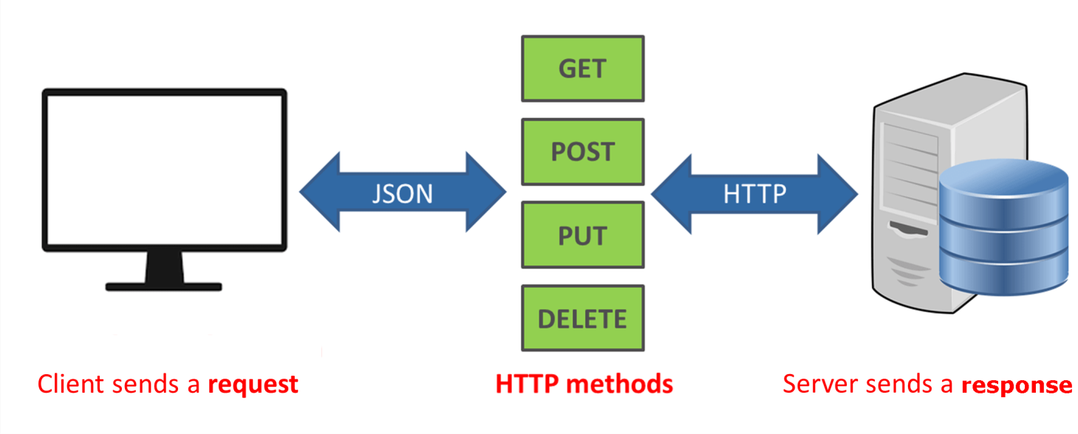
What is REST API
REST is acronym for REpresentational State Transfer
It referred to as RESTful API or RESTful web service
It is an application program interface (API) that uses HTTP requests to GET, PUT, POST and DELETE data.

Slide 11
HTTP Basic Concepts
HTTP stands for Hypertext Transfer Protocol
HTTP Request is a packet of information that one computer sends to another computer to communicate something

Slide 12
HTTP Basic Concepts
HTTP Request Structure
HTTP Verbs : GET, POST, PUT, DELETE …
A set of HTTP Headers
type of Browser
type of content
what type of response is accepted in return
A body or payload
POST and PUT can have payloads, GET and DELETE can not.

Slide 13
HTTP Basic Concepts
HTTP Response is the packet of information sent by Server to the Client in response to an earlier Request made by Client

Slide 14
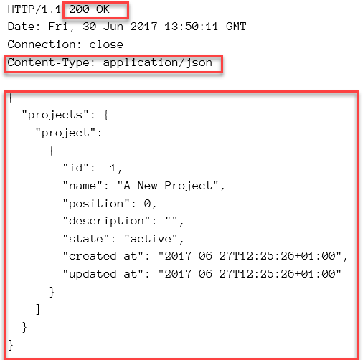
HTTP Basic Concepts
Example of HTTP Response

Slide 15
HTTP Basic Concepts
HTTP Status Codes
1xx - Informational
2xx - Success e.g. 200 Success
3xx - Redirection e.g. 302 Temporary Redirect
4xx - Client Error e.g. 400 Bad Request, 404 Not Found
5xx - Server Error e.g. 500 Internal Server Error
Payloads: JSON or XML

Slide 16
HTTP Basic Concepts
Public Request (no auth)
Authentication
Basic Authentication Headers
Bearer Authentication Headers
Custom Headers
Session Cookies

Slide 17
3. API test with RestSharp

Slide 18
Dotnet basic command
Show list supported templates
dotnet new list
Create a project by template
dotnet new nunit --name "TestDemo" --framework net8.0
dotnet new classlib --name "Test.Core" --framework net8.0
Add a project reference
dotnet add Testing/Testing.csproj reference Core/Core.csproj
Run test
dotnet test
Confidential.

Slide 19
API test with RestSharp (NUnit)
The main purpose of RestSharp is to make synchronous and asynchronous calls to remote resources over HTTP. As the name suggests, the main audience of RestSharp are developers who use REST APIs.
Before you can use RestSharp in your application, you need to add the NuGet package. You can do it using your IDE or the command line:
dotnet add package RestSharp
Link: https://restsharp.dev/docs/intro/
Confidential.

Slide 20
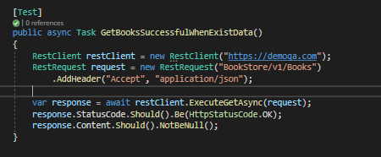
API test case example in RestSharp (NUnit)
Confidential.

Slide 21
Assertions
Assertions are statements you create that check one aspect of the HTTP response. You can create multiple assertions for one check that assert various aspects of a response, for example:
HTTP response status equals 200.
HTTP response body equals the text “success”.
HTTP response time is lower than 2000 milliseconds.
HTTP response header “X-Custom-Header” equals “SomeValue”.
HTTP response JSON object has a key called “projectName” with a
value “Project”
Confidential.

Slide 22
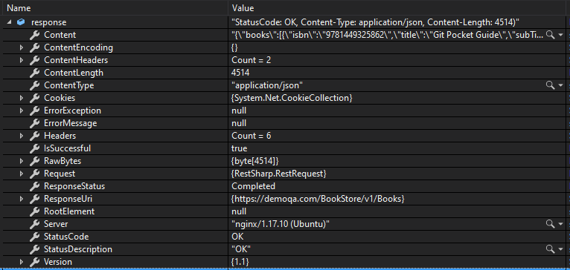
The response
After all RestSharp yields the response as an object literal containing properties such as status, body, headers, duration.
Confidential.

Slide 23
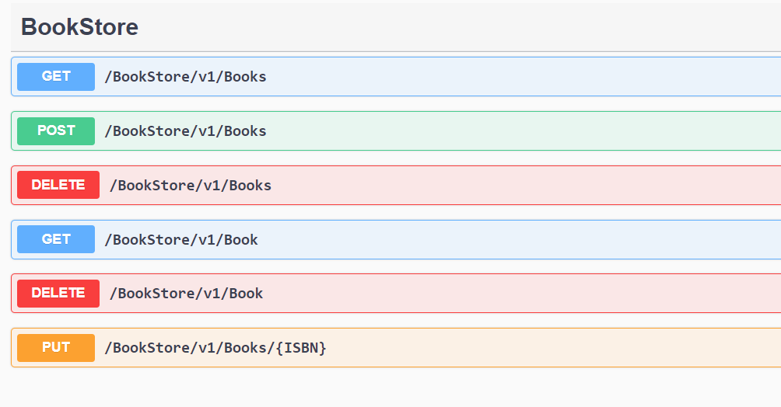

Methods
Method: tells the server what kind of action the client wants the server to take in. Some most commonly seen in API’s are:
GET - Asks the server to retrieve a resource.
POST - Asks the server to create a new resource.
PUT - Asks the server to edit/update an
existing resource.
DELETE - Asks resource.
the server to delete a
PATCH - Asks the server to update partial modifications an existing resource.
Confidential.

Slide 24
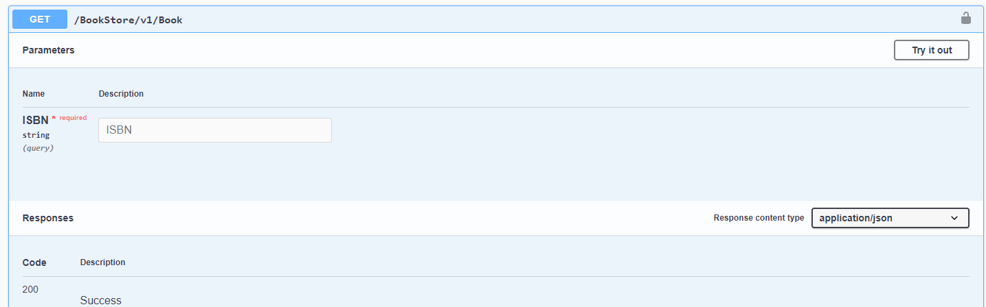
GET Method With Query String
{{demoqa}}/BookStore/v1/Book?ISBN=9781593275846
Confidential.

Slide 25
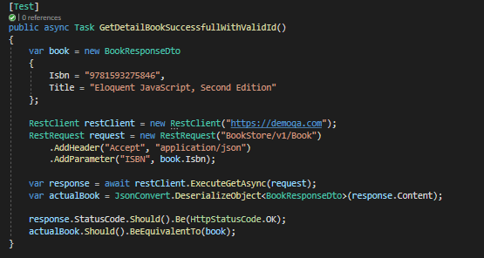
GET Method
Confidential.

Slide 26
Demo
Scenario 1
Use the GET method in 'https://serverest.dev/usuarios’ to retrieve all users data.
Validate status code.
Validate the content of the response body.
Confidential.

Slide 27
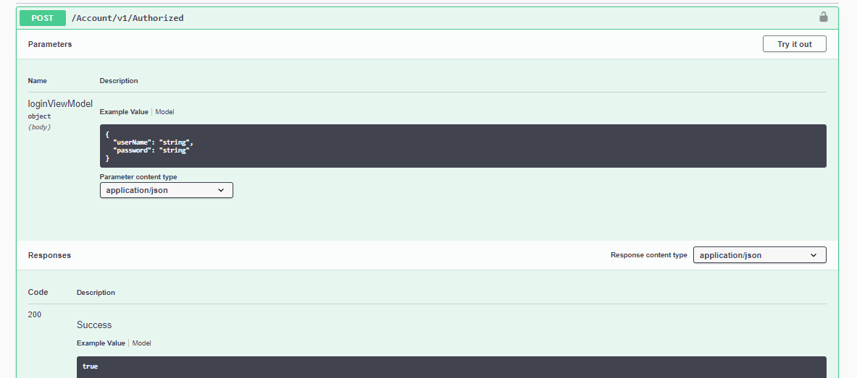
POST: Basic Authorization (API document)
https://demoqa.com/swagger/#/Account/AccountV1AuthorizedPost
Confidential.

Slide 28
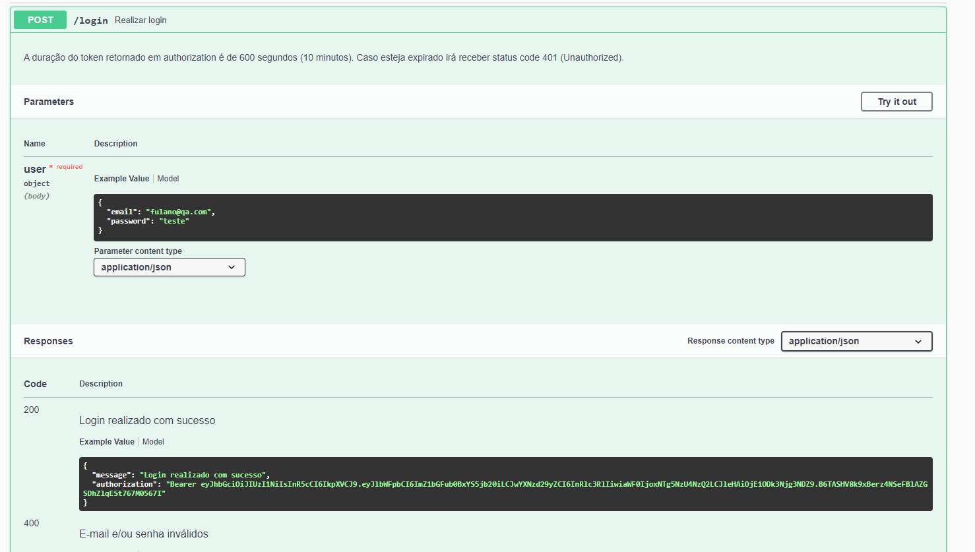
POST: Generate Token (API document)
https://serverest.dev/#/Login/post_login
Confidential.

Slide 29
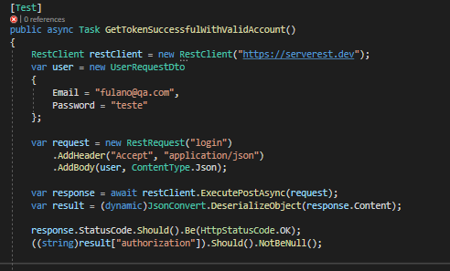
POST: Generate Token (Rest Sharp)
Confidential.

Slide 30
Json Schema
JSON Schema is a vocabulary that allows you to annotate and validate JSON documents.
Benefits
Describes your existing data format(s).
Provides clear human- and machine- readable
documentation.
Validates data which is useful for:
Automated testing.
Ensuring quality of client submitted data.
Confidential.

Slide 31
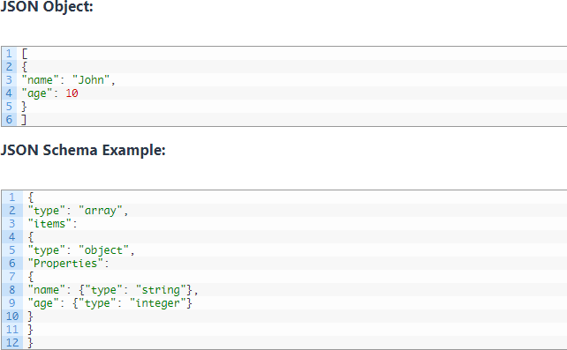
Example
Confidential.

Slide 32
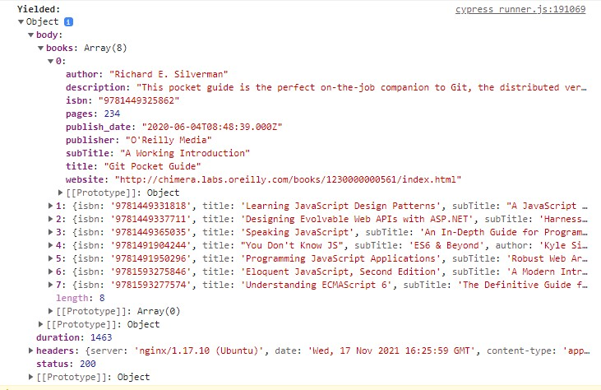
API Response Example
A body of the API response example
Confidential.

Slide 33
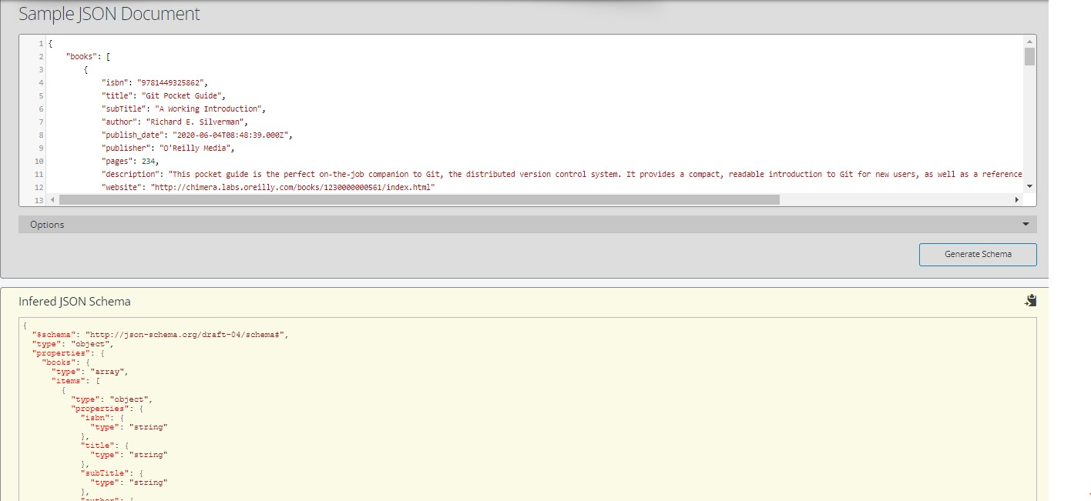
Create JSON Schema from API response
Open online tool: https://www.liquid-technologies.com/online-json-to-schema-converter
Copy json object from response and paste to the online tool to convert.
Confidential.

Slide 34
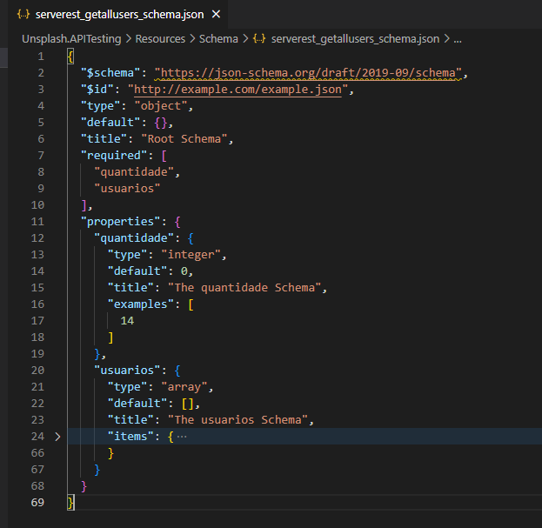
JSON Schema file
https://serverest.dev/#/Usu%C3%A1rios/get_usuarios
Confidential.

Slide 35
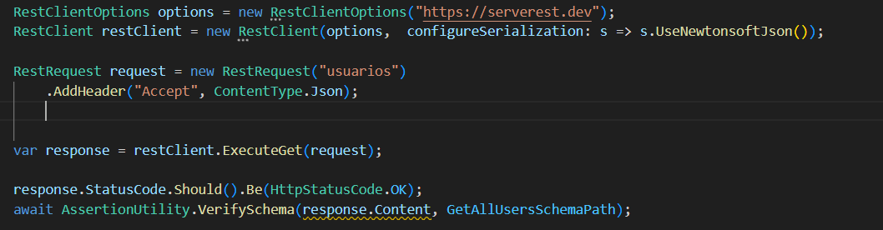
Validate Schema (Rest Sharp)
Confidential.

Slide 36
Demo
Scenario 2
Use the POST method in ’https://gorest.co.in/public- api/users’ to create a new user.
Validate status code.
Validate the content of the response body.
Run and generate report
Confidential.

Slide 37

Exercise
1. API Testing for https://demoqa.com/Account/v1/GenerateToken
2. Get token (print)
3. Verify the token is not null
Confidential.

Slide 38
Framework Architecture
Build Framework Core Component
Build Framework Test Component
4. Steps for building an automation framework
Notes:
38

Slide 39
Framework Architecture
Notes:
39

Slide 40
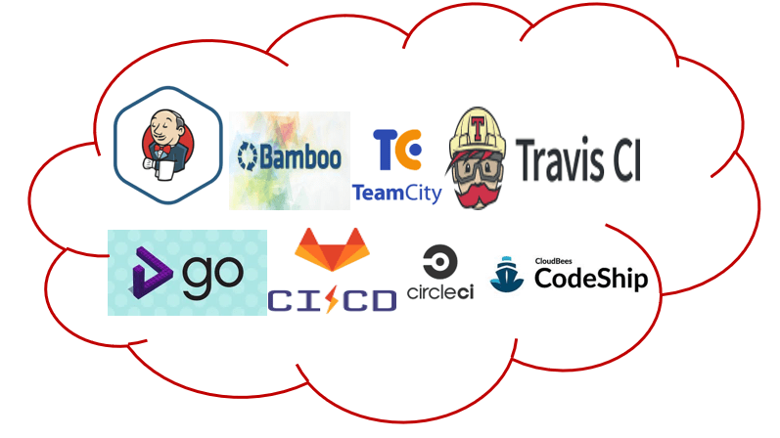
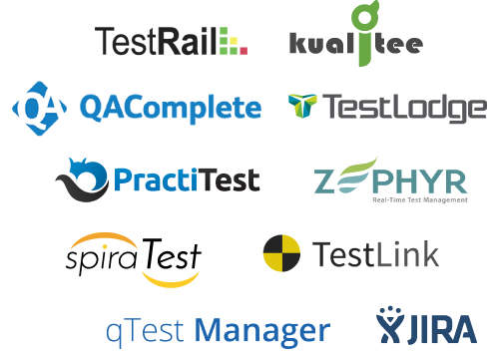





Framework Architecture
Choose Toolset:
Test Runner
Automation Tool
Build Tool
Report Tool
Framework
Extent Report
Notes:
40

Slide 41

Framework Architecture
Framework
Core
Log
Integration
Utilities
Driver
API
Element
Report
Extent Report
Test
Page
Test case
NUnit
Data
Helper
Notes:
41

Slide 42
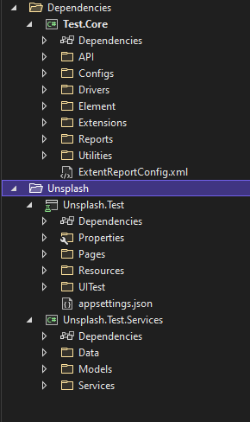
Framework Architecture
Core
Test
Notes:
42

Slide 43
Driver (Skip)
Element (Skip)
API
Report
Build framework core component
Notes:
43

Slide 44
API
API
Uri
Method
Header
Parameter
addParam()
addHeader()
sendRequest()
…
Notes:
44

Slide 45
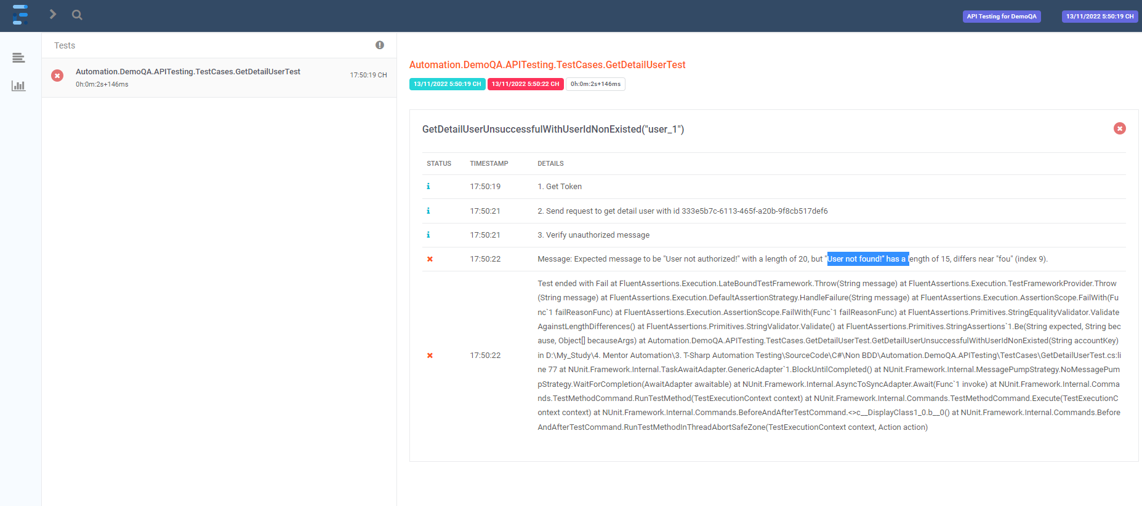
Report
https://www.ecanarys.com/Blogs/ArticleID/305/Extent-Reports-in-Selenium-CSharp-C
Notes:
45

Slide 46
Test
Page (skip)
API Services
Build test component
Notes:
46

Slide 47

Test
1. Create TestBase Class
2. Create test classes to contain test case
Add all test case related to a component to a class
Create sub package if necessary
Set priority/group for test case
Notes:
47

Slide 48
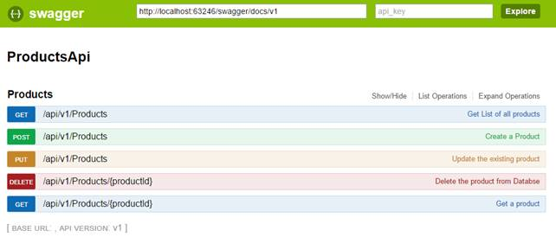
API Services
Create API class based on component
Notes:
48

Slide 49

Notes:
49

Slide 50
References
Request:
https://restsharp.dev/intro.html#getting-started
Reporter: https://www.extentreports.com/docs/versions/4/net/index.html
JSON Schema:
https://www.jsonschema.net/app/schemas/0
http://json-schema.org/understanding-json-schema/
Postman:
https://learning.postman.com/docs/getting-started/introduction/
Fluent Assertion:
https://methodpoet.com/fluent-assertions/
Json Object:
https://json2csharp.com/
Nuget:
https://www.nuget.org/packages/RestSharp
Confidential.

Slide 51
Thank you
Notes:
This is confidential
51

