Slide 1



API Automated Testing with RestSharp (NUnit)
NASHTECH
Truong Nguyen
Confidential.

Slide 2

Agenda
What is API Testing (skip)
Why we do API tests? (skip)
What is REST API? (skip)
What do you need to test an API?
API Testing with RestSharp
Demo & Exercises
How to build an automation API testing framework
Confidential.

Slide 3
What is API Testing?

Slide 4
What is an API?
API stands for “Application Programming Interface.”
API is an interface to an application designed for other computer systems to use.
APIs can be used on web-based systems, operating systems, database systems and computer hardware.

Slide 5
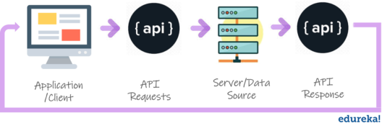
What Is API & API Testing
API enables communication and data exchange between two separate software system.
The purpose of API Testing is to check the functionality, reliability, performance, and security of the programming interfaces.
Confidential.

Slide 6
What is API Testing?
It is a type of software testing that involves testing APIs directly.
It is to check whether the API meets expectations in terms of functionality, reliability, performance, and security of an application
In API Testing our main focus will be on a Business logic layer of the software architecture

Slide 7
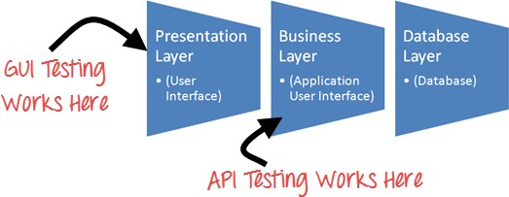
API Testing
Confidential.

Slide 8
2. Why we do API tests?

Slide 9
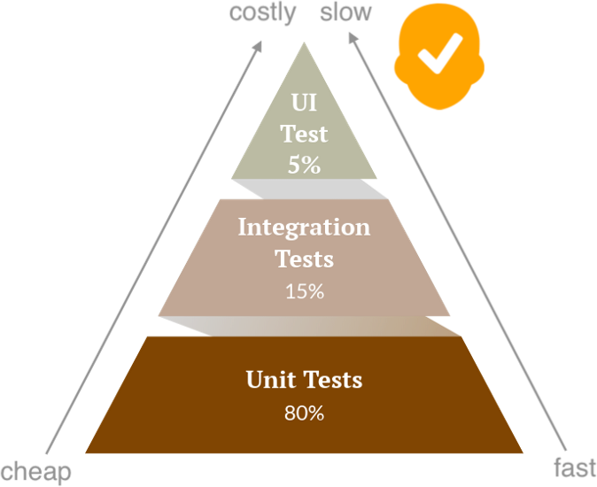
Why We Do API Tests
Identifies bugs before it goes to UI
Effective testing at a lower level over high-level
Reduces future efforts to fix defects
Time-saving
Confidential.

Slide 10
3. What is REST API

Slide 11
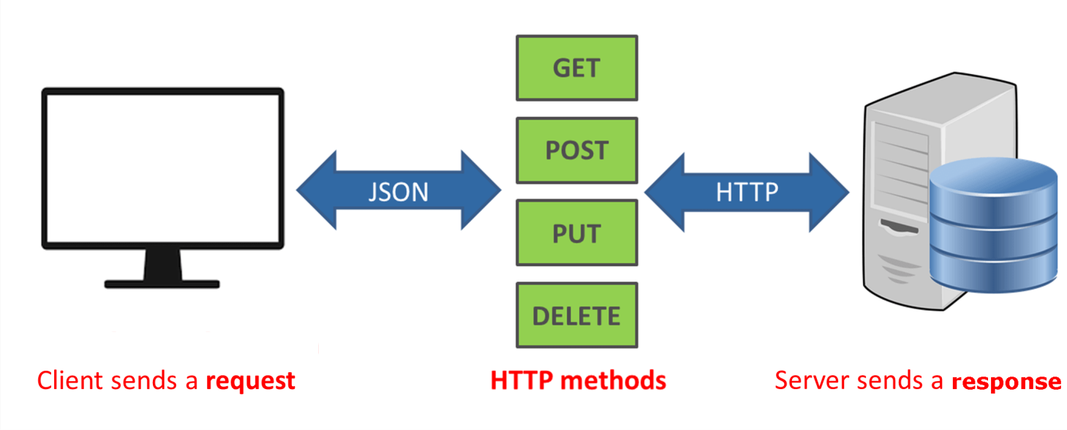
What is REST API
REST is acronym for REpresentational State Transfer
It is an architectural style for building web services. It referred to as RESTful API or RESTful web service
It is an application program interface (API) that uses HTTP requests to GET, PUT, POST and DELETE data.

Slide 12
HTTP Basic Concepts
HTTP stands for Hypertext Transfer Protocol
HTTP Request is a packet of information that one computer sends to another computer to communicate something

Slide 13
HTTP Basic Concepts
HTTP Request Structure
HTTP Verbs : GET, POST, PUT, DELETE …
A set of HTTP Headers
type of Browser
type of content
what type of response is accepted in return
A body or payload
POST and PUT can have payloads, GET and DELETE can not.

Slide 14
HTTP Basic Concepts
Public Request (no auth)
Authentication
Basic Authentication Headers
Bearer Authentication Headers
Custom Headers (API Key)
Session Cookies

Slide 15
HTTP Basic Concepts
HTTP Response is the packet of information sent by Server to the Client in response to an earlier Request made by Client

Slide 16
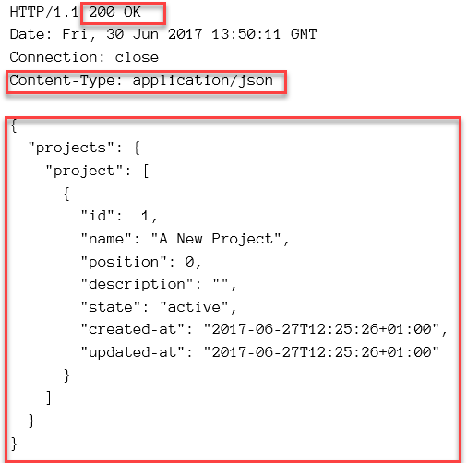
HTTP Basic Concepts
Example of HTTP Response

Slide 17
HTTP Basic Concepts
HTTP Status Codes
1xx - Informational
2xx - Success e.g. 200 Success
3xx - Redirection e.g. 302 Temporary Redirect
4xx - Client Error e.g. 400 Bad Request, 404 Not Found
5xx - Server Error e.g. 500 Internal Server Error
Payloads: JSON or XML

Slide 18
3. What do you need to test an API?

Slide 19
Understand the API Specification
What does the API do? (Purpose, function)
Request method: GET, POST, PUT, DELETE, etc.
URL pattern and required parameters
Request/response format (JSON, XML)
Status codes expected
Authentication method (API key, Bearer Token, etc.)

Slide 20
Prepare API Testing Tools
Tool | Purpose
Postman | Manual API testing
Curl | Command-line testing
RestSharp | Automated API testing in C#
Swagger UI | Explore API docs & test

Slide 21
Set up Test Data & Environment & Service
Aspect | Description
Test Data Preparation | Define required data for testing
Data Cleanup | Clean up test data after execution to avoid pollution
Base URL Configuration | Use correct API base URL per environment (Dev/QA/Staging)
Authentication Setup | Get access token or API key, session header,...
Service Dependencies | Ensure dependent services are ready or mock them, can monitor log.
Database | Use DB to verify results, set up test data, and clean up after test run

Slide 22
Define Test Scenarios
✅ Positive test cases (valid input, correct flow)
❌ Negative test cases (missing/invalid input, wrong auth)
🔁 Edge cases (empty list, nulls, limits)
🔐 Auth scenarios (valid/invalid/missing tokens)
⏱ Performance & timeout tests (optional)
HTTP Status Codes
1xx - Informational
2xx - Success e.g. 200 Success
3xx - Redirection e.g. 302 Temporary Redirect
4xx - Client Error e.g. 400 Bad Request, 404 Not Found
5xx - Server Error e.g. 500 Internal Server Error
Payloads: JSON or XML

Slide 23
Assertions
Assertions are statements you create that check one aspect of the HTTP response. You can create multiple assertions for one check that assert various aspects of a response, for example:
HTTP response status equals 200.
HTTP response body equals the text “success”.
HTTP response time is lower than 2000 milliseconds.
HTTP response header “X-Custom-Header” equals “SomeValue”.
HTTP response JSON schema validation
HTTP response JSON object has a key called “projectName” with a
value “Project”
Confidential.

Slide 24
Json Schema
JSON Schema is a contract that defines the structure, data types, and required fields of a JSON object..
Benefits
Describes your existing data format(s).
Provides clear human- and machine- readable
documentation.
Validates data which is useful for:
Automated testing.
Ensuring quality of client submitted data.
Confidential.

Slide 25
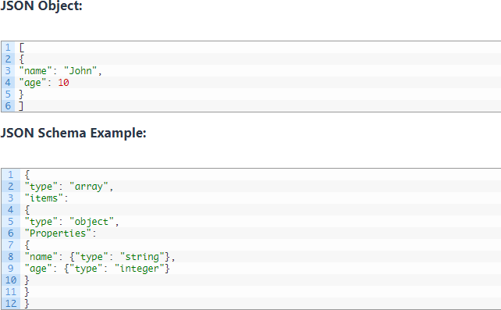
Example
Confidential.

Slide 26
4. API test with RestSharp

Slide 27
What is RestSharp?
The main purpose of RestSharp is to make synchronous and asynchronous calls to remote resources over HTTP. As the name suggests, the main audience of RestSharp are developers who use REST APIs.
It provides a simple and powerful API to interact with RESTful services.
Link: https://restsharp.dev/docs/intro/
Confidential.

Slide 28
Why use RestSharp for API Testing
Easy to use: RestSharp provides a simple and readable syntax to make HTTP requests.
Great integration with NUnit: Easily integrates with NUnit for running automated tests.
Supports HTTP Methods: GET, POST, PUT, DELETE, PATCH, etc.
Handles Responses: Parse response data (JSON, XML, etc.) from the API.
Handles Complex Requests: Supports adding parameters, headers, body content, etc., to requests.
Confidential.

Slide 29




Basic steps to send a request using RestSharp
1. Initialize the client: RestClient is used to make requests to the API.
2. Create the request: RestRequest defines the endpoint and HTTP method.
3. Send the request and get the response: client.Execute(request) sends the request and gets the response.
4. Validate the response: Validate the returned data.
Link: https://restsharp.dev/docs/category/using-restsharp
Confidential.

Slide 30
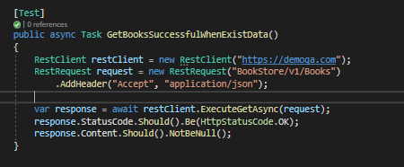
API test case example in RestSharp (NUnit)
Confidential.

Slide 31
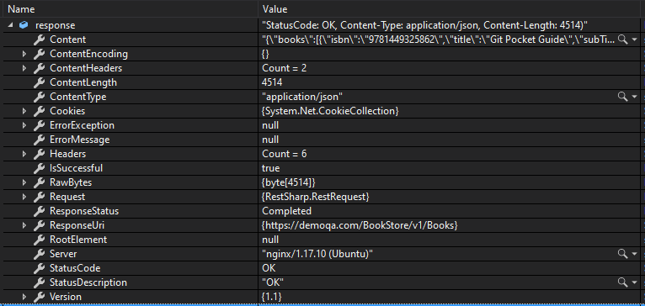
The response
After all RestSharp yields the response as an object literal containing properties such as status, body, headers, duration.
Confidential.

Slide 32
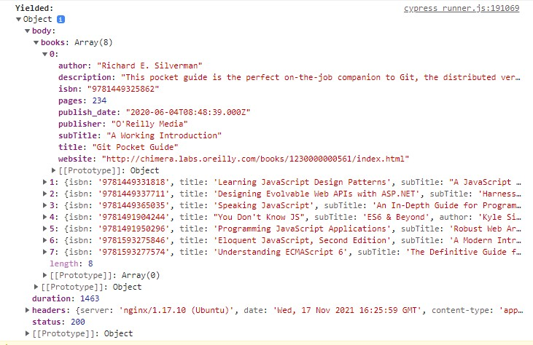
API Response Example
A body of the API response example
Confidential.

Slide 33
5. Demo & Exercises

Slide 34
How to create a test project
Show list supported templates
dotnet new list
Create a project by template
dotnet new nunit --name "TestDemo" --framework net8.0
dotnet new classlib --name "Test.Core" --framework net8.0
Add a project reference
dotnet add Testing/Testing.csproj reference Core/Core.csproj
Run test
dotnet test
Confidential.

Slide 35
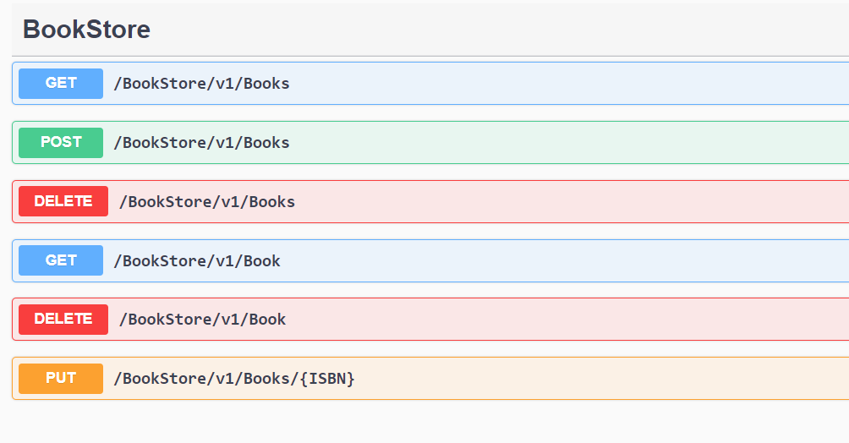

DEMOQA Swagger - BookStore
Method: tells the server what kind of action the client wants the server to take in. Some most commonly seen in API’s are:
GET - Asks the server to retrieve a resource.
POST - Asks the server to create a new resource.
PUT - Asks the server to edit/update an
existing resource.
DELETE - Asks resource.
the server to delete a
PATCH - Asks the server to update partial modifications an existing resource.
Confidential.

Slide 36
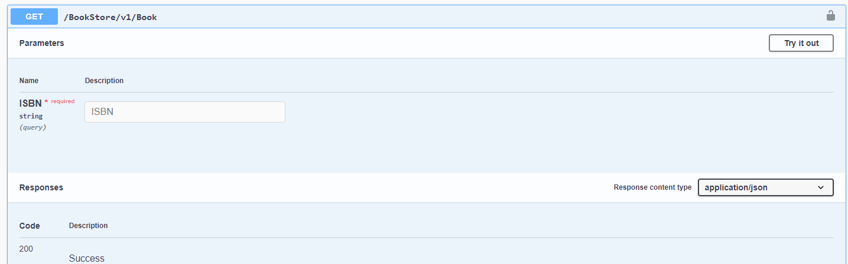
GET Method With Query String
{{demoqa}}/BookStore/v1/Book?ISBN=9781593275846
Confidential.

Slide 37
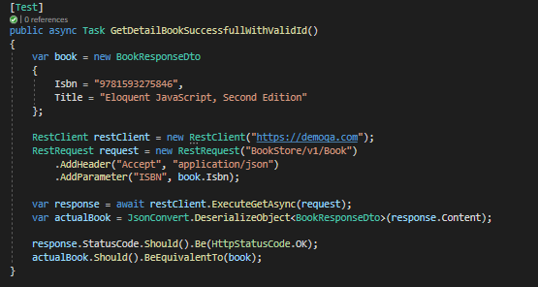
GET Method
Confidential.

Slide 38
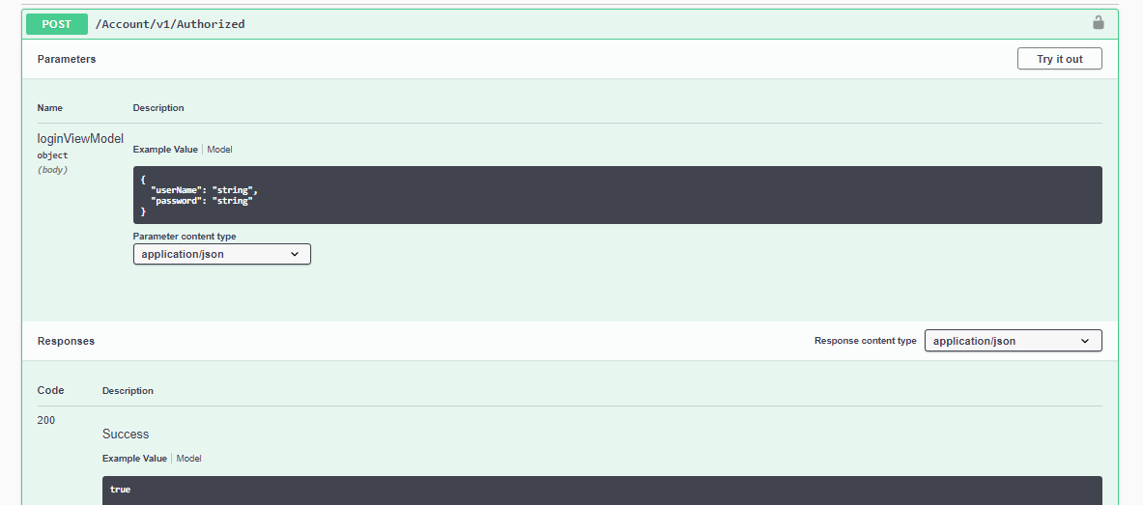
POST: Basic Authorization (API document)
https://demoqa.com/swagger/#/Account/AccountV1AuthorizedPost
Confidential.

Slide 39
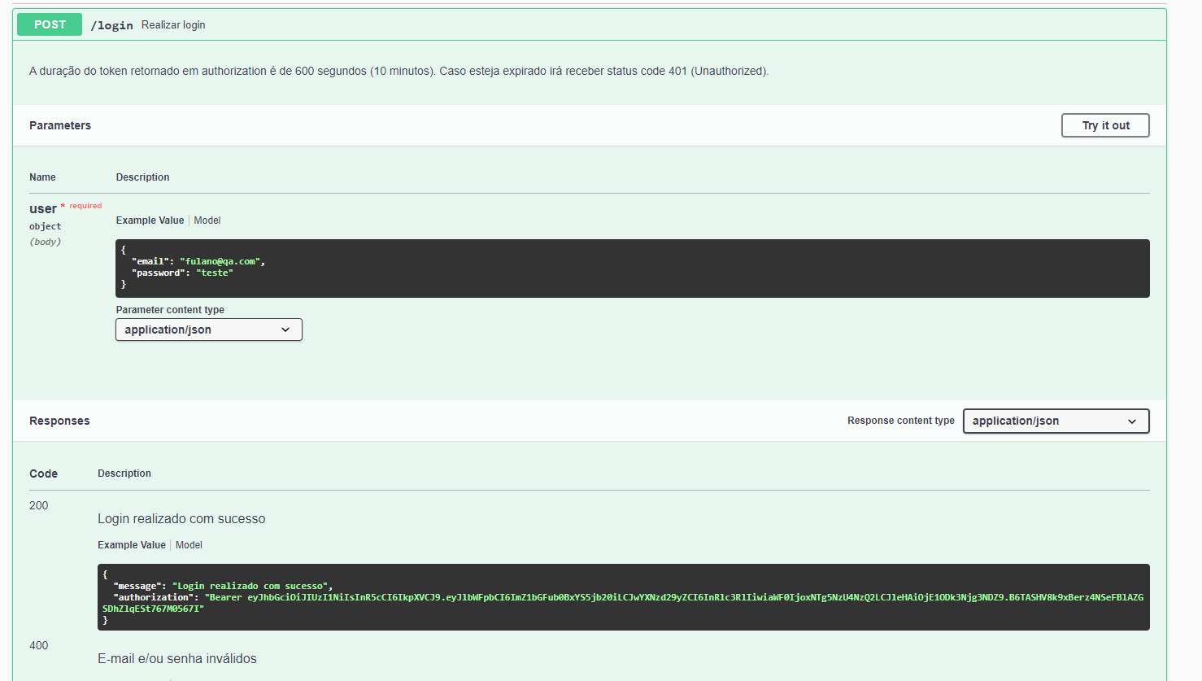
POST: Generate Token (API document)
https://serverest.dev/#/Login/post_login
Confidential.

Slide 40
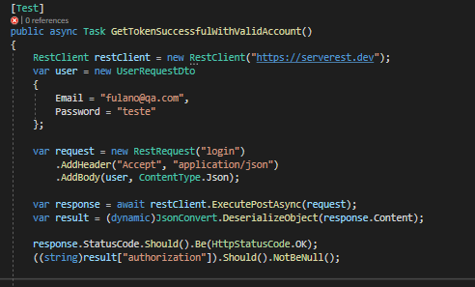
POST: Generate Token (Rest Sharp)
Confidential.

Slide 41
Demo validate schema of Json response
Scenario 1
Use the GET method in 'https://serverest.dev/usuarios’ to retrieve all users data.
Validate status code.
Validate the schema of the response body.
Confidential.

Slide 42
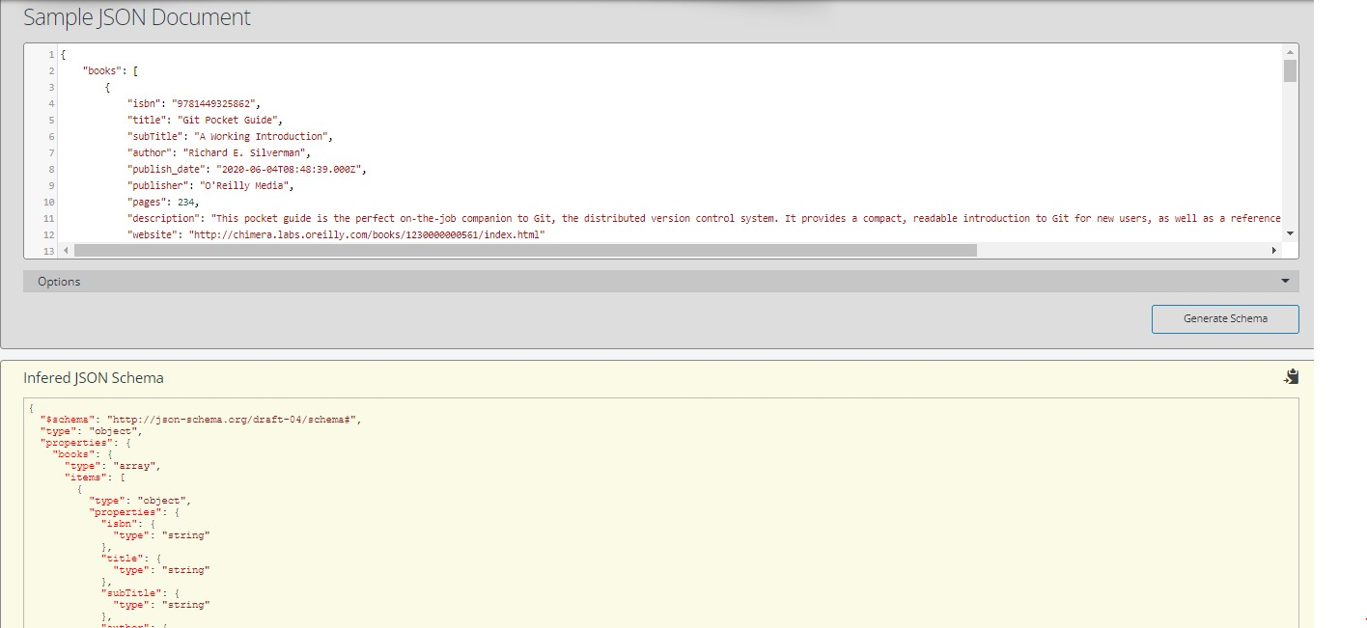
Create JSON Schema from API response
Open online tool: https://www.liquid-technologies.com/online-json-to-schema-converter
Copy json object from response and paste to the online tool to convert.
Confidential.

Slide 43
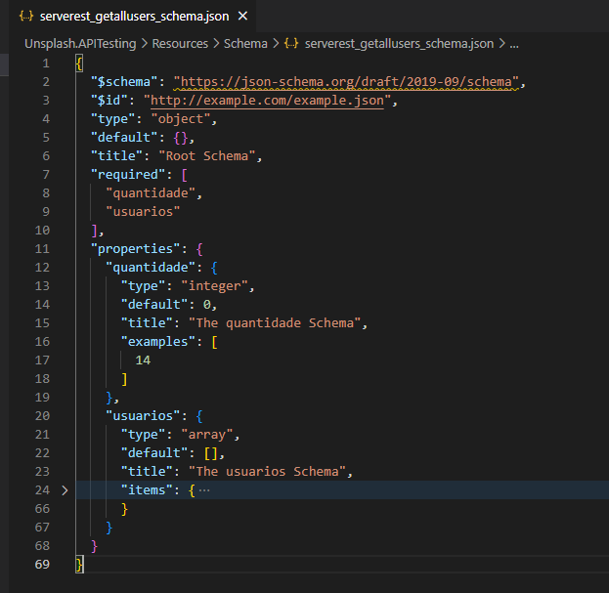
JSON Schema file
https://serverest.dev/#/Usu%C3%A1rios/get_usuarios
Confidential.

Slide 44
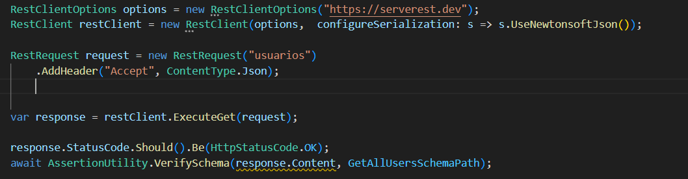
Validate Schema (Rest Sharp)
Confidential.

Slide 45
Demo
Scenario 2
Use the POST method in ’https://gorest.co.in/public- api/users’ to create a new user.
Validate status code.
Validate the content of the response body.
Run and generate report
Confidential.

Slide 46

Exercise
1. API Testing for https://demoqa.com/Account/v1/GenerateToken
2. Get token (print)
3. Verify the token is not null
Confidential.

Slide 47
Framework Architecture
Build Framework Core Component
Build Framework Test Component
4. Steps for building an automation framework
Notes:
‹#›

Slide 48
Framework Architecture
Notes:
‹#›

Slide 49
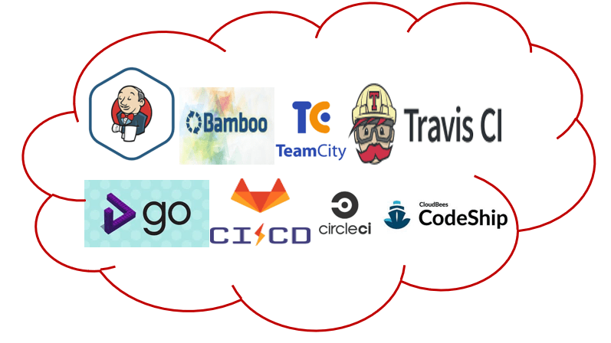
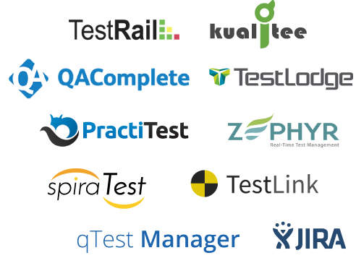





Framework Architecture
Choose Toolset:
Test Runner
Automation Tool
Build Tool
Report Tool
Framework
Extent Report
Notes:
‹#›

Slide 50

Framework Architecture
Framework
Core
Log
Integration
Utilities
Driver
API
Element
Report
Extent Report
Test
Page
Test case
NUnit
Data
Helper
Notes:
‹#›

Slide 51
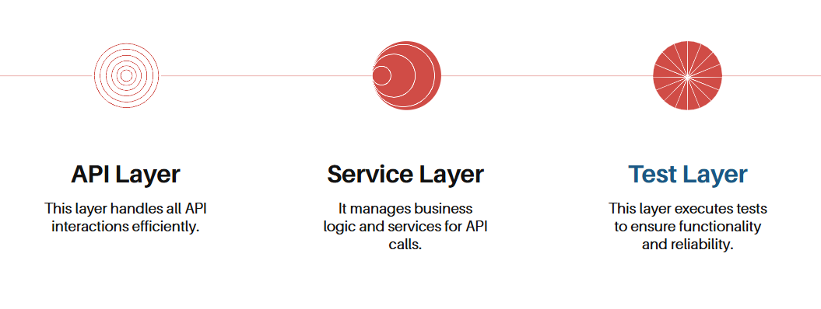
Framework Layer
Confidential.

Slide 52
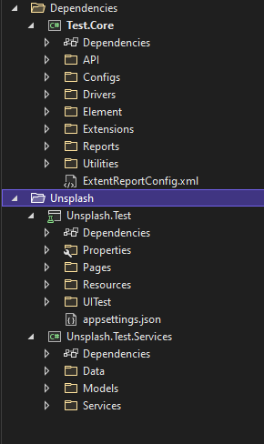
Framework Architecture
Core
Test
Notes:
‹#›

Slide 53
Driver (Skip)
Element (Skip)
API
Report(Skip)
Build framework core component
Notes:
‹#›

Slide 54
API
API
Uri
Method
Header
Parameter
addParam()
addHeader()
sendRequest()
…
Notes:
‹#›

Slide 55
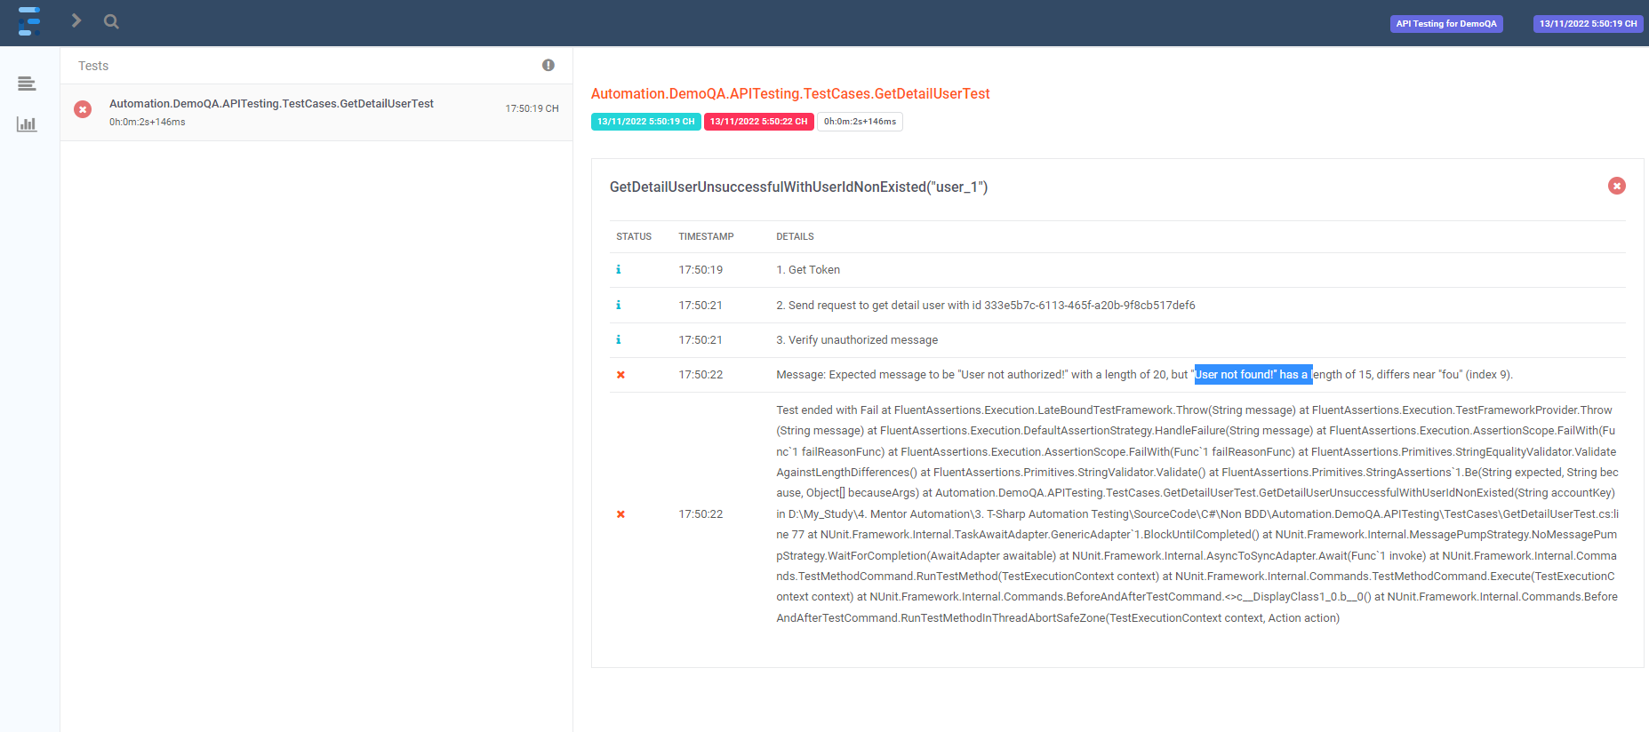
Report
https://www.ecanarys.com/Blogs/ArticleID/305/Extent-Reports-in-Selenium-CSharp-C
Notes:
‹#›

Slide 56
API Services
Test
Page (skip)
Build test component
Notes:
‹#›

Slide 57
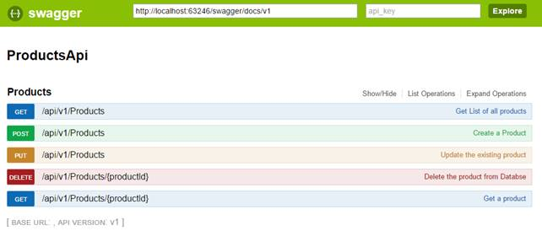
API Services
Create API class based on component
Notes:
‹#›

Slide 58
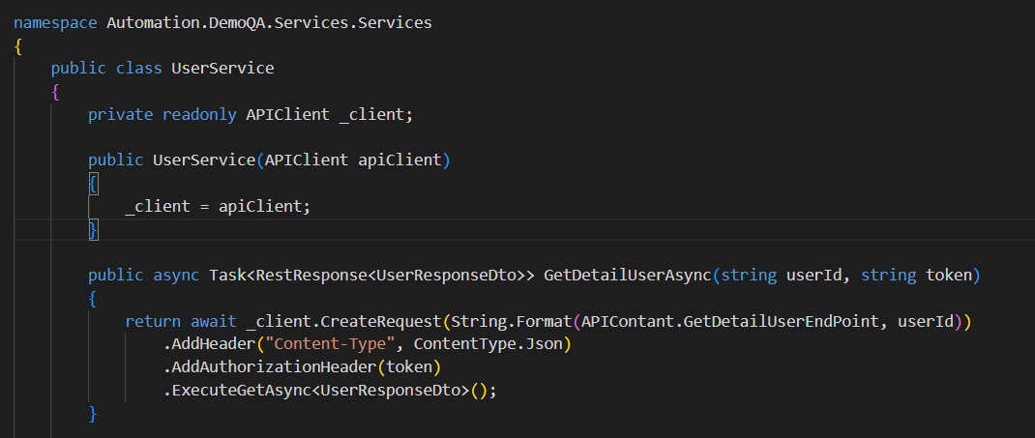
Example code for class service
Confidential.

Slide 59
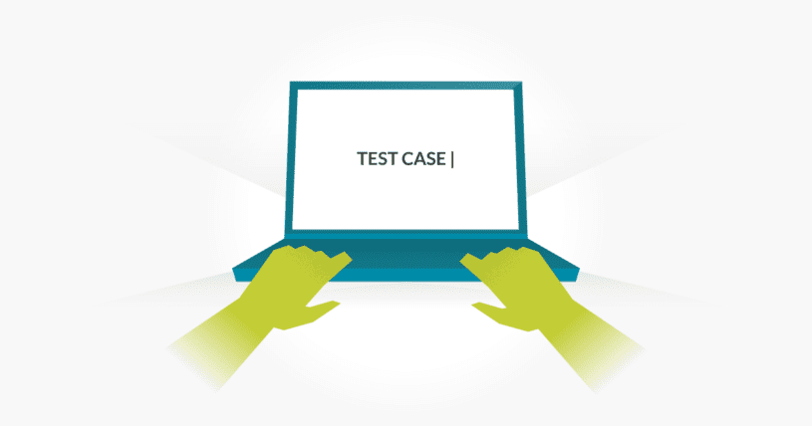
Test
1. Create BaseTest Class
2. Create test classes to contain test case
Add all test case related to a component to a class
Create sub package if necessary
Set priority/group for test case
Notes:
‹#›

Slide 60
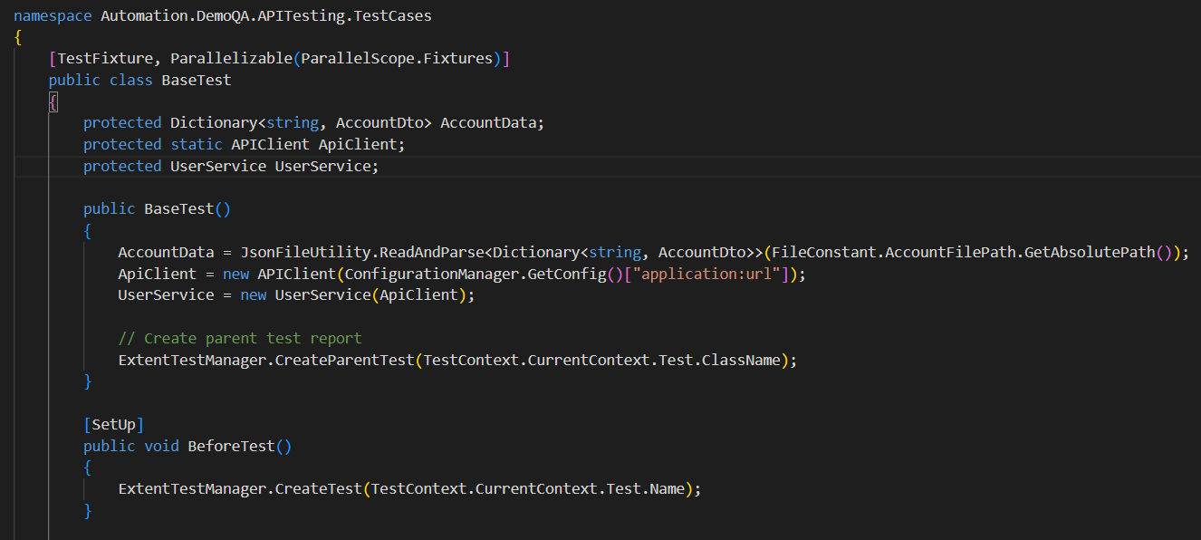
Example code for BastTest
Confidential.

Slide 61
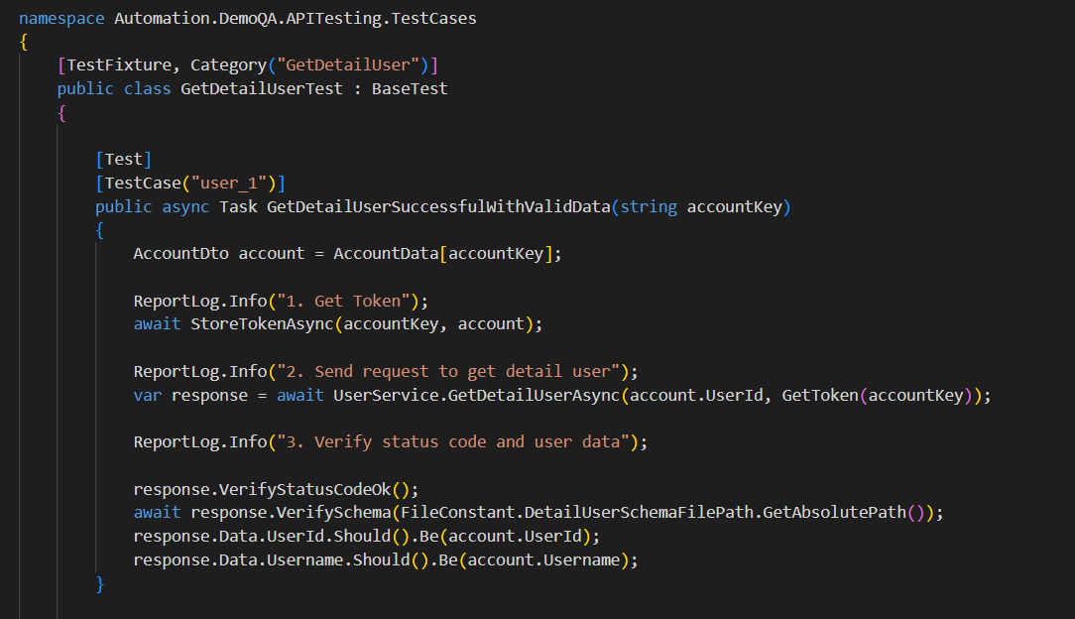
Example code for test class
Confidential.

Slide 62

Notes:
‹#›

Slide 63
References
Request:
https://restsharp.dev/intro.html#getting-started
Reporter: https://www.extentreports.com/docs/versions/4/net/index.html
JSON Schema:
https://www.jsonschema.net/app/schemas/0
http://json-schema.org/understanding-json-schema/
Postman:
https://learning.postman.com/docs/getting-started/introduction/
Fluent Assertion:
https://methodpoet.com/fluent-assertions/
Json Object:
https://json2csharp.com/
Nuget:
https://www.nuget.org/packages/RestSharp
Confidential.

Slide 64
Thank you
Notes:
This is confidential
‹#›

