Slide 1
World Value survey
China 2012
He Guo

Slide 2
What is world value survey?
Global social scientist research project
Some group of researchers from all over the world involved in this project.
Conducted in almost 100 countries which contain almost 90 percent of the world’s population
Wave 6 data consisted 2010-2014 wave

Slide 3
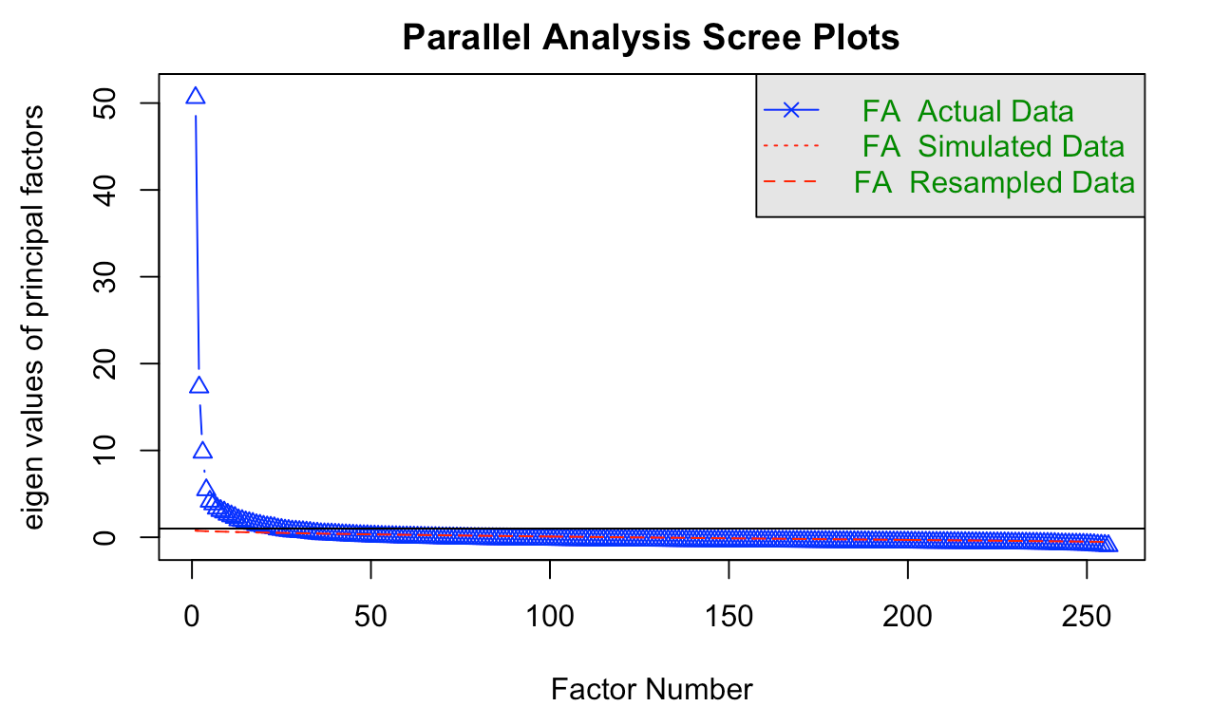
Factor Analysis
15 Factors
Social value
Gender attitude:
Family & Religion
Social tolerance and trust
Institutions attitude
Culture difference
Moral principle
National security and global governance
Demography
…

Slide 4
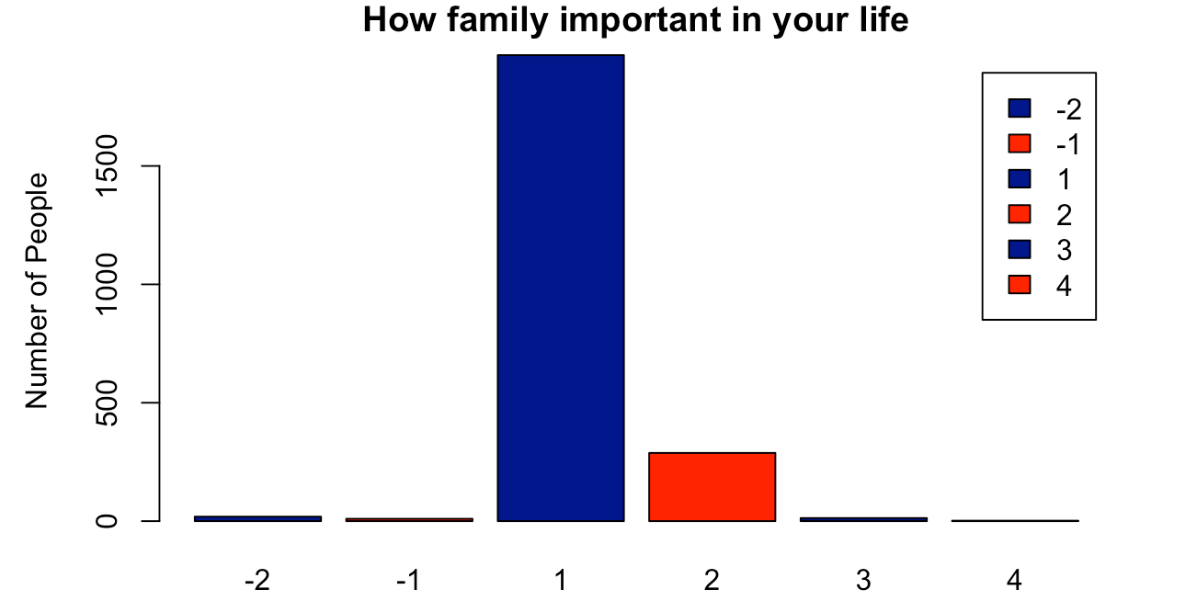
Importance of Family

Slide 5
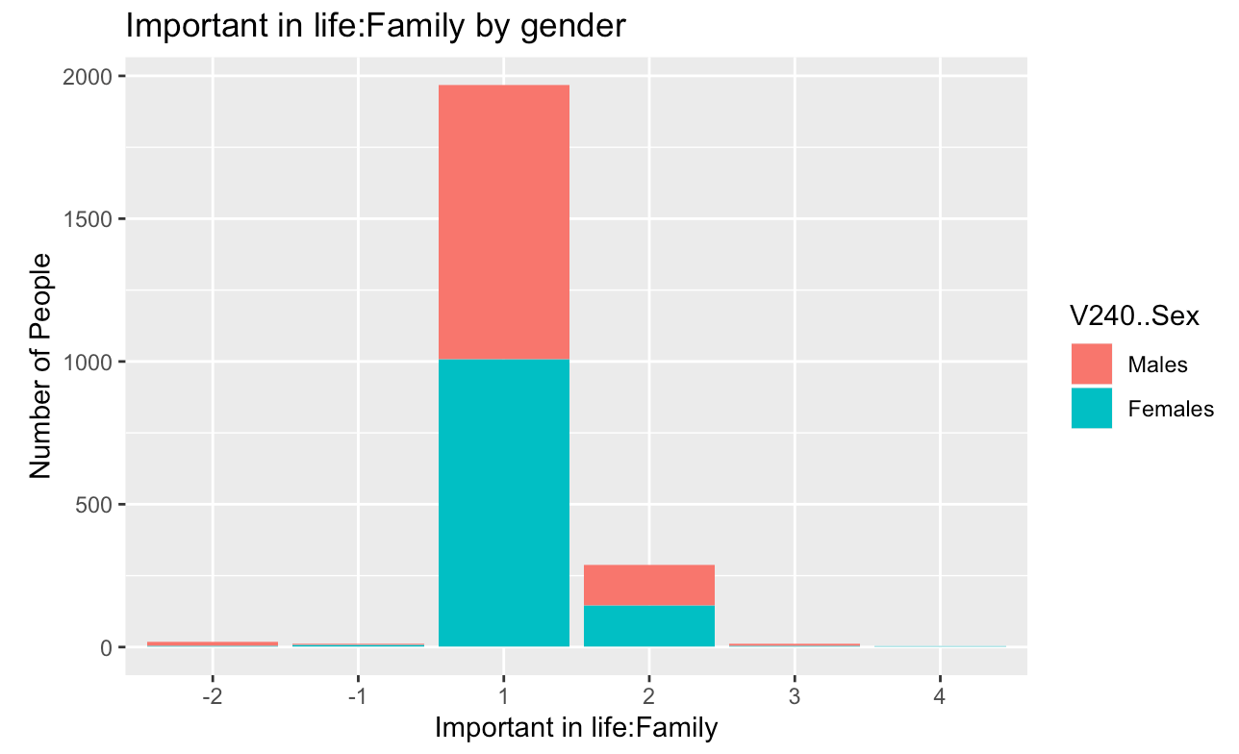
Importance of Family Toward Gender

Slide 6
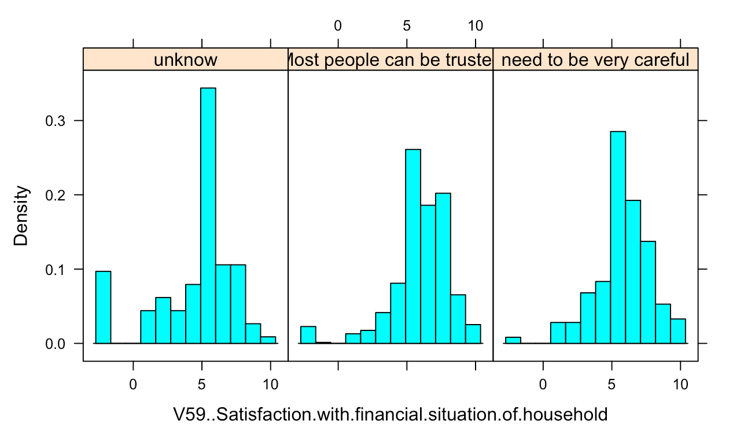
do you trust others?

Slide 7
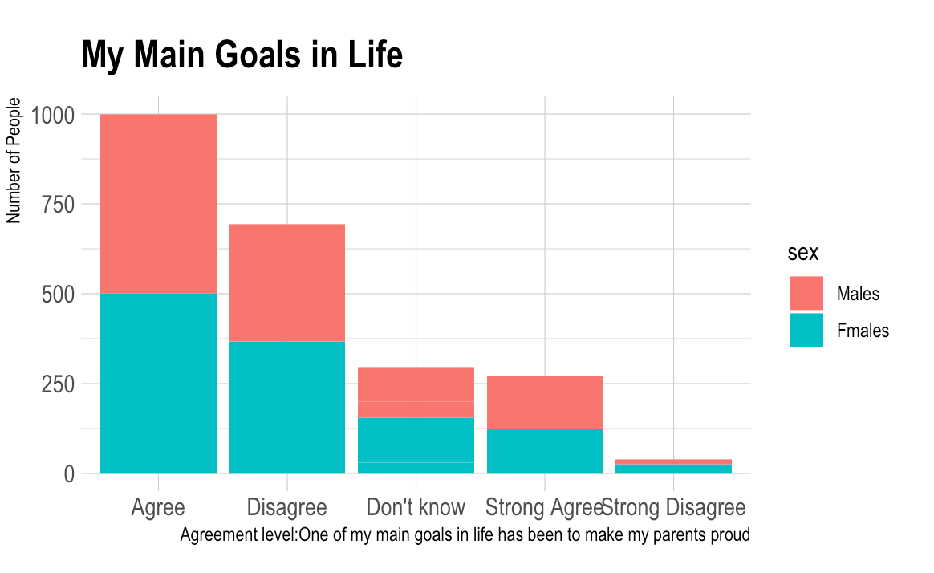

Slide 8
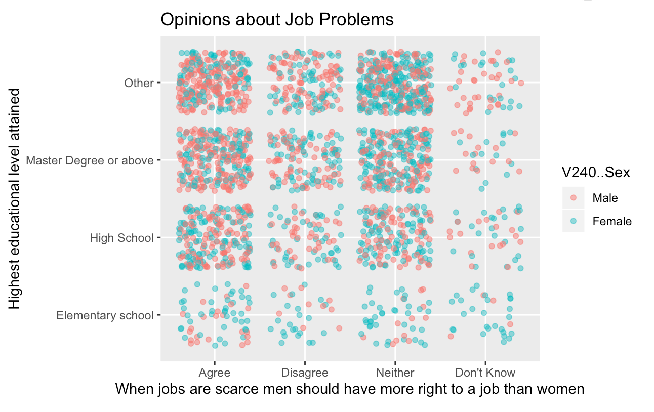

Slide 9
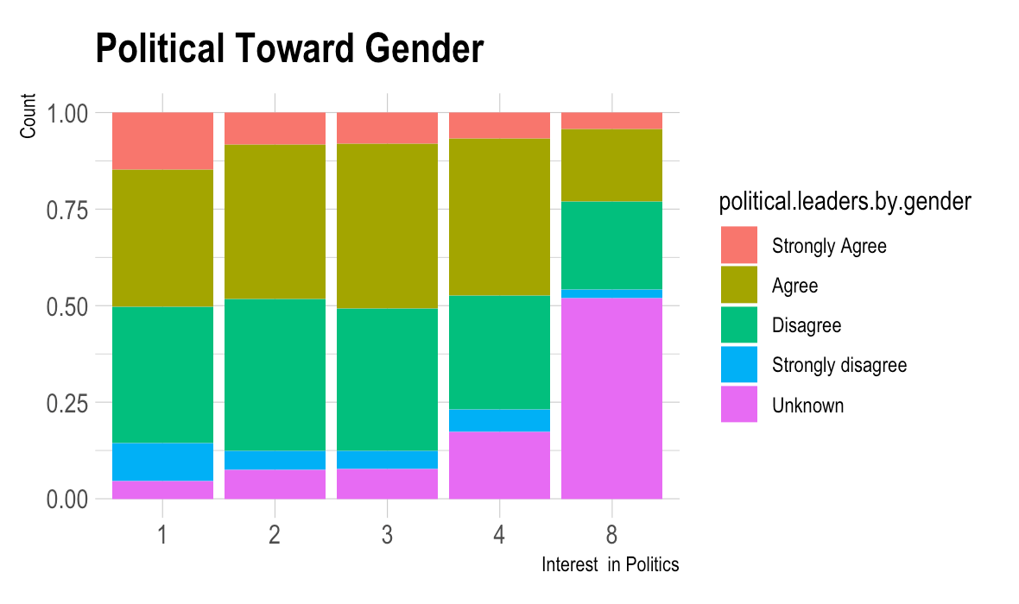
Political OPINIONS

Slide 10
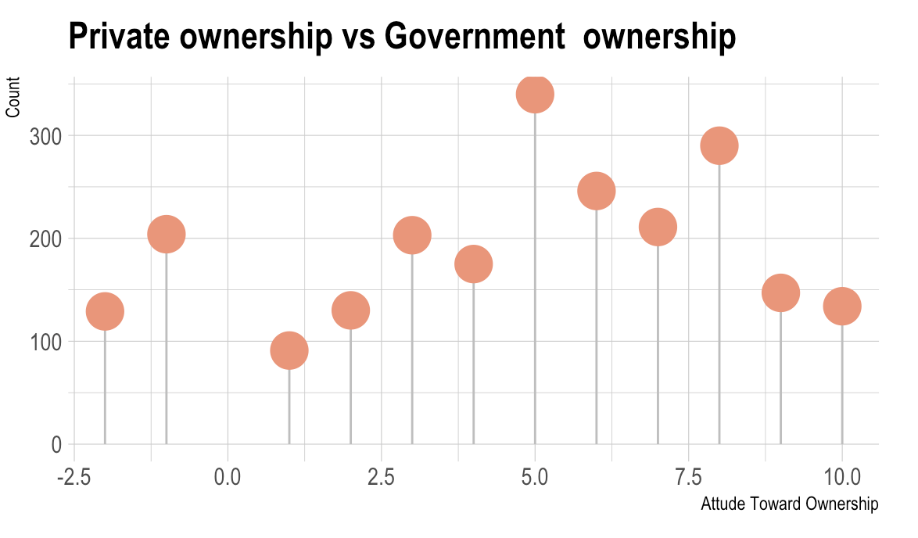

Slide 11
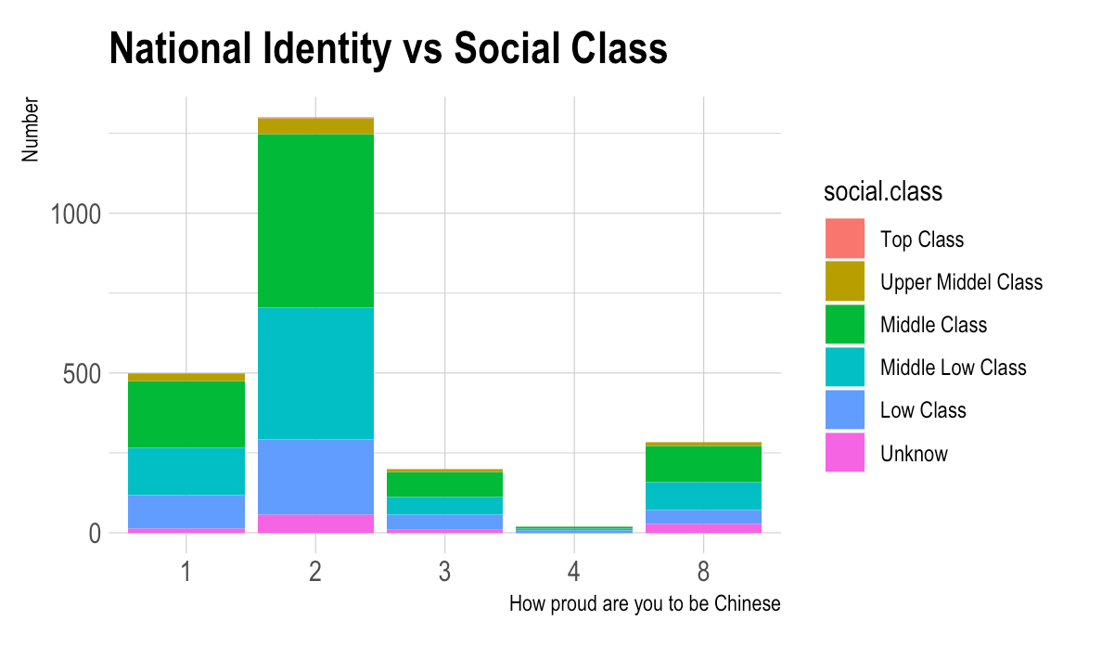
National Identity

Slide 12
Conclusion
Family is important to Chinese
Does not belong to any religion group
Main goal of their life is to make their parents proud
Different viewpoint between gender
survey have a scientific design

