Slide 2
Pre-requisite
Script for each topic
For BCC Knowing 1.1 Computer Video No 1 & Video No 2
Existing Videos of BCC need to be analyzed through Gemini and add new areas to be embedded in script and than generate the new final script through Gemini / Claude
Quiz Preparation
License for Vyond (10$ License 4)
Theme (Conversational or Presenter)
Characters
Voice over for Characters
Team Roles (Script Writer role, Ani maker role , Reviewer role)

Slide 3

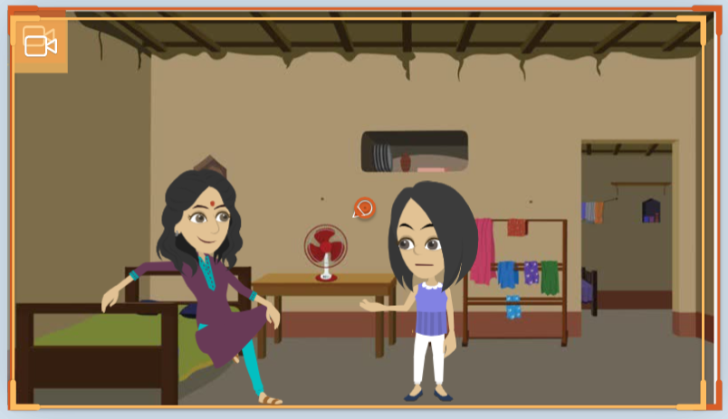


Background
Background Name | Used For | Background Image
Office – Lounge Meeting | AI for Beginners
 | BCC - 1-4 No change
Semi Urban Leaving Room | BCC – 5,6,7 – Semi
BCC – New Module | 8,9,10 – New Modules

Slide 4
AI for Beginners Script Structure
Script Structure | Type | Character | Script Context | Duration (approx.)
Opening Script | Conversational | 2 Girls | Conversation Between 1 Girls, 1 women (Need to decide) They will talk about the Topic approximately for a 30 seconds | 30 seconds
About This Course | Presenter with one character | 1 Girls | 1 Girl will explain that what will be covered in this course with the help of Learning Objective (30 Seconds) | 30 seconds
Script Body – All Scene | Presenter with one character | 1 Girls | 1 Girl for each of the scene would be presenting and explain in each of the scene (2 Minutes) | 2 Minute
Summary | Presenter with One character | 1 Girl | Summary script ready by the character at the end (30 Sec) | 30 seconds
Video should not go beyond 4.5 minutes
Urban Background

Slide 5
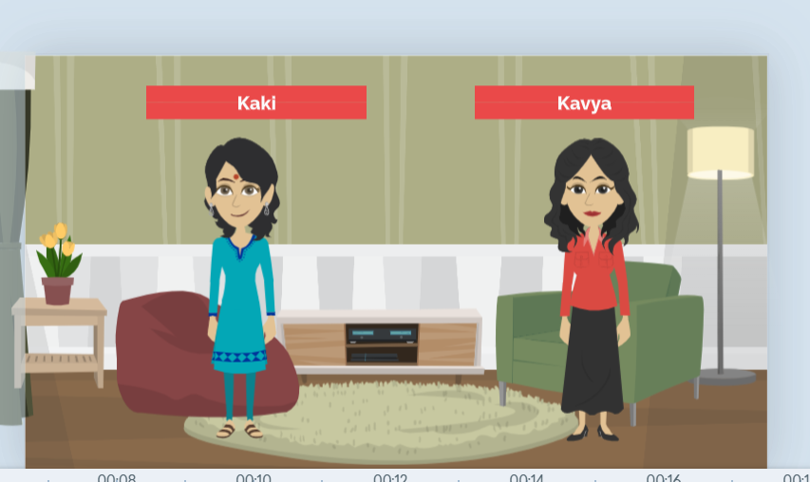
Characters Dimensions – AI for Beginners

Slide 6
BCC
About this Course Slide needs to be added (only voice over no character) roughly 10-20 seconds
Conversational with 2 Characters
Same as earlier
Summary needs to be added
Quiz afterwards
1-4 Content (Village Theme No Change in background) same Characters
5, 6 ,7 semi urban background required with same characters
New Module 8,9,10 (Urban background , Characters same)

Slide 7

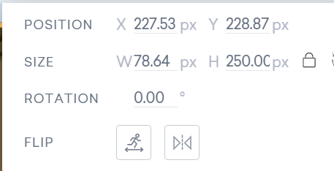

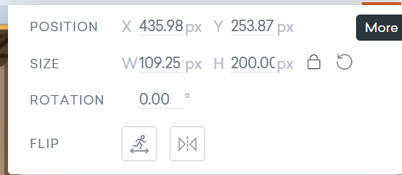

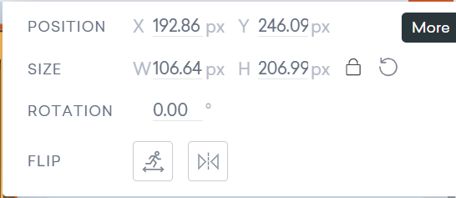

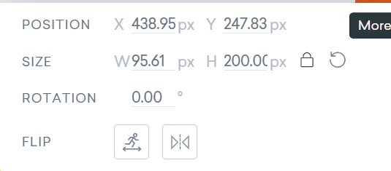
Characters Dimensions –BCC
Standing Position
Devika Kaki
Kavya
Sitting Position

Slide 8
Audio Script License
Total Video Minutes available | License 1 – Minutes available
BCC – 3120 Minutes | 121 Minutes available
AI for Beginners -1920 Minute

Slide 9
Configuration Management
Configuration Manager would be Ashish Bharadwaj
Every body has o sync up daily between 5to 6 with CM for Update the configuration Management

Slide 10
Teams
Course | Team Leader | Team Members
BCC | Sneha

Slide 11
Course | Team Leader | Team Members
AI For Beginners

