Slide 1

Autonomous warfare: Are there ever situations where it could be condoned?

Slide 2
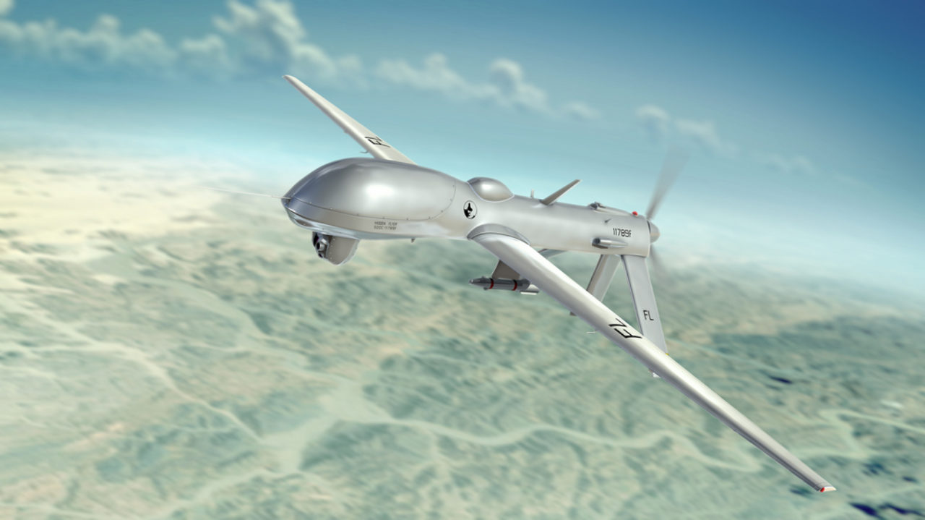
What is autonomous warfare?
Autonomous warfare is the use of robotic systems that are able to select and attack targets without a human operator.
Notes:
You may be familiar with the use of pilotless drone. These drones could be fully automated to locate, find and then eliminate a target based on a set of predetermined criteria.

Slide 3
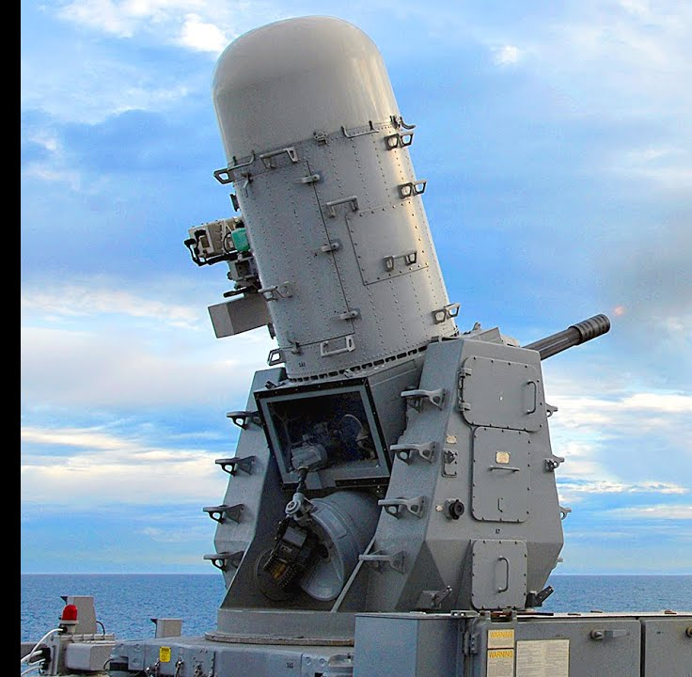
Autonomous weapons today
The concept of autonomous warfare is not new.
Since the 1970s, autonomous weapons have been used in self-defence.
The current debate centres on ‘Killer robots’ or lethal autonomous weapons (LAWs), which can autonomously search, identify and eliminate enemy targets without human intervention.
Notes:
Phallanx ships gun. A radar controlled turret which can identify potential threats towards the ship such as anti ship missile or fast jets. Rank the threats in order of danger and then engage the threats, all in the space of approximately 400 ms. However the current systems are not ‘lethal’ as they are not designed to specifically target people

Slide 4
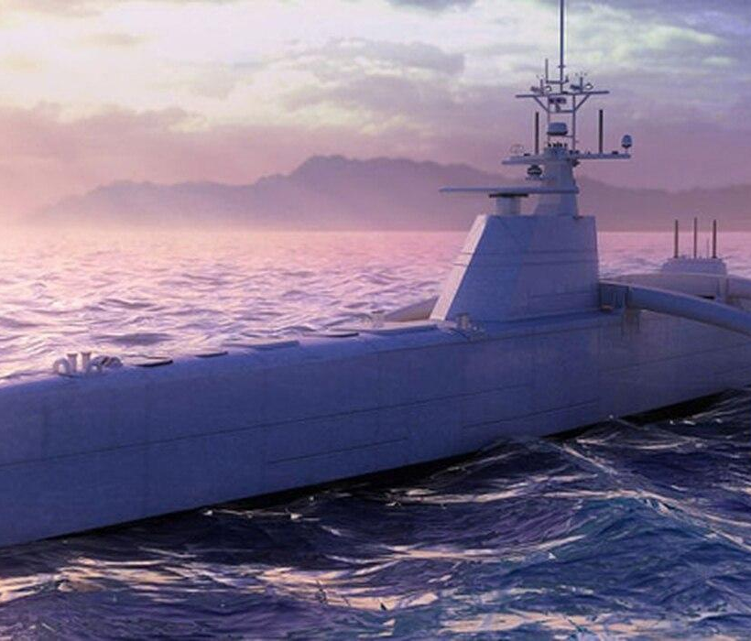
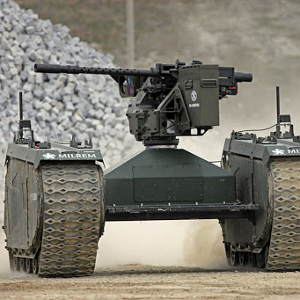
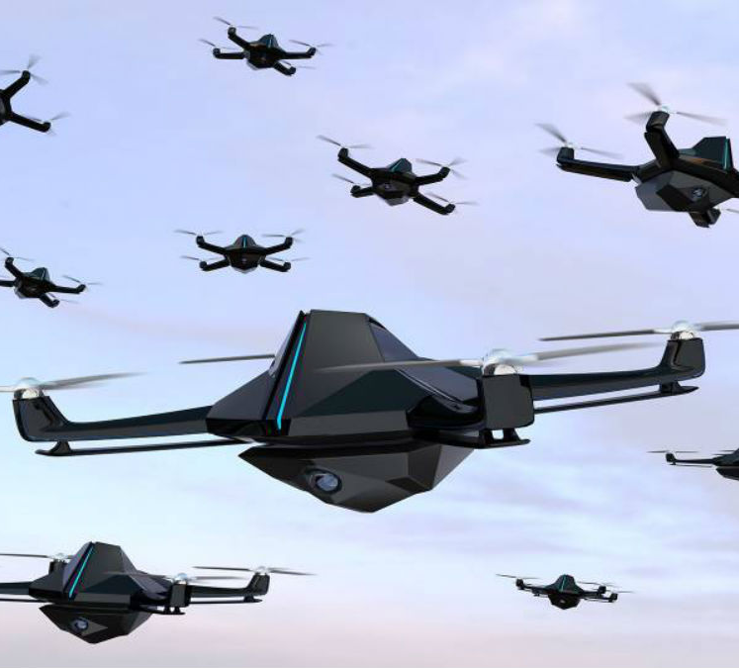
Potential future uses
Submarines deployed for up to three months to hunt and destroy enemy submarines.
Infantry support weapons which can be deployed alongside soldiers to detect and fire on enemy positions in battle.
Drones deployed in swarms to track and eliminate targets.
Notes:
Major powers are researching technology from autonomous submarines to automated support weapons
However, it is the use of drones the size of your hand, which can be deployed in swarms and used to track down and eliminate targets

Slide 5
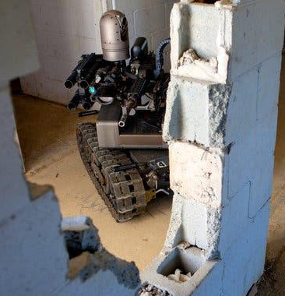
Arguments in favour of LAWs
They do not have capacity for human fallibility - e.g. getting tired, stressed or angry, and so cannot make emotional decisions.
Capable of much faster decision-making, which can be crucial to success in war.
Can collect and store lots of data
More cost-effective in the long-term than human resources.
Protect the physical and mental health of human soldiers.

Slide 6

Arguments against the use of LAWs
Should a machine be authorised to make a life and death decision?
How do we ensure a machine can correctly identify enemy, friendly and civilian populations?
Who is accountable for the weapon if an unlawful act is committed? The commander, the drone, manufacturer…?
Algorithms can be biased
Risk of hacking
Does it make entering into warfare more likely or an easier decision if own Armed Forces are less ‘on the line’?
Might it lead to an Arms Race?

Slide 7
So, are there any situations where autonomous warfare could be condoned?
Notes:
So now you’ve heard some of the current and potential future uses of autonomous warfare, the advantages and disadvantages of it - has anyone here changed their mind?

Slide 8
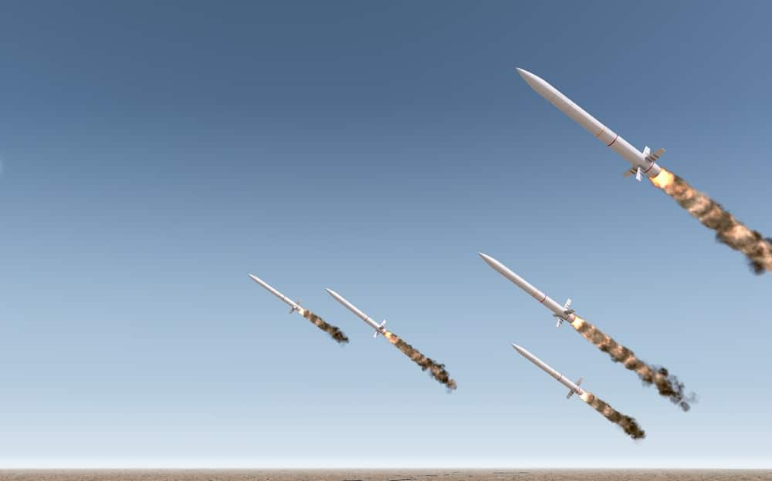
Conclusions
This technology could be greatly advantageous in supporting soldiers in war, especially identifying enemy positions and collecting information.
There needs to be regulation to address the concerns around the potential issues especially in non-conventional warfare.
Like WMDs, this can act as a useful deterrent against countries developing similar technology.
There’s a long way to go before they should be deployed
Notes:
The key advantage of these weapons is the ability to search and identify the enemy and collect data about them.
Using these weapons will depend on the type of war – large scale conventional warfare
Differencing between legitimate targets will need to be addressed, not just between military and civilian – how can you surrender to a robot?
Human intervention is still needed losing the autonomy of the weapon system
Current rules of war are needed to be changed – some these weapons can be classed as WMDs which can limit how they are tested and used
Having the capabilities and using them are two different things

Slide 9

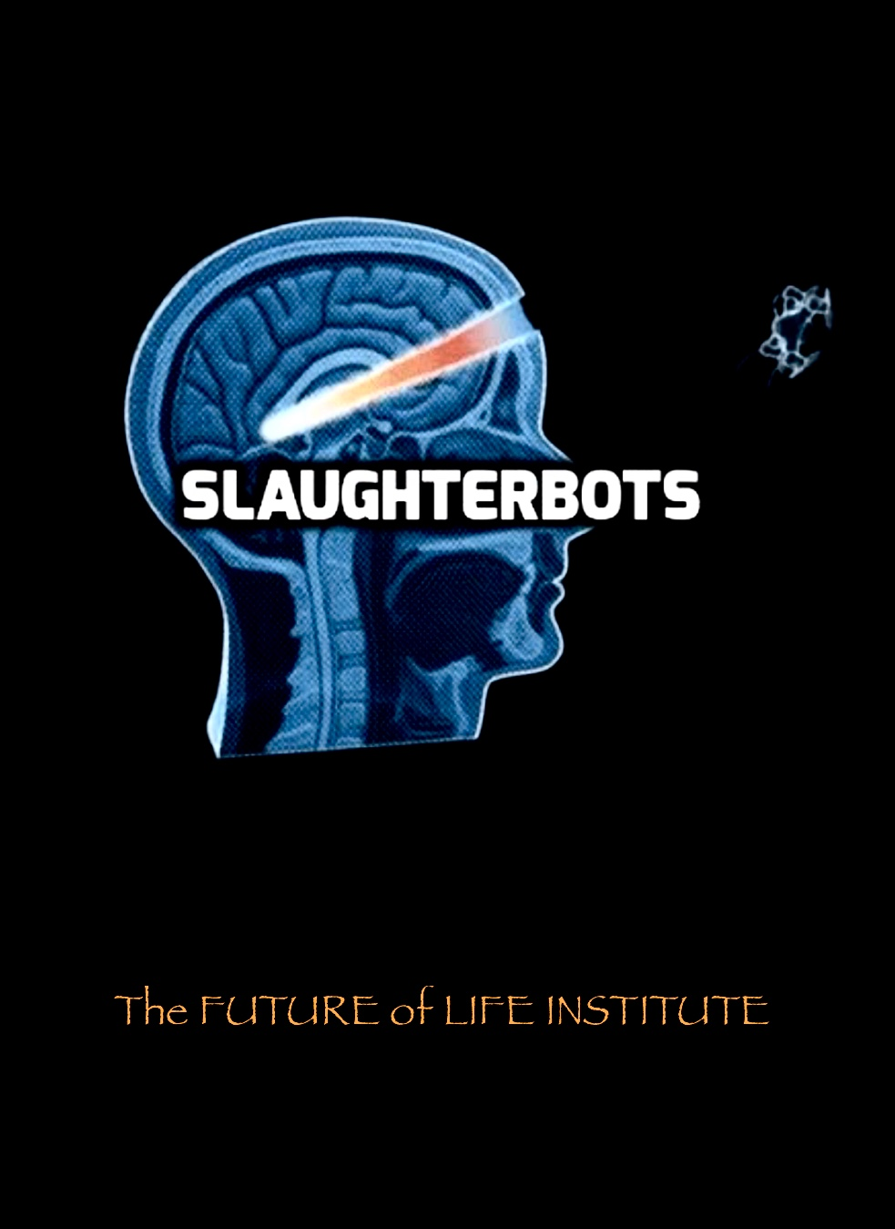
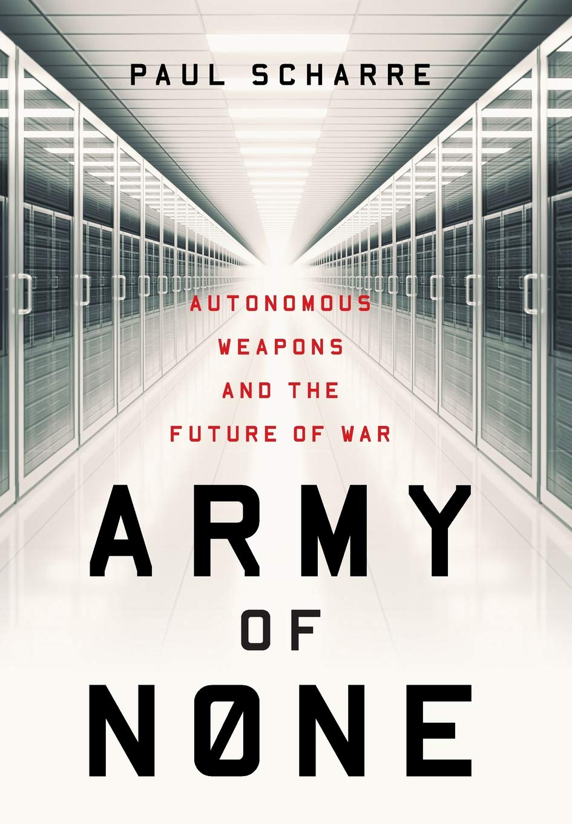

Further reading
Organisation established to ban fully autonomous weapons.
Slaughterbots - (2017) Film depicting the use of AI and facial recognition to assassinate political opponents based on pre-programmed criteria.
Slaughterbots official website calling to ban lethal weapons
Army of None: Autonomous Weapons and the Future of War, Paul Schare (2018). A book exploring the uses of AI in warfare
Arms control - A page assessing the debate on arms limitations

Slide 10
References
Acheson, R., Conboy, C. et. Al (202AD). Campaign to Stop Killer Robots. [online] Stop Killer Robots. Available at: https://www.stopkillerrobots.org/wp-content/uploads/2020/02/2020_Campaigners-Kit_FINAL.pdf.
Arkin, R., Russell, S. and Min-Seok, K. (2018). The Security Times The Security Times. [online] Available at: https://www.the-security-times.com/wp-content/uploads/2018/02/ST_Feb2018_Doppel-2.pdf [Accessed 8 Nov. 2020].
Gayle, D. (2019). UK, US and Russia among those opposing killer robot ban. The Guardian. [online] 29 Mar. Available at: https://www.theguardian.com/science/2019/mar/29/uk-us-russia-opposing-killer-robot-ban-un-ai.
Grubrud, M. (2016). Full Page Reload. [online] IEEE Spectrum: Technology, Engineering, and Science News. Available at: https://spectrum.ieee.org/automaton/robotics/military-robots/why-should-we-ban-autonomous-weapons-to-survive [Accessed 8 Nov. 2020].
Hambling, D. (2020). U.S. Army’s New Drone Swarm May Be A Weapon Of Mass Destruction. [online] Forbes. Available at: https://www.forbes.com/sites/davidhambling/2020/06/01/why-new-us-armys-tank-killing-drone-swarm-may-be-a-weapon-of-mass-destruction/?sh=7352bf5bece8 [Accessed 8 Nov. 2020].
Kallenborn, Z. (2020). Swarms of Mass Destruction: The Case for Declaring Armed and Fully Autonomous Drone Swarms as WMD. [online] Modern War Institute. Available at: https://mwi.usma.edu/swarms-mass-destruction-case-declaring-armed-fully-autonomous-drone-swarms-wmd/ [Accessed 8 Nov. 2020].
Klare, M.T. (2019). Autonomous Weapons Systems and the Laws of War | Arms Control Association. [online] Armscontrol.org. Available at: https://www.armscontrol.org/act/2019-03/features/autonomous-weapons-systems-laws-war.
Markoff, J. (2010). War Machines: Recruiting Robots for Combat (Published 2010). The New York Times. [online] 27 Nov. Available at: https://www.nytimes.com/2010/11/28/science/28robot.html#:~:text=%E2%80%9COne%20of%20the%20great%20arguments [Accessed 8 Nov. 2020].
Müller, V. (2016). Autonomous Killer Robots Are Probably Good News. In: E. Di Nucci and F. Santoni de Sio, eds., Drones and Responsibility: Legal, Philosophical and Socio-Technical Perspectives on the Use of Remotely Controlled Weapons. [online] London: Ashgate. Available at: https://philpapers.org/archive/MLLAKR.pdf [Accessed 8 Nov. 2020].
Piper, K. (2019). Death by algorithm: the age of killer robots is closer than you think. [online] Vox. Available at: https://www.vox.com/2019/6/21/18691459/killer-robots-lethal-autonomous-weapons-ai-war.
Primer, A. (2018). Algorithmic Bias and the Weaponization of Increasingly Autonomous Technologies A PRIMER No. 9. [online] United Nations Institute for Disarmament Research. Available at: https://unidir.org/sites/default/files/publication/pdfs/algorithmic-bias-and-the-weaponization-of-increasingly-autonomous-technologies-en-720.pdf.
Scharre, P. (2019). Army of none : autonomous weapons and the future of war. New York: W.W. Norton & Company, . ©218.
Sparrow, R. (2016). Robots and Respect: Assessing the Case Against Autonomous Weapon Systems. Ethics & International Affairs, 30(1), pp.93–116.
Stop Autonomous Weapons (2017). Slaughterbots. YouTube. Available at: https://www.youtube.com/watch?v=9CO6M2HsoIA.
www.paxforpeace.nl. (n.d.). Peace organisation PAX - Killer Robots. [online] Available at: https://www.paxforpeace.nl/our-work/programmes/killer-robots [Accessed 8 Nov. 2020].

