Slide 1
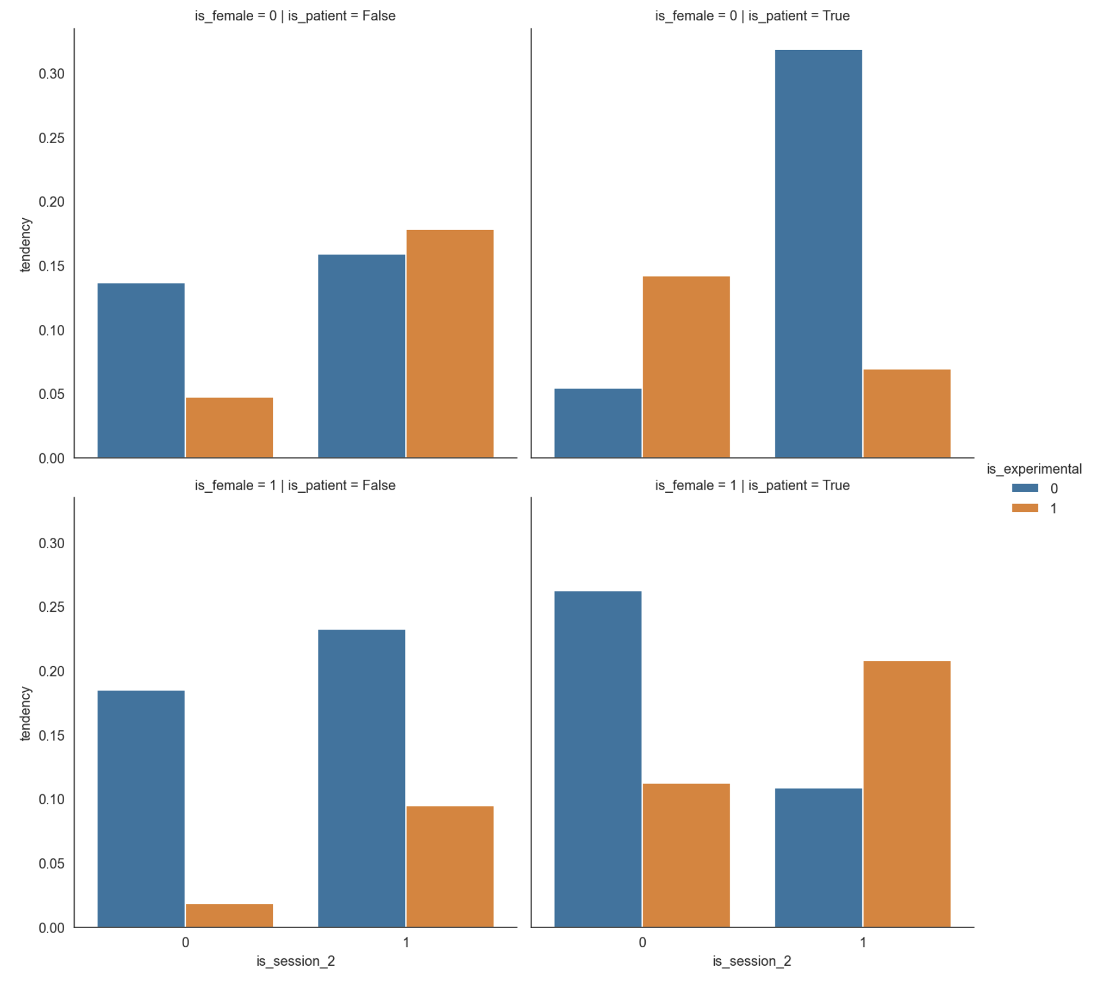
Healthy
Patient
Control
Experimental
Food approach (RT)
Men
Session 1
Session 2
Session 1
Session 2
Food approach (RT)
Women
Session 1
Session 2
Session 1
Session 2

Slide 2
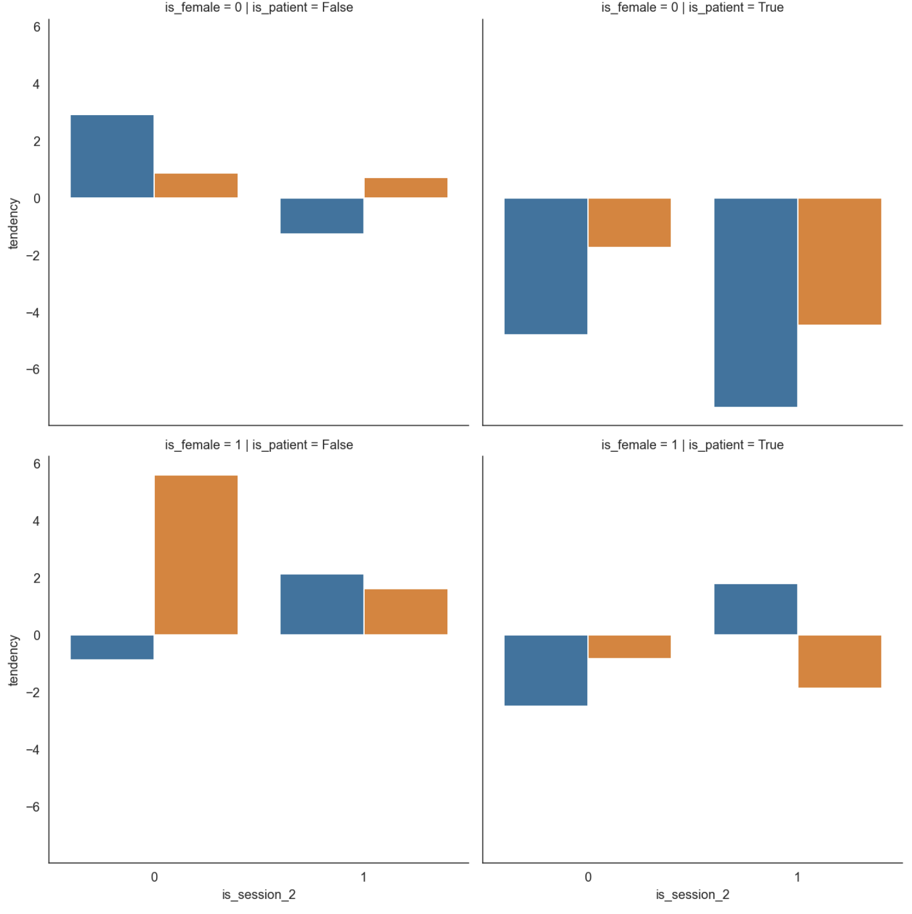
Healthy
Patient
Control
Experimental
Food approach (froce)
Men
Session 1
Session 2
Session 1
Session 2
Food approach (froce)
Women
Session 1
Session 2
Session 1
Session 2

