Slide 1
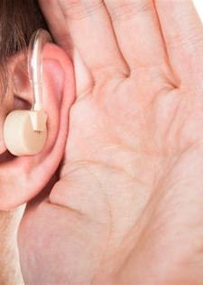
Digital Hearing Aid - Enhancing the Listening Experience
We have discovered how digital signal processing techniques used in MATLAB are revolutionizing the way we experience sound.
Hamza Ikram (2020-CE-06)
Talha Arfan (2020-CE-15)

Slide 2
Literature Survey
A.R. Vasista and R. Srinivasan in 2018
Enhancing speech intelligibility and reducing feedback in digital hearing aids
1
2
3
M. B. Rad and H. Kazemi Boroujeni in 2016
G. Tamas et al.
Hearing aid signal processing strategy based on spectral subtraction, dynamic range compression, and a notch filter.
An algorithm for noise reduction in digital hearing aids using the discrete wavelet transform (DWT) and adaptive filtering techniques.

Slide 3
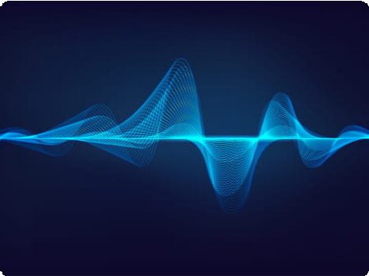
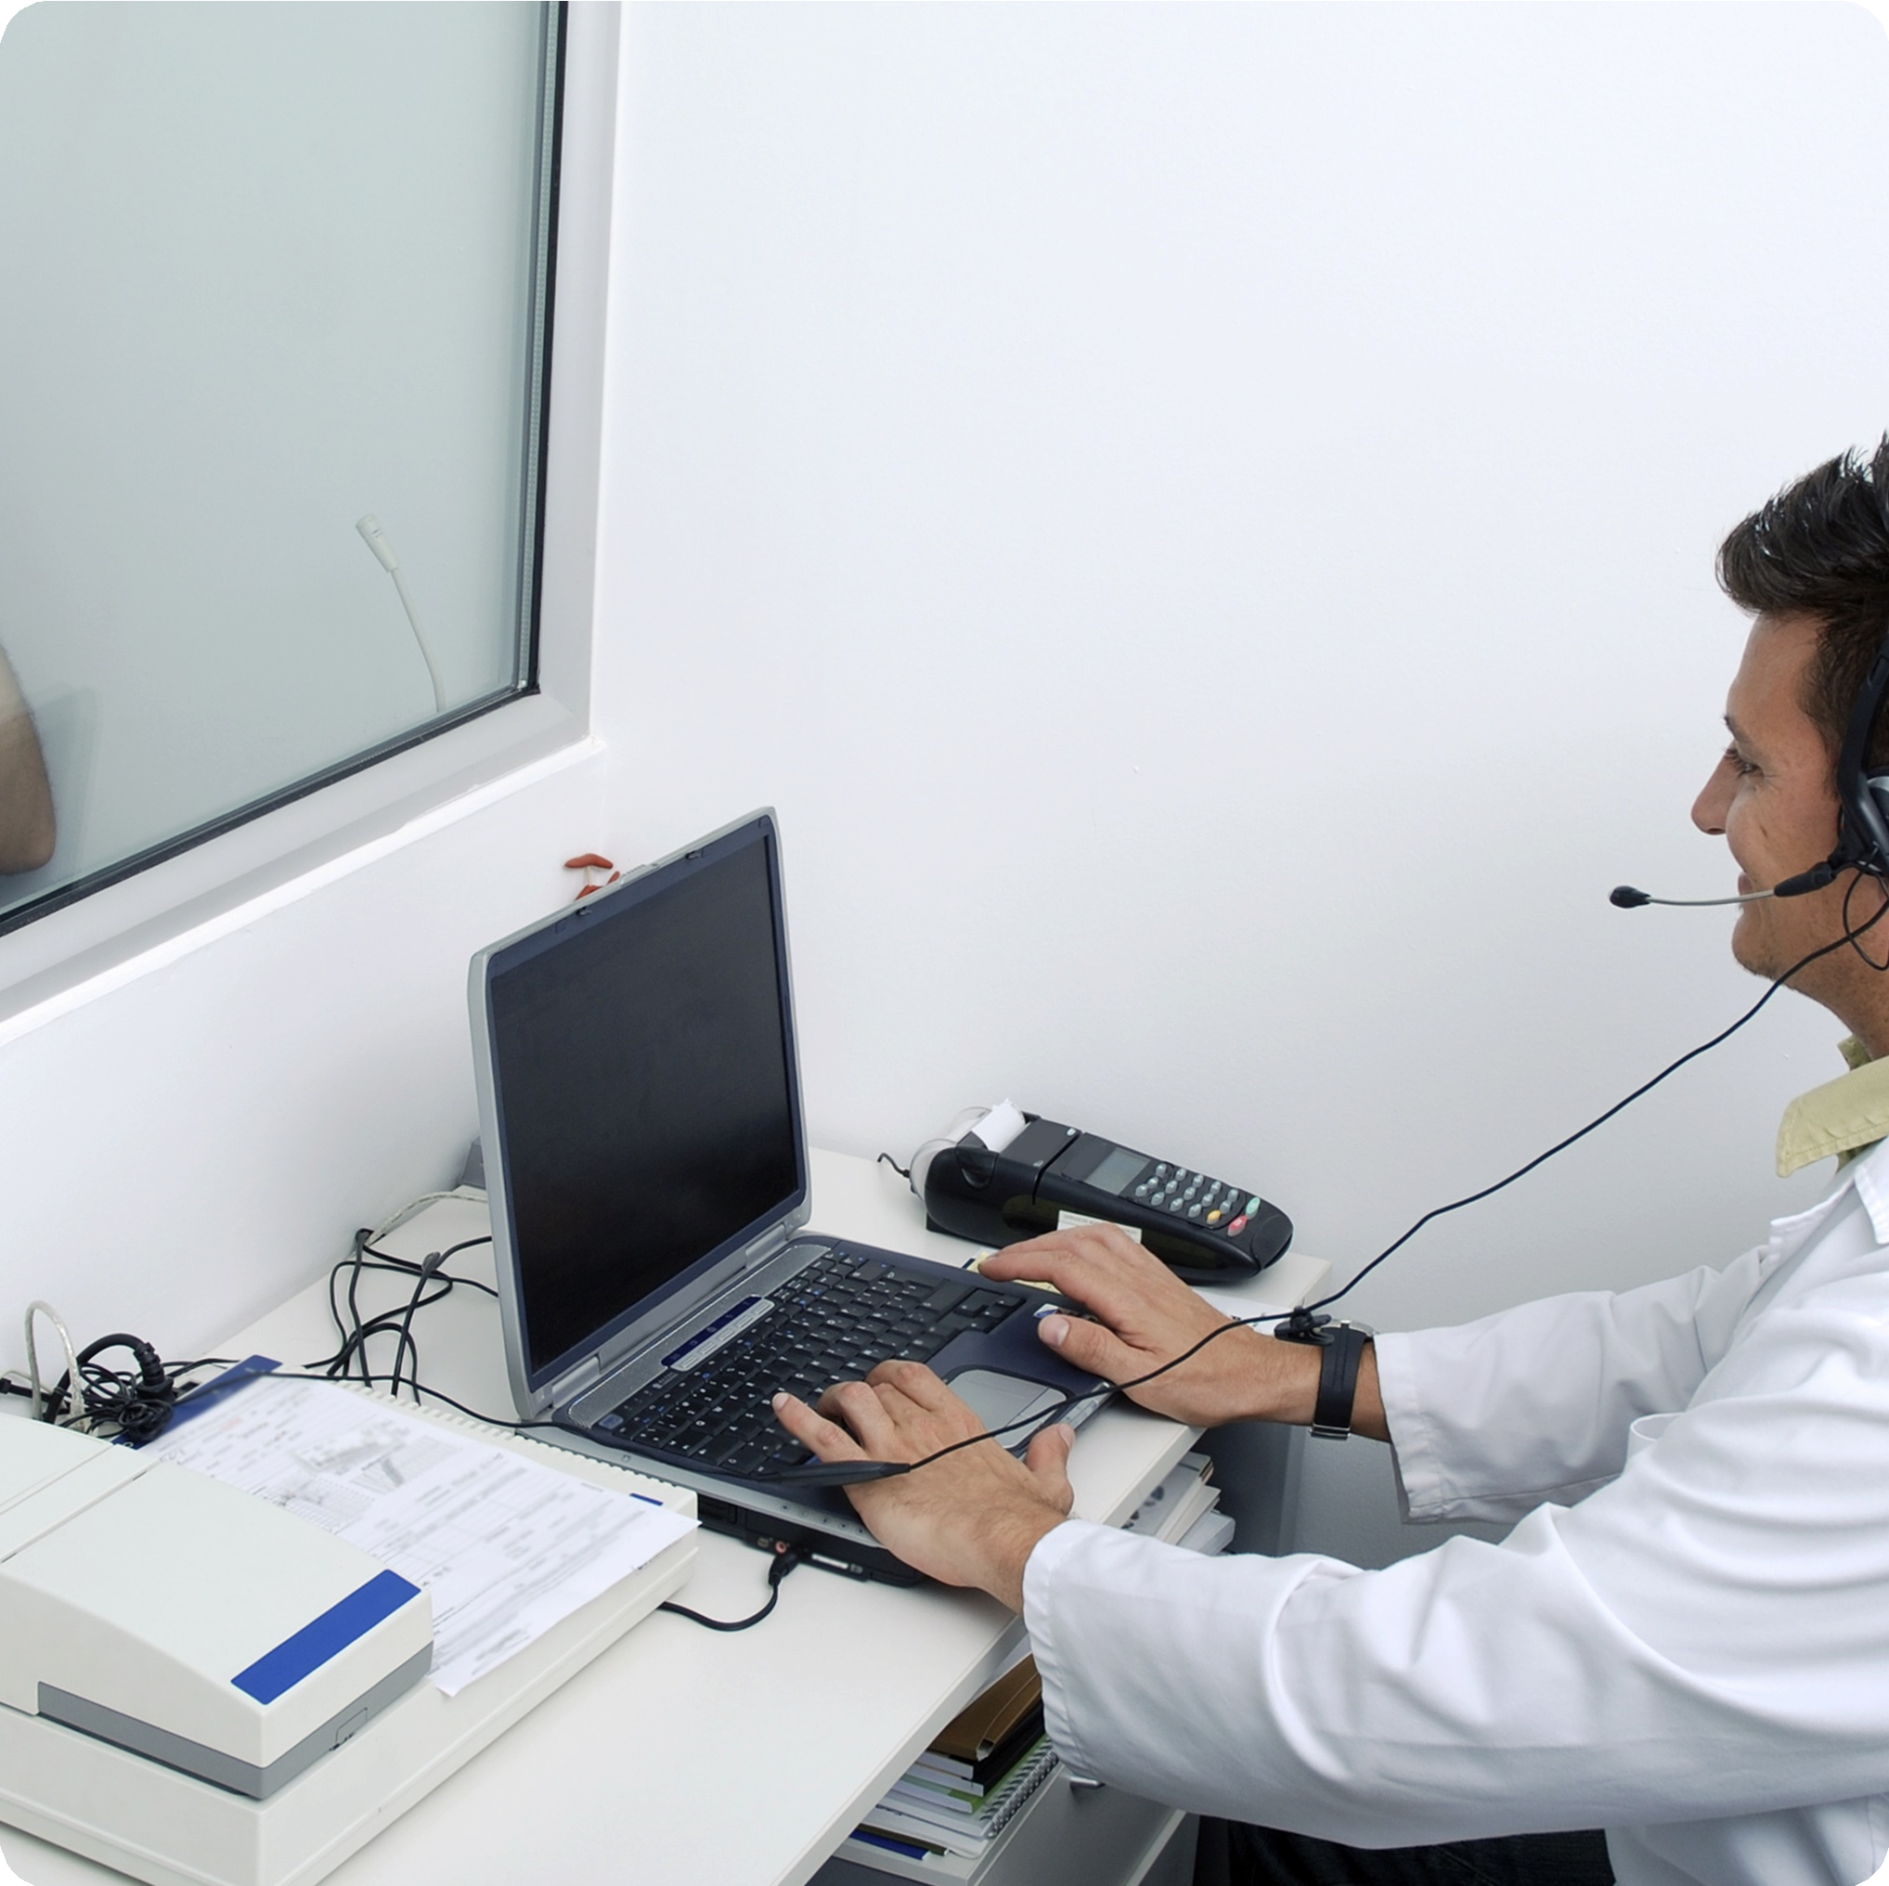
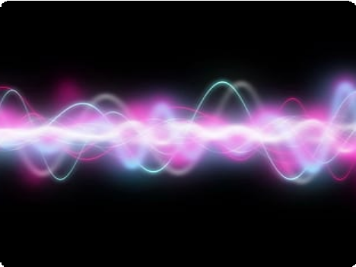
Dataset Details
Hearing Aid Sound Dataset
Hearing Loss Simulator
AURORA 4
This dataset contains hearing aid sound recordings from 10 different hearing aids.
This dataset simulates hearing loss in speech signals.
This dataset contains recordings of spoken language in noisy environments.

Slide 4
Methodology
Understand the Hearing Aid System
The first step is to understand the basic architecture of the hearing aid system.
Apply DSP Algorithm
This can include noise reduction, amplification, and frequency filtering, among other things. We have used both Wavelet Transform and Fourier Transform
to process signal.
Real-time Implementation
The final step is to implement the DSP algorithms in a real-time system. This involves integrating the algorithms with the components of the hearing aid.
Simulate Hearing Aid System
The next step is to simulate the hearing aid system in MATLAB.

Slide 5
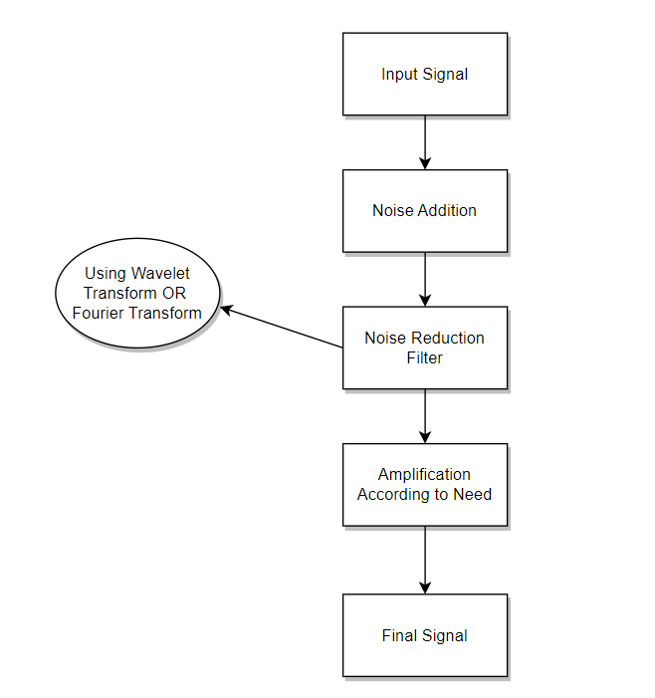
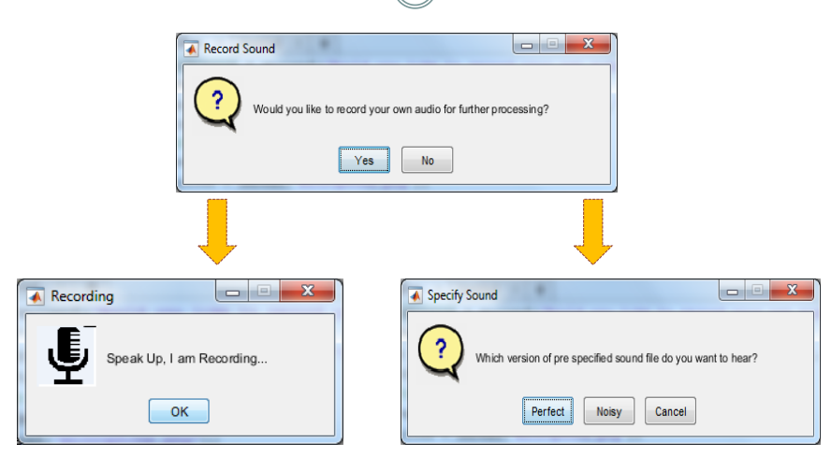
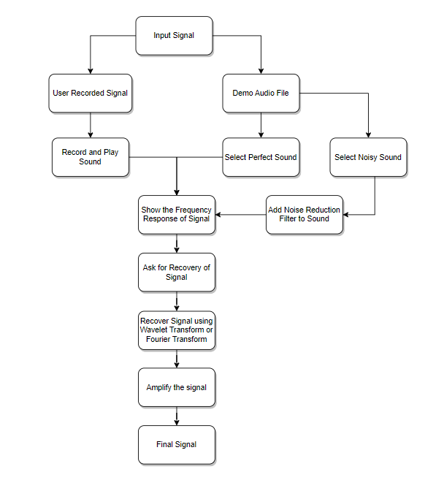
Workflow Diagrams
Project Flowchart
DSP Block Diagram
User Interface Design
The signal flow from the microphone to the speaker in a digital hearing aid.
The different processing steps involved and how they are connected in a DSP-based hearing aid.
The user interface of our project digital hearing aid.

Slide 6
Results and Evaluations
1 2
3
Noise Reduction
Amplification
Real-world Performance
This project has successfully implementation of a noise reduction algorithm to mitigate unwanted background noise in the audio signals. The algorithm utilized techniques such as spectral subtraction, adaptive filtering, or spectral gating to estimate and remove noise components.
This project also focused on amplifying the audio signals to compensate for hearing loss. A gain adjustment algorithm was developed to increase the amplitude of the input signals while preserving their overall quality and preventing distortion.
We have studied about the performance of digital hearing aids in day-to-day situations, including background noise, busy environments, and more.

Slide 7
Techniques Studied
Adaptive Noise Cancellation
This technique is used to eliminate background noise in hearing aids.
Speech processing
Digital hearing aid DSP project uses speech processing techniques to enhance speech signals that contain different noise sources.
Automatic gain control
Automatic gain control is a technique used to automatically adjust the volume of an audio signal, based on a pre-set range of volume levels.

Slide 8
Conclusion
This project points to the vast potential of DSP in addressing critical challenges in the:
Medical Industry
Particularly in Enhancing Hearing
Speech Recognition Abilities in individuals with Hearing Impairments
Our final solution provides a solid foundation for future research and development in the digital hearing aid space, which we hope will continue to improve the lives of people with hearing impairments.

