Slide 1
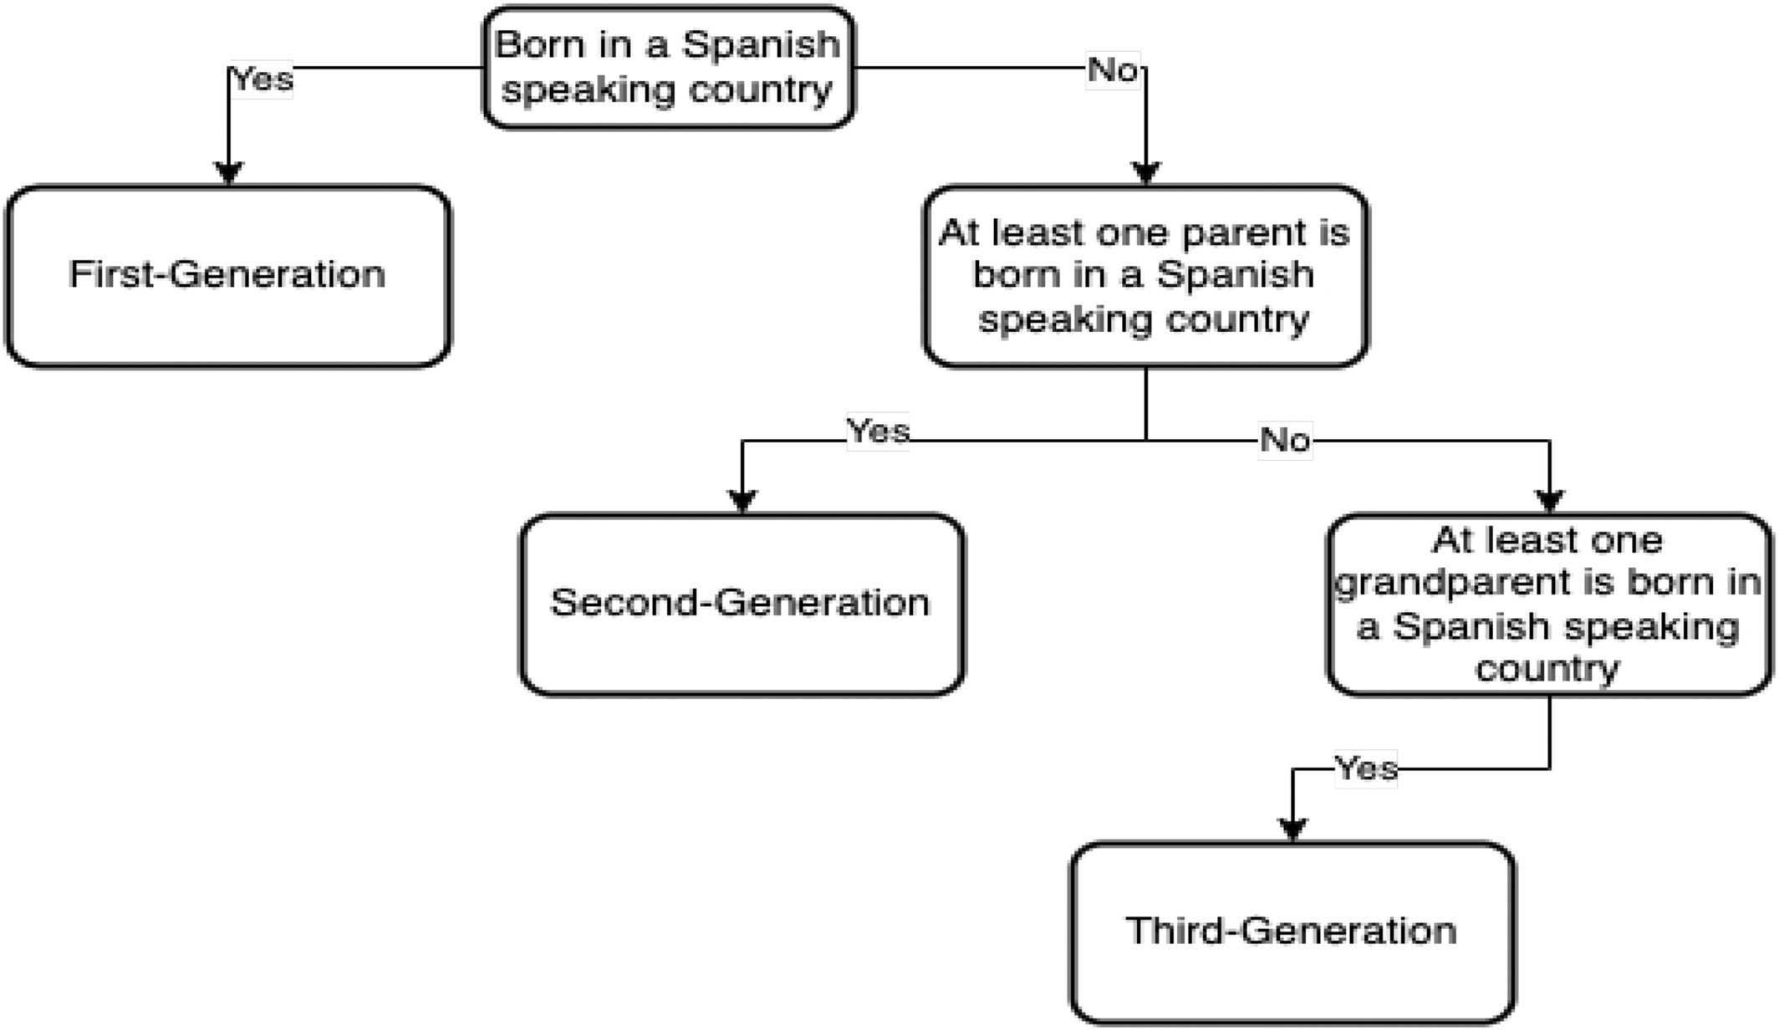
The effect of racial and ethnic attitudes on Hispanic identity in the United States
Southern Economic Journal, Volume: 92, Issue: 2, Pages: 338-358, First published: 09 December 2024, DOI: (10.1002/soej.12749)
Notes:
Diagram of the three different generations of Hispanic immigrants. This diagram shows how the different generations are defined.
IF THIS IMAGE HAS BEEN PROVIDED BY OR IS OWNED BY A THIRD PARTY, AS INDICATED IN THE CAPTION LINE, THEN FURTHER PERMISSION MAY BE NEEDED BEFORE ANY FURTHER USE. PLEASE CONTACT WILEY'S PERMISSIONS DEPARTMENT ON PERMISSIONS@WILEY.COM OR USE THE RIGHTSLINK SERVICE BY CLICKING ON THE 'REQUEST PERMISSIONS' LINK ACCOMPANYING THIS ARTICLE. WILEY OR AUTHOR OWNED IMAGES MAY BE USED FOR NON-COMMERCIAL PURPOSES, SUBJECT TO PROPER CITATION OF THE ARTICLE, AUTHOR, AND PUBLISHER.

