Slide 1
Chapter 1: Introduction – Thinking Like a Data Detective
What is a “Data Detective”?

Slide 2
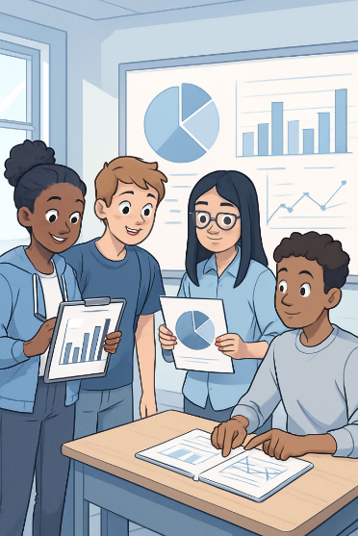
Thinking Like a Data Detective
Data is everywhere — and most of it is trying to tell you something. Your job is to figure out what’s signal and what’s noise.
In this chapter:
How data shapes decisions — from algorithms to policy
Analytical frameworks for evaluating claims and sources
Core statistical concepts: variables, distributions, correlation vs. causation
Introduction to coding agents as analytical tools
Notes:
Welcome to the world of data detection! In this presentation, we'll explore how to think critically about the numbers and statistics we encounter every day.

Slide 3
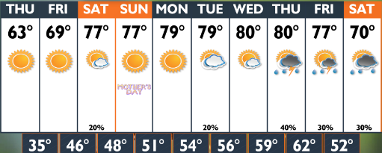
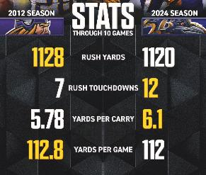
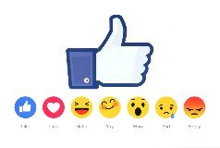
Data in Everyday Life – Why Data Matters
Can you think some data examples in your daily life?
Weather forecast
Sport stats
Social media trends
Notes:
Think of 3 ways you used or saw data today (examples: sports scores, weather forecast, social media likes).
Younger students (Grades 5–8): Write or draw your examples.
Advanced students (Grades 9–11): What decisions might people make based on this data?
Activity: Students list examples of data they encountered today (e.g., weather app, steps on smartwatch, social media stats).
Discussion: “Which data do you trust most? Why?”
Goal: Build awareness of data in daily life.

Slide 4
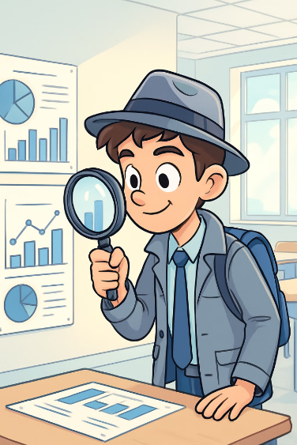
What Is a “Data Detective”?
Applies systematic skepticism — treats every claim as a hypothesis to be tested against evidence.
Interrogates methodology: how data was collected, who collected it, and what incentives may have shaped it.
Uses tools — spreadsheets, statistical summaries, visualizations, and code — to surface patterns invisible to the naked eye.
Distinguishes correlation from causation and resists the pull of compelling but misleading narratives.
Communicates findings with appropriate uncertainty — knowing what the data does and does not support.

Slide 5
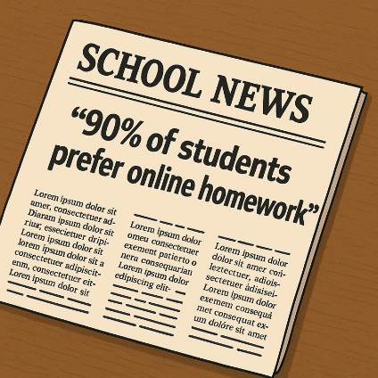
What would Data Detective ask?
Imagine your school newspaper claims that “90% of students prefer online homework.”
How did they get that number?
Did they survey all students or just a few?
Could the wording of the question have influenced the answers?
Notes:
Claim: 90% of students prefer online homework. Your job: Be a data detective!
Everyone: Write 3 questions you would ask before believing this claim.
Advanced:
Design 2 different survey questions.
Which one is less biased? Why?

Slide 6
Chapter 1: Introduction – Thinking Like a Data Detective
The Perils of "Face Value"

Slide 7
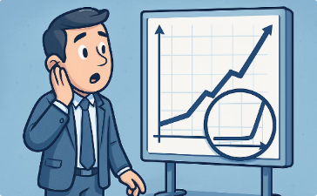
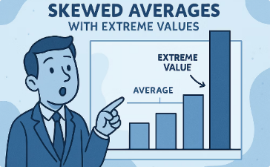
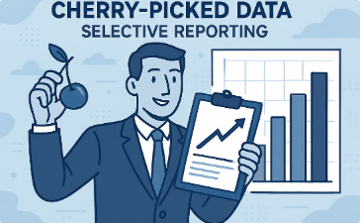
The Perils of "Face Value"
Misleading Scales
Skewed Averages
Cherry-Picked Data
Zoomed-in axes can make small changes look dramatic — a 2% shift appears catastrophic when the y-axis starts at 98.
Outliers skew the mean without affecting the median — always ask which measure of central tendency best represents the distribution.
Selecting a convenient time window or subgroup can reverse a trend — this is why peer review requires full data disclosure.

Slide 8
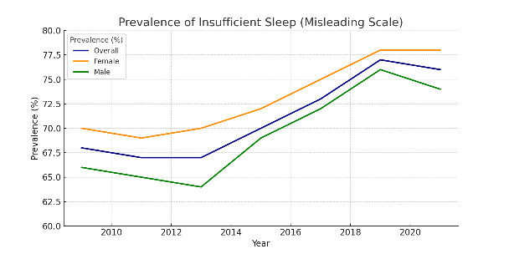
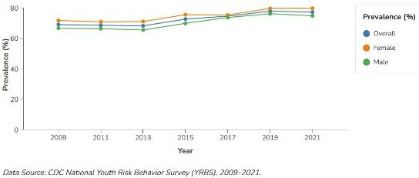
Pay Attention to What You See
Manipulated axis
Correct axis:
https://www.cdc.gov/sleep/data-research/facts-stats/high-school-students-sleep-facts-and-stats.html?

Slide 9
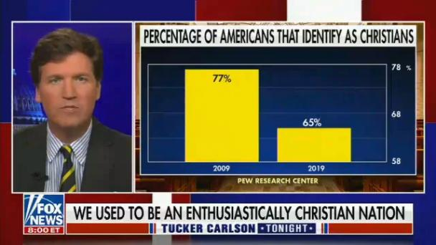
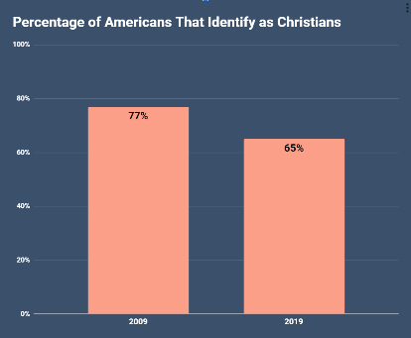
Misleading scales
Can you spot the issue with this plot?
Source: https://medium.com/%40thomas.ellyatt/bad-data-visualisation-real-life-examples-out-there-in-the-wild-eb5032329aeb

Slide 10
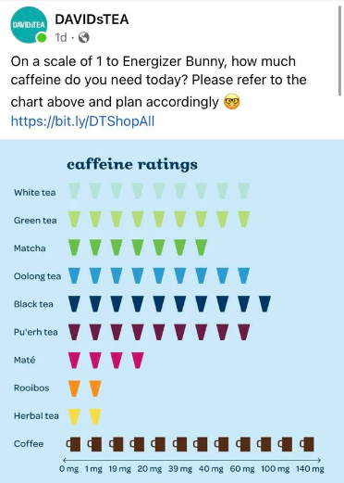
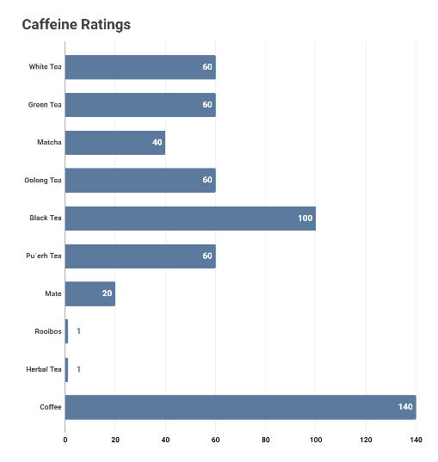
Can you spot the issue with this plot?
Source: https://medium.com/%40thomas.ellyatt/bad-data-visualisation-real-life-examples-out-there-in-the-wild-eb5032329aeb

Slide 11
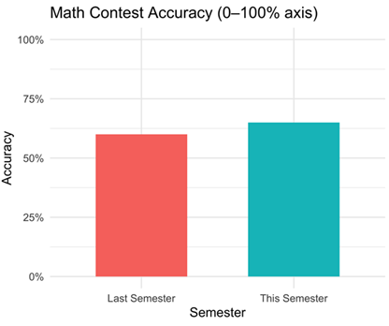
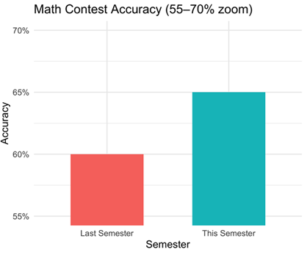
Misleading Scales
Your team’s math-contest accuracy rose from 60% last semester to 65% this semester.
Can you spot the differences on two plots?
Which plot presents the difference accurately?

Slide 12

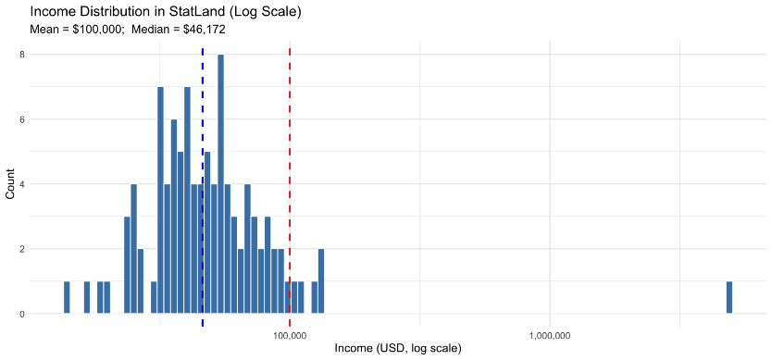
Skewed Averages - Example of Stat Land
Average income in the Stat Land!
What is the mean income?
Does the mean income well represent everyone in the Stat Land?
This one person skews the dataset, making $5M/year
Median
Mean

Slide 13

Cherry picking data
By deliberately cherry picking inappropriate time periods, here 1998–2012, an artificial "pause" can be created, even though the overall warming trend continues.
Source: https://en.wikipedia.org/wiki/Cherry_picking

Slide 14
Chapter 1: Introduction – Thinking Like a Data Detective
The Mindset of a Data Detective: Curiosity and Skepticism

Slide 15


The Mindset of a Data Detective: Curiosity and Skepticism
Cultivate curiosity as a professional habit: every statistic is an invitation to ask “Why? How? Under what conditions?”
Follow the evidence chain: from raw data → measurement → analysis → claim — each link can introduce error or bias.
Practice calibrated skepticism: demand methodological transparency, not just numerical results.
Guard against anchoring: the first data point you encounter shapes all subsequent interpretation — seek disconfirming evidence deliberately.

Slide 16

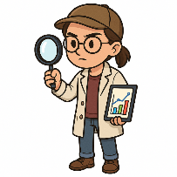


The school newspaper claim
Wow, why do so many prefer online? What do they like about it?
90% seems high, did they really ask everyone?
Why and how the data was collected?
What would be your answer if the question phrased as:
“Do you enjoy the flexibility of online homework?”
A curious person
A skeptical person
A data detective
Curiosity keeps you engaged and digging deeper
Skepticism ensures you validate and verify rather than jump to conclusions. Both are necessary.

Slide 17
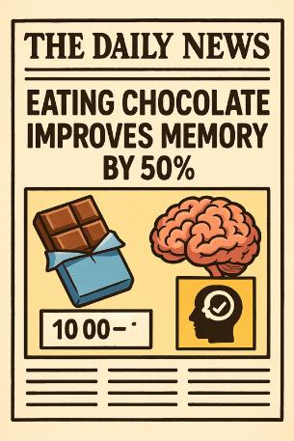
Chocolate mystery
Claim: Eating chocolate improves memory by 50%.
As a data detective what questions would you ask about the data behind it?
Work in pairs to list 3–4 questions
Notes:
Claim: Eating chocolate improves memory by 50%.
Younger students: What simple test could you design to check this? (Draw or describe.)
Advanced students: What are possible confounding factors? (e.g., test difficulty, sample size).

Slide 18

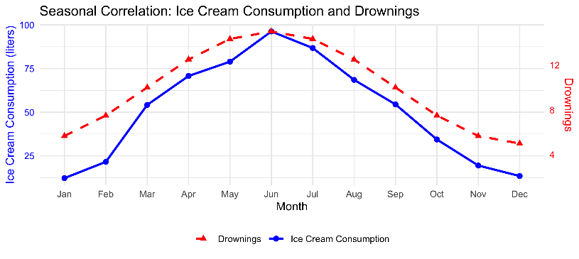
Ice Cream and Drowning - classic case of misinterpreting data
Is there a hidden factor here?
Can you say ice cream consumption “causes” drowning?

Slide 19
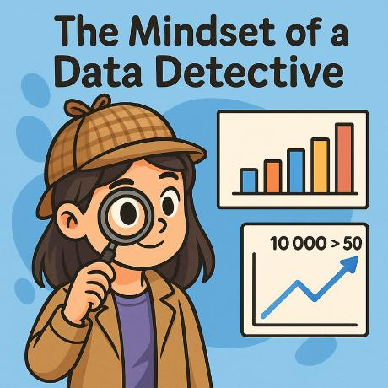

The Mindset of a Data Detective
Critical Thinking
Examining information from all angles
Skepticism
Not accepting claims without verification
Curiosity
Asking questions and digging deeper

Slide 20

Cultivating Curiosity
Ask "Why?"
Wonder about the reasons behind patterns you observe in data.
Ask "How?"
Investigate the methods used to collect and analyze the data.
Ask "What if?”
Consider alternative explanations or approaches to the data.

Slide 21
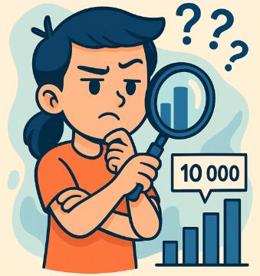
Practicing Skepticism
Verify Sources
Check where data comes from and who collected it before trusting it.
Consider Biases
Think about who might benefit from presenting data in a certain way.
Question Methods
Ask how data was collected and whether the approach was sound.
Consider Biases
Compare data from different sources to get a more complete picture.

Slide 22

The SIFT Framework for Evaluating Claims
Stop: Pause before sharing or accepting a claim — your gut reaction is the least reliable filter.
Investigate the source: What is the publisher’s track record, funding, and potential conflicts of interest?
Find better coverage: Seek the original study, data set, or primary source rather than relying on media summaries.
Trace claims: Follow data back upstream — sampling method, sample size, response rate, and how variables were operationalized all matter.

Slide 23
What is reliable?
1. TikTok: “Teens who use social media 3+ hours daily have lower test scores”
2. Company advertisement: “Use our app and boost test scores by 50%”
3. Study in Youth & Society: Based on a survey of 1,459 middle schoolers, frequent social media use was associated with decreased academic achievement, accounting for factors like age, gender, and race
4. According to Centers for Disease Control, 1 in 4 teens (ages 12–17) who use screens 4+ hours daily reported anxiety (27.1%) or depression (25.9%) in the past 2 weeks, significantly higher than teens using screens less (<4 hrs: 12.3% anxiety; 9.5% depression) (https://www.cdc.gov/nchs/products/databriefs/db513.htm)
Work in pairs to
Rank the sources by reliability (most → least):
Justify rankings (method, sample, controls, sources, etc)
Notes:
Advanced students: Explain why you ranked them this way (sample size, controls, bias).

Slide 24
Chapter 1: Introduction – Thinking Like a Data Detective
Basic Data Terminology

Slide 25
Basic Data Terminology
Data
Dataset
Variable
Observation
Structured vs. Unstructured — tabular rows/columns are structured; text, images, and social posts are unstructured and require preprocessing.
A structured collection of data; can be tidy (one observation per row, one variable per column) or messy — real-world data is almost always messy.
Can be quantitative (continuous or discrete) or categorical (nominal or ordinal). The type determines which statistical operations are valid.
One record (a row) representing a single entity. Sample size n = number of observations; larger n generally reduces sampling error.

Slide 26
How to read a dataset
Variable 1
Variable 2
Variable 3
Name | Age | Favorite Subject
Alice | 14 | Math
Bob | 15 | History
Carmen | 14 | Science
Observation 1
Observation 2
Observation 3
A data can be textual (names and favorite subject), or numeric (age).
In this dataset we have 3 observations (rows) and 3 variables (columns).

Slide 27
Let’s Explore a Dataset
Sample Dataset
Calculate the mean and median for each variable. Do they differ? Why might that matter?
Describe the apparent relationship between screen time and sleep. Is this correlation positive or negative? Can you say it’s causal? What would you need to know?
With only n=5 observations, how confident can you be in any pattern you observe? What sample size would give you more confidence, and why?
What confounding variables might explain this relationship? Propose a follow-up study design that could isolate the effect of screen time.
Student
Daily Screen Time (hrs)
Nightly Sleep (hrs)
A
3
8
B
7
6
C
2
9
D
8
5
E
5
7
Notes:
Questions:
Most screen time, least screen time
Most sleep, least sleep
Do you notice any pattern or relationship between screen time and sleep in this sample? Look carefully at the numbers."
"Final detective challenge: If you were a school counselor looking at this data, what advice might you give to these students?"

Slide 28
Chapter 1: Introduction – Thinking Like a Data Detective
Becoming a Critical Thinker with Data

Slide 29
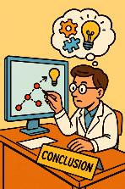
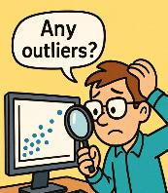
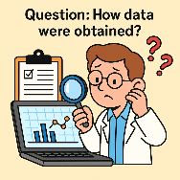
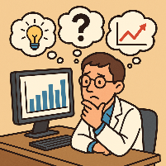
Becoming a Critical Thinker with Data
Question how data were obtained.
Check if the data make sense (are there any obvious errors or outliers?).
Consider alternative explanations for what the data show.
Use logic and reasoning to connect data to conclusions.

Slide 30
Ask Questions about the Data
Who?
Who collected it, who funded it, and who is represented or excluded? Coverage bias systematically omits populations that are harder to reach.
What?
What construct is being measured — and is the measurement actually valid? (e.g., GPA measures academic performance, but does it measure learning?)
When & Where?
When and where was the data collected (could things have changed since then or be different elsewhere)?
Why & How?
Why was the data collected (purpose) and how (methodology)?

Slide 31
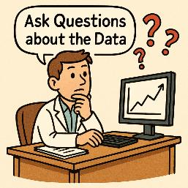
Ask Questions about the Data
Who?
Who collected the data and who is represented in it? Does it include all relevant people or just a subset?
What?
What exactly is being measured and what isn’t?
When & Where?
When and where was the data collected? Could things have changed since then or be different elsewhere?
Why & How?
Why was the data collected (purpose) and how (methodology)?

Slide 32
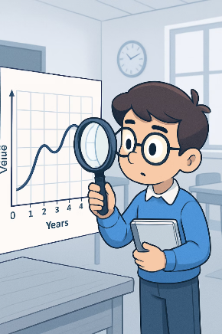
Examine the Evidence
Scrutinize axes: Is the y-axis truncated? Does it start at zero? What does the scale choice emphasize or conceal?
Check methodology disclosures: sample size, response rate, confidence intervals, and p-values are all red flags when missing.
When possible, access the raw data: summary statistics flatten distributions and can hide bimodality, heavy tails, or outlier clusters.
Distinguish statistical significance from practical significance — a result can be statistically real yet too small to matter in the real world.
Build your own interpretation before reading the author’s conclusion — then compare. Where you differ is often where the most interesting analysis lives.

Slide 33
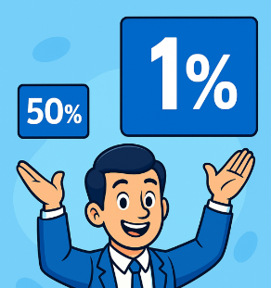

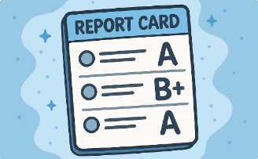
Consider Context
Context gives meaning to the data.
The new movie made $100M!
Is $100 million good? Depends on the budget and industry standards.
I got 75 out 100 from a test.
Is 75/100 good? Depends on the class average and difficulty.
1% might be bigger than 50%.
1% of a city of one million is larger than 50% of a small town with 1,000 population.

Slide 34
Challenge
Claim: “Crime increased 200% this year”
Apply the SIFT framework and answer these questions in your group:
1. A 200% increase from what baseline? (From 1 incident to 3 is also 200%.)
2. Which crime types are included? Violent crime and property crime trend very differently.
3. Could reporting rates have changed (e.g., new online reporting system) rather than actual incidents?
Notes:
Activity: Show isolated statistics without context (e.g., "Crime increased 200% this year"). Students brainstorm what additional information they need to properly evaluate the claim. Skills: Recognizing incomplete information, asking for baseline data and timeframes. Variation: Provide the missing context and have students reassess their initial conclusions.

Slide 35
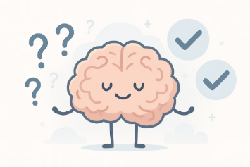
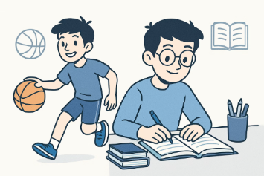

Be Aware of Confirmation Bias
What Is It?
Example
How to Combat It
A cognitive bias where we preferentially seek, interpret, and remember information consistent with our pre-existing beliefs — even when contradictory evidence is equally available.
Related: motivated reasoning — where the conclusion is decided first and “evidence” is gathered to support it rather than to test it.
A researcher who believes social media causes depression may only publish studies that confirm it — this is publication bias, a systemic form of confirmation bias in science.
The backfire effect: when shown contradictory evidence, people sometimes strengthen their original belief rather than update it.
Practice “steel-manning”: construct the strongest possible version of the opposing view before dismissing it.
Pre-mortem thinking: before accepting a result, ask “How could this be wrong?” — a technique used by scientists, auditors, and intelligence analysts.

Slide 36
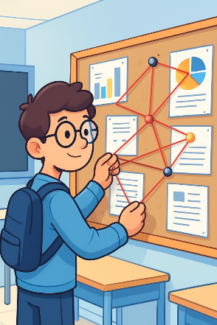
Use Logical Reasoning
Deductive vs. Inductive Reasoning
Deductive: Start with a general rule, apply it to a specific case. Valid logic + true premises = certain conclusion.
Inductive: Observe specific cases and generalize — the foundation of data science. Conclusions are probabilistic, never certain.
Establishing Causation (Not Just Correlation)
Three requirements: temporal order (cause precedes effect), covariation (they move together), and elimination of confounders (no third variable explains both).
Randomized controlled experiments are the gold standard — observational data alone rarely establishes causation.

Slide 37
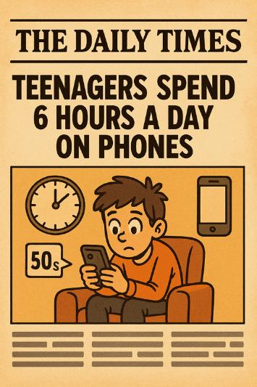
Challenge
Claim: Teenagers spend 6 hours a day on phones.
As a data detective what questions would you ask about the data behind it?
1. Operationalization: What counts as “on a phone”? Active use only? Screen-on time? Music playing in pocket?
2. Measurement method: Self-report surveys vs. screen-time app data — which is more accurate, and why might each be biased?
3. Population: Which teenagers? Age range, geography, socioeconomic background? A global average would look very different from a US suburban average.
4. Distribution: Is 6 hours the mean or median? If a small number of heavy users skew the mean, the median might be 3 hours — a very different story.

Slide 38
Assignment
Work in groups to find a data-backed claim from a news article, research summary, or advertisement. Apply a full methodological audit:
Methodology Evaluation Rubric:
1. Source & Credibility: Who produced this? What are their incentives? Is this peer-reviewed, journalism, or marketing?
2. Methodology: How was the data collected? What was the sample size, sampling method, and response rate?
3. Operationalization: How were key terms defined and measured? Could a different definition change the result?
4. Confounders & Alternative Explanations: What third variables might explain the relationship? Is causation being implied from correlation?
5. Verdict: On a scale of 1–5, how reliable is this claim? What would it take to move the rating up one point?
Deliverable: A 1-page audit report using the rubric above. Be prepared to present your verdict and defend it.

Slide 39
The Journey Ahead
You’ve built the mindset. Now build the toolkit.
Coming up: we move from analyzing data manually to writing code that does it for you — and then to working alongside AI coding agents that can accelerate your analysis.
The Road Ahead
Chapter 2: Data Wrangling — loading, cleaning, and reshaping datasets with Python/pandas
Chapter 3: Visualization — translating data into charts that reveal (and sometimes deceive)
Chapter 4: Coding Agents — using AI as a collaborator to write, debug, and extend your analysis code
The skills you practiced today — skepticism, source evaluation, causal reasoning — are exactly what make you an effective partner with an AI agent.

Slide 40
Bonus: Code It Yourself
Collect class screen-time data, then open a Python notebook and load your numbers into a list. Calculate the mean, median, and standard deviation — compare your manual answer to Python’s output.
Calculate the mean and median. Did an outlier (like someone who said “12 hours”) affect the mean?
Use matplotlib to plot the same data twice: once with a full y-axis (starting at 0) and once truncated. Screenshot both — how different do they look? This is the y-axis manipulation you saw earlier, now in code.

Slide 42
Chapter 1: Introduction – Thinking Like a Data Detective
Introduction to Coding Agents

Slide 43
What Is a Coding Agent?
A coding agent is an AI system that reads instructions in plain English, writes code to carry them out, runs that code, observes the results, and iterates — all in a loop.
How it differs from a regular chatbot:
Chatbot: answers questions with text. Coding agent: executes real code and returns real outputs.
Chatbot: one-shot response. Coding agent: multi-step loop (plan → code → run → check → revise).
What coding agents can do for data analysis:
Load and clean messy datasets, compute statistics, generate visualizations, and explain every step of the code it writes.

Slide 44
How a Coding Agent Thinks
The Agent Loop
1. Understand: Parse your goal from natural language into a concrete task.
2. Plan: Break the task into sub-steps (e.g., load data → filter rows → compute mean → plot).
3. Code: Write Python (or another language) to execute each sub-step.
4. Execute: Run the code and capture any outputs, errors, or warnings.
5. Reflect: If an error occurred or output looks wrong, revise the code and retry.
Why this matters for you:
You direct the agent with your analytical judgment. The agent handles syntax. Together you move much faster than either alone.

Slide 45
You Are Still the Detective
The agent is a tool, not the analyst
A coding agent will do exactly what you ask — even if what you asked was the wrong question. Garbage in, garbage out still applies.
It can compute a correlation coefficient in seconds. It cannot tell you whether the correlation is meaningful without your domain knowledge.
Your critical thinking skills are non-negotiable:
You must frame the right question — the agent cannot know what you are actually trying to understand.
You must evaluate the output — check that results are plausible, the right columns were used, and no silent errors occurred.
You must interpret the findings — statistical output has no meaning until a human connects it to the real world.

Slide 46
Prompting a Coding Agent Effectively
The quality of your output depends on the quality of your prompt
Weak: “Analyze this data.” Strong: “Load the CSV, show me the first 5 rows, then compute the mean and median of the sleep column and flag any values below 4 hours as outliers.”
Prompt best practices:
1. Specify the task precisely: what column, what operation, what output format.
2. Give context: explain what the data represents and what question you’re trying to answer.
3. Ask for explanations: “Explain what each line of the code does” turns every analysis into a learning opportunity.
4. Challenge its output: “Is this the right chart type for this data?” or “What assumptions does this method make?”

Slide 47
Hands-On: Agent-Assisted Data Investigation
Activity (small groups, 20 minutes)
You will use a coding agent to investigate a real dataset. Your job is to direct the agent, evaluate its outputs, and draw conclusions.
Step 1 — Pose a question:
Choose a question your group cares about (e.g., “Is there a relationship between hours of sleep and GPA in this dataset?”).
Step 2 — Direct the agent:
Write a precise prompt asking it to load the data, compute the relevant statistics, and produce a scatter plot.
Step 3 — Evaluate and challenge:
Is the output correct? Are there outliers? Does the chart tell the right story? Ask the agent to adjust and explain its reasoning.
Step 4 — Present your verdict:
What does the data support? What does it not support? What would you need to strengthen the claim?

