Slide 1
Chapter 3: Introduction to R – Your First Data Analysis

Slide 2
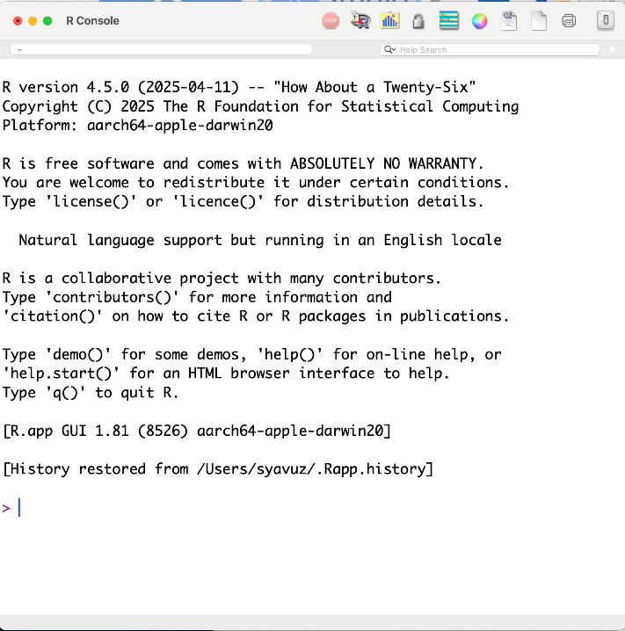
What is R and Why Use It for Data Analysis?
R is an open-source statistical computing language purpose-built for data analysis, modeling, and visualization — used by researchers at Google, the FDA, the New York Times, and most academic journals.
Created by statisticians Ross Ihaka and Robert Gentleman (1993). Free, open-source, and backed by CRAN (Comprehensive R Archive Network) with 20,000+ packages.

Slide 3
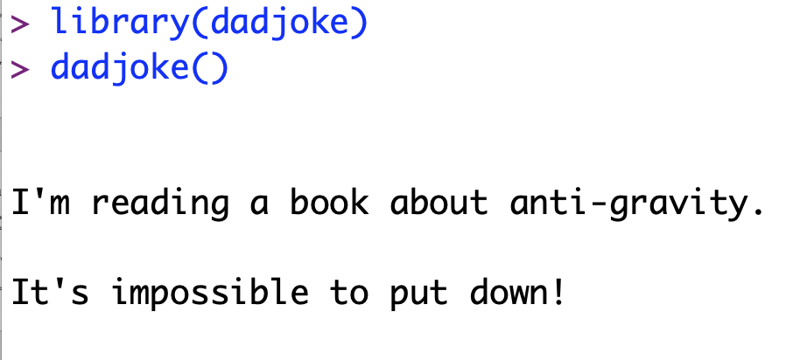
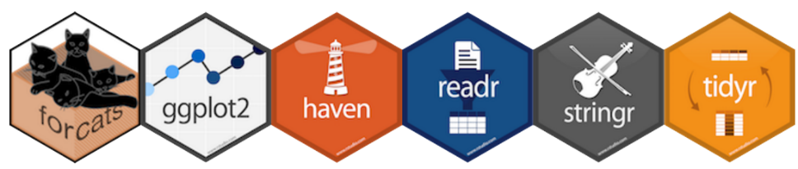
What is R and Why Use It for Data Analysis?
The R ecosystem includes 20,000+ packages on CRAN. The most important: tidyverse (data wrangling), ggplot2 (publication-quality graphics), caret/tidymodels (machine learning), and Shiny (interactive web apps).
R vs Python: R was built by statisticians and excels at statistical tests, mixed models, and reproducible research. Python dominates ML pipelines. Many professional data scientists use both — choose R when the question is statistical.

Slide 4
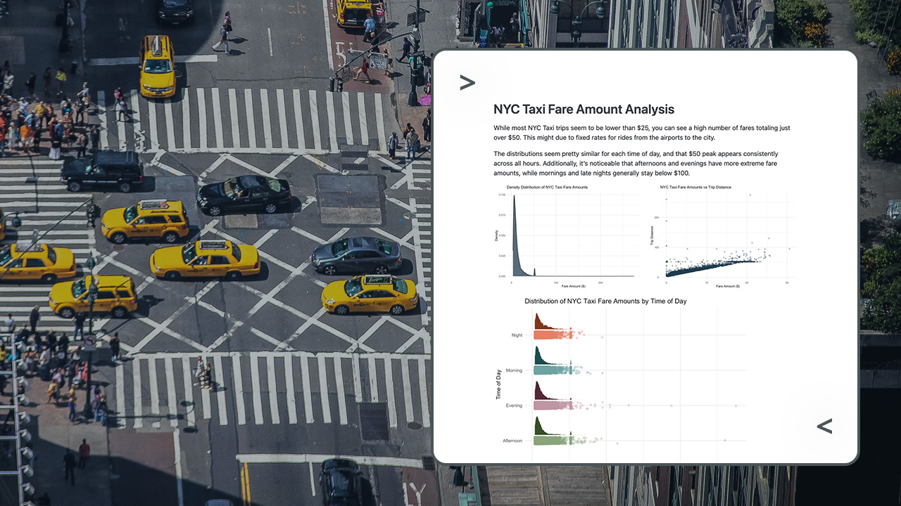
Real world examples
Source: https://posit.co/blog/reporting-on-nyc-taxi-data-with-rstudio-and-databricks/

Slide 5
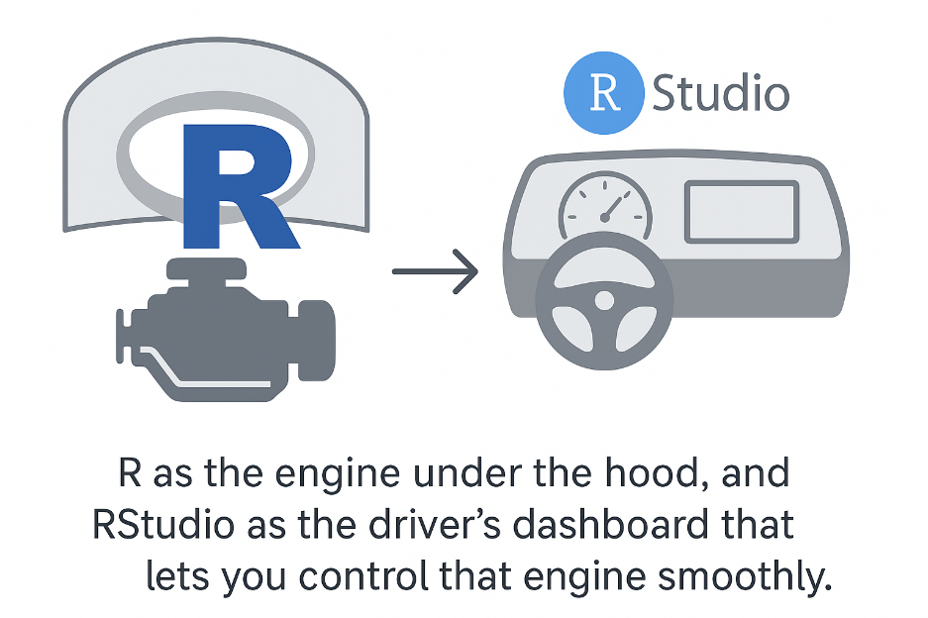
Getting Started: Installing R and RStudio
Rstudio is a user-friendly application that makes coding in R easier.
RStudio is an IDE (Integrated Development Environment), which means it provides tools like a script editor, results console, and plotting window all in one place.

Slide 6
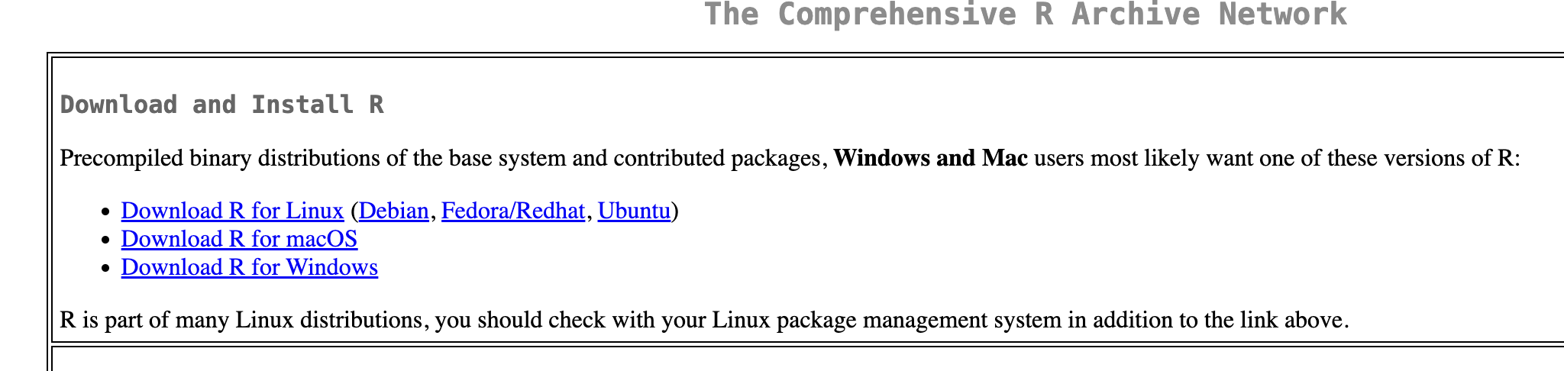
Step 1: Install R
Go to: https://cran.rstudio.com/
Choose your operating system (Windows, Mac, or Linux) and download the latest version of R.
After it’s downloaded follow the prompts and install it into your machine

Slide 7
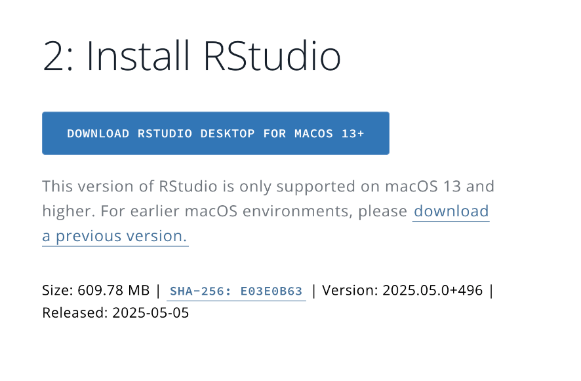
Step 2: Install RStudio.
Go to: https://posit.co/download/rstudio-desktop/
Click on “Download Rstudio …”
Follow the prompts
Install it into your machine

Slide 8
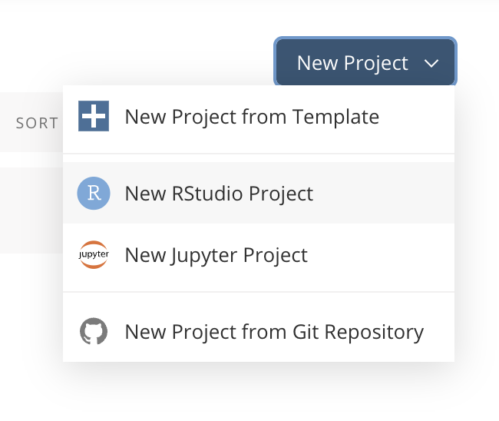
Step 3: In Case You Can’t Install
To use it, go to the RStudio Cloud website: https://posit.cloud/
Sign up for a free account, and create a new project.
You’ll get an interface almost identical to RStudio Desktop.
This way, you can follow along with R coding through your browser without installing anything.

Slide 9
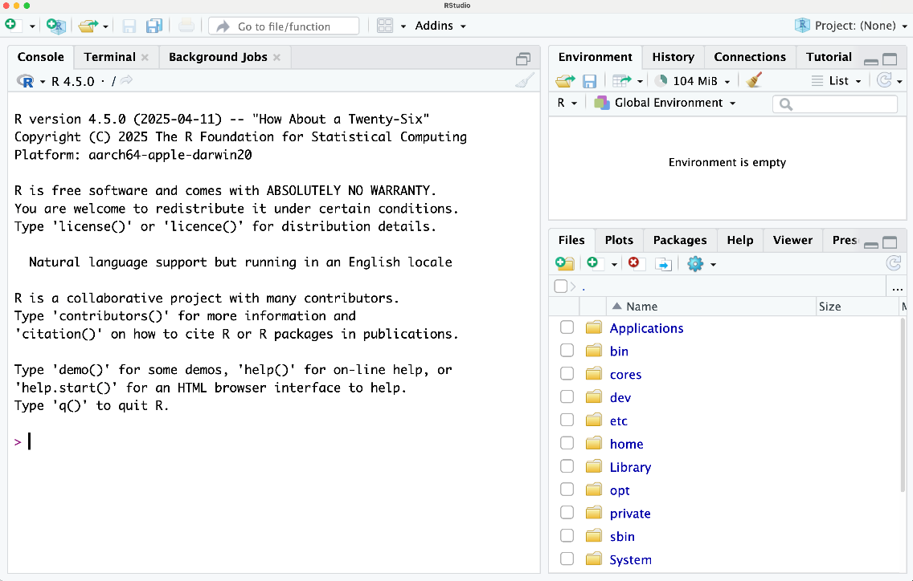

Step 4: Run it!
Run Rstudio
You should see 3 panes
Click on the left top sign to start a new script

Slide 10
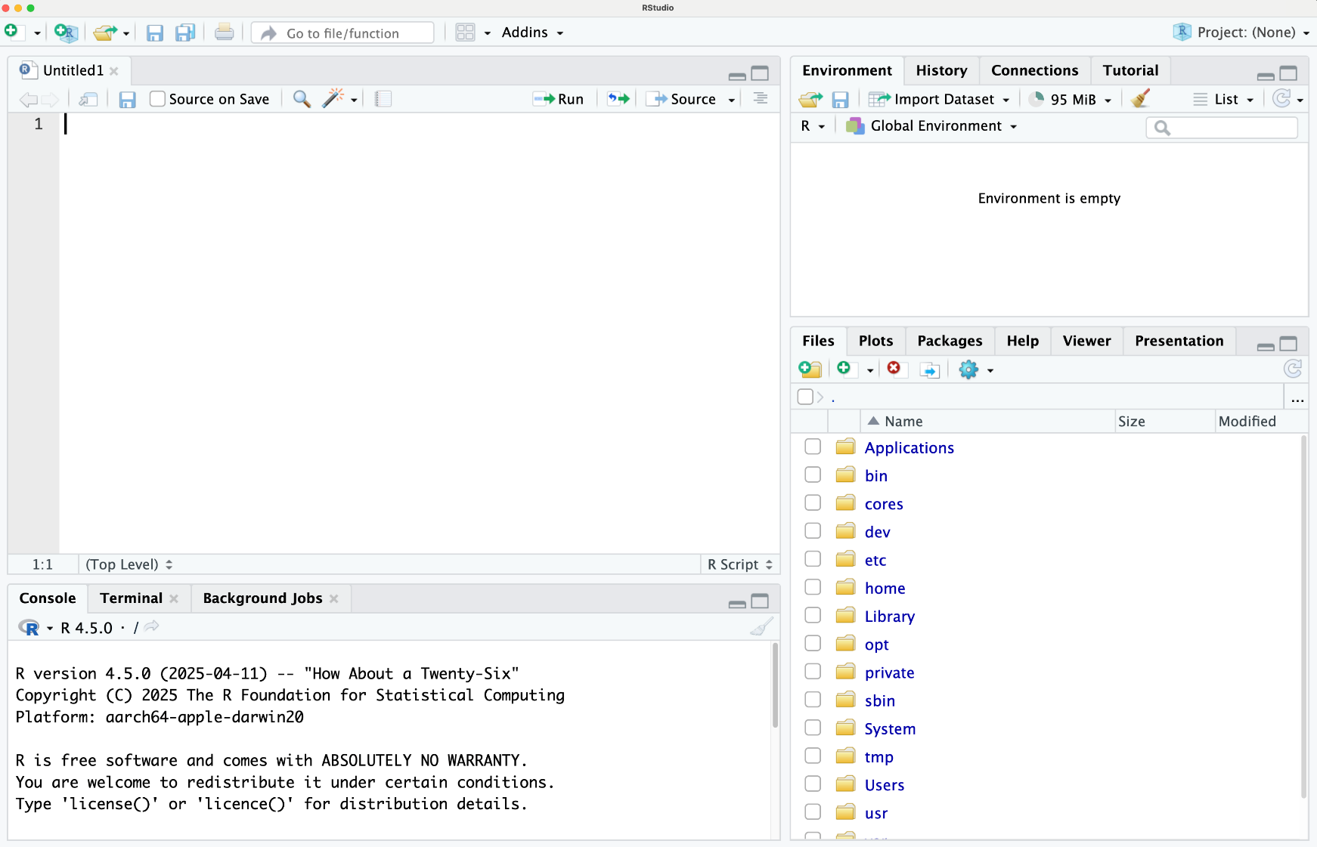
This is a text editor for your R scripts. You can write multiple lines of code, save, and run parts or all of it.
The Environment tab lists all the variables, data frames, and values you have created in your R session.
This pane has multiple tabs
Files: Lets you navigate files on your computer.
Plots: Whenever you create a plot (graph) in R, it will appear here.
Packages: Shows a list of R packages installed on your system.
Help: If you use R’s help system the documentation will appear in this tab.
Viewer: (Sometimes present) Used for viewing web content or interactive reports.
The console is R’s command line. You can type commands one at a time and press Enter to execute or “ctrl+enter” on your script and it will come here.

Slide 11
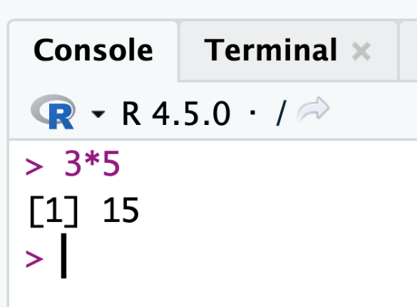
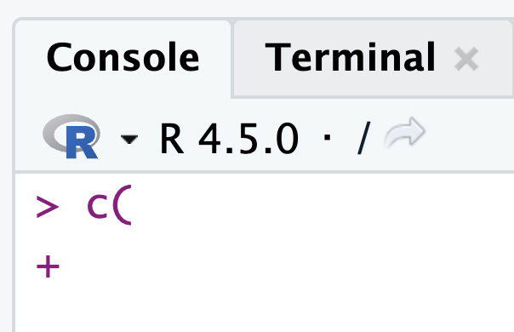
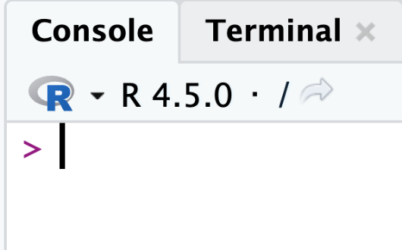
R Console Notes
The console is not running anything and it’s ready to go.
I didn’t close my parenthesis.
It’s waiting for me to finish my line. If you see this check your code!
I just used it as a calculator. Try it, it’s fun!

Slide 12
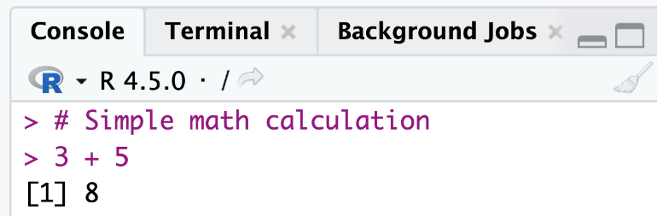
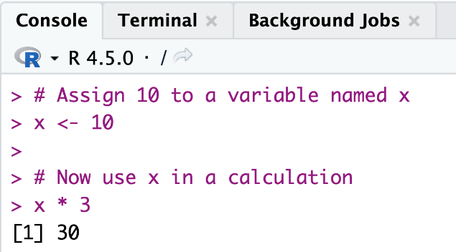
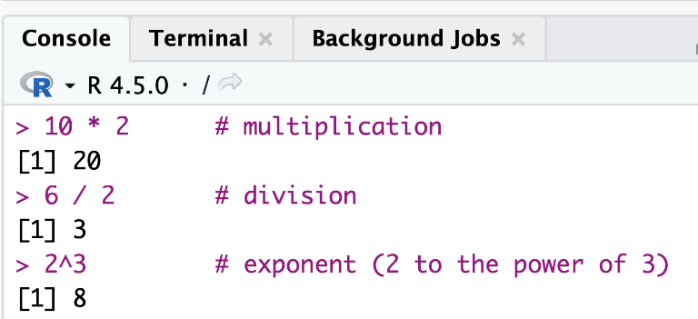
Running Your First R Commands
Quick note: <- and = are the same in R. But sticking to <- will avoid some subtle issues.

Slide 13
Exercise
Part A — Arithmetic and assignment:
Create a <- 5 and b <- 7. Compute: a+b, a-b, a*b, a/b, a^2, b%%a. What does %% (modulo) return?
Part B — Vectors (R’s basic data structure):
scores <- c(85, 92, 78, 95, 61). Compute mean(scores), median(scores), sd(scores), range(scores). What does c() stand for?
Part C — Vector arithmetic is vectorized: try scores * 0.9 (10% grade penalty). What happens? How does this differ from Python lists?

Slide 14
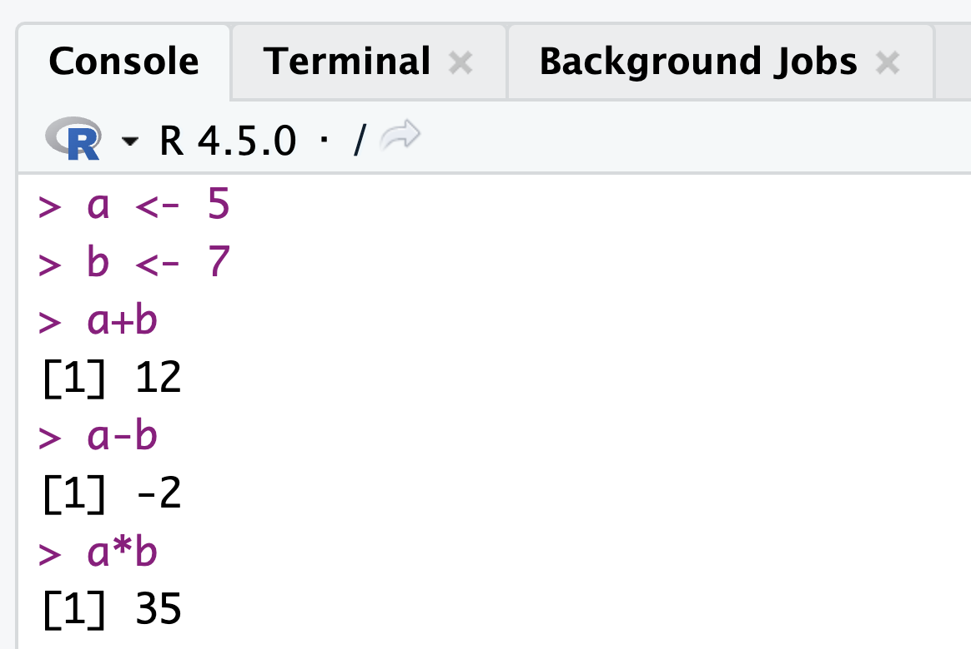
Exercise
Create two variables: a = 5 and b =7
Calculate;
a+b
a-b
a*b

Slide 15

Working with Data: Reading a CSV File in R
Data often comes in files, and a common format is CSV (Comma-Separated Values).
Let’s use a small example dataset about cars (originally derived from mtcars dataset in R).
Contains information on a set of cars:
their fuel efficiency (miles per gallon),
number of cylinders,
horsepower
Source: https://www.ebay.com/itm/362971887232

Slide 16
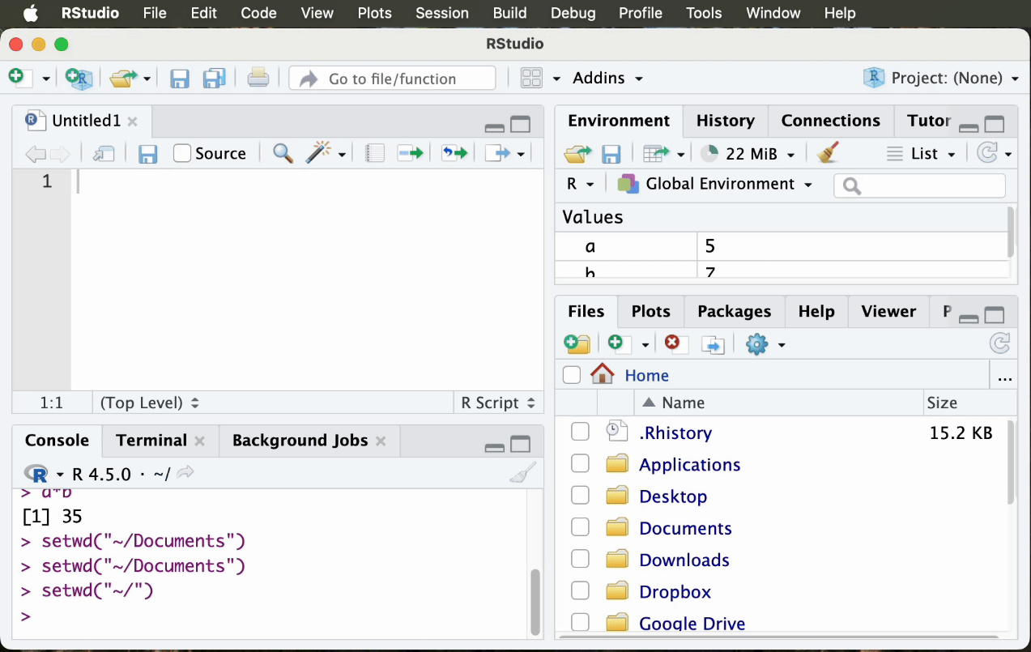
Set Working Directory

Slide 17
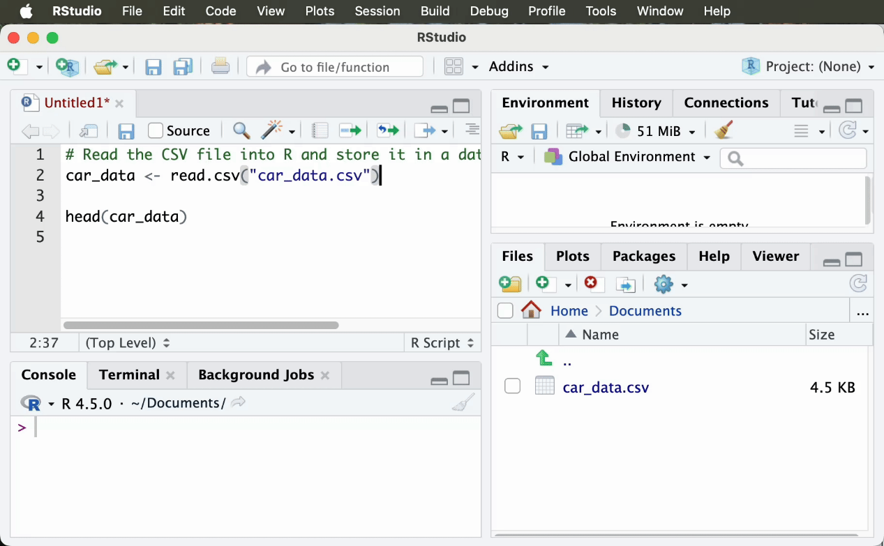
Read the CSV file

Slide 18
What happens when you run “read.csv”?
R opens the file car_data.csv.
It parses the contents, assuming the first line has column names (like "mpg", "cyl", "hp", etc.) and the subsequent lines are data.
It creates a data frame object named car_data in memory to hold the data.
In the Environment panel, you’ll see car_data listed with a preview like obs=74 vars=12.

Slide 19
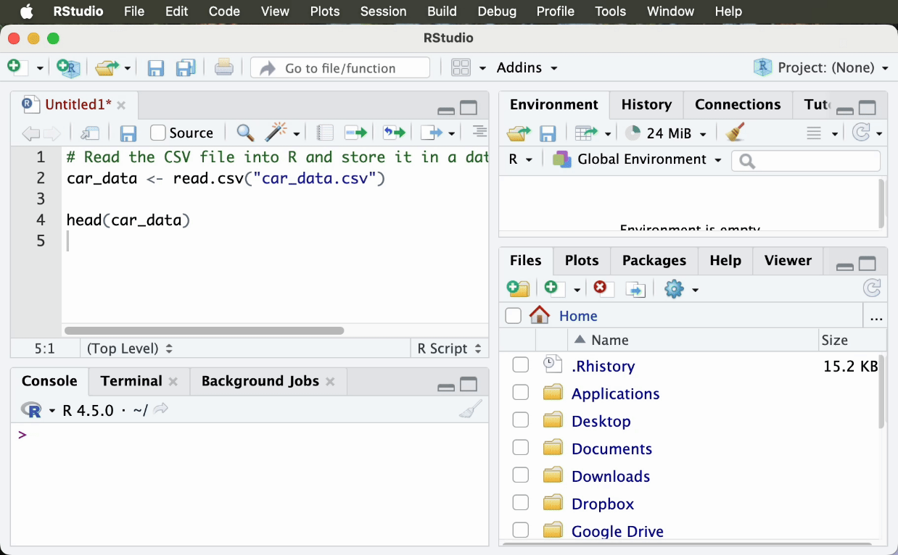
Possible Error Message
If you didn’t’ specify the data path correctly or set your working directory correctly, R can’t find the file.
Solution
Set your working directory again, or
Change your car_data.csv path to correct path.

Slide 20
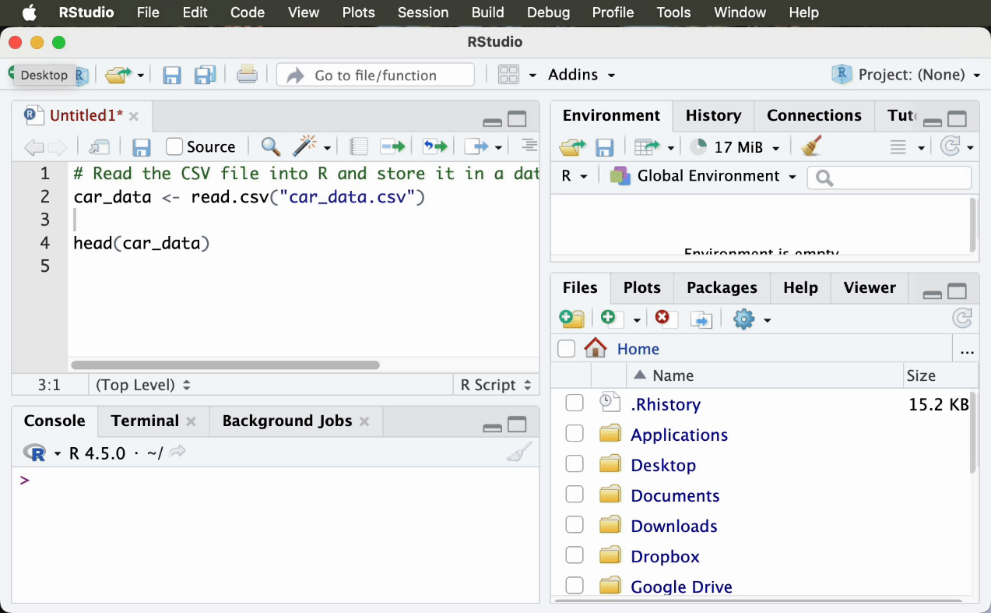
Still having trouble? Another solution
Click File → Import Dataset → From Text (base) → Find and select your file (Open) → Import

Slide 21
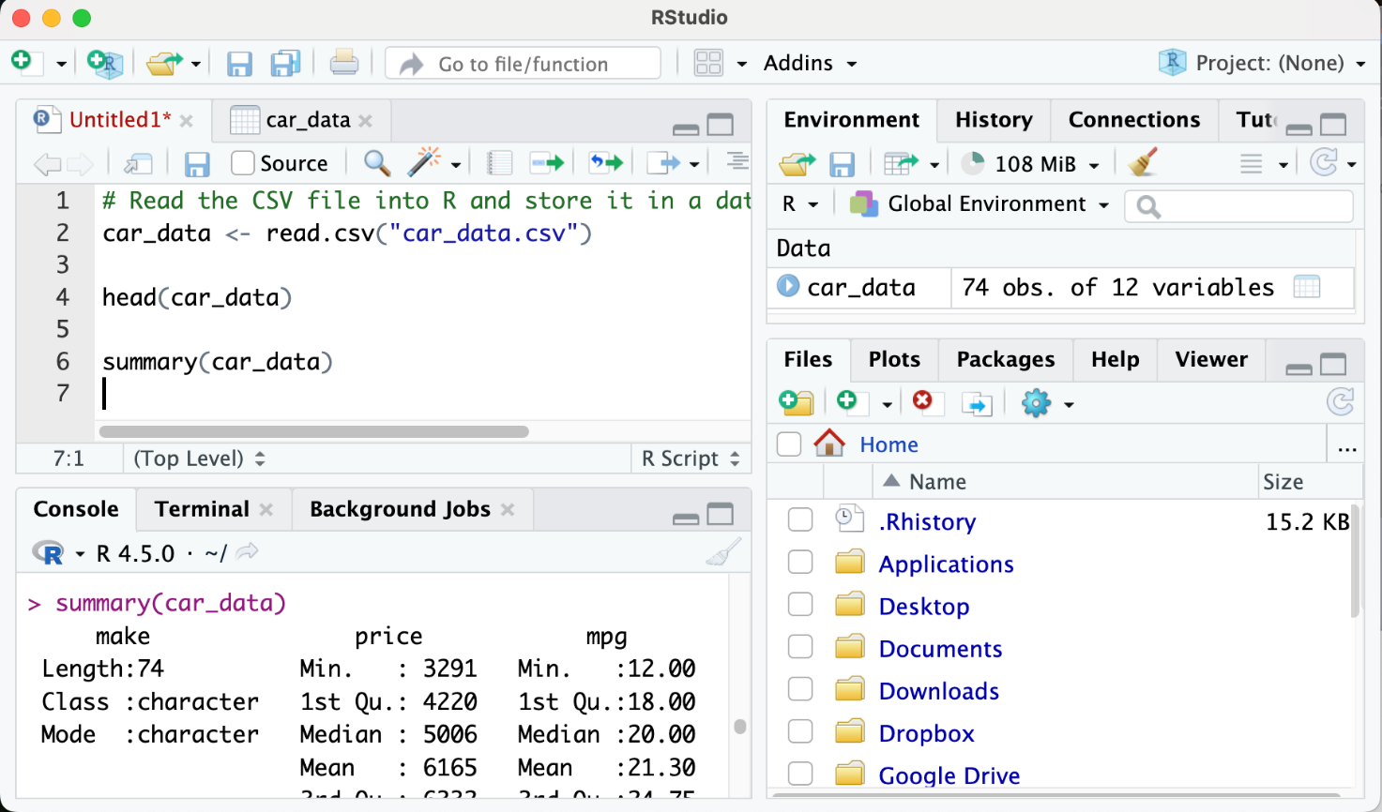
Get Summary Statistics

Slide 22
Some functions
head(df, n=6): first n rows. Run immediately after loading data. str(df) shows column types — critical for catching numeric IDs read as character.
nrow(df) and ncol(df) return dimensions. dim(df) returns both as a vector. names(df) lists all column names.
summary(df): for numerical columns shows Min/Q1/Median/Mean/Q3/Max. For categorical (factor) columns shows frequency counts. Notice when mean and median diverge — that signals skew or outliers.
summary() reveals outliers: when mean >> median, the distribution is right-skewed. Columns showing “NA’s: N” alert you to missing values immediately. Min, 1st Quartile, Median, Mean, 3rd Quartile, and Max.

Slide 23
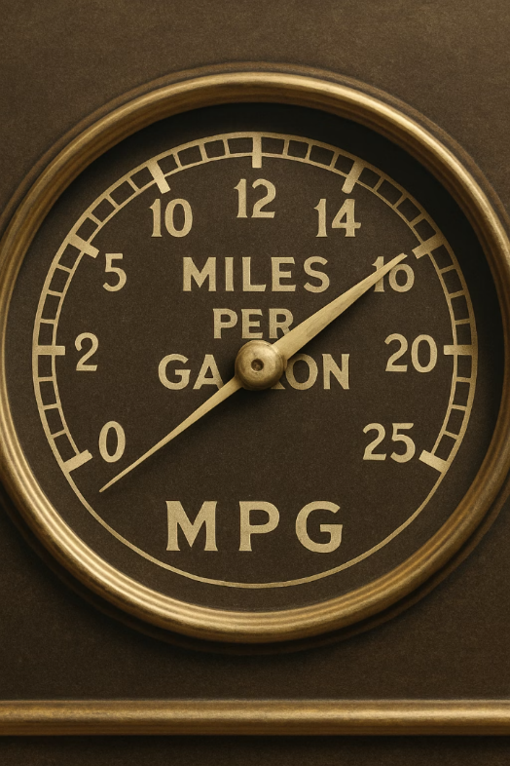
Check your knowledge
What is the min and max mpg?
What is the mean and median mpg?

Slide 24
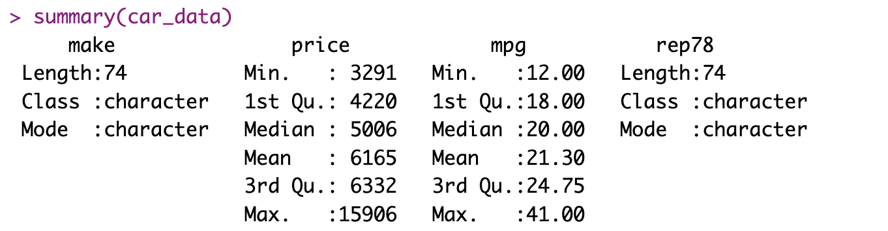
Check your knowledge
What is the min and max mpg?
What is the mean and median mpg?

Slide 25
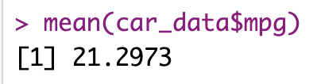
Some more functions
The $ operator extracts a column as a vector. Combine with any R function: mean(), median(), sd(), quantile(), table(). Use logical indexing to filter: car_data$mpg[car_data$foreign==1].
Also valid: car_data[["mpg"]] (bracket notation). In tidyverse dplyr, you access columns directly inside mutate(), filter(), summarise() without $. car_data$mpg selects the mpg vector. Try: quantile(car_data$mpg, probs=c(0.25, 0.75)) to get the IQR boundaries. car_data data frame.” In R, the $ operator lets you access a column by name.

Slide 26

Your turn!
Calculate mean, median, and standard deviation of car price. Then: is the mean or median a better measure of typical price? Why? Use summary(car_data$price) to check for outliers.
Extension: compute the coefficient of variation (sd/mean * 100). What does it tell you about price variability? These are 1974 prices — a $6,000 car in 1974 is roughly $38,000 today.

Slide 27
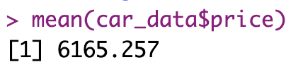
Your turn!
Calculate the mean price of a car using the mean function!

Slide 28
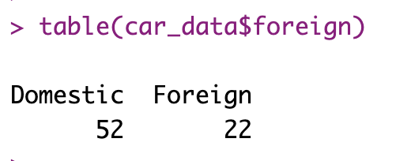
Frequency “table” function
“table” function provides us the frequency values for each category.
For example, there is a variable called “foreign”, which shows whether the car is domestic or foreign.
We can find how many of them are domestic and how many of them are foreign using the table function.

Slide 29
Writing and Running R Scripts
It’s OK to run your codes on Console for a quick check.
But for a project or assignment, you’ll want to save your code so you can run it again or share it.
This is where the script comes in.
Creating a script: In RStudio, go to File -> New File -> R Script

Slide 30
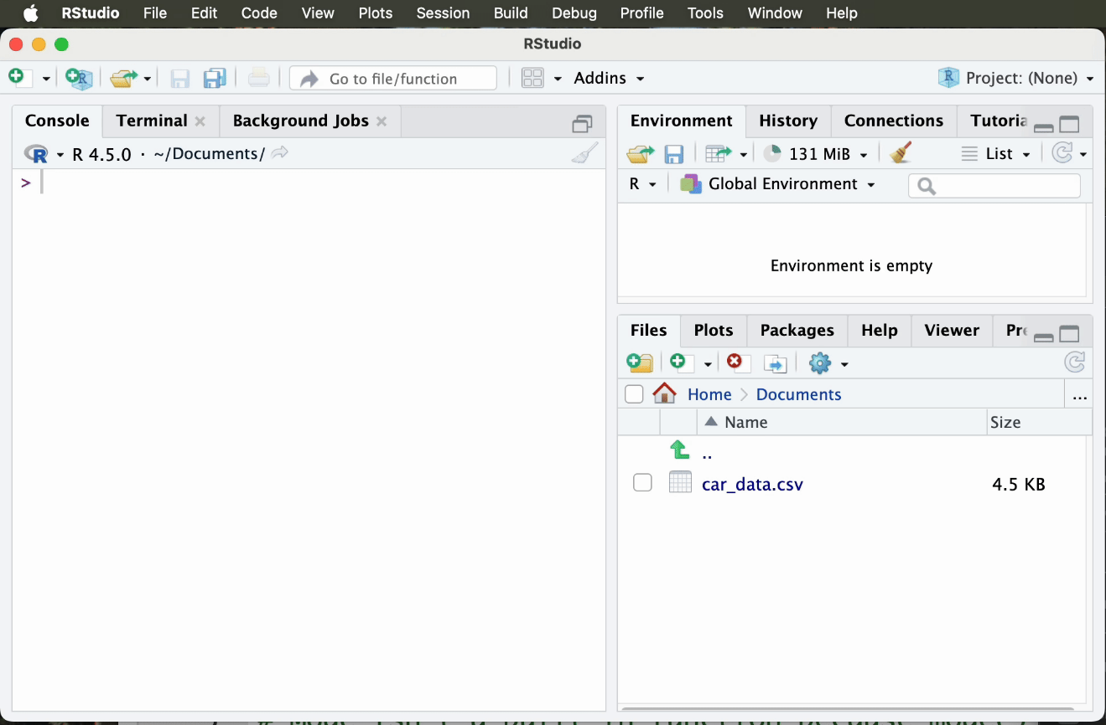
New Script

Slide 31
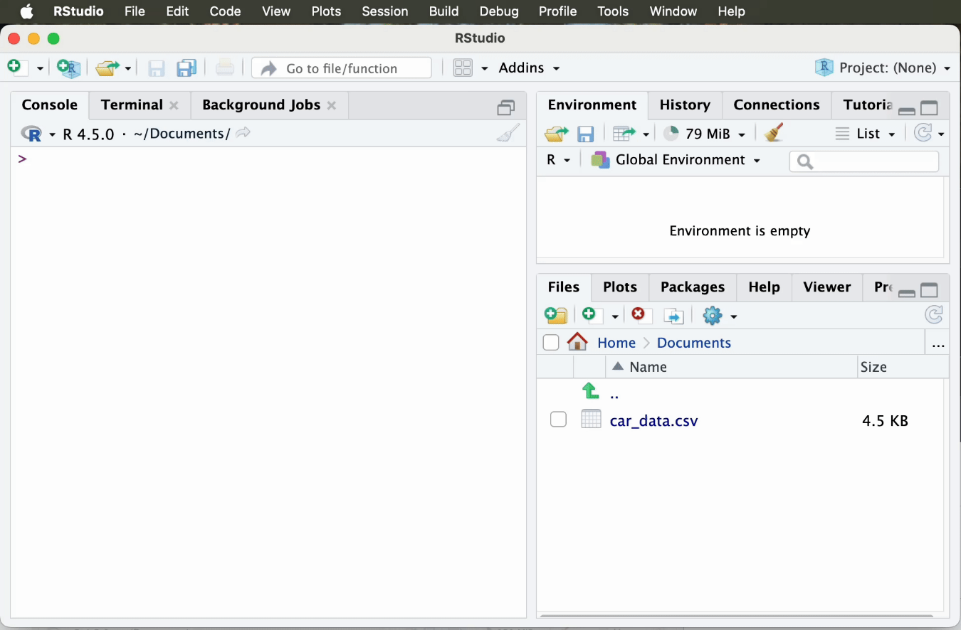
New Script - 2

Slide 32
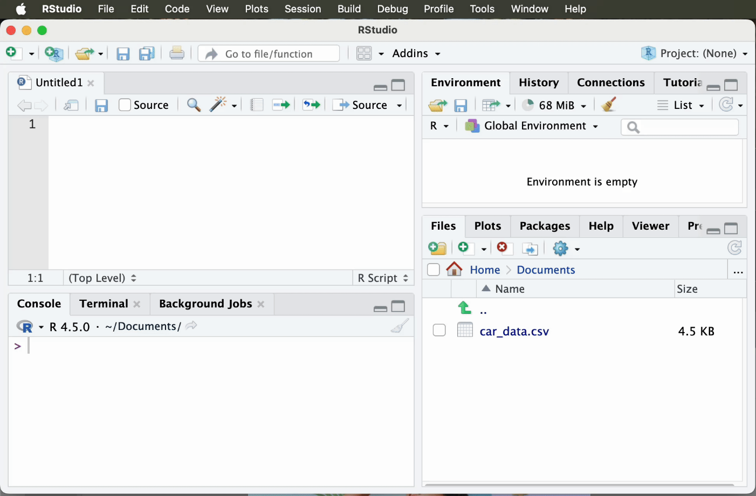
Save Your Script

Slide 33








Benefits of Using Scripts
Reproducibility
Organization
Scientific reproducibility: anyone with your script and data can rerun your exact analysis. This is now required by many journals and organizations.
Version control: scripts can be tracked with Git, so you can see every change made and roll back mistakes — essential for professional and academic work.
Sharing
Troubleshooting
Collaboration: share your .R script and others can reproduce, extend, or peer-review your work — the foundation of open science.
Auditability: every transformation is documented in code, not hidden in manual spreadsheet steps. Your analysis can be independently verified.

Slide 34
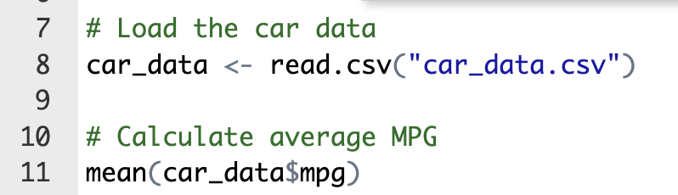
Using Comments in Scripts
What Are Comments?
Text preceded by # symbol that R ignores when running code.
Used to explain what your code does in plain language.

Slide 35




Data Visualization: Why It Matters
See Patterns
Tell Stories
A mean of 21 MPG tells you little — a histogram instantly shows whether the distribution is symmetric, skewed, bimodal, or has outliers. Numbers compress; plots reveal.
The grammar of graphics (ggplot2): every chart is built from data + aesthetic mappings + geometric layers. This mental model applies across R, Python (seaborn/plotly), and Vega-Lite.
Generate Insights
Base R plots are fast for exploration; ggplot2 is the standard for publication and presentation. We start with base R, then introduce ggplot2 syntax.

Slide 36
Simple Data Analysis Example: Summaries and Visualizations
We start with base R graphics for speed. In practice, ggplot2 is the standard — we preview its syntax after the base R examples. Both produce the same plots; ggplot2 scales to complex, layered visualizations.
A Histogram of a numeric variable (MPG) to see its distribution.
A Bar Chart of a categorical-like variable (number of foreign cars) to see how many cars fall into each category.

Slide 37
Histogram of MPG
A histogram shows the distribution of a continuous numeric variable by grouping values into “bins” (ranges) and plotting bars for the count of observations in each bin.
In base R, we will use the hist() function:
# Plot a histogram of the MPG (Miles per Gallon) column
hist(car_data$mpg,
main="Distribution of Car MPG",
xlab="Miles per Gallon (MPG)",
col="skyblue", border="black")

Slide 38
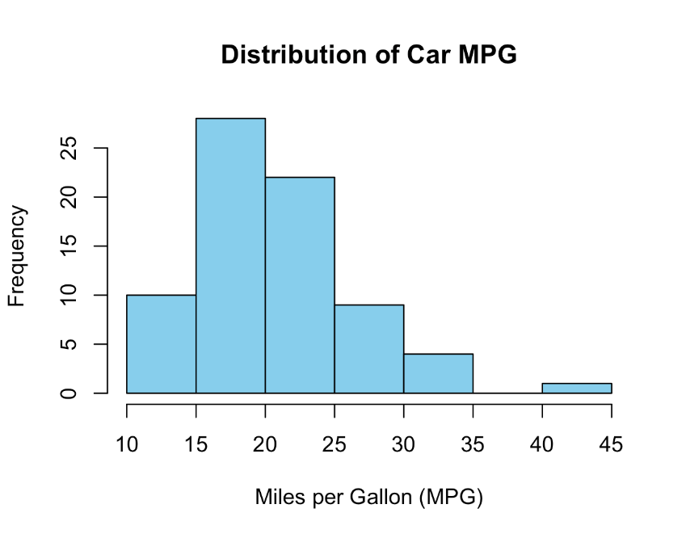
Histogram of MPG
# Plot a histogram of the MPG (Miles per Gallon) column
hist(car_data$mpg,
main="Distribution of Car MPG",
xlab="Miles per Gallon (MPG)",
col="skyblue", border="black")

Slide 39
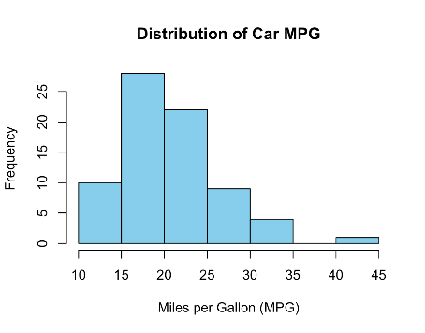
Histogram of MPG – Let’s break down the argument
# Plot a histogram of the MPG (Miles per Gallon) column
hist(car_data$mpg,
main="Distribution of Car MPG",
xlab="Miles per Gallon (MPG)",
col="skyblue", border="black")
Data we want to plot
Color fills the bars
Color outlines the bars

Slide 40
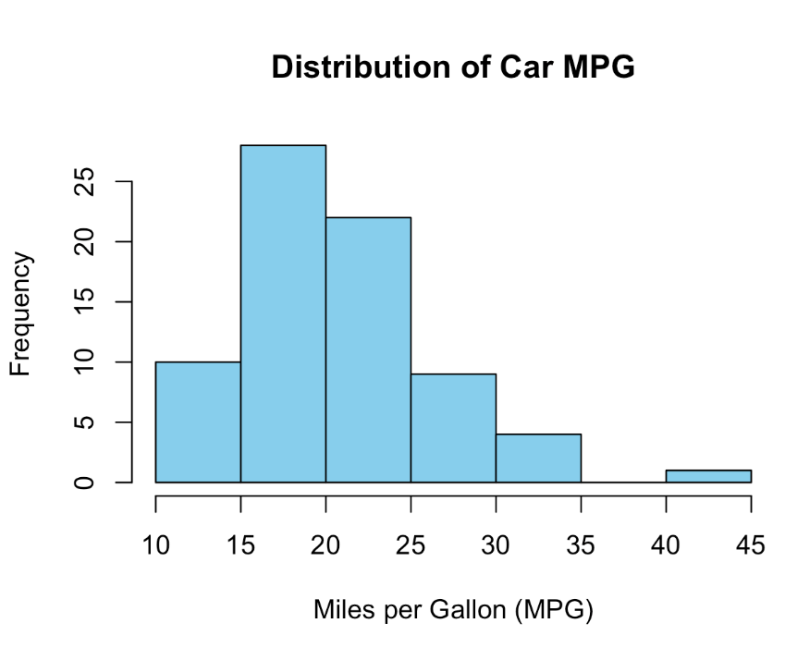
Histogram – Interpretation
This histogram shows the distribution shape of MPG. Shape reveals more than any single statistic — here we can assess skewness, outliers, and the most common value range.
This distribution is right-skewed: the right tail extends further. This means mean > median, and a few high-MPG outliers pull the average up.
The mode is in the 15–20 MPG bin. The median is a better center than the mean for skewed data. Detective question: did you expect this shape before plotting? in that range.
Detective question: if you only saw the mean MPG of 21.3, would you have guessed this shape? This is exactly why visualization precedes modeling — distributions tell stories statistics summarize away.

Slide 41
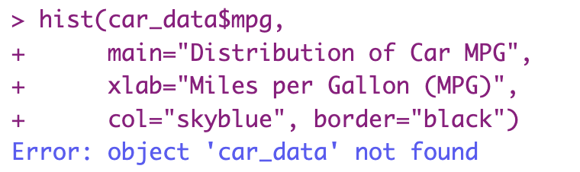
Quick Tip: Read the error
You will get an error message now or later. Read the error message!
The below message says, R can’t find the data file. If you get this error, it means that “car_data” is not in your environment and you need to read it.

Slide 42
Bar Chart
Let’s visualize the distribution of a categorical variable: the number of foreign cars.
Base R has a barplot() function, which can take a vector of counts and plot bars.
We can pipe the output of table() directly into barplot()
for_counts <- table(car_data$foreign)
barplot(for_counts,
main="Number of Cars by Production Location",
xlab="Production",
ylab="Number of Cars",
col="coral")

Slide 43
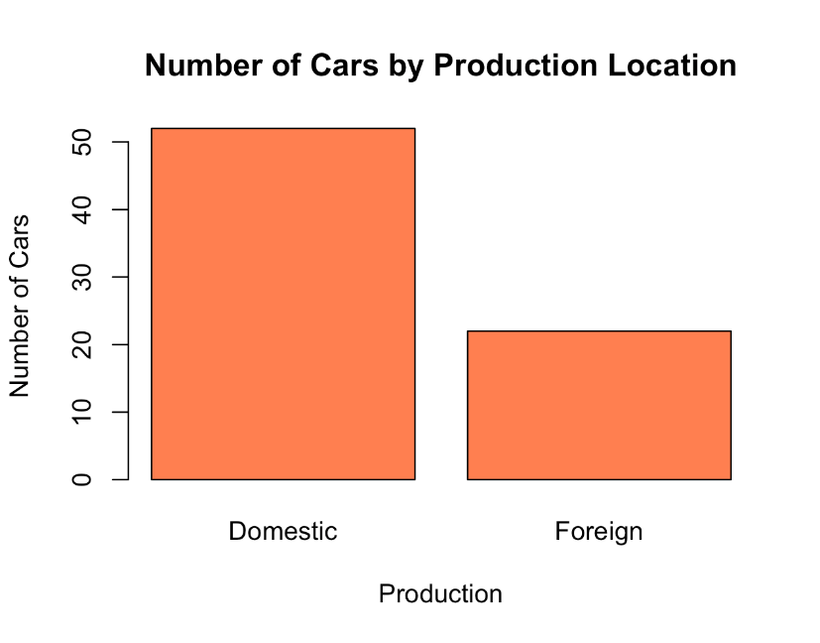
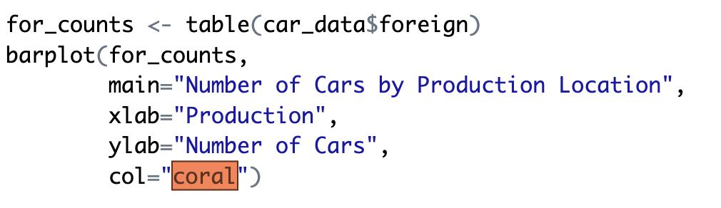
Bar Chart

Slide 44

Bar Chart – Let’s break down the argument
creates a table of counts
We pass the table count as the data
Title and axis labels
Filling color of the bars

Slide 45
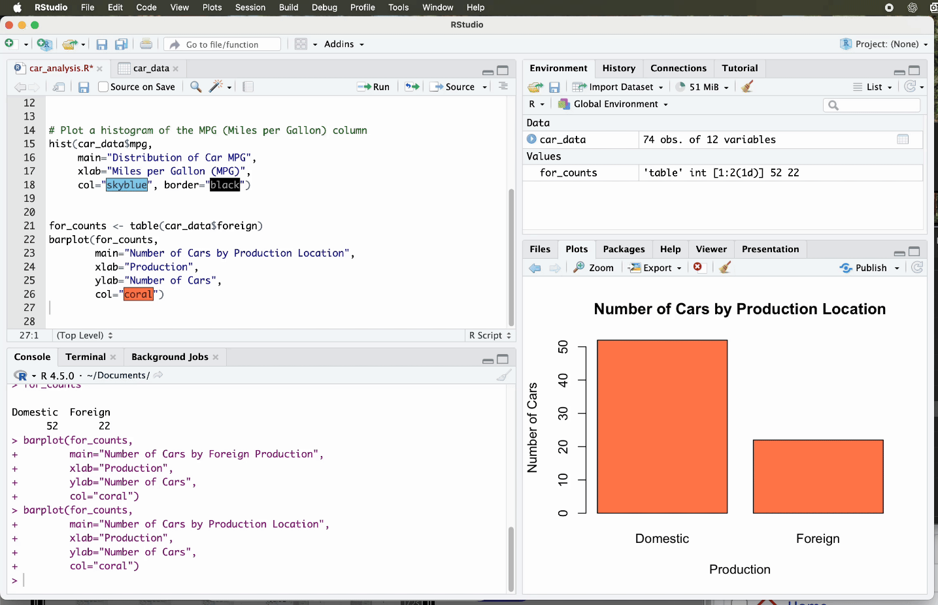
Saving Your Plots (Optional)

Slide 46
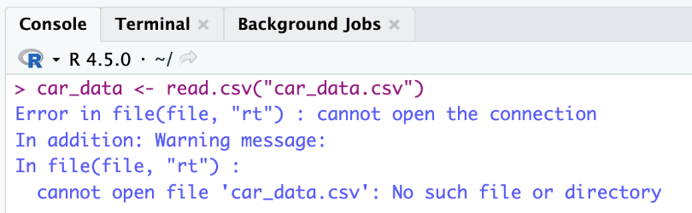

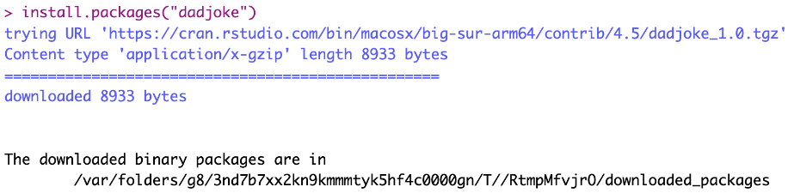

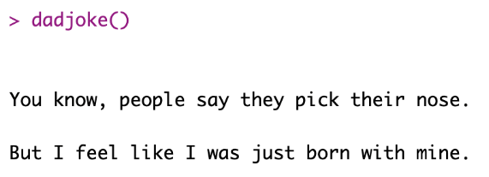
Common Pitfalls and How to Troubleshoot
Means you forgot to load the package that provides that function. You can install the package as shown below.
File not found error
This means R cannot find the file.
Usual file path problem.
Ensure that the CSV is in your working directory or provide the correct path.
getwd() → Shows your working directory
setwd("path/to/your/folder") → sets your working directory
After installation, you need to call it from the library.
Finally, the function works!

Slide 47
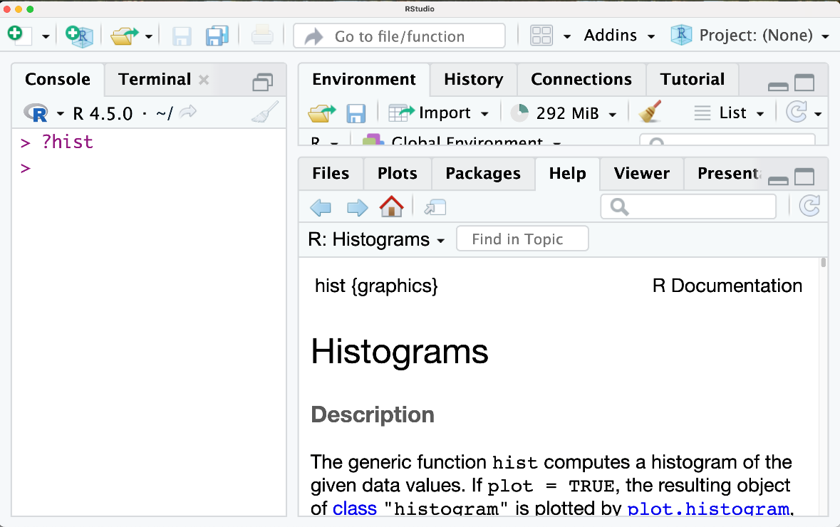
How to use R help?
You can get the help document for almost any function by typing question mark and the function name

Slide 48
Chapter 3 Summary
R as an analytical environment:
✓ R is a statistical computing language with 20,000+ packages. Its vectorized operations and built-in statistical functions make it purpose-built for data analysis.
✓ RStudio provides a four-pane IDE: script editor, console, environment, and plots/packages/help. Scripts ensure reproducibility; comments document intent.
Working with data:
✓ Data frames: 2D tabular structure. Access columns with $. Always run str(), head(), and summary() after loading data to detect type issues, missingness, and outlier signals.
✓ Visualization reveals what statistics compress: skewness, outliers, bimodality, and patterns only visible in shape. Base R hist() and barplot() for exploration; ggplot2 for presentation.
Key mindset:
✓ Always plot before modeling. When mean and median diverge, investigate why. A right-skewed distribution suggests outliers pulling the mean — the median tells the more typical story.

Slide 49
Your Turn!
Create a histogram of the price similar to what we did for MPG. Describe the shape: is it skewed or roughly symmetric? Are there multiple peaks?

Slide 50
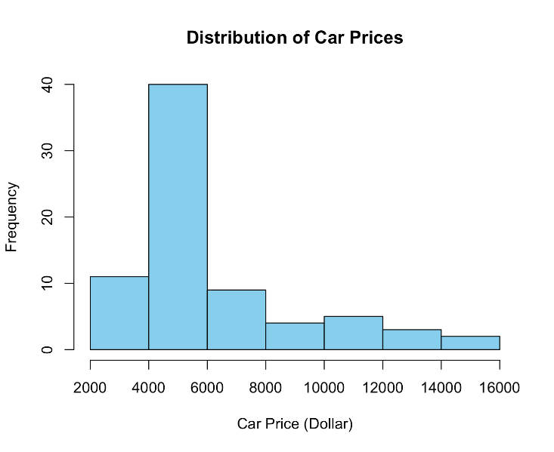
Your Turn!
Create a histogram of the price similar to what we did for MPG. Describe the shape: is it skewed or roughly symmetric? Are there multiple peaks?
car_data <- read.csv("car_data.csv")
hist(car_data$price,
main="Distribution of Car Prices",
xlab="Car Price (Dollar)",
col="skyblue", border="black")

Slide 51
Your Turn!
Most cars are between 4,000 and 6,000 dollars and the most expensive ones are around $16,000.
car_data <- read.csv("car_data.csv")
hist(car_data$price,
main="Distribution of Car Prices",
xlab="Car Price (Dollar)",
col="skyblue", border="black")

Slide 52
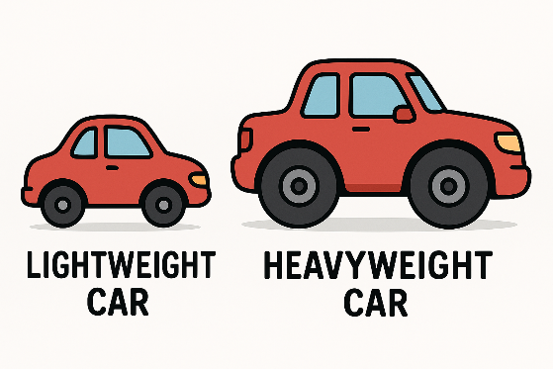
Challenge
Use plot() to create a scatter plot of weight vs. MPG. Before running the code, formulate a hypothesis: what direction do you expect the relationship to go, and why?
After plotting: (1) Describe the direction, form, and strength of the relationship. (2) Are there outliers? (3) Does this look linear or curved? (4) What does this suggest about the physics of fuel efficiency?

Slide 53

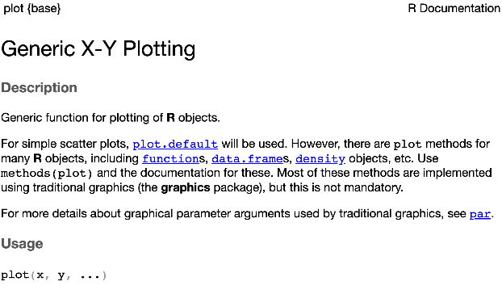
Challenge
First, find which variables to use:
Weight and MPG
Second, which variable to use:
plot function would work fine
If you don’t know how to do it, you can check the help file by
?plot
Let’s run it now!

Slide 54
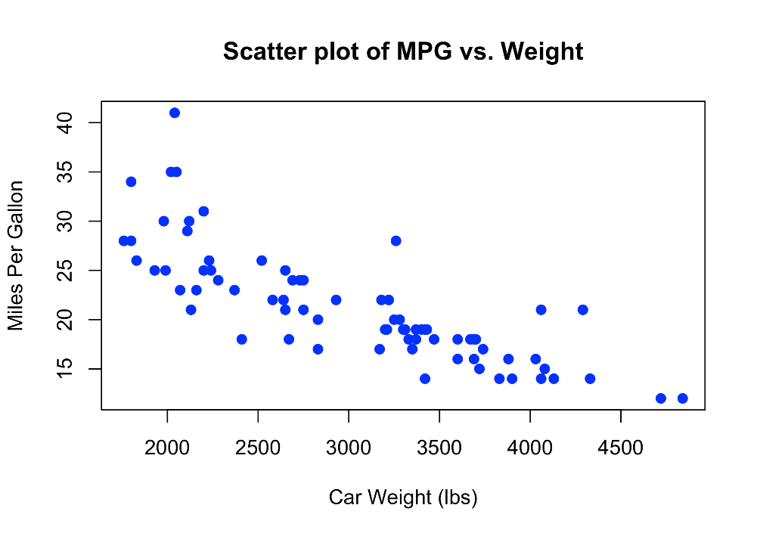
Challenge
plot(car_data$weight, car_data$mpg,
main = "Scatter plot of MPG vs. Weight",
xlab = "Car Weight (1000 lbs)",
ylab = "Miles Per Gallon",
pch = 19, # solid circles
col = "blue")
Interpretation: As car weight increases, miles per gallon (MPG) generally decreases, indicating that heavier cars tend to be less fuel efficient.

Slide 55

Reflection Questions
What Was Easy?
What Was Challenging?
Which R concepts map directly to Python (from Ch. 2)? Which are fundamentally different? What does R’s vectorized arithmetic imply about how it handles data?
The $ operator, working directory, and factor data types trip up most new R users. What mental model helped you understand them? What would you explain differently to someone new?
What Story Does the Data Tell?
Based on MPG, weight, and price distributions: what hypotheses would you form about what drove car design in the 1970s? How would you test them with the data available?

Slide 57
Chapter 3: Introduction to R
Coding Agents for R-Based Analysis

Slide 58
Using a Coding Agent with R
A coding agent can write, run, and debug R code based on your natural language instructions — but you must frame the analytical question precisely.
What the agent handles: syntax (function names, argument order, $ notation), package loading, error messages, and iterating on plot aesthetics.
What you must handle: choosing the right statistical method, interpreting whether the output answers your actual question, and catching plausible-but-wrong results.
Workflow: (1) Describe your dataset and question. (2) Ask for EDA first (str, summary, head). (3) Request specific plots or statistics. (4) Verify the output against what you know about the data.
Key risk: agents confidently produce incorrect code. Always check — does the output match what summary() told you? Are the axis labels right? Is the sample size what you expected?

Slide 59
Prompting a Coding Agent for R Analysis
Weak prompt vs. strong prompt — the difference is specificity and analytical framing:
Weak: "Analyze the car data." → Agent may produce arbitrary outputs that don’t answer any specific question.
Strong: "Load car_data.csv. Run str() and summary(). For the mpg column: compute mean, median, sd, and IQR. Then produce a histogram with 10 bins. Describe whether the distribution is skewed and why mean vs median differ."
Follow-up prompts that sharpen the analysis:
"Is the relationship between weight and mpg linear? Produce a scatter plot and overlay a regression line using abline(lm(mpg~weight, data=car_data))."
"Compare the mean and median mpg for domestic vs. foreign cars separately. Which group has higher variability? Use tapply()."
"Flag any car with mpg more than 2 standard deviations from the mean as an outlier. Print those rows."

Slide 60
Hands-On: Agent-Assisted R Analysis
Activity (pairs, 25 minutes) — use car_data.csv with a coding agent:
Step 1 — Data audit: Prompt the agent to run str(), head(), summary(), and dim(). Report the number of rows, columns, data types, and any columns with NA values.
Step 2 — Distribution analysis: Ask for histograms of mpg, weight, and price. For each, identify: is it skewed? Symmetric? Are there visible outliers? Which measure of center is most appropriate?
Step 3 — Group comparison: Use tapply() to compare mean mpg for domestic vs. foreign cars. Then ask: is this difference statistically meaningful, or could it be sampling noise?
Step 4 — Catch the agent: Deliberately ask a vague question ("tell me something interesting"). Evaluate whether the agent’s response actually answers a meaningful analytical question.
Present: one insight that surprised you, and one output you had to correct or reframe.

Slide 61
Chapter 3: What You Can Do Now
R environment:
✓ Set up RStudio (or Posit Cloud), run scripts, and use comments to document analytical decisions.
✓ Load CSV data with read.csv(), inspect with str()/head()/summary(), and access columns with the $ operator.
Data analysis in R:
✓ Compute mean, median, sd, quantile(), and table() on real data. Interpret summary() output to identify skew, outliers, and missing values.
✓ Create histograms, bar charts, and scatter plots in base R. Interpret distribution shape — connecting visual patterns to statistical concepts (skewness, outliers, central tendency).
Agent-assisted analysis:
✓ Write precise analytical prompts for a coding agent working in R. Verify its outputs against known summary statistics and catch plausible-but-wrong results.

