Slide 1
Chapter 8: Exploring the Clues – Intro to Exploratory Data Analysis (EDA)
From Raw Numbers to Real Insights — The Art of Asking the Right Questions

Slide 2

Exploring the Clues: Intro to Exploratory Data Analysis
Welcome to the world of data detective work! In this chapter, we'll learn how to explore and understand data before jumping to conclusions.

Slide 3




What is Exploratory Data Analysis?
Detective Work
Visual Methods
EDA is like using a magnifying glass to inspect data and understand its story.
We use charts and graphs to see patterns that might be hidden in numbers.
Creating a Map
EDA gives us a "map" of the data landscape before we dive deeper.

Slide 4
Why EDA Matters
Discover Insights
Find patterns and relationships you might otherwise miss
Catch Problems
Identify errors and outliers early
Guide Analysis
Know which direction to take your investigation

Slide 5
The Purpose of EDA
Understand Variables
Examine Distributions
What data do we have and what does it represent?
How are values spread out? Are scores mostly high, low, or even?
Find Relationships
Spot Errors
Do students who study more tend to have higher
grades?
Is a student's age listed as 200? That's clearly wrong!

Slide 6
EDA is Like Solving a Mystery
Without EDA
Trying to solve a puzzle without looking at the picture on the box
Jumping to conclusions without gathering all the clues
Missing important patterns that could lead to wrong answers
With EDA
Examining all the evidence before making judgments
Letting the data tell its own story
Building a solid foundation for deeper analysis

Slide 7
Chapter 8
Getting Started: Sorting, Filtering, and Grouping Data

Slide 8
Basic Tools: Sorting
What is Sorting?
Arranging data in order (highest to lowest, alphabetical, etc.)
Why Sort?
Quickly find extreme values (highest/lowest scores)
Example
Sorting exam scores shows Carlos (95) is top performer, Brian (72) scored lowest

Slide 9
Let’s Sort it out!
Name | Class | Exam Score
Alice | A | 88
Brian | B | 72
Carlos | A | 95
Diana | B | 85
Eva | A | 91
Frank | B | 78
Here is the data
Use R and Python to sort by Exam Scores

Slide 10
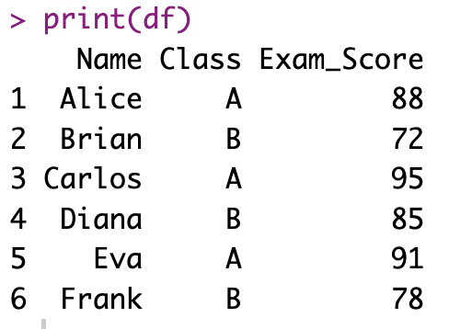
Sort it with R
# Create the data
df <- data.frame(
Name = c("Alice", "Brian", "Carlos", "Diana", "Eva", "Frank"),
Class = c("A", "B", "A", "B", "A", "B"),
Exam_Score = c(88, 72, 95, 85, 91, 78)
)
# View the data
print(df)

Slide 11
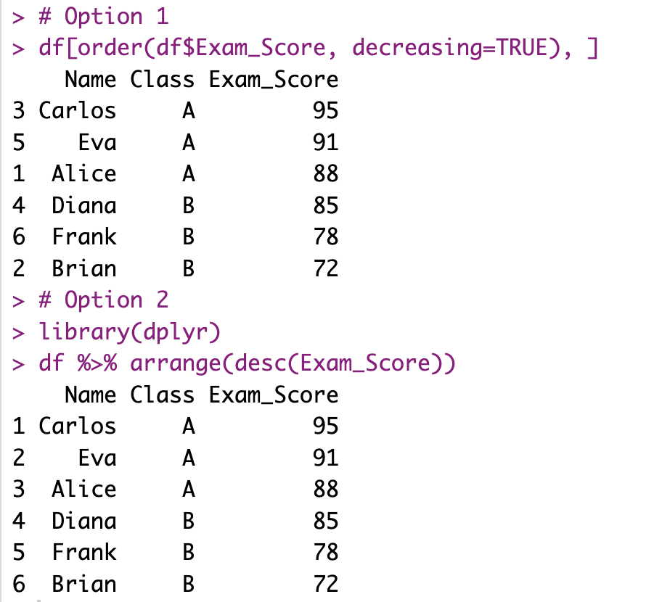
Sort it with R - 2
# Option 1
df[order(df$Exam_Score, decreasing=TRUE), ]
# Option 2
library(dplyr)
df %>% arrange(desc(Exam_Score))

Slide 12
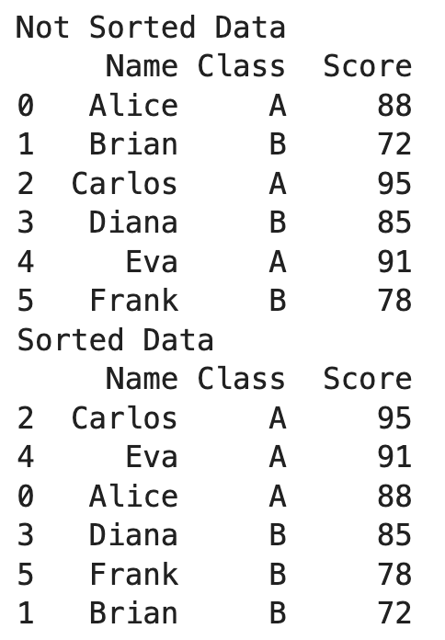
Sort it with Python
import pandas as pd
# Example data as a list of dictionaries
students = [
{"Name": "Alice", "Class": "A", "Score": 88},
{"Name": "Brian", "Class": "B", "Score": 72},
{"Name": "Carlos", "Class": "A", "Score": 95},
{"Name": "Diana", "Class": "B", "Score": 85},
{"Name": "Eva", "Class": "A", "Score": 91},
{"Name": "Frank", "Class": "B", "Score": 78}
]
df = pd.DataFrame(students)
print("Not Sorted Data")
print(df)
# Sort by Score in descending order
sorted_df = df.sort_values(by="Score", ascending=False)
print("Sorted Data")
print(sorted_df)

Slide 13




Basic Tools: Filtering
What is Filtering?
Selecting only rows that meet certain conditions
Why Filter?
Focus on relevant subsets of data (e.g., only Class A students)
Example Uses
Show only failing grades that need attention
Focus on responses from a specific time period

Slide 14
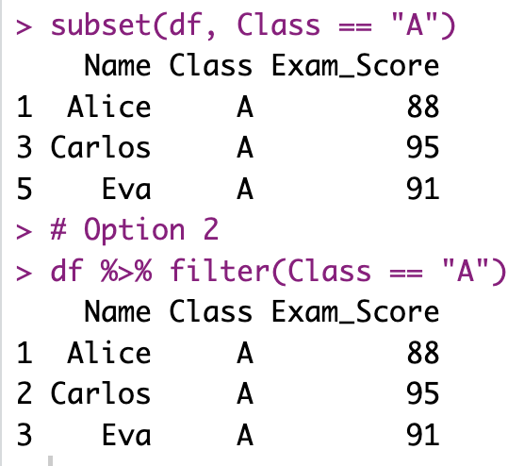
Let’s Filter with R
You can use either subset or filter (under dplyr package).
# Option 1
subset(df, Class == "A")
# Option 2
df %>% filter(Class == "A")

Slide 15
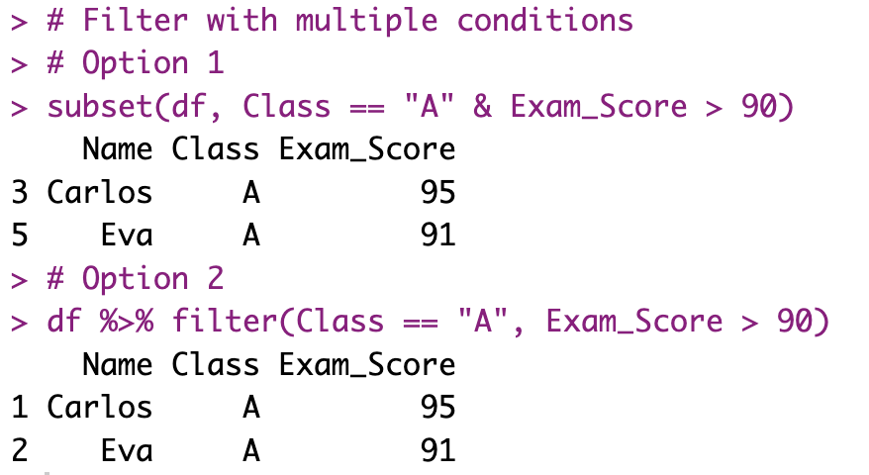
Let’s Filter with R
You can also filter based on multiple conditions
# Filter with multiple conditions
# Option 1
subset(df, Class == "A" & Exam_Score > 90)
# Option 2
df %>% filter(Class == "A", Exam_Score > 90)

Slide 16
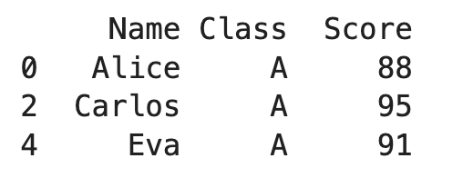
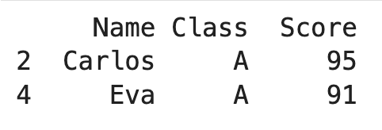
Let’s Filter with Python
class_a_df = df[df["Class"] == "A"]
print(class_a_df)
class_a_df_over90 = df[(df["Class"]=="A") & (df["Score"] > 90)]
print(class_a_df_over90)

Slide 17








Basic Tools: Grouping & Summarizing
Group
Summarize
Split data into categories
Calculate statistics for each group
Insight
Compare
Draw conclusions from patterns
See differences between groups

Slide 18
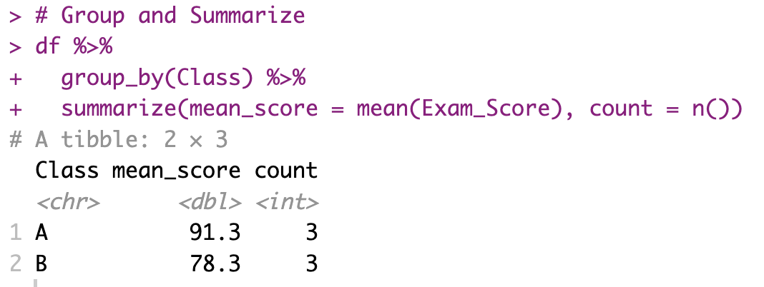
Let’s Get Averages By Class - R
# Group and Summarize
df %>%
group_by(Class) %>%
summarize(mean_score = mean(Exam_Score), count = n())

Slide 19
Let’s Get Averages By Class - R
You can use group_by within dplyr to group
Summarize to get the mean scores
# Group and Summarize
df %>%
group_by(Class) %>%
summarize(mean_score = mean(Exam_Score), count = n())

Slide 20
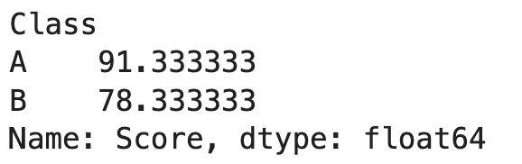
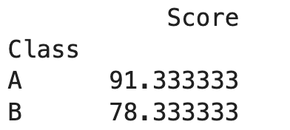
Let’s Get Averages By Class - Python
# Option 1
# Group by Class and calculate mean Score
mean_scores = df.groupby("Class")["Score"].mean()
print(mean_scores)
# Option 2
# Group by Class and calculate mean Score using agg()
mean_scores = df.groupby("Class").agg({"Score": "mean"})
print(mean_scores)

Slide 21
Your Turn!
Use the student_community_service.csv data
Sort by service hours: Which student has the highest hours? Which has the lowest?
Filter by grade: How many seniors are there in the dataset? What is the range of service hours among seniors?
Group by grade and summarize: Calculate the average service hours for each grade (9, 10, 11, 12). Which grade level, on average, has done the most community service?
Challenge: Can you find a variable that might explain the pattern you see? Write a hypothesis: “I think [X] is associated with higher service hours because...” How would you test it?

Slide 22
Check your answers
Find the example answers for R: Ch8_HandsOnActivitySortingFiltering.R
For Python: Ch8_HandsOnActivitySortingFiltering.ipynb

Slide 23
Chapter 8
Univariate Exploration: Looking at One Variable at a Time

Slide 24




Univariate Analysis: One Variable at a Time
Examine One Clue
Look at one variable in isolation
Understand Distribution
See how values are spread out
Calculate Statistics
Find center, spread, shape, outliers

Slide 25




Key Questions for One Variable
What values are most common?
Which categories appear most often? Where do most numeric values fall?
Where is the center?
What's the average or median value? What's typical?
How spread out is the data?
Are values clustered together or widely scattered?
Any unusual values?
Are there outliers that stand far from the rest?

Slide 26
Categorical vs. Numerical Variables
Categorical (Qualitative)
Numerical (Quantitative)
Limited set of categories or labels
Examples: blood type, favorite subject, letter grade
Analyze with: frequency tables, bar charts
Measured in numbers
Examples: height, test score, hours of sleep
Analyze with: mean, median, histograms, boxplots

Slide 27
Exploring Categorical Data
Categorical variables are like labels – they name or group things (e.g., blood type, favorite subject, or grades like A/B/C).
You don’t do math on them – instead, you count how often each category appears.
Frequency tables show how many times each label shows up.
Relative frequency tells you the proportion – like “30% of students got an A.”
Bar charts are perfect visuals: categories on the x-axis, bar heights show counts or percentages.
Great for spotting trends, like which subject is most popular or which grade is most common.

Slide 28
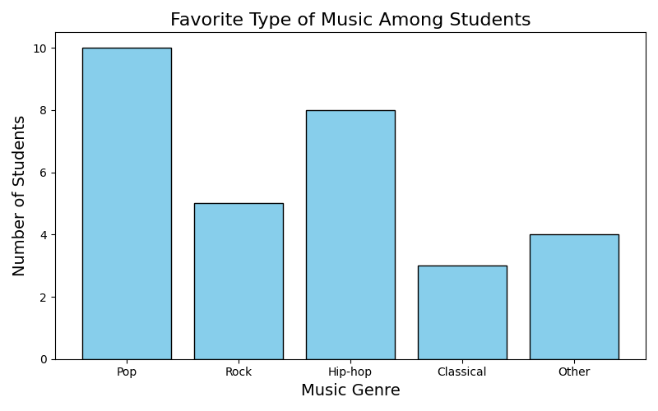
Example
Supposed we surveyed 30 students on their favorite type of music.
With this plot we can see Pop is the most popular genre in this sample, and Classical the least.

Slide 29
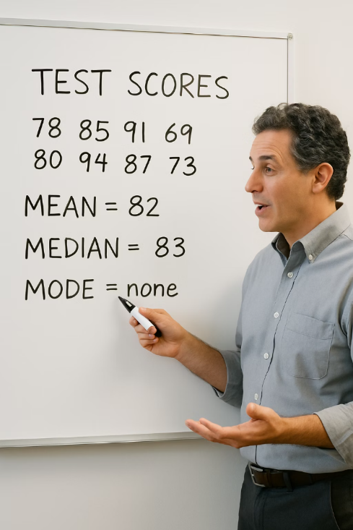
Exploring Numerical Data: Summary Statistics
Measures of Center
Measures of Spread
Mean (average): sum divided by count — sensitive to outliers
Range: maximum - minimum
Standard deviation (SD): avg distance from mean — ~68% of data falls within 1 SD
Median: middle value when ordered — robust to outliers (use for skewed data)
Interquartile range (IQR): middle 50% spread
Mode: most common value
Example: Exam Scores
Mean: 83
Median: 82.5
Range: 25 (max 94 - min 69)
Standard deviation: ~10 (most scores within 73–93)

Slide 30
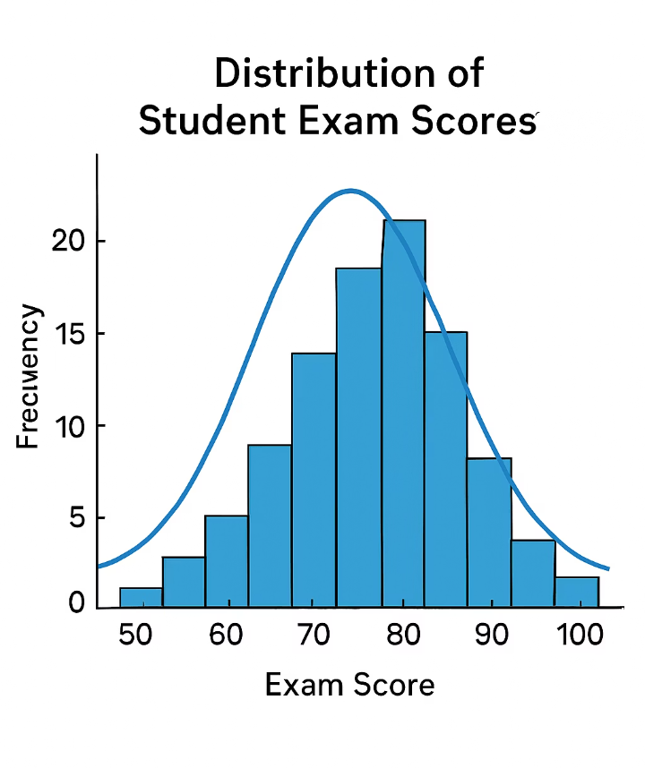
Exploring Numerical Data: Histogram
A histogram shows the distribution of numeric data by dividing it into bins (ranges) and counting how many values fall in each bin.
Bell-shaped
Right-skewed
Symmetric around the middle (normal distribution)
Tail extends to the right (most values low, few high values)
Left-skewed
Tail extends to the left (most values high, few low values)

Slide 31
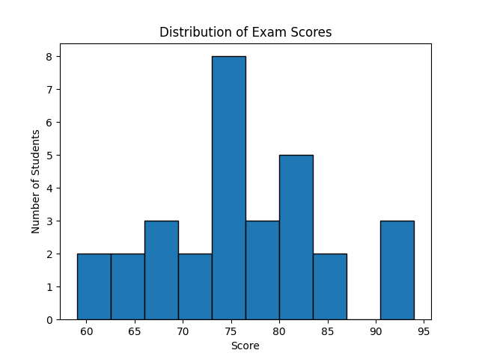
Exploring Numerical Data: Histogram
A histogram shows the distribution of numeric data by dividing it into bins (ranges) and counting how many values fall in each bin.
Bell-shaped
Right-skewed
Symmetric around the middle (normal distribution)
Tail extends to the right (most values low, few high values)
Left-skewed
Tail extends to the left (most values high, few low values)

Slide 32
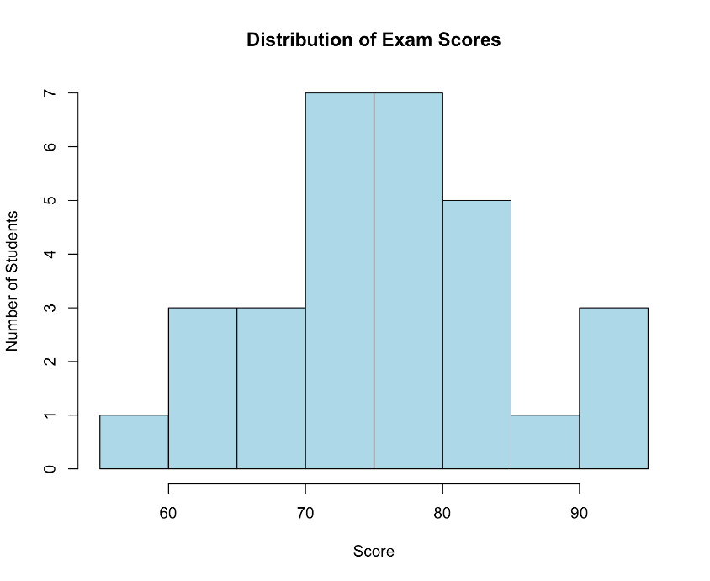
Histogram in R
scores <- c(83, 77, 84, 93, 76, 76, 94, 86, 73, 83, 73, 73, 80, 59, 61, 72, 68, 81, 69, 64, 93, 76, 79, 64, 73, 79, 66, 82, 72, 75)
hist(scores, breaks=10, main="Distribution of Exam Scores",
xlab="Score", ylab="Number of Students",
col = "lightblue",
border = "black",)

Slide 33
Histogram in Python
import matplotlib.pyplot as plt
scores = [83, 77, 84, 93, 76, 76, 94, 86, 73, 83, 73, 73, 80, 59, 61, 72, 68, 81, 69, 64, 93, 76, 79, 64, 73, 79, 66, 82, 72, 75]
plt.hist(scores, bins=10, edgecolor='black')
plt.title("Distribution of Exam Scores")
plt.xlabel("Score")
plt.ylabel("Number of Students")
plt.show()

Slide 34
Interpreting a Histogram
Histogram Summary: Most students scored between 70 and 90, forming a clear cluster.
Peak Performance: The highest bar (mode) is around 80–85, showing the most common scores.
Shape of the Distribution: The data is roughly symmetric around 80 – meaning no major skew.
Outlier Alert: One student scored much lower, in the 50–60 range – an example of an outlier.
What It Suggests: Most students performed reasonably well, but one student may have struggled.
Takeaway: A histogram helps tell the story of the data — where most students are, and who stands out.

Slide 35
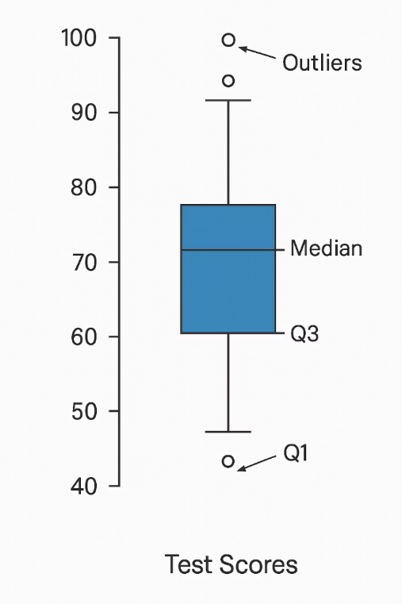
Exploring Numerical Data: Boxplot
Box
Shows the middle 50% of data (interquartile range)
Line in Box
Represents the median (middle value)
Whiskers
Extend to show the range of typical values
Dots
Individual points show outliers (unusual values)

Slide 36
Interpreting Distributions
Symmetric vs. Skewed
Symmetric: balanced on both sides
Right-skewed: long tail on right (mean > median)
Left-skewed: long tail on left (mean < median)
Peaks
Unimodal: one clear peak
Bimodal: two distinct peaks (two groups)
Multimodal: multiple peaks
Spread
Narrow: values clustered together
Wide: values spread out
Gaps: missing ranges of values

Slide 37
Hands-On Activity: Univariate Exploration
Objective: Develop skills in summarizing and visualizing one variable at a time.
Use the combined_class.csv data from the previous session
Pick the Club column. Tally the frequencies of each category. Create a bar chart. Write a sentence about which category was most common and which was least.

Slide 38
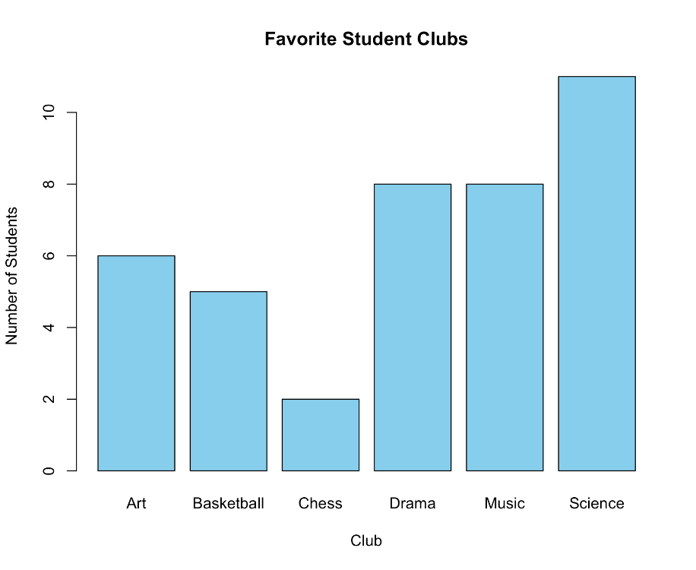
R
# Hands-on Activity
combined_class <- read.csv("combined_class.csv")
# Convert to factor
club <- factor(combined_class$Club)
# Use table to count frequencies
club_table <- table(club)
club_table
# Plot using barplot (not hist, since hist is for numeric data)
barplot(club_table,
col = "skyblue",
border = "black",
main = "Favorite Clubs Students",
xlab = "Club",
ylab = "Number of Students")

Slide 39
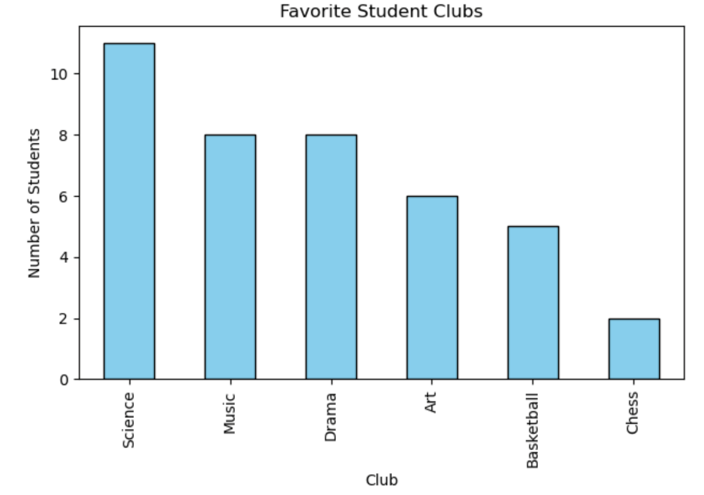
Python
import pandas as pd
import matplotlib.pyplot as plt
# Read the CSV file
combined_class = pd.read_csv("combined_class.csv")
# Count frequencies of the 'Club' column
club_counts = combined_class['Club'].value_counts()
# Plot the bar chart
club_counts.plot(kind='bar', color='skyblue',
edgecolor='black')
# Add labels and title
plt.title("Favorite Clubs Students")
plt.xlabel("Club")
plt.ylabel("Number of Students")
plt.tight_layout()
plt.show()

Slide 40
Hands-On Activity: Univariate Exploration - 2
Use students_scores.csv
Explore Math_Score column
Calculate the mean, median, and range.
Create a histogram.
Does the data look symmetric or skewed? Identify any outliers.

Slide 41
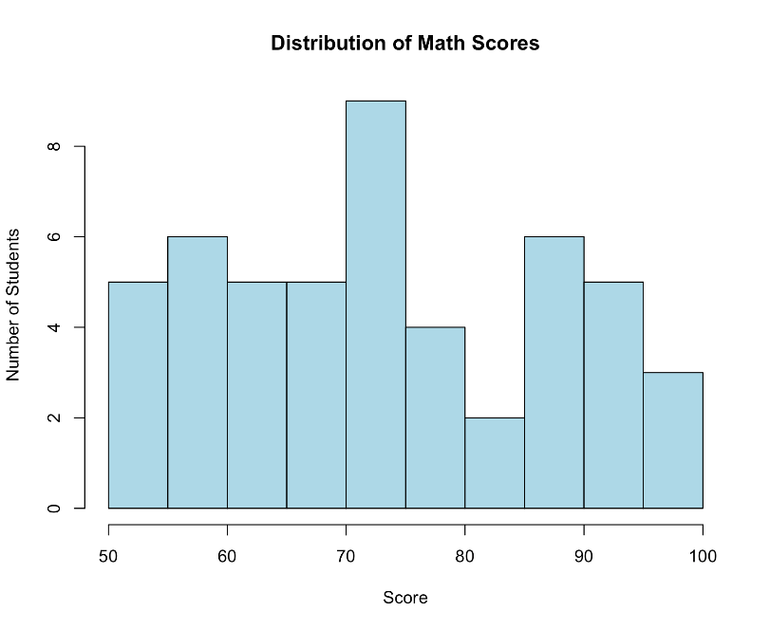
Hands-On Activity: Univariate Exploration - 2
# Hands-on Activity 2
students_scores <- read.csv("students_scores.csv")
# Calculate the mean, median, and range.
cat("Mean Score:", mean(students_scores$Math_Score))
cat("Median Score:", median(students_scores$Math_Score))
cat("Score Range:", c(max(students_scores$Math_Score)-min(students_scores$Math_Score)))
hist(students_scores$Math_Score, breaks=10, main="Distribution of Math Scores",
xlab="Score", ylab="Number of Students",
col = "lightblue",
border = "black",)

Slide 42
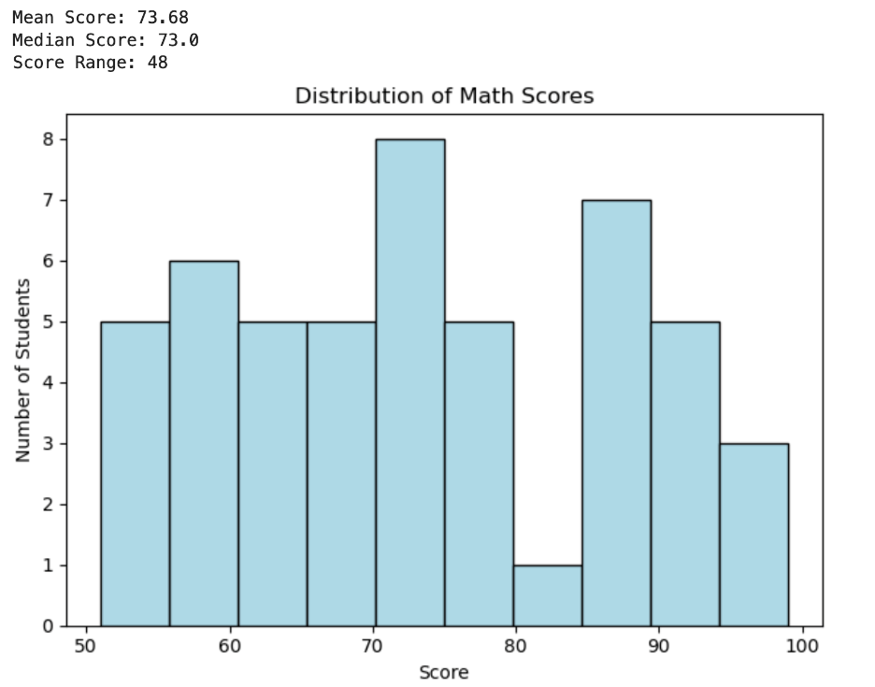
Python
import pandas as pd
import matplotlib.pyplot as plt
# Read the CSV file
students_scores = pd.read_csv("students_scores.csv")
# Calculate and print mean, median, and range
mean_score = students_scores['Math_Score'].mean()
median_score = students_scores['Math_Score'].median()
score_range = students_scores['Math_Score'].max() - students_scores['Math_Score'].min()
print("Mean Score:", mean_score)
print("Median Score:", median_score)
print("Score Range:", score_range)
# Plot histogram
plt.hist(students_scores['Math_Score'], bins=10, color='lightblue', edgecolor='black')
plt.title("Distribution of Math Scores")
plt.xlabel("Score")
plt.ylabel("Number of Students")
plt.tight_layout()
plt.show()

Slide 43
Chapter 8
Bivariate Exploration: Investigating Relationships Between Two Variables

Slide 44




Bivariate Analysis: Relationships Between Variables
Connections
Patterns
Comparisons
How two variables relate to each other
Trends, correlations, or groupings
Differences between groups

Slide 45






Types of Bivariate Analysis
Categorical vs. Categorical
Gender vs. club preference
Numeric vs. Numeric
Use: Contingency tables, bar charts
Study hours vs. exam score
Use: Scatterplots, correlation
Categorical vs. Numeric
Class (A/B) vs. test score
Use: Side-by-side boxplots, group means

Slide 46
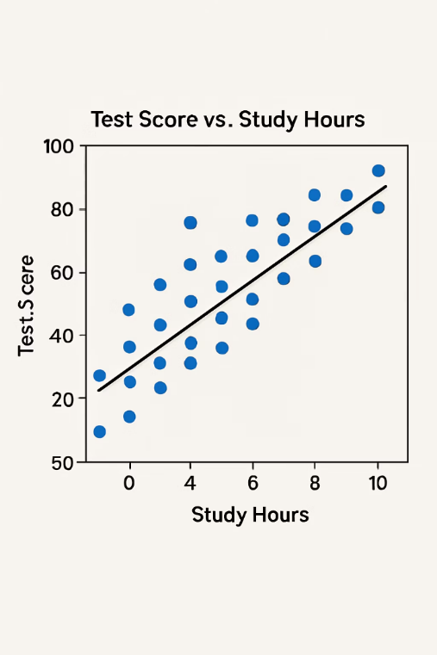
Numeric vs. Numeric: Scatterplots
Each Point
Represents one observation with two values (x,y)
Trend
Upward trend shows positive correlation, downward shows negative
Strength
Tight cluster around line = strong relationship, scattered = weak
Outliers
Points that don't follow the general pattern

Slide 47
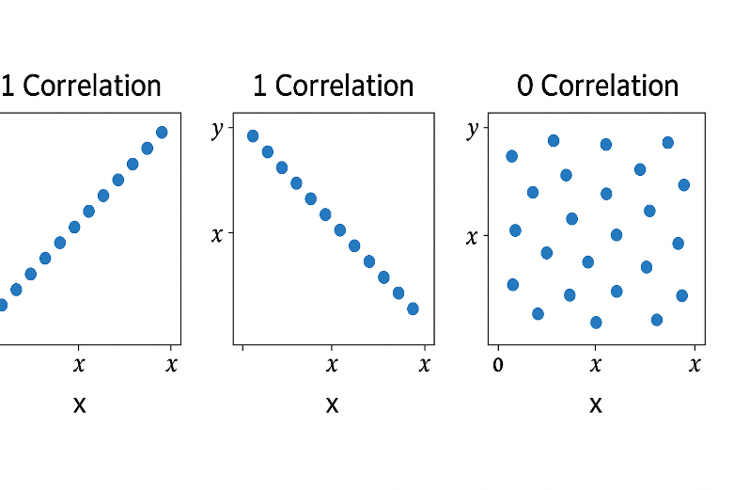
Correlation
+1.0
0
Perfect Positive
No Correlation
As one variable increases, the other increases exactly proportionally
No linear relationship between the variables
-1.0
Perfect Negative
As one variable increases, the other decreases exactly proportionally

Slide 48
Numeric vs Numeric (Scatterplots):
What is a Scatterplot?
A graph where each point represents one observation with two values — one on the x-axis and one on the y-axis (e.g., Hours Studied vs. Exam Score).
Trend / Correlation
Upward trend = Positive correlation (more study, higher score)
Downward trend = Negative correlation
No trend = No clear relationship
Shape of Relationship
Linear = Points form a straight line
Non-linear = Relationship curves or flattens (e.g., diminishing returns on study time)
Strength of Relationship
Points tightly packed = Strong relationship
Points widely scattered = Weak relationship
Outliers
Look for students who don’t fit the pattern — like studying a lot but scoring low (or the opposite).

Slide 49
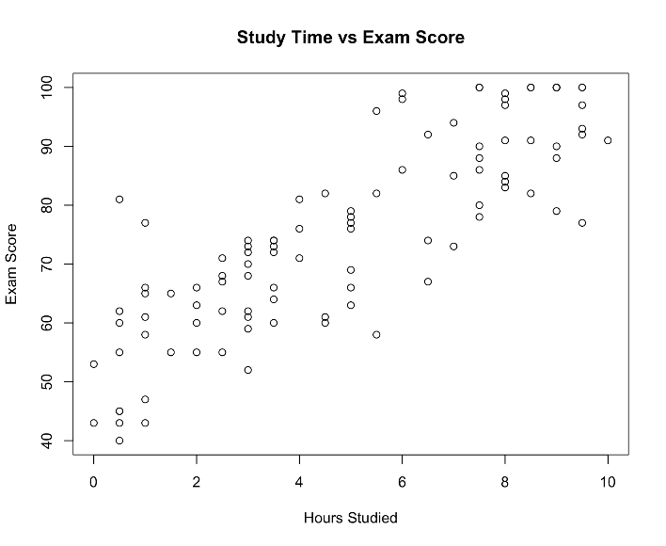
Let’s Try It!
Read the “Student_Data_Ch8.csv”
Create a scatterplot for Study Hours and Exam Score
# Scatterplot
df <- read.csv("Student_Data_Ch8.csv")
plot(df$Study_Hours, df$Exam_Score,
xlab="Hours Studied", ylab="Exam Score",
main="Study Time vs Exam Score")

Slide 50
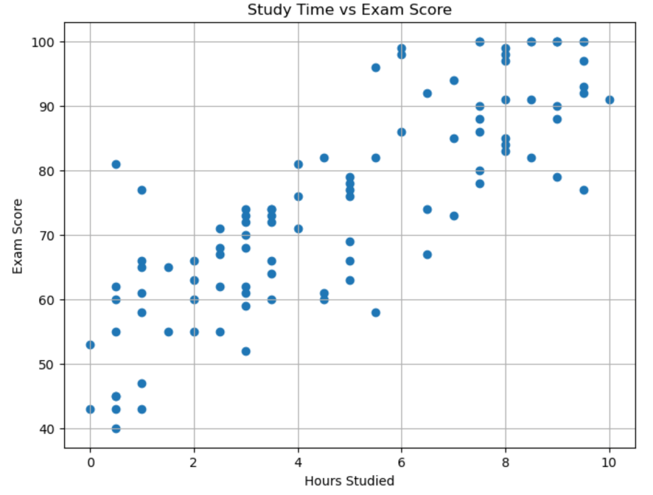
Try with Python!
import pandas as pd
import matplotlib.pyplot as plt
# Load the dataset
df = pd.read_csv("Student_Data_Ch8.csv")
# Create scatterplot
plt.figure(figsize=(8, 6))
plt.scatter(df["Study_Hours"], df["Exam_Score"])
plt.xlabel("Hours Studied")
plt.ylabel("Exam Score")
plt.title("Study Time vs Exam Score")
plt.grid(True)
plt.show()

Slide 51
Categorical vs. Categorical
This is often explored via contingency tables or bar charts. Such as on the right.
To visualize, a grouped bar chart, stacked bar chart or mosaic plot could be used
 | Sports | Arts | Academic
Male | 15 | 5 | 10
Female | 8 | 12 | 10

Slide 52
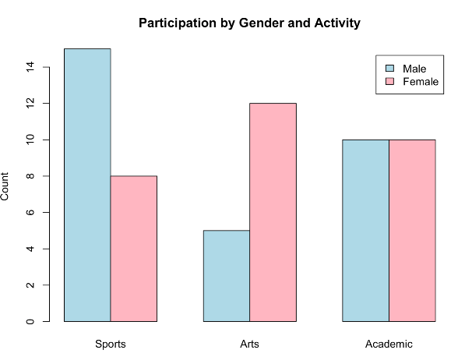
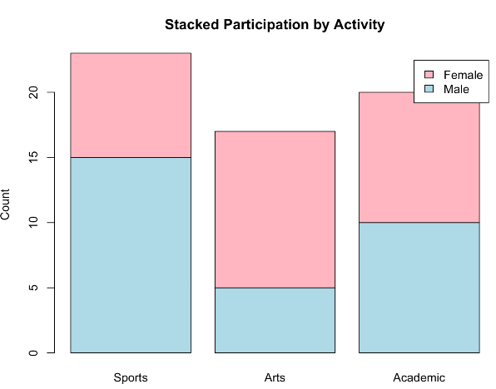
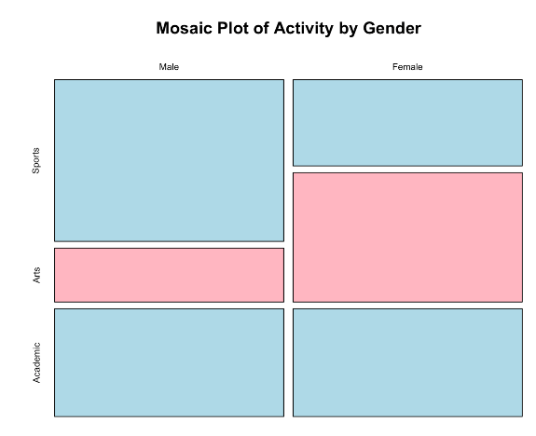
Categorical vs. Categorical
Bar Chart
Stacked Bar Chart
Mosaic Chart

Slide 53
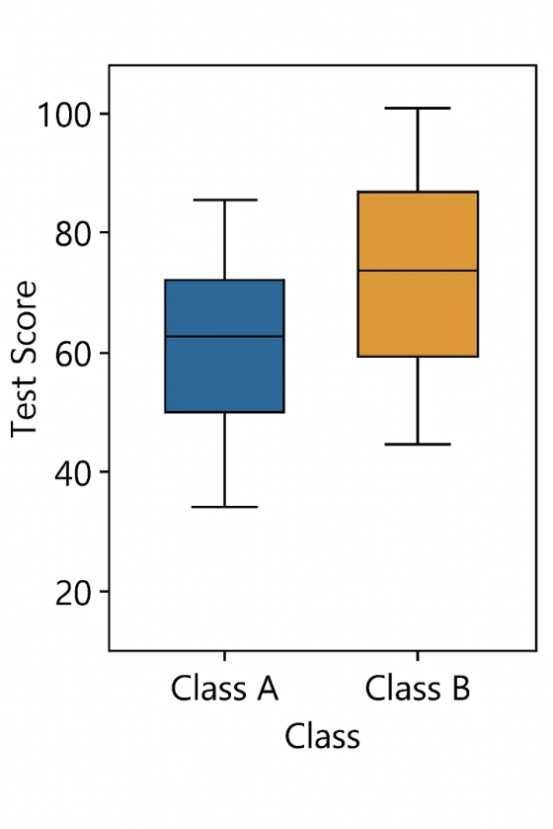
Categorical vs Numeric
Example: Compare test scores (numeric) between two classes A and B (categorical).
Compare heights between boys and girls.
Compare some measurement across different categories (like income across different education levels).
A side-by-side boxplot is preferred choice.

Slide 54
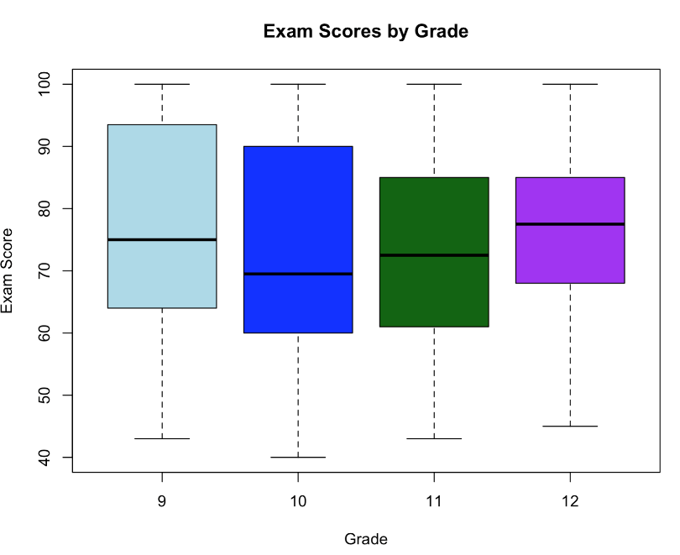
Let’s Try! - R
Read the “Student_Data_Ch8.csv”
Create a side by side box plot for Grade and Exam Scores
# Read the data
df <- read.csv("Student_Data_Ch8.csv")
# Boxplot: Exam Score by Grade
boxplot(Exam_Score ~ Grade, data = df,
xlab = "Grade",
ylab = "Exam Score",
main = "Exam Scores by Grade",
col = c("lightblue","blue","darkgreen","purple"))

Slide 55
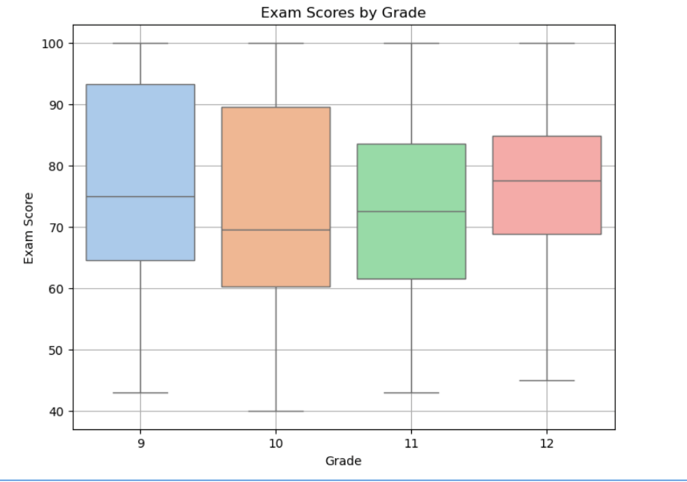
Let’s Try! - Python
import pandas as pd
import seaborn as sns
import matplotlib.pyplot as plt
# Load the dataset
df = pd.read_csv("Student_Data_Ch8.csv")
plt.figure(figsize=(8, 6))
sns.boxplot(x="Grade", y="Exam_Score", hue="Grade", data=df, palette="pastel", legend=False)
plt.xlabel("Grade")
plt.ylabel("Exam Score")
plt.title("Exam Scores by Grade")
plt.grid(True)
plt.show()

Slide 56
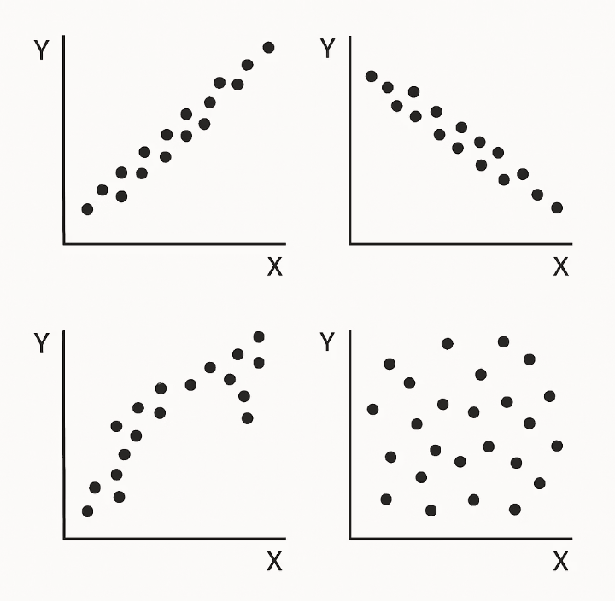
Patterns in Bivariate Analysis
Positive Association
As one variable increases, the other tends to increase (more study time, higher scores)
Negative Association
As one variable increases, the other tends to decrease (more absences, lower grades)
No Association
No clear relationship between variables (random cloud in scatterplot)
Group Differences
One category consistently has higher/lower values than another

Slide 57
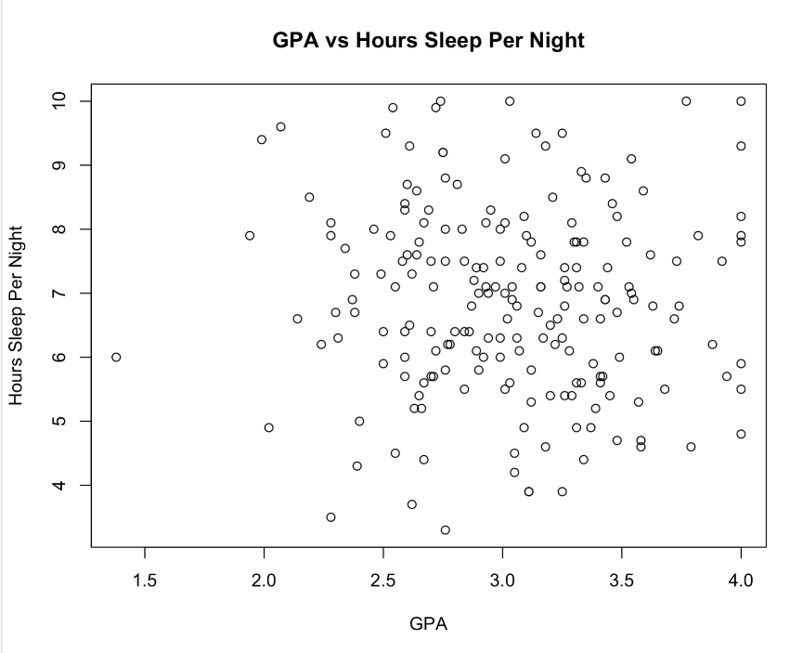
Your Turn!
Objective: Examine relationships between two variables using real data.
Use: high_school_student_survey.csv
Get a scatterplot for GPA and Hour Sleep Per Night
Use R or Python
Codes are under Ch8.R and Ch8.ipynb

Slide 58
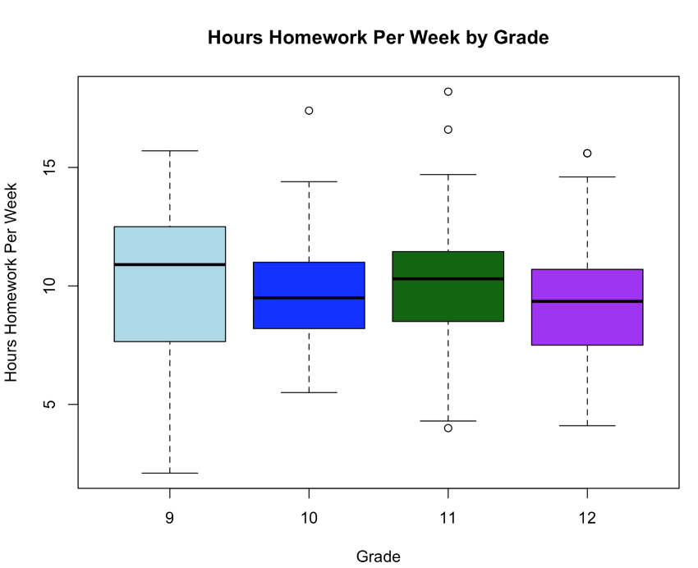
Your Turn! - 2
Take grade level and Hours_Homework_Per_Week
Compute the group means and medians.
Create a side-by-side boxplot.
Which group tends to have higher values? How do their variabilities compare?
Codes are under Ch8.R and Ch8.ipynb

Slide 59
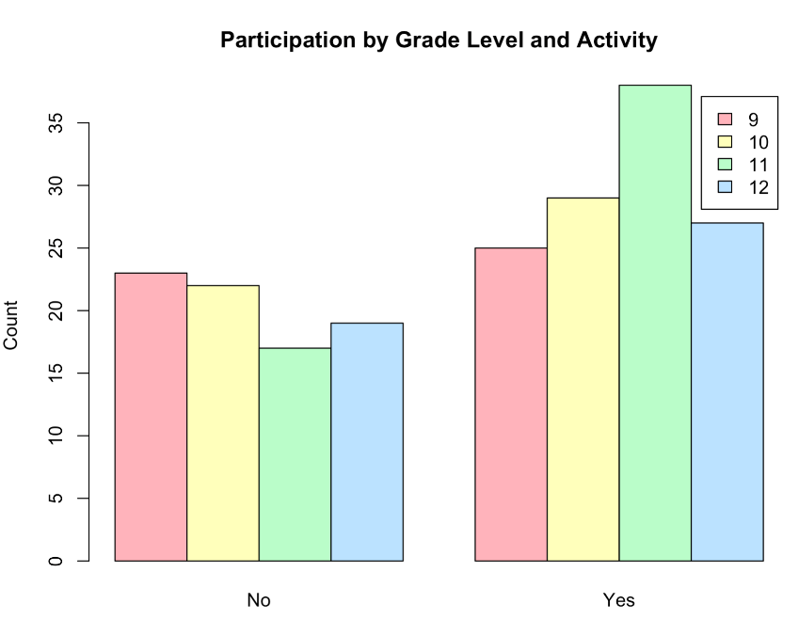
Your Turn! - 3
Is there a relationship between grade level and extracurricular activity?
Make a small table of counts for each combination.
Create a bar chart.

Slide 60
Your Turn! - 4
For each exploration, write a brief summary of what you found.

Slide 61
Chapter 8
Visual Tools for EDA: Charts that Tell a Story

Slide 62
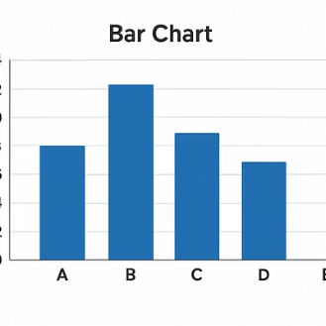
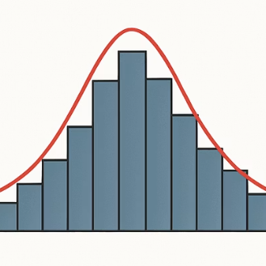
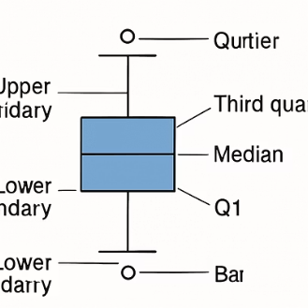
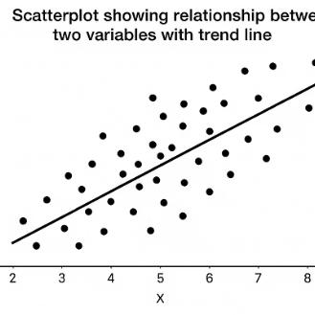
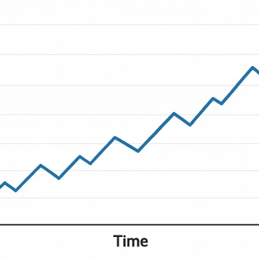
Visual Tools for EDA
Different charts help us see different aspects of our data. Choose the right visual for your data type and question.

Slide 63
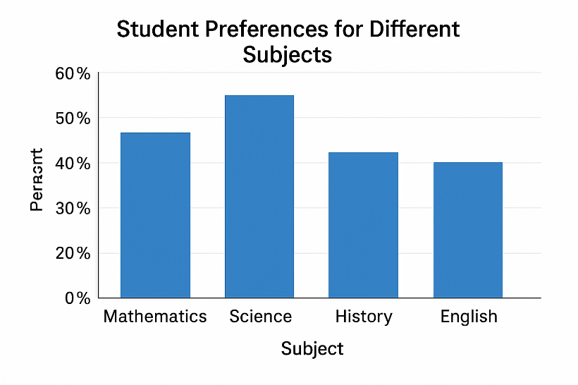
Bar Chart
When to Use
For categorical data
To show frequencies or counts
To compare categories
Tips
Label categories clearly
Consider sorting by height
Use grouped bars for multiple categories

Slide 64
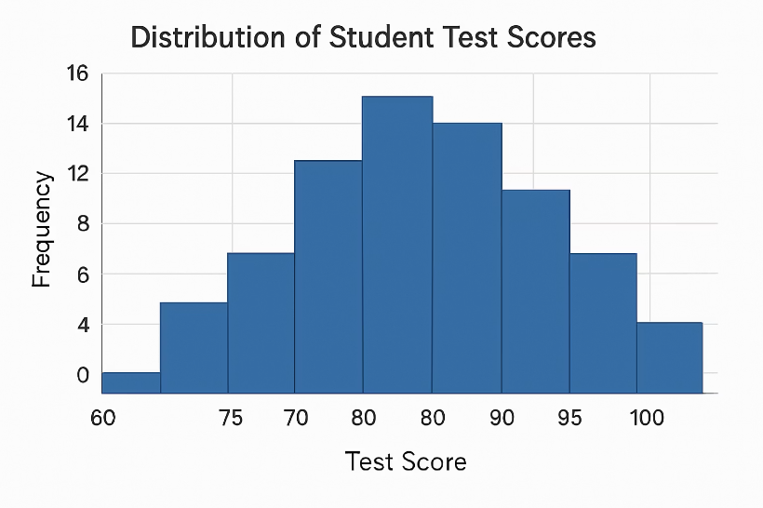
Histogram
When to Use
For numerical data
To show distribution
To see shape, center, spread
Tips
Choose appropriate bin width
Label axes clearly
Look for patterns in shape

Slide 65
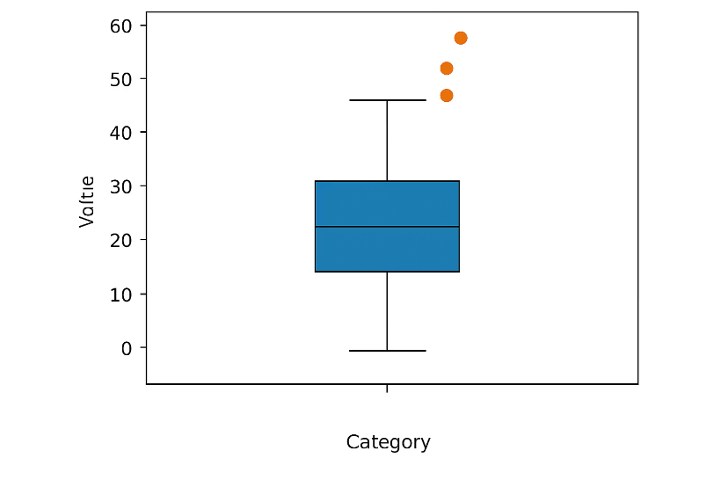
Boxplot
When to Use
For numerical data
To show distribution summary
To compare groups
Tips
Note the median (middle line)
Check for outliers (dots)
Compare box sizes for spread

Slide 66
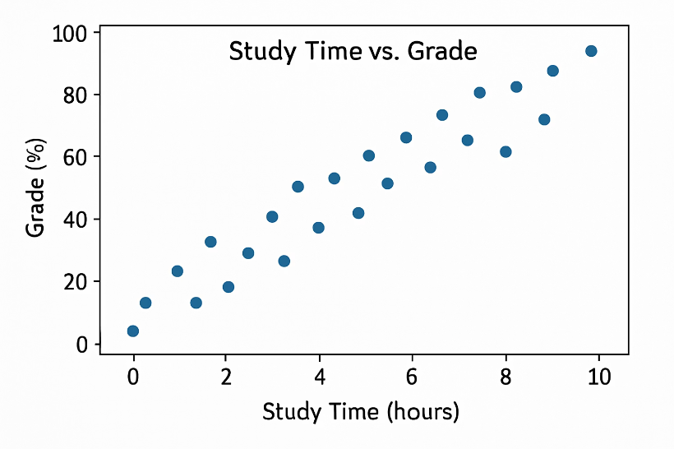
Scatterplot
When to Use
For two numerical variables
To show relationships
To identify correlation
Tips
Look for trends (up/down)
Check for outliers
Consider adding a trend line

Slide 67
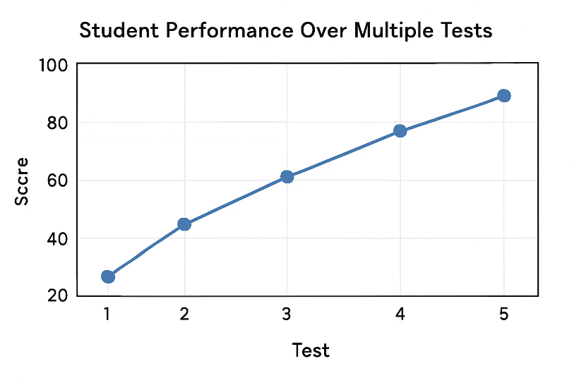
Line Chart
When to Use
For data over time or sequence
To show trends
To track changes
Tips
Only use when x-axis has natural order
Label time points clearly
Consider multiple lines for comparison

Slide 68
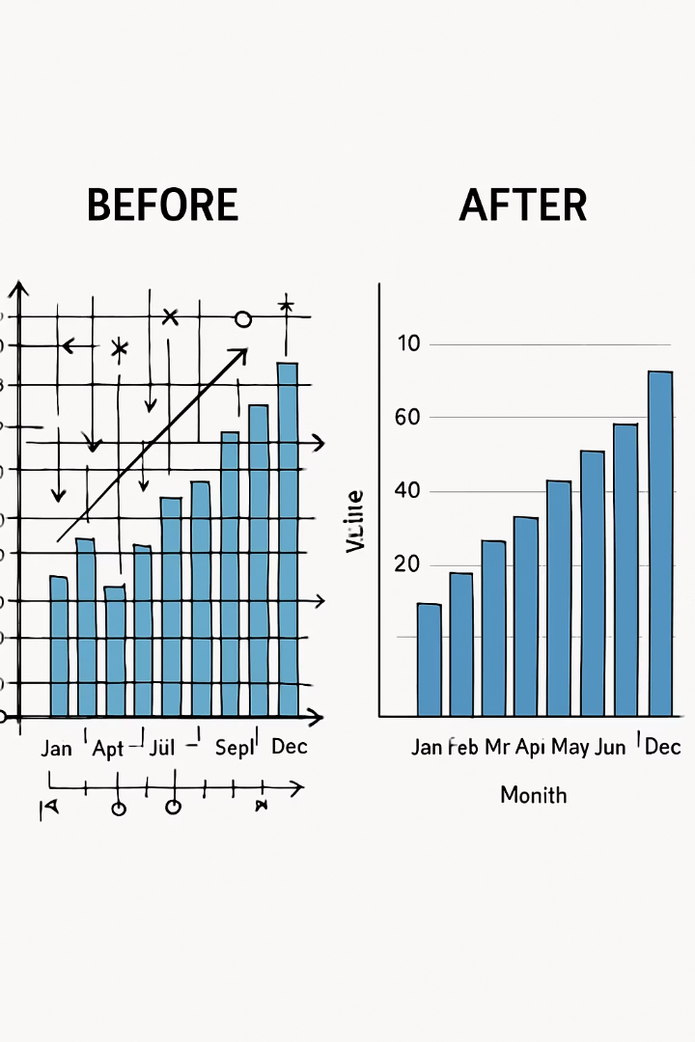




Visualization Best Practices
Label Everything
Include clear titles, axis labels, and legends
Keep It Simple
Don't overload one chart with too much information
Use Color Wisely
Colors should enhance understanding, not confuse
Double-Check
If something looks odd, verify the data

Slide 69
Chapter 8
Case Study: EDA in Action

Slide 70
Step 1: Overview and Quality Check
Use highschool_student_survey.csv
Explore this dataset to find interesting patterns and insights about student life and academic performance.
The Dataset
Hours of homework per week
GPA
Hours of sleep per night
Grade level (9,10, 11, 12)
Gender
Extracurricular participation (Yes/No)
Read in
Check the head
Calculate basic summary stats for numeric columns and frequencies for categorical ones.
Report/adjust if you see any weird values

Slide 71
Step 2: Univariate EDA
Plot a histogram of GPA.
Check a bar chart of extracurricular participation.
Look at a boxplot of hours of homework and grade level.
Summarize hours of sleep.

Slide 72
Step 3: Bivariate EDA
Numeric vs Numeric: Plot hours of homework vs GPA.
1
Calculate a correlation matrix for numeric vars (homework, GPA, sleep).
2
Compare GPA by extracurricular participation via boxplot.
3
Compare hours of homework by grade level.
4
Look at a table of extracurricular participation by grade level.
5
Check gender vs hours of sleep with boxplot.
6

Slide 73
Step 4: Patterns and Anomalies
Note down patterns.
Trend
Difference
Outlier
No relation

Slide 74
Form Your Story!
Write Down Your Story
Example:
“It appears that as students progress through grades, their homework load increases. Despite spending more time, their sleep tends to decrease slightly by senior year. We found that those involved in extracurricular activities tended to maintain slightly higher GPAs on average, though the causal relationship isn’t clear. Most students have moderate sleep (~7 hours), but a few are getting dangerously low amounts of sleep which is a concern. We also saw that study habits vary widely – even among those with similar GPAs, homework hours ranged a lot, suggesting different work strategies or course loads.”

Slide 75
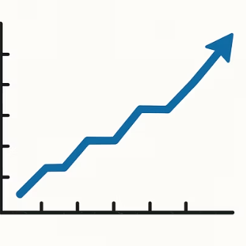
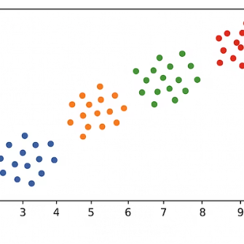
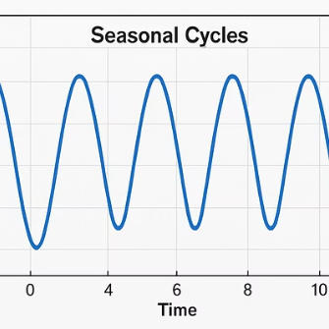
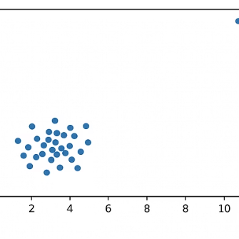
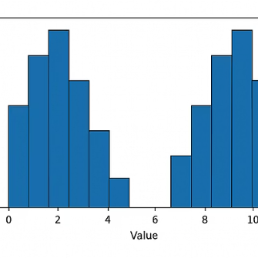
Common Patterns to Look For
Trends
Clusters
General direction in data
Groupings of observations
Cycles
Outliers
Repeating patterns
Points that stand apart

Slide 76

Common Anomalies to Watch For
Outliers
Gaps
Values far from the rest. Could be errors or interesting exceptions.
Ranges where no observations fall. Might indicate an interesting divide.
Unexpected Patterns
Data Errors
Relationships that don't match what you'd expect based on theory.
Impossible values (negative heights) or duplicate records that don't make sense.

Slide 77




The EDA Process
Ask Questions
Explore
What do I want to know?
Look at variables and relationships
Refine
Discover
Adjust and ask new questions
Find patterns and anomalies
EDA is iterative - one finding often leads to new questions and further exploration.

Slide 78

Key Takeaways
1
EDA is Essential
Always explore your data before jumping to conclusions or complex models.
2
Use Basic Operations
Sorting, filtering, and grouping help answer simple but important questions.
3
Examine One Variable at a Time
Understand distributions using summary statistics and visualizations.
4
Look for Relationships
Explore how pairs of variables relate to each other.

Slide 79

More Key Takeaways
1
Visualize
2
Watch for Patterns and Anomalies
A well-chosen plot can reveal insights at a glance that might be buried in numbers.
Look for trends, clusters, outliers, and other interesting features.
3
Be Iterative
4
Document Findings
EDA is not a strict recipe but an exploration that follows your curiosity.
Keep track of what you discover to inform later analysis.

Slide 80
Chapter 8 Complete — You Are Now an EDA Detective!
Skills you’ve mastered in Chapter 8:
Sorting, filtering, and grouping data with R and Python
Univariate analysis: histograms, boxplots, summary statistics
Bivariate analysis: scatterplots, correlation, grouped boxplots
Correlation ≠ causation — thinking critically about relationships
Using a coding agent as a helper — prompting, verifying, and iterating
Coming Up: Chapter 9 — Making Inferences (from Sample to Population)
We’ll go beyond describing data to making conclusions — confidence intervals, hypothesis testing, and statistical significance.

Slide 81
Chapter 8
Meet Your Coding Agent — AI-Assisted Data Analysis

Slide 82
What is a Coding Agent?
🤖 An AI Programming Partner
A coding agent is an AI (like Claude, GitHub Copilot, or ChatGPT) that understands your data goal, writes code, and explains results — like having a knowledgeable teammate.
💻 What Can It Do?
Generate R or Python code from plain English
Explain what code does, line by line
Debug errors when things go wrong
Suggest which charts to use and why
Summarize findings in plain language
⚠️ What It Is NOT
Not a replacement for your thinking! You still need to understand the data, ask good questions, and critically evaluate the output.
Agents make mistakes — you are the expert.
🌐 Real Examples
Claude.ai — conversational, explains concepts
GitHub Copilot — autocompletes in VS Code
ChatGPT / Gemini — general-purpose assistants
All can write and explain data analysis code when given clear, specific instructions.

Slide 83
How Coding Agents Help Your EDA
Instant Code Generation
Describe your goal in plain English: “Plot a histogram of Math scores colored by grade.” The agent writes the code instantly.
Error Debugging
What's the average or median value? What's typical?
Chart Recommendations
Ask “What chart should I use to compare GPA across grade levels?” and get a justified answer.
Interpretation Help
Share output or a plot description and ask “What does this pattern tell us about the data?”

Slide 84
Prompting a Coding Agent: The Art of Good Instructions
❌ Weak Prompt (Vague)
“Plot my data”
Problems: No file mentioned. No column names. No chart type. No goal. The agent has to guess — and usually guesses wrong.
✅ Strong Prompt (Specific)
“I have students.csv with columns Grade (9–12), Math_Score, and Sleep_Hours. Using Python, create a boxplot comparing Math_Score distributions for each grade level. Use seaborn and label axes clearly.”
Prompt Recipe (4 Ingredients)
1. Data: Name the file and key columns
2. Language: Specify R or Python
3. Goal: Say exactly what you want to see or compute
4. Format: Mention chart type, labels, colors if needed
Pro tip: If the code fails, paste the error back and say “I got this error — can you fix it?”
Critical rule: Always read and understand the code before running it. Never paste blindly!

Slide 85
Working WITH a Coding Agent (Not FOR It)
You Bring the Questions
Agents are powerful, but YOU decide what to investigate. Formulate your own hypotheses first, then ask the agent to help test them.
Verify Every Output
What's the average or median value? What's typical?
Iterate and Refine
Good EDA is a conversation: run code, look at output, ask a follow-up. “The histogram is right-skewed — what might explain this?”
Cite Your Work
When you use agent-generated code in a project, note it. Understand it well enough to explain every line if asked.

Slide 86
Hands-On: Use a Coding Agent to Analyze Data
Open Claude.ai (or GitHub Copilot). Use Student_Data_Ch8.csv as your dataset for this activity
Task 1 — Write a prompt: Ask the agent to calculate summary statistics for Math_Score and Study_Hours. Run the code, check if results make sense.
Task 2 — Visualize: Prompt the agent to create a scatterplot of Study_Hours vs. Math_Score, colored by Grade. Describe what you see.
Task 3 — Dig deeper: Ask: “Does the relationship between study hours and scores look different for different grades?” Prompt the agent to help investigate.
Reflect: Write 3–5 sentences summarizing your findings. What did the agent do well? What did you have to correct or clarify? What would you ask next?

Slide 87
Correlation ≠ Causation: The Detective’s Most Important Warning
Just because two variables move together does NOT mean one causes the other!
Classic “Spurious” Correlations
🍨 Ice cream sales & shark attacks Both rise in summer — but eating ice cream doesn’t attract sharks. The hidden cause is hot weather.
🧥 Nicolas Cage films & pool drownings A real statistical correlation — and completely meaningless. Pure coincidence.
🚲 Shoe size & reading ability in children Both increase with age — age is the real driver.
How to Think About It
Ask: Could there be a lurking variable? A hidden third variable that drives both (like “age” or “season”).
Ask: Does the direction make sense? Causation requires a plausible mechanism — can you explain how A actually causes B?
In EDA, always say: “associated with” not “causes” unless you ran a controlled experiment.
Discussion: In our student data, study hours and exam scores are correlated. Does studying cause higher scores? How would you test this?

