Slide 1
Chapter 10: Solving a Data Mystery
Your capstone project: bring together EDA, inference, and storytelling to crack a real data case.

Slide 2

Data Detective: Solving a Data Mystery
Welcome to Chapter 10!
You'll now put your data detective skills to the test in a real-world mini project.
We'll walk through the entire process of solving a data mystery about declining bee populations.

Slide 3
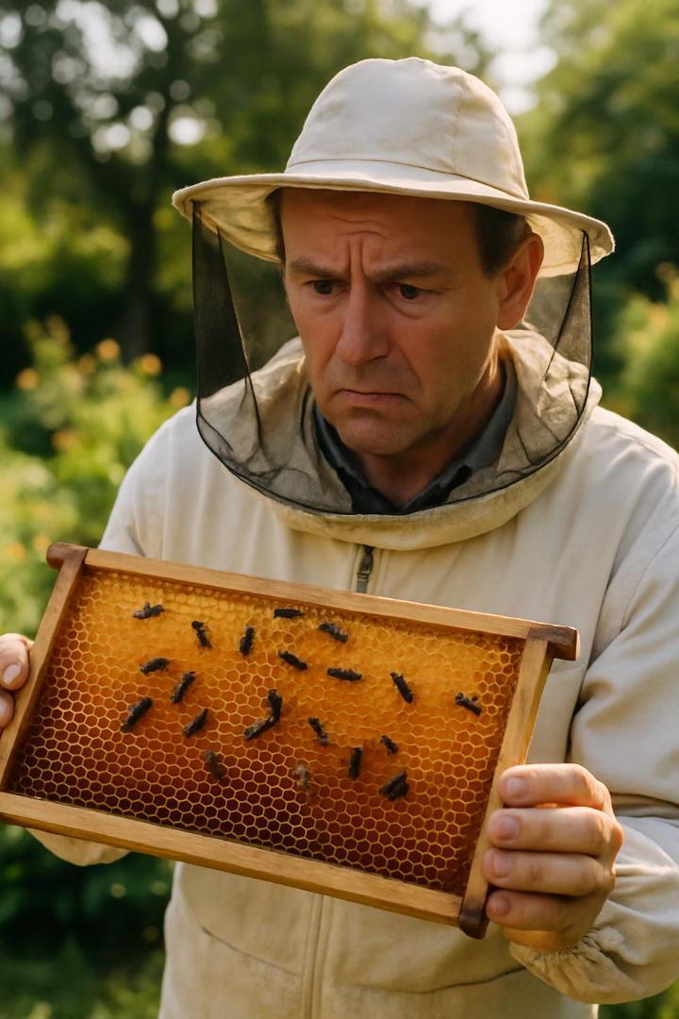



The Mystery: Disappearing Bees
The Puzzle
The Question
A community garden has noticed bee counts dropping in summer months (June-July).
What factors could be causing this mid-summer bee decline?
The Data
Monthly bee counts, local weather data, and notes about events like pesticide spraying.

Slide 4
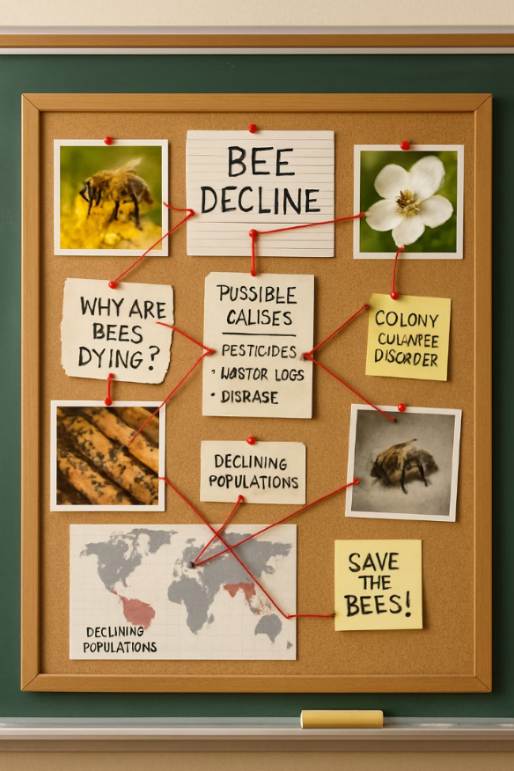



Framing the Mystery
Identify the Question
Why are local bee counts declining in summer months?
Consider Possible Causes
Heat? Lack of rain? Pesticides? Disease?
Define Success
Find patterns or correlations that explain the decline.

Slide 5
Data Detective's Approach
Ask Good Questions
Start with clear questions to guide your investigation.
Form Hypotheses
Develop theories but remain open to evidence.
Follow the Evidence
Let the data lead you to conclusions.

Slide 6
Let’s Break Down the Problem
What data is available?
Monthly bee counts, local temperature and rainfall, and records of nearby events like pesticide use.
What is the hypothesis?
Bee decline may be linked to extreme heat, drought, or pesticide spraying.
What does a solution look like?
Finding patterns—such as drops in bee counts after heatwaves, low rainfall, or pesticide use—could reveal a cause.

Slide 7
Planning the Investigation
Gather and Inspect Data
Load datasets and perform initial inspection.
Combine Datasets
Merge bee counts with weather data by date.
Interpret Findings
Draw conclusions based on evidence.
Clean the Data
Check for missing values, outliers, and standardize formats.
Exploratory Analysis
Look for patterns and relationships in the data.

Slide 8
Step 1: Gather and inspect the data
Use: bee_counts.csv. Monthly bee counts for past years.
Variables: Year, Month, ﻿Bee Count
Use: weather.csv. Monthly weather data.
﻿﻿Variables: Year, ﻿﻿Month, ﻿﻿Average Temperature, ﻿﻿Total Rainfall
Use: events.csv (optional). Notes on events like pesticide applications
Variables: Year, ﻿﻿Month, ﻿﻿PesticideUsed (Yes/No)

Slide 9
Step 2: Clean the data. Using our checklist from Chapter 7
1
Check Row and Column Counts
2
Review Column Names
Verify datasets have expected dimensions.
Ensure naming is consistent across datasets.
3
Examine Data Types
4
Preview Sample Entries
Confirm appropriate types (numeric, date, categorical).
Look at first few rows to understand data structure.
This initial inspection helps identify potential issues before diving deeper into analysis.

Slide 10
Step 3: Combine the data
We’ll merge the bee counts with the weather data on Year and Month so that each record has both the bee count and corresponding weather for that month.
If there’s event data, we might merge that as well by date.

Slide 11
Step 4: Exploratory Analysis
Check overall bee count trend over time
Look for consistent mid-summer drops using a line chart or time series plot.
Explore relationship with weather
Compare bee counts to temperature and rainfall.
Use scatter plots or overlay weather data on bee count line charts.
Investigate impact of events (e.g., pesticide use)
If event data includes indicators like “yes” for pesticide use, compare bee counts in months following those events.
Consider using grouped summaries or side-by-side boxplots for comparison.

Slide 12
Step 5: Interpret the findings
Identify patterns
Such as bee declines during extremely hot and dry June–July periods.
Consider the role of events
Like pesticide use, in worsening the decline.
Distinguish correlation from causation
The data may suggest a link, but further investigation is needed for certainty.

Slide 13
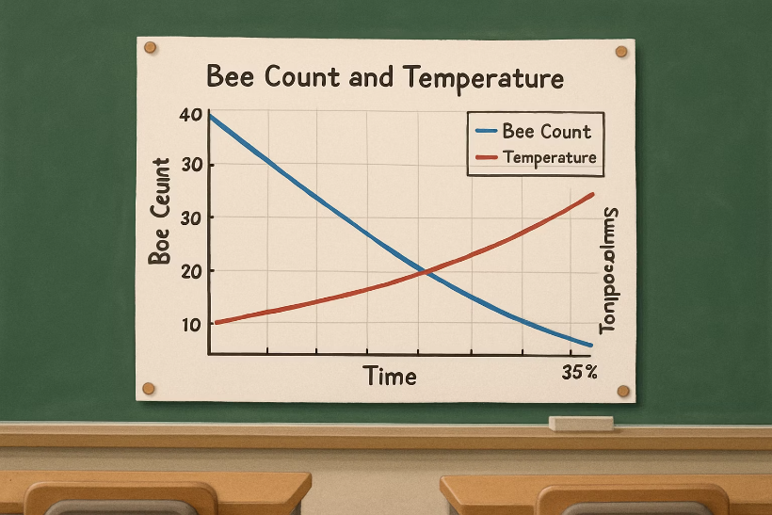
Step 6: Present the solution

Slide 14
Do Your Own Work!
Select your software (R or Python). If time allows, run on both and compare outputs.
Follow the steps.
Don’t forget to write your log record.
Check your results against Ch10.R and Ch10.ipynb. If yours differ — investigate why. Differences are learning opportunities.

Slide 15
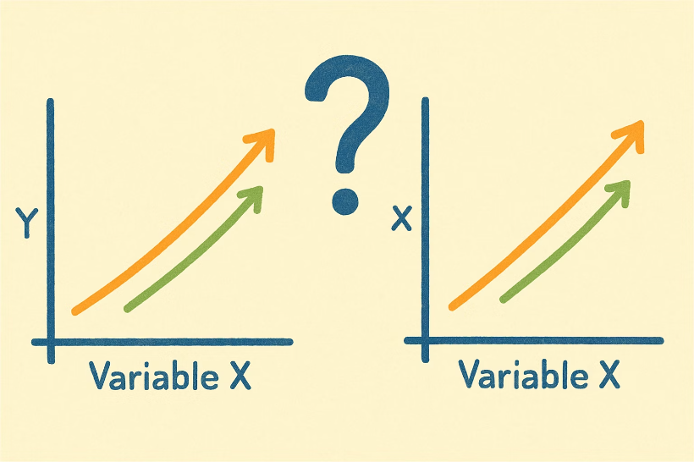
Correlation vs. Causation – Important Distinction
Strong correlation (r ≈ -0.7 between temp and bee counts) is compelling evidence — but NOT proof of causation.
Lurking variables (pesticide use, disease, habitat loss) could explain the pattern. A controlled experiment — where you manipulate only temperature — would be needed to establish causation.
The biological mechanism is plausible and consistent, which raises our confidence — but correlation plus a mechanism still isn’t the same as proof. Always stay honest about what your data can and cannot show.

Slide 16
Chapter 10
Are Your Findings Similar?

Slide 17
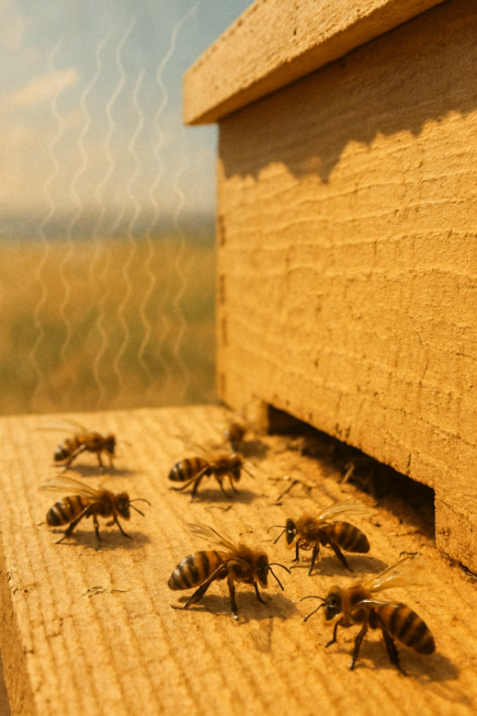



Key Findings
Consistent Pattern
Temperature Correlation
Bee populations drop consistently in June-July compared to spring and late summer.
These drops coincide with the hottest temperatures of the year.
Rainfall Relationship
Lower rainfall periods also correlate with reduced bee counts.

Slide 18
The Most Plausible Explanation
Heat Stress
Primary factor affecting bee activity
Drought Conditions
Reduced nectar and pollen availability
Temporary Effect
Recovery when conditions improve
Extreme heat and dry conditions in early summer are stressing the bee colonies. High heat can cause bees to stay in the hive to cool it, reducing foraging activity. Drought can reduce food availability.

Slide 19
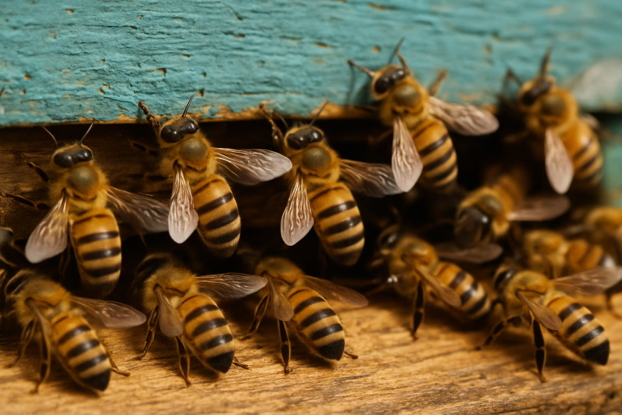
How Heat Affects Bees
Biological Impacts
﻿﻿Bees must ventilate hives when hot
﻿﻿Foraging activity decreases
Water needs increase
﻿Nectar production in flowers decreases
During extreme heat, bees may spend more energy cooling the hive than collecting food, explaining the observed population decline.

Slide 20
Recovery Pattern
Spring (April-May)
Late Summer (August-September)
Peak bee activity with moderate temperatures and good rainfall.
Bee counts recover as temperatures moderate and conditions improve.
1
2
3
Early Summer (June-July)
Bee counts drop during hottest, driest period.
The recovery in late summer supports our theory that the decline is due to temporary environmental stress rather than a permanent issue.

Slide 21
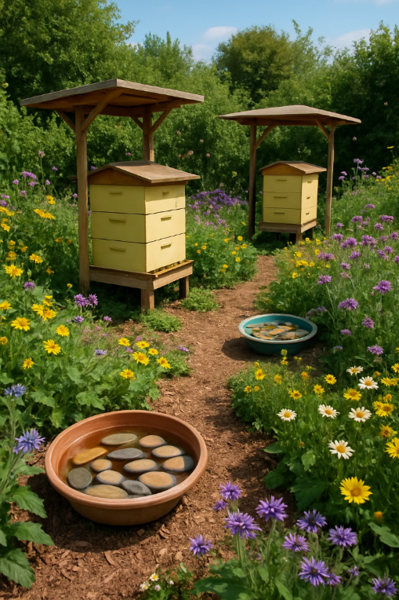




Recommendations for the Garden
Provide Water Sources
Add Shade
Create shade over hives during peak summer heat.
Set up shallow water dishes near hives during hot periods.
Avoid Summer Pesticides
Plant Heat-Resistant Flowers
Don't add chemical stress during already difficult periods.
Ensure nectar sources even during hot weather.

Slide 22
Further Investigation Ideas
Experimental Interventions
Parasite Monitoring
Regional Comparison
Test if providing additional water or shade to the hives in summer helps the bees.
Check for parasites or diseases in late spring to rule those out or identify them as contributing factors.
Gather data from other nearby areas to see if they observe the same pattern.
These additional investigations could strengthen our conclusions or reveal other factors at play.

Slide 23
Chapter 10
Communicating Your Findings

Slide 24

Communicating Your Findings
Introduction
Explain the mystery and why it matters.
Data and Methods
Describe what data you used and how you analyzed it.
Key Findings
Present the most important results with visual evidence.
Conclusion
State your answer to the mystery and suggest actions.

Slide 25
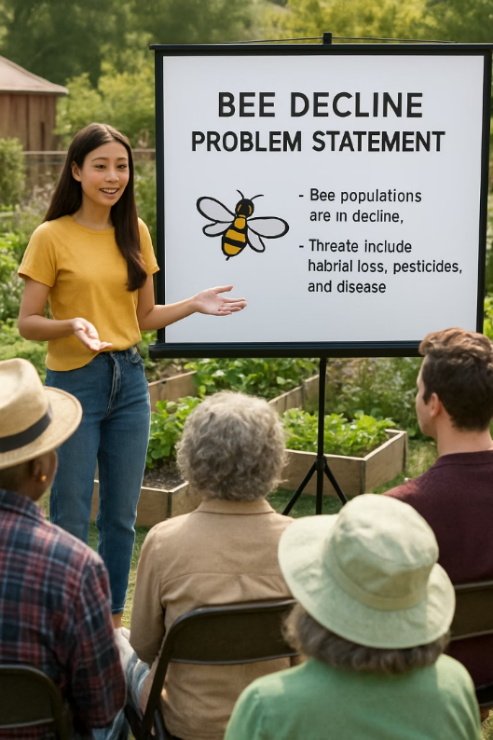
Sample Introduction
"The Case of the Disappearing Bees: Solved! Our community garden has been puzzled by a consistent drop in bee counts during summer months. As data detectives, we investigated this mystery using bee count records and weather data to uncover the likely cause."
A good introduction captures attention and clearly states the problem you're solving. It should also explain why the issue matters (bees are important pollinators for the garden).

Slide 26
Sample Data and Methods
What to Include
﻿﻿Data sources used
Time period covered
Key variables analyzed
Analysis techniques
Any major data cleaning steps
Example Statement
"We analyzed six years of monthly bee count data (2018-2023) alongside temperature and rainfall records. After cleaning and combining the datasets, we looked for patterns and correlations between bee populations and weather conditions."
Keep technical details simple when presenting to a general audience.

Slide 27
Sample Findings Presentation
Visual Evidence
Include a simple graph showing bee counts dropping as temperature rises.
Example Statement
"We found that bee counts were lowest in the hottest months. When average monthly temperature rose above 30°C, bee counts dropped by about 30%. The bees consistently recovered when temperatures moderated in late summer."
Highlight the key correlation values that support your conclusion.

Slide 28
Sample Conclusion
Answer the Mystery
Reassurance
Actionable Suggestions
Heat stress and possibly drought conditions are causing the summer bee decline.
The bees recover naturally when conditions improve in late summer.
Provide shade, water sources, and avoid pesticides during hot periods.
A good conclusion provides clear answers and practical next steps based on your findings.

Slide 29
Chapter 10
Reflection and Key Takeaways

Slide 30
Reflection
Reflect on the hardest part
Was it data wrangling, merging datasets, or handling outliers?
Consider what you’d do if no clear pattern emerged (e.g., no correlation with weather)
Would you collect more data or try a different analysis?
Think about how breaking the task into steps (planning, cleaning, exploring, etc.) helped you manage a complex problem.

Slide 31












The Data Detective Process
Frame It
Plan It
Define the question clearly
Outline data needs and steps
Communicate It
Wrangle It
Share insights effectively
Clean and combine data
Explain It
Explore It
Draw evidence-based conclusions
Find patterns and clues
This process can be applied to any data mystery you encounter in the future.

Slide 32




Common Challenges in Data Projects
Messy Data
Unclear Patterns
Real-world data is rarely clean and often requires significant preparation.
Sometimes relationships aren't obvious and require deeper investigation.
Multiple Factors
Limited Data
Real problems often have multiple contributing causes.
You may not have all the data you ideally want.
Successful data detectives adapt their approach to overcome these challenges.

Slide 33

Value of Domain Knowledge
Understanding the subject matter helps you
﻿﻿Form better hypotheses
Identify relevant variables
Spot suspicious data points
Interpret results meaningfully
In our bee mystery, knowing that bees are affected by heat and need water helped guide our investigation and interpret our findings.

Slide 34
The Importance of Documentation
Record Decisions
Explain Reasoning
Track Versions
Document how you handled missing values, outliers, and other data issues.
Note why you chose certain analysis methods or made specific assumptions.
Keep track of different versions of your analysis as it evolves.
Good documentation helps others understand your work and allows you to revisit your analysis months later.

Slide 35
Practice Exercise: Write Your Own Summary
Introduction
Approach
Write 1-2 sentences explaining the bee mystery and why it matters.
Write 1-2 sentences describing what data you used and how you analyzed it.
Findings
Conclusion
Write 1-2 sentences highlighting the key evidence you discovered.
Write 1-2 sentences stating your solution and recommendations.
This exercise helps you practice translating technical analysis into clear communication.

Slide 36
Example Summary
"Our community garden's bees have been mysteriously disappearing during summer months, threatening plant pollination. By analyzing six years of bee counts alongside weather data, we discovered a strong relationship between high temperatures and declining bee populations. The evidence shows that when temperatures exceed 30°C, bee counts drop by about 30%, but recover when conditions improve. We recommend providing shade and water sources for the hives during hot periods to help the bees thrive year-round."
This summary concisely covers the problem, approach, findings, and recommendations in plain language.

Slide 37





Key Takeaways from This Project
Clean Data is Crucial
Data preparation is often the most time-consuming but essential step.
Integration Reveals Insights
Combining multiple data sources often leads to deeper understanding.
Structured Approach Works
Following a step-by-step process helps manage complex problems.
Context Enhances Analysis
Domain knowledge improves hypothesis formation and interpretation.

Slide 38
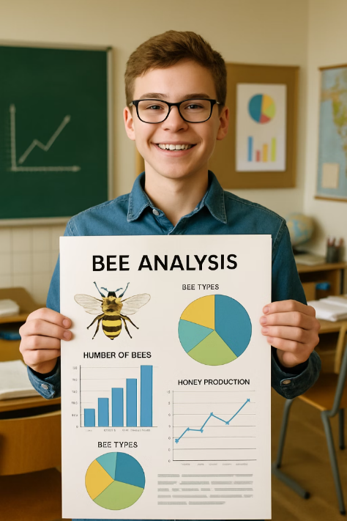
Congratulations, Data Detective!

Slide 39
You’ve Completed the Data Detective Series!
Across 10 chapters, you have built a complete data science toolkit:
Ch 1–2: Thinking like a detective — data types, formats, and basic statistics
Ch 3–4: R and Python — your data analysis power tools
Ch 5–7: Collecting, cleaning, and wrangling real-world data
Ch 8: EDA — finding patterns and relationships in data
Ch 9: Statistical inference — from sample to confident conclusion
Ch 10: The full pipeline — frame, wrangle, analyze, communicate, and act
What comes next?
Machine learning, advanced statistics, data engineering, and AI — all build on exactly what you’ve learned here. You are ready.

Slide 40
Chapter 10
Coding Agents for Your Data Mystery

Slide 41
Using a Coding Agent Across the Full Project Pipeline
🔍 Step 1: Framing
Ask: “Help me write a clear research question and two hypotheses about [your topic].”
🧹 Step 2: Cleaning
Ask: “Here is my CSV. Write R code to check for missing values, outliers, and type issues.”
🔗 Step 3: Merging
Ask: “Merge bee_counts.csv and weather.csv on Year and Month columns using Python pandas.”
📊 Step 4: EDA
Ask: “Create a scatterplot of Bee_Count vs Max_Temp, add a trend line, and compute Pearson’s r.”
🧪 Step 5: Inference
Ask: “Run a t-test to compare mean bee counts in June–July vs. other months. Interpret the p-value.”
📝 Step 6: Storytelling
Ask: “Summarize my findings for a community garden newsletter. Keep it under 100 words, no jargon.”
⚠️ Golden Rule: The agent helps you CODE each step — YOU do the thinking, hypothesizing, and interpreting.

Slide 42
A Real Agent Conversation: Bee Mystery EDA
👤 Student Prompt
“I have a merged dataset called bee_weather with columns: Month, Bee_Count, Max_Temp_C, Total_Rainfall_mm. Using R, create two plots side-by-side: (1) a line chart of Bee_Count over months, and (2) a scatterplot of Max_Temp_C vs Bee_Count with a trend line and the Pearson correlation printed on the plot.”
Why this is a strong prompt:
Names the dataset and all relevant columns
Specifies the language (R)
Describes exactly what each chart should show
Asks for a specific statistic (Pearson’s r) on the plot
🤖 Agent’s R Code
library(ggplot2); library(gridExtra)
r_val <- round(cor(bee_weather$Max_Temp_C,
bee_weather$Bee_Count), 2)
p1 <- ggplot(bee_weather, aes(x=Month,
y=Bee_Count)) + geom_line() + geom_point()
p2 <- ggplot(bee_weather, aes(x=Max_Temp_C,
y=Bee_Count)) + geom_point() +
geom_smooth(method="lm") +
labs(subtitle=paste("r =", r_val))
grid.arrange(p1, p2, ncol=2)
Your job after running it:
Read the r value. Does it confirm a strong negative relationship? Write one sentence interpreting it in context of the bee mystery.

Slide 43
Choose Your Own Mystery — Extension Challenge
Finished the bee mystery? Pick one of these real-world mysteries and run your own full investigation using the same 6-step pipeline and a coding agent.
🏫 School Performance
Mystery:
Why do some schools in a district consistently outperform others?
Data to explore:
Test scores, class size, teacher experience, income levels, spending per student
🏃 Sports Performance
Mystery:
What statistics best predict whether an NBA player will be an All-Star?
Data to explore:
Points, assists, rebounds, shooting %, minutes played, team win rate
🌍 Climate Patterns
Mystery:
Has the temperature in your city changed over the last 30 years? When? By how much?
Data to explore:
NOAA historical weather records, monthly averages, extreme event counts
📱 Social Media
Mystery:
What features make a YouTube video go viral? Is it length, title, or upload time?
Data to explore:
Views, likes, comments, duration, category, upload day/time, subscriber count

Slide 44
Final Reflection: You + the Agent = A Powerful Team
🧠 What YOU Bring
Domain curiosity — knowing bees matter and asking why counts drop
Hypothesis formation — “maybe it’s heat or drought”
Critical judgment — recognizing correlation ≠ causation
Storytelling — translating data into actionable recommendations
Ethics — being honest about what the data can and cannot show
🤖 What the AGENT Brings
Speed — generates and debugs code in seconds
Syntax recall — knows ggplot2, seaborn, scipy so you don’t have to memorize
Error explanation — turns cryptic messages into plain English fixes
Language adaptation — rewrites technical findings for different audiences
Breadth — can suggest approaches you hadn’t considered
Together: you provide the questions and judgment; the agent provides the computational muscle. That combination is what real data scientists use every day.

