Slide 1
Day 2: Introduction to Python – Data Analysis in Python

Slide 2

Install Anaconda (Python + Jupyter)
Go to: https://www.anaconda.com/download/success
Download the correct option for your system
The file is large, it may take a few mins
After the download is complete, run and install it.

Slide 3

Launch Jupyter Notebook
Start Anaconda Navigator
Sign in is optional
Launch Jupyter Notebook

Slide 4





What is Jupyter Notebook?
Interactive Environment
Create documents that mix code, output, and explanatory text.
Cell-Based Structure
Break work into steps (cells), run each step, and see results immediately.
Visualization Support
Display charts and graphs directly in your notebook.
Shareable Format
Easy to share your analysis and results with others.

Slide 5
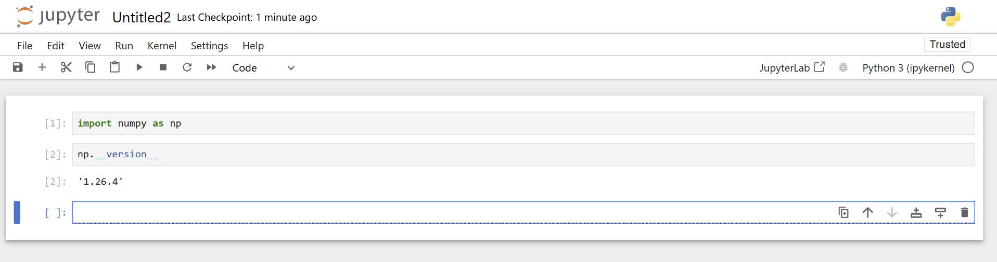
Navigating the Jupyter Notebook Interface

Slide 6
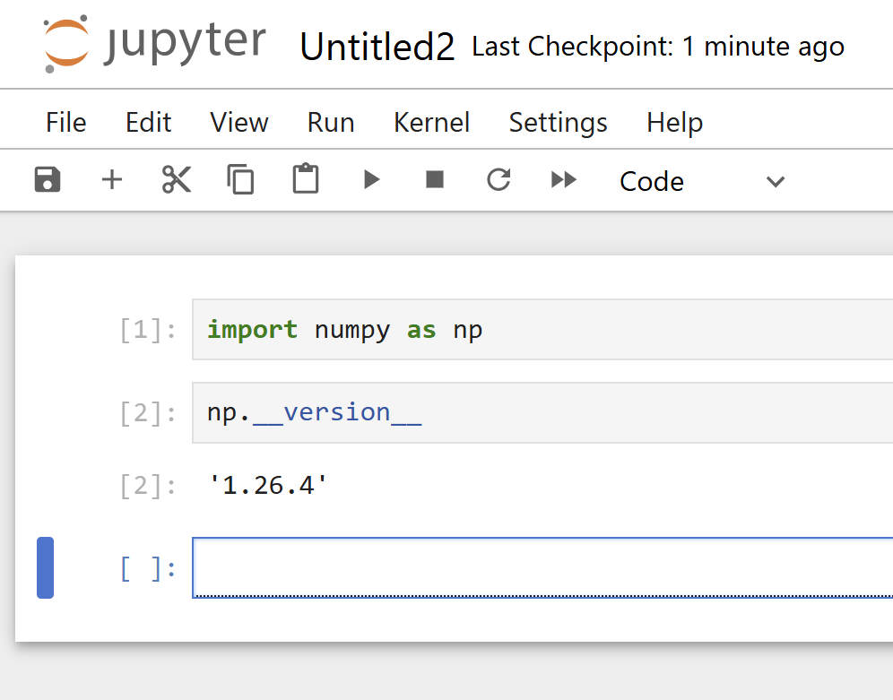
Navigating the Jupyter Notebook Interface
Menu bar
Tool bar
Run button
Input Code
Output

Slide 7
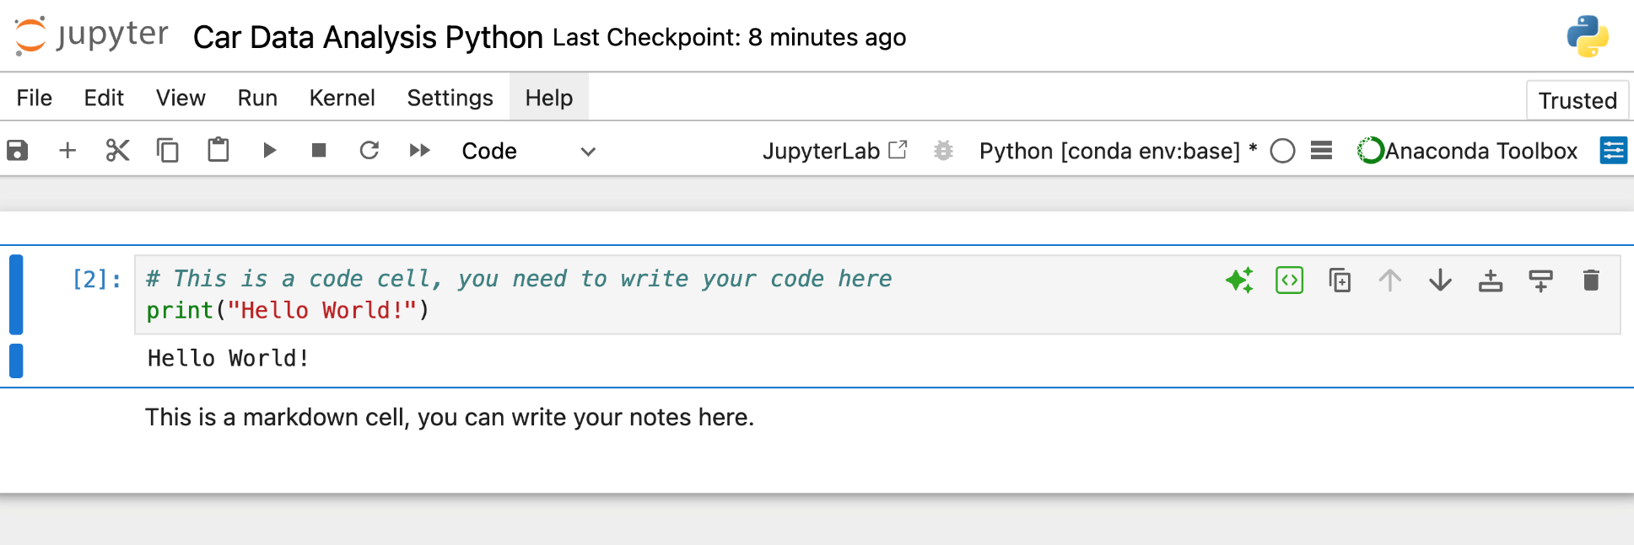
Notebook Name
Shows the running engine on the backend
Code cell
Output, after you hit the run button
Markdown cell
Number of executions
Adds code/markdown line above or below

Slide 8
What is a variable?
A variable is a named reference to a value stored in memory.
Python is dynamically typed — the type is inferred at runtime. The same variable name can be reassigned to a different type.
Example:

Slide 9
Data Types
str — immutable text sequence: "Hello". Supports slicing, f-strings, .split()/.join(). "Hello"[1:3] == "el"
int — arbitrary precision whole number: 14, -3, 10**100. No overflow. Division always returns float: 7/2 == 3.5
float — 64-bit IEEE 754 decimal: 3.14. Caution: floating-point precision means 0.1 + 0.2 != 0.3
bool — subclass of int (True==1, False==0): True, False. Drives control flow; supports and/or/not operators

Slide 10
Printing
print() writes to stdout by default. Can redirect to stderr with file=sys.stderr, or to a file. Accepts sep= and end= kwargs for formatting.
Example:

Slide 11
String Formatting (3 Ways)
Concatenation (avoid — fragile with non-strings):
name = "Alice"
print("Hello, " + name)
f-string (preferred — readable and efficient):
print(f"Hello, {name}! You are {age} years old.")

Slide 12
User Input
input() always returns a string — cast to int or float for numeric input. Validate before using.
age = int(input("Enter your age: ")) # cast to int
print(f"In 5 years you will be {age + 5}") # arithmetic now works

Slide 13
Python Fundamentals: Mini Exercises
Exercise A — Type Exploration:
Create a float variable, then convert it to int. What happens to the decimal?
Create a string "3.14" and convert it to float. What happens with int("3.14")?
Assign x = 5, then x = "five". What does type(x) return each time? Why?
Exercise B — f-string formatting:
Store a name, age, and GPA. Print: "Alice (age 17) has a 3.85 GPA." using an f-string. Round GPA to 1 decimal.
Exercise C — Input + type casting:
Prompt for two numbers, cast to float, print their sum, difference, and ratio.
Handle the case where the user types a non-number — what error do you get?
Exercise B — f-string formatting:
Bonus: use a try/except block to catch the ValueError and print a helpful message instead.

Slide 14
Lists – A Collection of Items
A list is an ordered, mutable sequence. Supports mixed types, negative indexing, and slicing.
Example:
colors = ["red", "blue", "green"]
print(colors)

Slide 15
Accessing List Items
Python uses zero-based indexing. Negative indices count from the end: colors[-1] == last element. Slicing: colors[1:3] returns elements at index 1 and 2.
print(colors[-1]) # green (last)
print(colors[1:3]) # ['blue', 'green'] — slicing

Slide 16
Adding and Changing List Items
Common list methods (lists are mutable — in-place modification):
colors.append("yellow")
print(colors)
Key methods: .append() — end, .insert(i, x) — at index, .remove(x) — first match, .sort() — in place, sorted() — returns new list
colors[0] = "pink“
print(colors)

Slide 17
Loops – Doing Things Repeatedly
A for loop iterates over any iterable. Use enumerate() to get index + value, range() for numeric sequences.
for i, color in enumerate(colors):
print(f"{i}: I like {color}") # i=0,1,2...

Slide 18
If Statements
Use if/elif/else chains. Python uses and/or/not (not &&/||). Membership: "blue" in colors is O(n); use sets for O(1).
if "blue" in colors and len(colors) > 2:
print(f"Blue found! List has {len(colors)} items.")

Slide 19
Lists, Loops & Conditionals: Mini Challenge
Create a list of 5 exam scores (e.g., 88, 72.5, 95, 61, 83).
A — Loop and print each with a label: "Score 1: 88", etc. B — Add if/elif/else inside the loop to grade each score (A/B/C/Below C).
C — Calculate the mean without any library. Compare to sum(scores)/len(scores).

Slide 20
What is a Dictionary?
A dictionary stores data as key-value pairs.
Example:
student = {"name": "Alice", "age": 14, "grade": 9}
Dicts are hash maps — O(1) average lookup. Keys must be hashable (strings, ints, tuples):
Key: unique identifier — like a column name in a DataFrame
Value: any Python object — int, list, dict, even a function

Slide 21
Accessing Dictionary Values
Direct access raises KeyError if key missing. Use .get():
print(student.get("gpa", 0.0)) # returns 0.0 if key missing
print(list(student.keys())) # all keys as a list

Slide 22
Adding and Updating Values
Three ways to add/update (all mutate the dict in place):
student["favorite_color"] = "blue"
Remove a key: del student["grade"] or student.pop("grade", None)
student.update({"age": 15, "gpa": 3.9}) # batch update

Slide 23
Loops with Dictionaries
Prefer .items() to unpack key-value pairs simultaneously. Dict comprehensions build dicts concisely.:
for key, val in student.items(): # preferred
print(f"{key} -> {val}")

Slide 24
Day 2: Data 101: Types, Formats, and Basic Statistics

Slide 25

Data 101
Welcome to Data 101!
In this chapter, we'll explore the fundamentals of data types, formats, and basic statistics.
Think of yourself as a data detective learning to use essential tools to solve mysteries hidden in data points.

Slide 26

Data 101: Learning Objectives
By the end of this chapter you will be able to:
1. Classify any variable as nominal, ordinal, discrete, or continuous — and explain which statistical operations are valid for each type.
2. Identify data in CSV, JSON, database, and spreadsheet formats and explain the tradeoffs between them.
3. Compute mean, median, mode, range, and standard deviation by hand and in Python/R.
4. Interpret summary statistics critically — knowing when the mean misleads and when the median is more informative.
5. Use Python (pandas) to load a CSV, inspect a DataFrame, and compute descriptive statistics programmatically.
6. Collaborate with a coding agent to perform exploratory data analysis, verifying and interpreting the agent’s outputs.
Types of Data
Learn to distinguish between categorical and numerical data
Data Formats
Explore how data is organized and stored
Apply these concepts to real-world scenarios
Master the tools to summarize and describe data
Basic Statistics
Practical Applications

Slide 27
Chapter 2
Types of Data: Categorical vs. Numerical

Slide 28
Types of Data: Categorical vs. Numerical
Data Type
Categorical
Numerical
Discrete
Nominal
Ordinal
Continuous
This taxonomy traces back to Stanley Stevens (1946) and underpins which statistical operations are mathematically valid:
Categorical (qualitative): identity or membership — nominal and ordinal scales
Numerical (quantitative): magnitude — interval and ratio scales. Only numerical data supports arithmetic operations like mean and standard deviation.

Slide 29

Categorical Data
Categorical variables encode membership, not magnitude. Valid operations are limited to counting, frequency tables, and mode — not mean or standard deviation.
Even when coded as numbers (e.g., 1=Male, 2=Female), arithmetic is meaningless — average gender is not a concept.
Eye color, blood type, ZIP code, student ID — all categorical despite potentially numeric encoding.
Statistical tools for categorical data: frequency tables, bar charts, chi-square tests, contingency tables.
Choosing the wrong operation (e.g., mean on a zip code) produces a result that looks valid but is analytically meaningless.
Rule of thumb: if two values can be averaged and the result is interpretable, the variable is likely numerical.
20% prefer History — note: percentages are valid summary statistics for categorical data.

Slide 30
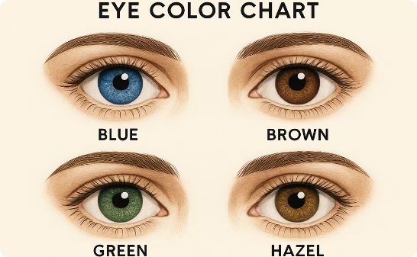

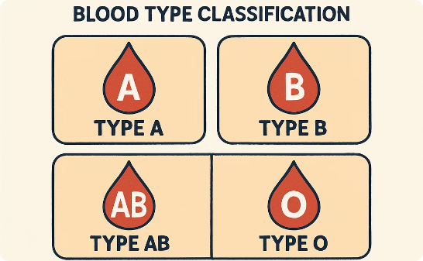
Examples of Categorical Data
Eye Color
Favorite Subject
Blood Type

Slide 31
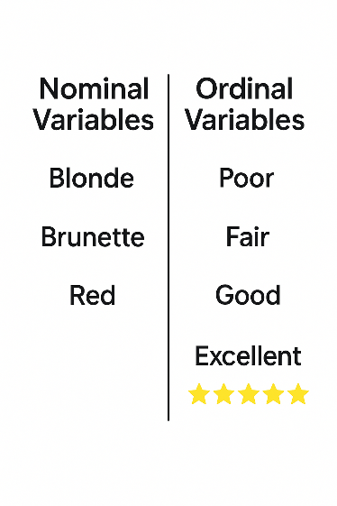
Categorical Data
Categorical data can be further divided into two subtypes:
Nominal
Meaning “in name only”
Categories with no natural order
Just different names with no ranking
Ordinal
Categories with a natural ranking
Exact differences between ranks is unknown

Slide 32
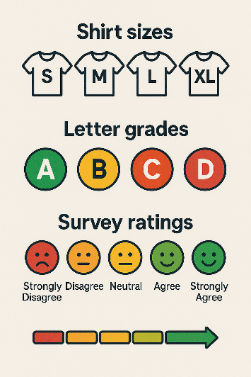
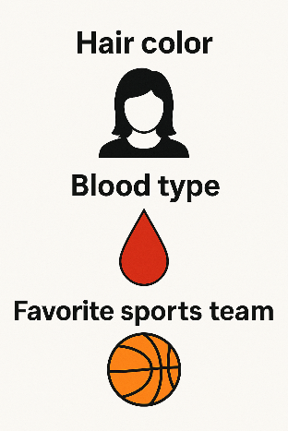
Nominal vs. Ordinal
Use nominal for categories with no intrinsic order (just different names).
Use ordinal for categories that can be ranked.
Nominal
Hair color
Blood type
Ordinal
Shirt sizes (S, M, L, XL)
Letter grades (A, B, C, D, F)
Survey ratings (Strongly Disagree to Strongly Agree)
Favorite Sports team

Slide 33
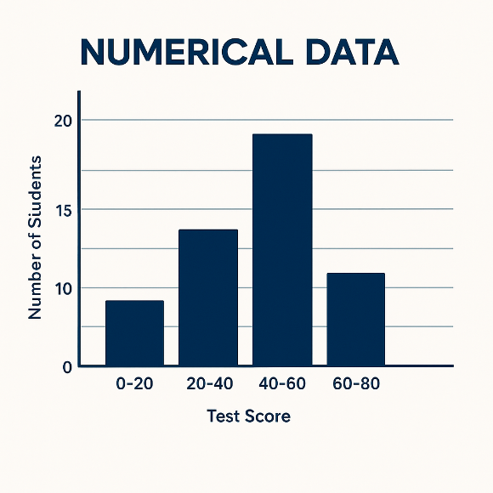
Numerical Data
Numerical variables encode magnitude. Two further subtypes from Stevens’ scale theory:
Interval scale: differences are meaningful but ratios are not. Temperature in °C is interval — 20°C is not "twice as hot" as 10°C.
Ratio scale: has a true zero, so ratios are meaningful. Height, weight, income — 0 means none. Most numerical data in practice is ratio scale.

Slide 34
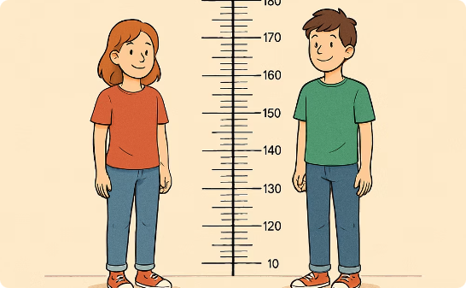
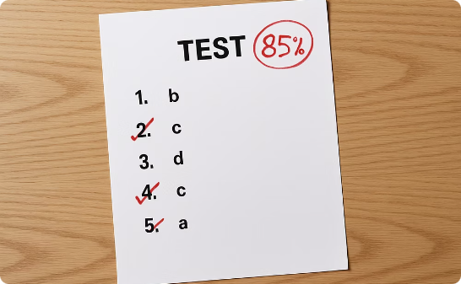

Examples of Numerical Data
Height
Test Scores
Time
Measured in centimeters or inches
Points or percentages earned on assessments
Duration measured in seconds, minutes, hours

Slide 35
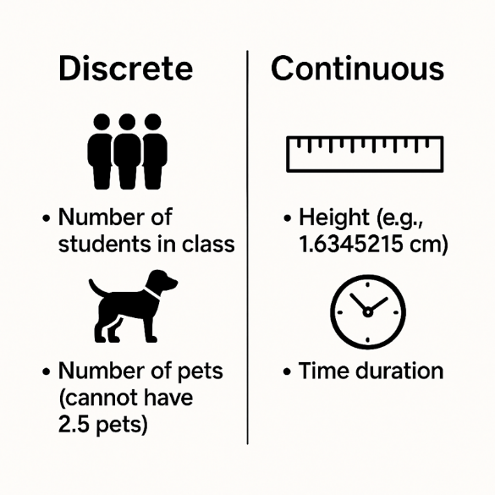
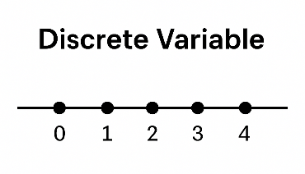
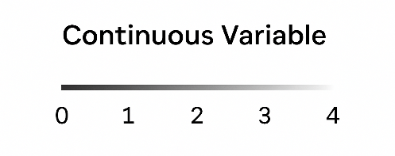
Numerical Data
Numerical data can be further broken down into two subtypes:
Discrete: can only take specific, separated values, usually whole numbers.
Number of students in class
Number of pets (you can’t have 2.5 pets)
Continuous: can take any value in a continuous range.
Height (your height may be 1.6345215… cm)
Time duration

Slide 36

Check Your Understanding - 1
Student ID number (like 1001, 1002, … assigned as an identifier)
Nominal
Ordinal
Discrete
Continuous

Slide 37
Check Your Understanding - 1
Student ID number (like 1001, 1002, … assigned as an identifier)
Nominal
Ordinal
Discrete
Continuous

Slide 38
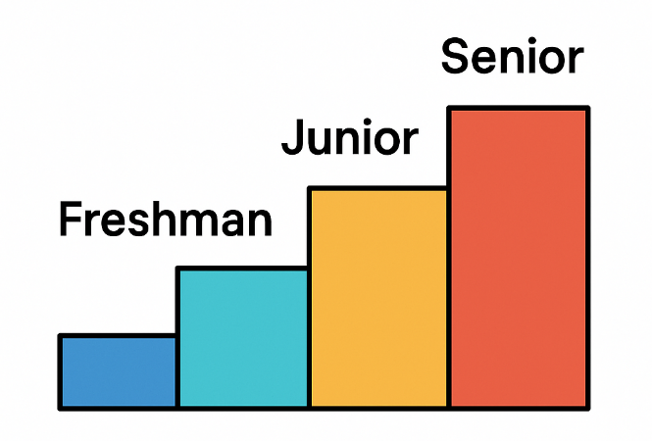
Check Your Understanding - 2
Grade Level (Freshman, Sophomore, Junior, Senior)
Nominal
Ordinal
Discrete
Continuous

Slide 39
Check Your Understanding - 2
Grade Level (Freshman, Sophomore, Junior, Senior)
Nominal
Ordinal
Discrete
Continuous

Slide 40
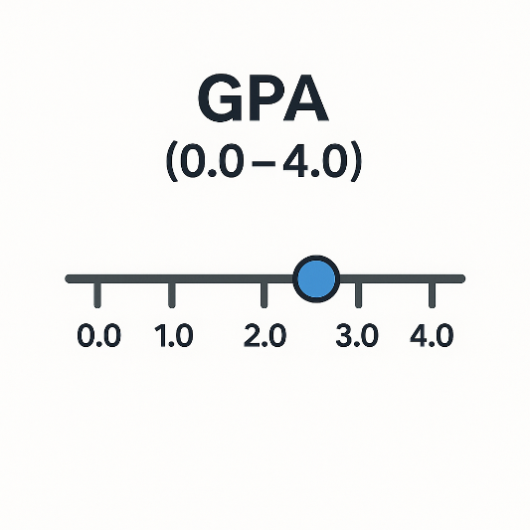
Check Your Understanding - 3
GPA (Grade Point Average on a scale, e.g., 0.0 to 4.0, which can have decimals)
Nominal
Ordinal
Discrete
Continuous

Slide 41
Check Your Understanding - 3
GPA (Grade Point Average on a scale, e.g., 0.0 to 4.0, which can have decimals)
Nominal
Ordinal
Discrete
Continuous

Slide 42
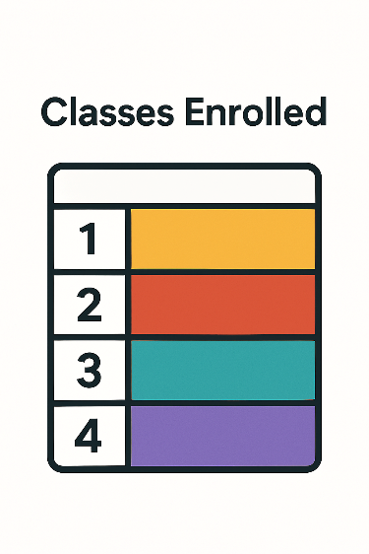
Check Your Understanding - 4
Classes Enrolled (number of classes the student is taking this semester)
Nominal
Ordinal
Discrete
Continuous

Slide 43
Check Your Understanding - 4
Classes Enrolled (number of classes the student is taking this semester)
Nominal
Ordinal
Discrete
Continuous

Slide 44
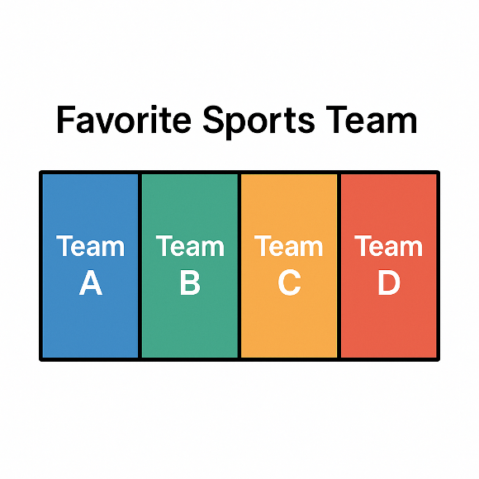
Check Your Understanding - 5
Favorite Sports Team (text response, e.g., “Chicago Bulls”)
Nominal
Ordinal
Discrete
Continuous

Slide 45
Check Your Understanding - 5
Favorite Sports Team (text response, e.g., “Chicago Bulls”)
Nominal
Ordinal
Discrete
Continuous

Slide 46
Why Data Types Matter
Data type determines what you can legitimately do with a variable.
Statistical validity: Mean and standard deviation only make sense for numerical data. Applying them to ordinal data (e.g., averaging survey ratings) produces a number that looks meaningful but may not be.
Visualization choice: Categorical → bar chart, pie chart, frequency table. Numerical → histogram, box plot, scatter plot. Wrong chart for wrong type = misleading graphic.
Algorithm requirements: Many machine learning models require numerical input. Categorical variables must be encoded (one-hot encoding, label encoding) before modeling.
Storage efficiency: Storing a categorical variable as a string wastes memory. In pandas, declaring dtype=’category’ can reduce memory by 50–90% for variables with few unique values.
Data detective rule: Before any analysis, always inspect dtypes. A zip code stored as int64 looks numerical but is nominal — computing its mean is nonsense.
Analysis Methods
Visualization
Interpretation
Different data types require different approaches
Data type determines appropriate graph types
Understanding type helps avoid incorrect conclusion
Calculation Options
Only certain operations make sense for each type

Slide 47
Quick Wrap-up
Data Type |  | Definition | Examples / Explanation
Categorical | Nominal | Classifies data into distinct categories based on a characteristic. Cannot be ordered or measured quantitatively. | Gender, eye color, types of fruit
 | Ordinal | Ranks data in a specific order (e.g., from high to low). No defined interval between ranks. | Education levels (e.g., high school < college < graduate)
Numerical | Discrete | Quantitative data with countable values. No or minimal fractional values. | Number of children in a school, number of text message received in a day
 | Continuous | Quantitative data with infinitely divisible values. | Height, weight, time

Slide 48
Chapter 2
Data Formats and Structures: Organizing the Clues

Slide 49

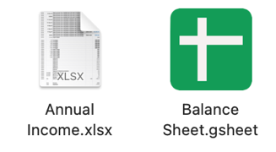
Data Formats and Structures: Organizing the Clues
Name | Age | Favorite Subject
Alice | 14 | Math
Bob | 15 | History
Carmen | 14 | Science
Tables
Organizes data into rows and columns
Spreadsheets
A file that allows organizing and manipulation tables
Database
A structured collection of data

Slide 50
Tables
Also called tabular format or tabular data.
Each row represents one observation and each column a variable.
Student ID | Classes Enrolled | GPA
1001 | 3 | 3.4
1002 | 4 | 2.9
1003 | 2 | 3.8

Slide 51
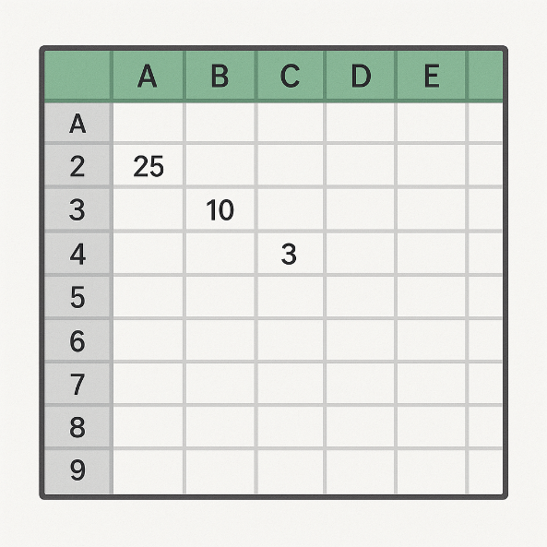
Spreadsheets
A spreadsheet is a file that allows you to organize and manipulate tables of data.
Some examples:
Microsoft Excel
Google Sheets
LibreOffice Calc
Apple Numbers
Allows having multiple sheets (tabs).
User-friendly, easy to edit, apply formulas and make charts.

Slide 52
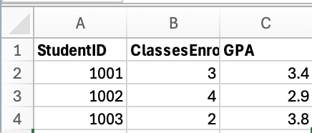
Spreadsheets - 2
Spreadsheets can include extra features beyond raw data, such as formulas, formatting.
For pure data storage and seamless transfer to another software, a simpler format is often used: CSV (Comma-Separated Values) and Text Files
StudentID,ClassesEnrolled,GPA
1001,3,3.4
1002,4,2.9
1003,2,3.8
In a spreadsheet
In a CSV format

Slide 53

Spreadsheets - 3
Formal description of CSV: a text file format that uses commas to separate values, and newlines to separate records.
There are also other formats, such as TSV (tab-separated values).
In TSV, instead of comma, each variable is separated by tab.
Main goals of CSV and TSV:
Portable table data stroge
Universal compatibility, can be accessed by almost any data software
Simple, don’t carry text format or formulas, requires less storage
Simple, don’t carry Macros and possible viruses

Slide 54

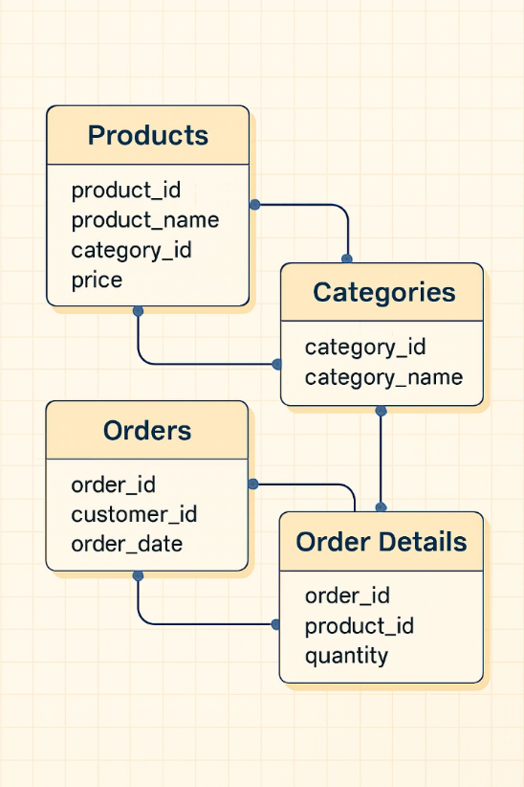
Databases and SQL Tables
Structured collection of data, often organizes data into multiple tables.
Such as one for product, one for customer orders.
SQL is the most common language to interact with database.
Difference between a database and spreadsheet is that the data lives in a database engine and you retrieve it by querying.
Querying → asking for certain columns or filtering rows.
Multiple people can work with it simultaneously.

Slide 55
Other Data Formats
{
"students": [
{
"StudentID": 1001,
"ClassesEnrolled": 3,
"GPA": 3.4
},
{
"StudentID": 1002,
"ClassesEnrolled": 4,
"GPA": 2.9
},
{
"StudentID": 1003,
"ClassesEnrolled": 2,
"GPA": 3.8
}
]
}
JSON or XML often used for data interchange on the web or storing nested data.
<Students>
<Student>
<StudentID>1001</StudentID>
<ClassesEnrolled>3</ClassesEnrolled>
<GPA>3.4</GPA>
</Student>
<Student>
<StudentID>1002</StudentID>
<ClassesEnrolled>4</ClassesEnrolled>
<GPA>2.9</GPA>
</Student>
<Student>
<StudentID>1003</StudentID>
<ClassesEnrolled>2</ClassesEnrolled>
<GPA>3.8</GPA>
</Student>
</Students>
XML
Extensible Markup Language - structured data format
JSON
JavaScript Object Notation - common for web data

Slide 56
Why Formats Matter
Data Format | Strengths | Limitations
Excel / Spreadsheets | Easy for humans to enter & read Great for small-to-medium datasets Quick manual analysis | Poor for automated processing Doesn’t scale to very large datasets
CSV / TSV (text files) | Language-agnostic interchange format Handles fairly large data Simple and portable | All-text so huge files can be cumbersome No schema or data integrity checks
Databases | Efficient with very large datasets Complex querying & filtering Concurrent access & integrity | Requires DB setup & SQL knowledge Overkill for simple/small datasets
Others (JSON / XML) | Supports hierarchical/complex structures Ideal for web data interchange | Must parse before analysis Verbose (esp. XML)

Slide 57
Metadata: Data About Data
Also called a data dictionary.
Explains each variable and possible values.
Field | Type | Description | Allowed values / Range
StudentID | Integer | Unique identifier for each student | Any positive integer
ClassesEnrolled | Integer | Number of classes the student is taking this semester | 0, 1, 2, …
GPA | Continuous | Grade Point Average on a 0.0–4.0 scale (allowing decimals) | 0.0 – 4.0
Data table
Metadata

Slide 58
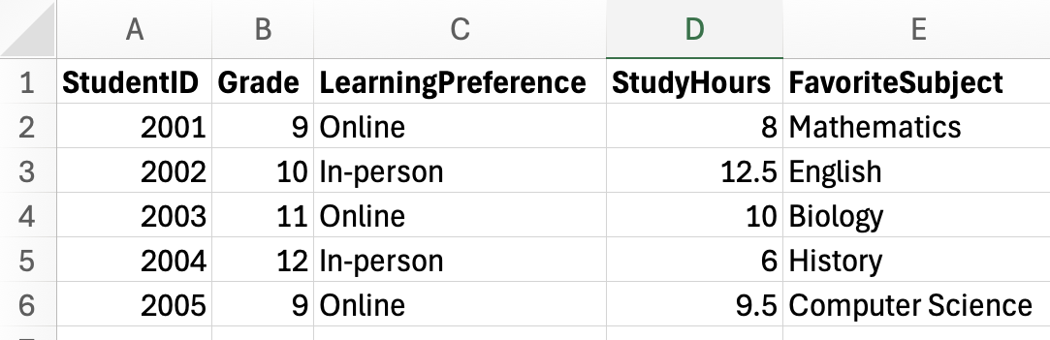
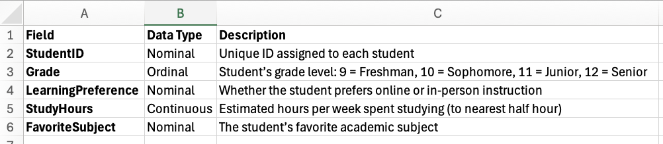
Metadata: Data About Data
Good data comes with metadata.
If you’re creating your own dataset, take notes about each variable – that’s metadata that will help you or others later.
Metadata

Slide 59
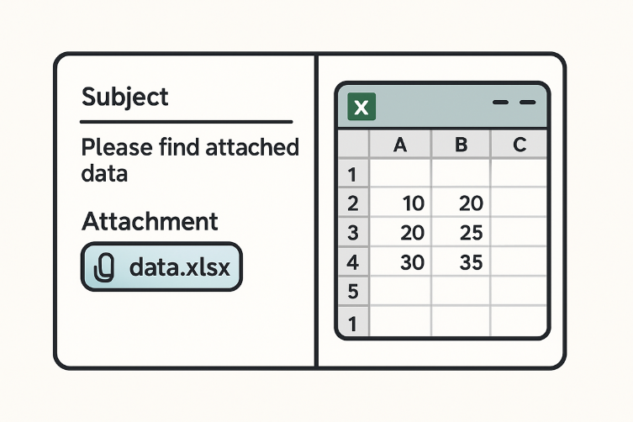
Check Your Understanding - 1
You receive an email with an attachment “data.xlsx” which opens in Excel showing rows and columns. What can we call to this?

Slide 60
Check Your Understanding - 1
You receive an email with an attachment “data.xlsx” which opens in Excel showing rows and columns. What can we call to this?
Excel spreadsheet file

Slide 61
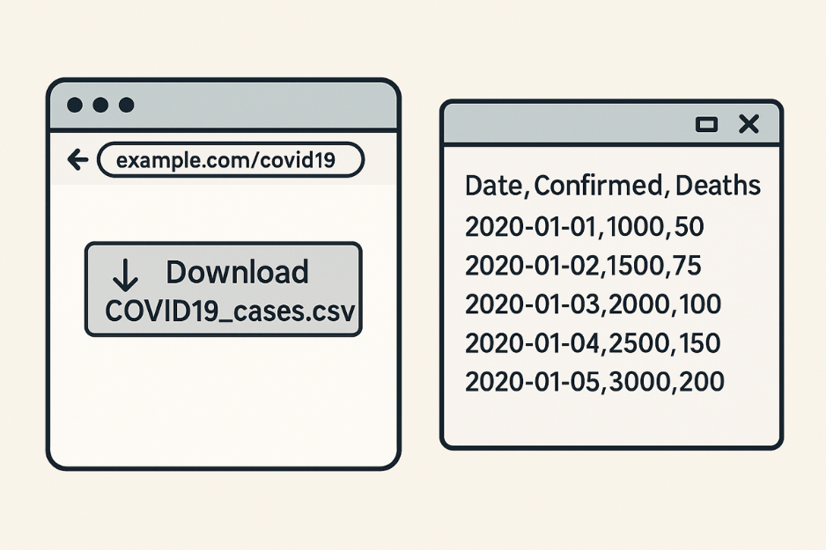
Check Your Understanding - 2
A website allows you to download “COVID19_cases.csv” which when opened in a text editor shows comma-separated values. How can you identify this?

Slide 62
Check Your Understanding - 2
A website allows you to download “COVID19_cases.csv” which when opened in a text editor shows comma-separated values. How can you identify this?
That’s a CSV text file (comma-separated values).

Slide 63

Check Your Understanding - 3
Your school’s student records are stored in a system where you can query information but not directly open a file; an IT staff exports a report for you. Can you identify this?

Slide 64
Check Your Understanding - 3
Your school’s student records are stored in a system where you can query information but not directly open a file; an IT staff exports a report for you. Can you identify this?
That implies a database, they likely ran a query and exported a report, probably as a CSV or PDF for you, but the main storage is a database.

Slide 65
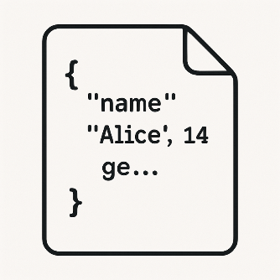
Check Your Understanding - 4
You have a text file with a bunch of { "name": "Alice", "age": 14, ... } entries and curly braces, etc. Can you identify this?

Slide 66
Check Your Understanding - 4
You have a text file with a bunch of { "name": "Alice", "age": 14, ... } entries and curly braces, etc. Can you identify this?
That looks like JSON format commonly used for data with keys and values.

Slide 67
Chapter 2
Summary Statistics: Describing Data with Numbers

Slide 68
Summary Statistics: Describing Data with Numbers
Summary statistics compress a dataset into a few numbers. Two key dimensions: central tendency (where is the middle?) and dispersion (how spread out?). These are descriptive statistics — Chapter 9 extends this to inferential statistics, where we use sample statistics to estimate unknown population parameters.
Summary Statistics
Central Tendency
Mean
Median
Dispersion / Variability
Range
Mode
Standard Deviation

Slide 69
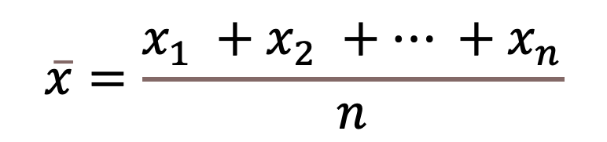
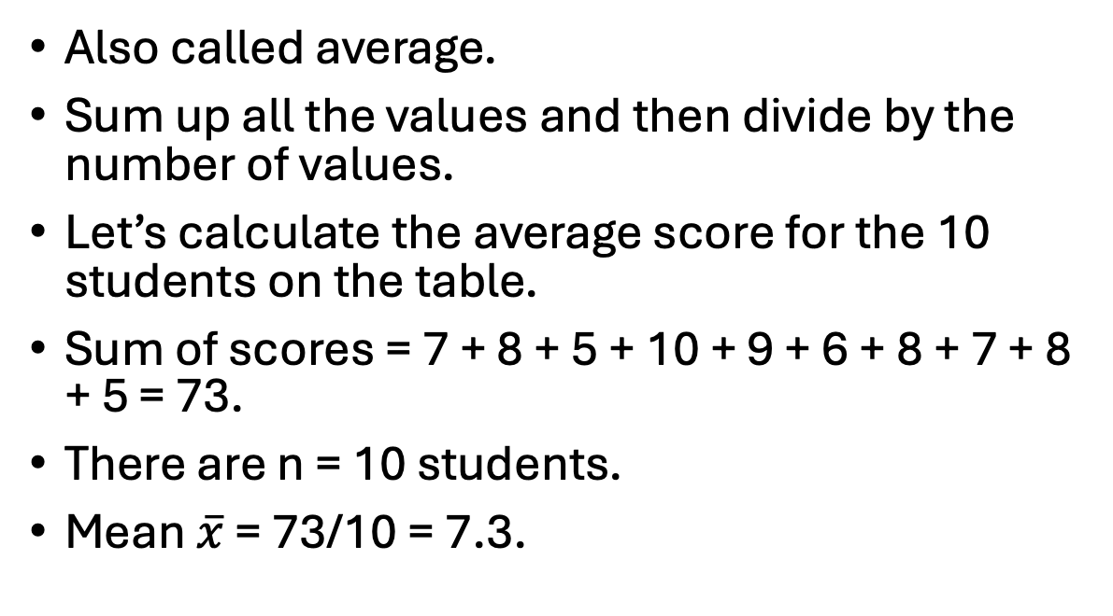
Mean
$$\overline{x}=\frac{x_{1} +x_{2} +… +x_{n}}{n}$$
Also called average.
Sum up all the values and then divide by the number of values.
Let’s calculate the average score for the 10 students on the table.
Sum of scores = 7 + 8 + 5 + 10 + 9 + 6 + 8 + 7 + 8 + 5 = 73.
There are n = 10 students.
Mean $\overline{x}$ = 73/10 = 7.3.
Name | Score
Alice | 7
Ben | 8
Carlos | 5
Diana | 10
Ethan | 9
Fiona | 6
George | 8
Hannah | 7
Isaac | 8
Julia | 5

Slide 70
Median
Name | Score
Julia | 5
Carlos | 5
Fiona | 6
Hannah | 7
Alice | 7
Isaac | 8
George | 8
Ben | 8
Ethan | 9
Diana | 10
Middle value of the dataset.
Especially useful when there are outliers in the data.
To find the median:
Sort the data.
If n is odd, median = value at position (n+1)/2 (when sorted in ascending order).
If n is even, median = average of values at positions n/2 and (n/2 + 1).

Slide 71
Median
Name | Score
Julia | 5
Carlos | 5
Fiona | 6
Hannah | 7
Alice | 7
Isaac | 8
George | 8
Ben | 8
Ethan | 9
Diana | 10
n=10 is even.
The middle two positions are 5th and 6th.
Median = (7 + 8) / 2 = 7.5.
Half of the students scored 7.5 or below, and half scored 7.5 or above.

Slide 72
Mode
The most frequently occurring value in the dataset.
It’s possible to have:
bi-modal or multi-modal - if multiple values tie for highest frequency
no mode - every value occurs equally
On the table, the most frequent score is 8, therefore the mode is 8.
Name | Score
Alice | 7
Ben | 8
Carlos | 5
Diana | 10
Ethan | 9
Fiona | 6
George | 8
Hannah | 7
Isaac | 8
Julia | 5
Score | Frequency
5 | 2
6 | 1
7 | 2
8 | 3
9 | 1
10 | 1
Frequency Table
Table

Slide 73
Measure | Strengths | Weaknesses
Mean | Uses all data points Familiar to most people. Works well for symmetric distributions. Useful for further statistical analysis | Sensitive to outliers. Can be misleading for skewed data. May not represent a “typical” value. Not applicable to categorical data
Median | Not affected by outliers. Better for skewed distributions. Represents the “middle” observation. Works for ordinal data | Ignores specific values (just uses position). Less familiar to some people. Less useful for further statistical analysis. Not applicable to nominal data
Mode | Shows the most common value. Works for categorical data. Not affected by outliers. Useful for identifying peaks | May not exist if all values are unique. Multiple modes possible. Can be unstable in small samples. Less useful for further analysis

Slide 74
Range
The range measures the spread of the data by taking the difference between the maximum and minimum values.
It’s a very simple measure of variability.
Min score is 5, max score is 10.
Range is 10 – 5 = 5
Name | Score
Alice | 7
Ben | 8
Carlos | 5
Diana | 10
Ethan | 9
Fiona | 6
George | 8
Hannah | 7
Isaac | 8
Julia | 5

Slide 75
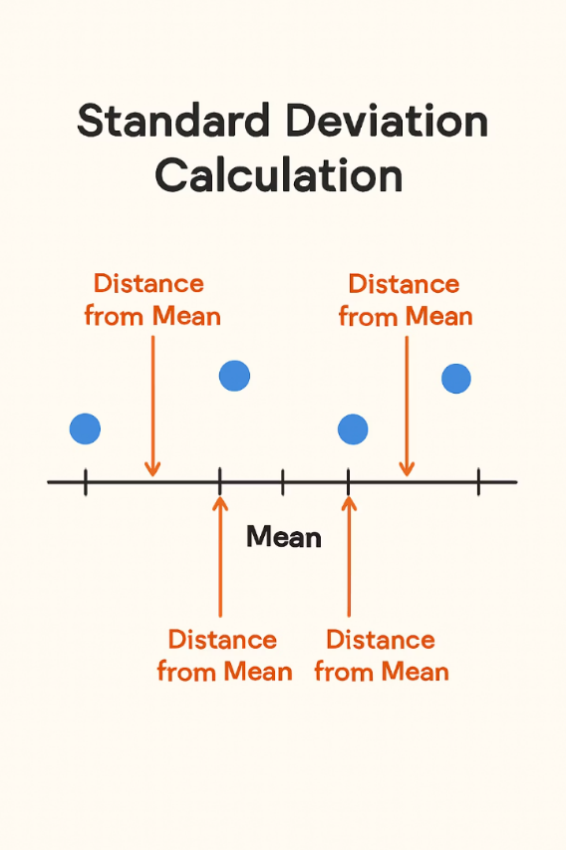
Standard Deviation
Standard deviation (σ for population, s for sample) measures average distance from the mean. Its square is the variance (σ²). Variance is additive for independent variables — a property used extensively in statistics and ML.
Low SD: data clustered tightly around the mean — high precision, low variability. Coefficient of variation (CV = SD/mean) is useful for comparing spread across different scales.
High SD: data spread widely — signals heterogeneity in the sample. In a normal distribution, SD defines the empirical 68-95-99.7 rule.

Slide 76
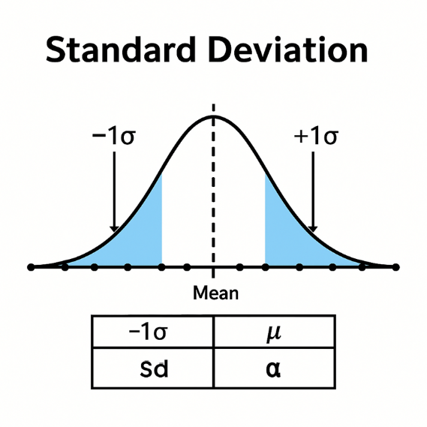
Standard Deviation
How to calculate the standard deviation
Calculate how far each data point is from the mean.
Square those distances (to avoid negative differences canceling out).
Take the average of those squared distances (that gives a quantity called the variance).
Then take the square root of that average (that gives the standard deviation).

Slide 77
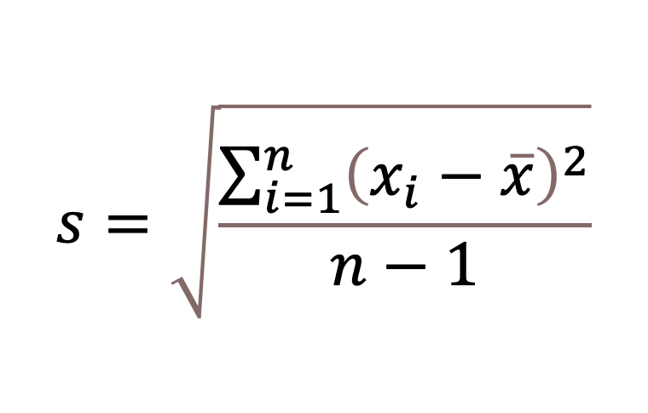
Standard Deviation
s: sample standard deviation
∑: sum symbol (add up the terms)
i=1 to n: index from 1 to sample size
𝑥_𝑖​: score for student i
𝑥 ̅: sample mean
n: sample size
The next slide will show how we can use standard deviation for normal distribution.
$$s=\sqrt{\frac{\sum_{i=1}^{n}{{\left(x_{i}−\overline{x}\right)}^{2}}}{n−1}}$$

Slide 78
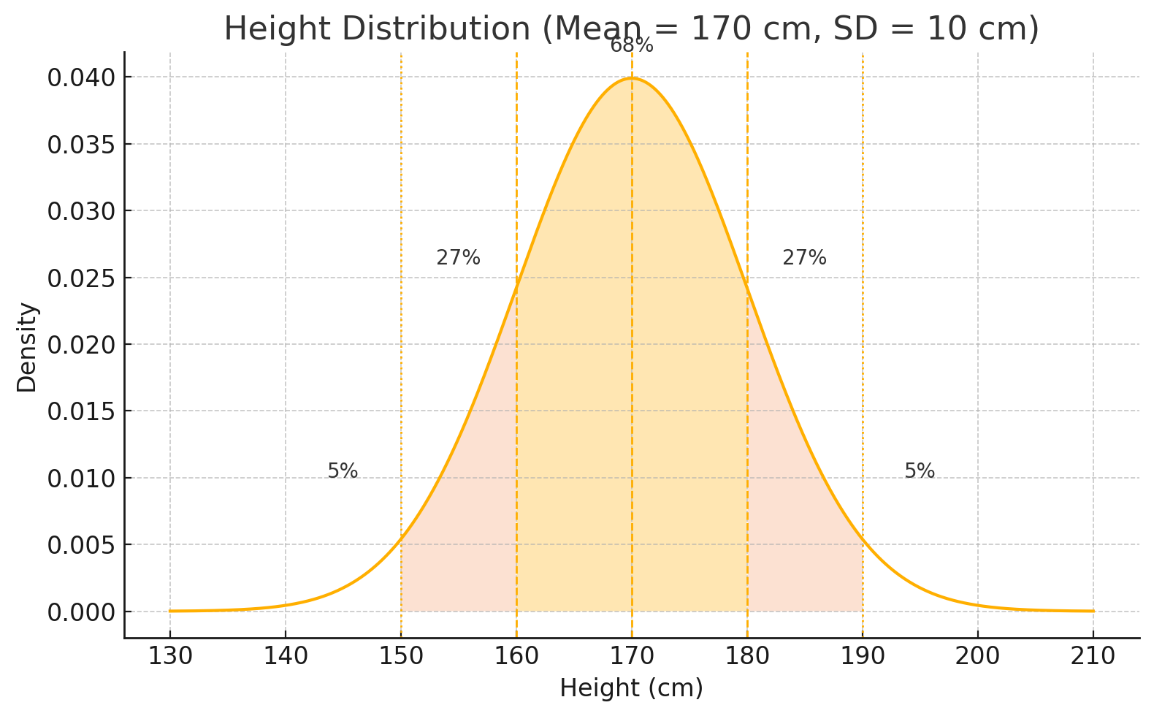
The Normal Distribution and the Empirical Rule
Many natural measurements approximate a normal distribution. The empirical rule lets you interpret SD in practical terms:
68% within ±1 SD — the "typical" range. If your score is within 1 SD of the mean, you are in the majority.
27% between ±1 and ±2 SD — notable but not extreme. A data point here is unusual but not rare.
5% beyond ±2 SD — these are statistical outliers by conventional definition. In quality control, values beyond ±3 SD (0.3%) trigger investigation.

Slide 79
Exercise-0
Name | Score
Alice | 7
Ben | 8
Carlos | 5
Diana | 10
Ethan | 9
Fiona | 6
George | 8
Hannah | 7
Isaac | 8
Julia | 5
Let’s calculate the standard deviation of the table on the left.

Slide 80

Exercise-1
Name | Score
Alice | 7
Ben | 8
Carlos | 5
Diana | 10
Ethan | 9
Fiona | 6
George | 8
Hannah | 7
Isaac | 8
Julia | 5
First calculate the mean.
Which we already did!
$\overline{x}$ = 73/10 = 7.3.

Slide 81
Exercise-2
Name | Score | Difference
Alice | 7 | 0.3
Ben | 8 | 0.7
Carlos | 5 | -2.3
Diana | 10 | 2.7
Ethan | 9 | 1.7
Fiona | 6 | -1.3
George | 8 | 0.7
Hannah | 7 | -0.3
Isaac | 8 | 0.7
Julia | 5 | -2.3
Second, calculate how far each data point is from the mean.
Which means, calculate “score – mean” for each score

Slide 82
Exercise-3
Name | Score | Difference | Sq Difference
Alice | 7 | -0.3 | 0.09
Ben | 8 | 0.7 | 0.49
Carlos | 5 | -2.3 | 5.29
Diana | 10 | 2.7 | 7.29
Ethan | 9 | 1.7 | 2.89
Fiona | 6 | -1.3 | 1.69
George | 8 | 0.7 | 0.49
Hannah | 7 | -0.3 | 0.09
Isaac | 8 | 0.7 | 0.49
Julia | 5 | -2.3 | 5.29
Third, square those distances!

Slide 83
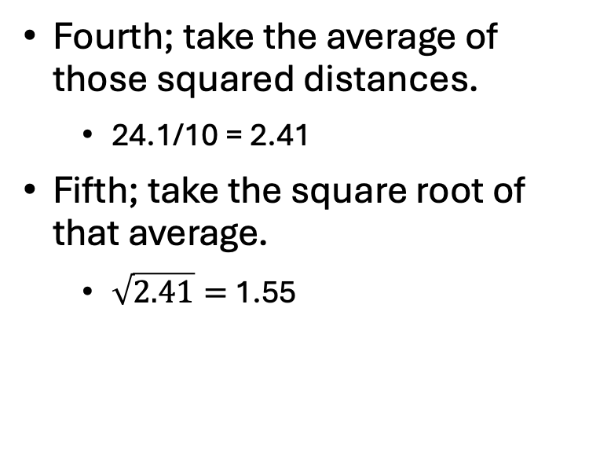
Exercise-4
Name | Score | Difference | Sq Difference
Alice | 7 | -0.3 | 0.09
Ben | 8 | 0.7 | 0.49
Carlos | 5 | -2.3 | 5.29
Diana | 10 | 2.7 | 7.29
Ethan | 9 | 1.7 | 2.89
Fiona | 6 | -1.3 | 1.69
George | 8 | 0.7 | 0.49
Hannah | 7 | -0.3 | 0.09
Isaac | 8 | 0.7 | 0.49
Julia | 5 | -2.3 | 5.29
Sum |  |  | 24.1
Fourth; take the average of those squared distances.
24.1/10 = 2.41
Fifth; take the square root of that average.
$\sqrt{2.41}=$1.55

Slide 84
Exercise-5 - What does 1.55 mean?
Many students’ scores tend to be within about 1.55 points of the mean (7.3).
We can check
1 standard deviation above the mean is ~8.85, 1 below is ~5.75.
Most scores (except maybe the 10 and one of the 5s) are in the range 5.75 to 8.85.
Standard deviation gives a sense of typical deviation; 2 standard deviations (~3.10) would cover a broader range ~4.20 to 10.40 which actually includes all scores here (since lowest was 5, highest 10).

Slide 85
Standard Deviation – Quick Note
Bessel’s Correction: why sample SD divides by n−1 instead of n.
When estimating a population SD from a sample, dividing by n systematically underestimates the true spread (because the sample mean is already optimized to minimize deviations). Dividing by n−1 corrects for this bias — the "1" accounts for the one degree of freedom used estimating the mean.
When n is large (say, n > 30), the difference is negligible. At n=5 it is substantial: n−1=4 inflates SD by 12%.
Python stats.stdev() and R sd() both use n−1 by default. Use stats.pstdev() / R sd(x)*sqrt((n-1)/n) for population SD.
Convention for this course: use n by hand for simplicity; always note which formula when reporting results.

Slide 86
Check Your Understanding
Name | Time
Alice | 12
Ben | 9
Carlos | 15
Diana | 10
Ethan | 14
The table on the left provides data on the time (in minutes) 5 friends spent on a quiz.
Calculate, mean, median, mode, range and standard deviation!

Slide 87
Check Your Understanding - 1
Name | Time
Alice | 12
Ben | 9
Carlos | 15
Diana | 10
Ethan | 14
Sum | 60
Mean: (12+9+15+10+14)/5 = 60/5 = 12 minutes
Median:
First sort → sort [9, 10, 12, 14, 15] → middle value is 12.
Mode: no mode – all values occurred once, or you could say all are equally frequent
Range:
Max: 15, Min: 9
Range: 15 – 9 = 6

Slide 88
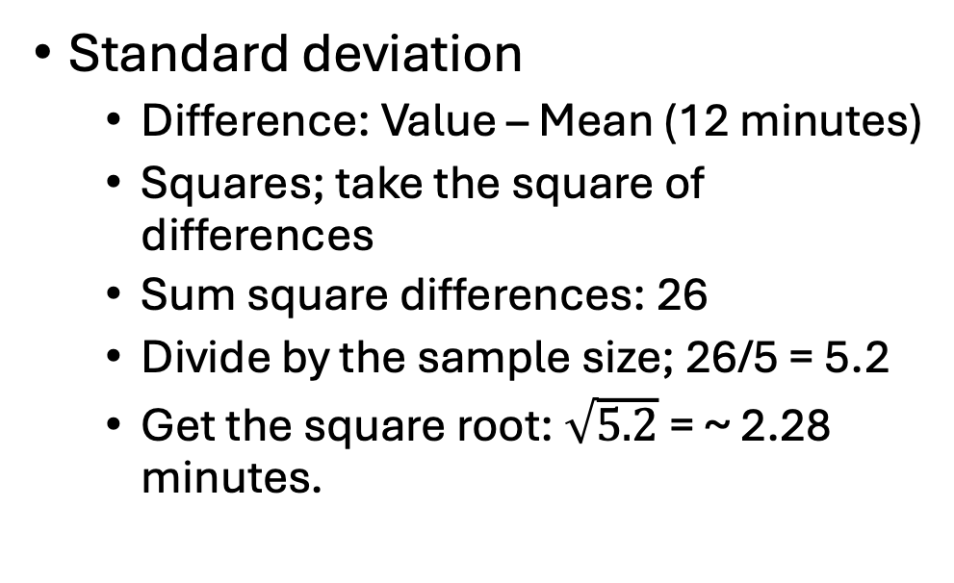
Check Your Understanding - 2
Name | Time | Difference | Sq Difference
Alice | 12 | 0 | 0
Ben | 9 | -3 | 9
Carlos | 15 | 3 | 9
Diana | 10 | -2 | 4
Ethan | 14 | 2 | 4
Sum | 60 |  | 26
Standard deviation
Difference: Value – Mean (12 minutes)
Squares; take the square of differences
Sum square differences: 26
Divide by the sample size; 26/5 = 5.2
Get the square root: $\sqrt{5.2}$= ~ 2.28 minutes.

Slide 89
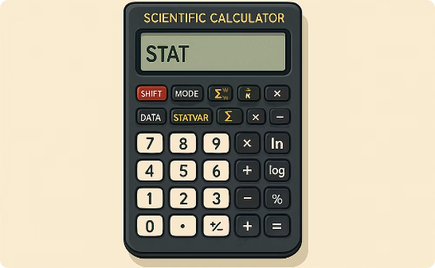
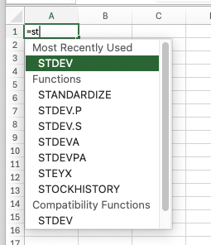
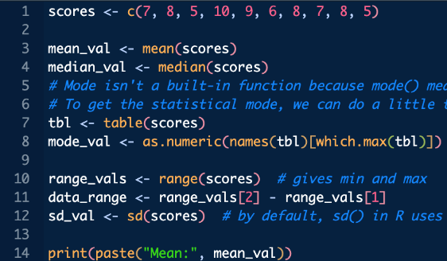
Computing Statistics: Tools of the Trade
Calculators
Many scientific calculators have built-in statistical functions
Programming
Languages like Python and R offer powerful statistical capabilities
Spreadsheets
Excel and Google Sheets have functions like AVERAGE, MEDIAN, MODE, STDEV

Slide 90
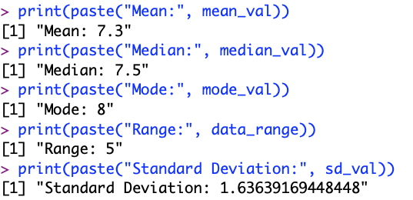
Example in R
scores <- c(7, 8, 5, 10, 9, 6, 8, 7, 8, 5)
mean_val <- mean(scores)
median_val <- median(scores)
# Mode isn't a built-in function because mode() means something else in R (data type).
# To get the statistical mode, we can do a little trick:
tbl <- table(scores)
mode_val <- as.numeric(names(tbl)[which.max(tbl)]) # get value with max frequency
range_vals <- range(scores) # gives min and max
data_range <- range_vals[2] - range_vals[1]
sd_val <- sd(scores) # by default, sd() in R uses sample standard deviation (n-1 in denom)
print(paste("Mean:", mean_val))
print(paste("Median:", median_val))
print(paste("Mode:", mode_val))
print(paste("Range:", data_range))
print(paste("Standard Deviation:", sd_val))

Slide 91
Exercise-0
Here is the number of books read by 6 students over the summer;
3, 0, 11, 4, 7, 5

Slide 92
Exercise-1
Here is the number of books read by 6 students over the summer;
3, 0, 11, 4, 7, 5
What is the mean number of books read by 6 students?

Slide 93
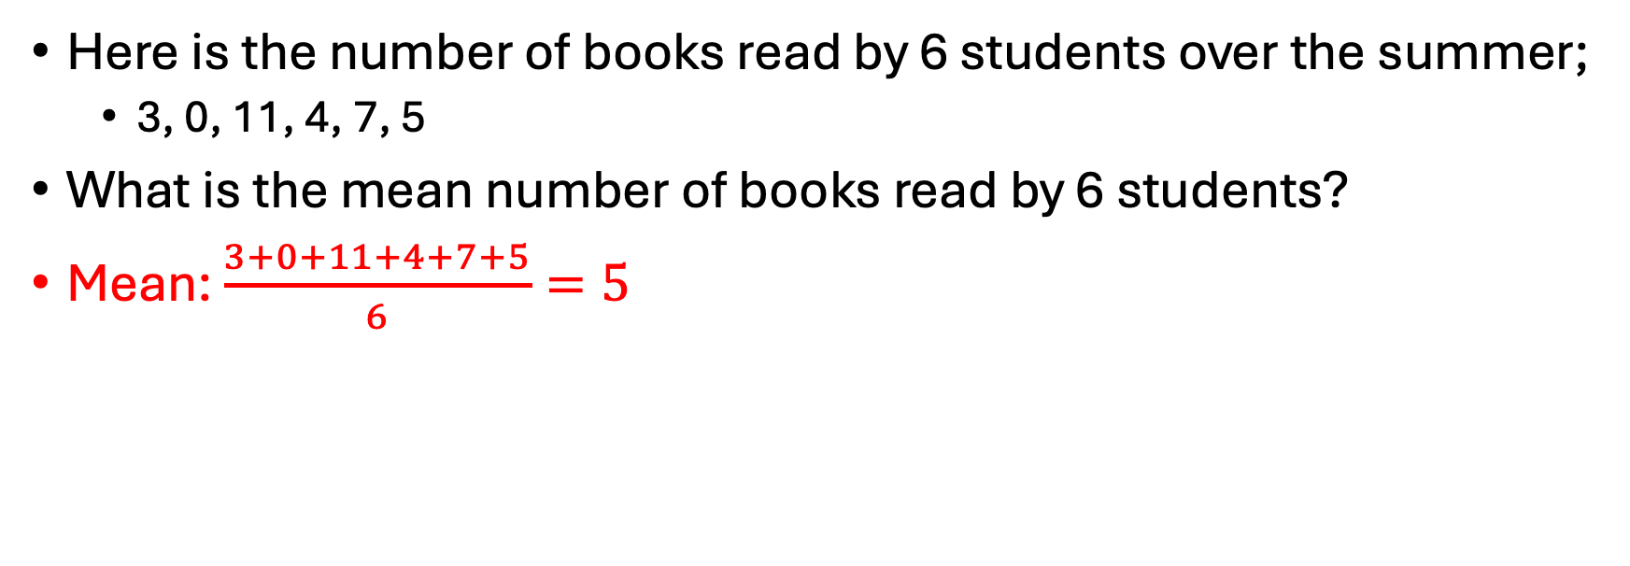
Exercise-1
Here is the number of books read by 6 students over the summer;
3, 0, 11, 4, 7, 5
What is the mean number of books read by 6 students?
Mean: $\frac{3+0+11+4+7+5}{6}=5$

Slide 94
Exercise-2
Here is the number of books read by 6 students over the summer;
3, 0, 11, 4, 7, 5
What is the median number of books read by six students?

Slide 95
Exercise-2
Here is the number of books read by 6 students over the summer;
3, 0, 11, 4, 7, 5
What is the median number of books read by six students?
Since n=6 and it’s even, take 3rd and 4th values which are 4 and 5, median = 4.5.

Slide 96
Exercise-3
Here is the number of books read by 6 students over the summer;
3, 0, 11, 4, 7, 5
What is the mode of the number of books read by six students?

Slide 97
Exercise-3
Here is the number of books read by 6 students over the summer;
3, 0, 11, 4, 7, 5
What is the mode of the number of books read by six students?
Mode = none (all values appear only once).

Slide 98
Exercise-4
Here is the number of books read by 6 students over the summer;
3, 0, 11, 4, 7, 5
What is the range?

Slide 99
Exercise-4
Here is the number of books read by 6 students over the summer;
3, 0, 11, 4, 7, 5
What is the range?
Range = 11 - 0 = 11.

Slide 100
Exercise-5
Here is the number of books read by 6 students over the summer;
3, 0, 11, 4, 7, 5
What is the standard deviation?

Slide 101
Exercise-5
Here is the number of books read by 6 students over the summer;
3, 0, 11, 4, 7, 5
What is the standard deviation?
Differences from mean [ -2, -5, 6, -1, 2, 0 ]; squares [4,25,36,1,4,0]; average = 70/6 ≈ 11.67; std dev ≈ √11.67 ≈ 3.417.

Slide 102
Exercise-6
Here is the number of books read by 6 students over the summer;
3, 0, 11, 4, 7, 5
Mean = 5
Median = 4.5
Mode = None
Range = 11
Standard deviation = 3.4
How would you interpret this results?

Slide 103
Exercise-6
Mean and median are relatively close.
One student is pulling the mean up a bit above the median (11 books).
The range is quite large (0 to 11), showing a big disparity.
Standard deviation ~3.4 indicates a fair spread relative to mean 5 (some well below, some well above).
The mean might suggest “around 5 books” as typical, but note half the students read 4 or fewer (median 4.5).
There is no mode; everyone’s reading count was unique.
In this case, the median might be seen as a bit more representative.

Slide 104
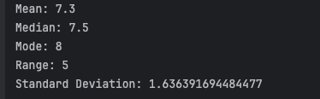
Example in Python
Name | Score
Alice | 7
Ben | 8
Carlos | 5
Diana | 10
Ethan | 9
Fiona | 6
George | 8
Hannah | 7
Isaac | 8
Julia | 5
Let’s go back to the previous example where we had 10 students and their scores.
scores = [7, 8, 5, 10, 9, 6, 8, 7, 8, 5]
import statistics as stats
mean_val = stats.mean(scores)
median_val = stats.median(scores)
mode_val = stats.mode(scores) # Note: mode() will return one of the modes if there's a tie
pstdev_val = stats.stdev(scores) # Sample standard deviation (divide by n-1)
# Alternatively stats.pstdev(scores) for population std dev (divide by n)
data_range = max(scores) - min(scores)
print("Mean:", mean_val)
print("Median:", median_val)
print("Mode:", mode_val)
print("Range:", data_range)
print("Standard Deviation:", pstdev_val)

Slide 105
What is Pandas?
pandas is the standard Python library for tabular data analysis — built on top of NumPy arrays for performance.
Core workflow: load → inspect → clean → transform → analyze → visualize. pandas handles every step.
Main data structures:
Series: 1D labeled array. Each column of a DataFrame is a Series. Supports vectorized operations.
DataFrame: 2D labeled table. Rows have an index, columns have names. The workhorse of data analysis in Python.

Slide 106
Installing & Importing Pandas
import pandas as pd
pd is the universal alias — all pandas documentation uses it. Install once: pip install pandas. pandas ships with Anaconda.

Slide 107
Creating a Series
A Series is like a list with labels.
import pandas as pd
colors = pd.Series(["Red", "Blue", "Green"])
print(colors)

Slide 108
Creating a DataFrame
A DataFrame is like a table with rows and columns:
import pandas as pd
data = {
"Name": ["Alice", "Bob", "Charlie"],
"Age": [14, 15, 16],
"Favorite Color": ["Blue", "Green", "Red"]
}
df = pd.DataFrame(data)
print(df)

Slide 109
Viewing Data
Essential DataFrame inspection commands — always run these first when loading new data:
df.head(10) # first 10 rows — pass n to control how many
df.tail() # last 5 rows df.shape # (rows, columns) as a tuple df.dtypes # data type of every column df.describe() # count/mean/std/min/quartiles/max for numerical cols df.info() # column names, dtypes, non-null counts, memory

Slide 110
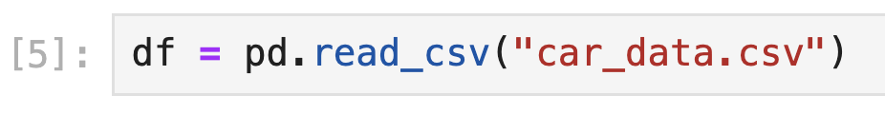
Reading a CSV
pd.read_csv() is the entry point for most real-world data. Key parameters: read_csvsep="," (or "\t" for TSV), header=0, index_col, usecols, dtype, parse_dates, na_values.
After loading: immediately run df.shape, df.dtypes, df.head(), df.describe() to understand what you have. Your Jupyter notebook should be in the same folder as “car_data.csv” or provide the full path. Use pathlib.Path for cross-platform compatibility.

Slide 111





What We've Learned Today!
Data Types
Categorical (nominal/ordinal) and numerical (discrete/continuous)
Data Formats
Tables, spreadsheets, CSV files, and databases
Summary Statistics
Mean, median, mode, range, and standard deviation
Calculation Tools
By hand, calculators, spreadsheets, and programming

Slide 112
What we have learned so far!
Term | Definition
Data | Facts, figures, or information collected about something, often in the form of numbers or text.
Dataset | An organized collection of data, usually presented in tabular form (rows = observations, columns = variables).
Observation (Case) | A single data point or record in a dataset, corresponding to one entity or individual, providing values for all variables.
Variable | A characteristic or attribute that can vary between observations, represented by a column in a dataset.
Categorical Variable | A variable that represents categories or groups (qualitative). Arithmetic operations don’t apply.
Nominal Variable | A categorical variable with no inherent order among categories.
Ordinal Variable | A categorical variable with a clear order or ranking to categories, but uneven or unknown spacing between them.
Numerical Variable | A variable that represents a quantity (quantitative). Values are numeric and arithmetic operations make sense.
Discrete Variable | A numerical variable that can only take specific values (often integers or counts). No intermediate values between those specifics.
Continuous Variable | A numerical variable that can take any value in a range. Values can be infinitely fine-grained in theory (limited by measurement precision).

Slide 113
What we have learned so far!
Term | Definition
Spreadsheet | A file or application (like Excel or Google Sheets) for organizing data in tables, often allowing formulas and easy data entry/viewing.
CSV (Comma-Separated Values) | A plain text file format for tabular data where each row is on a new line and values are separated by commas.
Database | A system for storing large or complex data, often in multiple tables with relationships. Typically accessed via queries (SQL).
Mean (Average) | The sum of all numeric values divided by the number of values by the sample size. Represents the central tendency.
Median | The middle value in a sorted list of numbers (or average of two middle values if the list length is even)​.
Mode | The most frequently occurring value in a dataset​. A dataset may have one mode, multiple modes, or none (if all values are unique).
Range | The difference between the maximum and minimum values in a dataset​. Indicates the total spread.
Standard Deviation | A measure of how spread out numbers are around the mean, defined as the square root of the variance (average of squared deviations from mean)​.
Critical Thinking (in data) | The practice of objectively analyzing and evaluating information (data) to form a judgment. Involves curiosity (questioning) and skepticism (verification).
Data Detective | A metaphor for someone who uses critical thinking to investigate data, searching for clues (patterns, anomalies) and verifying facts to uncover the truth.

Slide 114


Next Steps in Your Data Journey
Data Visualization
1
Chapter 8 (EDA): histograms, box plots, scatter plots with matplotlib and seaborn
Relationships Between Variables
Chapter 8: correlation matrices, scatter plot matrices, and identifying confounders
Statistical Inference
Chapter 9: confidence intervals, hypothesis testing, and p-values
Next up: Chapter 3 introduces R as a complementary tool, then Chapter 5 digs into how data is collected — the source of most real-world data quality problems.

Slide 116
Chapter 2: Data 101
Coding Agents for Data Analysis

Slide 117
Pandas + Coding Agent: Workflow
Combining pandas with a coding agent supercharges exploratory analysis:
1. You describe the dataset and your question in plain language.
2. The agent writes pandas code: load → inspect dtypes → compute stats → plot.
3. You verify the output — do the dtypes make sense? Are there unexpected nulls?
4. You iterate: "Now filter to only rows where GPA > 3.0 and recompute the mean."
Key principle: the agent handles syntax, you handle analytical judgment.
Always run df.dtypes and df.describe() first — a good agent will do this automatically; a great analyst checks the output critically.

Slide 118
Prompting for Data Type Analysis
Weak prompt vs. strong prompt for data type work:
Weak: "Analyze this CSV." → Agent may apply wrong statistics to categorical columns.
Strong: "Load students.csv. For each column, identify whether it is nominal, ordinal, discrete, or continuous. Flag any columns that appear numerical but should be treated as categorical (e.g., IDs, zip codes)."
Follow-up prompts to deepen the analysis:
"Which columns have more than 10% missing values? How should each be handled given its data type?"
"For each numerical column, compute mean, median, and SD. Where mean and median differ by more than 10%, flag as potentially skewed."
"Produce a frequency table and bar chart for each categorical column."

Slide 119
Hands-On: Agent-Assisted EDA Sprint
Activity (pairs, 20 minutes) — use the provided students_survey.csv:
Step 1 — Inspect: Prompt the agent to load the file, show df.head(), df.shape, df.dtypes, and df.describe(). Identify any type mismatches.
Step 2 — Type audit: For each column, classify the data type. Flag any columns the agent assigned the wrong dtype and explain why.
Step 3 — Stats: Prompt for mean, median, and SD on all numerical columns. Identify the column with the highest coefficient of variation (CV = SD/mean).
Step 4 — Challenge the output: Ask the agent "Is the mean or the median a better measure of center for each column, and why?"
Present: which column was most surprising, and what did the agent miss that you caught?

Slide 120
Chapter 2 Summary: What You Can Do Now
Analytical skills:
✓ Classify any variable as nominal, ordinal, discrete, or continuous and explain which statistical operations are valid.
✓ Compute and interpret mean, median, mode, range, and standard deviation — including when each measure misleads.
✓ Apply Bessel’s correction and distinguish population SD from sample SD.
Technical skills:
✓ Load a CSV with pandas, inspect dtypes and shape, and compute descriptive statistics with df.describe().
✓ Write Python list/dict/loop code and handle type casting and errors.
✓ Direct a coding agent to perform a full data type audit and descriptive statistics report, then critically evaluate its output.

