Slide 1
Chapter 4: Data Analysis in Python

Slide 2





Why Python for Data Analysis?
Easy to learn syntax
Batteries included
Readable, expressive syntax with strong typing conventions. Python is the #1 language in data science, ML, and AI research — knowing it opens every modern data role.
NumPy (vectorized math), pandas (tabular data), matplotlib/seaborn (visualization), scikit-learn (ML), TensorFlow/PyTorch (deep learning) — the complete data science stack.
Broad usage
Large community
Netflix uses Python for recommendation algorithms, Spotify for music analysis, NASA for mission data pipelines, and Instagram for backend infrastructure — you’ll see examples in this chapter.
The largest data science community worldwide. Stack Overflow, GitHub, Kaggle, and Hugging Face are all Python-first — help is always one search away, including from AI coding agents.

Slide 3
General-purpose, widely used beyond data science
Built Built for stats and data analysis
Clean, beginner-friendly
Popular Libraries: pandas, NumPy, scikit-learn, etc.
Data science, web, automation
Massive, industry-driven
Easy with production systems
Less intuitive, uses <-
Popular Libraries: ggplot2, dplyr, caret, etc.
Statistical analysis, research
Strong academic base
Less common in production

Slide 4

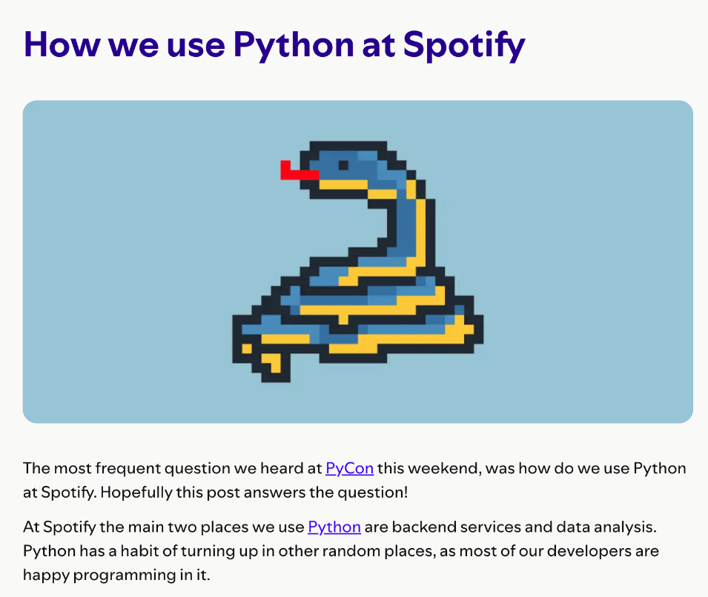
Real World Examples
Source: https://engineering.atspotify.com/2013/03/how-we-use-python-at-spotify
Source: https://pythonflood.com/python-at-netflix-the-python-story-behind-netflixs-streaming-empire-c11704a4c0bb

Slide 5
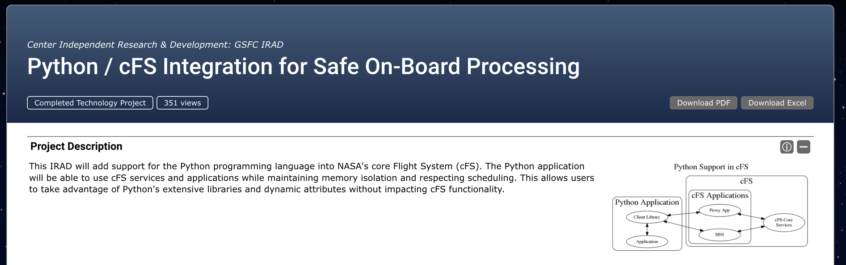
Real World Examples
https://techport.nasa.gov/projects/95917

Slide 6
Setting Up Python: Anaconda and Jupyter Notebooks
Let’s start with beginner-friendly options:
Anaconda Distribution (with Jupyter Notebooks) – a popular all-in-one installer.
In case you can’t install:
Google Colab – an online Jupyter Notebook environment that runs in your browser (no installation required).

Slide 7
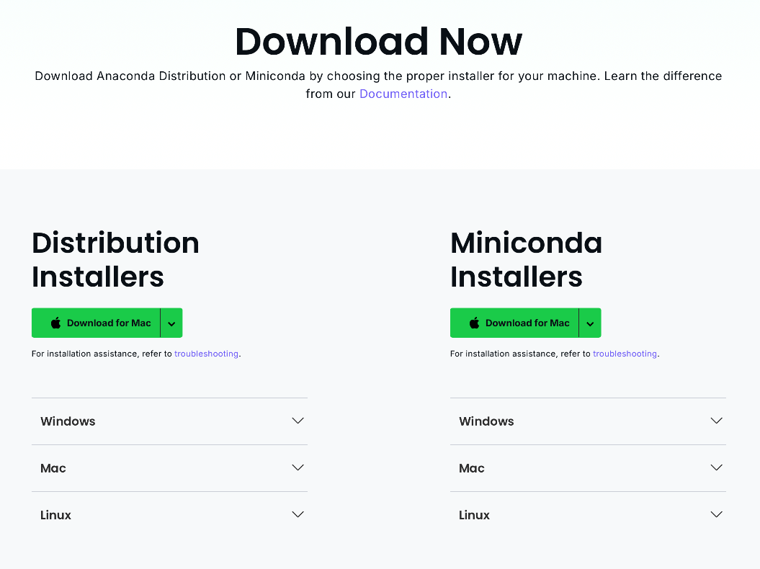
Install Anaconda (Python + Jupyter)
Go to: https://www.anaconda.com/download/success
Download the correct option for your system
The file is large, it may take a few mins
After the download is complete, run and install it.

Slide 8
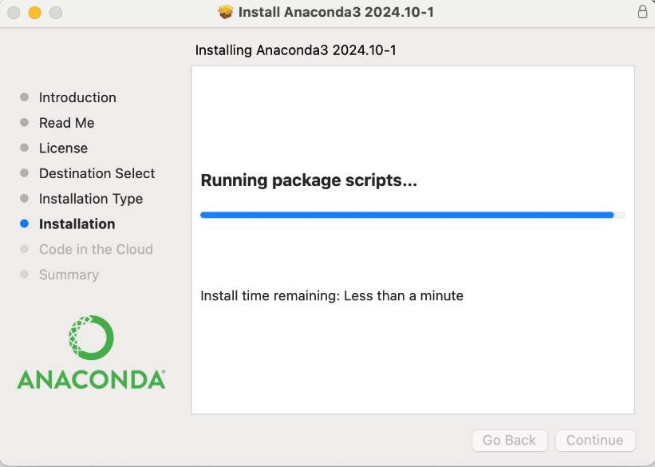
Install Anaconda (Python + Jupyter)
Follow the prompts.
It will be a different screen for Mac and Windows.
Installation may take a few mins.
Once it’s done, you will have
Python and
Anaconda Navigator

Slide 9

Launch Jupyter Notebook
Start Anaconda Navigator
Sign in is optional
Launch Jupyter Notebook

Slide 10
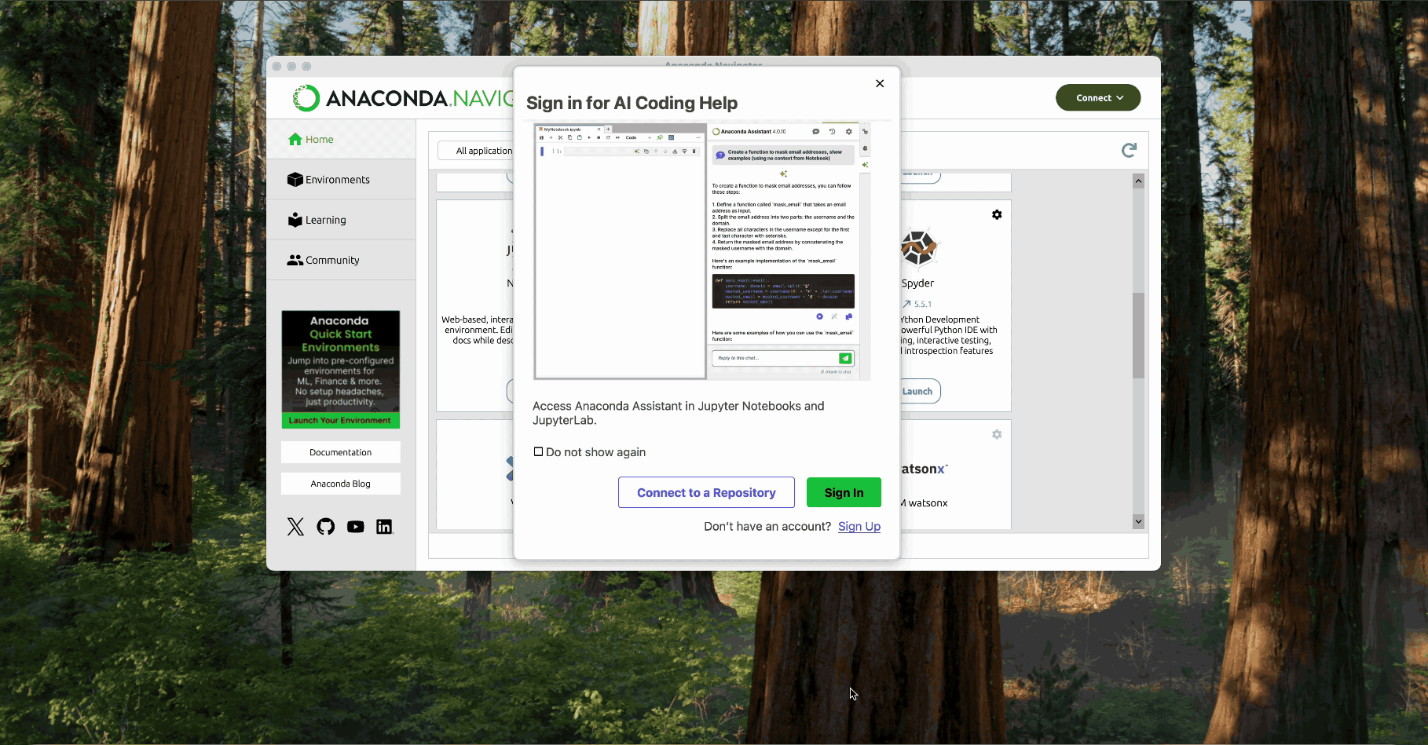

Slide 11
Launch Jupyter Notebook – via Command Line
On Windows:
Open command line
Type: Anaconda Prompt
On Mac/Linux:
Open terminal app
Type: jupyter notebook

Slide 12


Slide 13





What is Jupyter Notebook?
Interactive Environment
Create documents that mix code, output, and explanatory text.
Cell-Based Structure
Break work into steps (cells), run each step, and see results immediately.
Visualization Support
Display charts and graphs directly in your notebook.
Shareable Format
Easy to share your analysis and results with others.

Slide 14
Option 2: Google Colab
If installing software is an issue or you want to get started quickly, Google Colab is a fantastic option.
Colab is essentially a Jupyter Notebook hosted by Google on the cloud, and it’s free to use (with some limitations) if you have a Google account.

Slide 15

Google Colab
Go to→ https://colab.research.google.com
If prompted, sign in with your Google account.

Slide 16
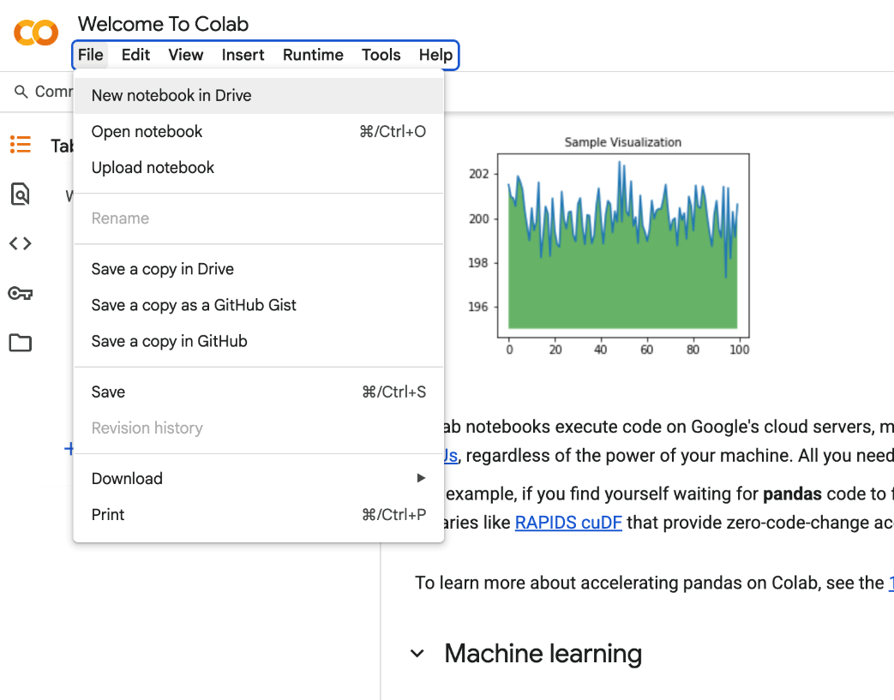
Google Colab
Create a Notebook
It looks and works almost exactly like a Jupyter Notebook.
It uses Google cloud servers.
If you need to use a local file, you need to upload it.

Slide 17


Other Options
There are many other options to use for Python.
PyCharm
VS Code

Slide 18
Why Jupyter in this class?
Jupyter implements the literate programming paradigm: code, output, and narrative coexist in one document — making analysis self-documenting and reproducible. Required by many research journals and data competitions.etween code.
To add a text cell in Jupyter, switch the cell to “Markdown” mode and you can write descriptions in plain English (and even include math or images).
Markdown supports LaTeX math, hyperlinks, images, and tables — a single .ipynb file can contain a complete analysis from data loading to conclusions, shareable as a PDF or web page.nalysis easier to follow.

Slide 19
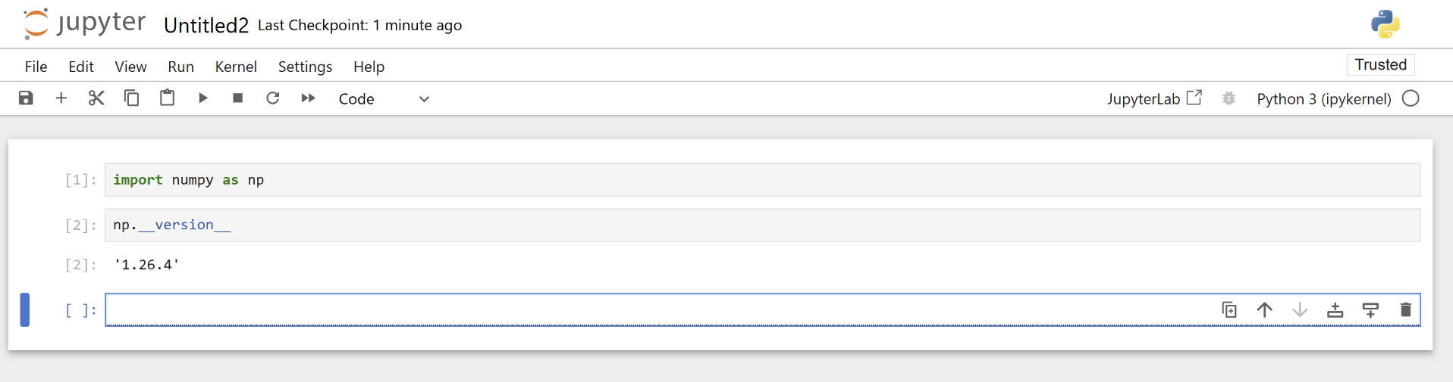
Navigating the Jupyter Notebook Interface

Slide 20
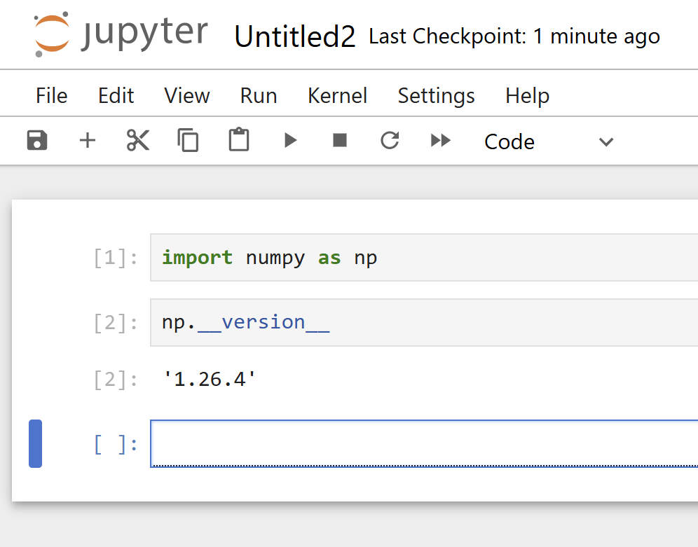
Navigating the Jupyter Notebook Interface
Menu bar
Tool bar
Run button
Input Code
Output

Slide 21
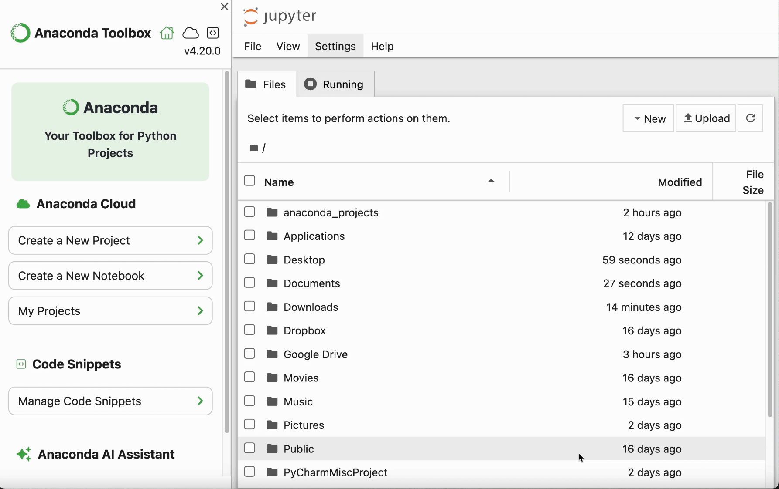

Slide 22
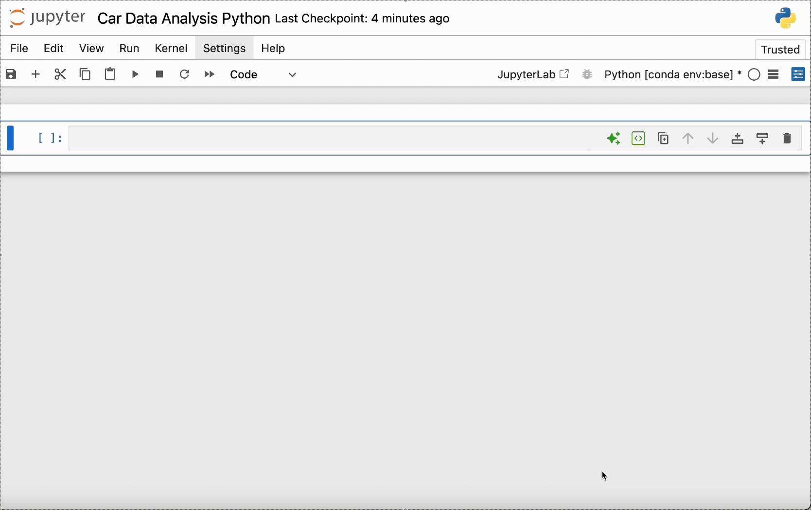

Slide 23
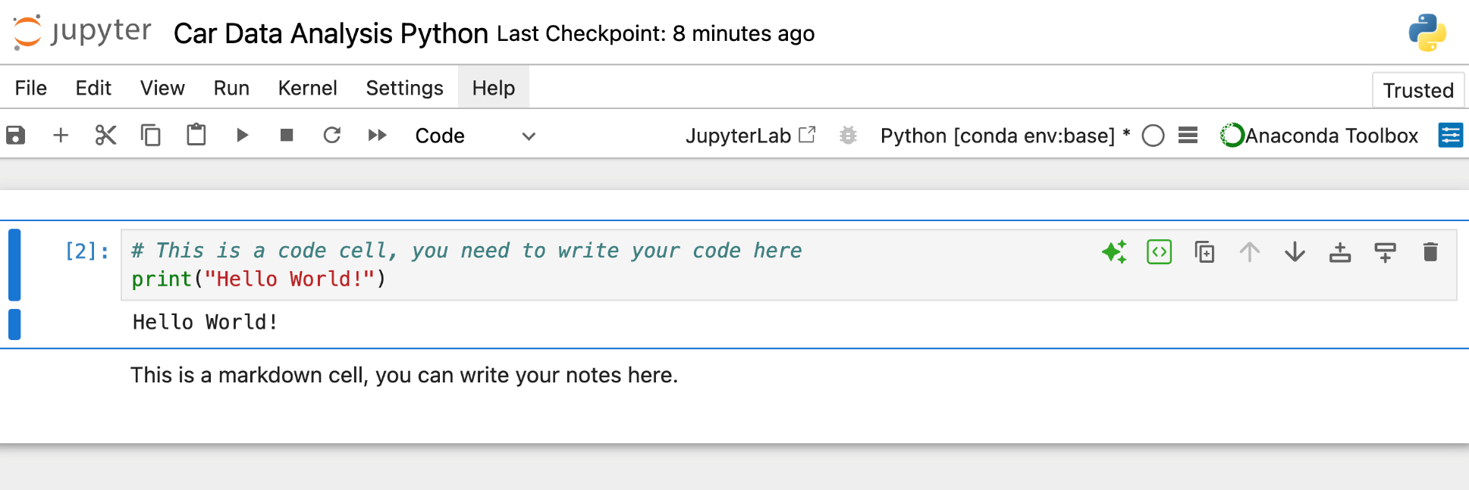
Notebook Name
Shows the running engine on the backend
Code cell
Output, after you hit the run button
Markdown cell
Number of executions
Adds code/markdown line above or below

Slide 24
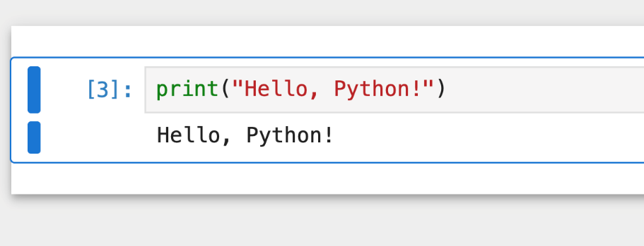
Try it yourself!
Start the Jupyter Notebook
Create a new notebook (under Documents or folder of your choice)
Write the following into the code line:
print(“Hello, Python!”)
Run it!

Slide 25
What is Pandas?
pandas is the standard Python library for tabular data — built on NumPy arrays for speed. The primary data structure (DataFrame) was inspired by R’s data.frame.
Core EDA workflow: load → inspect dtypes → clean → transform → aggregate → visualize. pandas handles every step. Most real-world datasets live in DataFrames first.
Main data structures:
Series: 1D labeled array. Each column of a DataFrame is a Series. Supports vectorized operations — no loops needed.
DataFrame: 2D labeled table with a row index and named columns. Think SQL table or Excel sheet — with the full power of Python.

Slide 26
Analysis Steps
The 5-Step EDA Workflow in Python:
Step 1 — Import libraries: pandas, NumPy, matplotlib, seaborn. Every analysis starts here.
Step 2 — Load the dataset: pd.read_csv(). Check df.shape immediately — does the row count match what you expect?
Step 3 — Data audit: df.head(), df.dtypes, df.info(), df.describe(). Flag type mismatches and missing values before any analysis.
Step 4 — Answer specific questions: compute statistics (mean, median, groupby, value_counts). Each answer raises new questions — that’s EDA.
Step 5 — Visualize: histograms for distributions, bar charts for categories, scatter plots for relationships. Always interpret shape, not just numbers.

Slide 27



Step 1: Import Libraries
Import
matplotlib for plotting
pandas for data frame
NumPy for numeric analyses
How can we import them?
(Answer is on the next slide)

Slide 28
Step 1: Import Libraries
We use the import function.
Provide the package name.
Use as function to define the short name we want to use.
Provide the definition.
import pandas as pd
import numpy as np
import matplotlib.pyplot as plt

Slide 29
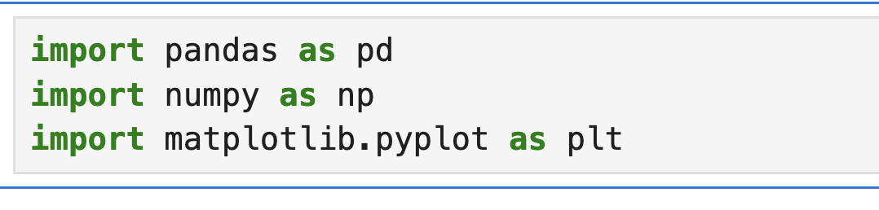
Step 1: Import Libraries
If everything is loaded correctly you wont see any output.

Slide 30
Step 2: Load the Dataset
Make sure car_data.csv is in the current directory or provide the path.
Define your name data frame name, for short we like to call it df.
Use panda -now pd in our environment- to read the
Check whether it worked!
df = pd.read_csv("car_data.csv")
print("Data loaded. Number of rows and columns:", df.shape)

Slide 31
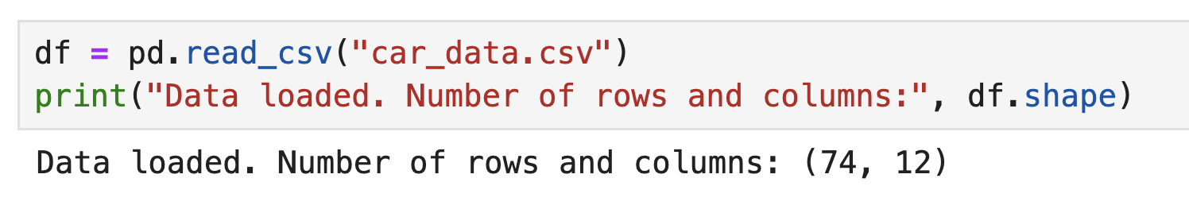
Step 2: Load the Dataset
It will create the following output:
Within the print function, we define the text "Data loaded. Number of rows and columns:" and the function to print.
In this example we printed df.shape

Slide 32
Step 3: Quick Data Peek
After every data load, run these four commands before anything else: df.head and df.describe functions.
df.head outputs the first number of rows we ask for.
df.describe provides the summary statistics.
df.head(5)
df.describe()

Slide 33
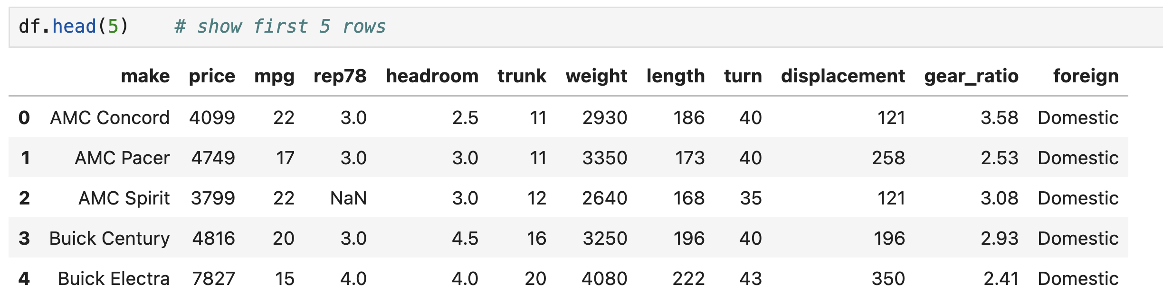
Step 3: Quick Data Peek

Slide 34
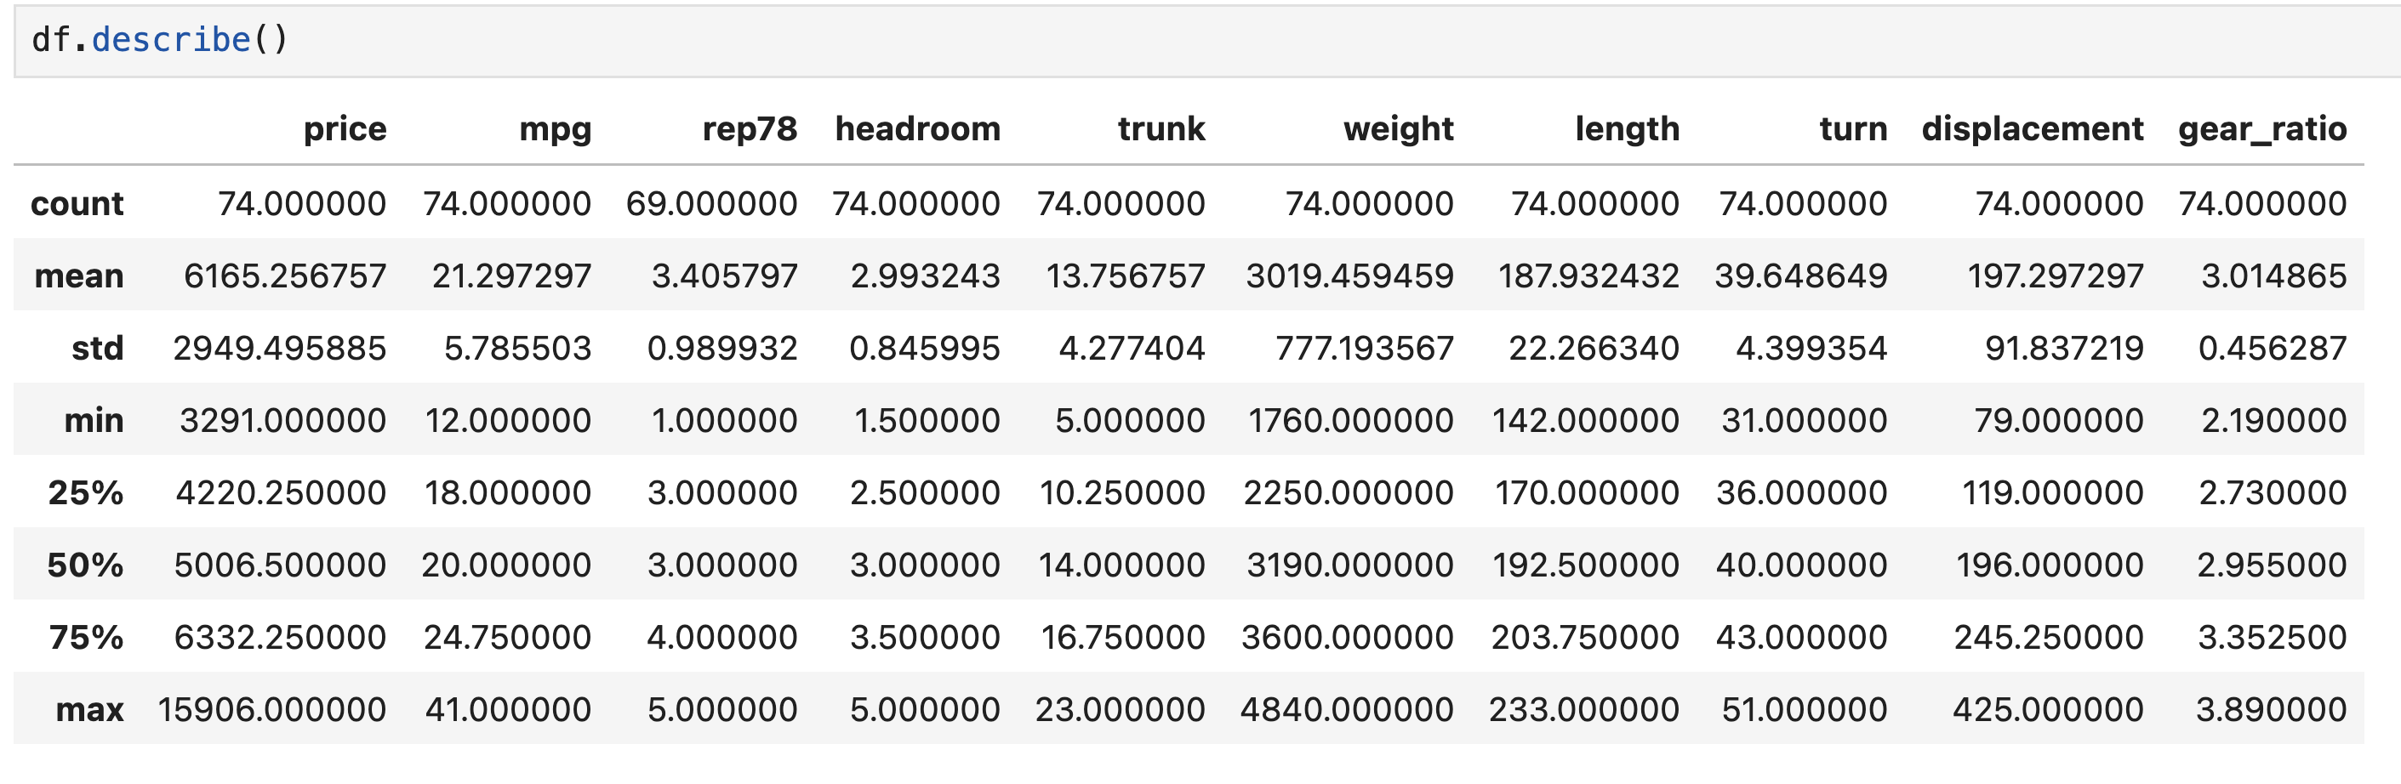
Step 3: Quick Data Peek

Slide 35
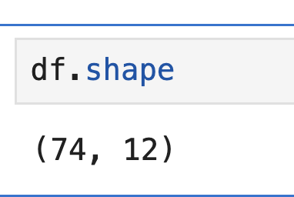
Let’s check the size
You can check the size of the data frame by df.shape function.
It shows the number of rows and columns.

Slide 36
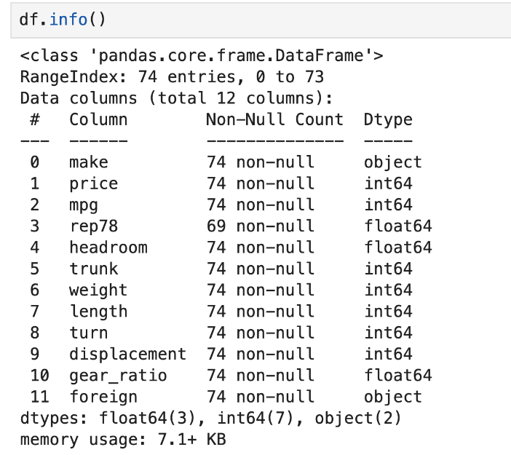
Information about the variables
To see column names and types we can use df.info()
int64 and float64 are continuous data

Slide 37
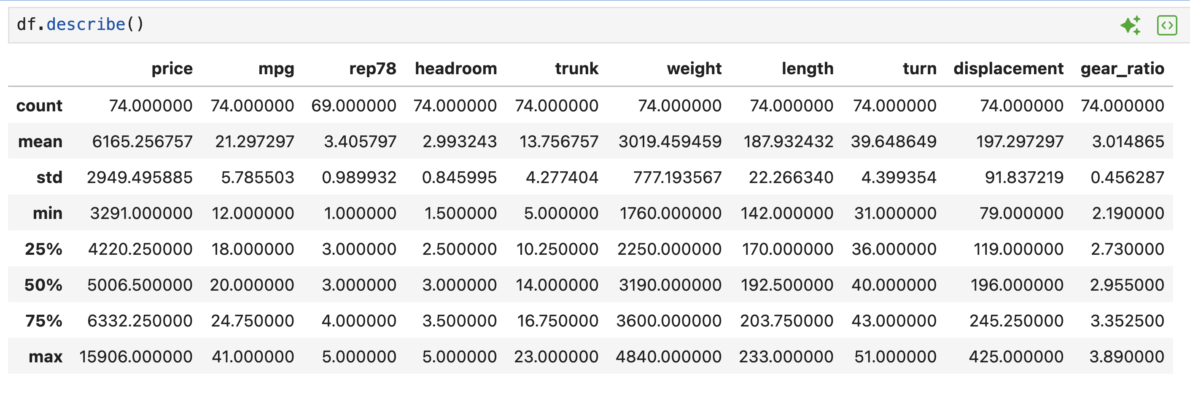
Summary Statistics
df.describe provides summary statistics for all the numeric variables.

Slide 38

Attention!
Always validate your data with these 5 checks:
Always(1) df.shape — expected row count? (2) df.dtypes — types match data dictionary? (3) df.describe() — min/max plausible? (4) df.isnull().sum() — missing values? (5) Mean vs median — similar or diverging?

Slide 39
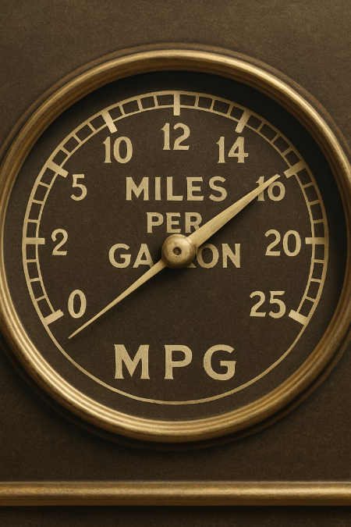
Step 4: Specific Analysis Questions
Let’s answer a couple of questions with our data:
Question 1: What is the average and median MPG of these cars?

Slide 40
Step 4: Question 1
We will use the mean function for average and the median function for the median value.
You can simply get the output of the mean by
df["mpg"].mean()
But the below code produces nicer output
avg_mpg = df["mpg"].mean()
median_mpg = df["mpg"].median()
print(f"Average MPG = {avg_mpg:.2f}")
print(f"Median MPG = {median_mpg:.2f}")
f-string formatting to print the values with 2 decimal places (:.2f)

Slide 41
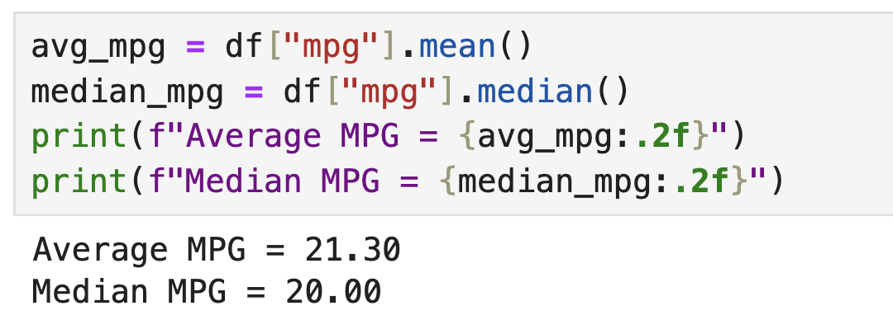
Step 4: Question 1
Mean MPG = 21.30, Median MPG = 20.00. The mean exceeds the median — a signature of right skew. A few high-MPG cars (e.g., 40+ MPG compact imports) pull the mean upward. The median is the better “typical” value here. This is why we always compute both.an is 20, which suggests the distribution might be a bit skewed by some high MPG values

Slide 42
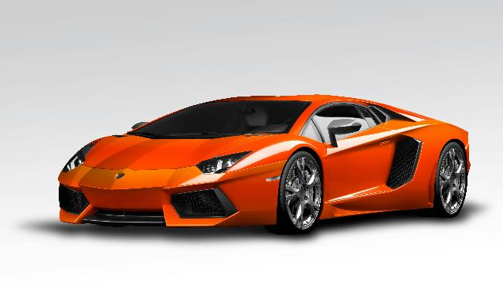
Step 4: Question 2
Question 2: How many cars are produced abroad?
Think which variable we should use
Think which function we should use

Slide 43
Step 4: Question 2
We will use the variable “foreign”
We need to use the value_counts function
Using print function allows us to have nice output with explanation
for_counts = df["foreign"].value_counts()
print("Foreign Production Counts:")
print(for_counts)

Slide 44
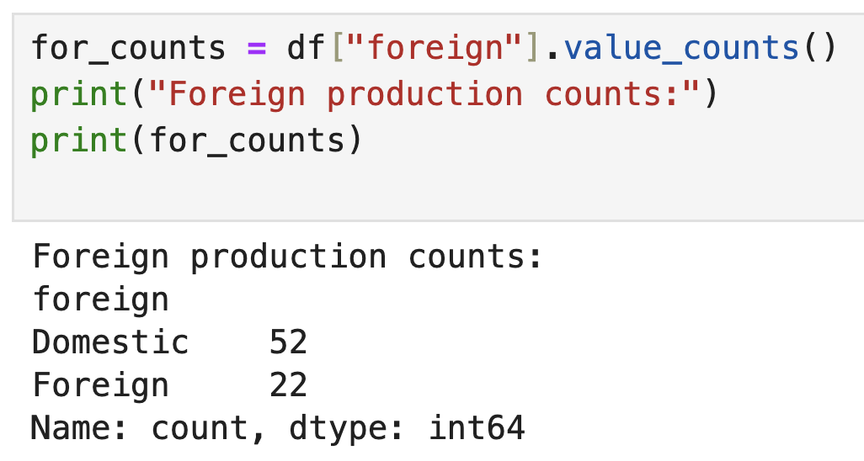
Step 4: Question 2
Answer: There are 22 foreign and 52 domestic cars.

Slide 45
Step 4: Question 3
Question 3: Does the price of cars differ by where they are produced?
Two variables
Production location
Price
Need to compute the average price for foreign and domestic cars
Use groupby() function

Slide 46
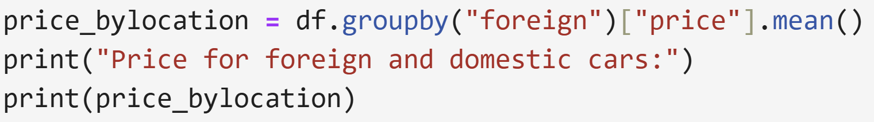
Step 4: Question 3
Use groupby() function

Slide 47
Step 5: Visualization

Slide 48

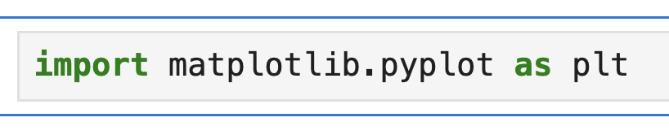
Basic Plotting in Python (Matplotlib)
Python has multiple plotting libraries.
The foundational one is Matplotlib, which provides low-level plotting functions.
Let’s import the package as “plt”.

Slide 49
Step 5: Visualization
How is miles per gallon is distributed?
A histogram shows the distribution of a continuous numeric variable by grouping values into “bins” (ranges) and plotting bars for the count of observations in each bin.

Slide 50
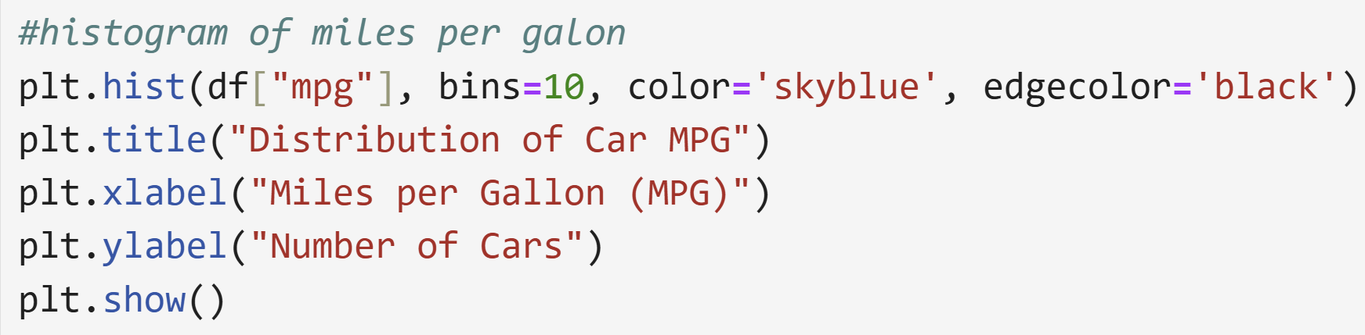
Histogram of MPG in Python

Slide 51
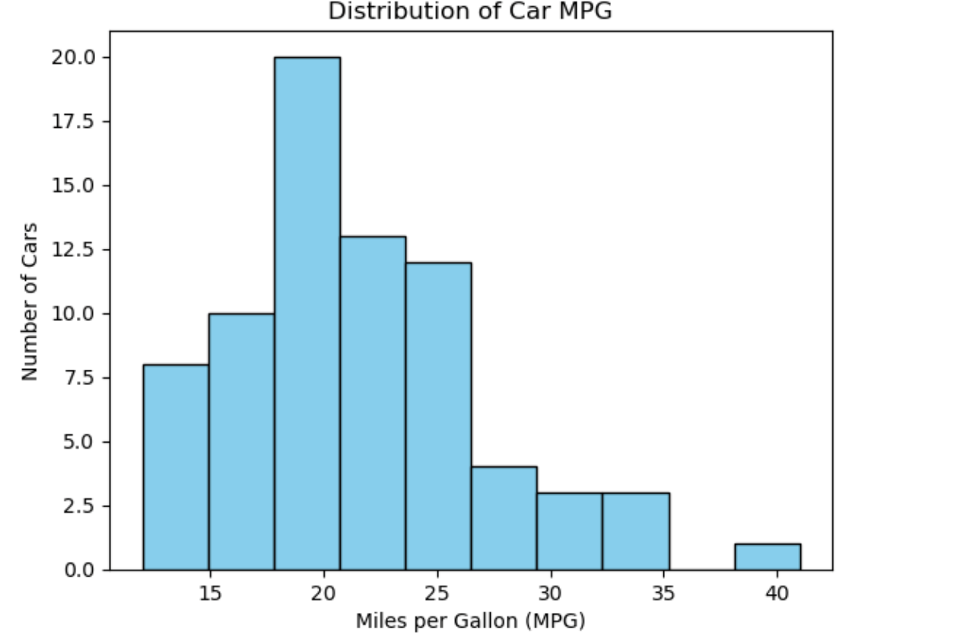
Histogram of MPG in Python

Slide 52
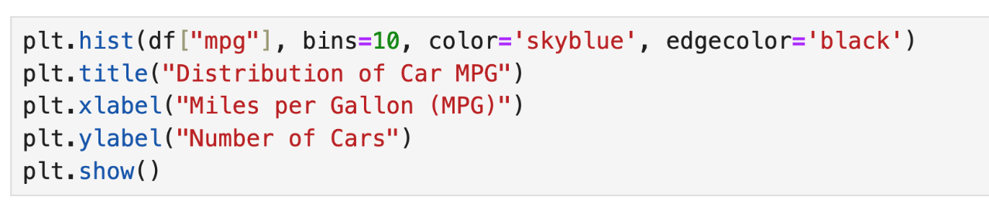
Histogram of MPG in Python
plt.hist(df["mpg"], bins=10) creates a histogram with 10 intervals (bins).
color='skyblue', edgecolor='black' styles the bars (similar to R).
plt.title, plt.xlabel, plt.ylabel: add title and axis labels as in R.
plt.show() displays the plot — good practice, especially in scripts.

Slide 53
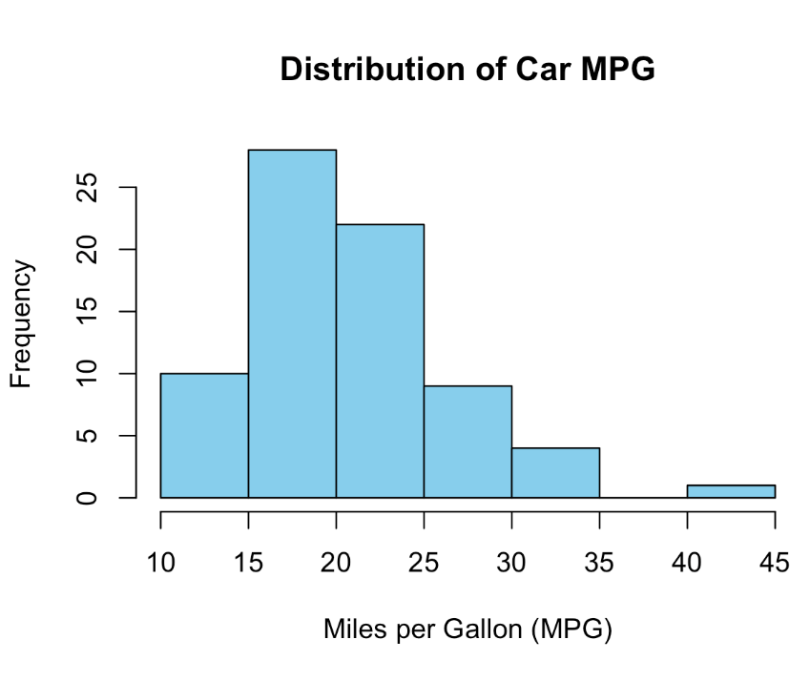
Histogram – Interpretation
This histogram shows MPG distribution shape — each bar is a bin (value range), height is count. Shape tells you things no single statistic can: skewness, clusters, gaps, outliers.
This is right-skewed — the right tail is longer. Mean (21.3) > Median (20.0) — a classic signature. A few fuel-efficient imports pull the mean upward. r MPG within a certain range.
The mode bin is 15–20 MPG. Ask: would you have predicted this shape from the mean alone? This is why visualization precedes modeling.
Compare with Python code: try bins=5 vs bins=20. Fewer bins over-smooth; too many bins show noise. The choice of bins is an analytical decision, not a technical one.

Slide 54

Your Turn!
Plot a histogram of car price. How does it look like? Do the prices usually similar? Does the distribution look skewed?
Think which function you need to use!

Slide 55
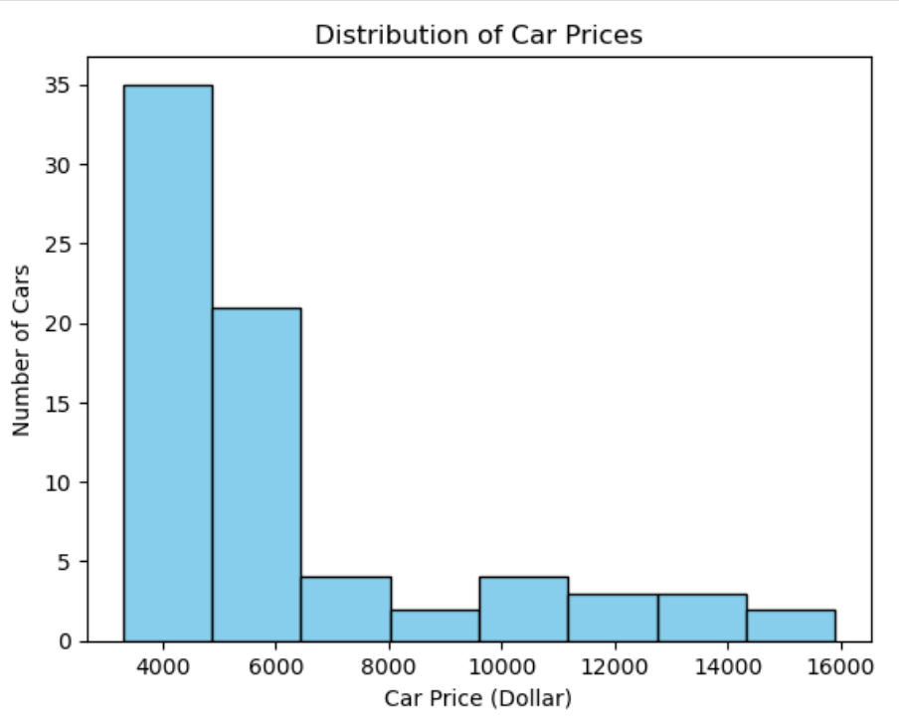
Your Turn!
plt.hist(df[”price"], bins=10, color='skyblue', edgecolor='black')
plt.title("Distribution of Car Prices")
plt.xlabel("Car Price (Dollar) ")
plt.ylabel("Number of Cars")
plt.show()

Slide 56
Step 5: Visualization
Question: What percent of cars are produced abroad?
For categorical data, it shows rectangular bars with heights or lengths proportional to the values that they represent.

Slide 57
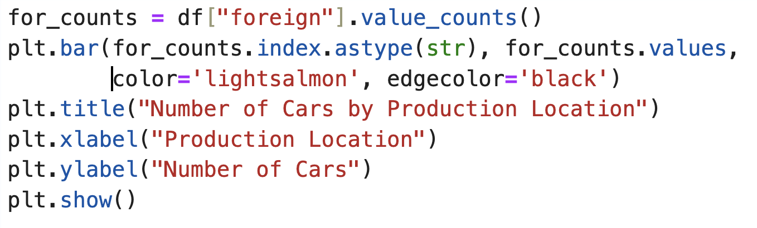
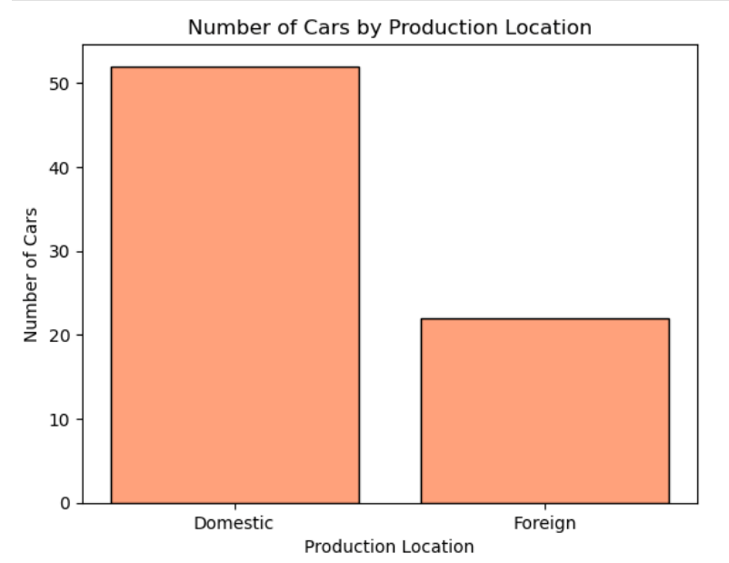
Bar Chart in Python

Slide 58
Bar Chart in Python
Selects the specific variable
Creates the frequency table
Title and axis labels
Prints the plot
Provides the values on the x-axis
Provides the values on the y-axis

Slide 59
Your turn
This time, let’s draw a histogram for the car prices.
Which variable we should use? – “price”
Which function we should use? – plt.hist
plt.hist(df["price"], bins=8, color='skyblue', edgecolor='black')
plt.title("Distribution of Car Prices")
plt.xlabel("Car Price (Dollar) ")
plt.ylabel("Number of Cars")
plt.show()

Slide 60
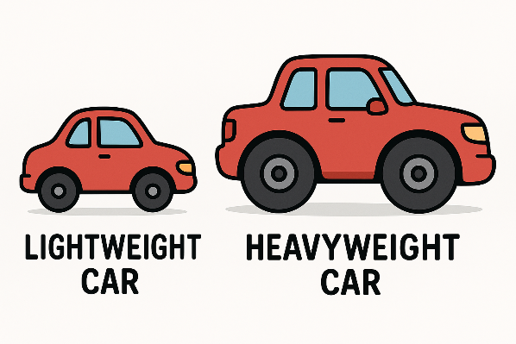
Let’s exercise
Before plotting, formulate a hypothesis: what direction do you expect? What physics principle explains it? After plotting: describe direction, form (linear/curved?), strength, and any outliers.
Let’s get a scatterplot.
Hint: use plt.scatter(x, y) or sns.scatterplot(x=, y=, data=)

Slide 61
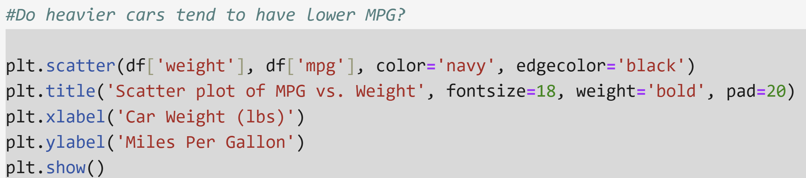
Let’s exercise

Slide 62
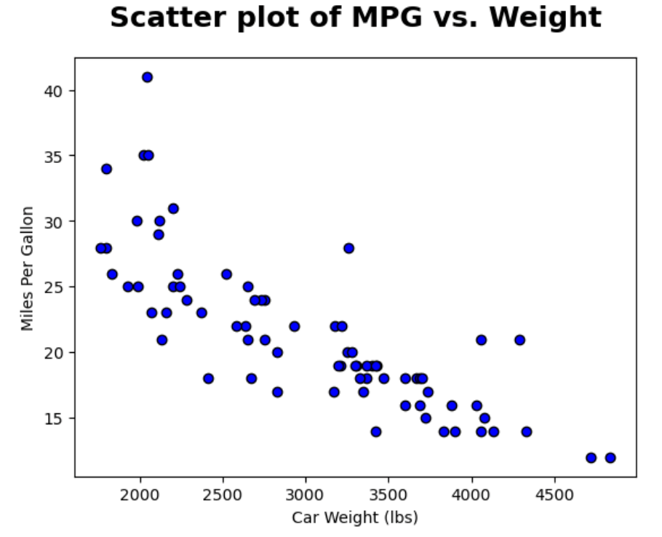
Let’s exercise
Interpretation: As car weight increases, miles per gallon (MPG) generally decreases, indicating that heavier cars tend to be less fuel efficient.

Slide 63
Assignment
Dataset Investigation Rubric — for your chosen dataset, complete each step and document your findings: Step 1 — Load with pd.read_csv(), then run:
df.head()
df.describe()
df.shape
df.info()
Step 2 — Type audit: run df.dtypes. Flag any columns that look numerical but should be categorical (e.g., IDs, zip codes). Step 3 — Analysis: for each numerical variable of interest, compute mean, median, std, and IQR. Note where mean and median diverge.
Plot bar charts or histograms.
Calculate the frequencies or average statistics (mean and median).
Step 4 — Visualization: at least one histogram (with appropriate bin count), one bar chart for a categorical variable. Step 5 — Interpretation: for each plot, write 2–3 sentences connecting the visual pattern to a statistical concept (skewness, outliers, or mode).

Slide 64

Your Turn!
Compute the median price and compare it to the mean price in Python.

Slide 65
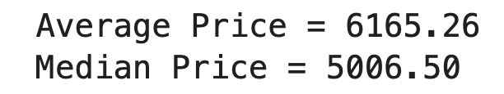
Your Turn!
avg_price = df["price"].mean()
median_price = df["price"].median()
print(f"Average Price = {avg_price:.2f}")
print(f"Median Price = {median_price:.2f}")
Interpretation: Average car price is $6,165.26 and median is $5,006.50, The mean ($6,165) exceeds the median ($5,007) — right skew from a small number of expensive luxury cars. The median better represents the typical car price. Coefficient of variation = sd/mean ≈ 57% — substantial variability.

Slide 66








Reflection: R vs. Python
Speed of Development
Visualization
R: one-line summary() with quartiles for all columns. Python: df.describe() + df.dtypes separate. For statistical analysis, R often has fewer keystrokes. For ML pipelines, Python wins.
R’s ggplot2 (grammar of graphics) is more principled — every chart is data + aesthetics + geometry. Python’s matplotlib is more imperative but seaborn wraps it more cleanly for statistical plots.
Integration
Learning Curve
Python integrates with APIs, web services, databases, ML frameworks, and cloud platforms. R integrates tightly with academic publishing (R Markdown, Quarto). Most data teams use both.
R: function-centric (everything is a function call). Python: object-oriented (methods called on objects). Both are learnable — the concepts transfer; only the syntax differs.

Slide 67

Being Bilingual in Data Science
Flexibility
pandas + matplotlib for quick EDA; ggplot2 + dplyr for statistical reporting; scikit-learn (Python) for ML; Stan/brms (R) for Bayesian modeling. The question isn’t which is better — it’s which is right for this job.
Collaboration
Most industry data teams are bilingual. A Python-only analyst who can’t read an R script will miss insights from 50% of the academic literature. Vice versa for R-only analysts missing Python ML tools.
Career Advantage
Top data science job postings increasingly list both. Kaggle competitions and academic research often require Python; pharma, finance, and social science research often require R. Knowing both doubles your reach.
Learning Transfer
Data frames, vectorization, the split-apply-combine pattern, and the grammar of graphics are language-agnostic concepts. Learn them once; apply them everywhere — including in coding agents.

Slide 68




Chapter 4 Summary
Python Environment Setup
Jupyter’s literate programming model (code + prose + output) enables reproducible analysis. Anaconda or Google Colab provide the full scientific Python stack out of the box.
pandas for Data Analysis
5-step EDA: import → load → audit (dtypes, shape, nulls) → analyze (mean/median/groupby/value_counts) → visualize. Always validate before computing statistics.
📈
Matplotlib for Visualization
Histograms (distributions), bar charts (categories), scatter plots (relationships). Interpret shape, not just numbers — skewness, outliers, and clustering are only visible in plots.
Guided Coding Practice
R vs. Python: both are industry-standard. R excels in statistical modeling and reproducible reports; Python excels in ML pipelines and production. Professional data scientists use both.

Slide 70
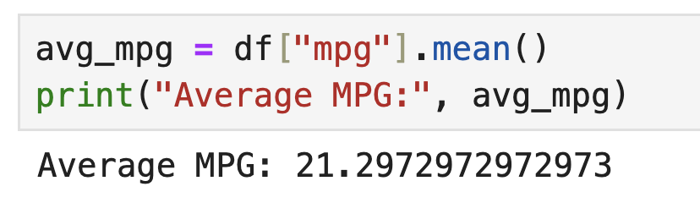
Get the mean for a specific variable
df["mpg"] helps selecting the “mpg” column
“.mean()” provide the mean value.
Here is the working code: df["mpg"].mean
Note: Here we saved the calculated mean value as “avg_mpg” object. After that we use print to print a nice output.

Slide 71
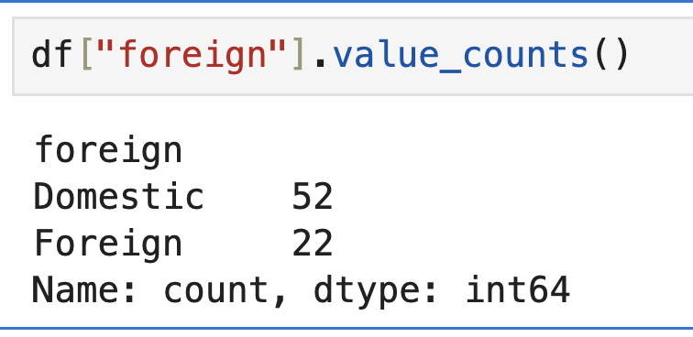
Frequency counts
To count occurrences like we did with table(car_data$cyl) in R, pandas offers value_counts()

Slide 72
R vs. Python: Syntax Comparison
Task
R Syntax
Python (pandas) Syntax
Reading data
read.csv("file.csv")
pd.read_csv("file.csv")
Viewing data
head(df)
df.head()
Summary stats
summary(df)
df.describe()
Accessing column
df$col
df["col"]
Mean of column
mean(df$col)
df["col"].mean()
Frequency count
table(df$col)
df["col"].value_counts()
Installing packages
install.packages("pkg")
pip install pkg (in terminal)
Call package from library
library(pkg)
import pkg

Slide 73
Chapter 4: Data Analysis in Python
Coding Agents for Python-Based EDA

Slide 74
Python + Coding Agent: EDA Workflow
An agent can execute your entire EDA pipeline — but only if you give it precise, analytical instructions:
Weak: "Analyze the data." → Agent produces arbitrary outputs with no analytical focus.
Strong: "Load car_data.csv. Run df.shape, df.dtypes, df.describe(), and df.isnull().sum(). Report any columns with null values or dtypes that look wrong. Then compute mean and median for all numerical columns and flag where they differ by more than 10%."
The 4-step agent loop for EDA:
1. You set the analytical question. 2. Agent writes and runs pandas code. 3. You evaluate the output — does it actually answer the question? Are dtypes right? Is the sample size expected? 4. You iterate with follow-up questions.
Key risk: agents confidently produce wrong code. Always cross-check — df.shape should match the expected row count, df.describe() min/max should be physically plausible.

Slide 75
Seaborn: Statistical Visualization in Python
Why seaborn over matplotlib for statistical plots:
matplotlib is imperative (you specify every detail). seaborn is declarative — built on matplotlib, it generates statistically-informed plots in one line.
Key seaborn functions for EDA:
sns.histplot(df, x="mpg", kde=True) — histogram with kernel density estimate overlay
sns.boxplot(df, x="foreign", y="price") — compare price distributions across groups in one call
sns.scatterplot(df, x="weight", y="mpg", hue="foreign") — scatter colored by category
sns.heatmap(df.corr(), annot=True) — correlation matrix for all numerical variables at once
Ask your coding agent: "Reproduce our EDA plots using seaborn. Add a KDE overlay to the MPG histogram and a regression line to the scatter plot."

Slide 76
Hands-On: Agent-Assisted Python EDA
Activity (pairs, 25 minutes) — use car_data.csv with a coding agent in Jupyter:
Step 1 — Audit: Prompt the agent to run df.shape, df.dtypes, df.describe(), and df.isnull().sum(). Review every output. Flag any dtype that looks wrong.
Step 2 — Statistics: Ask for mean, median, and std of all numerical columns. Which variable has the highest coefficient of variation (std/mean)? What does that tell you?
Step 3 — Visualization: Request a seaborn histplot for mpg and price, a boxplot comparing price by foreign/domestic, and a scatter of weight vs. mpg with a regression line.
Step 4 — Interpretation: For each plot, write one sentence connecting the shape to a statistical concept (skewness, outlier, correlation). Does the agent’s interpretation match yours?
Challenge: ask the agent a deliberately vague question. Evaluate whether its output answers a meaningful analytical question or just produces output.

Slide 77
Chapter 4: What You Can Do Now
Python environment:
✓ Set up Jupyter (Anaconda or Google Colab) and run the 5-step EDA workflow from import to visualization.
Data analysis in Python:
✓ Load CSV with pd.read_csv(). Audit with df.shape, df.dtypes, df.describe(), df.isnull().sum(). Flag mismatches before computing statistics.
✓ Compute mean, median, std, IQR, value_counts(), and groupby() aggregations. Interpret when mean and median diverge and why.
✓ Create matplotlib histograms, bar charts, and scatter plots. Generate seaborn statistical plots (histplot with KDE, boxplot, heatmap).
Bilingual data science:
✓ Map equivalent operations between R and Python (summary() ↔ describe(), $ ↔ df["col"], tapply() ↔ groupby()). Know when to use each language.
✓ Direct a coding agent to perform full EDA in Python, evaluate its outputs critically, and iterate with precise analytical follow-up prompts.

