Slide 1
RESEARCH METHODS
DAY 7

Slide 2
Welcome to Day 7!
Let’s continue to explore the world of data analysis.
Descriptive statistics: Describe & summarize data
Inferential statistics: Go beyond summary and “infer” conclusions
Note: You already know most of this from Data Detectives sessions!
Then we will reflect on advanced details of reviewing the literature & academic writing.

Slide 3





Descriptive Statistics: Summarizing Data
Mean (Average)
Median
Mode
S______ of all values divided by n________ of values.
M_______ value when data is ordered from smallest to largest.
Most f________ occurring value in the dataset.
Range
Difference between l_______ and s________ values.

Slide 4
Descriptive Statistics: Summarizing Data
Mean (Average)
Median
Mode
Sum of all values divided by number of values.
Middle value when data is ordered from smallest to largest.
Most frequently occurring value in the dataset.
Range
Difference between largest and smallest values.

Slide 5





Outliers: Values That Stand Out
What Are Outliers?
Data points much h___ or l____ than most other values.
Why They Matter
Can significantly affect the m_______ but have less impact on the m_______.
Identifying Outliers
Look for values f__ from the g_____l pattern of data.
Handling Outliers
Investigate w__ they exist before deciding whether to i_______ them.

Slide 6
Outliers: Values That Stand Out
What Are Outliers?
Data points much higher or lower than most other values.
Why They Matter
Can significantly affect the mean but have less impact on the median.
Identifying Outliers
Look for values far from the general pattern of data.
Handling Outliers
Investigate why they exist before deciding whether to include them.

Slide 7
Descriptive Statistics Example
Quiz Scores Dataset
{4, 7, 8, 9, 9, 10, 10, 10}
Mean =
Median =
Mode =
Range =
Possible outlier:

Slide 8
Descriptive Statistics Example
Quiz Scores Dataset
{4, 7, 8, 9, 9, 10, 10, 10}
What This Tells Us
Mean = 8.375
Average performance around 8-9 points
Median = 9
Half scored 9 or above
Mode = 10
Most common score was perfect (10)
Range = 6
Moderate spread between highest and lowest
Possible outlier: 4
One student struggled significantly more than others

Slide 9








Identifying Trends and Patterns
Trends Over Time
Cycles and Seasonality
Upward, downward, or flat direction of change.
Repeating patterns at regular intervals.
Patterns in Categories
Clusters and Gaps

Slide 10
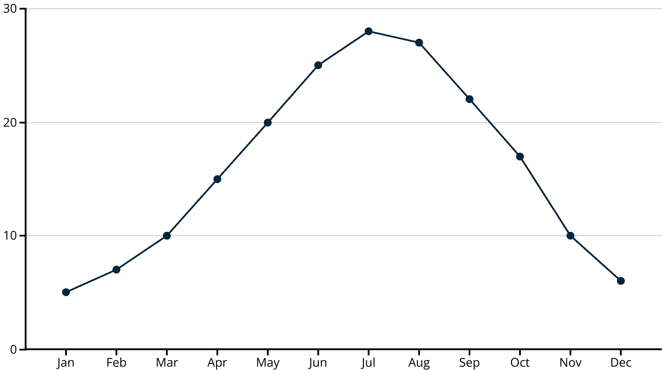
Trends Over Time
Temperature in Celcius

Slide 11
Trends Over Time
This temperature
chart shows a clear
seasonal cycle –
temperatures rise in
spring, peak in
summer, then
fall in autumn and
winter. This
cyclical
pattern repeats
annually.

Slide 12
Identifying Trends and Patterns
Trends Over Time
Cycles and Seasonality
Upward, downward, or flat direction of change.
Repeating patterns at regular intervals.
Patterns in Categories
Clusters and Gaps
Consistent relationships between different categories.

Slide 13
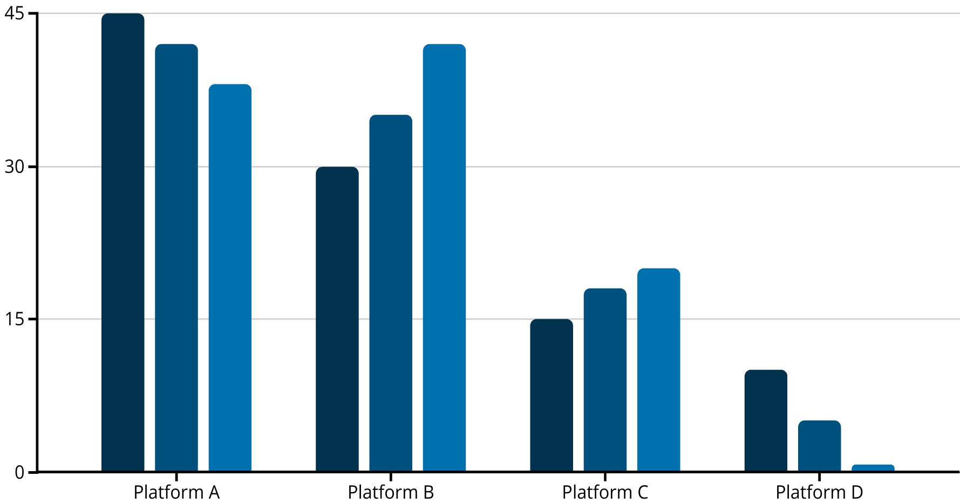
Patterns in Categories
This chart shows patterns in social media usage over three years.
Platform A is _______, Platform B is _________, Platform C shows steady _________, and
Platform D is ______________.
2021 Users
2022 Users
2023 Users

Slide 14
Patterns in Categories
This chart shows patterns in social media usage over three years.
Platform A is declining, Platform B is growing rapidly, Platform C shows steady growth, and
Platform D is disappearing.
2021 Users
2022 Users
2023 Users

Slide 15
Identifying Trends and Patterns
Trends Over Time
Cycles and Seasonality
Upward, downward, or flat direction of change.
Repeating patterns at regular intervals.
Patterns in Categories
Clusters and Gaps
Groups of similar values or areas with no data.
Consistent relationships between different categories.

Slide 16
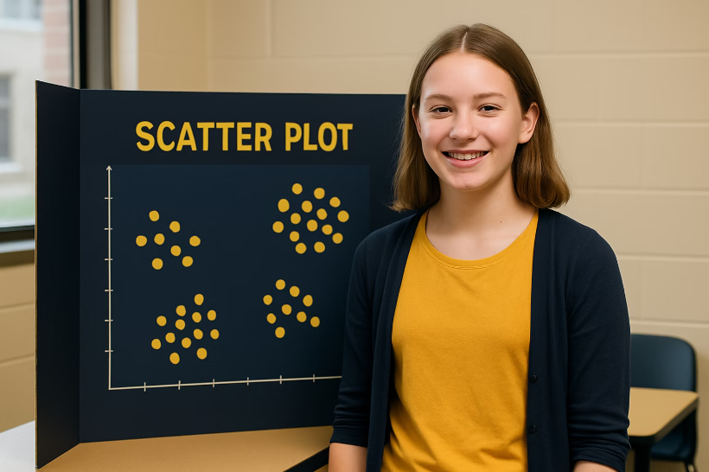
Clusters and Gaps
What to Look For
Clusters show where many data points bunch together, indicating common ranges or typical combinations.
Gaps show ranges with few or no data points, revealing what might be rare or impossible.
Both help identify natural groupings in your data.

Slide 17








Why Finding Patterns Matters
Make Predictions
Forecast future outcomes based on past patterns
Inform Decisions
Use data trends to guide choices
Discover Relationships
Identify connections between variables
Understand Complex Systems
See how different factors interact

Slide 18
Correlation vs. Causation
Correlation
Causation
When two variables change together - as one increases or decreases, so does the other.
When one event directly results from another - changing one variable produces a change in the other.
Example: Ice cream sales and sunburns both increase on hot days.
Example: Pushing the gas pedal causes a car to speed up.
Just because things happen together doesn't mean one causes the other!
Proving causation usually requires controlled experiments.

Slide 19
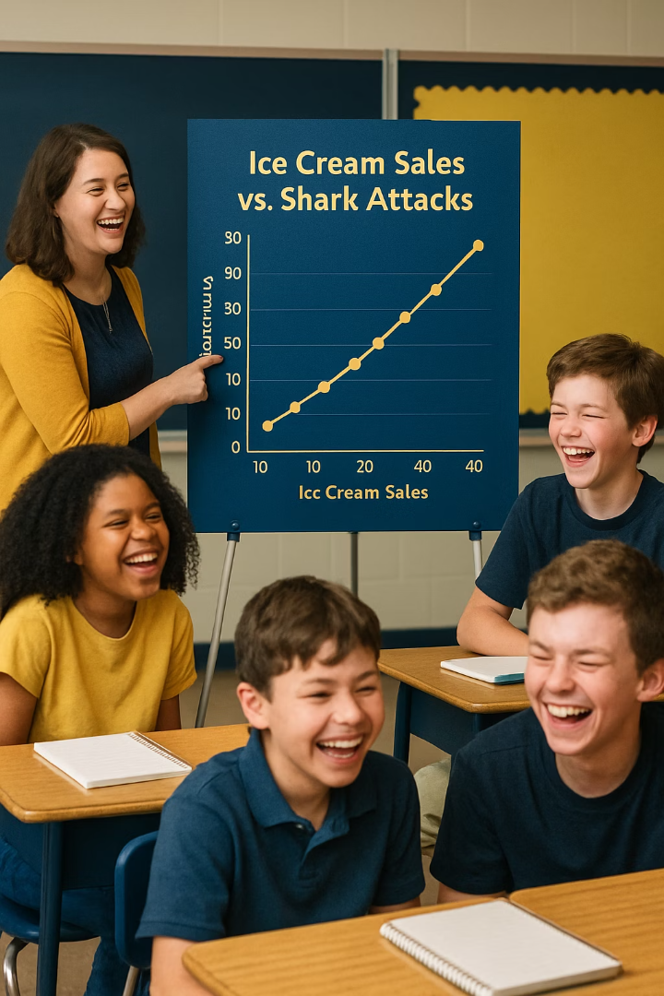
Spurious Correlations: Coincidence, Not Causation
Ice Cream and Shark Attacks
Backpack Weight and Math Scores
Both increase in summer, but buying ice cream doesn't attract sharks!
Heavier backpacks correlate with better scores, but weight doesn't cause learning.
Hidden Variables
Often a third factor (like summer weather or study habits) explains both variables.

Slide 20

Determining Causation
Conduct Controlled Experiments
Randomly assign subjects to treatment and control groups, keeping everything else the same.
Apply Critical Thinking
Ask if there's a logical reason one variable could influence the other.
Consider Reverse Causation
Could B actually be causing A instead of A causing B?
Look for Third Factors
Could both variables be influenced by something else entirely?

Slide 21
Inferential Statistics: Beyond Description
What Is Inferential Statistics?
Example Question
Making conclusions that go beyond just describing your data.
You try a new study technique and your test score improves.
Helps determine if patterns are meaningful or just random chance.
Was the technique effective, or did you just happen to get an easier test?
Uses probability to test hypotheses and make predictions.
Inferential statistics helps answer this by measuring how likely the improvement was due to chance.

Slide 22

Hypotheses: Making Testable Claims
Null Hypothesis (H₀)
Alternative Hypothesis (H₁)
Claims nothing special is happening or there is no effect.
What you're trying to find evidence for.
Example: "The new studying technique has no effect on scores."
Example: "The new studying technique improves scores."
Testing Process
Collect data and analyze whether it supports the alternative or is consistent with the null.

Slide 23
P-Values: Measuring Probability
What Is a P-Value?
Coin Flip Example
A number describing how likely your data would occur by r________ chance if the null hypothesis were true.
Null hypothesis: Coin is fair (50% heads)
You flip 50 times and get 40 heads
Small p-value (typically below 0.__) suggests the result is unlikely due to chance.
P-value would be very small because this outcome is unlikely with a fair coin
Large p-value suggests the result could easily happen by chance.
Conclusion: Reject null hypothesis, coin is probably biased

Slide 24
P-Values: Measuring Probability
What Is a P-Value?
Coin Flip Example
A number describing how likely your data would occur by random chance if the null hypothesis were true.
Null hypothesis: Coin is fair (50% heads)
You flip 50 times and get 40 heads
Small p-value (typically below 0.05) suggests the result is unlikely due to chance.
P-value would be very small because this outcome is unlikely with a fair coin
Large p-value suggests the result could easily happen by chance.
Conclusion: Reject null hypothesis, coin is probably biased

Slide 25




Statistical Significance
Set threshold (usually 0.05)
Decide significance level before analyzing data
Calculate p-value
Determine probability of results under null hypothesis
Compare to threshold
If p < 0.05, result is statistically significant
Draw conclusion
Significant results suggest real effect, not just chance

Slide 26
Teaching Methods Example
The Scenario
Statistical Analysis
Two teaching methods compared with 30 students each.
If p-value = 0.01:
B_____ 0.05 threshold
Method A's students scored 5 points higher on average than Method B's.
Statistically s_______ difference
Method likely made real impact
Question: Is this difference meaningful or just random variation?
If p-value = 0.3:
A_____ 0.05 threshold
N__ statistically significant
Difference might just be l____

Slide 27
Teaching Methods Example
The Scenario
Statistical Analysis
Two teaching methods compared with 30 students each.
If p-value = 0.01:
Below 0.05 threshold
Method A's students scored 5 points higher on average than Method B's.
Statistically significant difference
Method likely made real impact
Question: Is this difference meaningful or just random variation?
If p-value = 0.3:
Above 0.05 threshold
Not statistically significant
Difference might just be luck

Slide 28

SHIFTING FOCUS
PARTS OF A RESEARCH REPORT

Slide 29
Refresher
Literature Review

Slide 30
Refresher
What is a Literature Review?
A literature review is a summary and analysis of what has already been written on a topic.
It helps you:
Understand what’s already known,
See where there are gaps or debates,
Avoid repeating others’ work,
And build a strong foundation for your own research.

Slide 31
Refresher
How to Conduct a Lit Review
Step 1: Clarify Your Topic or Research Question
Step 2: Search for Reliable Sources
Step 3: Skim and Select
Read abstracts first to decide if the source is relevant.
Choose a mix of recent, relevant, and diverse perspectives.
Aim for at least 5–10 solid sources (depending on assignment length).
Step 4: Take Notes
Write down the main point of each source.
Note how it relates to your topic, and any key quotes or data.
Use color coding or a chart to organize themes or arguments.

Slide 32
Refresher
How to Conduct a Lit Review
Step 5: Group by Themes or Ideas
Don’t stop at summarizing each article one by one.
Instead, group your notes by common ______, ___________, or _______.
Ask: What do these sources have in common? How do they differ?
Step 6: Start Writing
Step 7: Cite Everything

Slide 33
Refresher
How to Conduct a Lit Review
Step 5: Group by Themes or Ideas
Don’t stop at summarizing each article one by one.
Instead, group your notes by common themes, disagreements, or trends.
Ask: What do these sources have in common? How do they differ?
Step 6: Start Writing
Step 7: Cite Everything

Slide 34
How to Write a Literature Review
Let’s remember that this is an academic writing.

Slide 35

Academic Writing Characteristics
Formal Tone
Objective Focus
Professional language without slang or contractions. "A survey was conducted" rather than "I asked my friends."
Emphasizes evidence over opinion. "The data suggest..." instead of "I think..."
Thorough Detail
Proper Citations
Provides enough information for others to replicate your work or evaluate your methods.
Acknowledges all sources using standard formats like APA, MLA, or Chicago style.

Slide 36
Literature Review Template
Begin with a short introduction:
What is your topic?
Why is it important?
Give the broad context of the problem.
Body:
Share what other studies have found.
Organize the body by themes, not by author.
End with a summary:
Summarize what was found.
Clarify how your project connects to past research.
Name the patterns you noticed in the literature.
Identify the gaps and/or questions remain to be explored.

Slide 37
How to Synthesize Multiple Sources in a Lit Review
What does synthesis mean?
A good lit review is more than just summarizing what you found.
It means combining ideas from different sources to see how they relate to each other, not just what each one says.

Slide 38
How to Synthesize Multiple Sources in a Lit Review
Look for Connections
Ask yourself:
Do the authors agree or disagree?
Are they studying the same issue from different perspectives?
Does one source support, expand on, or challenge another?
Group Ideas, Not Authors
Don’t organize your review by author: “Smith says..., then Jones says...”
Instead, organize by theme, issue, or trend:
For example: “Many studies agree that social media affects attention span (Smith, 2021; Lee, 2020), but a few challenge this idea (Gomez, 2022).”

Slide 39
How to Synthesize Multiple Sources in a Lit Review
Use Comparative Language
Helpful phrases: “Similarly…” “In contrast…” “Building on…”. “While some researchers argue..., others suggest…”. “There is a general consensus that…”
Highlight Gaps or Conflicts
Point out where sources disagree or where more research is needed.
Example: “While most studies link sleep to better memory, few explore how this differs by age group.”
End With a Big Picture
What have you learned from all the sources combined? What patterns, debates, or gaps have you noticed? This sets the stage for your own research question.

Slide 40
Refresher
Importance of giving reference
Why Do We Cite?

Slide 41
Refresher
Importance of giving reference
Why Do We Cite?
Citing your sources means giving credit to the original authors of the ideas, words, or data you use in your work.
We cite to:

Slide 42
Refresher
Importance of giving reference
Why Do We Cite?
Citing your sources means giving credit to the original authors of the ideas, words, or data you use in your work.
We cite to:
Avoid plagiarism (taking credit for someone else's work),
Show where your information came from, and
Help others find those sources if they want to learn more.

Slide 43
Refresher
What to Cite? What not to Cite?

Slide 44
Refresher
What to Cite? What not to Cite?
You should cite:
Direct quotes (even short ones),
Paraphrased ideas (putting someone else’s idea into your own words),
Statistics or data,
Images, charts, or graphics you didn’t create.
You do not need to cite:
Common knowledge (e.g., “Water freezes at 0°C”),
Your own original thoughts.

Slide 45
How to Cite?
There are different citation styles (APA, MLA, Chicago), but the basic idea is the same:
You include the author’s name, date, and sometimes the page number in your text, and then list the full details at the end of your work.
Example in APA Style:
In-text citation: "Teens who sleep less are more likely to report symptoms of depression" (Williams, 2021, p. 45).
Works Cited/References page: Williams, A. (2021). The Science of Teen Sleep. TeenHealth Publishing.
When citing online resources, instead of writing just a link, include full source info:
Not this: https://example.com/article
Do this: Smith, J. (2022). Climate change and food security. National Environmental Journal. https://example.com/article

Slide 46
Tips for Citations
Keep track of your sources as you research (write down author, title, date, and link).
Don’t wait until the end to cite; build it in as you go.
Use citation tools (like EasyBib, Zotero, or built-in Google Docs citation feature) to help format correctly.
Always double-check your citations with your teacher’s required style guide.
Closing Thought
Citing is part of being a trustworthy researcher. It shows you're respectful of other people’s work and serious about your own.

Slide 47
Let’s look into your Literature Review slides
Team-up!

Slide 48
Presentation outline
Title Slide: Introduce yourself and the project by naming the title, presenters, date of presentation, the Institutions at which the study is conducted. Add logos if you can.
Topic Slide: Name your global challenge, define it (cite your source), state why this is important (cite your sources)
Literature Review Slide: What do you know about this issue based on your literature review? Have a couple statements arranged by ideas / themes. Cite your sources.
Research Question Slide: Name your research questions(s) and if possible hypothesis
Methods Slide: State that your work is secondary research. Introduce your data source (including the year data was collected) & sample (including its size and key characteristics). Name key variables. Name the tools you used to analyze data.
Results Slides:
- First share descriptive statistics for each key variable (mean, median, mode, range)
- Provide numbers, graphs, tables.. as suitable. This can be multiple slides.
Discussion: How you interpret what you have found
Conclusion: Final words and good-bye
References: List your references. Be consistent with the style.

Slide 49

Homework - Teamwork
Continue adding to your presentation slides
Incorporate your results to your PowerPoint

Slide 50
EXTRA SLIDES FOR DAY 7

Slide 51





Comparing Two Groups: The t-Test
Purpose
Compares means of two groups to see if they're significantly different.
Calculation Factors
Considers difference between means, variability within groups, and sample size.
Results
Produces t-statistic and p-value to determine significance.
Common Uses
Testing new methods, comparing treatments, evaluating interventions.

Slide 52

t-Test Example: Learning App Study
The Scenario
Class A tried a new learning app for a month.
Class B used traditional homework.
Class A mean score: 85
Class B mean score: 80
Question: Is the 5-point difference due to the app or just chance?
t-statistic: 3.59
p-value: 0.0009
Result: Statistically significant (p < 0.05)
Conclusion: The app likely had a positive effect on scores.

Slide 53
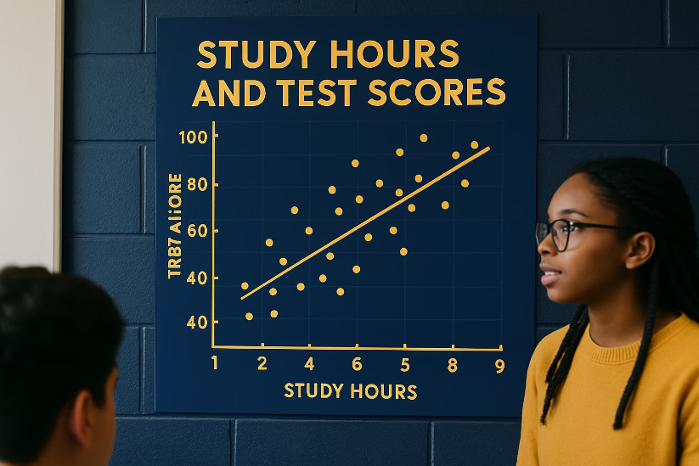
Regression Analysis: Finding Relationships
What Is Regression?
A method to model or predict one variable based on another.
Finds the "line of best fit" through data points.
Quantifies the relationship between variables.
Example: Predicting test scores based on study hours.
The upward slope shows more study time relates to higher scores.

Slide 54

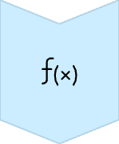
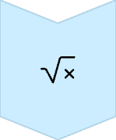


Linear Regression Equation
The Formula
Y = a + bX
The Variables
Y is the predicted value, X is the independent variable
The Intercept
a is where the line crosses the y-axis (Y when X=0)
The Slope
b shows how much Y changes when X increases by one unit

Slide 55
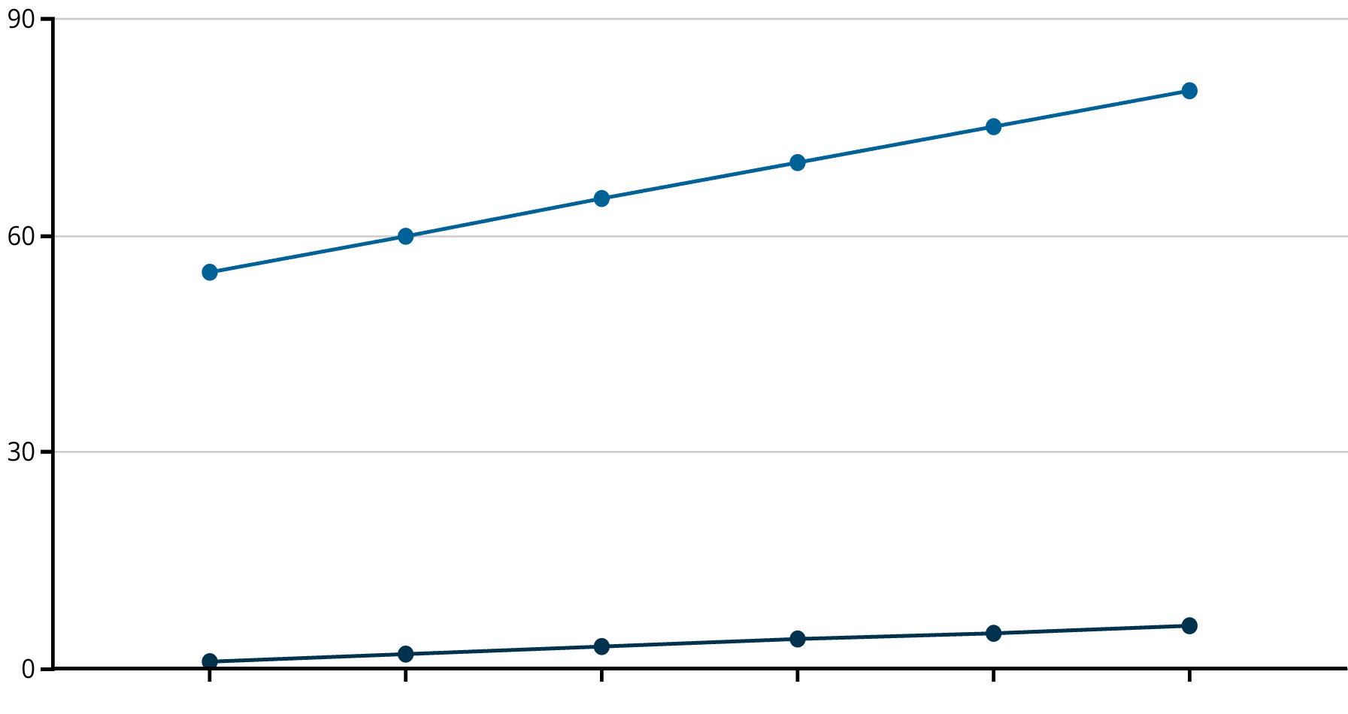
Regression Example: Study Hours vs. Test Scores
Y - Test Score
Y = a + bX
Predicted Value =
Intercept + slope x IV
Intercept: what Y is when X is 0
Slope: how much Y changes when X increases by one unit
X - Study Hour
Regression equation: Score = 50 + 5*(Hours)
Interpretation: Each additional hour studied is associated with an increase of 5 points on the test, on average.
Prediction: A student studying 8 hours would score about 50 + 5*8 = 90 points.
Study Hours
Test Score

Slide 56

Important Regression Concepts
Residuals
R-squared
Interpolation vs. Extrapolation
Differences between actual values and predicted values. Smaller residuals mean better fit.
Number between 0 and 1 showing how much variation in Y is explained by X. Higher is better.
Predicting within observed range (safer) vs. outside that range (riskier).

Slide 57




Quasi-Experimental Designs
When true experiments aren't possible, researchers use clever statistical designs to approximate experiments using observational data.
Selection Bias Challenge
Goal
Find ways to estimate cause-and-effect without random assignment.
Groups receiving treatment may differ in other ways that affect outcomes.
Methods
Special techniques help address selection bias and isolate treatment effects.

Slide 58
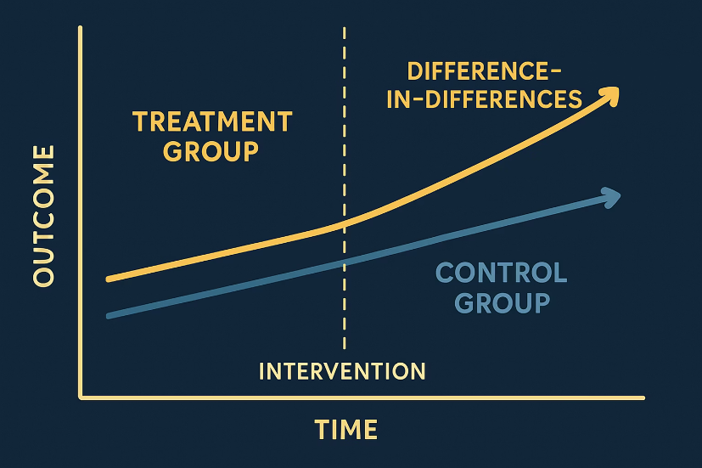
Difference-in-Differences (DID)
How It Works
Compare changes over time between a treatment group and a control group.
Calculate: (After – Before for Treatment) – (After – Before for Control)
This removes common factors affecting both groups, isolating the treatment effect.
Group A (with program): 70 → 78 (+8)
Group B (no program): 68 → 70 (+2)
Difference-in-differences: +8 – +2 = +6 points

Slide 59
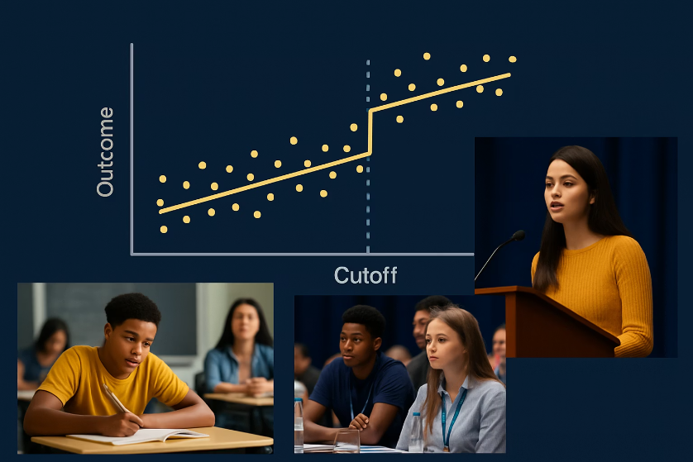
Regression Discontinuity (RD)
How It Works
Takes advantage of a sharp cutoff for treatment assignment.
Compares outcomes for subjects just below and just above the cutoff.
These subjects should be very similar except for receiving treatment.
Example: Students scoring below 50 get special tutoring.
Compare students who scored 49 vs. 51 - practically same ability, but different treatment.
Any jump in outcomes at the cutoff suggests causal effect.

Slide 60
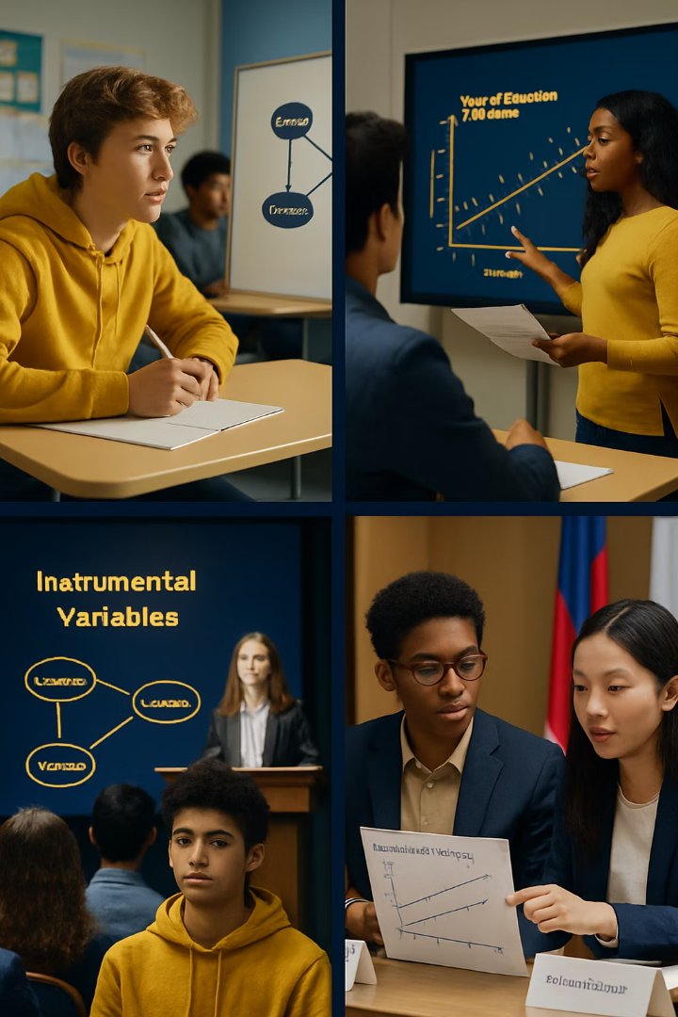




Instrumental Variables (IV)
Find an Instrument (Z)
Something that affects X but not Y directly
Isolate Variation
Use only the variation in X caused by Z
Measure Effect
See how this "clean" variation affects Y
Draw Conclusions
Estimate causal impact of X on Y

Slide 61
Matching: Creating Comparable Groups
How It Works
Example
Match each treated subject with similar non-treated subjects.
For each student in tutoring program, find another student with:
Compare outcomes between matched pairs.
Similar initial grades
Creates balanced groups as if in an experiment.
Similar background
Similar motivation level
Compare outcomes between matched pairs to estimate tutoring effect.

Slide 62

Case Study: After-School Tutoring Program
50
20
Total Students
Tutored Group
9th graders in a high school math class
Students who voluntarily attended after-school tutoring
30
Non-Tutored Group
Students who did not attend the tutoring program
Question: Did the tutoring program help improve math scores?

Slide 63





Case Study: Data Analysis Steps
Descriptive Analysis
Calculate means: Tutored group improved 8 points, Non-tutored improved 3 points.
Visualize Data
Create bar graphs showing before and after scores for both groups.
Inferential Analysis
Perform t-test on improvement scores (p=0.02, statistically significant).
Address Selection Bias
Use matching to compare similar students from both groups.
Draw Conclusions
Tutoring likely caused a 5-point improvement in math scores.

Slide 64

Hands-On Activity: Investigating the Digital Divide
Choose a Research Question
Focus on a specific aspect of internet access and equity (rural vs. urban, income differences, etc.).
Visit a Public Data Source
Explore data.census.gov, nces.ed.gov, or similar sites to find relevant statistics.
Organize and Analyze Data
Create tables and graphs to visualize findings and identify patterns.
Reflect on Meaning
Consider implications for educational opportunity and potential solutions.

Slide 65
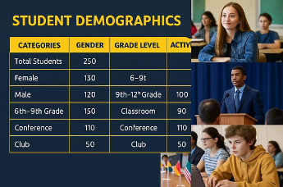

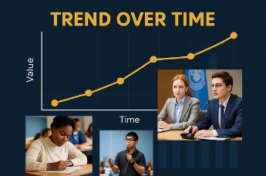
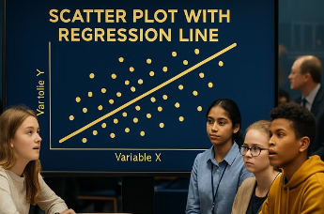

Key Takeaways
Data Organization
Effective Visualization
Organize data carefully to create a solid foundation for analysis.
Choose appropriate visualizations to represent your data clearly.
Statistical Summaries
Pattern Recognition
Use statistics to summarize and understand data patterns.
Identify meaningful patterns that reveal insights within your data.
Correlation vs. Causation
Testing Hypotheses
Distinguish between correlation and causation when interpreting relationships.
Apply inferential methods to test hypotheses and draw reliable conclusions.
These skills will help you make sense of information in school and beyond!

