Slide 1
RESEARCH METHODS
DAY 6

Slide 2
Welcome to Day 6!
Let’s learn more about data.
Understanding different types of data.
Avoiding biases in data collection.
Data recording: best practices.
Understanding & reporting data: Tools to use.

Slide 3
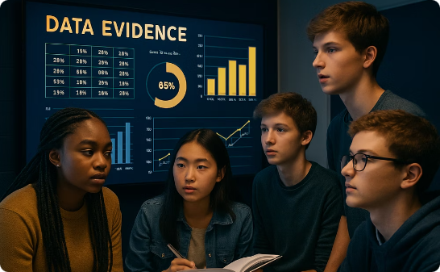


What is Data?
Evidence
Foundation
Towards Replicable Conclusions
Information collected to examine hypotheses, address questions, or describe phenomena.
Transforms uncertainty into insight with observable reality.
Moves beyond opinion toward supported, replicable conclusions.

Slide 4


Quantitative vs. Qualitative Data

Slide 5
Quantitative vs. Qualitative Data
Quantitative Data
Qualitative Data
Information that can be measured or counted
Descriptive, non-numerical information
Test scores
Open-ended survey responses
Survey ratings
Observational notes
Hours spent on homework
Interview narratives
Growth measurements
Written explanations
Expressed in numbers
Provides context and depth

Slide 6
A Balanced Approach
Integrated Research
Qualitative Depth
Combines approaches for comprehensive understanding
Quantitative Precision
Explains the "why" behind patterns
Measures patterns with numerical accuracy

Slide 7

Primary vs. Secondary Data

Slide 8
Primary vs. Secondary Data
Primary Data
Information you collect directly through your own effort
Experiments
Surveys
Interviews
Observations
Secondary Data
Information that already exists, collected by others
Books
Websites
Articles
Databases

Slide 9

When to Use Each Type
1
Use Primary Data When...
Your question is specific and unique
You need fresh data nobody has collected
You want control over how data is obtained
2
Use Secondary Data When...
Information already exists
You need to save time
You need broader context
3
Best Practice
Many strong research projects use both types for a fuller understanding

Slide 10
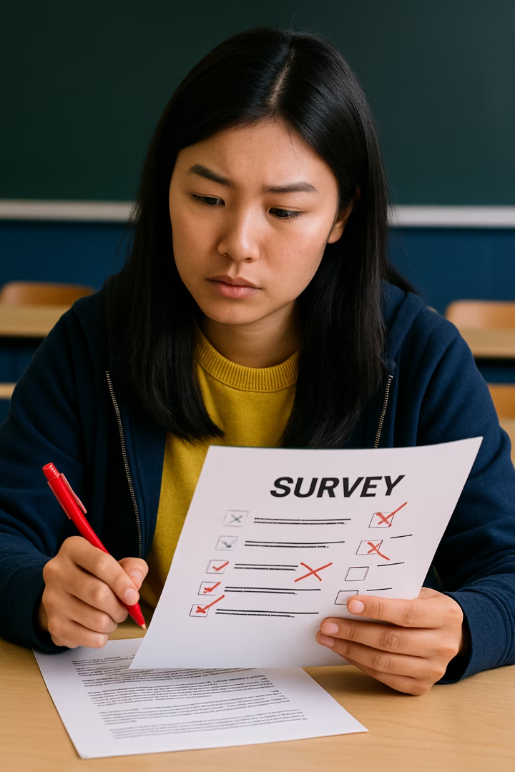
Common Mistakes in Research

Slide 11
Common Mistakes in Research
We can make mistakes at every stage.
When selecting participants - selection bias
When collecting data - measuring bias, response bias
When analyzing data - confirmation bias
When reporting results - reporting bias

Slide 12
Common Mistakes in Research
Biased Sampling
Example: Only surveying students who participate in sports about favorite activities.
Fix: Include students with diverse interests and backgrounds.
Fix: Go for random sampling if it is possible.

Slide 13



Importance of Random Sampling
Representative Results
Random sampling helps ensure your findings reflect the whole population
Reduced Bias
Everyone has an equal chance of being selected
Statistical Validity
Allows for more accurate statistical analysis

Slide 14
Common Mistakes in Research
Biased Sampling
Leading Questions
Example: Only surveying students who participate in sports about favorite activities.
Example: "Don't you agree that homework is too stressful?"
Fix: Include students with diverse backgrounds. Go for random sampling if possible.
Fix: "How would you describe your experience with homework?"

Slide 15
Fixing Biased Questions
Biased Questions
Neutral Alternatives
Don't you agree that school starts too early?
What time do you think school should start?
Why is the new lunch policy so unfair?
What are your thoughts on the new lunch policy?
How much do you hate doing homework?
How would you describe your experience with homework?
Wouldn't you prefer having more recess time?
What is your opinion about current recess time?

Slide 16
Common Mistakes in Research
Biased Sampling
Leading Questions
Example: Only surveying students who participate in sports about favorite activities.
Example: "Don't you agree that homework is too stressful?"
Fix: Include students with diverse backgrounds. Go for random sampling if possible.
Fix: "How would you describe your experience with homework?"
Confirmation Bias
Example: Only noticing data that supports your hypothesis.
Fix: Actively look for evidence that contradicts your expectations.

Slide 17
Accuracy in Data Recording

Slide 18
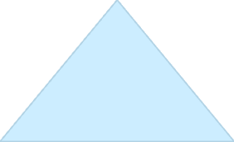





Accuracy in Data Recording
Valid Conclusions
Accurate data leads to trustworthy findings
Replicable Research
Others can verify and build on your work
Research Integrity
Honest recording reflects scientific ethics

Slide 19

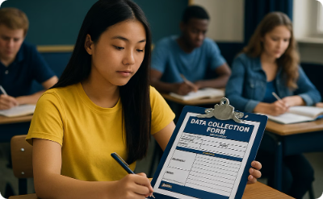


Data Recording Best Practices

Slide 20
Data Recording Best Practices
Record Immediately
Use Standardized Forms
Document Visually
Back Up Your Data
Don't rely on memory - write down observations right away.
Take photos or videos when appropriate.
Keep multiple copies in different locations.
Create consistent templates for data collection.

Slide 21
Tools We Use To Work on Data
Some common tools make it easier to spot patterns, test ideas, and share results with others. These include:
Statistics software to run analyses,
SPSS (Statistical Package for the Social Sciences) or R, both of which are used in academic research and professional fields to run complex calculations, such as correlations or regressions
Charts or visuals to help others understand what the data shows. Data visualization tools such as Canva or Tableau can assist us in creating informative visuals.
Excel, Google Sheets, Numbers (on Mac) allow us to make simple statistical calculations, make tables, sort data, and create graphs. Let’s take a look.

Slide 22

Tables
Tables arrange data in rows and columns, making information clear at a glance.
Student
Math Score
Science Score
Reading Score
Alex
85
92
78
Jamie
92
88
95
Taylor
78
85
90

Slide 23
Tables
Tables arrange data in r___ and c____, making information c_____ at a glance.
Student
Math Score
Science Score
Reading Score
Alex
85
92
78
Jamie
92
88
95
Taylor
78
85
90

Slide 24
Tally Charts: Counting Made Simple
Tally charts record f___________ with marks grouped in sets of f________.
Transportation
Tally
Total
Perfect for counting observations in real time without losing track.
Walking
IIII IIII II
12
Biking
IIII
5
Example: Counting how students commute to school.
Bus
IIII IIII
10
Car
IIII IIII IIII III
18

Slide 25
Tally Charts: Counting Made Simple
Tally charts record frequencies with marks grouped in sets of five.
Transportation
Tally
Total
Perfect for counting observations in real time without losing track.
Walking
IIII IIII II
12
Biking
IIII
5
Example: Counting how students commute to school.
Bus
IIII IIII
10
Car
IIII IIII IIII III
18

Slide 26
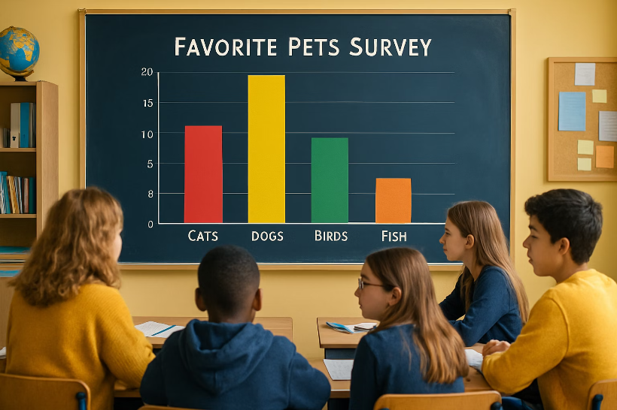
Bar Graphs: Comparing Categories
What They Show
Bar graphs compare amounts across different c__________ using bars of equal w_______.
Perfect for categorical data like favorite pets, subjects, or sports.
The h__________ of each bar represents the value for that category.

Slide 27
Bar Graphs: Comparing Categories
What They Show
Bar graphs compare amounts across different categories using bars of equal width.
Perfect for categorical data like favorite pets, subjects, or sports.
The height of each bar represents the value for that category.

Slide 28
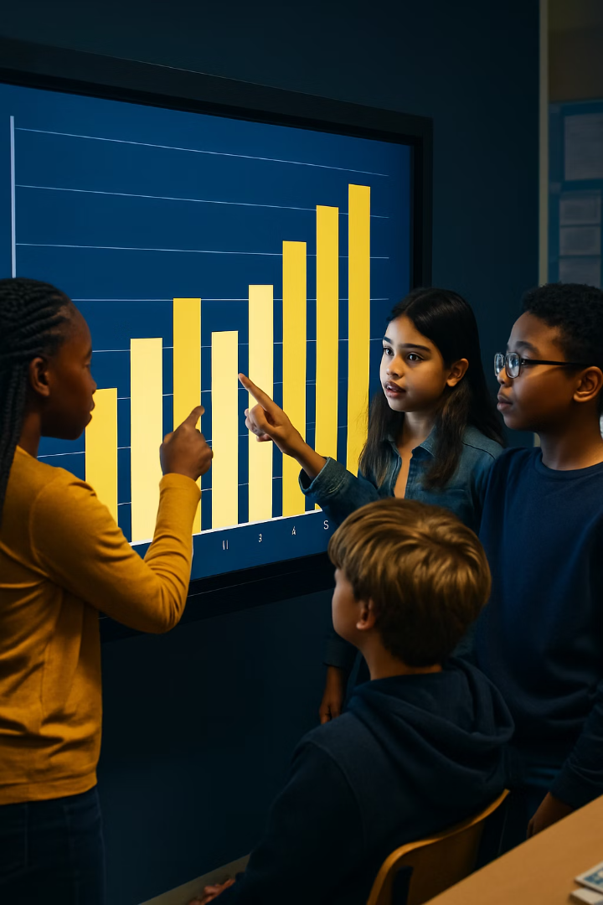




Reading Bar Graphs
Check the Labels
Identify what's being compared and the scale of measurement.
Compare Heights
Taller bars represent larger values.
Look for Patterns
Notice which categories have highest/lowest values.
Ask Questions
Wonder why certain patterns appear in the data.

Slide 29
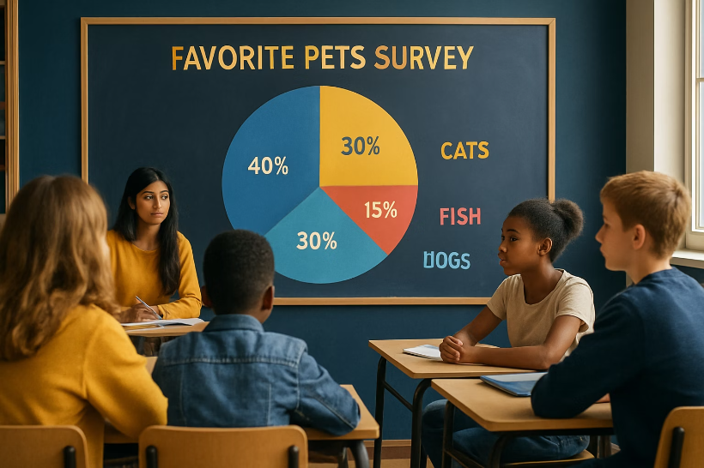
Pie Charts: Showing Parts of a Whole
Shows how a w______ is divided into parts, like slices of a p__.
Each slice represents a p_________ or fraction of the total.
Data Breakdown
Pet
Students
Percentage
Dogs
15
50%
Cats
10
33%
Birds
5
17%
Total
30
100%
The pie chart makes it easy to see that dogs are the most popular pet, chosen by half the students.
Example: Favorite Pets

Slide 30
Pie Charts: Showing Parts of a Whole
Shows how a whole is divided into parts, like slices of a pie.
Each slice represents a percentage or fraction of the total.
Data Breakdown
Pet
Students
Percentage
Dogs
15
50%
Cats
10
33%
Birds
5
17%
Total
30
100%
The pie chart makes it easy to see that dogs are the most popular pet, chosen by half the students.
Example: Favorite Pets

Slide 31
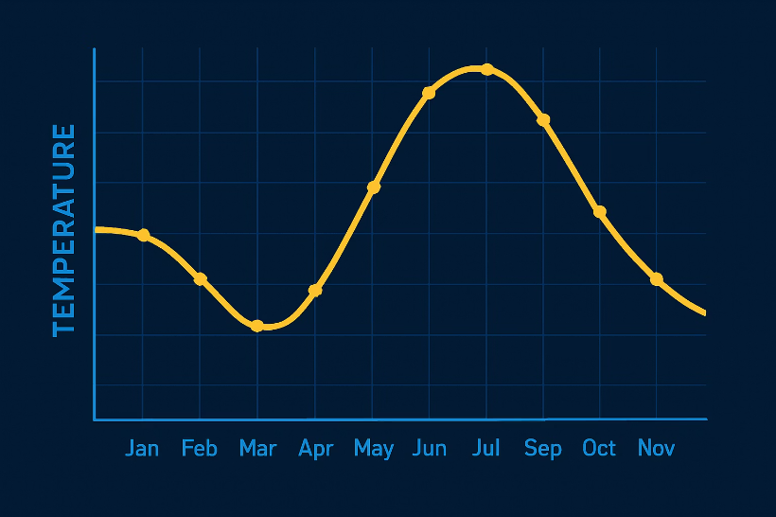
Line Graphs: Tracking Changes Over Time
What They Show
Line graphs display data that c__________ continuously over time.
Points are plotted and connected with l____ to show trends.
Perfect for showing how something increases, decreases, or fluctuates.

Slide 32
Line Graphs: Tracking Changes Over Time
What They Show
Line graphs display data that changes continuously over time.
Points are plotted and connected with lines to show trends.
Perfect for showing how something increases, decreases, or fluctuates.

Slide 33





Reading Line Graph Trends
Upward Slope
Values i_________ over time (scores improving, population growing).
Downward Slope
Values d_________ over time (temperatures dropping).
Flat Line
Little or no c________ over that period.
Jagged Line
F_______ (ups and downs) over t_______.

Slide 34
Reading Line Graph Trends
Upward Slope
Values increasing over time (scores improving, population growing).
Downward Slope
Values decreasing over time (temperatures dropping).
Flat Line
Little or no change over that period.
Jagged Line
Fluctuations (ups and downs) over time.

Slide 35
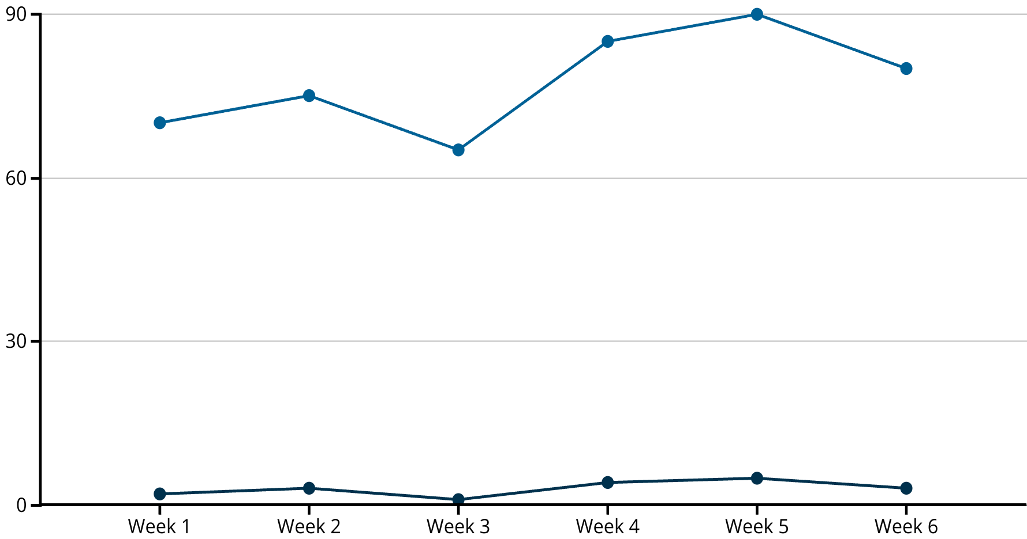
Line Graph Example: Study Time vs. Quiz Scores
Hours Studied
Quiz Score
This line graph shows how study time and quiz scores changed over six weeks. Notice how quiz scores tend to rise when study hours increase, suggesting a positive relationship between studying and performance.

Slide 36

Choosing the Right Graph
Bar Graph
Pie Chart
Best for comparing c__________ like favorite foods, test grades by subject, or sports participation.
Best for showing p______ of a whole like budget breakdown, time spent on activities, or survey responses.
Line Graph
Best for showing c_________ over time like temperature trends, growth patterns, or progress tracking.

Slide 37
Choosing the Right Graph
Bar Graph
Pie Chart
Best for comparing categories like favorite foods, test grades by subject, or sports participation.
Best for showing parts of a whole like budget breakdown, time spent on activities, or survey responses.
Line Graph
Best for showing changes over time like temperature trends, growth patterns, or progress tracking.

Slide 38

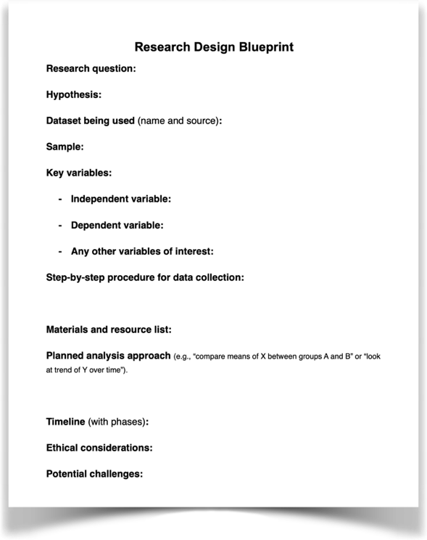
Homework - Teamwork
Simply explore your data. Look at your data to see which graphs and tables can help you answer your research question. (You can work on crafting them tomorrow but at first see what may come out of your data.
Start your presentation slides: Lit review & Research Questions

Slide 39
EXTRA SLIDES FOR DAY 6

Slide 40
Let’s shift our attention to data ethics!
As you work with data, be mindful of the
ethical considerations.

Slide 41
What is Data Ethics?
Data ethics is about using data responsibly, honestly, and fairly and it applies to every step of the process including collecting, analyzing, sharing, or presenting it. Whether you're doing a science fair project or studying global issues, ethical data use matters.
Why Should We Care?
Data can shape decisions, influence opinions, and affect real people. If used dishonestly, data can mislead, harm others, or spread false information.

Slide 42
Basic Rules of Data Ethics
1. Don’t Cherry-Pick
Only showing data that supports your idea and ignoring data that doesn’t is dishonest.
Report all results, even if they surprise or challenge your expectations.
2. Don’t Manipulate Data to Fit Your Hypothesis
Changing numbers or tweaking how you measure things just to get a better result is not okay.
Let the data speak for itself.
Don’t round, group, or leave out data points to make your idea look better.
3. Protect People’s Privacy
If you collect data from real people, protect their identities and personal information.
Ask for permission (informed consent).
Keep names or sensitive details private unless permission is given.

Slide 43
Basic Rules of Data Ethics
4. Be Clear and Honest
Don’t mislead with fancy graphs or confusing statistics.
Avoid using tricky visuals that exaggerate results.
Label graphs clearly and explain what the numbers mean.
5. Give Credit
If you use data from other sources, say where it came from.
Always cite your sources (websites, reports, surveys).
Don’t act like someone else’s data is your own.
6. Think About Harm
Ask: Could this data hurt or stereotype anyone?
Consider whether your research might unintentionally reinforce bias or harm a group of people.
Avoid making generalizations based on incomplete or biased data.

Slide 44
Final thought
Data is power!
Hence, it comes with responsibility.
Be honest, fair, and curious—not just right.

