Slide 1
RESEARCH METHODS
DAY 5

Slide 2
New Slide to introduce activity:
TEAM PRESENTATIONS: Lit Findings
Curriculum says:
Team Presentations: Literature Findings (30 min)
Each team presents 1–2 interesting findings from their literature review (from Session 4 Mission Sheet Part 2). Class gives one piece of feedback per team: 'One question this raises for me...'

Slide 3
New Slide to introduce activity:
EVIDENCE OF IMPORTANCE
Curriculum says:
Evidence of Importance (20 min)
Using the 'Evidence of Importance' Handout: teams compile 2–3 statistics or findings from their literature review that show why their research topic matters.
This becomes the opening of their final presentation.

Slide 4

Designing a Research Project
Let’s explore how to plan, execute, and analyze research that answers meaningful questions.

Slide 5
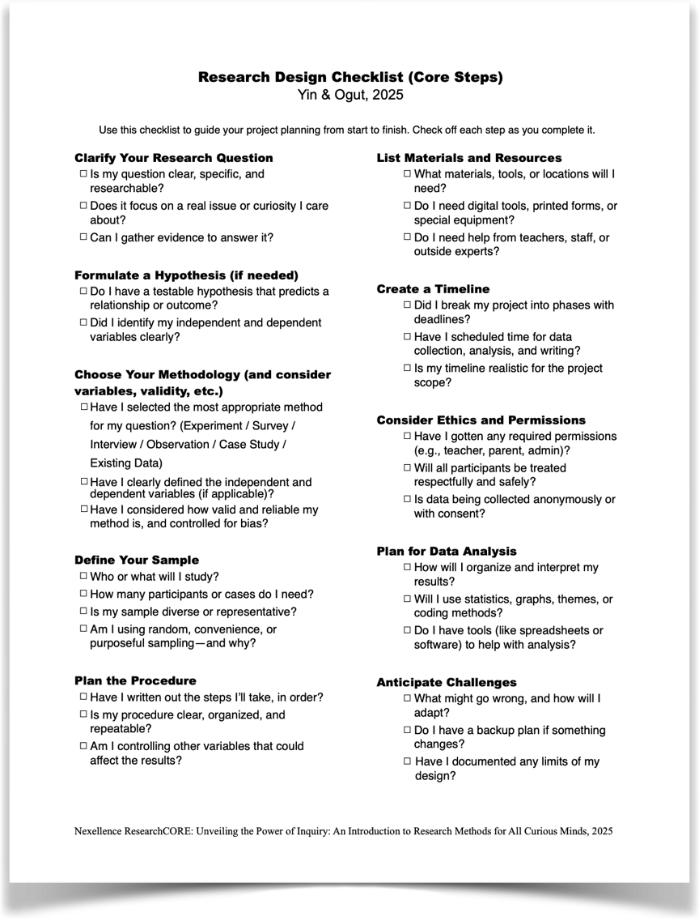
DO WE STILL HAVE THE SAME CORE STEPS HANDOUT TO SHARE?
If yes, this slide can stay.
Designing a Research Project
To make the steps of designing easier, you can review & follow our checklist.

Slide 6




Not in Curriculum but should keep
Failing to Plan is Planning to Fail
Research Requires Direction
Create a Blueprint
A well-designed project saves time and increases the chances of valid, meaningful findings.
Like baking without a recipe or traveling without a map, research without planning leads to confusion.
Develop a Game Plan
We'll cover methodologies, tools, variables, and ethical considerations for your research journey.

Slide 7
Choosing a Research Method
The first step in designing your project is selecting the right method to answer your question.
Methodology includes…
Your overall approach / strategy:
Your data collection tools / techniques

Slide 8

Choosing a Research Method
The first step in designing your project is selecting the right method to answer your question.
Methodology includes…
Your overall approach / strategy:
Qualitative vs. Quantitative
Your data collection tools / techniques

Slide 9
Choosing a Research Method
The first step in designing your project is selecting the right method to answer your question.
Methodology includes…
Your overall approach / strategy:
Quantitative Methods
Qualitative Methods
Focus on numbers and measurable data.
Good for questions about "how many," "how much," or testing relationships between variables.
Focus on descriptions and non-numerical insights.
Good for exploring experiences, opinions, and understanding "why" or "how."

Slide 10
Choosing a Research Method
The first step in designing your project is selecting the right method to answer your question.
Methodology includes…
Your overall approach / strategy:
Qualitative. Quantitative. Mixed.
Your data collection tools / techniques
HERE YOU HAVE A COUPLE DIFFERENT OPTIONS!
You can use already collected data: Secondary Research
You can collect your own data using one or multiple methods. Ex: You can conduct an experiment and/or make natural observations. (Next)

Slide 11
Choosing a Research Method
The first step in designing your project is selecting the right method to answer your question.
Methodology includes…
Your overall approach / strategy:
Qualitative vs. Quantitative
Your data collection tools / techniques
Experiment
Surveys
Interview
Focus Groups
Observation
Case Study

Slide 12

Experiments: Testing Cause and Effect
When to Use
Key Components
Best for questions about cause-and-effect relationships.
Independent variable (what you change)
You can manipulate variables
Dependent variable (what you measure)
You need to control other factors
Control group (for comparison)
Your question starts with "What is the effect of...?"
Random assignment (reduces bias)
Example: Testing if sunlight affects plant growth by placing identical plants in different light conditions.
Mostly quantitative

Slide 13

Quasi-Experiments:
Real-World Testing
Definition
When to Use
Similar to experiments
but without random assignment or
full control over all factors.
When true experiments aren't feasible or ethical, but you still want to test relationships between variables.
Limitations
Harder to establish causation because other factors might influence results.
Mostly quantitative

Slide 14





Surveys: Gathering Opinions and Data
Broad Reach
Versatile Questions
Quantifiable Results
Multiple Formats
Collect information from many people quickly.
Use multiple-choice, scales, or open-ended questions.
Easily analyze and visualize responses.
Distribute on paper, online, or in person.
Common to use in both quantitative and qualitative studies

Slide 15

Interviews and Focus Groups: In-Depth Insights
Interviews
Focus Groups
One-on-one conversations to explore personal experiences and perspectives.
Guided discussions with several participants to gather multiple viewpoints.
Detailed individual responses
Group interaction generates ideas
Follow-up questions possible
Good for sensitive topics
See how opinions form and change
Both methods provide rich qualitative data that numbers alone can't capture.
Efficient for hearing from many people

Slide 16





Observation:
Watching Real Behavior
Natural Settings
Observe behavior as it naturally occurs without intervention.
Structured or Unstructured
Use checklists for specific behaviors or take open-ended notes on everything you see.
Time Sampling
Observe at different times to capture variation in behavior patterns.
Minimize Observer Effect
Be discreet so your presence doesn't change the behavior you're studying.
Can be utilized in quantitative or qualitative studies

Slide 17

Case Studies: Deep Dives
Definition
When to Use
Intensive study of a single case or small number of cases to gain in-depth understanding.
For unique situations, rare phenomena, or when you need comprehensive understanding of one example.
Limitations
Findings may not generalize to other cases or populations.
Mostly qualitative but can include quantitative elements

Slide 18





Using Existing Data:
Secondary Research
Efficient Access
Historical Perspective
Multiple Sources
Use data already collected by others instead of gathering new information.
Government reports, research studies, archives, statistics, and historical documents.
Analyze trends over time periods you couldn't study directly.
Source Verification
Always evaluate the credibility and quality of secondary data sources.

Slide 19

Mixed Methods: Combining Approaches & Tools
Benefits
Examples
Provides fuller picture of the topic
Survey + interviews
Experiment + questionnaire
Combines breadth and depth
Observation + focus groups
Numbers + stories = comprehensive understanding
Case study + statistical analysis
Compensates for weaknesses in single methods
Mixed methods require careful planning but provide rich, multidimensional insights.

Slide 20




Not in the curriculum but can stay
Choosing the Right Method
Consider your research question
What type of answer do you need? Numbers, descriptions, or both?
Assess your resources
How much time, access, and materials do you have available?
Think about participants
Who will you study and how many can you realistically include?
Weigh strengths and limitations
Each method has trade-offs. Choose what best fits your specific needs.

Slide 21
NEW SLIDE NEEDED
Activity: Design Your Study (25 min)
Teams complete Session 5 'Research Design & Methodology' Mission Sheet: identify methodology, dataset, sample, potential limitations.
Instructor circulates to check feasibility.

Slide 22
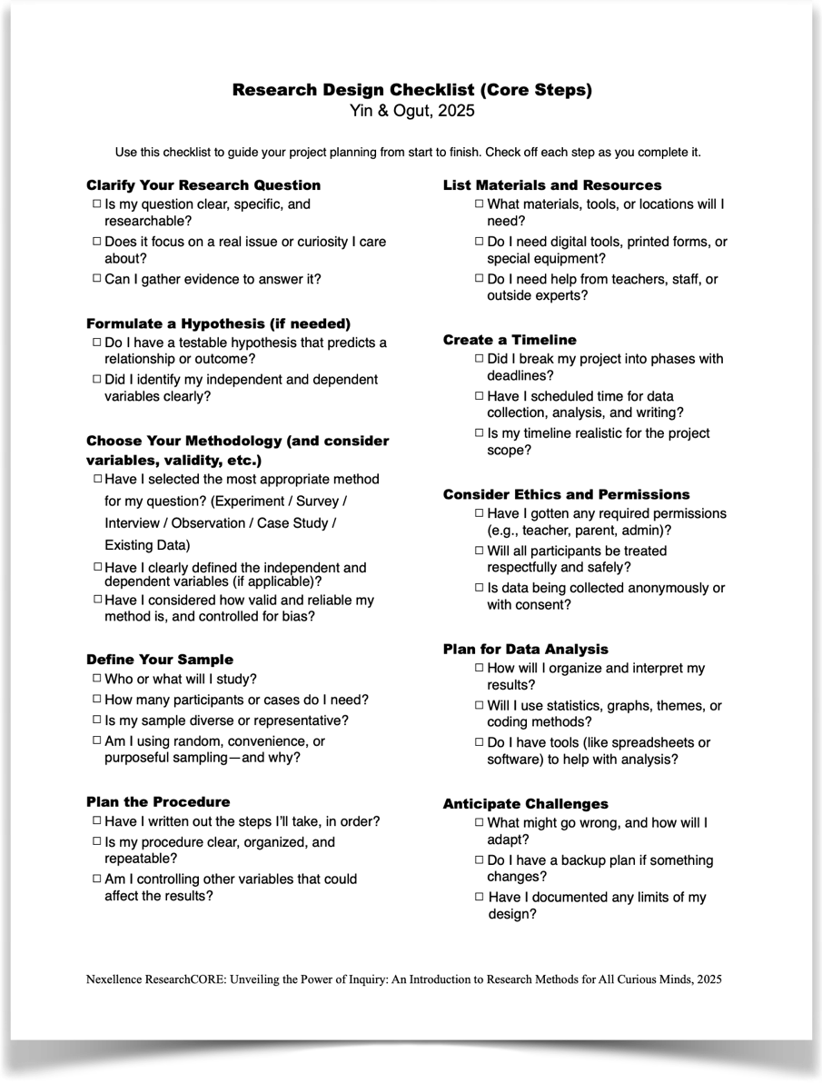
FITS
can stay
Tomorrow we continue to
look into planning
Specifically reflecting on validity & reliability,
sampling, and materials/resources.

Slide 23

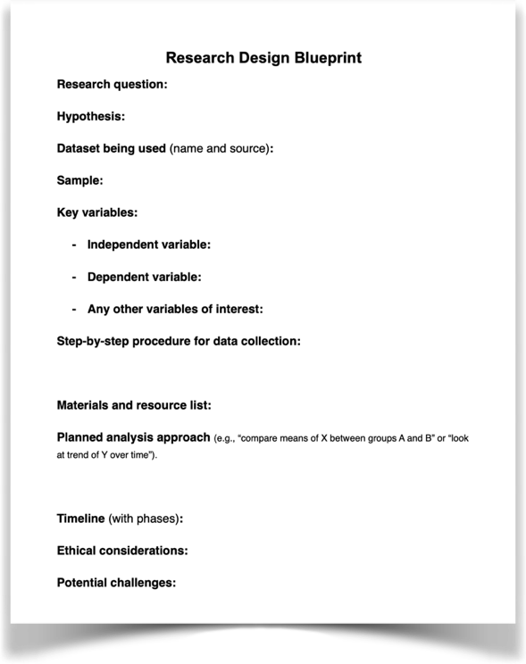
NEEDS TO BE UPDATED based on curriculum
BUT curriculum seems to be missing giving directions on reading literature over the weekend. Keep that part of this original slide.
After-Class Team Session (3:15 – 5:15 PM)
Teams work with TA / peer mentor available. Produce a tangible output before dinner. Not free time.
Complete Research Design Mission Sheet as a team — methodology, data source, sample description, potential limitations
Confirm dataset is finalized: name, source, timeframe, row/column count. If collecting primary data, finalize your instrument today
Evening Work Period (7:00 – 9:00 PM)
Individual + partner work during CTD RTA study hours. TA available for drop-in questions.
Individual reflection: What are your study's two biggest limitations? Write 3–4 sentences explaining each and how you might address them
DataCORE Journal: What is one question about your data you cannot yet answer? What analysis would you need to run?
(RcS): Draft the Methods section of your research proposal — past tense, 200–250 words, all fields from Session 5 Mission Sheet covered
Homework - Teamwork
Review: "Research Design Checklist” with your team members.
Start working on Handout 4: Research Design Blueprint. Finish first half of the items.
Continue with your lit review. Review 1-2 more articles and keep track of your resources through “Source Tracker”. Identify 2–3 of the most important or interesting findings you gathered from the literature. Share your notes with one team members.

Slide 24
NEW SLIDE NEEDED
Scientific Storytelling: Methods Paragraph Practice (10 min)
Write one sentence describing your methodology in plain language: 'This study uses secondary data from [source] to examine whether [IV] is associated with [DV] among [population].' No jargon. Read aloud.

