Slide 1
Chapter 6: Dirty Data
Detecting Data Issues and Ensuring Quality

Slide 2




The Data Cleaning Reality
80% Cleaning, 20% Analysis
Be a Data Detective
Garbage In, Garbage Out
A data detective doesn’t just run code — they verify that outputs match expectations, trace anomalies back to their source, and document every decision made.
The 2012 Reinhart-Rogoff scandal: a landmark economic paper influencing austerity policy worldwide was based on a spreadsheet with selective data exclusions. Dirty data doesn’t just affect grades — it shapes government policy.
Industry surveys consistently find 60–80% of a data scientist’s time is spent cleaning data. At companies like Airbnb and LinkedIn, entire teams are dedicated to data quality infrastructure.

Slide 3

What We'll Learn
In this chapter:
Section 1 — Types of dirty data: missing values (MCAR/MAR/MNAR), outliers, typos, inconsistent formats, duplicates, and integration errors.
Section 2 — Cleaning strategies: validation rules, systematic detection, imputation methods, deduplication, and documenting your decisions.
Section 3 — Hands-on: clean a real messy dataset in Python and R, produce a cleaning log, and verify your results.
Section 4 — Data quality in practice: professional terminology (ETL, data lineage, schema validation), consequences of dirty data, and reporting on cleaning decisions.
Throughout: use a coding agent to automate detection, generate cleaning reports, and verify that cleaned data meets quality criteria.
Identify Common Data Problems
Learn to spot missing values, outliers, typos, and inconsistencies.
Apply Cleaning Strategies
Discover methods to remove, correct, or impute problematic data.
Ensure Data Quality
Understand why clean data is essential for trustworthy analysis.

Slide 4
Chapter 6
What is “Dirty Data”? Common Data Problems

Slide 5

What is "Dirty Data"?
Dirty data: data with errors or quality problems that can mislead analysis
Like a detective with bad evidence, a researcher can be misled by faulty data
Common issues include:
Incorrect or missing values
Duplicate entries
Inconsistent formatting
Outliers or impossible values

Slide 6
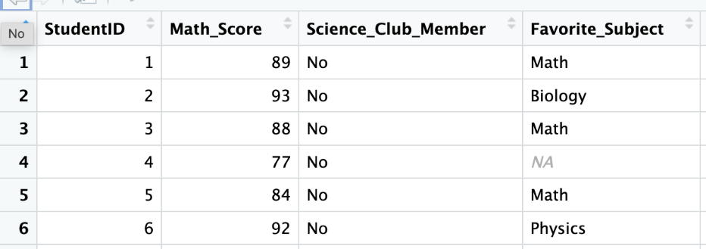
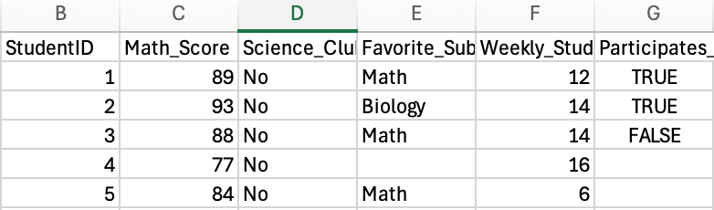
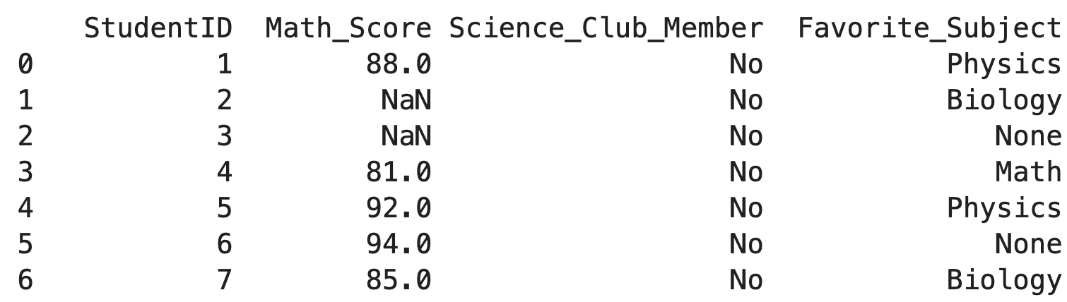
Missing Data
R
Excel
Python

Slide 7

Missing Data
Missing data = blank or null entries where info wasn’t recorded
Three types of missingness: MCAR (Missing Completely At Random — safe to ignore or impute), MAR (depends on observed data — imputation can work), MNAR (missingness predicts itself — the most dangerous; biases results systematically).
Happens often in real life—people skip survey questions or sensors glitch
Many analysis methods can’t handle missing values automatically
Too much missing data can bias resultsMNAR example: sicker patients drop out of a drug trial, making remaining data look healthier than reality. Always ask: is there a pattern to what is missing? Detection: df.isnull().mean() per column; heatmap for row-level patterns.
Detection in pandas: df.isnull().sum() per column, df.isnull().mean() for rate. Visualize with a heatmap: sns.heatmap(df.isnull(), cbar=False) shows missing patterns across rows and columns simultaneously.

Slide 8


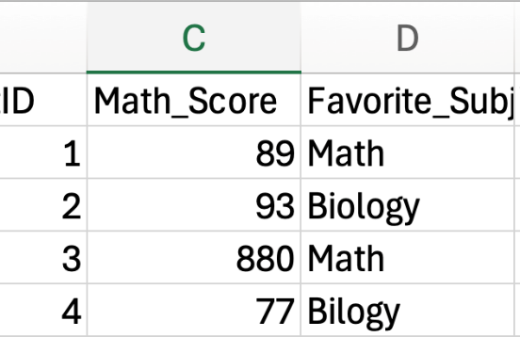

Typos & Data Entry Errors
Human Error
Misalignment
Entry errors pass a dtype check but fail a domain check — 88 is a valid integer but an impossible student age. Schema validation is necessary but not sufficient; always pair with range checks and domain knowledge.
Answers might get shifted to wrong rows when entering data manually.
Unexpected Values
Detection strategy: after computing summary statistics, always check whether min, max, mean, and std are plausible given domain knowledge. An age_max of 150 or a score_min of -5 are data detective red flags.

Slide 9
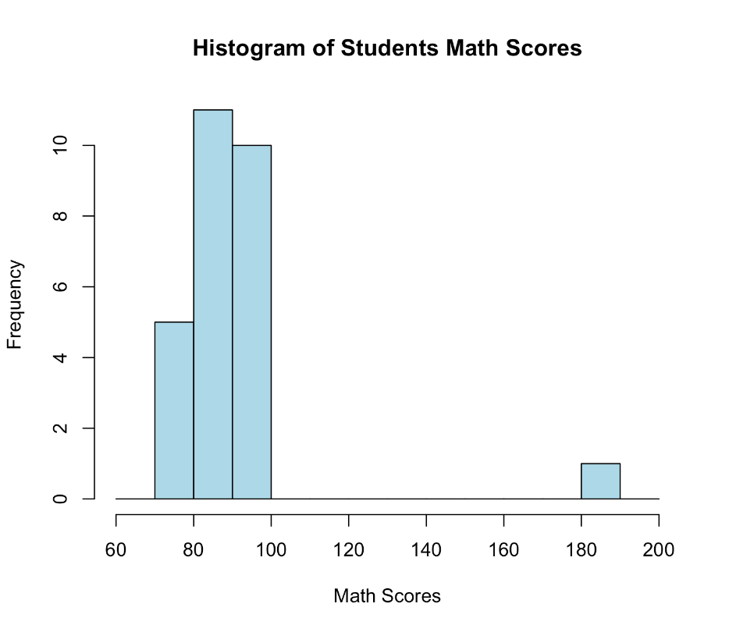
Outliers
Outlier is a value much farther from the rest of the data
Can be a real but unusual case, or a data entry mistake (e.g., age “199” or height “845”)
Outliers can distort averages and graphs
Sometimes outliers are legitimate, sometimes errors—always investigate before deciding what to do
One student scored above 180!!! Could it be true?

Slide 10




How Outliers Affect Analysis
Skew Averages
Distort Visualizations
Lead to Wrong Conclusions
One extreme value shifts the mean but not the median — this is why comparing mean and median is an outlier diagnostic. A right skew (mean > median) signals potential high outliers.
Three detection methods: (1) Domain threshold (Age>100), (2) IQR rule: outlier if value < Q1−1.5×IQR or > Q3+1.5×IQR, (3) Z-score: |z| > 3 means the value is 3 SDs from the mean.
Key decision: is this a data error (fix it) or a legitimate extreme value (keep it, note it)? A 180-point score might be a typo OR it might be a genuine exceptional student — domain knowledge determines the answer.

Slide 11








Inconsistencies in Data Format
Category Labels
Date Formats
Some responses say "Male", others say "M" - computers see these as different!
Mixing "2025-04-16" and "April 16, 2025" causes confusion in analysis.
Number Formats
Different Units
Numbers stored as text or with different separators (5,000 vs 5000).
Heights recorded in both inches and centimeters without clear labels.

Slide 12
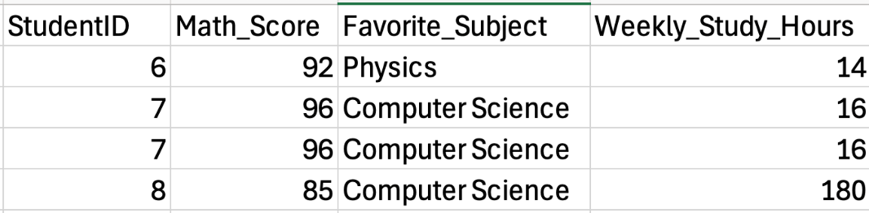
Inconsistencies in Data Format
Duplicated Values
Incorrect or Impossible Values (There is only 168 hours in a week 24*7 = 168)

Slide 13

Hidden Inconsistencies
Invisible Spaces
Case Sensitivity
Trailing/leading spaces are invisible but computationally distinct. Fix with df["col"].str.strip(). One line prevents a silent category explosion that only shows up when you check value_counts().
Case normalization: df["col"].str.lower() or .str.upper() before any groupby or merge. Without this, "Male", "male", and "MALE" count as three separate categories in your frequency tables.
Leading Zeros
Leading zero issues: ZIP codes or student IDs stored as int lose "06001" → 6001. Always store ID fields as strings (dtype=object). Check: df.dtypes and verify ID columns are not numeric.

Slide 14
Missing Documentation
What's a Data Dictionary?
Why It Matters
A document describing each variable in your dataset:
Without proper documentation, it's easy to misinterpret data.
What each field means
Units of measurement
Example: A column labeled "Temp" could be Celsius or Fahrenheit - a huge difference!
Possible values
How data was collected

Slide 15
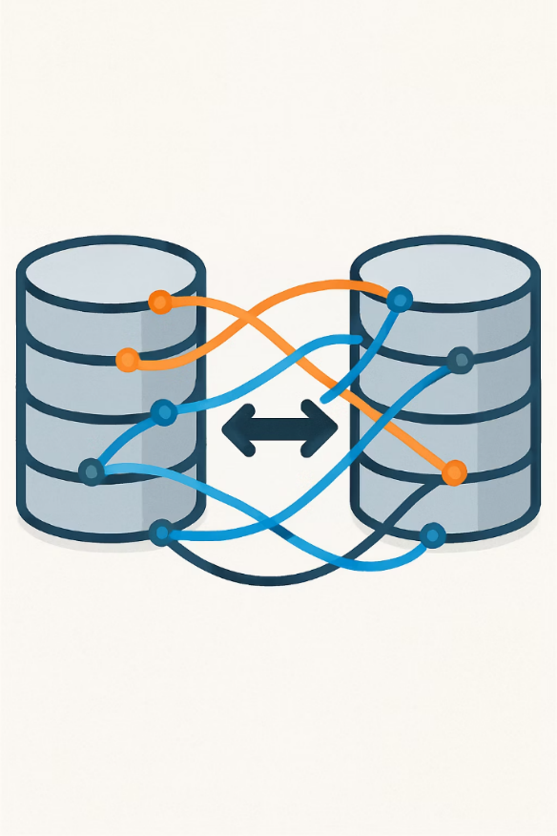



Data Integration Errors
Multiple Data Sources
Combining data from different spreadsheets or systems.
Mismatched Records
Student names get paired with wrong test scores during merging.
Hidden Problems
Records look complete but contain incorrect information.

Slide 16
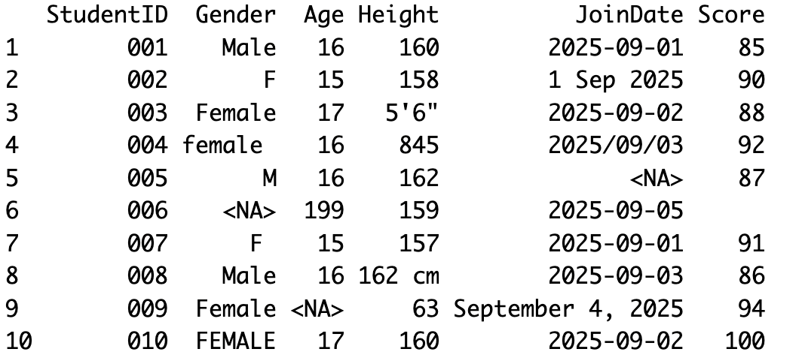
Do you see any issues here?

Slide 17
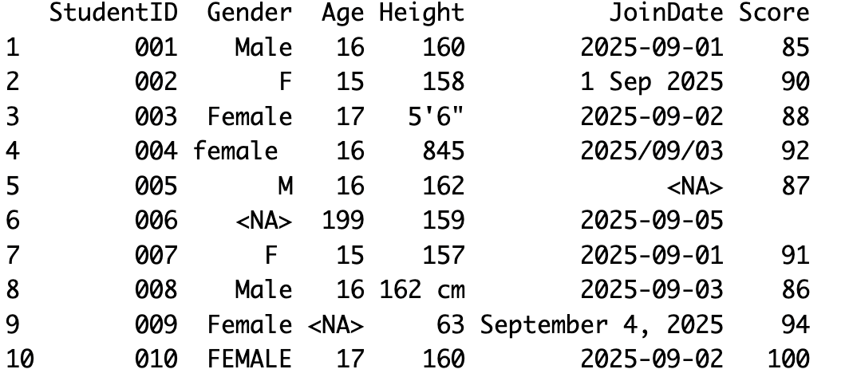
Do you see any issues here?
Gender variable: inconsistent & missing & trailing space
Age variable: outlier and missing
Height: mixed units, outlier, character in the numeric vector
Score: missing as empty string

Slide 18



Why Dirty Data Matters
Wrong Statistics
Errors lead to incorrect averages, counts, and other calculations.
Software Errors
Many analysis tools can't handle missing or incorrect data types.
Misinterpretations
Bad data leads to false conclusions and
poor decisions.

Slide 19
Chapter 6
Strategies for Cleaning Data

Slide 20
Strategies for Cleaning Data
Validate
Detect
Clean
Check if values meet expected criteria
Find problems systematically
Apply fixes consistently
Verify
Test that cleaning worked

Slide 21

Data Validation
1
Define Acceptable Ranges
2
Check Categories
Define a schema for each column: dtype (int64, float64, object, datetime), valid range (0≤GPA≤4.0), allowed categories (["M","F","Non-binary"]), and nullable (True/False). A data dictionary is the source of truth.
Schema validation in pandas: use pd.api.types.is_numeric_dtype() and df["col"].isin(valid_set). For production pipelines, libraries like Great Expectations automate schema checks across thousands of rows.
3
Verify Required Fields
4
Look for Logical Consistency
Flag any missing values in essential columns.
Cross-field consistency checks: if Birth_Year=2005 and Grade=11 these are consistent. Use assertions in code to catch violations before they propagate into analysis.

Slide 22

Finding Problems Systematically
Count Missing Values
df.isnull().sum() for counts; df.isnull().mean().round(2) for rates. Flag columns with >5% missing — they need a strategy decision (impute, drop, or document).
Sort to Find Duplicates
df.duplicated().sum() for count; df[df.duplicated(keep=False)] to see all duplicate rows. Decide key: are full-row duplicates errors, or is duplicate Student_ID with different scores a data entry vs. merge issue?
Calculate Basic Stats
df.describe() for all numerics at once. Then apply domain knowledge: Age_max=150 is impossible; Score_min=-5 is invalid; GPA_max=5.0 could be a different scale. Build an explicit range contract before cleaning.
List Unique Values
df["col"].value_counts() shows all category frequencies. df["col"].nunique() flags unexpected variety: a yes/no field showing 6 unique values has inconsistencies. Always inspect categoricals before any groupby.

Slide 23
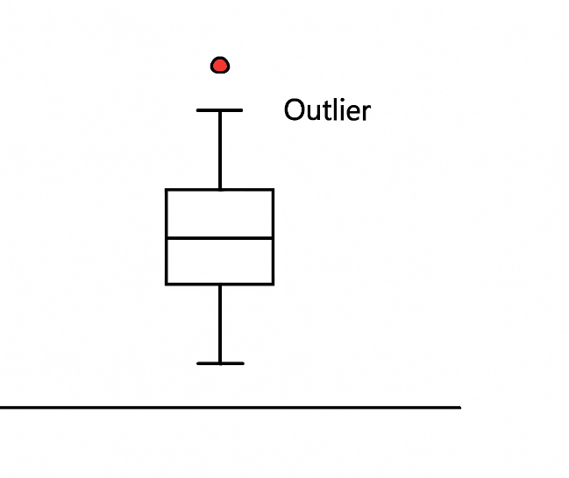
Visualizing to Find Problems
Box Plots are great for spotting outliers that fall outside the whiskers.
The isolated point above shows a clear outlier that needs investigation.

Slide 24
Handling Missing Data
Omit
Remove rows with missing values
Simple approach
Impute
Fill in with estimated values
Use mean/median or category averages
Leave as-is
Python and R excludes missing values analyses without dropping the entire record.
Works if few missing values
Can lose too much data
Or predict based on other variables
It can get sophisticated fast

Slide 25
Handling Outliers
Is it an Error?
First, determine if the outlier is a mistake or a genuine extreme value.
If It's an Error
Correct it if you know the intended value
If It Might Be Real
Keep it but use robust methods (median-based stats)
Report analyses with and without it
Cap extreme values (winsorizing)
Use median instead of mean
Remove it if you can't fix it confidently

Slide 26
Correcting Inconsistencies
Fix Typos
Correct misspellings like "Femael" to "Female" in categories.
Trim Unwanted Characters
Standardize Formats
Remove extra spaces, commas in numbers, and other problematic symbols.
Convert all dates to one format, all gender labels to one set.
Create a Data Dictionary
Define what each column should contain as a guide for cleaning.

Slide 27

Removing Duplicates
Identify Exact Duplicates
Find records that match completely across all fields.
Check for Partial Duplicates
Look for records that match on key fields but differ slightly in others.
Decide Which to Keep
For partial duplicates, determine which record is more complete or accurate.

Slide 28

Removing Duplicates
Identify Exact Duplicates
Find records that match completely across all fields.
Check for Partial Duplicates
Look for records that match on key fields but differ slightly in others.
Decide Which to Keep
For partial duplicates, determine which record is more complete or accurate.

Slide 29

Document Your Cleaning
Keep a Log
Note Decisions
Record all changes made: "Replaced missing scores with class average"
Explain why you chose certain approaches: "Removed outliers above 3 standard deviations"
Track Impact
Note how cleaning affected results: "Average age changed from 43 to 17 after fixing errors"

Slide 30

Test Your Cleaned Data
1
Check for Remaining Issues
Are there still missing values or outliers you meant to address?
2
Verify Basic Statistics
Do averages, minimums, and maximums now look reasonable?
3
Confirm Categories
Are all categorical values now consistent and correctly spelled?
4
Count Records
Does the number of records match what you expect after cleaning?

Slide 31
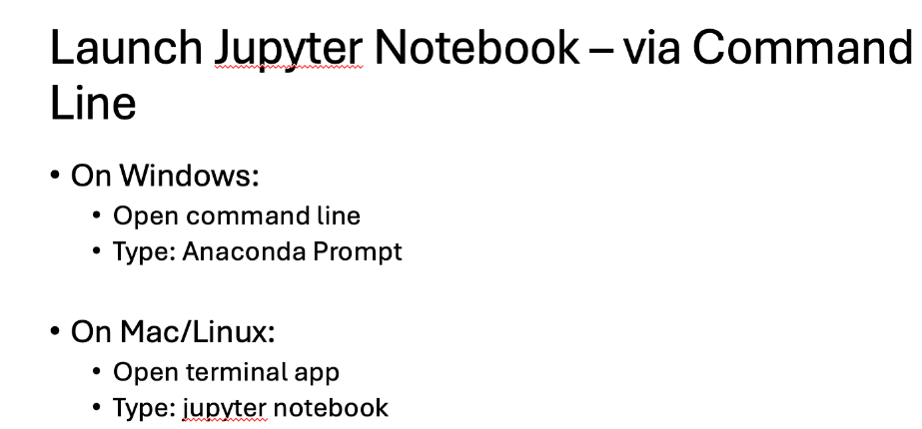
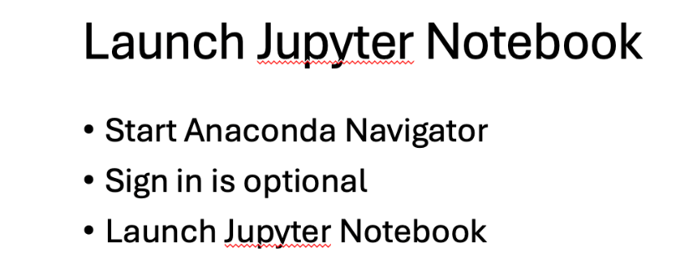
Let’s Do It!!!
Open Python!
Do you remember how to do it?
Slides from Ch 4:

Slide 32
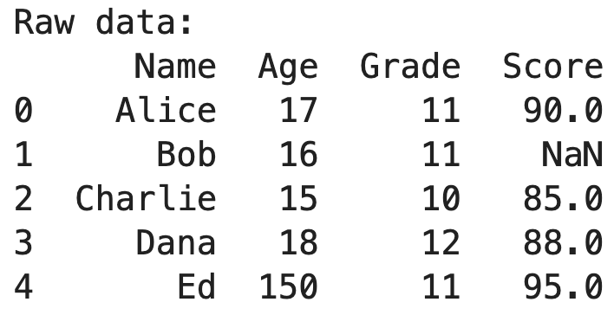
Create your messy data!
This code will call pandas package
Create a data frame with Bob’s score is missing and Ed’s sooo old!
import pandas as pd
data = {
'Name': ['Alice', 'Bob', 'Charlie', 'Dana', 'Ed'],
'Age': [17, 16, 15, 18, 150],
'Grade': [11, 11, 10, 12, 11],
'Score': [90, None, 85, 88, 95]
}
df = pd.DataFrame(data)
print("Raw data:")
print(df)

Slide 33
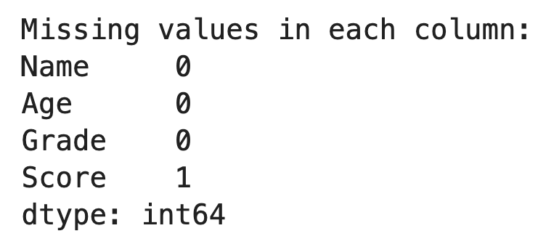
Check the missing
We have only 5 students and 4 columns in this data. It’s easy to find the issues with naked eye.
Think if you had 1,000,000 rows and 10,000 columns
Let’s check the missing now!
🤯
print("\nMissing values in each column:")
print(df.isna().sum())

Slide 34
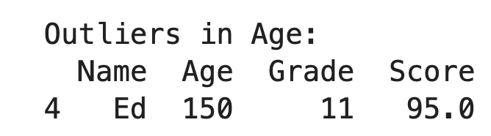
Check outliers
Three detection methods: (1) Domain threshold (Age>100), (2) IQR rule: flag if value < Q1−1.5×IQR or > Q3+1.5×IQR (robust to skew), (3) Z-score: |z|>3 (best for normal distributions). Here we use a domain threshold
# Identify outliers in Age (say anything > 100 is suspicious)
outliers = df[df['Age'] > 100]
print("\nOutliers in Age:")
print(outliers)

Slide 35
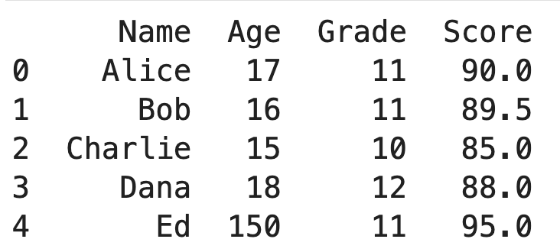
Let’s Clean
Fill Bob’s Score with the mean of other scores, and fix Ed’s age.
# Fill missing Score with mean of existing scores
mean_score = df['Score'].mean(skipna=True) # skipna ignores NaN
df.fillna({'Score':mean_score}, inplace=True)

Slide 36
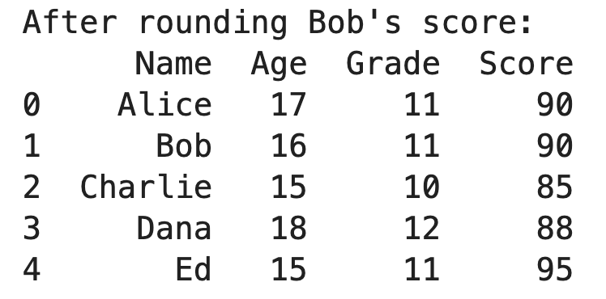
Let’s Clean 2
All the scores are integer, let’s convert Bob’s 89.5 to an integer for consistency
df['Score'] = df['Score'].round(0).astype('Int64') # round and make integer (using pandas Int64 type to allow NA if any)
print("\nAfter rounding Bob's score:")
print(df)

Slide 37
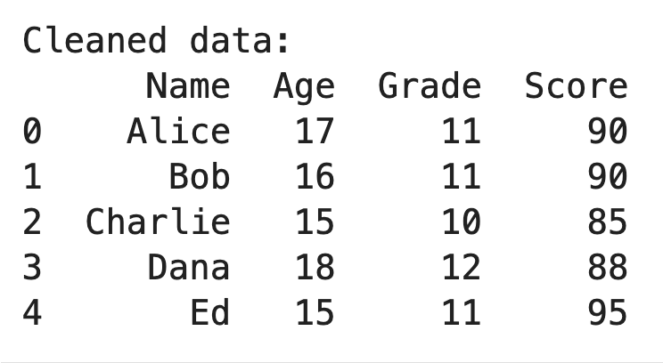
Let’s Clean 3
This replaces all the Age values higher than 100 with 15.
# Fix outlier Age (assume it's a typo and should be 15)
df.loc[df['Age'] > 100, 'Age'] = 15
print("\nCleaned data:")
print(df)

Slide 38
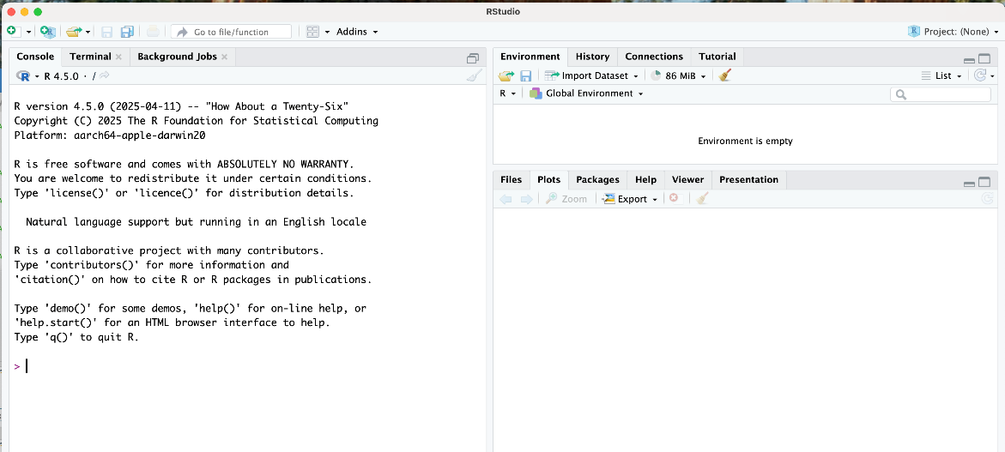
Let’s Try it with R
Do you remember how to start R?
Just run RStudio!

Slide 39
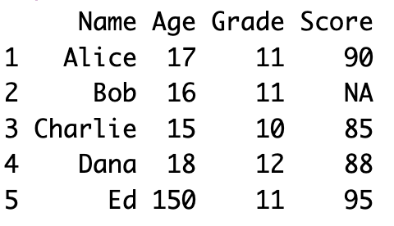
Create the data
# Create the data.frame
df <- data.frame(
Name = c("Alice", "Bob", "Charlie", "Dana", "Ed"),
Age = c(17, 16, 15, 18, 150),
Grade = c(11, 11, 10, 12, 11),
Score = c(90, NA, 85, 88, 95), # use NA for missing
stringsAsFactors = FALSE # keep character columns as character
)
# Print it out
cat("Raw data:\n")
print(df)

Slide 40
Missing and Outlier
In R, is.na function find the missing value.
Here how to impute mean for missing and replace the age over 100 with 15.
df$Score[is.na(df$Score)] <- mean(df$Score, na.rm=TRUE)
df$Age[df$Age > 100] <- 15

Slide 41
Key cleaning functions/techniques (summary)
Python
filtering for outliers (e.g., df[df['col'] > value]),
unique()summary(df) for quick check descriptives
is.na() for missing,
R
.isna()
.fillna() assignment for imputation
.drop_duplicates() checks for duplicates
df.describe() in pandas

Slide 42
Chapter 6
Why Data Quality is Critical: Trustworthy Analysis

Slide 43
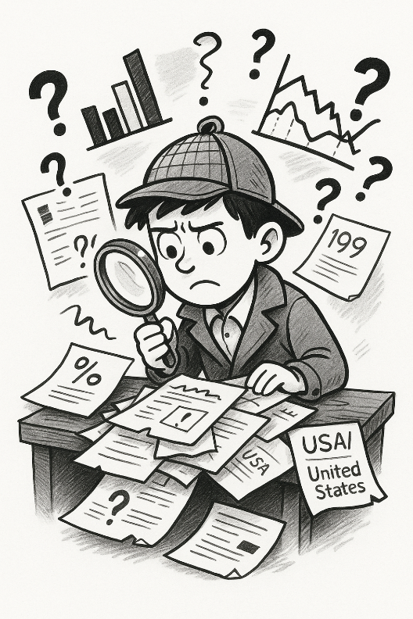
Why Data Quality is Critical: Trustworthy Analysis
Like a building needs a solid foundation, analysis needs clean data.
Even the best analysis methods can't save bad data. Garbage in, garbage out.
Clean data makes your findings credible to others.

Slide 44

Consequences of Dirty Data
Misguided Decisions
Real case: a software company’s churn model trained on duplicate customer records predicted 40% lower churn — overprovisioning servers by $2M annually before the duplication was caught.
Erroneous Research
Reinhart-Rogoff (2013): a landmark economics paper cited by governments worldwide to justify austerity was based on a spreadsheet that excluded certain country-years from a key calculation. A grad student found the error. Policy was already enacted.
Loss of Trust
The credibility multiplier: one discovered error makes everyone doubt the entire analysis. Clean data builds trust; dirty data destroys it — and the destruction is asymmetric (hard to rebuild).
Wasted Effort
Redoing analysis after discovering data issues wastes valuable time.

Slide 45




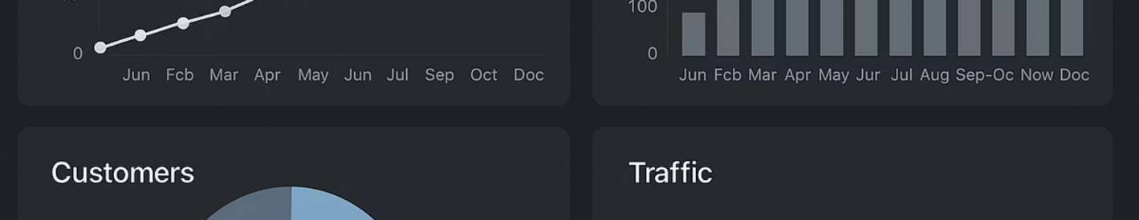
Benefits of Clean Data
Reveals True Patterns
Enables Integration
Clean data lets you see actual trends without distortion from errors.
Standardized data can be combined with other sources for richer analysis.
Saves Time Later
Improves Visualizations
Investing in cleaning prevents rework and troubleshooting during analysis.
Charts and graphs based on clean data are more accurate and informative.

Slide 46
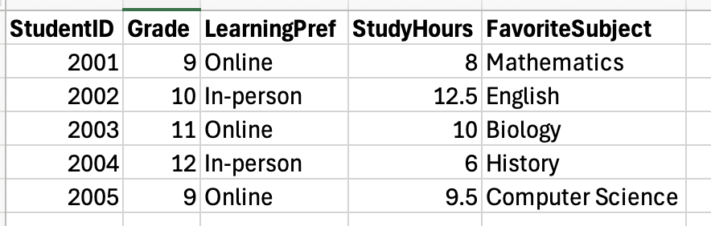
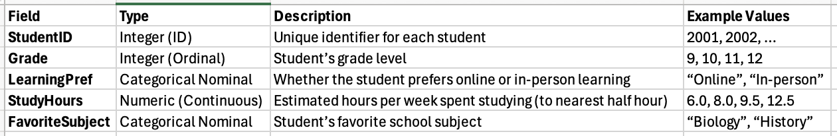
Important Tip!
Creating a data dictionary and validating data against it helps maintain quality.
Data Dictionary

Slide 47





Professional Data Cleaning Terms
ETL
Data Wrangling
Data Profiling
Extract, Transform, Load — the pipeline that moves data from source systems (databases, APIs) through cleaning and transformation into analytical stores. A broken ETL job is often the root cause of data quality incidents.
Informal term for the hands-on work of cleaning — filtering, reshaping, joining, and transforming raw data until it’s fit for analysis. In Python: pandas; in R: dplyr/tidyr.
Systematic examination of a dataset to understand structure (schemas, dtypes), content (distributions, frequency tables), and quality (missing rates, outliers). Always the first step before cleaning.
Data Preprocessing
Broader than wrangling: includes feature engineering, normalization, encoding, and train/test splitting. In ML workflows, preprocessing pipelines are often codified to ensure consistency between training and production data.

Slide 48
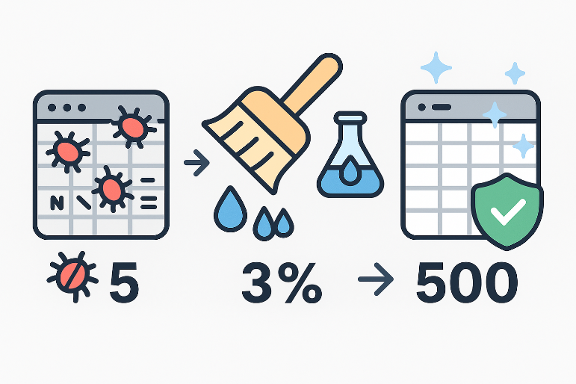
When You Write a Report
Explain the cleaning process. Such as;
“After cleaning the data, we found and corrected 5 data entry errors and filled 3% missing values using domain-appropriate methods. The cleaned dataset of 500 responses was then analyzed…”.
Professional standard: always report (1) raw dataset dimensions, (2) final cleaned dimensions, (3) what was removed and why, (4) how missing values were handled (method and imputed count), (5) any assumptions made. Omitting this is a reproducibility failure.

Slide 49
Chapter 6
Group Activity

Slide 50
Group Activity – Data Cleaning
Your Data: messy_school_data.csv
Use either Python or R.
Identify all the issues and perform the cleaning steps.
Create a log report.

Slide 51
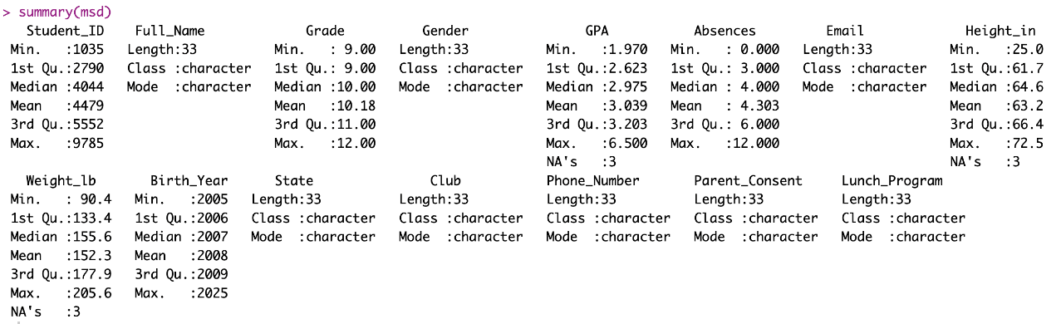
Group Activity with R – Example Answer
Read the dataset (don’t forget to change the path or save the csv data to your working directory)
msd <- read.csv("messy_school_data.csv")
Check the summary statistic
summary(msd)

Slide 52
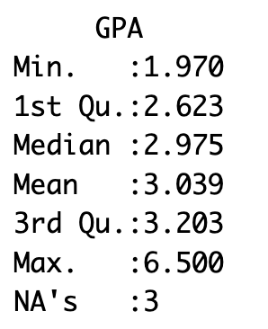
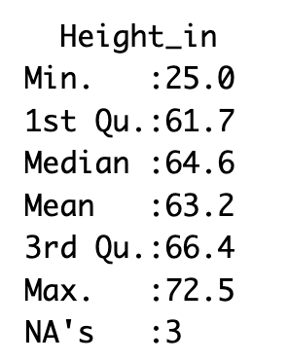
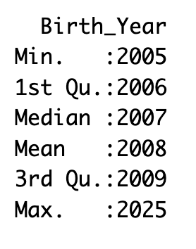
Group Activity with R – Example Answer
You will see the issues for the numeric variables
Max GPA is 6.5!!! Doesn’t look right.
Smallest height is 25 inches!!
There is a student born in 2025?

Slide 53
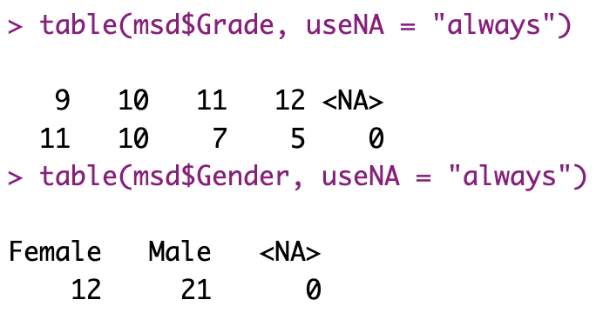
Group Activity with R – Example Answer
Let’s check the categorical variables using table function, which provides frequency.
We can write a function or loop to check each variable, but for simplicity let’s do it one by one.

Slide 54
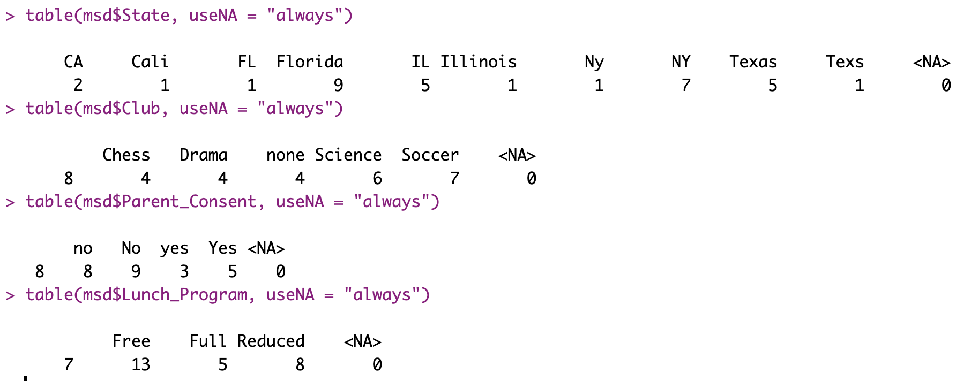
Group Activity with R – Example Answer

Slide 55
Group Activity with R – Example Answer
State variable has both CA and Cali, FL and Florida, IL and Illinois, Ny and NY, Texas and Texs categories. These categories should be combined.
Club variable has none category, which might be missing or No club association.
Parent Consent has, no and No, yes and Yes.

Slide 56
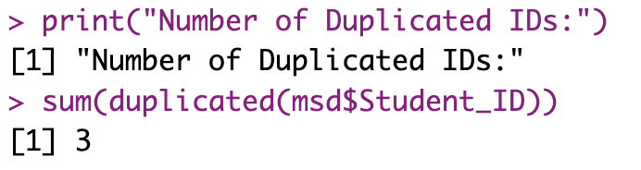
Group Activity with R – Example Answer
Check duplicates!
In R, use duplicated function (returns TRUE or FALSE)
Let’s check if there are any duplicated IDs
print("Number of Duplicated IDs:")
sum(duplicated(msd$Student_ID))
There are three duplicated student IDs, let’s find them

Slide 57
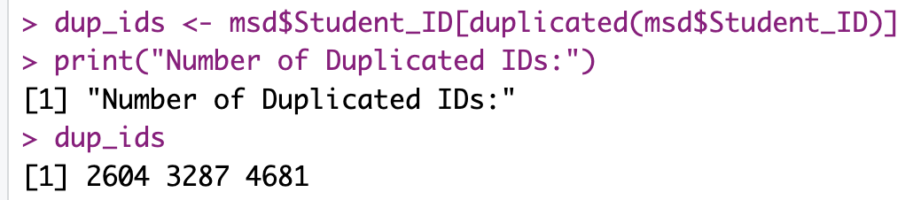
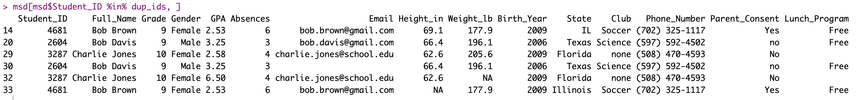
Group Activity with R – Example Answer
Let’s find which students are duplicated
dup_ids <- msd$Student_ID[duplicated(msd$Student_ID)]
print("Duplicated IDs:")
dup_ids

Slide 58
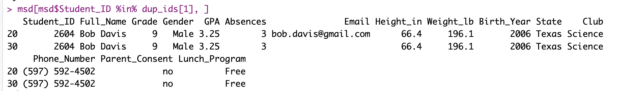
Group Activity with R – Example Answer
Let’s decide which row to select, we have only 3 rows here, if you have more it’s better to automize.
Let’s check duplicated ID =1
Row 30 doesn’t have the email the rest is the same. Let’s get rid of line 30. But first, check other.

Slide 59
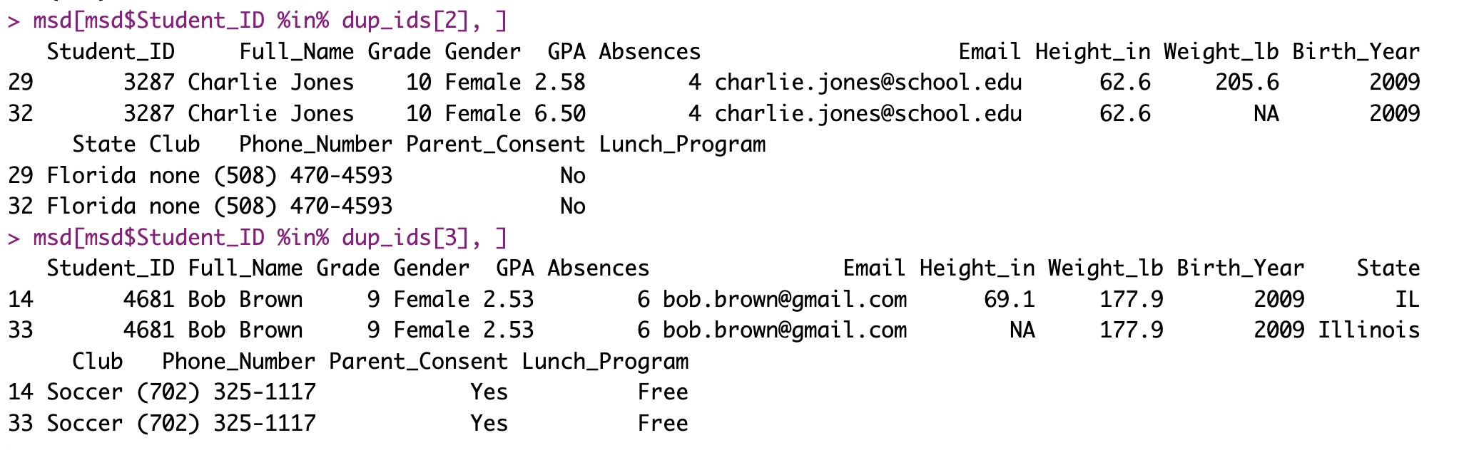
Group Activity with R – Example Answer
Decide which rows we should remove

Slide 60
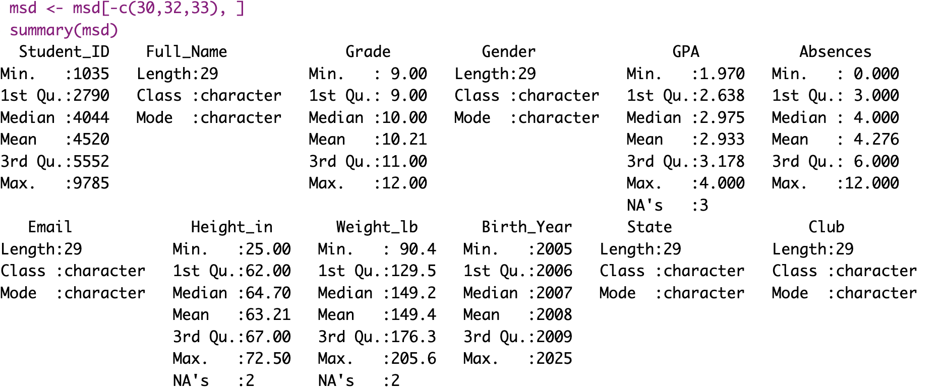
Group Activity with R – Example Answer
Remove rows 30, 32, 33 and some issues are already been resolved

Slide 61
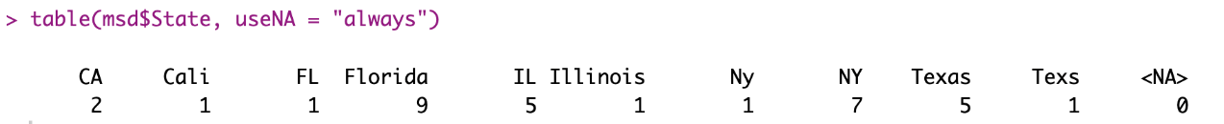
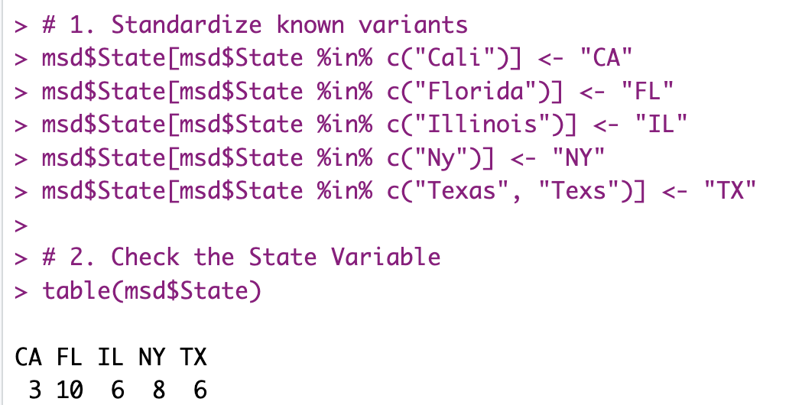
Group Activity with R – Example Answer
Fix the categories
# 1. Standardize known variants
msd$State[msd$State %in% c("Cali")] <- "CA"
msd$State[msd$State %in% c("Florida")] <- "FL"
msd$State[msd$State %in% c("Illinois")] <- "IL"
msd$State[msd$State %in% c("Ny")] <- "NY"
msd$State[msd$State %in% c("Texas", "Texs")] <- "TX"
# 2. Check the State Variable
table(msd$State)

Slide 62
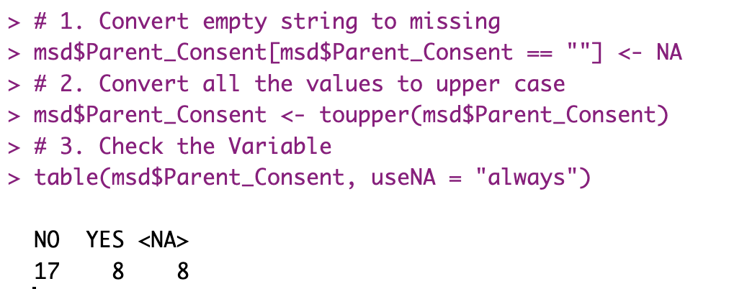
Group Activity with R – Example Answer
# 1. Convert empty string to missing
msd$Parent_Consent[msd$Parent_Consent == ""] <- NA
# 2. Convert all the values to upper case
msd$Parent_Consent <- toupper(msd$Parent_Consent)
# 3. Check the Variable
table(msd$Parent_Consent, useNA = "always")

Slide 63
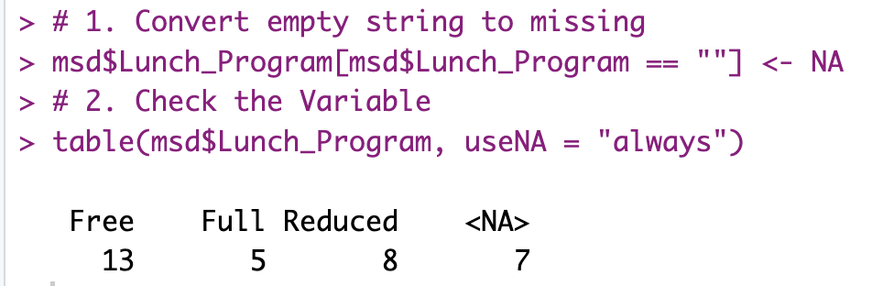
Group Activity with R – Example Answer
Lunch program variable

Slide 64
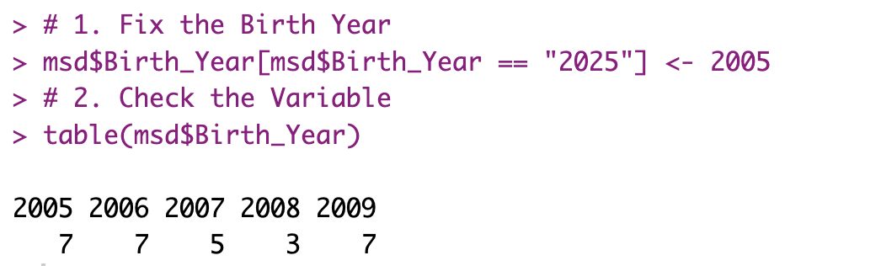
Group Activity with R – Example Answer
Birth year should 2005 instead of 2025 for the 11th grader

Slide 65
Group Activity with R – Example Answer
Check the height
Let’s sort it, 25 seems a bit short, we don’t know what it can be. We can either remove (make it missing) or impute a mean value

Slide 66
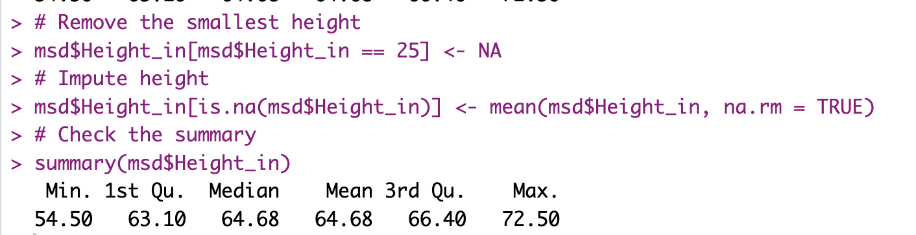
Group Activity with R – Example Answer
Let’s erase it, we will impute later
# Remove the smallest height
msd$Height_in[msd$Height_in == 25] <- NA
# Impute height
msd$Height_in[is.na(msd$Height_in)] <- mean(msd$Height_in, na.rm = TRUE)
# Check the summary
summary(msd$Height_in)

Slide 67
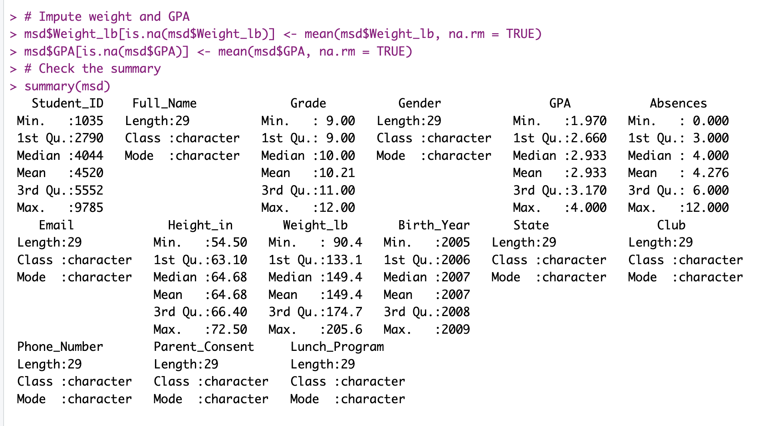
Group Activity with R – Example Answer
Impute weight and GPA, and check the summary
# Impute weight and GPA
msd$Weight_lb[is.na(msd$Weight_lb)] <- mean(msd$Weight_lb, na.rm = TRUE)
msd$GPA[is.na(msd$GPA)] <- mean(msd$GPA, na.rm = TRUE)
# Check the summary
summary(msd)

Slide 68
Log Record
Step | Activity | Description
1 | Import & Initial Inspection | • Read “messy_school_data.csv”• Viewed head() and summary() • Ran frequency tables for Grade, Gender, State, Club, Parent_Consent, Lunch_Program
2 | Duplicate ID Check | • Counted duplicated Student_ID • Identified repeated IDs • Reviewed rows for each duplicate
3 | Remove Duplicate Rows | • Dropped rows 30, 32, 33
4 | State Standardization | • Replaced “Cali”→“CA”, “Florida”→“FL”, “Illinois”→“IL”, “Ny”→“NY”, “Texas”/“Texs”→“TX”
5 | Parent_Consent Cleaning | • Converted "" to NA• Upper-cased all entries
6 | Lunch_Program Cleaning | • Converted "" to NA
7 | Birth_Year Correction | • Changed erroneous “2025” entries to 2005
8 | Height_in Outlier Handling | • Detected low value 25″ as outlier • Replaced 25 with NA • Imputed missing with mean
9 | Weight_lb & GPA Imputation | • Filled NA in Weight_lb and GPA with their respective column means
10 | Final Verification | • Reviewed summary() on cleaned data • Checked frequency counts for key fields

Slide 69
Group Activity with R – Quick Note
There is no single way of cleaning data.
You can make write more sophisticated codes, create function to work with all the variables, for many possible scenarios.
In this example, we wanted to show you step by step process, which was a lot of coding.

Slide 70
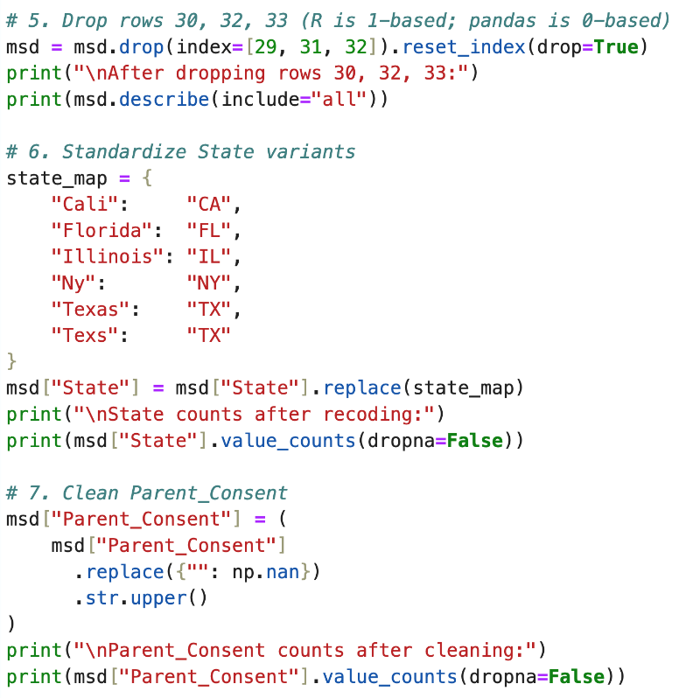
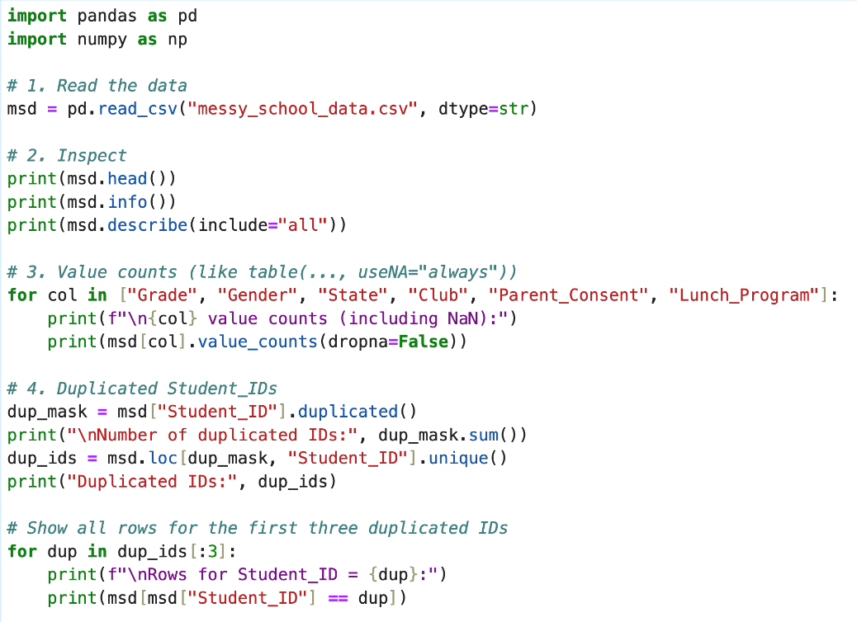
Group Activity Answer with Python

Slide 71
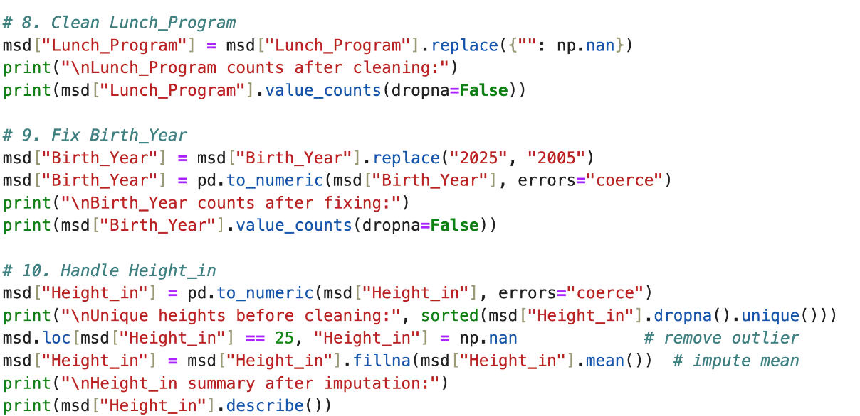
Group Activity Answer with Python

Slide 72
Chapter 6
Chapter 6 Summary

Slide 73

Data Quality Importance Review
80%
Fit-for-Purpose
Cleaning Time
Accuracy
Percentage of time data scientists typically spend on cleaning data.
Data quality is contextual: financial transactions may require near-perfect accuracy; survey data tolerates 5% missingness. The goal is data that is fit for the specific analytical purpose.
0
Tolerance
Amount of dirty data acceptable in critical applications like healthcare.

Slide 74
Coding Tools Review
Python (pandas)
R
df.isna() - Find missing values
is.na() - Find missing values
df.fillna() - Replace missing values
mean(x, na.rm=TRUE) – Calculate mean ignoring NA
df.drop_duplicates() - Remove duplicates
unique() - Find unique values
df.replace() - Fix incorrect values
gsub() - Replace text patterns

Slide 75

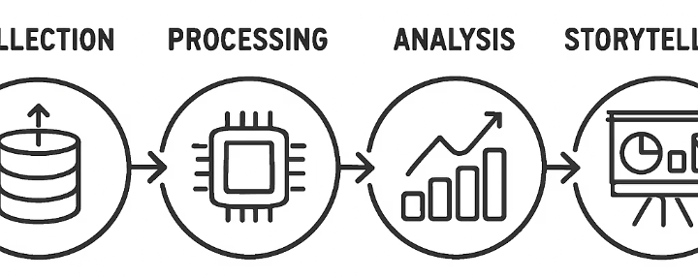



From Detective to Storyteller
Collect Data
Gather information through surveys, experiments, or existing sources.
Clean Data
Ensure data quality by fixing errors and inconsistencies.
Analyze Data
Apply statistical methods and visualizations to find patterns.
Tell the Story
Communicate insights in a compelling, understandable way.

Slide 77
Chapter 6: Dirty Data
Coding Agents for Data Quality & Cleaning
Detecting Data Issues and Ensuring Quality

Slide 78
Using a Coding Agent for Data Auditing
A coding agent can automate your entire data audit — but you must interpret the results:
Weak: "Clean this CSV." → Agent guesses at issues without domain context.
Strong: "Load messy_school_data.csv. For each column: (1) report dtype, (2) count missing values and compute missing rate, (3) list all unique values for categorical columns, (4) report min/max/mean/std for numerical columns. Flag any column where the missing rate exceeds 5% or the max value is implausible given the column name."
Key verification steps after the agent runs:
Check that df.shape before and after cleaning match your expectations. Did the agent drop rows you wanted to keep?
Ask: "How many rows were removed? What was the original row count vs. cleaned row count? Were any columns modified? Print a before/after comparison for each changed column."
Always run the cleaning log prompt: "Produce a numbered step-by-step log of every change made to the dataset, including the old value, new value, and the reason."

Slide 79
Automated Outlier Detection with a Coding Agent
Ask for all three outlier detection methods simultaneously:
"For each numerical column in the dataset, apply three outlier detection methods: (1) domain threshold (flag Age>100, GPA>4.0, Height_in<40 or >90), (2) IQR rule (Q1-1.5*IQR, Q3+1.5*IQR), and (3) z-score |z|>3. For each flagged value, print the row, the column, and which method(s) flagged it."
The agent will produce a table of suspicious values across all methods. Your job: evaluate each one using domain knowledge. Is Age=150 a typo or a data entry error? Is Height_in=25 an infant or a measurement error?
The critical question you must answer (not the agent):
For each outlier: is it a data error (fix it), a legitimate extreme value (keep it and note it), or ambiguous (make it missing and document the decision)?
Pro tip: ask the agent to plot a box plot and histogram for each flagged column. Visual confirmation prevents you from acting on a false positive from a single detection method.

Slide 80
Hands-On: Agent-Assisted Cleaning of messy_school_data.csv
Activity (pairs, 25 minutes):
Step 1 — Audit: Prompt the agent to produce a full data quality report (dtypes, missing rates, unique values, min/max). Review every output before proceeding. Flag anything that looks wrong.
Step 2 — Detect: Ask the agent to apply IQR outlier detection to all numerical columns and list all unique values for all categorical columns. Identify at least 3 issues beyond what the original slides showed.
Step 3 — Clean: Direct the agent to fix each issue one at a time. After each fix, verify with df.describe() or value_counts() that the fix worked correctly and didn’t introduce new problems.
Step 4 — Log: Ask the agent to produce a numbered cleaning log in the professional format from slide 68. Compare your log to the example answer.
Challenge: find one issue the original example answer missed. Use the agent to detect it and fix it.

Slide 81
Chapter 6: What You Can Do Now
Dirty data recognition:
✓ Identify the six dirty data types (missing MCAR/MAR/MNAR, outliers, typos, format inconsistencies, duplicates, integration errors) and explain how each distorts analysis differently.
Data cleaning skills:
✓ Clean a real dataset in Python using df.isnull().sum(), .str.strip(), .str.lower(), fillna(), IQR outlier detection, and drop_duplicates(). Produce a professional cleaning log.
✓ Clean the same dataset in R using is.na(), mean(na.rm=TRUE), toupper(), and duplicated(). Understand equivalent operations across both languages.
Data quality thinking:
✓ Apply a data quality checklist before any analysis. Report cleaning decisions transparently including row counts, missing rates, and imputation methods used.
✓ Direct a coding agent to automate data auditing and outlier detection, verify its outputs, and catch cases where the agent made a plausible-but-wrong cleaning decision.

