Slide 1
Chapter 7: Data Wrangling in Action

Slide 2
By the end of this chapter you will be able to:
1. Detect, evaluate, and handle missing values using listwise deletion and mean/median imputation — and explain which method is appropriate given the missingness type (MCAR vs. MNAR).
2. Apply the IQR method to detect outliers programmatically in both Python and R, and choose from four evidence-based handling strategies.
3. Standardize date formats and text inconsistencies using pd.to_datetime(), str.strip(), and regex replacement.
4. Filter, select, and reshape DataFrames using boolean indexing, .query(), and column selection.
5. Combine datasets using all four join types (inner, left, right, full) and vertical concatenation (append/bind_rows).
6. Apply the 8-step data cleaning checklist to a real messy dataset and document every decision in a cleaning log.

Slide 3
Detecting Missing Values - R
In R, is.na() returns TRUE for missing (NA) values and FALSE otherwise
Summing the result counts the total NAs, since TRUE = 1 and FALSE = 0 in R
# Create a sample vector of scores with some NAs
scores <- c(88, 92, NA, 75, 90, NA, 85)
# Check which elements are NA
is.na(scores)
# [1] FALSE FALSE TRUE FALSE FALSE TRUE FALSE
# Count how many NAs
sum(is.na(scores))
# [1] 2

Slide 4
Detecting Missing Values - Python
import pandas as pd
# Create a pandas Series of scores with some NaN values
scores = pd.Series([88, 92, None, 75, 90, None, 85])
# Check which entries are null
scores.isnull()
# 0 False
# 1 False
# 2 True
# 3 False
# 4 False
# 5 True
# 6 False
# dtype: bool
# Count how many null values
scores.isnull().sum()
# 2
In Python’s pandas, isnull() (or equivalently isna()) returns a Series of booleans indicating missing values.
We then use .sum() to count the True values.

Slide 5
Removing Missing Data
Listwise deletion (complete-case analysis): removes any row containing at least one missing value. Simple and guaranteed complete data — but valid only if data is MCAR (Missing Completely At Random).
Advanced: dropna(thresh=k) keeps rows with at least k non-null values — useful when you can tolerate some missingness. dropna(subset=[’col’]) targets specific columns only.
Simple and guarantees no missing values remain
Downside: if lots of data is missing, you lose a lot of cases
Critical: if missingness is MNAR (e.g., low scorers more likely to skip), listwise deletion inflates the apparent average. Always check whether completers differ from non-completers before deleting rows.

Slide 6
Two Ways to Handle Missing Data
Remove Missing Data
Impute Missing Data
﻿﻿Simple approach
﻿﻿Ensures complete data
﻿﻿Risk: Could lose too much data
Delete rows with missing values.
Fill in the blanks with estimated values.
﻿﻿Preserves data quantity
﻿﻿Methods: mean, median, mode
﻿﻿Risk: Added values aren't real

Slide 7
Removing Missing Data in R
The drop_na function in tidyr package removes any rows with NA values.
Option 1
Install.packages("tidyr") # If you don’t already installed it
library(tidyr)
# Suppose df is a data frame with some NAs
clean_df <- drop_na(df)
# This will drop any rows of df that contain NA in any column.
Option 2
clean_df <- na.omit(df)

Slide 8
Removing Missing Data in Python
Pandas provides the dropna() method for DataFrames.
df.dropna(how='all') would drop only rows that are completely empty
df.dropna(subset=['col1','col2']) would drop rows missing data in specific columns of interest.
# Assume df is a pandas DataFrame with some missing values
clean_df = df.dropna()
# By default, this drops any row with any NaN in it.

Slide 9
Let’s Do It!
Read the students_scores.csv data
Check the dimensions of the data
Remove missing students
Check the dimensions again
How many rows did you lose?

Slide 10
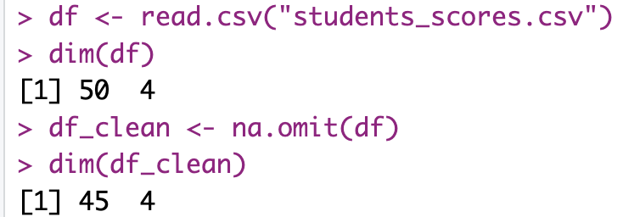
R
df <- read.csv("students_scores.csv")
dim(df)
df_clean <- na.omit(df)
dim(df_clean)

Slide 11
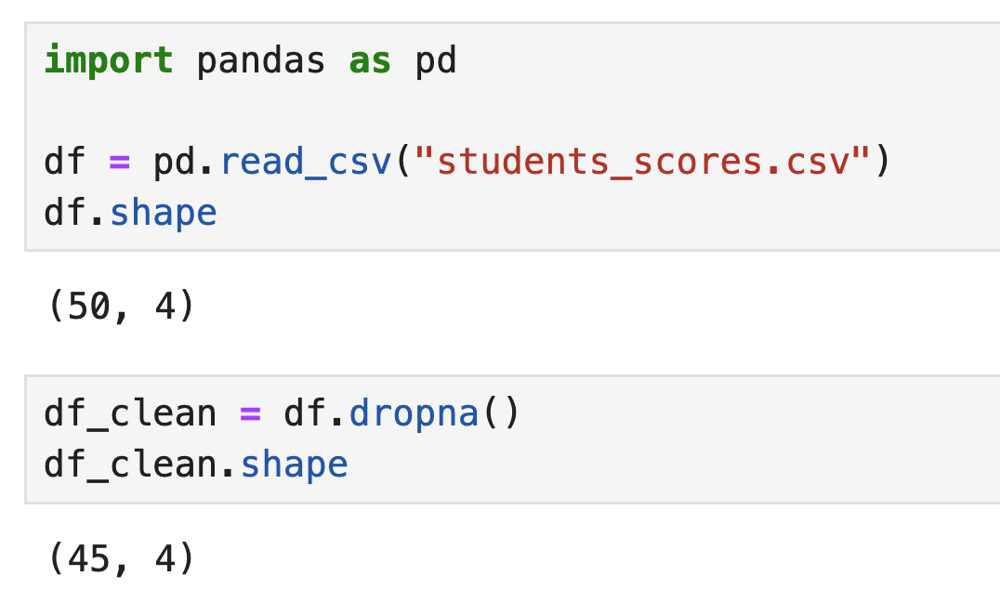
Python
import pandas as pd
df = pd.read_csv("students_scores.csv")
df.shape
df_clean = df.dropna()
df_clean.shape

Slide 12
Imputing Missing Data (Filling in the Blanks)
Imputationreplaces missing values with estimates — but every method makes assumptions. Mean imputation reduces variance and inflates correlations. Choose method based on why data is missing (MCAR/MAR/MNAR).
Strategies from simple to advanced:
Use a static value (e.g., 0 or “Unknown”)
Fill with the mean or median (for numeric data)
For time-series: use forward fill (last value) or backward fill (next value)
MCAR data: mean/median imputation is defensible. MAR data: regression imputation or KNN imputation (fill with average of k nearest neighbors). MNAR data: no simple fix — document and report the limitation.
Mean imputation warning: replacing 20% of a variable with its mean artificially shrinks the standard deviation and inflates correlations with other variables. Always report the imputation method and percentage imputed.

Slide 13
Let’s Practice with R
Option 1
scores <- c(88, 92, NA, 75, 90, NA, 85)
# Calculate mean of scores, excluding NA (na.rm = TRUE to remove NAs in calculation)
mean_score <- mean(scores, na.rm = TRUE)
mean_score
# [1] 86
# Replace NA values with the mean
scores_filled <- ifelse(is.na(scores), mean_score, scores)
scores_filled
# [1] 88.0 92.0 86.0 75.0 90.0 86.0 85.0
Option 2
library(tidyr)
scores_filled <- replace_na(scores, mean_score)

Slide 14
Let’s Practice with Python
scores = pd.Series([88, 92, None, 75, 90, None, 85])
# Calculate mean of the scores (ignoring NaN by default)
mean_score = scores.mean()
mean_score
# 86.0
# Fill NaN values with the mean
scores_filled = scores.fillna(mean_score)
scores_filled
# 0 88.0
# 1 92.0
# 2 86.0
# 3 75.0
# 4 90.0
# 5 86.0
# 6 85.0
# dtype: float64

Slide 15

Identifying and Handling Outliers
What Are Outliers?
Examples
Values that deviate markedly from the rest of the distribution. Important: outliers are not inherently wrong — they may be legitimate extreme values (record-breaking athlete), data errors (typo), or evidence of a completely different process.
A student's height recorded as 300 cm or a survey response of "50" on a scale of 1-5.
Why They Matter
Effect on statistics: a single outlier can shift the mean by several standard deviations while leaving the median unchanged. This is why comparing mean and median is an outlier diagnostic — divergence signals potential outliers.

Slide 16
What Counts as an Outlier? – The IQR Method
Find Q1 and Q3
Calculate the first quartile (25th percentile) and third quartile (75th percentile).
Calculate IQR
Interquartile Range = Q3 - Q1
Set Thresholds
Lower threshold = Q1 - 1.5*IQR
Upper threshold = Q3 + 1.5*IQR
Identify Outliers
Any value below the lower threshold or above the upper threshold is an outlier.

Slide 17
Let’s Practice with R
# Sample data: homework minutes for a class of students
homework_minutes <- c(120, 90, 100, 95, 110, 105, 115, 300)
summary(homework_minutes)
# Min. 1st Qu. Median Mean 3rd Qu. Max.
# 90 95 105 129.4 115 300
# Calculate Q1, Q3, and IQR
Q1 <- quantile(homework_minutes, 0.25)
Q3 <- quantile(homework_minutes, 0.75)
IQR_val <- IQR(homework_minutes) # which is Q3 - Q1
Q1; Q3; IQR_val
# Q1 = 95, Q3 = 115, IQR = 20
# Determine the outlier thresholds
lower_thresh <- Q1 - 1.5 * IQR_val # 95 - 30 = 65
upper_thresh <- Q3 + 1.5 * IQR_val # 115 + 30 = 145
lower_thresh; upper_thresh
# lower_thresh = 65, upper_thresh = 145
# Find values outside these thresholds
homework_minutes[homework_minutes < lower_thresh | homework_minutes > upper_thresh]
# [1] 300
In the example, Q1 = 95 and Q3 = 115, so the IQR (interquartile range) is 20
Outlier thresholds: below 65 or above 145 minutes (using 1.5 × IQR rule)
Most values fall within 65–145 minutes
One value, 300 minutes, is flagged as an outlier
This could be a data entry error or a very unusual case

Slide 18
Let’s Practice with Python
import numpy as np
homework_minutes = np.array([120, 90, 100, 95, 110, 105, 115, 300])
Q1 = np.percentile(homework_minutes, 25)
Q3 = np.percentile(homework_minutes, 75)
IQR_val = Q3 - Q1
lower_thresh = Q1 - 1.5 * IQR_val
upper_thresh = Q3 + 1.5 * IQR_val
outliers = homework_minutes[(homework_minutes < lower_thresh) | (homework_minutes > upper_thresh)]
print(Q1, Q3, IQR_val, lower_thresh, upper_thresh, outliers)
# 95.0 115.0 20.0 65.0 145.0 [300]

Slide 19





Handling Outliers: Four Strategies
Investigate
Remove
Replace
Always investigate first: compare the outlier to the source data or domain knowledge. Is Age=300 physically impossible? Is Sales=$50M plausible given other context? The answer determines the correct strategy.
Remove only if confirmed data errors. Removing legitimate extreme values biases your analysis — the very student with 300 minutes of homework is the most interesting data point.
Winsorizing (capping): replace values above the 95th percentile with the 95th percentile value instead of removing them. Preserves the observation while limiting its influence: df["col"].clip(upper=df["col"].quantile(0.95))
Keep but Use Robust Methods
Sensitivity analysis: run the analysis both with and without the outlier. If conclusions change dramatically, the outlier is influential — report both results and let the reader decide.

Slide 20
Remove the Outlier with R
Option 1
# Remove outliers from the vector
homework_no_outliers <- homework_minutes[homework_minutes >= lower_thresh & homework_minutes <= upper_thresh]
homework_no_outliers
# [1] 120 90 100 95 110 105 115
mean(homework_minutes)
# [1] 129.375 (with the outlier)
mean(homework_no_outliers)
# [1] 105.0 (without the outlier)
Option 2
library(dplyr)
df_clean <- df %>% filter(minutes >= lower_thresh & minutes <= upper_thresh)

Slide 21
Remove the Outlier with Python
# Filter the numpy array for values within [lower_thresh, upper_thresh]
homework_no_outliers = homework_minutes[(homework_minutes >= lower_thresh) & (homework_minutes <= upper_thresh)]
print(homework_no_outliers)
# [120 90 100 95 110 105 115]
import pandas as pd
df = pd.DataFrame({'minutes': homework_minutes})
df_clean = df[(df['minutes'] >= lower_thresh) & (df['minutes'] <= upper_thresh)]
df_clean['minutes'].mean()
# 105.0

Slide 22




Standardizing Formats: Why It Matters
Date Format Issues
Text Consistency Problems
"2025-12-31" vs "12/31/2025" vs "31-Dec-2025" - all the same date!
"USA" vs "U.S.A." vs "United States" - all referring to the same country!
The Consequences
Inconsistent formats prevent matching, combining, and analyzing data correctly.

Slide 23
Standardizing Formats
Date Format Issues
Text Consistency Problems
"2025-12-31" vs "12/31/2025" vs "31-Dec-2025" - all the same date!
"USA" vs "U.S.A." vs "United States" - all referring to the same country!
The Consequences
Inconsistent formats prevent matching, combining, and analyzing data correctly.

Slide 24
Date Formats: The Time Traveler's Dilemma
The Problem
The Solution
Dates can be written in many different formats:
﻿﻿MM/DD/YYYY (US style)
﻿﻿DD/MM/YYYY (European style)
﻿﻿YYYY-MM-DD (ISO standard)
﻿﻿"January 1, 2023" (text format)
Convert all dates to a standard date data type that computers recognize.
This allows proper sorting, filtering, and calculations with dates.

Slide 25
Fix Dates with R
The lubridate package (part of the tidyverse) is very handy for date parsing.
First, install the package
install.packages("lubridate")
library(lubridate)
dates <- c("01/05/2022", "2022-01-06", "Jan 7 2022")
# These are "January 5, 2022", "January 6, 2022", "January 7, 2022" in different formats.
parsed_dates <- mdy(dates[1]) # mdy for month-day-year format like "01/05/2022"
parsed_dates <- c(parsed_dates, ymd(dates[2])) # ymd for year-month-day
parsed_dates <- c(parsed_dates, mdy(dates[3])) # mdy for Jan 7 2022.
parsed_dates
# [1] "2022-01-05" "2022-01-06" "2022-01-07"

Slide 26
Fix Dates with Python
Pandas recognized all three formats and converted them to Timestamp objects
import pandas as pd
dates = ["01/05/2022", "2022-01-06", "Jan 7 2022"]
parsed_dates = [pd.to_datetime(d) for d in dates]
print(parsed_dates)
# [Timestamp('2022-01-05 00:00:00'),
# Timestamp('2022-01-06 00:00:00'),
# Timestamp('2022-01-07 00:00:00')]

Slide 27

Text Consistency
Case Consistency
Remove Extra Spaces
Convert text to consistent case (upper, lower, or title case).
Trim leading and trailing whitespace that can cause mismatches.
Standardize Synonyms
Map variations like "NYC," "New York City," and "New York, NY" to one standard form.

Slide 28
Text Standardization with R
Example 1
words <- c(" Apple", "apple ", "APPLE")
# Trim whitespace
words <- trimws(words)
# Convert to lower case
words_lower <- tolower(words)
words_lower
# [1] "apple" "apple" "apple"
Example 2
countries <- c("USA", "U.S.A.", "United States")
countries_clean <- gsub("\\.|\\s", "", countries) # remove dots and spaces
countries_clean <- ifelse(countries_clean %in% c("USA", "UnitedStates"), "USA", countries_clean)
countries_clean
# [1] "USA" "USA" "USA"

Slide 29
Text Standardization with Python
Example 1
words = pd.Series([" Apple", "apple ", "APPLE"])
words = words.str.strip() # remove leading/trailing whitespace
words_lower = words.str.lower() # convert to lowercase
print(words_lower.tolist())
# ['apple', 'apple', 'apple']
Example 2
# For replacements and removing punctuation:
countries = pd.Series(["USA", "U.S.A.", "United States"])
countries_clean = countries.str.replace(r"\.", "", regex=True) # remove dots
countries_clean = countries_clean.str.replace(" ", "", regex=True) # remove spaces
countries_clean = countries_clean.replace({"UnitedStates": "USA"})
print(countries_clean.tolist())
# ['USA', 'USA', 'USA']

Slide 30
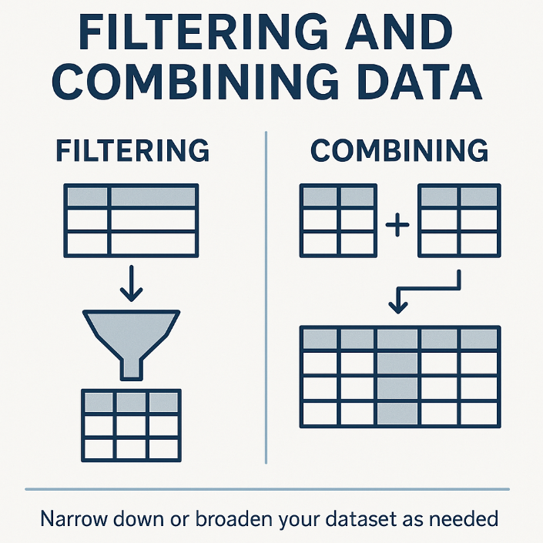
Filtering and Combining Data
Data subsetting is where analytical judgment and code meet: filtering defines the population you’re studying. Every filter is an analytical decision that should be documented — "I filtered to Grade==9" changes what conclusions are valid.
Method chaining: in pandas, you can chain operations: df.dropna().query("Grade==9")[["Student","Math_Score"]].reset_index(). This produces clean, readable pipelines. In R, the pipe operator |> (or %>%) achieves the same.
Rule: always filter after you’ve understood the full dataset. Premature filtering can hide patterns in data you haven’t examined yet.

Slide 31

Filtering Rows by Condition Using R
library(dplyr)
# Assume students_df is a data frame with a column Grade (9, 10, 11, 12)
# We want only 9th graders
freshmen_df <- students_df %>% filter(Grade == 9)
# If we also only want those who scored above 80 in Math and 9th graders:
high_achievers <- students_df %>% filter(Grade == 9, MathScore > 80)

Slide 32
Filtering Rows by Condition Using Python
Option 1
df = pd.read_csv("students_scores.csv")
# Assume students_df is a pandas DataFrame with similar structure
freshmen_df = df[df['Grade'] == 9]
# For multiple conditions, use & for AND, | for OR, and parentheses around each condition:
high_achievers = df[(df['Grade'] == 9) & (df['Math_Score'] > 80)]
Option 2
freshmen_df = df.query("Grade == 9")
high_achievers = df.query("Grade == 9 and Math_Score > 80")

Slide 33
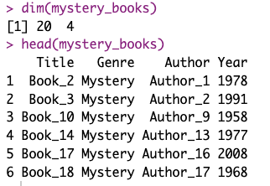
Let’s Exercise – R
Read the books.csv
Filter data with only mystery books
books <- read.csv("books.csv")
mystery_books <- books %>% filter(Genre == "Mystery")
dim(mystery_books)
head(mystery_books)

Slide 34
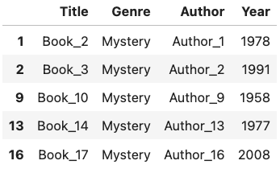
Let’s Exercise – Python
Read the books.csv
Filter data with only mystery books
Option 1
books = pd.read_csv("books.csv")
mystery_books = books[books['Genre'] == 'Mystery']
mystery_books.head()
Option 2
mystery_books = books.query("Genre == 'Mystery'")

Slide 35
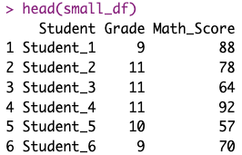
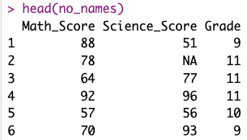
Selecting and Dropping Columns with R
Selecting columns (or dropping columns) can make data easier to work with.
Also, can protect privacy if we remove sensitive information.
# Select only Name, Grade, and MathScore from students_df
small_df <- df %>% select(Student, Grade, Math_Score)
head(small_df)
# You can also drop columns by using a minus sign
no_names <- df %>% select(-Student, -English_Score)
head(no_names)

Slide 36
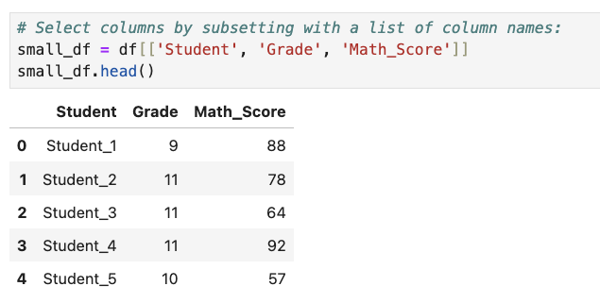
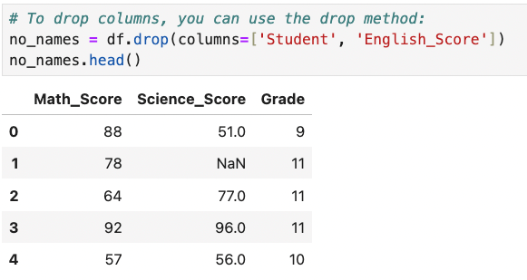
Selecting and Dropping Columns with Python

Slide 37








Combining Data: Merging and Joining
Merging Tables
Matching Keys
Combining data from different sources based on a common key
Finding records that match between datasets
Verifying Results
Appending Rows
Ensuring the combined data makes sense
Stacking datasets with the same structure

Slide 38
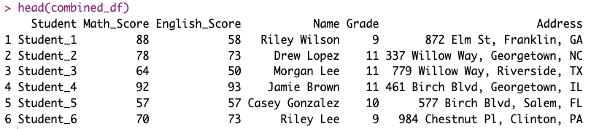
Combining Data with R
# Filter Student Scores
df <- read.csv("students_scores.csv")
scores_df <- df %>% select("Student", "Math_Score", "English_Score")
# Read Student Information
info_df <- read.csv("Student_Information.csv")
combined_df <- scores_df %>% left_join(info_df, by = "Student")
head(combined_df)

Slide 39
Combining Data
LEFT JOIN: all rows from left table, matched rows from right. NaN fills unmatched right-side values. Use when left table is your analytical ground truth and you need to enrich it.scores_df and bring in matching info from info_df.
inner_joinINNER JOIN: only rows present in both tables. Warning: silently drops unmatched rows — check df.shape before and after to confirm no unexpected data loss.
full_joinFULL JOIN: all rows from both tables, NaN where no match. Use for data reconciliation: finding records in one source but not another.
right_joinRIGHT JOIN: all rows from right table, matched rows from left. Equivalent to left join with tables swapped. After any join: check df.shape and df.isnull().sum() to verify (info_df in this case).

Slide 40
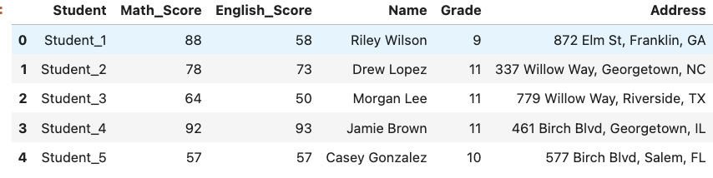
Combining Data with Python
df = pd.read_csv("students_scores.csv")
scores_df = df[["Student", "Math_Score", "English_Score"]]
info_df = pd.read_csv("Student_Information.csv")
combined_df = pd.merge(scores_df, info_df, on="Student", how="left")
combined_df.head()

Slide 41
Appending Rows (Stacking Data)
What is Appending?
Common Scenarios
Stacking one dataset below another with the same columns.
Combining data from different time periods
Merging data from different locations
Like adding more pages to a book with
the same format.
Consolidating multiple surveys with the same questions
Building a complete dataset from partial files

Slide 42
Appending Rows: Stacking Data
What is Appending?
Common Scenarios
Stacking one dataset below another with the same columns.
Combining data from different time periods
Merging data from different locations
Like adding more pages to a book with the same format.
Consolidating multiple surveys with the same questions
Building a complete dataset from partial files

Slide 43
Appending Rows (Stacking Data) with R
# Read the 2021 scores CSV file into a data frame
scores_2021_df <- read.csv("Scores_2021.csv")
# Display the dimensions (number of rows and columns) of the 2021 data frame
dim(scores_2021_df)
# Read the 2022 scores CSV file into a data frame
scores_2022_df <- read.csv("Scores_2022.csv")
# Display the dimensions of the 2022 data frame
dim(scores_2022_df)
# Combine the 2021 and 2022 data frames by stacking them on top of each other
all_scores_df <- bind_rows(scores_2021_df, scores_2022_df)
# Display the dimensions of the combined data frame
dim(all_scores_df)

Slide 44
Appending Rows (Stacking Data) with Python
# Read the 2021 scores CSV file into a DataFrame
scores_2021_df = pd.read_csv("Scores_2021.csv")
# Display the shape (number of rows and columns) of the 2021 DataFrame
print(scores_2021_df.shape)
# Read the 2022 scores CSV file into a DataFrame
scores_2022_df = pd.read_csv("Scores_2022.csv")
# Display the shape of the 2022 DataFrame
print(scores_2022_df.shape)
# Combine the 2021 and 2022 DataFrames by stacking them on top of each other
all_scores_df = pd.concat([scores_2021_df, scores_2022_df], ignore_index=True)
# Display the shape of the combined DataFrame
print(all_scores_df.shape)

Slide 45

Your Turn!
We have 2 datasets, lab_results.csv and patients.csv
Combine the two files
Experiments different join types
This Photo by Unknown Author is licensed under CC BY-NC-ND

Slide 46
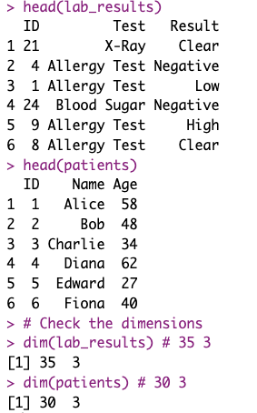
Answers with R
First, read the datasets
# 1. Read the DataSets
lab_results <- read.csv("lab_results.csv")
patients <- read.csv("patients.csv")
# 2. Know your data
# Check the heads
head(lab_results)
head(patients)
# Check the dimensions
dim(lab_results) # 35 3
dim(patients) # 30 3

Slide 47
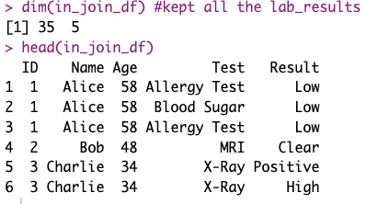
Answers with R
Try inner_join
It kept all the matching data
# 3. Try inner_join
library(dplyr)
in_join_df <- patients %>% inner_join(lab_results, by = "ID")
dim(in_join_df) #kept all the lab_results
head(in_join_df)

Slide 48
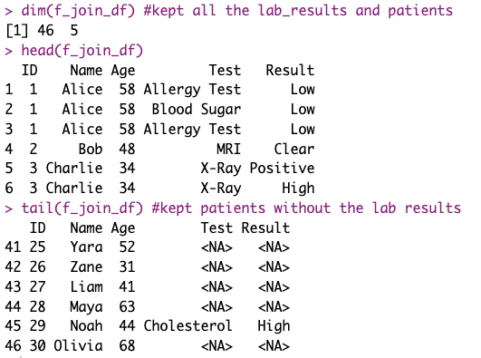
Answers with R
Try full_join
It kept all data regardless of match
# 4. Try full_join
f_join_df <- patients %>% full_join(lab_results, by = "ID")
dim(f_join_df) #kept all the lab_results and patients
head(f_join_df)
tail(f_join_df) #kept patients without the lab results

Slide 49
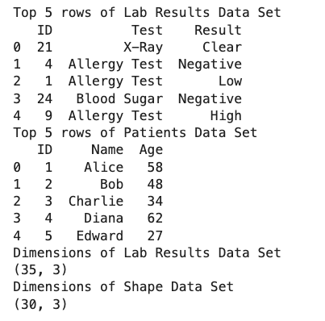
Answers with Python
# 1. Read the DataSets
import pandas as pd
lab_results = pd.read_csv("lab_results.csv")
patients = pd.read_csv("patients.csv")
# 2. Know your data
# Check the heads
print("Top 5 rows of Lab Results Data Set")
print(lab_results.head())
print("Top 5 rows of Patients Data Set")
print(patients.head())
# Check the dimensions
print("Dimensions of Lab Results Data Set")
print(lab_results.shape)
print("Dimensions of Shape Data Set")
print(patients.shape)

Slide 50
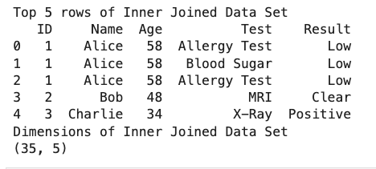
Answers with Python
# 3. Try inner_join
in_join_df = pd.merge(patients, lab_results, on="ID", how="inner")
print("Top 5 rows of Inner Joined Data Set")
print(in_join_df.head())
print("Dimensions of Inner Joined Data Set")
print(in_join_df.shape)

Slide 51
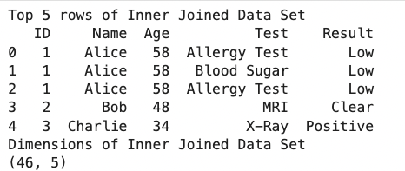
Answers with Python
# 4. Try outer (full) join
full_join_df = pd.merge(patients, lab_results, on="ID", how="outer") #same as full_join in R
print("Top 5 rows of Inner Joined Data Set")
print(full_join_df.head())
print("Dimensions of Inner Joined Data Set")
print(full_join_df.shape)

Slide 52
Chapter 7
Summary

Slide 53




Data Cleaning Checklist
Understand Your Data Context
Read the data dictionary first. Without domain knowledge, you can’t distinguish a valid extreme value from an error. Ask: what is the unit? What is the valid range? What do missing values mean in this context?
Check the Structure
Check df.shape, df.dtypes, df.describe(), df.isnull().sum() for every new dataset. Before cleaning anything, form hypotheses about what you expect to find — surprises are the most important signals.
Handle Missing Data
Identify missingness type (MCAR/MAR/MNAR). Choose method: listwise deletion only for MCAR; mean/median imputation for continuous MCAR/MAR; document all decisions with before/after row counts.
Identify Outliers
Apply at least two detection methods (IQR + domain knowledge). For each flagged value: investigate before acting. Document whether you removed, replaced, winsorized, or kept it.

Slide 54




Data Cleaning Checklist (Continued)
Standardize Formats
Parse all dates to a single format (ISO 8601: YYYY-MM-DD) using pd.to_datetime(). Normalize text with .str.strip().str.lower(). Test with value_counts() after each transformation.
Filter as Needed
Every filter is an analytical decision — document it in your log. "Filtered to Grade==9" restricts generalizability. If you filter outliers, note that conclusions apply only to the filtered population.
Combine Data
Always check row counts after merging. An unexpected row count increase suggests many-to-many matches. An unexpected decrease indicates mismatched keys. Both are data quality issues, not just code bugs.
Verify and Save Clean Data
Run your original df.describe() and df.isnull().sum() against the cleaned version. Also run basic sanity checks: are there still negative ages? Any dates in the future? Does the mean now match domain expectations?

Slide 55
Let’s Merge and Clean!
You have two datasets
school_participation_class1.csv
school_participation_class2.csv
Columns: StudentID, Name, Grade, Age, Club, SignupDate.
Upon inspection, you find:
Some Age values are missing.
One Age is recorded as 144 (clearly an error, likely meant 14).
The SignupDate column has dates in mixed formats: some are "MM/DD/YYYY", others are "Month Day, Year".
Grade is recorded as 9, 10, 11, 12 but one entry says "Freshman" instead of 9.
There are two files (two classes) you need to combine, and a few students appear in both (duplicates).

Slide 56

Your task: Use the checklist to clean this data.
Understand Your Data Context
Check the Structure
Handle Missing Data
Identify Outliers
Standardize Formats
Filter as Needed
Combine Data
Verify and Save Clean Data

Slide 57
Answers
Check to see one way to deal with this issues in R: Ch7_FinalTaskAnswer.R
For Python: Ch7_FinalTaskAnswer.ipynb
Key principle: there is no single correct cleaning approach — different analytical questions may justify different decisions. What matters is that every decision is documented and defensible.
Your cleaning log is as important as the cleaned data. Without it, your analysis is not reproducible. A cleaned dataset without a log cannot be verified, audited, or extended by collaborators.
Check the example log record: Ch7_FinalTask_data_cleaning_log.csv

Slide 59
Chapter 7: Data Wrangling in Action
Coding Agents for Data Wrangling

Slide 60
Coding Agent Workflow for Data Wrangling
A coding agent can automate the full 8-step cleaning pipeline — but your analytical judgment drives every decision:
Weak: "Clean this dataset." → Agent applies arbitrary defaults (e.g., drops all rows with any missing value) without knowing your analytical goals.
Strong: "Load school_participation_class1.csv and class2.csv. Stack them with pd.concat. Then: (1) report df.shape and df.dtypes, (2) count missing values per column and flag rates >5%, (3) apply IQR outlier detection to all numerical columns, (4) report all unique values in the Grade and SignupDate columns."
After the audit, give cleaning instructions one step at a time:
"Fix SignupDate: convert all values to ISO format YYYY-MM-DD using pd.to_datetime(). Show me the first 5 rows of SignupDate before and after."
"Standardize Grade: replace 'Freshman' with 9. Show value_counts() before and after."
"After every cleaning step, print df.shape so I can verify no rows were unexpectedly dropped."

Slide 61
Verifying Agent-Cleaned Data
The most important skill: knowing when the agent made a plausible-but-wrong decision:
Common agent mistakes in wrangling: (1) Drops rows with ANY missing value when you only needed to handle one column. (2) Converts a ZIP code (stored as "06001") to integer 6001 — destroying the leading zero. (3) Fills all missing Ages with the mean, including rows where Age was MNAR.
Verify after every step: compare df.shape before and after. Check df.dtypes to catch silent type conversions. Run value_counts() on categorical columns to confirm standardization worked.
The cleaning log is your verification tool:
Ask: "Produce a cleaning log as a numbered list. For each step: what was changed, how many values/rows were affected, and what method was used."
Then verify each log entry against the data: if the log says "3 duplicate rows removed," confirm with df.shape that you lost exactly 3 rows, not 3 different ones.
Final check: rerun your original data quality audit on the cleaned dataset. Every issue from Step 1 should now be resolved.

Slide 62
Hands-On: Agent-Assisted Wrangling of Class Participation Data
Activity (pairs, 25 minutes) — using school_participation_class1.csv and class2.csv:
Step 1 — Stack and audit: Prompt the agent to concatenate the two files and produce a full data quality report (shape, dtypes, missing rates, unique values per column).
Step 2 — Clean one issue at a time: Direct the agent to fix Age=144, standardize date formats, fix Grade="Freshman", and remove duplicates. After each fix, verify with a targeted check (not a general "looks good").
Step 3 — Impute missing Ages: Ask the agent to impute with the column mean. Then ask: "How many rows were imputed? What was the mean before and after imputation? Did the standard deviation change?" Explain why it changed.
Step 4 — Generate the cleaning log: Ask for a numbered log matching the format from slide 68 (Ch. 6). Compare your log to the example answer.
Challenge: find one issue the agent misses or handles incorrectly. Document it and explain the better approach.

Slide 63
Chapter 7: What You Can Do Now
Missing data handling:
✓ Detect missing values with is.na()/isnull().sum(). Choose listwise deletion vs. mean/median imputation based on missingness type (MCAR/MAR/MNAR). Report imputation method and percentage imputed.
Outlier detection and treatment:
✓ Apply IQR outlier detection in Python (numpy.percentile) and R (quantile/IQR). Choose from the four strategies (investigate, remove, winsorize, robust methods) based on whether the outlier is an error or a legitimate extreme value.
Data transformation and combination:
✓ Standardize dates with pd.to_datetime() and text with .str.strip()/.str.lower()/regex. Filter with boolean indexing and .query(). Merge tables using all four join types and verify results with df.shape checks.
Agent-assisted wrangling:
✓ Direct a coding agent through the 8-step cleaning checklist. Verify each step, catch plausible-but-wrong cleaning decisions, and produce a reproducible cleaning log that fully documents every transformation.

