Slide 1
RESEARCH METHODS
DAY 4

Slide 2
Welcome to Day 4!
Let’s start with a fun Quiz!
And refresh our memories on source credibility.

Slide 3
Question 1
True or False: A personal blog is a reliable source for scientific facts.
False!

Slide 4
Question 2
Which of the following is usually the MOST reliable for accurate scientific information?
A. Wikipedia
B. TikTok video
C. Peer-reviewed science journal
D. Reddit post
Answer: C

Slide 5
Question 3
What should you check to see if a website is trustworthy?
A. Its color and design
B. If it has ads
C. Who wrote it and when it was last updated
D. How many emojis it uses
Answer: C

Slide 6
Question 4
Which source is the least likely to be biased?
A. A product review written by the company that made the product
B. A university study published in a journal
C. A celebrity’s opinion on a diet trend
D. A tweet from a random user
Answer: B

Slide 7
Question 5
True or False: An article that includes sources and references is more trustworthy than one that doesn’t.
True!

Slide 8
Question 6
True or False: All information on the internet is true if it has lots of likes or views.
False!

Slide 9
Question 7
True or False: It's okay to use Wikipedia as a starting point, but you should double-check the facts with more reliable sources.
False!
True!!!

Slide 10
Question 8
Which of these sources would most likely be considered a primary source?
A. A YouTube video about World War II
B. A soldier’s diary from World War II
C. A news article written last week about World War II
D. A textbook chapter on World War II
Answer: B

Slide 11
Question 9
Which of these sources is usually written by experts and reviewed before being published?
A. Peer-reviewed journal
B. Instagram story
C. Student opinion piece
D. Online ad
Answer: A

Slide 12
Question 10
Which of these shows bias in a source?
A. The author includes only one side of an argument
B. The source shows both pros and cons
C. The author lists sources at the end
D. The source has a publication date
Answer: A

Slide 13
Bonus Question
True or False: A website with lots of ads and pop-ups might not be a good place to find trustworthy information.
True!

Slide 14
Refresher
Reliable vs. Unreliable Sources
Reliable Sources
Unreliable Sources
Backed by verifiable evidence
Lack transparency
Created by experts
Anonymous or unclear authorship
Undergo review processes
Sensationalist language
Transparent about methods
One-sided arguments
Cite their sources
Missing citations

Slide 15








NEW!
Examples of Reliable Sources
CDC
NASA
NEJM
US Census Bureau
Centers for Disease Control and Prevention
National Aeronautics and Space Administration
Academic Medical Journal
Federal Statistical Agency
WHO
National Geographic
Smithsonian
APA
World Health Organization
Science and Education Publication
Research and Museum Institution
American Psychological Association
These institutions are known for rigorous research methods, expert review processes, and commitment to accuracy in their published information.

Slide 16






Refresher
Why Source Evaluation Matters
Credible Research
Strong sources lead to respected conclusions
Protection from Misinformation
Critical evaluation prevents spreading falsehoods
Critical Thinking Development
Evaluating sources builds essential life skills

Slide 17





Refresher
Red Flags of Misinformation
Sensational Language
"You won't believe this!" or excessive punctuation for shock value
Missing Attribution
No clear author, source, or supporting evidence
One-Sided Presentation
No acknowledgment of alternative perspectives or debates
Extraordinary Claims
Bold statements without proportional evidence

Slide 18

Refresher
Designing a Research Project

Slide 19
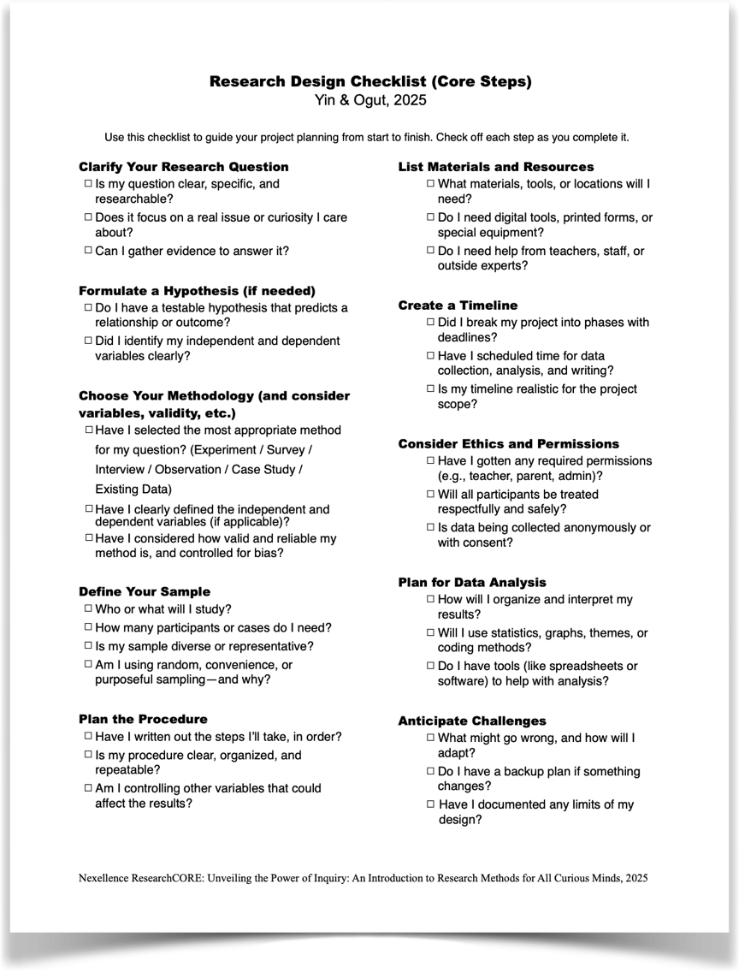
Designing a Research Project
To make the steps of designing easier, you can review & follow our checklist.

Slide 20
Designing a Research Project
Look where we are in the process…

Slide 21




Refresher
Failing to Plan is Planning to Fail
Research Requires Direction
Create a Blueprint
A well-designed project saves time and increases the chances of valid, meaningful findings.
Like baking without a recipe or traveling without a map, research without planning leads to confusion.
Develop a Game Plan
We'll cover methodologies, tools, variables, and ethical considerations for your research journey.

Slide 22

Refresher
Choosing a Research Method
The first step in designing your project is selecting the right method to answer your question.
Methodology includes…
Your overall approach / strategy:
Qualitative. Quantitative. Mixed.
Your data collection tools / techniques
Experiment
Surveys
Interview
Focus Groups
Observation
Case Study
Mixed Methods
(We talked about the first four methods of collecting your own data yesterday)

Slide 23





Observation:
Watching Real Behavior
Natural Settings
Observe behavior as it naturally occurs without intervention.
Structured or Unstructured
Use checklists for specific behaviors or take open-ended notes on everything you see.
Time Sampling
Observe at different times to capture variation in behavior patterns.
Minimize Observer Effect
Be discreet so your presence doesn't change the behavior you're studying.
Can be utilized in quantitative or qualitative studies

Slide 24

Case Studies: Deep Dives
Definition
When to Use
Intensive study of a single case or small number of cases to gain in-depth understanding.
For unique situations, rare phenomena, or when you need comprehensive understanding of one example.
Limitations
Findings may not generalize to other cases or populations.
Mostly qualitative but can include quantitative elements

Slide 25





Using Existing Data:
Secondary Research
Efficient Access
Historical Perspective
Multiple Sources
Use data already collected by others instead of gathering new information.
Government reports, research studies, archives, statistics, and historical documents.
Analyze trends over time periods you couldn't study directly.
Source Verification
Always evaluate the credibility and quality of secondary data sources.

Slide 26

Mixed Methods: Combining Approaches & Tools
Benefits
Examples
Provides fuller picture of the topic
Survey + interviews
Experiment + questionnaire
Combines breadth and depth
Observation + focus groups
Numbers + stories = comprehensive understanding
Case study + statistical analysis
Compensates for weaknesses in single methods
Mixed methods require careful planning but provide rich, multidimensional insights.

Slide 27
At camp, we are to conduct secondary research. What could you at a parallel universe or simply another time?
Let’s team brainstorm!
Here is the question to answer: If we were to answer your research question from scratch (no existing data), how could you go about collecting the data?

Slide 28
Shall we play a game?
Method Match

Slide 29




Choosing the Right Method
Consider your research question
What type of answer do you need? Numbers, descriptions, or both?
Assess your resources
How much time, access, and materials do you have available?
Think about participants
Who will you study and how many can you realistically include?
Weigh strengths and limitations
Each method has trade-offs. Choose what best fits your specific needs.

Slide 30
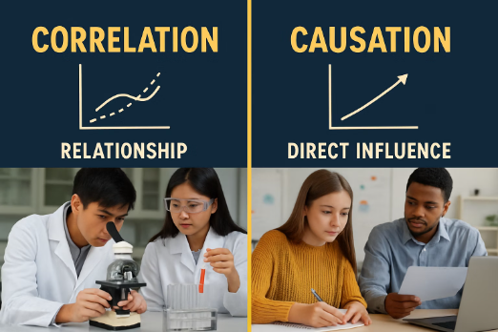
Correlation vs. Causation
Correlation
Causation
Two variables change together or are related.
One variable directly causes changes in another.
Shows a pattern or relationship
Shows cause and effect
Doesn't prove one causes the other
Requires controlled experiments
Harder to establish definitively
Found in surveys, observations, etc.
Remember:
“Correlation does not equal causation" is a fundamental principle in research.

Slide 31
The Shoe Size-Reading Ability Example
Kids with bigger feet tend to read better.
Variable 1: Shoe Size
Variable 2: Reading Ability
True Cause: Age
Age affects both shoe size and reading ability

Slide 32

Planning the Procedure
Once you've chosen a method,
you need a detailed step-by-step plan
for your research.

Slide 33
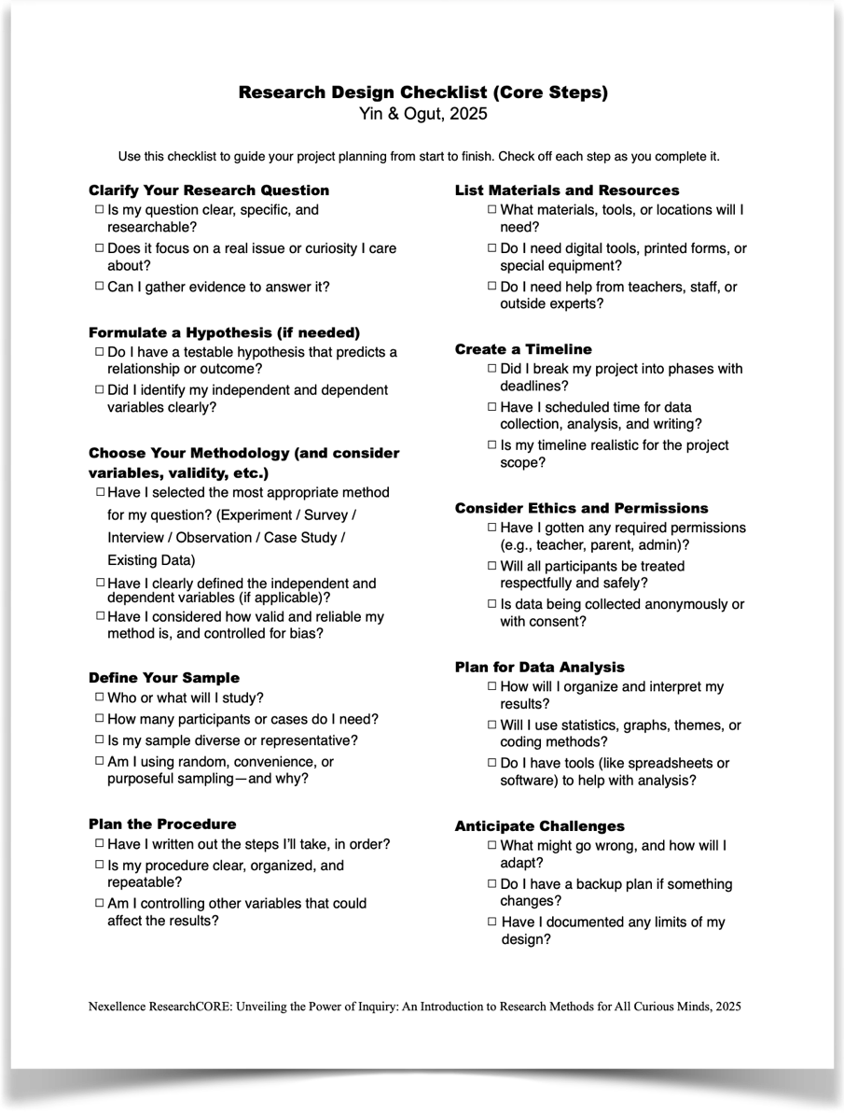
Planning the Procedure
Once you've chosen a method,
you need a detailed step-by-step plan
for your research.

Slide 34
Planning the Procedure
Once you've chosen a method, you need a detailed step-by-step plan for your research.
Anticipate Challenges
Plan Data Collection
Think about what might go wrong and how you'll handle it.
Consider All Variables
Decide exactly what data you'll gather and how you'll record it.
Write Clear Instructions
Identify what you'll change, what you'll measure, and what you'll keep constant.
Create a detailed "recipe" for your research that someone else could follow.

Slide 35





Experiment Procedure Planning
Define Your Groups
Decide who or what will be in experimental and control groups. Use random assignment when possible.
Define the Treatment
Clearly describe what you'll do with the experimental group. Be specific enough for replication.
Define Control Activities
Decide what the control group will do during the same time period.
Plan Data Collection
Determine exactly what measurements you'll take, when, and how.

Slide 36

Survey Procedure Planning
Distribution Method
Decide how to give out your survey: paper, online, in-person. Each has pros and cons for reach and response rate.
Target Respondents
Define who should take your survey. Aim for a representative sample, not just friends.
Question Design
Write clear, unbiased questions. Test them on a few people first to check for confusion.
Response Collection
Plan how to gather and analyze answers. Set a timeline with reminders for participants.

Slide 37




Observation Procedure Planning
Choose Locations and Times
Create a clear schedule for when and where you'll observe. Include multiple times to identify patterns.
Define Observation Focus
Decide exactly what behaviors or phenomena you'll look for to stay organized.
3
Plan to Minimize Influence
Be discreet so your presence doesn't change the behavior you're studying.
Create Recording Method
Decide how you'll document observations: tally sheet, notes, sketches, or digital tools.

Slide 38




Using Existing Data: Procedure Planning
Identify Sources
Make a list of all data sources you plan to use, like databases, archives, or publications.
Verify Credibility
Check that sources are trustworthy, like government agencies, universities, or reputable organizations.
Plan Data Extraction
Decide what specific information you need from each source and how you'll organize it.
Organize Information
Create a system to track where each piece of data came from and how it relates to your question.

Slide 39
Tomorrow we continue to
look into planning
Specifically reflecting on validity & reliability,
sampling, and materials/resources.

Slide 40

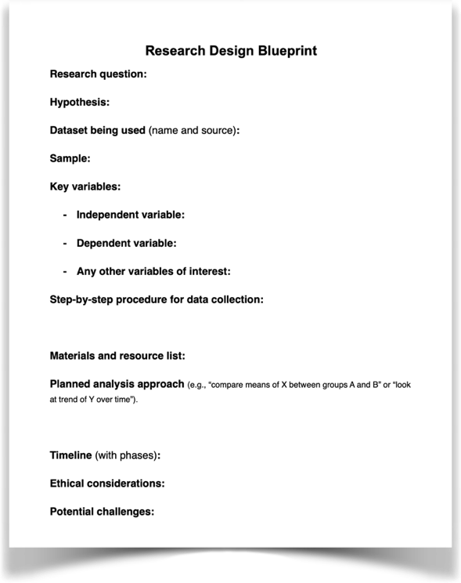
Homework - Teamwork
Review: "Research Design Checklist” with your team members.
Start working on Handout 4: Research Design Blueprint. Finish first half of the items.
Continue with your lit review. Review 1-2 more articles and keep track of your resources through “Source Tracker”. Identify 2–3 of the most important or interesting findings you gathered from the literature. Share your notes with one team members.

Slide 41

Let’s wrap up this session!
Questions? Final thoughts?

Slide 42
EXTRA SLIDES FOR DAY 4

Slide 43

Case Study: Leila's Smartphone Research
Research Question
Design Elements
"How does nighttime smartphone use relate to students' sleep quality and academic performance?"
Correlational study using surveys
120 students from grades 10-12
Sleep journals from 25 volunteers
Hypothesis
Follow-up interviews with 10 participants
Students with more phone use after 10 p.m. will report lower sleep quality and worse academic performance.
Leila's study examined a real-world issue affecting many students.

Slide 44




Leila's Research Timeline
Weeks 1-2: Baseline Data
Distribute digital survey during advisory periods. Collect information on smartphone usage, sleep quality, and academic focus.
Weeks 3-4: Follow-up
Conduct 10 individual interviews with participants showing varying screen time behaviors.
Week 5: Analysis
Code data, analyze results, and prepare presentation materials.

Slide 45
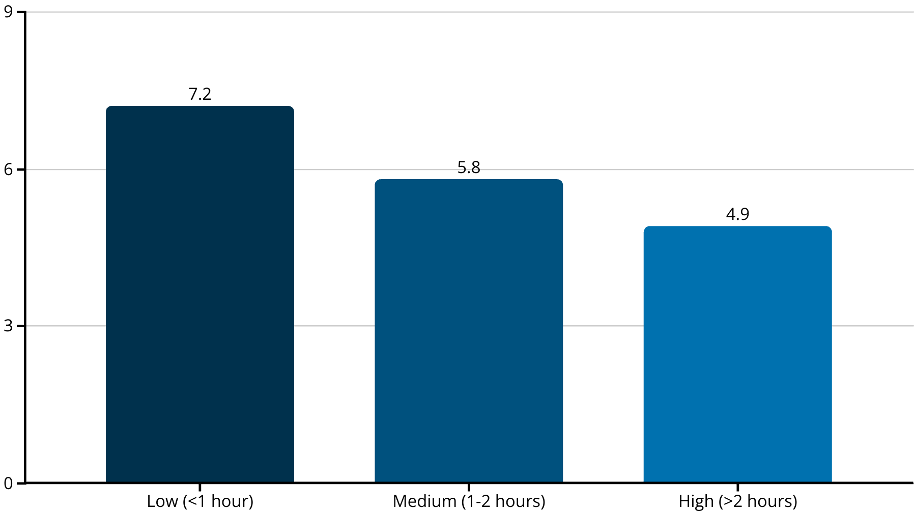
Leila's Findings
Sleep Quality
Academic Impact
Usage Type Matters
High screen time users reported significantly lower sleep quality than low users.
High screen users reported more difficulty concentrating in morning classes and more tardiness.
Reading or music users reported better sleep than social media or video streaming users.

Slide 46
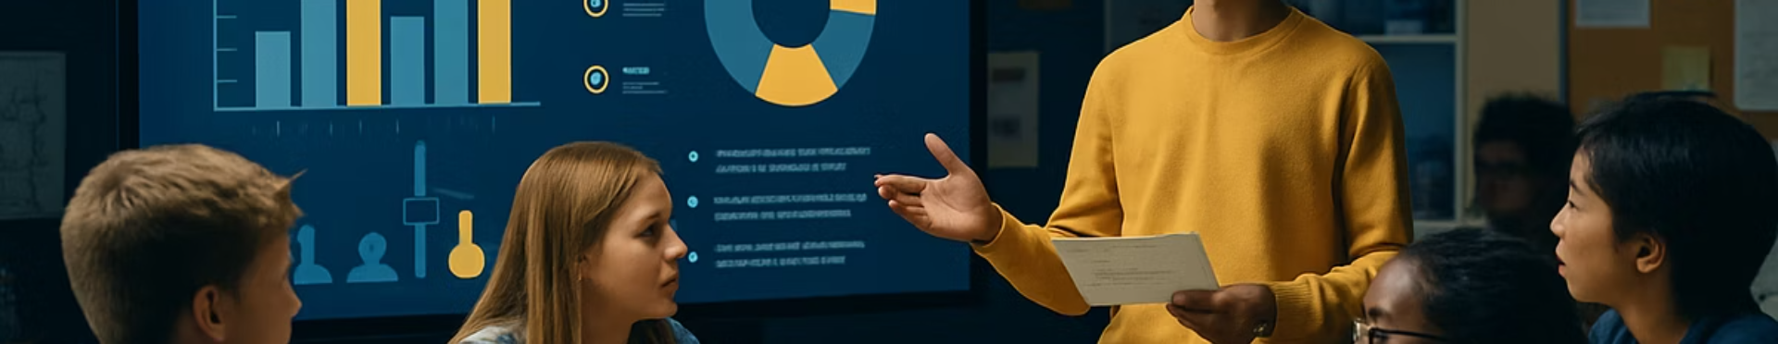
Leila's Research Impact
School Presentation
Student Campaign
Broader Conversation
Shared findings at a health and wellness night, educating the community about digital habits.
Inspired a student-led initiative promoting "screen-free wind-down hours" before bedtime.
Helped open discussion about digital wellness and healthy technology use among teens.

Slide 47
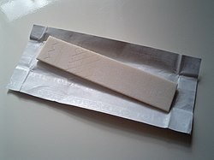
Next: Let’s Experiment!

Slide 48
Hands-On Mini Experiment
Chewing Gum & Memory
Research Question: “Does chewing gum improve short-term memory in middle and high school students?”
Hypothesis (Testable Statement): “Students who chew gum will remember more words from a list than students who don’t.”
So let’s think about what kind of data we can work with? Qualitative vs Quantitative?
And how we can go about collecting our data to test our very testable statement aka our hypothesis?

Slide 49
Hands-On Mini Experiment
Chewing Gum & Memory
Research Question: “Does chewing gum improve short-term memory in middle and high school students?”
Hypothesis (Testable Statement): “Students who chew gum will remember more words from a list than students who don’t.”
Experiment Steps:
Here is a list of 10 simple words.
We are to randomly divide you all into two groups (chewing gum vs. no gum).
You will see the list for 30 seconds. Then we will wait for 1 minute. Then you will write as many words as you can remember.
That would allow us to compare average number of words recalled per group.

Slide 50

Hands-On Mini Experiment
Chewing Gum & Memory - Research Design Discussion:
Independent variable:
Gum or no gum
Dependent variable:
Number of words remembered
Control variables:
Word list, exposure time, wait time before recall, setting
Could the results support or refute the hypothesis?
What might influence that outcome?
e.g., nerves, distractions, small sample size

