Slide 1
RESEARCH METHODS
DAY 5

Slide 2
Welcome to Day 5!

Slide 3

Let’s Reflect on our Process
What are your thoughts?
What are the challenges you are facing?
What can be done next?

Slide 4

REFINEMENT IS NORMAL!
Questions and hypotheses often evolve as you learn more.
But how do you “learn more”?
Answer: Literature Review
Next phase of research!

Slide 5
SMALL PROGRESS IS
STILL PROGRESS
You are just beginning this journey.
Allow yourself to take smaller steps. And trust the process.

Slide 6
HOW YOU LOOK AT IT
IS A GAME-CHANGER
If you see it like “spending your time reading articles” vs. making an exploration.
Take 2-3 key points from a resource and keep on with exploring.

Slide 7
Now, Let’s Continue with Planning
Reliability & Validity
Sampling

Slide 8
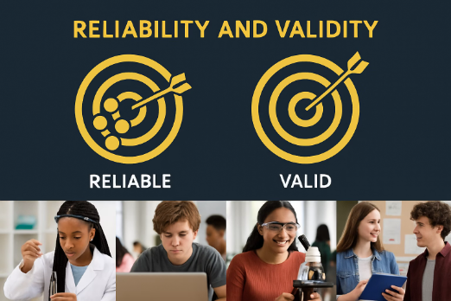
Reliability and Validity
Reliability
Consistency of results if repeated under the same conditions.
Would you get similar results if repeated?
Are measurements consistent?
Is your procedure standardized?

Slide 9





Improving Reliability
Standardize Procedures
Check Instruments
Use the same methods, instructions, and conditions for all participants or trials.
Ensure measuring tools are working properly and giving consistent readings.
Multiple Trials
Larger Sample Size
Repeat measurements or tests to see if results are consistent.
Include more participants or items to reduce the impact of individual variations.

Slide 10
Reliability and Validity
Reliability
Consistency of results if repeated under the same conditions.
Validity
Whether you're actually measuring what you intend to measure.
Does your method truly address your question?
Good research needs both reliability and validity to be trustworthy.
Are your measurements relevant?
Can you draw appropriate conclusions?

Slide 11

Improving Validity
Align Methods with Questions
Choose research approaches that directly address what you want to know.
Use Multiple Measures
Collect different types of data to get a more complete picture of what you're studying.
Control Variables
Identify and minimize factors that could confuse your results.
Pilot Test
Try out your methods on a small scale first to identify and fix problems.

Slide 12

Aisha's Research Revisited
Initial Approach (Poor)
Improved Approach (Better)
Different music for each friend
Same calm music playlist for all
"Productivity" measured by self-reports of “fine” or “good”
Productivity measured by task completion and quiz scores
Different tasks for each person
Inconsistent reporting methods
Same reading and math tasks for everyone
Consistent 30-minute sessions
The improved design has better reliability and validity, leading to more trustworthy results.

Slide 13

Sampling: Who or What Will You Study?
Good sampling makes your results more reliable, generalizable and valid.

Slide 14
Sampling: Who or What Will You Study?
What is a Sample?
Key Sampling Questions
A smaller subset of the population or items you're interested in.
How many people/items will you include?
How will you select them?
Since studying everyone or everything is usually impossible, researchers select representatives.
Will your sample represent the larger group?
What potential biases might affect your selection?
Good sampling makes your results more reliable, generalizable and valid.

Slide 15








Types of Sampling
Random Sampling
Everyone has equal chance of selection (like drawing names from a hat).

Slide 16
Types of Sampling
Stratified Sampling
Select from important subgroups to ensure representation (e.g., different grades).
Random Sampling
Everyone has equal chance of selection (like drawing names from a hat).
Cluster Sampling
Randomly select entire groups (randomly choose 3 classrooms)

Slide 17
Types of Sampling
Stratified Sampling
Select from important subgroups to ensure representation (e.g., different grades).
Random Sampling
Convenience Sampling
Everyone has equal chance of selection (like drawing names from a hat).
Select whoever is easiest to reach (like your own class).
Purposive Sampling
Deliberately select specific cases based on research needs.
Cluster Sampling
Randomly select entire groups (randomly choose 3 classrooms)

Slide 18
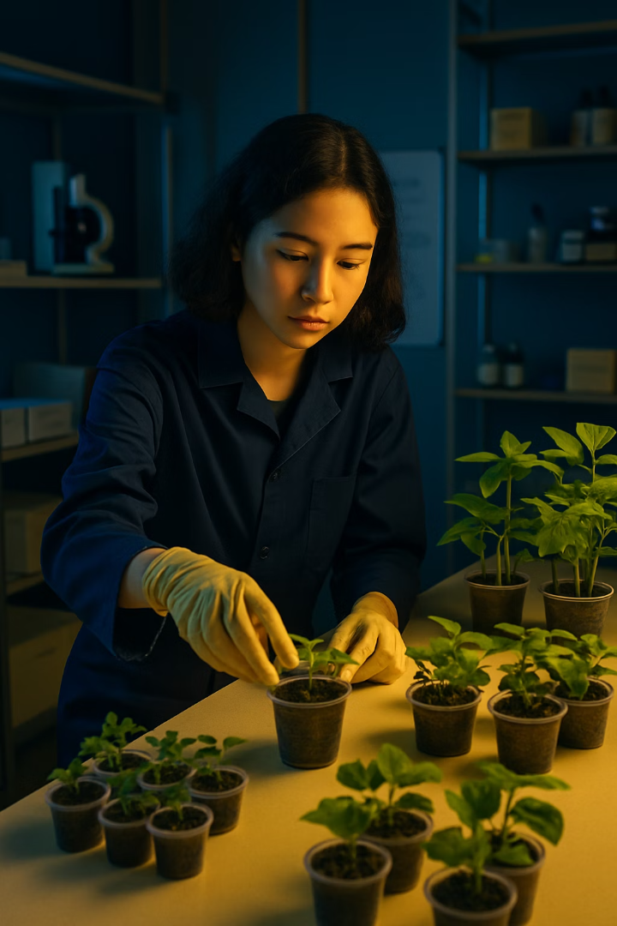
Sampling Examples
Survey
Instead of surveying all 1,200 students in a school, randomly select 120 students across all grade levels.
Plant Experiment
Use 30 plants of the same species and size, randomly assigning 15 to experimental and 15 to control groups.
Observation
Instead of observing a park 24/7, sample time periods by observing for 1 hour on mornings and 1 hour on afternoons.
Historical Research
Instead of reading every newspaper from 100 years, sample by examining the first issue of each month from selected years.

Slide 19
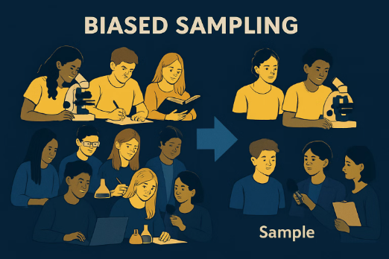
Sampling Bias
What is Sampling Bias?
Example
When your sample doesn't fairly represent the population you're studying.
Surveying only cooking club members about school lunch preferences would give biased results.
This can skew results and lead to incorrect conclusions.
These students likely have different food interests than the general student body.
Even with limited resources, try to broaden your sample to reduce obvious biases.

Slide 20





Practical Sampling Tips
Broaden Your Reach
Use Random Selection
Instead of just surveying friends, include students from different classes or groups.
When possible, use methods like drawing names or random number generators to select participants.
Consider Balance
Acknowledge Limitations
Try to include representation from important subgroups (different grades, genders, etc.).
Be transparent about who your sample represents and any potential biases.

Slide 21
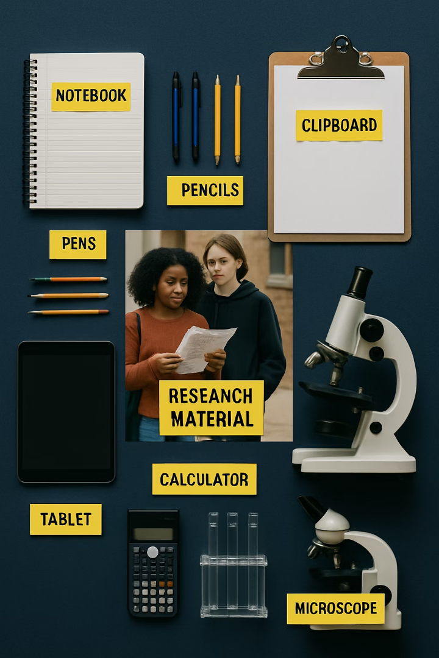



Materials and Resources
Access & Permissions
Equipment
Budget
People

Slide 22





Equipment Planning
Technology
Lab Supplies
Computers, tablets, cameras, recording devices, or specialized equipment.
Chemicals, test tubes, measuring tools, or experiment-specific materials.
Documentation Tools
Measurement Instruments
Survey forms, observation checklists, interview guides, or data collection sheets.
Stopwatches, rulers, scales, thermometers, or other measuring devices.

Slide 23

Budget Considerations
Low-Cost Alternatives
Look for free or inexpensive substitutes for costly materials. Borrow equipment when possible.
School Resources
Check what supplies your school already has available for student projects.
Funding Options
Consider mini-grants from school clubs, PTAs, or community organizations for special projects.
Scale Appropriately
Adjust your project scope to match available resources rather than overextending.

Slide 24





Access and Permissions
Physical Spaces
Information Access
Permission to use classrooms, labs, libraries, or community spaces for your research.
Approval to use school records, databases, or other information sources.
Participant Consent
Institutional Approval
Permission from people (and parents for minors) to participate in your study.
Permission from school administration for activities that affect school operations.

Slide 25

People Resources
Research Team
Friends or classmates who will help conduct the research. List specific roles and responsibilities.
Participants
How many people will be in your study? How will you recruit them? What will they need to do?
Supervisors
Teachers, parents, or other adults who need to oversee activities, especially for safety or access reasons.
Experts
People with specialized knowledge who might advise on your project or help interpret results.

Slide 26





Timeline and Logistics
Planning Phase
Design research, create materials, get permissions, and prepare resources.
Data Collection
Conduct experiments, distribute surveys, perform interviews or observations.
Analysis
Organize data, perform calculations, identify patterns, and interpret findings.
Reporting
Write up results, create visuals, prepare presentation, and share conclusions.

Slide 27
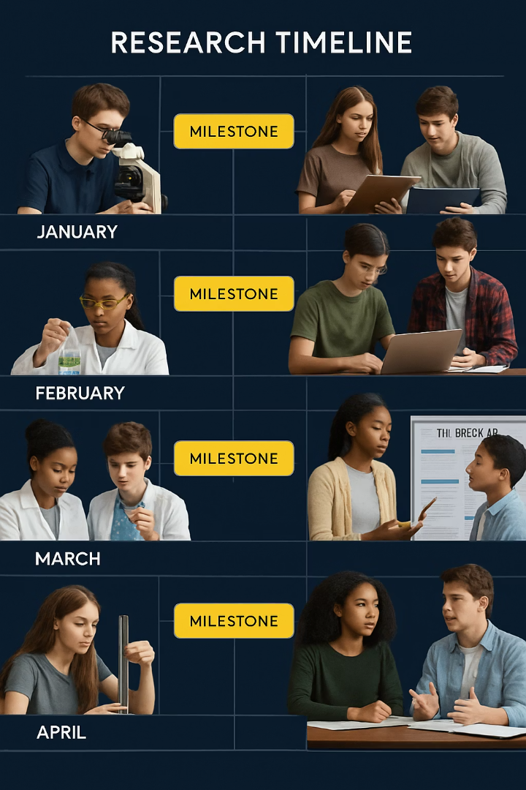




Creating a Detailed Timeline
Schedule Data Collection
Plan exactly when you'll collect data, with specific dates and times.
Estimate Duration
Calculate how long each session or step will take to ensure it's feasible.
Include Waiting Periods
Account for necessary delays between steps, like plant growth or survey response time.
Set Internal Deadlines
Create target dates for completing each phase to stay on track throughout the project.

Slide 28








Flexibility and Troubleshooting
Anticipate Challenges
Be Ready to Adapt
Think ahead about what might go wrong and how you'll handle it.
Prepare to adjust your methods if you discover better approaches.
Document Changes
Have Backup Plans
Record any modifications to your original plan and why you made them.
Create alternative approaches for critical parts of your research.

Slide 29

Literature Review

Slide 30
What is a Literature Review?
A literature review is a summary and analysis of what has already been written on a topic.
It helps you:
Understand what’s already known,
See where there are gaps or debates,
Avoid repeating others’ work,
And build a strong foundation for your own research.

Slide 31
How to Conduct a Lit Review
Step 1: Clarify Your Topic or Research Question
Step 2: Search for Reliable Sources
Step 3: Skim and Select
Read abstracts first to decide if the source is relevant.
Choose a mix of recent, relevant, and diverse perspectives.
Aim for at least 5–10 solid sources (depending on assignment length).
Step 4: Take Notes
Write down the main point of each source.
Note how it relates to your topic, and any key quotes or data.
Use color coding or a chart to organize themes or arguments.

Slide 32
How to Conduct a Lit Review
Step 5: Group by Themes or Ideas
Don’t stop at summarizing each article one by one.
Instead, group your notes by common themes, disagreements, or trends.
Ask: What do these sources have in common? How do they differ?
Step 6: Start Writing
Step 7: Cite Everything

Slide 33
Literature Review Template
Short Version
Begin with a short introduction:
What is your topic?
Why is it important?
Body:
Share what other studies have found.
Organize the body by themes, not by author.
End with a summary:
Clarify how your project connects to past research.

Slide 34
Importance of giving reference aka citing
What is Citing?
Citing your sources means giving credit to the original authors of the ideas, words, or data you use in your work.
We cite to:
Avoid plagiarism (taking credit for someone else's work),
Show where your information came from, and
Help others find those sources if they want to learn more.

Slide 35
What to Cite? What not to Cite?
You should cite:
Direct quotes (even short ones)
Paraphrased ideas (putting someone else’s idea into your own words)
Statistics or data
Images, charts, or graphics you didn’t create
You do not need to cite:
Common knowledge (e.g., “Water freezes at 0°C”)
Your own original thoughts
How to cite (more about this on Day 8):
Name of the first author & date - in the text
Full info - on the references page

Slide 36
Hands-on Reading / Writing Time

Slide 37

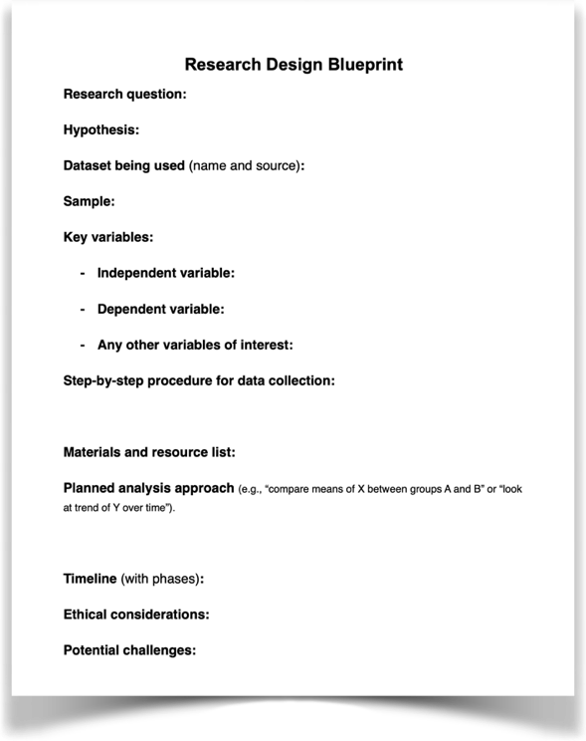
Homework - Teamwork
Finish Handout 4: Research Design Blueprint.
Continue with your lit review. Make sure you have resources that speak to why your topic is important. You would need this information for your upcoming presentation! As always, keep track of your resources through “Source Tracker”. Share your notes with your team members.

Slide 38
EXTRA SLIDES FOR DAY 5

Slide 39
Common Research Challenges
Participation Issues
Measurement Problems
Resource Limitations
Low survey response rates
Unclear results
Budget constraints
Participants dropping out
Equipment failures
Limited access
Scheduling conflicts
Inconsistent data
Time shortages
Solution: Recruit more than needed, send reminders, offer incentives, be flexible with scheduling.
Solution: Test instruments beforehand, use multiple measures, document anomalies, increase sample size.
Solution: Scale project appropriately, find alternatives, prioritize essential elements.

Slide 40





Ethical Considerations
Respect Privacy
Protect participants' identities and personal information. Use anonymous responses when possible.
Informed Consent
Ensure participants understand what they're agreeing to. Get permission from parents for minors.
Minimize Harm
Design research that doesn't cause physical or emotional distress to participants.
Get Approvals
Obtain necessary permissions from teachers, administrators, or other authorities.

