Slide 1
Chapter 2
Summary Statistics: Describing Data with Numbers

Slide 2
Summary Statistics: Describing Data with Numbers
Summary statistics compress a dataset into a few numbers. Two key dimensions: central tendency (where is the middle?) and dispersion (how spread out?). These are descriptive statistics — Chapter 9 extends this to inferential statistics, where we use sample statistics to estimate unknown population parameters.
Summary Statistics
Central Tendency
Mean
Median
Dispersion / Variability
Range
Mode
Standard Deviation

Slide 3
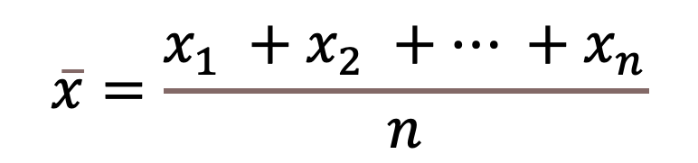
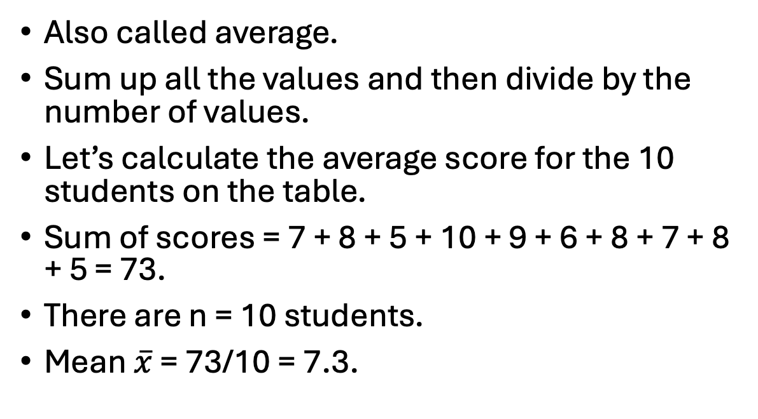
Mean
$$\overline{x}=\frac{x_{1} +x_{2} +… +x_{n}}{n}$$
Also called average.
Sum up all the values and then divide by the number of values.
Let’s calculate the average score for the 10 students on the table.
Sum of scores = 7 + 8 + 5 + 10 + 9 + 6 + 8 + 7 + 8 + 5 = 73.
There are n = 10 students.
Mean $\overline{x}$ = 73/10 = 7.3.
Name | Score
Alice | 7
Ben | 8
Carlos | 5
Diana | 10
Ethan | 9
Fiona | 6
George | 8
Hannah | 7
Isaac | 8
Julia | 5

Slide 4
Median
Name | Score
Julia | 5
Carlos | 5
Fiona | 6
Hannah | 7
Alice | 7
Isaac | 8
George | 8
Ben | 8
Ethan | 9
Diana | 10
Middle value of the dataset.
Especially useful when there are outliers in the data.
To find the median:
Sort the data.
If n is odd, median = value at position (n+1)/2 (when sorted in ascending order).
If n is even, median = average of values at positions n/2 and (n/2 + 1).

Slide 5
Median
Name | Score
Julia | 5
Carlos | 5
Fiona | 6
Hannah | 7
Alice | 7
Isaac | 8
George | 8
Ben | 8
Ethan | 9
Diana | 10
n=10 is even.
The middle two positions are 5th and 6th.
Median = (7 + 8) / 2 = 7.5.
Half of the students scored 7.5 or below, and half scored 7.5 or above.

Slide 6
Mode
The most frequently occurring value in the dataset.
It’s possible to have:
bi-modal or multi-modal - if multiple values tie for highest frequency
no mode - every value occurs equally
On the table, the most frequent score is 8, therefore the mode is 8.
Name | Score
Alice | 7
Ben | 8
Carlos | 5
Diana | 10
Ethan | 9
Fiona | 6
George | 8
Hannah | 7
Isaac | 8
Julia | 5
Score | Frequency
5 | 2
6 | 1
7 | 2
8 | 3
9 | 1
10 | 1
Frequency Table
Table

Slide 7
Chapter 4: Data Analysis in Python

Slide 8
What is Pandas?
pandas is the standard Python library for tabular data — built on NumPy arrays for speed. The primary data structure (DataFrame) was inspired by R’s data.frame.
Core EDA workflow: load → inspect dtypes → clean → transform → aggregate → visualize. pandas handles every step. Most real-world datasets live in DataFrames first.
Main data structures:
Series: 1D labeled array. Each column of a DataFrame is a Series. Supports vectorized operations — no loops needed.
DataFrame: 2D labeled table with a row index and named columns. Think SQL table or Excel sheet — with the full power of Python.

Slide 9
Analysis Steps
The 5-Step EDA Workflow in Python:
Step 1 — Import libraries: pandas, NumPy, matplotlib, seaborn. Every analysis starts here.
Step 2 — Load the dataset: pd.read_csv(). Check df.shape immediately — does the row count match what you expect?
Step 3 — Data audit: df.head(), df.dtypes, df.info(), df.describe(). Flag type mismatches and missing values before any analysis.
Step 4 — Answer specific questions: compute statistics (mean, median, groupby, value_counts). Each answer raises new questions — that’s EDA.
Step 5 — Visualize: histograms for distributions, bar charts for categories, scatter plots for relationships. Always interpret shape, not just numbers.

Slide 10



Step 1: Import Libraries
Import
matplotlib for plotting
pandas for data frame
NumPy for numeric analyses
How can we import them?
(Answer is on the next slide)

Slide 11
Step 1: Import Libraries
We use the import function.
Provide the package name.
Use as function to define the short name we want to use.
Provide the definition.
import pandas as pd
import numpy as np
import matplotlib.pyplot as plt

Slide 12
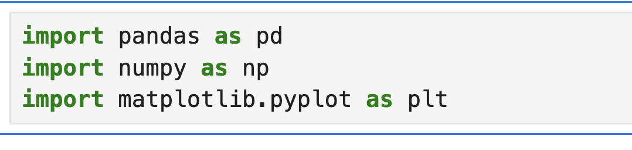
Step 1: Import Libraries
If everything is loaded correctly you wont see any output.

Slide 13
Step 2: Load the Dataset
Make sure car_data.csv is in the current directory or provide the path.
Define your name data frame name, for short we like to call it df.
Use panda -now pd in our environment- to read the
Check whether it worked!
df = pd.read_csv("car_data.csv")
print("Data loaded. Number of rows and columns:", df.shape)

Slide 14
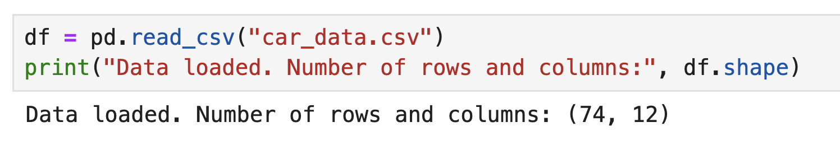
Step 2: Load the Dataset
It will create the following output:
Within the print function, we define the text "Data loaded. Number of rows and columns:" and the function to print.
In this example we printed df.shape

Slide 15
Step 3: Quick Data Peek
After every data load, run these four commands before anything else: df.head and df.describe functions.
df.head outputs the first number of rows we ask for.
df.describe provides the summary statistics.
df.head(5)
df.describe()

Slide 16
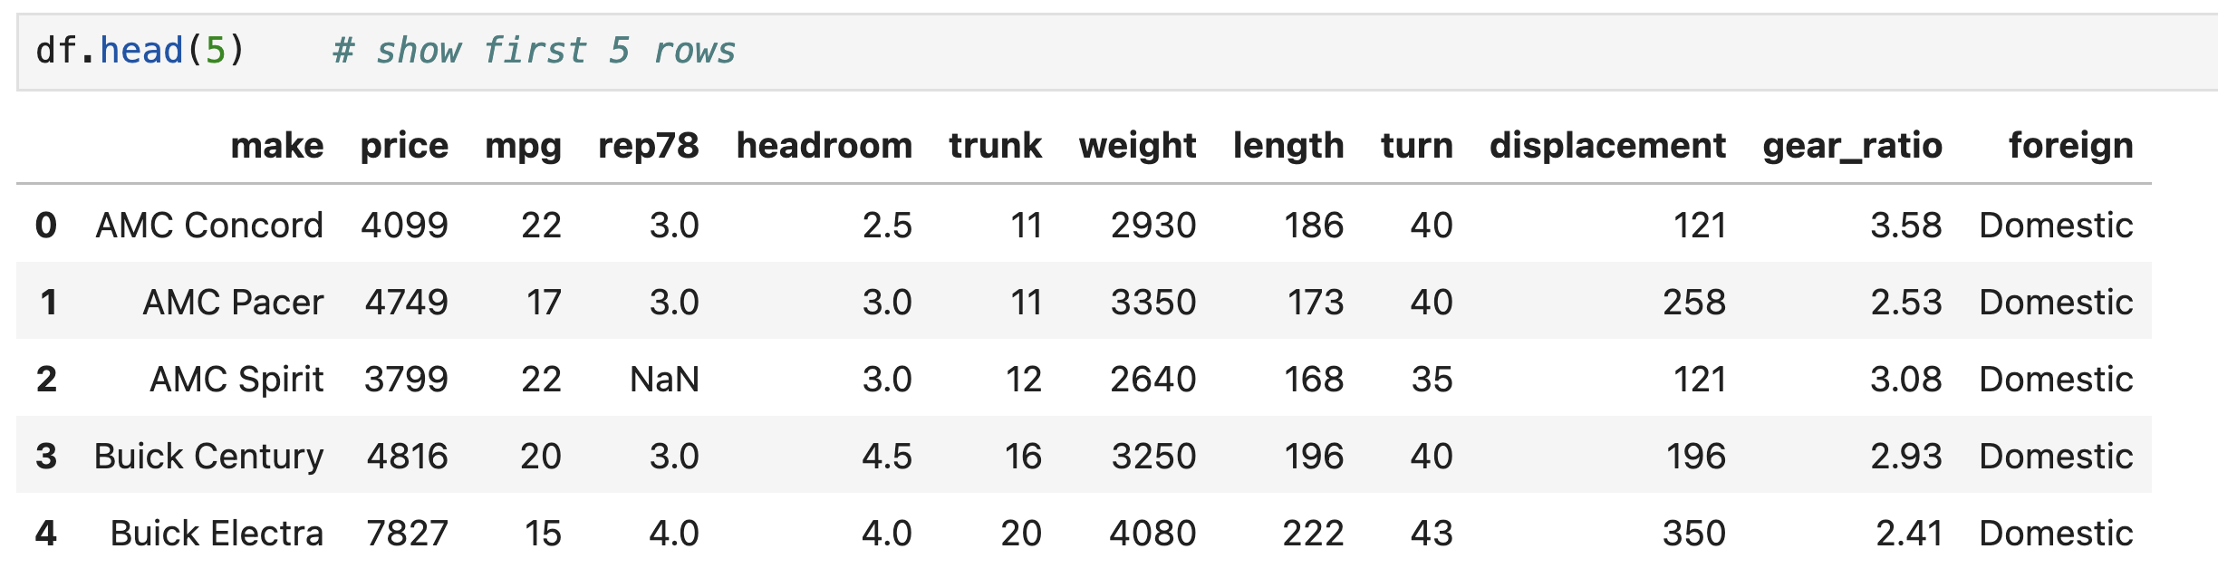
Step 3: Quick Data Peek

Slide 17
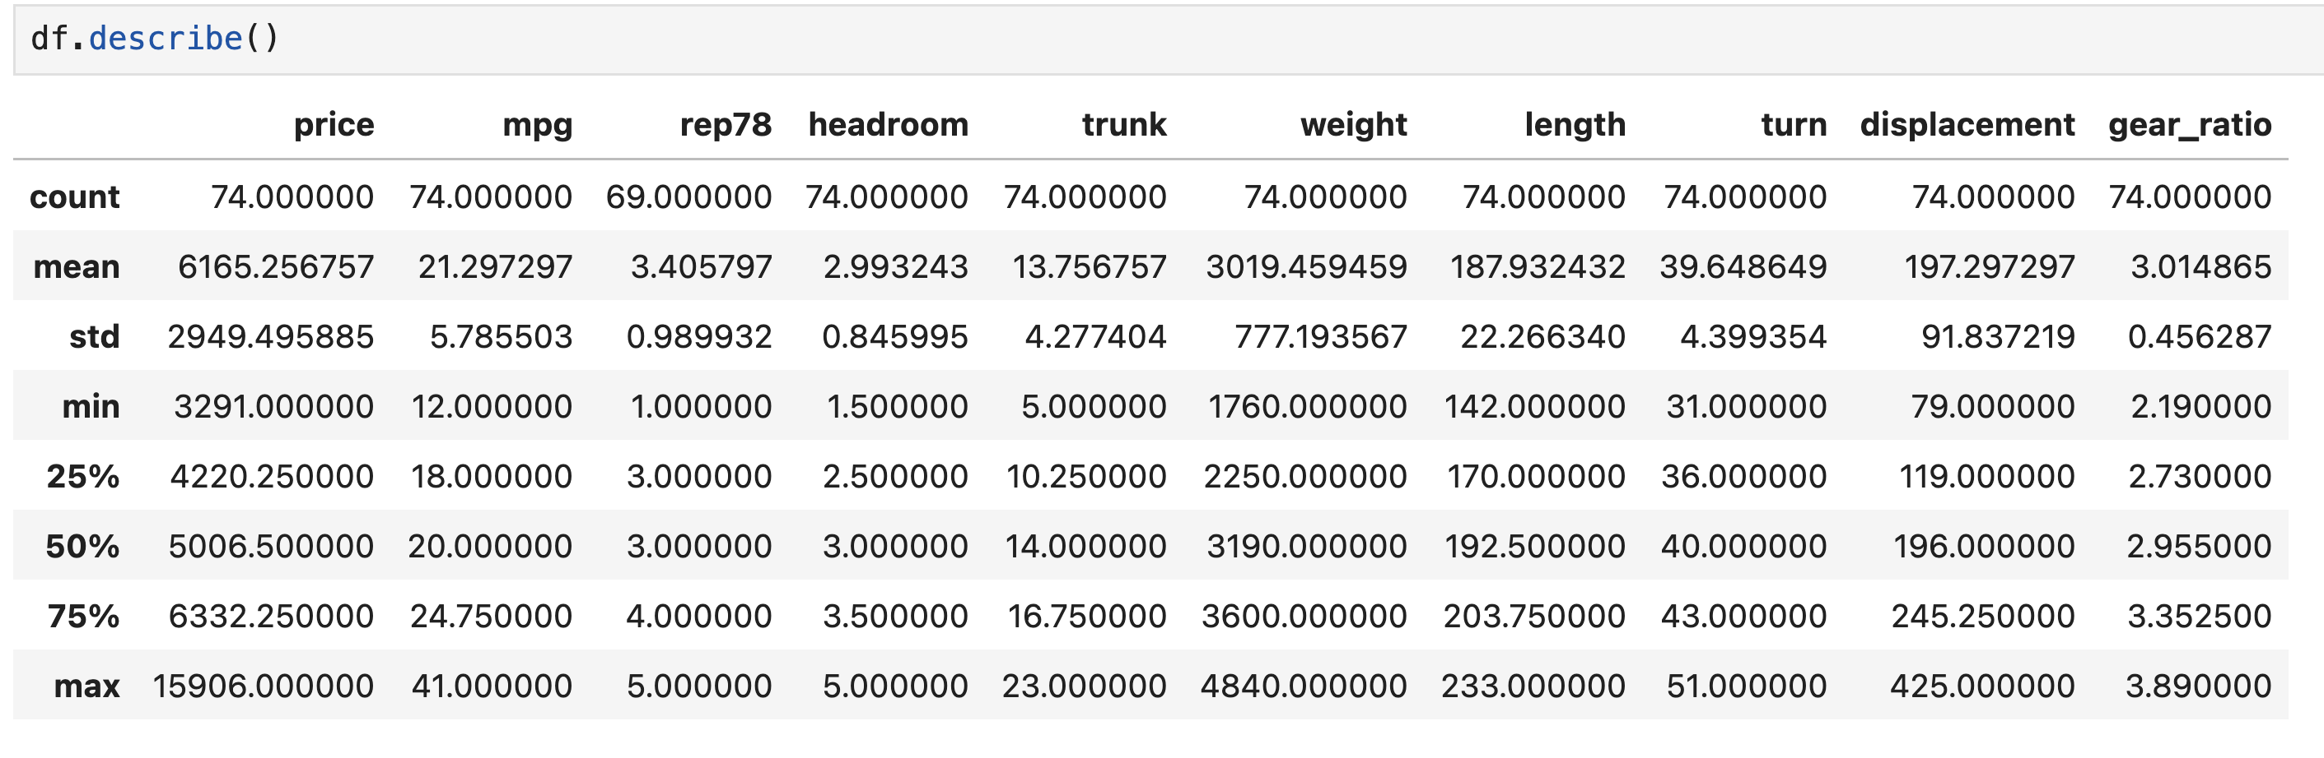
Step 3: Quick Data Peek

Slide 18
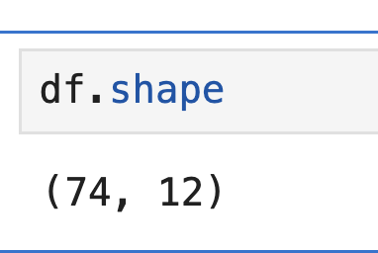
Let’s check the size
You can check the size of the data frame by df.shape function.
It shows the number of rows and columns.

Slide 19
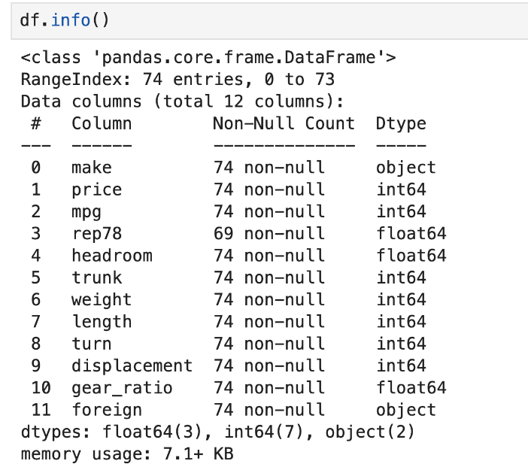
Information about the variables
To see column names and types we can use df.info()
int64 and float64 are continuous data

Slide 20
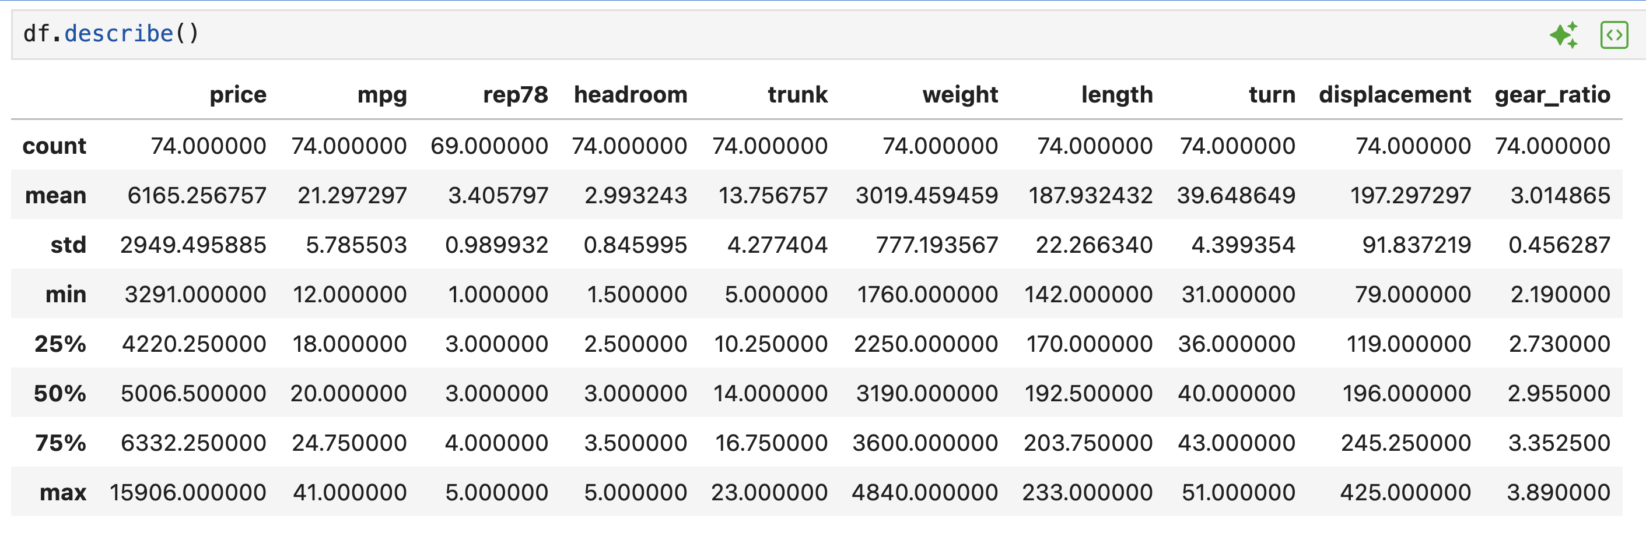
Summary Statistics
df.describe provides summary statistics for all the numeric variables.

Slide 21

Attention!
Always validate your data with these 5 checks:
Always(1) df.shape — expected row count? (2) df.dtypes — types match data dictionary? (3) df.describe() — min/max plausible? (4) df.isnull().sum() — missing values? (5) Mean vs median — similar or diverging?

Slide 22
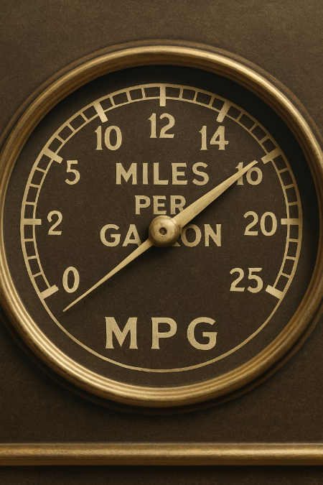
Step 4: Specific Analysis Questions
Let’s answer a couple of questions with our data:
Question 1: What is the average and median MPG of these cars?

Slide 23
Step 4: Question 1
We will use the mean function for average and the median function for the median value.
You can simply get the output of the mean by
df["mpg"].mean()
But the below code produces nicer output
avg_mpg = df["mpg"].mean()
median_mpg = df["mpg"].median()
print(f"Average MPG = {avg_mpg:.2f}")
print(f"Median MPG = {median_mpg:.2f}")
f-string formatting to print the values with 2 decimal places (:.2f)

Slide 24
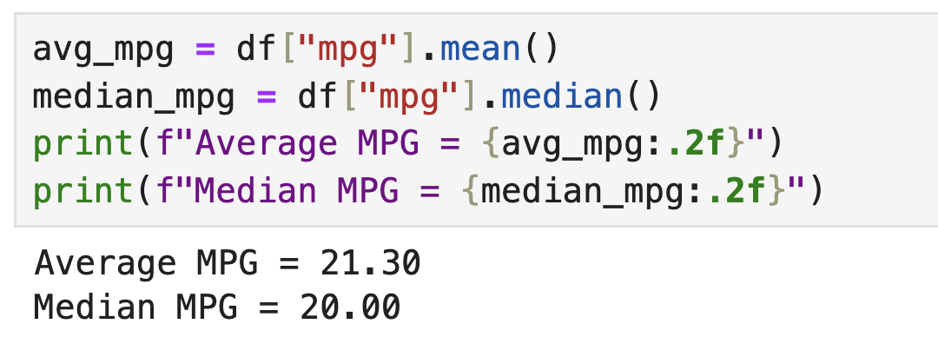
Step 4: Question 1
Mean MPG = 21.30, Median MPG = 20.00. The mean exceeds the median — a signature of right skew. A few high-MPG cars (e.g., 40+ MPG compact imports) pull the mean upward. The median is the better “typical” value here. This is why we always compute both.an is 20, which suggests the distribution might be a bit skewed by some high MPG values

Slide 25

Step 4: Question 2
Question 2: How many cars are produced abroad?
Think which variable we should use
Think which function we should use

Slide 26
Step 4: Question 2
We will use the variable “foreign”
We need to use the value_counts function
Using print function allows us to have nice output with explanation
for_counts = df["foreign"].value_counts()
print("Foreign Production Counts:")
print(for_counts)

Slide 27
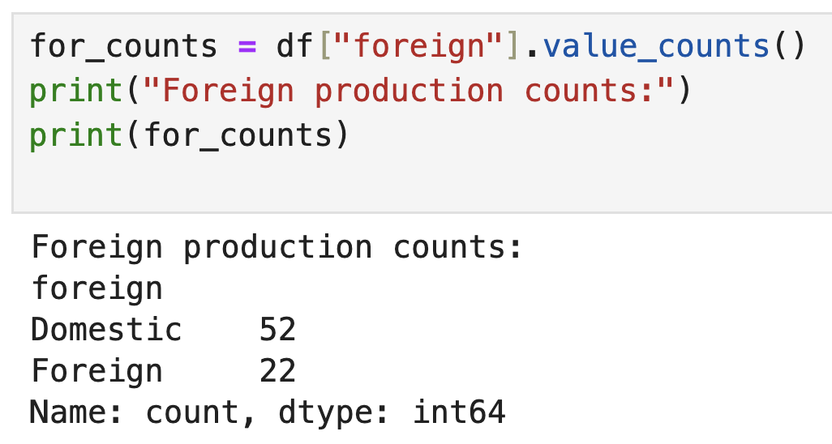
Step 4: Question 2
Answer: There are 22 foreign and 52 domestic cars.

Slide 28
Step 4: Question 3
Question 3: Does the price of cars differ by where they are produced?
Two variables
Production location
Price
Need to compute the average price for foreign and domestic cars
Use groupby() function

Slide 29
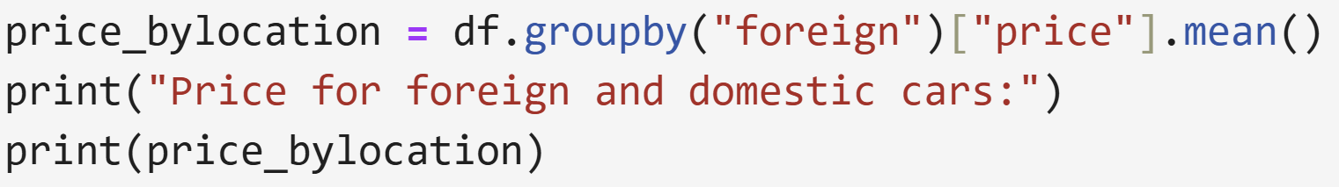
Step 4: Question 3
Use groupby() function

