Slide 1
RESEARCH METHODS
DAY 1

Slide 2
WELCOME TO
RESEARCH METHODS
by ResearchCORE!
Hands-on, fast-paced experience where you will be researchers tackling real-world problems.

Slide 3
NEED a NEW SLIDE with photos or videos from previous cohorts.
Introducing RISEI Lab and CTD.

Slide 4






Pick a Global Challenge
Journey Ahead:
Your Very Own
Research Process
Ask a Question
Gather Information
Analyze the Information
Draw Conclusions
Share Findings
- The final deliverables: A formal presentation by Day 10 and a research proposal by Day 9

Slide 5








Our approach
Curiosity
Fun
Engagement
Empowerment

Slide 6

Not only to learn how to conduct research,
but to learn how to think like a researcher to
Solve problems
Challenge assumptions
Make smart decisions
As you understand how the world works, you can change it for better!

Slide 7
GAME WOULD BE DIFFERENT FOR EVANSTON
Let’s Start with a Game
BINGO TIME!
Curriculum suggests Myth or Finding Game
Instructor reads 8 statements (some myths, some real findings) — students vote and then discuss. Examples: 'We only use 10% of our brains'; 'Left-brained vs. right-brained personalities are real'; 'Sugar causes hyperactivity in children.' Each connects to a real published study.

Slide 8
Out​
Let’s Start with a Game
BINGO TIME!
Walk around and find people who check the boxes on the bingo card.
Let us know once you check all the boxes in a line.

Slide 9
out​
B | I | N | G | O
Interested in space | Interested in volcanoes | Loves chemistry | Enjoys robotics | Likes science museums
Has done a science fair project | Enjoys coding | Likes astronomy | Wants to help the environment | Thinks science is fun
Wants to go to Mars | Loves building things |  | Wants to design apps | Interested in AI
Loves learning about the brain | Is into math challenges | Has built a robot | Wants to study insects | Loves dinosaurs
Wants to be an engineer | Curious about how things work | Watches history videos on YouTube | Interested in understanding human behavior | Wants to explore the ocean

Slide 10
NEED a NEW SLIDE reminding to take time to do pre-assessment for 15 min before starting the first lecture

Slide 11

What Is Research?
Let’s explore the fundamental concepts of research, distinguish between opinions and evidence-based conclusions, and examine the research process across disciplines.
Michelle Yin & Burhan Ogut

Slide 12





Out
(different map)
Chapter Roadmap
Research Question
Understanding the transition from curiosity to systematic inquiry state
Opinion vs Evidence
Distinguishing personal beliefs from research-based conclusions
Types of Research
Exploring scientific, social science, historical and interdisciplinary approaches
Core Principles
Learning the fundamental values that guide good research
Research Process
Following the step-by-step journey from question to conclusion

Slide 13




What is Research?
A Journey of Discovery
Question-Driven
Evidence-Based
Research is a systematic investigation to establish facts and reach new conclusions.
Every great discovery begins with a well-framed question that guides your direction.
Research relies on gathering and analyzing evidence rather than opinions or assumptions.

Slide 14

DIFFERENT EXAMPLE IDENTIFIED IN THE EVANSTON
CURRICULUM
(This may be too basic for our cohort anyways)
From Opinion to Evidence:
The Schoolday Fatigue Mystery

Slide 15
DIFFERENT EXAMPLE IDENTIFIED IN THE EVANSTON
CURRICULUM
(This may be too basic for our cohort anyways)
From Opinion to Evidence:
The Schoolday Fatigue Mystery
Eren's Opinion
Derin’s Hypothesis
Their Research Approach
Students are tired because they stay up too late scrolling through social media. TikTok is ruining sleep habits.
Early school start times might be the real issue, not necessarily phone use.
Design an anonymous survey, analyze patterns, read studies on teen sleep and blue light effects.

Slide 16
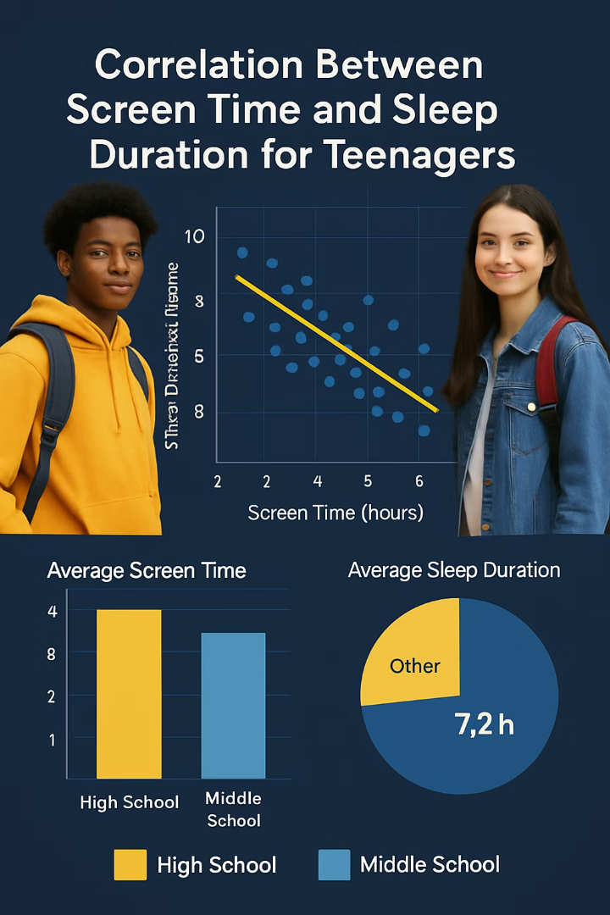




DIFFERENT EXAMPLE IDENTIFIED IN THE EVANSTON
CURRICULUM
(This may be too basic for our cohort anyways)
Their Evidence-Based Findings
Nuanced Results
8
Data showed a more complex picture than either initial assumption.
6
Sleep Duration (hours)
4
Phone Correlation
Excessive phone use did correlate with shorter sleep for some students.
0
Structural Factors
Students with strict screen limits still struggled with early wake-up times.
4
3
Multiple Causes
Both personal habits and school schedules contributed to morning fatigue.

Slide 17



NOT in curriculum BUT can stay and be mentioned very briefly
From Curiosity to Focused Questions
Curiosity Spark
The urge to know more about something that intrigues you
Wonder
Asking yourself "Why is this happening?" or "How does this work?"
Research Question
Transforming curiosity into a clear, specific question to explore

Slide 18
OUT​
From Curiosity to Focused Questions
Curiosity Spark
The urge to know more about something that intrigues you
Wonder
Asking yourself "Why is this happening?" or "How does this work?"
WHAT ARE YOU CURIOUS ABOUT?

Slide 19



OUT​
Transforming Curiosity into Research Questions
Pandemic Curiosity
"It's weird that people rushed to buy toilet paper during the pandemic."
Research Question
"What factors caused people to panic-buy toilet paper during COVID-19?"
Plant Curiosity
"My houseplants grow differently in different rooms
of my house."
Research Question
"How does sunlight exposure affect the growth rate of my houseplants?"

Slide 20
Can keep it and mention quickly
but not in the curriculum for Scholars
The Difference Between Opinion and Research
Opinion
Research
What you think or feel about something, based on personal perspective.
Systematic investigation that produces evidence-based conclusions.
Subjective
Objective
Based on personal belief
Based on data and evidence
May lack supporting evidence
Follows methodical processes

Slide 21
Can keep it and mention quickly
but not in the curriculum for Scholars
Examples of Opinion
Everyone should stop using social media completely.
It’s better to study late at night than early in the morning.
Recycling doesn’t make much of a difference to the planet.
Fast food should be banned in school cafeterias.
Climate change is too big of a problem for individuals to make a difference.

Slide 22
Can keep it and mention quickly
but not in the curriculum for Scholars
Examples of Research Statements
According to the CDC’s 2021 Youth Risk Behavior Survey, which surveyed over 14,000 U.S. high school students, nearly 30% reported feeling persistently sad or hopeless during the past year.
A 2020 global survey by Pew Research Center involving more than 13,000 adults in 13 countries found that 73% saw climate change as a major threat to their country.
A randomized controlled sleep study at UC Berkeley found that teens who slept at least 8 hours performed significantly better on memory tasks than those with less sleep. The study involved 105 adolescents aged 13–17. (Lopez et al., Sleep Research Journal, 2018)
The World Health Organization, based on data from dozens of national health agencies, estimates that air pollution causes 7 million premature deaths worldwide each year. (WHO, 2021)
In a Common Sense Media survey of 1,306 teens aged 13–17, 25% reported that social media had a mostly negative impact on their mental health. (Common Sense Media, 2021)

Slide 23
OUT
Let’s Play a Game:
OPINION or RESEARCH?

Slide 24
OUT​
A Stanford University longitudinal study (2019) followed 200 middle school students over two years and found that those practicing daily mindfulness showed lower stress and anxiety levels.

Slide 25
OUT​
Social media is ruining real-life friendships.

Slide 26
OUT​
The 2023 IPCC report, drawing from thousands of peer-reviewed climate studies and global temperature data, concluded with high confidence that human activities are the dominant cause of recent climate change. (Intergovernmental Panel on Climate Change, 2023)

Slide 27
OUT​
You can’t be truly successful without going to college.

Slide 28
OUT​
Homework should be optional for high school students.

Slide 29
OUT​
A JAMA Pediatrics study (2019) analyzed data from over 6,000 U.S. children aged 8–11 and found that those with more than 2 hours of recreational screen time daily had lower language and thinking skills.

Slide 30
OUT​
In the APA’s 2023 "Stress in America" survey, conducted with 3,185 teens and adults, over 70% of teenagers said they felt overwhelmed by responsibilities in the past month.

Slide 31
OUT​
Reading printed books is more enjoyable than reading on a screen.

Slide 32
OUT​
According to a National Sleep Foundation (2020) poll of 1,006 U.S. teens, 87% of high schoolers get less than the recommended 8–10 hours of sleep on school nights.

Slide 33
Can stay
A Key Attitude of a Researcher: Inquisition
How do I know that?
What information is this opinion based on?
What’s that claim based on?
Has anyone actually tested it?
Where is the evidence?

Slide 34
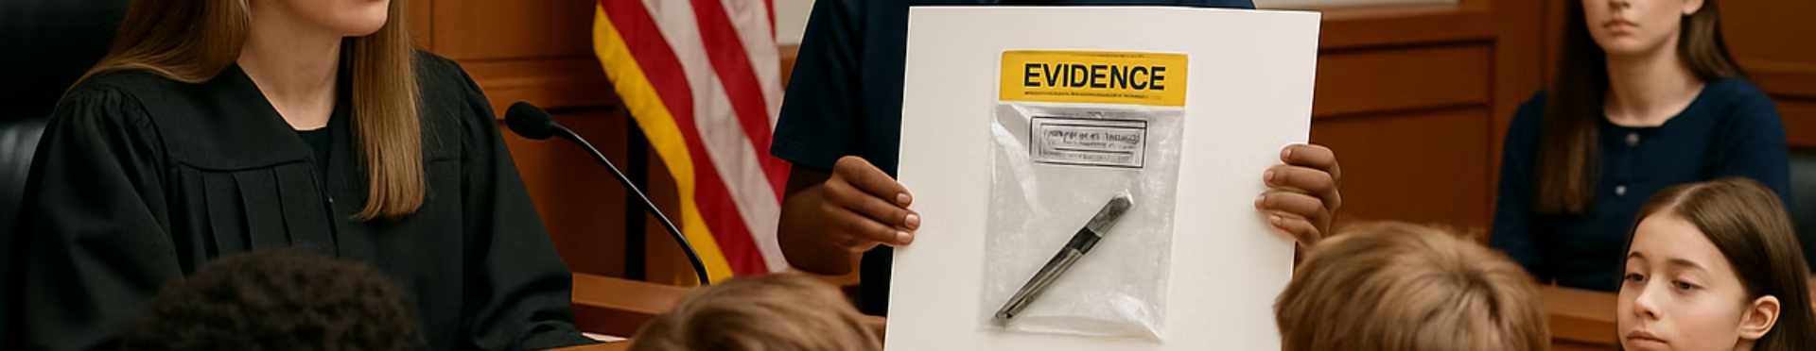
OUT​
Unless we want to add it on
Why Evidence Matters
47%
73%
5X
Misinformation
Better Decisions
Problem-Solving
Percentage of online content containing inaccurate claims
Improved outcomes when using evidence-based approaches
More effective solutions when based on research

Slide 35





OUT​
Questioning Claims: The Mozart Effect
The Claim
The Inquiry
The Research
The Evidence
"Listening to classical music while studying guarantees an A on the test."
"What's that claim based on? Has anyone actually tested it?"
Find scientific studies or conduct a small experiment comparing study methods.
Music may help mood or focus for some people, but doesn't "guarantee" success.

Slide 36
Not in curriculum
Types of Research: A Multidisciplinary Approach

Slide 37








Not in curriculum
Types of Research: A Multidisciplinary Approach
Scientific Research
Social Science Research
Explores the natural world through experiments and systematic observation
Examines human behavior and social systems through surveys and analyses
Historical Research
Interdisciplinary Research
Investigates the past through primary sources and contextual interpretation
Combines multiple fields to address complex questions holistically

Slide 38
Not in curriculum
Interdisciplinary Research
Climate Change Research
Public Health Crisis
Combines natural science, economics, sociology, and policy studies
Integrates biology, medicine, psychology, and historical precedent
Technology Ethics
Urban Planning
Bridges computer science, philosophy, psychology, and law
Merges architecture, sociology, economics, and environmental science

Slide 39
Not in curriculum
Core Principles of Good Research
No matter what the field is

Slide 40






Not in curriculum
Core Principles of Good Research
No matter what the field is
Be Honest
Be Systematic
Be Curious

Slide 41

Not in curriculum
Principle 1: Be Curious
The Starting Point
Everyday Questions
Curiosity is where all research begins—the spark that ignites investigation.
Major discoveries often begin with simple observations or moments of wonder.
Embracing the Unknown
Being comfortable asking "Why?" and "What if?" drives meaningful research.

Slide 42
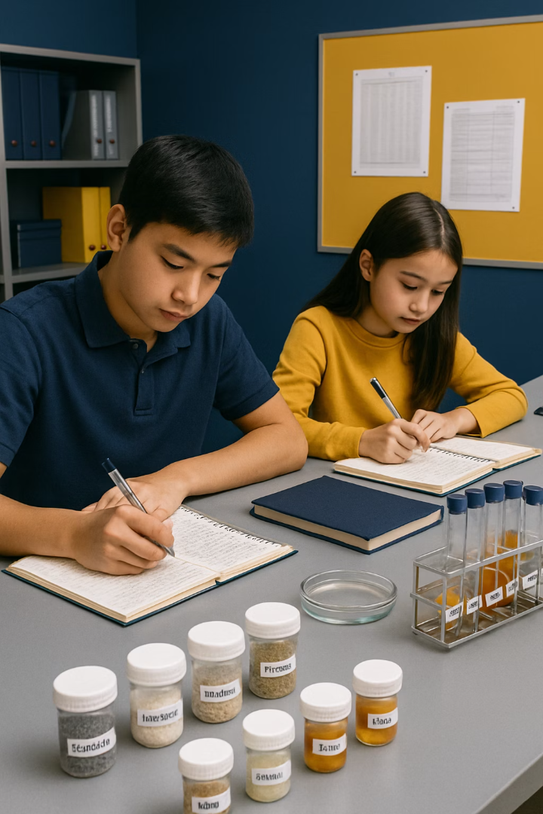
Not in curriculum
Principle 2: Be Systematic
Beyond Hunches
Replicability
Systematic research follows clear procedures rather than random exploration.
Others should be able to follow your process and reach similar conclusions.
Organization
Keeping careful records and following methodical steps builds credibility.

Slide 43





Not in curriculum
Principle 3: Be Honest
Report All Findings
Include inconvenient results that don't match your expectations
Accept Uncertainty
Acknowledge when the data doesn't show clear answers
Give Credit
Cite sources properly and acknowledge others' contributions
Build Trust
Integrity makes your research valuable in school and beyond

Slide 44
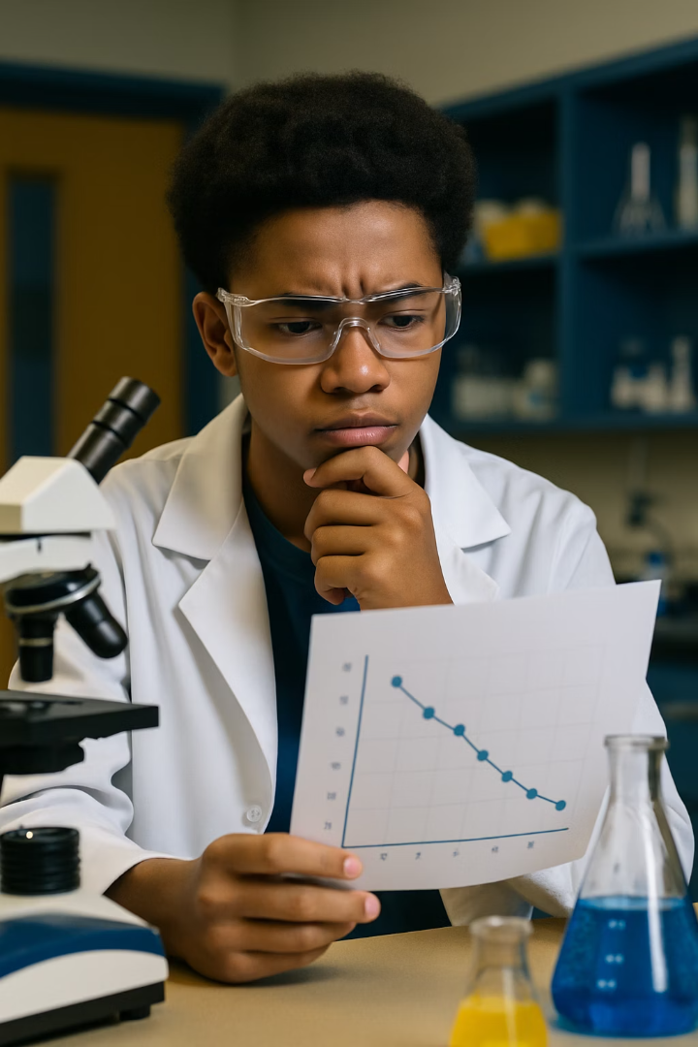
Not in curriculum
The Value of Being Wrong
Embrace Unexpected Results
Learning Opportunity
When your hypothesis is wrong, you've learned something valuable about what isn't true.
Surprising findings often lead to the most important discoveries in research.
Intellectual Honesty
Acknowledging incorrect assumptions demonstrates scientific integrity and builds credibility.

Slide 45
The Research Process
The journey from question to insight follows these essential steps:
Ask a Question
Formulate a clear, specific question worth investigating
Gather Information
Collect relevant data through appropriate methods
Analyze the Information
Examine data for patterns, trends, and meaning
Draw Conclusions
Develop evidence-based answers to your original question
Share Findings
Communicate results effectively to appropriate audiences

Slide 46
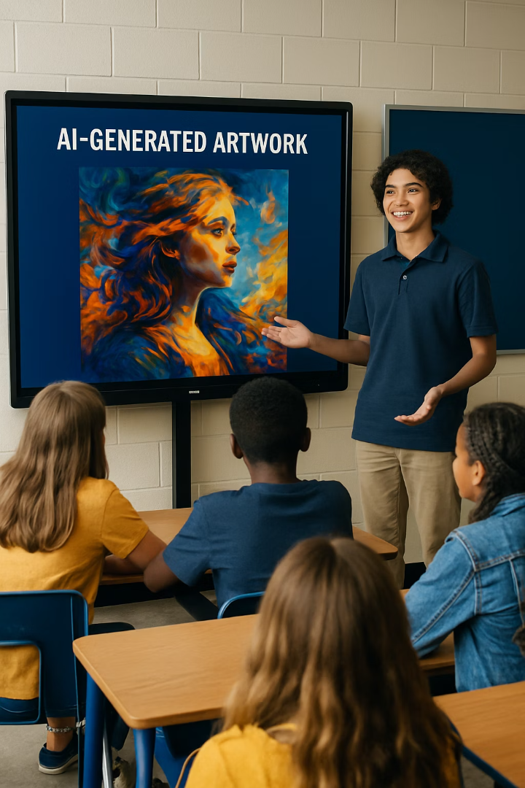



Curriculum suggests different examples
#1
Case walk-through: 'How did researchers figure out smoking causes lung cancer?' Walk through the stages: observational data → hypothesis → design → evidence → policy change. Connect each stage to the research cycle.
Real Research Example: AI Art in Education
Question
Could AI tools help more students feel empowered to create art?
Information Gathering
Surveys, teacher interviews, examples from other schools, literature review
Analysis
30% felt confident in drawing skills; 80% would try AI art tools
Conclusion & Action
AI art competition could broaden creative access; school launched pilot program

Slide 47
Curriculum suggests different examples
#2
Real-World PBL Case: Sports Analytics: Do Home Teams Really Win More?
Share the question: 'Do home teams have a real advantage in the NBA — and if so, why?' Present summary statistics from real NBA data (available at basketball-reference.com). Ask: Is this a research question? What evidence would we need? What would 'prove' it?
This case is used again in DataCORE Day 1 PM when students load actual NBA game data in Python.
Case Study: School Lunch Research
The Question
Research Design
Layla wondered: Are students getting nutritious lunches that support focus and learning?
Quantitative: Lunch program participation data
Qualitative: Student surveys and focus groups
Observational: Cafeteria behavior patterns
Hypothesis
Stakeholder: Staff interviews
Students avoid lunches due to taste, freshness, or variety issues—not lack of hunger.

Slide 48
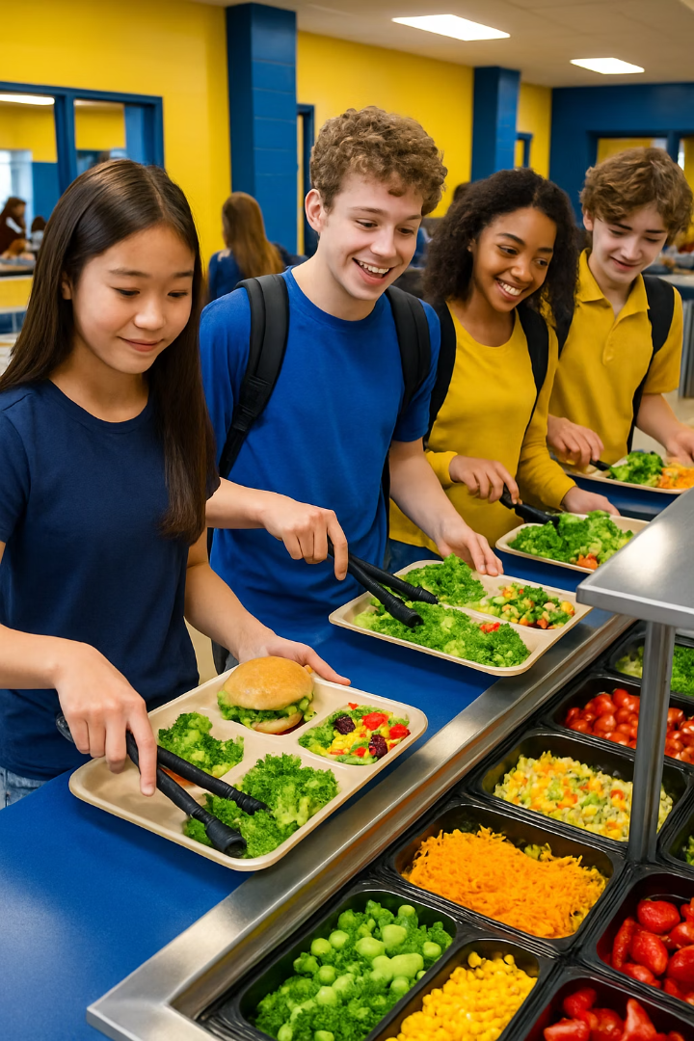




OUT​
Lunch Research: Findings and Impact
Key Findings
Students wanted fresher options, menu variety, and customization
Solutions Proposed
Student advisory panel, taste tests, nutritional labeling, diverse options
Results
School piloted ideas; lunch participation and satisfaction increased
Lesson
Research can solve real problems and improve everyday experiences

Slide 49





OUT​
Summary: Key Takeaways
Research Definition
Systematic investigation to answer questions using evidence
Opinion vs. Evidence
Research moves beyond personal beliefs to factual conclusions
Research Types
Scientific, social science, historical, and interdisciplinary approaches
Research Process
Question, gather, analyze, conclude, and share findings

Slide 50

Small Group Activity: Research in Daily Life
UPDATED ACTIVITY
Update slide accordingly
Teams of 3–4 students receive 5 real-world scenarios (a doctor testing a new medication; a city deciding where to build a bike lane; a company A/B testing a website design; a teacher comparing two teaching methods; a government tracking COVID-19 spread). Each team identifies: What is the research question? What data was collected? What was the conclusion?

Slide 51
OUT​
Activity: Find the Research in Your Life
Identify A Recent Decisions
List questions or choices you've faced lately, small or significant
Map Your Research Steps
Note how you gathered information before deciding
Evaluate Outcomes
Record your decisions and whether research improved results
Share and Reflect
Compare approaches with classmates or consider your research patterns

Slide 52
GLOBAL CHALLENGES
& TEAM FORMATION

Slide 53
Pick a Global Challenge
Journey Ahead:
Your Very Own
Research Process
Ask a Question
Gather Information
Analyze the Information
Draw Conclusions
Share Findings
- The final deliverables: A formal presentation by Day 10 and a research proposal by Day 9

Slide 54
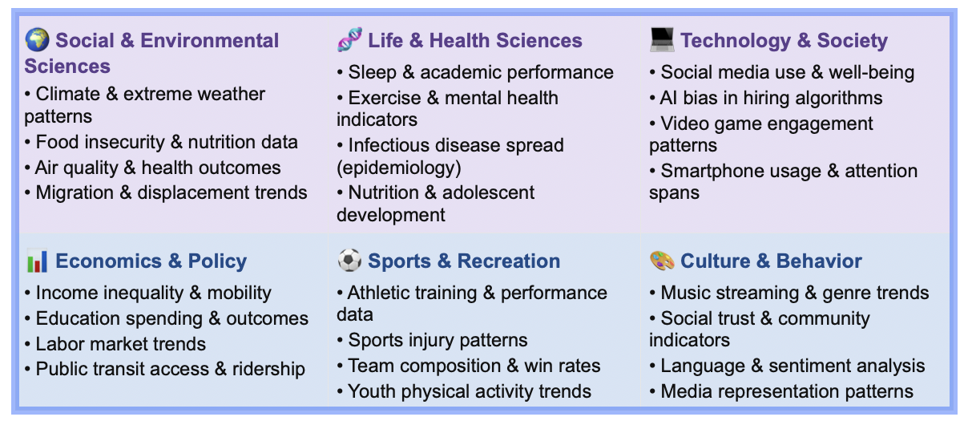
EXPAND THIS SLIDE and add more to include:
Introduce/display the six topic domains (see the pink blue table below ) and Global Top 10 challenges. ​
SIX GLOBAL CHALLENGES
Climate Change
Renewable Energy
Public Health Pandemics
Poverty and Inequality
Educational Access
Digital Privacy

Slide 55
Update with more relatable examples
Climate Change
What it’s about:
The Earth’s temperature is rising due to human activities, mainly burning fossil fuels, which leads to extreme weather, rising sea levels, and ecosystem disruptions.
Key Facts:
The global average temperature has already increased by 1.1°C (2°F) since the late 1800s (NASA, 2024).
2023 was the hottest year on record, with ocean temperatures hitting record highs (Copernicus Climate Change Service, 2024).
By 2050, over 1.2 billion people could be displaced by climate-related hazards like flooding, extreme heat, and droughts (Institute for Economics and Peace, 2020).

Slide 56
Update with more relatable examples
Renewable Energy
What it’s about:
To fight climate change and reduce pollution, we need to shift from fossil fuels to cleaner energy sources like solar, wind, and hydro.
Key Facts:
In 2023, 30% of global electricity came from renewable sources (IEA).
Solar power is now cheaper than coal in many countries (BloombergNEF, 2023).
In 2023, China added more solar capacity than the rest of the world combined, installing over 230 gigawatts - more than enough to power all of France (International Energy Agency, 2024).

Slide 57
Update with more relatable examples
Public Health Pandemics
What it’s about:
Diseases that spread quickly across populations, like COVID-19, can disrupt societies, economies, and healthcare systems on a global scale.
Key Facts:
COVID-19 led to over 770 million confirmed cases globally by 2024 (WHO).
Global vaccine distribution exposed serious inequalities: only 26% of people in low-income countries received at least one vaccine dose by late 2022 (Our World in Data).
In early 2020, China built two emergency hospitals in Wuhan in under 10 days, showcasing high-speed infrastructure deployment during health crises (BBC News, 2020).

Slide 58
Update with more relatable examples
Poverty and Inequality
What it’s about:
Not everyone has equal access to basic needs like food, shelter, education, and opportunity; this gap limits both individual lives and entire communities.
Key Facts:
Over 700 million people—about 1 in 11 globally—live on less than $2.15 a day (World Bank, 2024).
The richest 1% of the world’s population owns almost half of all global wealth (Oxfam, 2023).
China’s poverty rate fell from 88% in 1981 to less than 1% in 2020, largely through rural development and targeted subsidies (World Bank, 2021).

Slide 59
Update with more relatable examples
Educational Access
What it’s about:
Millions of children and teens still don’t have access to quality education.
Key Facts:
244 million children and youth are out of school worldwide (UNESCO, 2023).
Girls are more likely to be excluded from school in low-income countries, especially during crises like war or pandemics.
In Sub-Saharan Africa, 9 out of 10 children are unable to read a simple sentence by age 10 due to poor schooling conditions (UNESCO, 2022).

Slide 60
Update with more relatable examples
Digital Privacy
What it’s about:
As more of our lives happen online, protecting our personal data from being misused by companies, hackers, or even governments is increasingly urgent.
Key Facts:
In 2023, over 7 billion data records were exposed due to breaches (IT Governance).
Teens are among the most targeted age groups for scams and tracking via social media and apps (Pew Research, 2023). Yet, a global survey found that over 60% of teens do not understand how their online data is collected, shared or used (Harvard Kennedy School, 2023).
Add 4 more slides with other challenges' description and ex's.

Slide 61
NEW SLIDE to facilitate student engagement:
Each student completes the
'I am most curious about...' card (1 minute).
Students with similar interests may find each other to work in teams of two OR prefer to work individually.
​

Slide 62

OUT​
Or update
Looking Ahead: Tomorrow
Formulating Research Questions
From Broad to Specific
Methods to narrow general interests into precise, answerable research questions.
Techniques for developing focused, meaningful questions that drive effective research.
Identify Variables
Independent variable (what we change/compare), Dependent variable (what we measure), Confounding variable (the lurking third factor).

Slide 63
Update to match the new curriculum
After-Class Team Session (3:15 – 5:15 PM)
Teams work with TA / peer mentor available. Produce a tangible output before dinner. Not free time.
Team meeting (3:15 PM): Agree on global challenge topic using consensus protocol — each member ranks top 3; pick highest aggregate
Complete Mission Sheet Part 1 together as a team — compare answers, discuss differences
Team output due before dinner: Team name, topic selection, and one-sentence team research interest statement posted in shared doc
Evening Work Period (7:00 – 9:00 PM)
Individual + partner work during CTD RTA study hours. TA available for drop-in questions.
Individual: Complete Mission Sheet Part 2 — KWL table for your chosen topic domain
Individual reading: Review 'What is Research?' one-pager from class
Write a 200-word description of a research project you want to do — question, data source, expected finding
Homework:
Handout 1
Introduction to Research
Finalize teams
Explore data-sets
Decide on your “Global Challenge”
Climate Change
Public Health Pandemics
Poverty and Inequality
Renewable Energy
Educational Access
Digital Privacy

Slide 64
Update to match the new curriculum
After-Class Team Session (3:15 – 5:15 PM)
Teams work with TA / peer mentor available. Produce a tangible output before dinner. Not free time.
Team meeting (3:15 PM): Agree on global challenge topic using consensus protocol — each member ranks top 3; pick highest aggregate
Complete Mission Sheet Part 1 together as a team — compare answers, discuss differences
Team output due before dinner: Team name, topic selection, and one-sentence team research interest statement posted in shared doc
Evening Work Period (7:00 – 9:00 PM)
Individual + partner work during CTD RTA study hours. TA available for drop-in questions.
Individual: Complete Mission Sheet Part 2 — KWL table for your chosen topic domain
Individual reading: Review 'What is Research?' one-pager from class
Write a 200-word description of a research project you want to do — question, data source, expected finding
Homework:
Handout 1
Introduction to Research
Finalize teams
Explore data-sets
Decide on your “Global Challenge”
Climate Change
Public Health Pandemics
Poverty and Inequality
Renewable Energy
Educational Access
Digital Privacy

Slide 65

Let’s wrap up this session!
Questions? Final thoughts?

Slide 66
NEW SLIDE NEEDED
Scientific Storytelling — 'The Research Story Spine' (5 min)
Introduce the narrative structure: Every good presentation tells a story with Beginning (Why does this matter? What did we ask?), Middle (What did we do? What did we find?), and End (What does it mean? What comes next?).

Slide 67
NEW SLIDE NEEDED
Scientific Storytelling — '60-sec Presentation' (10 min)
Students practice in pairs: each person takes one of their topic interests and tells a 60-second 'story spine' of a research project they'd want to do.

Slide 68
OUT​
EXTRA SLIDES
(DIDN’T HAVE TIME TO COVER)

Slide 69
OUT​
NEXT:
GOAL SETTING

Slide 70
OUT​
WHAT WE KNOW ABOUT THIS ISSUE | WHAT WE WANT TO KNOW | ?

Slide 71
OUT​
WHAT ABOUT YOUR GOALS FOR THE CAMP?
Each team write down 2 goals.

