Slide 1

Urban Economics
Effects of incarceration on recidivism and labor market outcomes
Prof. Patrick Button

Slide 2
Plan for today
Overview of the question of how to determine the effects of incarceration.
Summary of two papers that measure how incarceration affects recidivism (re-committing crimes) and labor market outcomes (e.g., employment)
Bhuller, Manudeep, Gordon Dahl, Katrine Løken, and Magne Mogstad. 2016. “Incarceration, Recidivism and Employment.” NBER Working Paper 22648. https://doi.org/10.3386/w22648.
Eren, Ozkan, and Naci Mocan. 2019. “Juvenile Punishment, High School Graduation and Adult Crime: Evidence from Idiosyncratic Judge Harshness.” The Review of Economics and Statistics. https://doi.org/10.1162/rest_a_00872.

Slide 3
Measuring the effects of incarceration
A key policy question is how incarceration affects recidivism and labor market outcomes.
The idea is that incarceration, i.e. putting people in jail, reduces the chances that they engage in criminal activity later.
Is this the case?
First, let’s summarize some possible mechanisms of how incarceration could affect recidivism and labor market outcomes.

Slide 4
Measuring the effects of incarceration
Incarceration could reduce recidivism by:
Reducing the temptation to engage in criminal activity later, to avoid the costs of incarceration that were just experienced (i.e. a deterrent effect).
Increasing education or job training, to the extent that those programs are available in prison. This could increase job market opportunities which would decrease incarceration (think the “rational criminal” model).
Crime often occurs due to substance misuse or mental health issues. If incarceration reduces, rather than exacerbates, those issues then this could reduce recidivism and boost labor supply.

Slide 5
Measuring the effects of incarceration
Incarceration could increase recidivism by:
Causing a deterioration in human capital (i.e. skills, work experience) since the individual is generally not working. This needs to be contrasted with any education or training programs available in prison. The net effect could go either way.
Those with criminal records face discrimination in the job market, which reduces their ability to get a job. This leads to recidivism for many.
If incarceration increases substance misuse or mental health issues, that could reduce labor supply and increase recidivism.

Slide 6
Measuring the effects of incarceration
Determining what the net effect is of incarceration – does it increase or decrease recidivism/labor market outcomes – is tricky because incarceration is not randomly assigned.
Those who are sent to prison are different from those who are not.
A simple comparison of, say, labor market outcomes between those who faced incarceration and those who did not would give a biased estimate of the “effect” of incarceration on labor market outcomes.
E.g., those who faced incarceration had worse labor market outcomes anyways.

Slide 7
Measuring the effects of incarceration
The ideal would be to compare two on-average identical groups of people: one groups is put in prison and the other group is not.
This sort of randomized control trial is obviously not possible or ethical.
So, economists and social scientists look to “natural experiments”, or ways that there was quasi-random variation in incarceration.

Slide 8
Bhuller et al. (2016)
ABSTRACT: Understanding whether, and in what situations, time spent in prison is criminogenic or preventive has proven challenging due to data availability and correlated unobservables.
(i.e. those who face incarceration are different from those who do not)
This paper overcomes these challenges in the context of Norway’s criminal justice system, offering new insights into how incarceration affects subsequent crime and employment.
We construct a panel dataset containing the criminal behavior and labor market outcomes of the entire population, and exploit the random assignment of criminal cases to judges who differ systematically in their stringency in sentencing defendants to prison.
(i.e. judge fixed effects again!)

Slide 9
Bhuller et al. (2016)
ABSTRACT: …Using judge stringency as an instrumental variable, we find that imprisonment discourages further criminal behavior, and that the reduction extends beyond incapacitation.
Incarceration decreases the probability an individual will reoffend within 5 years by 27 percentage points, and reduces the number of offenses over this same period by 10 criminal charges.
In comparison, OLS shows positive associations between incarceration and subsequent criminal behavior.
(This is the misleading results that occurs with a naïve comparison. This estimate is biased towards showing that those who were incarcerated are more likely to commit crimes since those who are more likely to commit crimes anyways, independently of being incarcerated, are also more likely to be incarcerated.)
This sharp contrast suggests the high rates of recidivism among ex-convicts is due to selection, and not a consequence of the experience of being in prison.
(“Selection” is a term you’ll see often in empirical papers. The idea here is that there is not-random “selection” into treatment status. Those with higher rates of recidivism anyways “select” into incarceration. The idea is that selection bias occurs when there is this non-random “selection” into treatment status.)

Slide 10
Bhuller et al. (2016)
ABSTRACT: …Exploring factors that may explain the preventive effect of incarceration, we find the decline in crime is driven by individuals who were not working prior to incarceration.
Among these individuals, imprisonment increases participation in programs directed at improving employability and reducing recidivism, and ultimately, raises employment and earnings while discouraging further criminal behavior.
Contrary to the widely embraced 'nothing works’ doctrine, these findings demonstrate that time spent in prison with a focus on rehabilitation can indeed be preventive.

Slide 11
Recap – Judge Fixed Effects
This is another paper that uses judge fixed effects.
What are those again?
The idea is to exploit the fact that, naturally, in the judicial process in their data, there is random assignment to judges.
Some judges are more lenient while others are more strict.
This random allocation of judges creates quasi-random assignment in incarceration.
I.e. some individuals get incarcerated (or not) just because they randomly got a strict (lenient) judge.

Slide 12

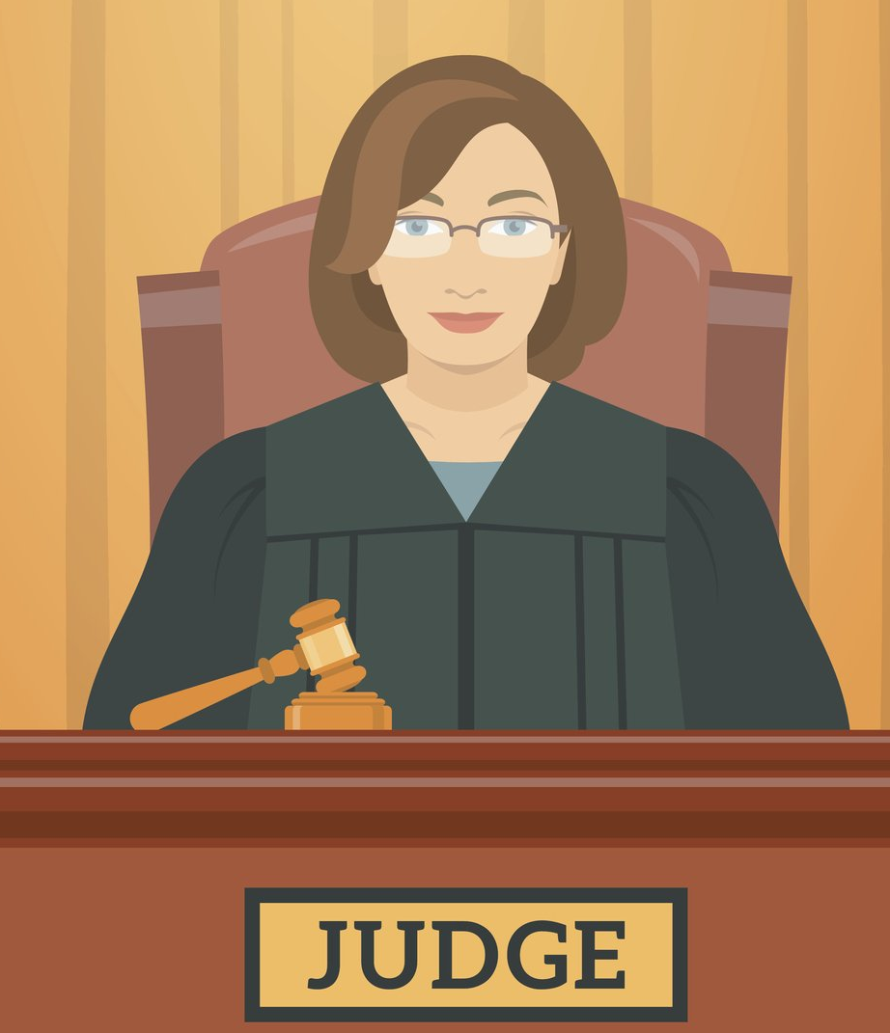



This quasi-random assignment of cases to judges creates quasi-random variation that can be used to study the causal effect of a conviction (or other judicial decision) on causal outcomes.
Lenient judge (less likely to convict)
Strict judge (more likely to convict)

Slide 13
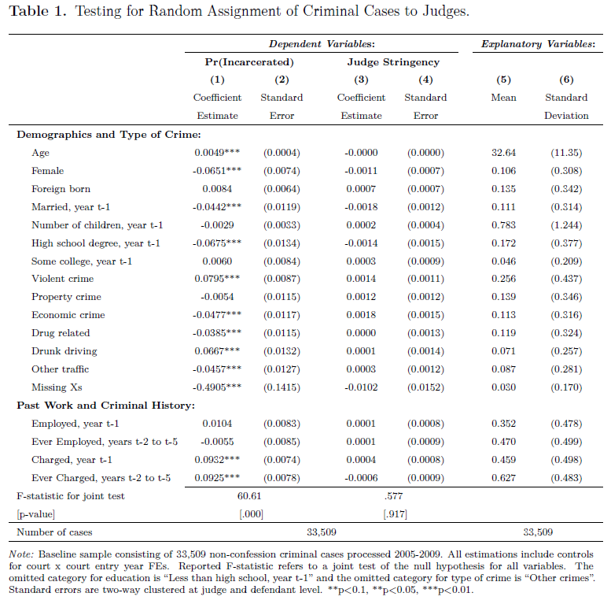
Columns (1) and (2) show how demographics, type of crime, and past work and criminal history affect the probability that you become incarcerated.
Not surprisingly, those who are incarcerated and different from those who are not.
E.g., older, more likely to be male, single, without education, more likely to have done violent crime, and they have more criminal history.

Slide 14
Columns (3) and (4) show how these factors related to judge stringency.
What we want to see if judge stringency is as-good-as-random is that there are few statistically significant relationships between judge stringency and demographic, crime, or work and criminal history factors.
There is no association (nothing is statistically significant), so this strongly suggests that the assignment is as-good-as-random

Slide 15
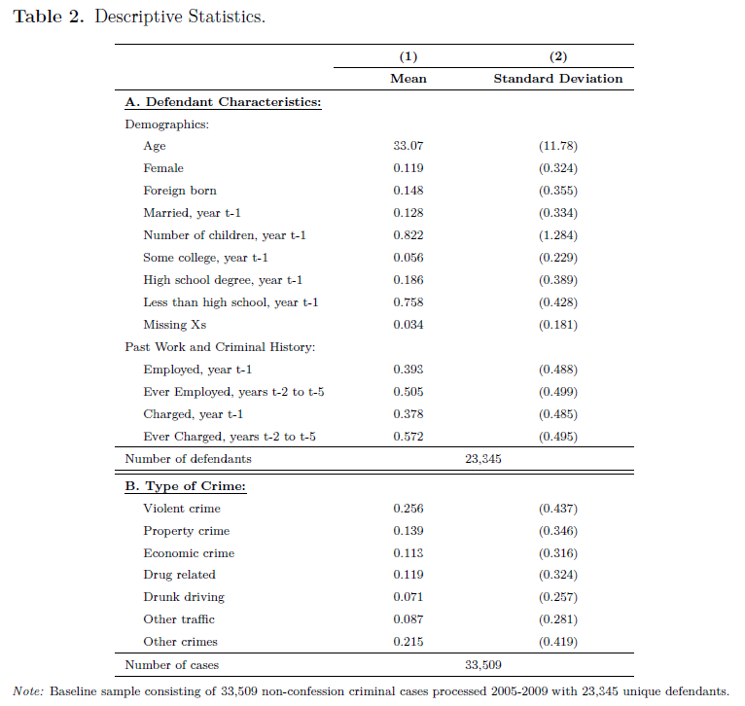
This descriptive statistics table tells you about the general make-up of their sample of individuals who are either assigned to incarceration or not.
Defendants are more likely to be male, unmarried, have children, have low levels of education, have criminal history, and have low levels of employment history.

Slide 16
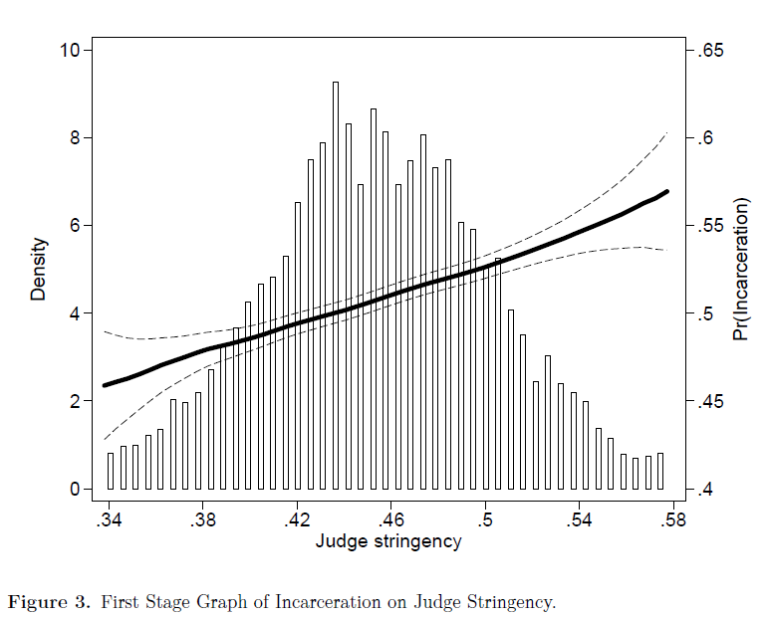
First stage – Does judge stringency affect incarceration?
Yes, as stringency increases, the probability of incarceration increases.
Range of probabilities is about 46% (most lenient) to 57% (most strict)
We can think of 11%/57% = about 19% of incarcerations occur due to judges being pickier than the more lenient judge.

Slide 17
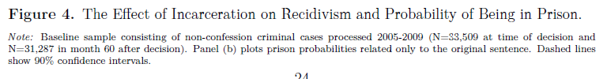
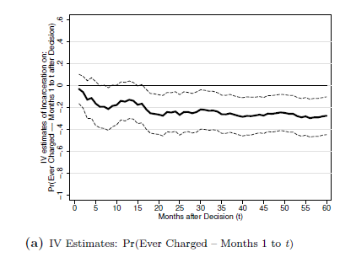
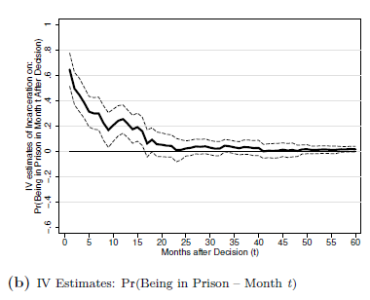
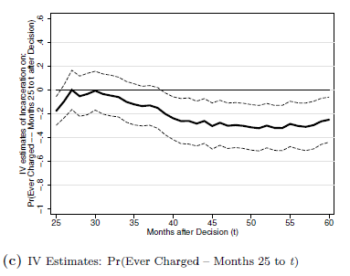

Slide 18
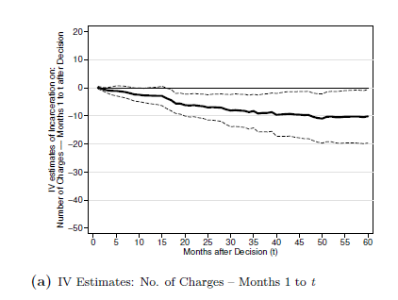
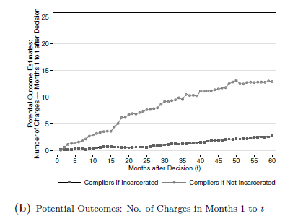

Slide 19
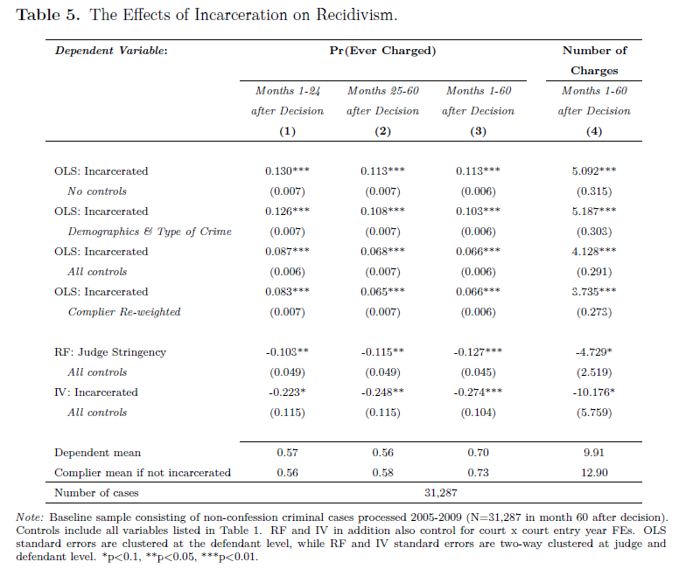
OLS estimates = Ordinary Least Squares. These are naïve estimates that just compare those incarcerated to those who are not.
These show a positive association between incarceration and recidivism.
Adding control variables cuts the effect in half, but even trying to control for observable factors to make those incarcerated = to those not incarcerated is an imperfect exercise.

Slide 20
RF/IV estimates = estimates that use judge fixed effects to compare on-average identical defendants who happened to be randomly assigned lenient vs strict judges.
These estimates show the opposite effect – incarceration reduces recidivism.
The decrease in recidivism persists even up to 60 months later.

Slide 21
The decrease is in recidivism is quite large.
The IV estimate for months 1-60 is
-0.274.
The dependent mean (the baseline mean) “ever charged” probability for those not incarcerated is 0.70.
Therefore, we can think of incarceration decreasing this probability from 0.70 (70%) to 0.70-0.274 = 0.426 (42.6%).
The incarceration rate decreases by 27.4 percentage points, or decreases by about 30.1% compared to the baseline rate of 70%.

Slide 22
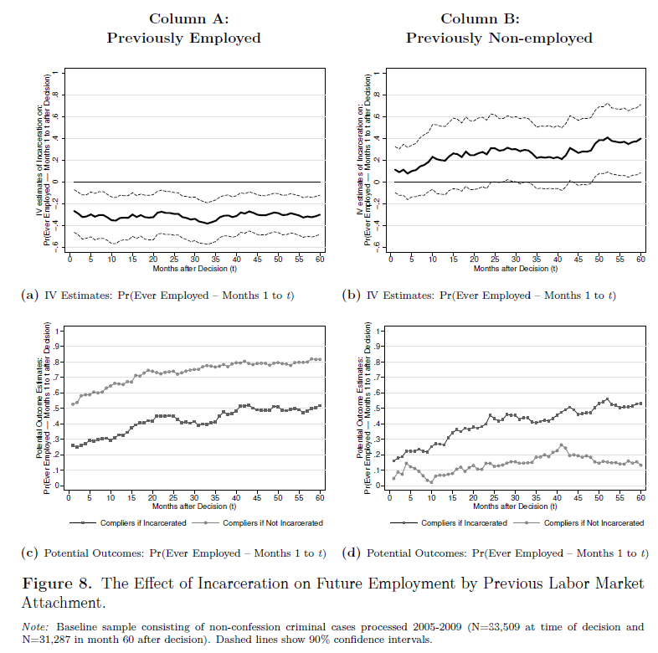
Being employed before the trial seems to affect the results.
We see that those who had been previously employed have employment decreases due to incarceration.
There is evidence that those who were non-employed before the trial experience an increase in employment due to incarceration.
In other results, the authors find that those previous non-employed were more likely to attend job training programs while in prison.

Slide 23
What does it mean to be incarcerated in Norway?
Their result that incarceration reduced recidivism and has mixed effects on employment may seem odd when thinking about incarceration in the US.
Prisons in Norway are different, where “life inside will resemble life outside as much as possible” and “offenders shall be placed in the lowest possible security regime”.
Low-level offenders to go “open” prisons, which are more like dorms.
All prisons offer education, mental health and training programs.
The most common programs are for high school and work-related training. Those not enrolled must work within prison.

Slide 24
What does it mean to be incarcerated in Norway?
Inmates have the right to daily physical exercise and access to a library and newspapers.
They have the same rights to health care as the regular population.
18% of inmates participate in a drug-related program while in prison.
After release, there is also an emphasis on helping offenders reintegrate into society, with access to active labor market and other programs set up to help ex-convicts find a job and access social services like housing support.

Slide 25
What does it mean to be incarcerated in Norway?
Key question: if this study were to have been done in the US, would the results be the same? Or would they be different since prisons in the US provide a much worse experience?

Slide 26
Eren and Mocan – Juvenile incarceration in louisiana
ABSTRACT: This paper contributes to the debate on the impact of juvenile crime punishment on high school completion and adult recidivism using administrative data from Louisiana.
We exploit random assignment of cases to judges and use idiosyncratic judge stringency in imprisonment to estimate the causal effect of incarceration.
(i.e. judge fixed effects yet again!)
We find that juvenile incarceration increases the propensity of being convicted for a drug offense in adulthood while it lowers the propensity to be convicted of a property crime.
Juvenile incarceration has also a detrimental effect on high school completion for earlier cohorts, but it has no impact on later cohorts.

Slide 27
This quasi-random assignment of cases to judges creates quasi-random variation that can be used to study the causal effect of a conviction (or other judicial decision) on causal outcomes.
Lenient judge (less likely to convict)
Strict judge (more likely to convict)

Slide 28
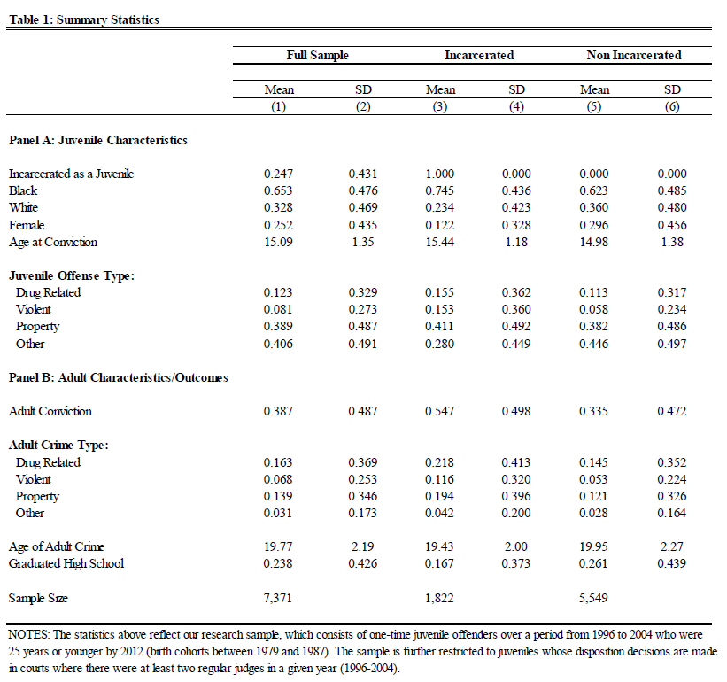
The juvenile defendants in their data are mostly black (65.3%), male (74.8%), and are age 15 on average.
Property and “other” crimes are most common.
On average 38.7% of these juvenile defendants get a conviction in adulthood, with the average age of the adult crime being at almost age 20.
Only 23.8% of the juvenile defendants will go on to eventually graduate high school.

Slide 29
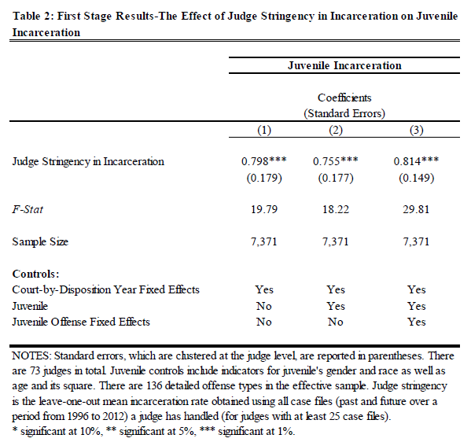
First stage = does judge stringency affect incarceration?
Answer: Yes, absolutely. Incarceration rates are strongly linked to judge stringency.

Slide 30
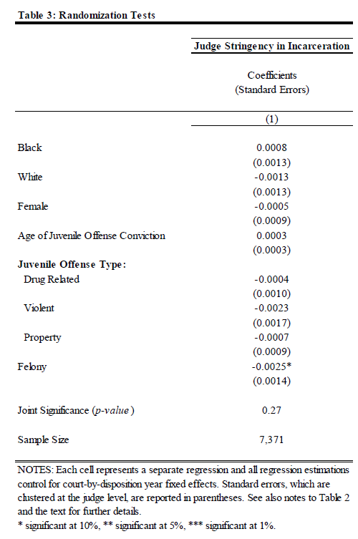
Is assignment to more lenient or more stringent judges as-good-as-random?
Answer: Yes, there is almost no association between defendant characteristics and if they were assigned to a more stringent judge.
(Note: one estimate is significant at the 10% level, but even if there are no effects for all these variables, we would expect to find a false positive 10% of the time. So, likely this one significant estimate is a false positive.)

Slide 31
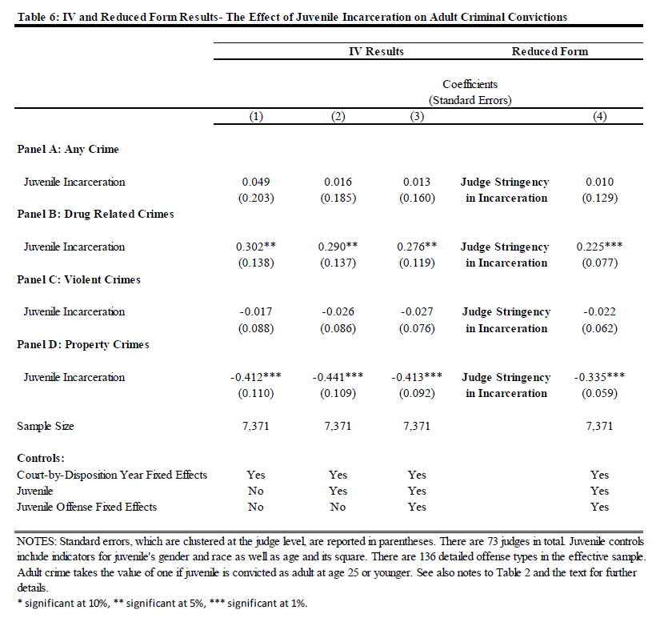
Using judge fixed effects, where they compare on-average juvenile defendants assigned either more lenient or more picky judges, they find that…
Incarceration increases drug-related crimes.
Incarceration decreases property crimes.

Slide 32
In other results, these effects are stronger the longer the person is in prison, especially for drug-related crimes.
In other results, for those born before 1983, incarceration reduces the probability of high school graduation.

Slide 33
Summary of both papers
Bhuller et al. (2016) – Adults, Norway – Incarceration reduces recidivism, mixed impacts on labor market outcomes.
Eren and Mocan (2019) – Juveniles, Louisiana – Incarceration reduces property crime recidivism but increases drug crime recidivism. Incarceration also reduces the probability of high school graduation for earlier cohorts (born before 1983).
Are the different results due to the different contexts? (e.g., juveniles vs. adults, Louisiana prisons vs. Norway prisons)
More research is likely needed. These are two recent new papers that get around the difficult “selection” issue by using administrative data and judge fixed effects.

