Slide 1
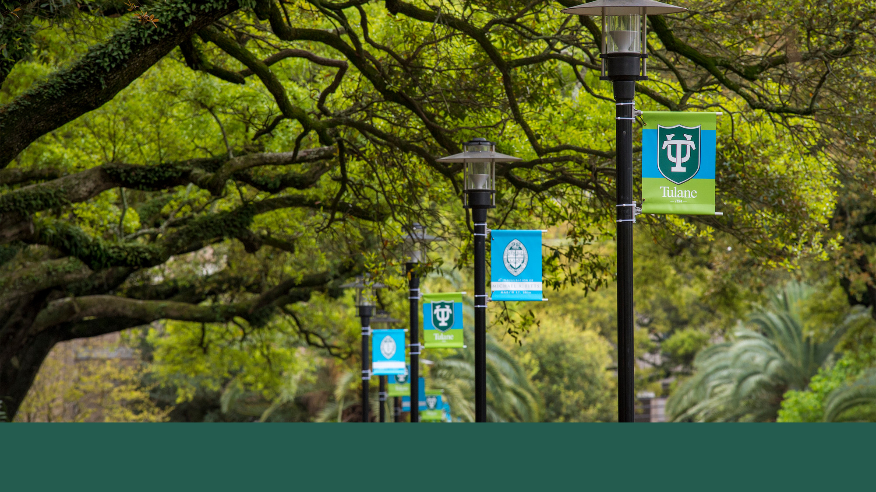
Urban Economics
Econ. Research on Racial Bias in policing
Prof. Patrick Button

Slide 2
Plan for today
Summary of two papers on racial bias police in policing.
Today will be racial bias in police searches, while next class will be racial bias in police use of force.
This lecture will cover two papers:
Coviello, Persico - 2015 - An Economic Analysis of Black-White Disparities in the New York Police Department's Stop-and-Frisk Program
Antonovics, Knight - 2009 - A New Look at Racial Profiling Evidence from the Boston Police Department

Slide 3
Coviello and Persico - NYC Stop and Frisk
Abstract: We introduce a model to explore the identification of two distinct sources of bias in the New York Police Department’s [former] stop-and-frisk program:
the police officer making the stop decisions and
the police chief allocating personnel across precincts.
We analyze 10 years of data from the stop-and-frisk program in light of this theoretical framework…

Slide 4
Coviello and Persico - NYC Stop and Frisk
Abstract: …We find that white pedestrians are slightly less likely than African American pedestrians to be arrested conditional on being stopped.
We interpret this finding as evidence that the officers making the stops are on average not biased against African Americans relative to whites, because the latter are stopped despite being a less productive stop for a police officer.
We find suggestive evidence of police bias in the decision to frisk
Further research is needed.

Slide 5
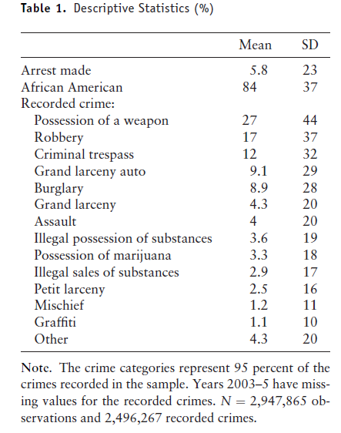
Summary statistics
Summary statistical table of 2,947,865 stop and frisk events in NYC.
5.8% of stops lead to arrests
African Americans make up 84% of people stopped.

Slide 6
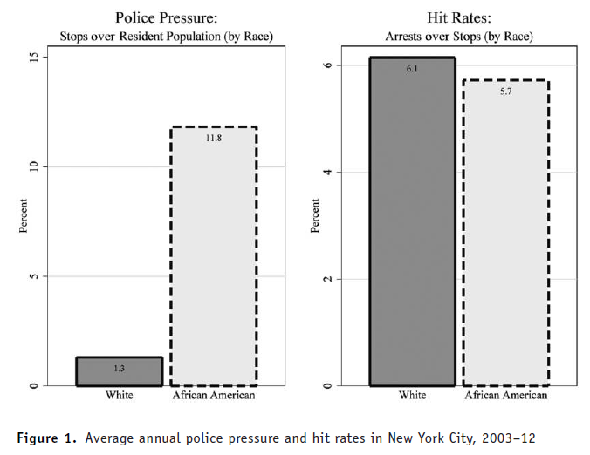
L: police pressure (stops/pop), R: Hit rate (arrests/stops)
Left figure:
African Americans were disproportionately more likely to have been stopped, compared to their population.
African Americans were stopped and frisked about 9x as often.

Slide 7
L: police pressure (stops/pop), R: Hit rate (arrests/stops)
Right figure:
Hit rate = how often a stop leads to an arrest.
Hite rates are similar between white and African American citizens.
The hit rate for whites is a bit higher, suggesting that the average white person stopped and frisked may be slightly more likely to be arrested.

Slide 8
L: police pressure (stops/pop), R: Hit rate (arrests/stops)
Regardless, this is not suggestive of statistical discrimination, where African Americans are searched because they are more likely to have done something that requires arrest.
If this were the case, then the hit rates for African Americans would be higher.
Instead, these results are suggestive of taste-based discrimination, where officers are choosing to search African Americans for reasons of personal preference (animus) and not due to the average criminality by race.

Slide 9
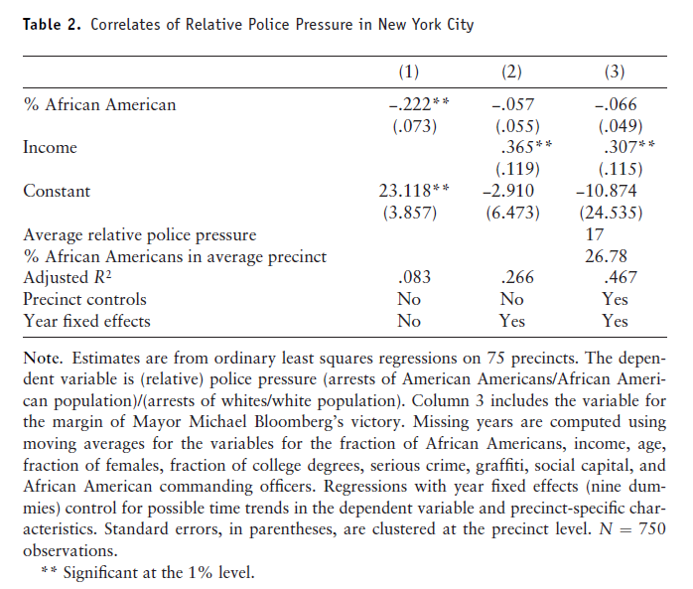
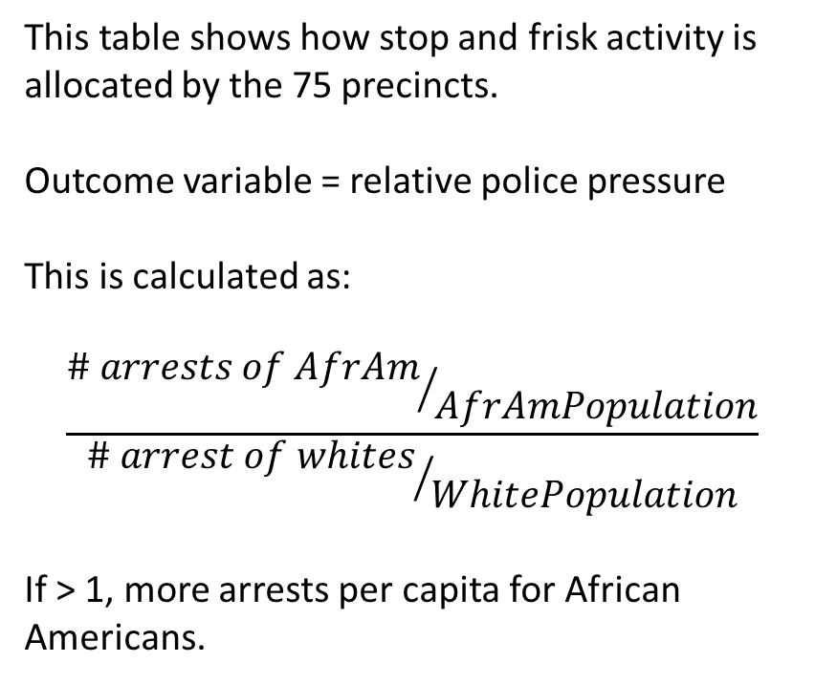
Correlates of Relative police pressure
This table shows how stop and frisk activity is allocated by the 75 precincts.
Outcome variable = relative police pressure
This is calculated as:
$$\frac{{\# arrests of AfrAm}/{AfrAmPopulation}}{{\# arrest of whites}/{WhitePopulation}}$$
If > 1, more arrests per capita for African Americans.

Slide 10
Correlates of Relative police pressure
Column (1) shows that precincts with a higher % African American residents have per capita arrest rates that are lower for African Americans relative to whites.
(Could suggest, e.g., that in whiter precincts, African Americans are relatively more likely to get stopped.)

Slide 11
Correlates of Relative police pressure
Adding precinct resident income estimates (column 2) makes this relationship between % American American and relative pressure disappear.
Instead, we see a strong positive relationship between income and relative pressure.
Interpretation: precincts where the residents are on-average richer have more relative police pressure on African Americans.
(So, you can think of this as police being more likely to stop and frisk African Americans in wealthier – often whiter – neighborhoods.)

Slide 12
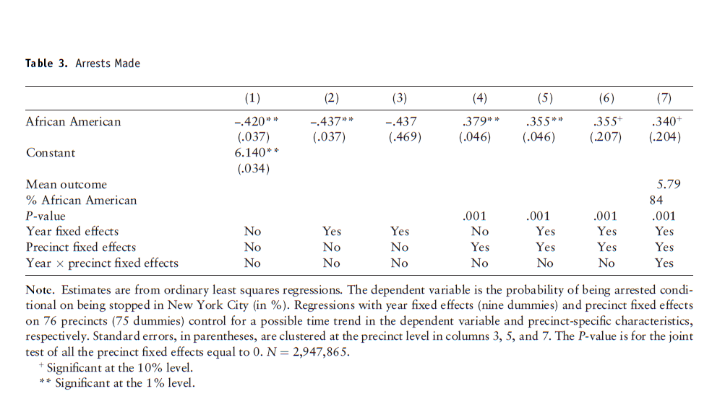
How arrest rates, conditional on stop, vary by race
Outcome variable = arrests made conditional being stopped
(i.e. arrests divided by stops, arrest rate given that a stop occurred)
Key independent variable = African American
The idea here is to see how being African American associates with arrest rates.
Columns (1) to (3) do not include precinct fixed effects.
Columns (4) to (7) do include precinct fixed effects.

Slide 13
How arrest rates, conditional on stop, vary by race
Precinct fixed effects means controlling for average differences between precincts in the outcome variable.
In this case, controlling for average differences by precinct in arrest made.
Columns (1) to (3) do not include precinct fixed effects.
Columns (4) to (7) do include precinct fixed effects.

Slide 14
How arrest rates, conditional on stop, vary by race
Without precinct fixed effects (col. 1 to 3), the data shows that African Americans are less likely to be arrested (conditional on stop).
With precinct fixed effects (col. 4 to 7), …. African Americans more likely to be arrested (conditional on stop)

Slide 15
Coviello and Persico - NYC Stop and Frisk
Interpretation:
With precinct fixed effects, the idea is that within the same precinct, an African-American person is more likely to be arrested than a white person.

Slide 16
How arrest rates, conditional on stop, vary by race
Without the precinct fixed effects, we are comparing white and African American pedestrians both within the same precinct and between different precincts.
If African Americans tend to more often be in precincts where they are often stopped and frisked, but not arrested, then that explain the negative estimates in columns (1) to (3).

Slide 17
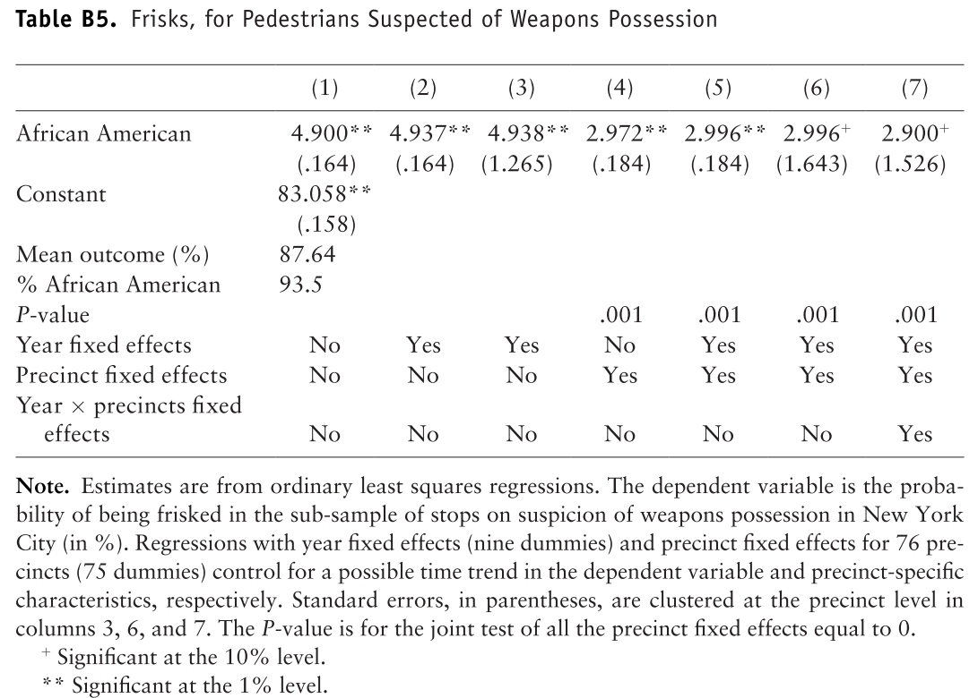
Frisks, for pedestrians suspected of weapons possession
In all case (with and without precinct fixed effects) there is strong or at least weak evidence that African Americans are more likely to be frisks compared to whites.

Slide 18
Coviello and Persico - NYC Stop and Frisk – Summary of results
African Americans were about 9x more likely to be stopped and frisked.
About 53.7% (39.3%) of stops of African Americans (whites) develop into frisks.
After controlling for precinct-level fixed effects (average differences between precincts, so comparing white vs. African American in the same precinct), they find that white pedestrians are slightly less likely than African American pedestrians to be arrested conditional on being stopped.
Two interpretations of this point…

Slide 19
NYC Stop and Frisk – Summary of results
…white pedestrians are slightly less likely than African American pedestrians in the same precinct to be arrested conditional on being stopped.
Interpretation 1) Suggestive in this case of no bias against African Americans, because whites are being stopped despite being slightly less productive stops for police officers (slightly lower arrest rate). Officers slightly “over stop” white pedestrians.
Interpretation 2) Another interpretation could be that officers are biased in their decisions to arrest, and are more likely to arrest African Americans.
It’s difficult to determine to what extent it’s 1) or 2) or a combination of both.

Slide 20
NYC Stop and Frisk – Summary of results
When analyzing frisking, they find that after controlling for precinct-level fixed effects (so, comparing white vs. African American in the same precinct), African Americans are less likely than white pedestrians to be arrested conditional on being frisked.
In this case, this is suggestive of bias against African Americans in the decision to frisk.
Police may have been “over frisking” African American pedestrians.
But the authors note that further research is needed on this point.

Slide 21
Antonovics and knight – boston police car searching
Abstract—This paper provides new evidence on racial profiling using information on the race of both motorists and police officers in Boston.
We develop a new test for distinguishing between preference-based (taste-based) and statistical discrimination.

Slide 22
Antonovics and knight – boston police car searching
Our test is based on the notion that if search decisions are driven purely by statistical discrimination, then they should be independent of officer race.
Our results, by contrast, demonstrate that officers are more likely to search if officer race and driver race differ.
We then investigate and rule out two alternative explanations for our finding

Slide 23
Antonovics and knight – background
The authors use a unique data set where they match the race of the police officer (white, black, Hispanic) with the race of the driver (white, black, Hispanic).
The observe these officer-driver pairs for every traffic stop made by officers in the Boston Police Department from about April 2001 to April 2003

Slide 24
Antonovics and knight – background
They can use this data to determine:
if certain racial groups are more likely to be searched
if officers of certain races are more likely to search vehicles in general
if officers of certain races are more likely to search drivers of certain races

Slide 25
Antonovics and knight – theory
The authors observe that black drivers are more likely to be searched after being stopped.
The authors use this data on car stops and searches by driver and officer race to test to what extent discrimination in car searches is due to preference-based discrimination (taste-based discrimination) or statistical discrimination.

Slide 26
Taste-Based Discrimination – “Animus”
Also called preference-based discrimination
Discrimination that occurs due to not liking or having animus against a group.
Think outright racism, homophobia, sexism, transphobia, ageism, etc.
The term was coined by Gary Becker, a famous labor economist who is known for being one of the first to apply economics to study discrimination in the labor market.
Unsurprisingly, taste-based discrimination is seen as uniformly bad, both because it is inequitable, but it also creates inefficiencies (e.g., inefficiently searching cars/people.)

Slide 27
Statistical discrimination
This theory is typically attributed to Kenneth Arrow's 1973 work The Theory of Discrimination and to Edmund Phelp's 1972 paper The Statistical Theory of Racism and Sexism.
The idea is that some discrimination is based on individuals using actual or perceived information about the differences between groups – i.e. actual or perceived statistical differences between groups.
Minority status – such as race or ethnicity – is used a proxy for something else.

Slide 28
Statistical discrimination - Policing
Police offers could (and likely do) statistically discriminate in interactions with citizens.
They may, for example, be more likely to assume that people of color have done something wrong, have drugs in their car, etc.,
For these “reasons”, police may be more likely to search people of color through car searches, “stop and frisk” etc.
In this example, race is used as a proxy for assumptions about criminality.

Slide 29
Distinguishing taste vs statistical
Antonovics and Knight (2009) use their data on traffics stops, and to what extent there were searches of vehicles by driver and officer rate to determine to what extent the discrimination they observe (higher search rates for black drivers) is due to taste-based discrimination or statistical discrimination.
If black/Hispanic drivers, conditional on being pulled over, are more likely to be searched than white drivers, and this does not vary by officer race, this is likely suggestive of statistical discrimination.
All officers are assuming that those groups are more likely to have drugs, weapons, etc.

Slide 30
Distinguishing taste vs statistical
If black/Hispanic drivers, conditional on being pulled over, are more likely to be searched than white drivers, and this does vary by officer race, this is likely suggestive of taste-based discrimination.
Officers of a particular race prefer to search motorists of a particular race more often, which likely reflects taste-based discrimination, since, otherwise, we would see similar behavior by officers of other races.

Slide 31
Distinguishing taste vs statistical
Antonovics and Knight (2009) thus conduct two tests:
Conditional on being stopped, do we see that black and/or Hispanic motorists are more likely to be searched, regardless of officer race?
If yes, there is statistical discrimination
Conditional on being stopped, do we see that black and/or Hispanic motorists are more likely to be searched by white officers?
If yes, white officers exhibit taste-based discrimination against black and/or Hispanic motorists.

Slide 32
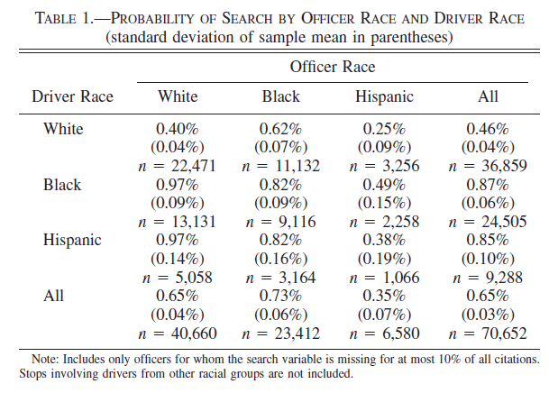
Antonovics and knight – boston police car searching
From the summary statistics, we can see so far that:
1) black and Hispanic drivers are more likely to be searched (rates of 0.87% and 0.85% versus 0.46%), and
2) In this raw data, black officers are more likely that white officers to search (0.73% to 0.65%) and white officers are more likely than Hispanic officers to search (0.65% to 0.35%)

Slide 33
Antonovics and knight – boston police car searching
These trends could be affected by neighborhoods, however, where perhaps black officers work in neighborhoods where search rates happen to be higher (e.g., higher crime areas).
For this reason, it’s important to add neighborhood fixed effects.
These fixed effects control for neighborhoods, which will have different search rates, and police officers of different races will be allocated to different neighborhoods.

Slide 34
Antonovics and knight – boston police car searching
Once neighborhood fixed effects are added, the interpretation is a comparison between white, black, and Hispanic drivers pulled over at stops within the same neighborhood by white, black, or Hispanic officers working in that same neighborhood.

Slide 35
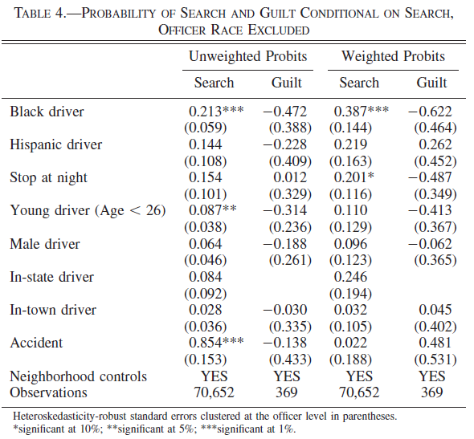
Antonovics and knight – boston police car searching
Without looking at the race of the police officer, these results show that black drivers are more likely to be searched (significant at the 1% level).
But are NOT more likely to be guilty, suggesting that this extra searching of black drivers is inefficient.
(The coefficient is actually negative, although the SE is large so its insignificant.)
No clear evidence that Hispanics are more likely to be searched (coefficient is positive but SE is quite large.)

Slide 36
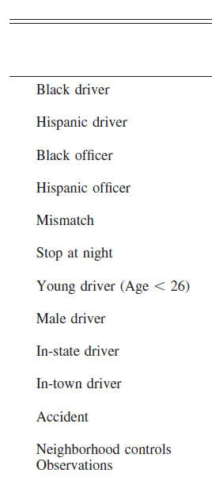
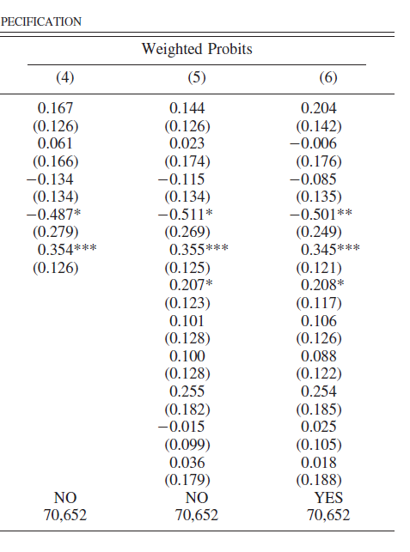
Results from Table 5
This table adds in officer race and a mismatch variable.
The coefficient on black (Hispanic) driver tells you how the search probability differs compared to white drivers. Positive = more likely to be searched than white drivers
The coefficient on black (Hispanic) officer tells you how the search probability differs compared to white officer. Positive = more likely to search than white officers
Mismatch = 1 if the driver and officer race are not the same, 0 otherwise.

Slide 37
Results from Table 5
We also see that Hispanic officers, compared to white officers, are much less likely to search drivers, regardless of the driver’s race.

Slide 38
Results from Table 5
We see that the coefficient on black driver is now insignificant compared to earlier.
This means that we don’t have enough evidence to suggest that black drivers are searched more often when there is NOT a race mismatch between driver and officer (i.e., mismatch = 0).
When we do have a mismatch (mismatch = 1), then searches are significantly more likely.

Slide 39
Results from Table 5
This suggests that what is driving the additional searches done against black drivers is officers of a different race.
This is most likely driven by extra searches by white officers since (1) there are more white officers than Hispanic officers in Boston, by far, and (2) white officers, as we see here, are more likely to search.

Slide 40
These extra searches of black drivers by white officers suggests taste-based discrimination since if it were statistical discrimination, then officers of other races would be searching at similar rates.
These extra searches, driven by taste-based discrimination, are inefficient since, as we saw earlier, black drivers are no more likely (and are perhaps less likely) to be guilty.
There is no statistical reason to search black drivers more, suggesting again that these extra searches stem from taste-based discrimination.

