Slide 1
The Economics of Crime: An Overview
Econ 3320 – Urban economics
Tulane university
Professor patrick button

Slide 2
Overview
Summary of some key points in Marie (2014) “Lessons on the Economics of Crime”
Overview of the “rational criminal” model (the “Becker” model) of crime.
Quick mention of key non-data related points from Dills, Miron, and Summers (2010) “What Do Economists Know About Crime?”
Maps and figures showing general crime trends and statistics, mostly in the US
Which crimes are most common?
Statistics on what % of crimes are reported or solved.
Crime rate trends in the US
Comparisons across states and countries in crime and incarceration rates.
Popular crime topics studied by economists since 2010
Overview of judge fixed effects.

Slide 3
What have economists contributed to the study of crime?
Marie (2014) summarizes four key contributions
A normative framework for evaluating criminal law and crime prevention.
The application of sophisticated quantitative methods to analyze the causes of crime and the effects of crime-control measures in this framework.
The conception of criminal behavior as individual choice, influenced by perceived consequences.
The aggregation of individual choices into a systems framework for understanding crime rates and patterns.

Slide 4
Economics focuses on policy
“Among the social sciences, economics tends to be best suited for addressing issues relevant to policy design. The economic model presumes that observed behaviour is not the inevitable result of underlying social conditions, but rather results from individual choices influenced by perceived consequences. If government policy can change those consequences, then behaviour change will follow.” (p. 8)

Slide 5
Economics focuses on policy
Economics can better focus on policy by studying causality.
What is the effect of some factor (e.g., economic opportunity, police spending) on crime?
The idea to go beyond just noticing correlations or associations, which, up until recently was more-so what those in sociology and psychology had done.
Economics can help answer these questions in two ways:

Slide 6
Economics focuses on policy
Economics can help answer policy questions using causality in two ways:
1) Economic (mathematical) models
The model comes up with predictions as to causal effects.
Pros: the conclusions are irrefutable if the model is correct.
Cons: the model could be incorrect (e.g., oversimplified)

Slide 7
Economics focuses on policy
Economics can help answer policy questions using causality in two ways:
2) Empirical methods (econometrics, data)
Uses data and actual policy events.
Either uses a randomized control trial or uses another methodology (e.g., difference-in-differences) to estimate causality.

Slide 8
Economics focuses on policy
2) Empirical methods (econometrics, data)
Sometimes uses field experiments (e.g., doing the randomization yourself, e.g., randomizing extra police presence)
Often leverages so-called “natural experiments” (a.k.a. quasi-experiments)
The idea behind a natural experiment is that there is something close to randomization happening without researcher intervention.
E.g., studying the impacts of a welfare program on criminal activity, by leveraging the fact that funding was only available for people depending on what day and what time of day they called into the hotline (Palmer, Phillips, and Sullivan, 2019, which we cover later)

Slide 9
Economics focuses on policy
2) Empirical methods (econometrics, data)
The idea behind a natural experiment is that there is something close to randomization happening without researcher intervention.
E.g., you can argue that a policy or event was random, like in Tella and Schargrodsky (2004) who found that a random terrorist event led to an increase in policy presence, and they leverage that to do a DiD (you will see more about this paper later)

Slide 10
Economics focuses on policy
2) Empirical methods (econometrics, data)
Pro: Observes real-life data and policy changes. The research is more “externally valid” compared to using models (e.g., models may not characterize actual behavior, which is complex).
Pro: Since this approach often has economists estimating the causal effects of actual policies or events, it’s easier to comment on those events.

Slide 11
Economics focuses on policy
2) Empirical methods (econometrics, data)
Con: using real-life data is complicated, and it’s often difficult to control for all factors (although this is a difficulty with models, too)
Con: The causal estimation strategy (e.g., DiD) requires assumptions that may not hold. E.g., the parallel trends assumption might not hold.

Slide 12
Economics focuses on policy
Given that both mathematical models and empirical (statistical) methods have pros and cons, it’s ideal to use both if possible.
In economics research more broadly, there has been more growth in empirical, data-driven research over models, likely due to (1) the increase in available data, (2) improvements in causal estimation techniques and statistical software, and (3) a stronger emphasis on studying actual events and actual human behavior.

Slide 13
Cost-benefit analysis
The economic approach to studying crime also brings with it cost-benefit analysis, which balances the cost and benefits of policy actions.
E.g., balance the benefits of reducing crime with the costs of reducing it.
Cost-benefit analysis is frequently used by government to guide policy.
Concepts like marginal costs come into play with cost-benefit analysis:
“The optimal amount of crime is unlikely to be zero, since at some point the marginal costs of additional prevention will exceed the marginal benefit of an additional reduction in crime.” (p. 8)

Slide 14
The “Rational Criminal” Model
A popular economic model of crime.
Models choice between criminal vs non-criminal activity.
Explains how criminal activity can be related to individual economic opportunities and to income inequality.
A simplified “rational criminal” model is presented in the textbook and in these slides.
Chapter 10.1 to 10.2.2 (up to page 214), and 10.3.4 (page 220)
This model is not supposed to explain all criminal behavior, but rather I am summarizing a simple version of this model so you have a sense of the types of models that economists often construct to explore how factors such as economic opportunity affect criminal behavior.

Slide 15
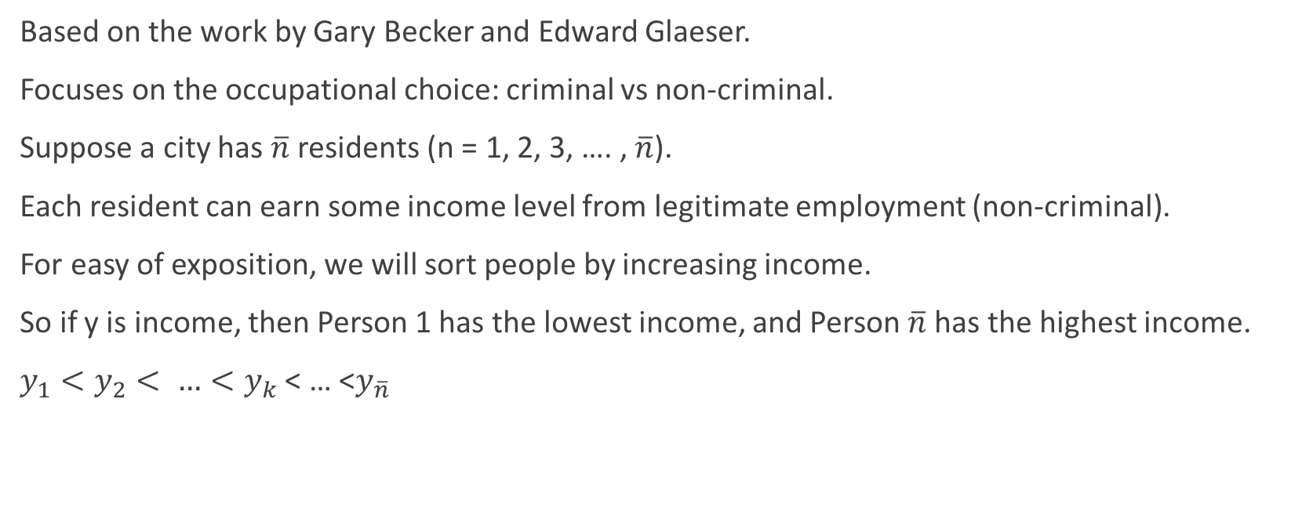
A simple model
Based on the work by Gary Becker and Edward Glaeser.
Focuses on the occupational choice: criminal vs non-criminal.
Suppose a city has $\overline{n}$ residents (n = 1, 2, 3, …. , $\overline{n}$).
Each resident can earn some income level from legitimate employment (non-criminal).
For easy of exposition, we will sort people by increasing income.
So if y is income, then Person 1 has the lowest income, and Person $\overline{n}$ has the highest income.
$y_{1}<y_{2}< …<y_{k}$ < … <$y_{\overline{n}}$

Slide 16
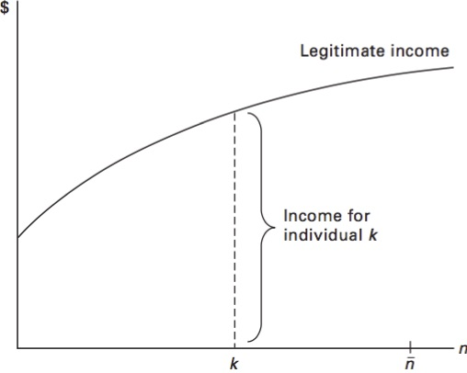
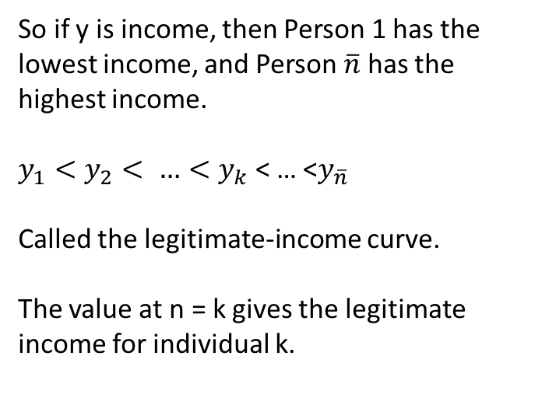
Income for Each Individual
So if y is income, then Person 1 has the lowest income, and Person $\overline{n}$ has the highest income.
$y_{1}<y_{2}< …<y_{k}$ < … <$y_{\overline{n}}$
Called the legitimate-income curve.
The value at n = k gives the legitimate income for individual k.

Slide 17
Criminal Activity – Overview
The alternative to legitimate income is criminal activity.
Individuals can instead steal from others.
Four variables go into calculating the benefits/costs of criminal activity:
1) Value of loot (called L);
2) Probability of apprehension by police (called a);
3) Cost of Jail Time (called J and J is positive as it gets subtracted);
4) Stigma cost to being a criminal (called e).

Slide 18
Criminal Activity – Set Up
The amount per period that individuals can steal is L (L for “loot”).
The value of L is linked to the incomes of rich individuals.
Criminals can be apprehended by police and lose their loot. Let the variable a be the probability of apprehension. So 0 < a < 1.
0 = never apprehended, 1 = always apprehended
Apprehension also imposes the cost of a jail term. Let this be J.
There is a stigma cost that criminals face regardless of if they are apprehended. This is e.

Slide 19
Criminal Activity - Value
1) If apprehended, the criminal has a benefit equal to -J - e
2) If they are not apprehended, the criminal has a benefit equal to L - e.
Case 1) happens with probability a, so Case 2) happens with probability 1-a.
The expected value of the benefit (weighted average between both cases) is:
Probability of Case 2 * Benefit of Case 2 + Probability of Case 1 * Benefit of Case 1
=(1 - a)L – (1 – a)e + a(-J - e) = (1 – a)L – e + ae –aJ -ae
= (1 – a)L – aJ - e

Slide 20
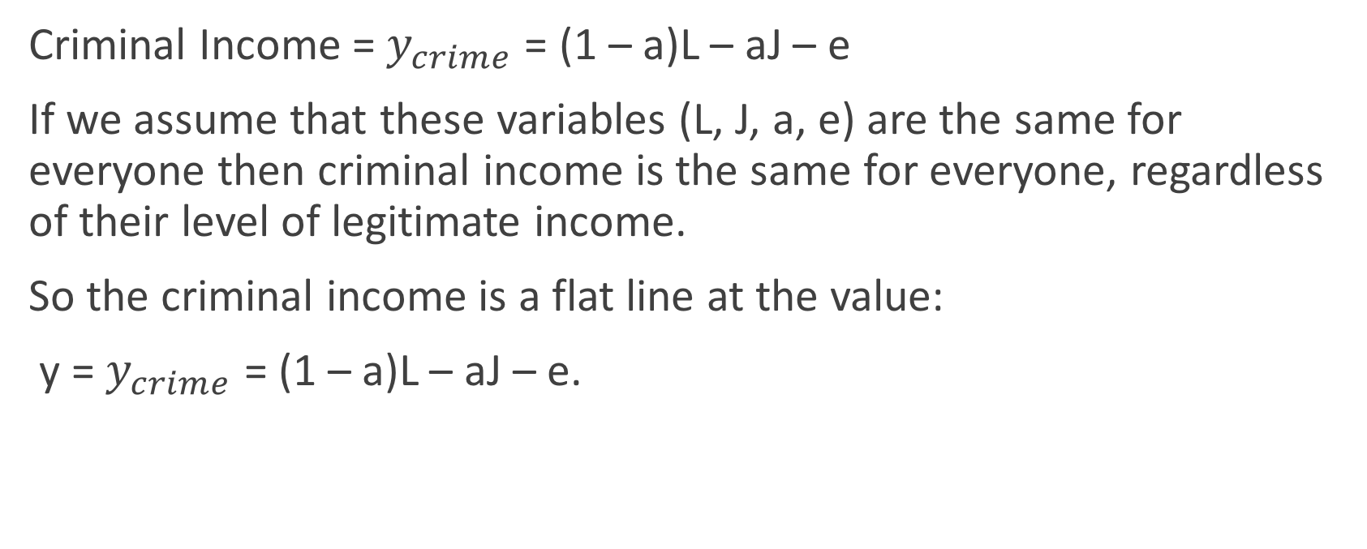
Criminal Activity - Value
Criminal Income = $y_{crime}$ = (1 – a)L – aJ – e
If we assume that these variables (L, J, a, e) are the same for everyone then criminal income is the same for everyone, regardless of their level of legitimate income.
So the criminal income is a flat line at the value:
y = $y_{crime}$ = (1 – a)L – aJ – e.

Slide 21
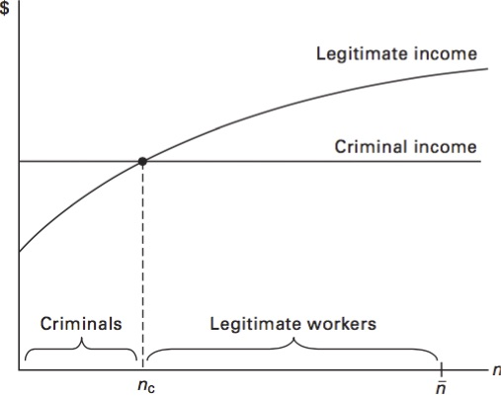
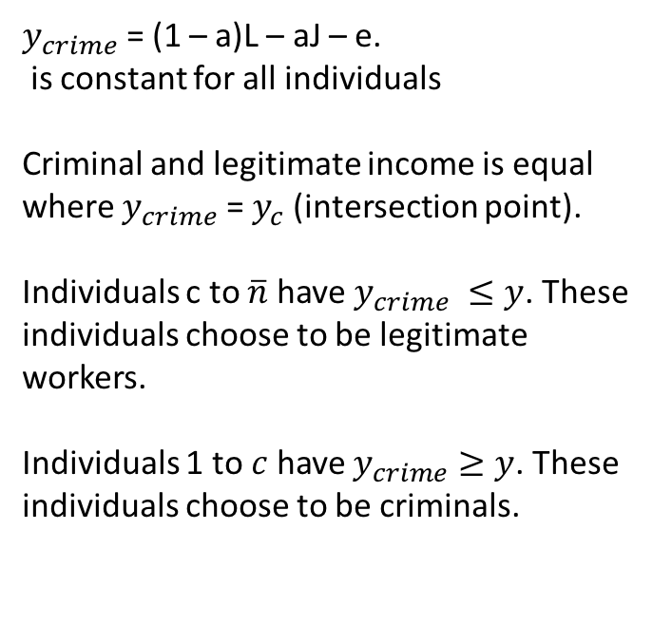
Adding Criminal Income
$y_{crime}$ = (1 – a)L – aJ – e.
is constant for all individuals
Criminal and legitimate income is equal where $y_{crime}$ = $y_{c}$ (intersection point).
Individuals c to $\overline{n}$ have $y_{crime} ≤y$. These individuals choose to be legitimate workers.
Individuals 1 to $c$ have $y_{crime}≥y$. These individuals choose to be criminals.

Slide 22
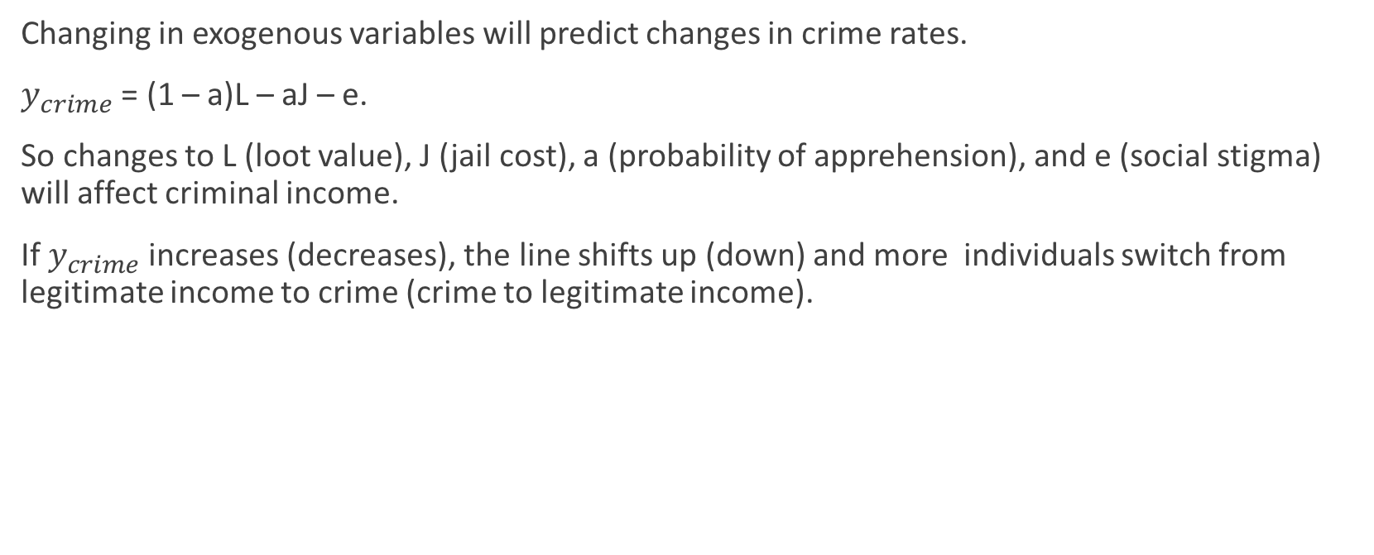
City Characteristics and Crime
Changing in exogenous variables will predict changes in crime rates.
$y_{crime}$ = (1 – a)L – aJ – e.
So changes to L (loot value), J (jail cost), a (probability of apprehension), and e (social stigma) will affect criminal income.
If $y_{crime}$ increases (decreases), the line shifts up (down) and more individuals switch from legitimate income to crime (crime to legitimate income).

Slide 23
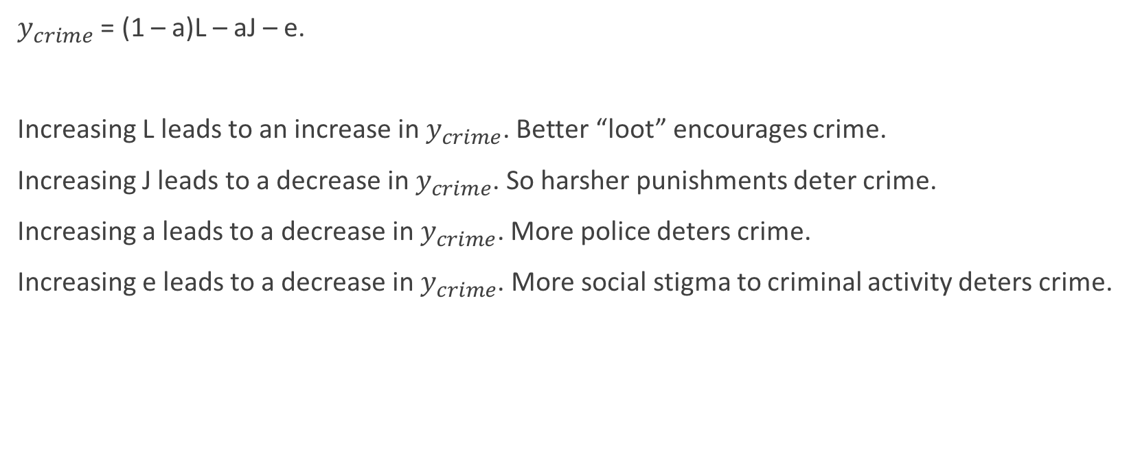
City Characteristics and Crime
$y_{crime}$ = (1 – a)L – aJ – e.
Increasing L leads to an increase in $y_{crime}$. Better “loot” encourages crime.
Increasing J leads to a decrease in $y_{crime}$. So harsher punishments deter crime.
Increasing a leads to a decrease in $y_{crime}$. More police deters crime.
Increasing e leads to a decrease in $y_{crime}$. More social stigma to criminal activity deters crime.

Slide 24
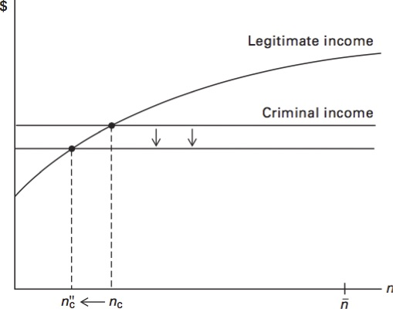
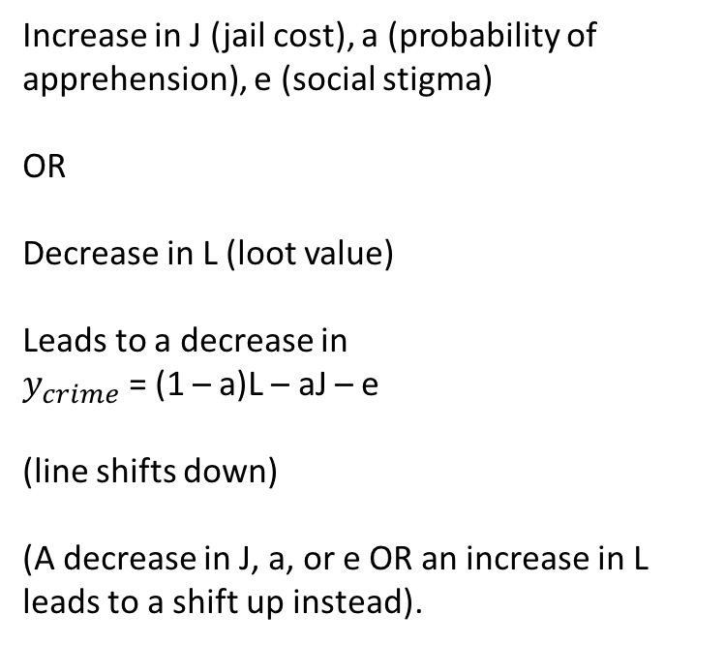
Increase in J (jail cost), a (probability of apprehension), e (social stigma)
OR
Decrease in L (loot value)
Leads to a decrease in
$y_{crime}$ = (1 – a)L – aJ – e
(line shifts down)
(A decrease in J, a, or e OR an increase in L leads to a shift up instead).

Slide 25
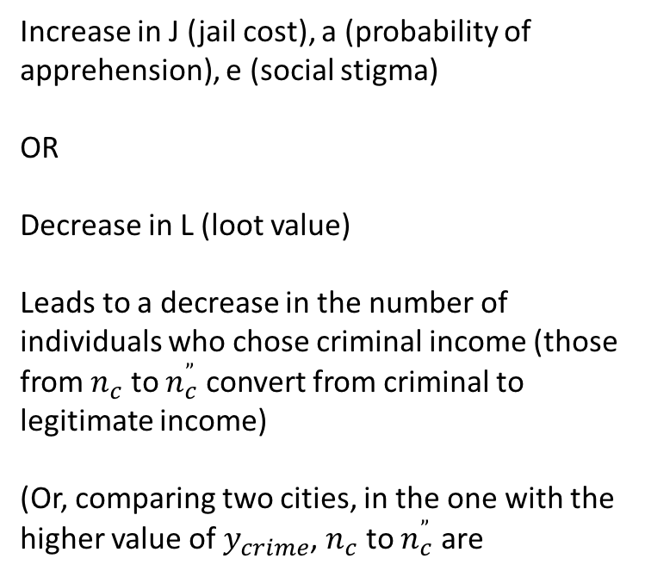
Increase in J (jail cost), a (probability of apprehension), e (social stigma)
OR
Decrease in L (loot value)
Leads to a decrease in the number of individuals who chose criminal income (those from $n_{c}$ to $n_{c}^{”}$ convert from criminal to legitimate income)
(Or, comparing two cities, in the one with the higher value of $y_{crime}$, $n_{c}$ to $n_{c}^{”}$ are

Slide 26
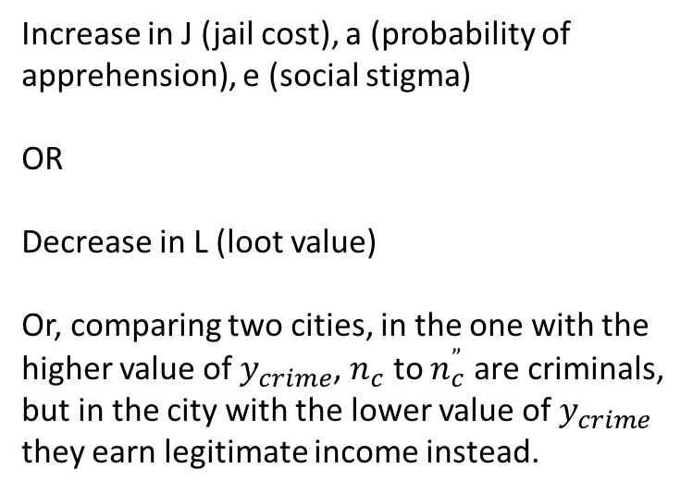
Increase in J (jail cost), a (probability of apprehension), e (social stigma)
OR
Decrease in L (loot value)
Or, comparing two cities, in the one with the higher value of $y_{crime}$, $n_{c}$ to $n_{c}^{”}$ are criminals, but in the city with the lower value of $y_{crime}$ they earn legitimate income instead.

Slide 27
The Economy and Criminal Behavior
The economy could affect criminal behavior.
Consider two cases:
1) Income changes for the disadvantaged population (those with lower values for legitimate income);
2) Income changes for the advantaged population (those with higher values for legitimate income).

Slide 28
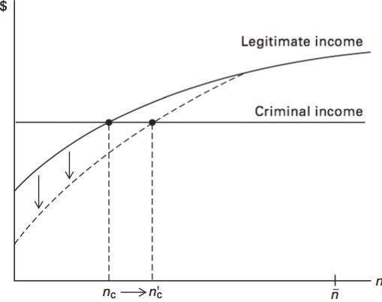
Income Decrease for the Disadvantaged
If increase for the disadvantaged decreases, the legitimate-income curve gets steeper.
This curve intersects the criminal income line at higher value of n.
More individuals rely on criminal rather than legitimate income.
Effect is the opposite for an income increase.

Slide 29
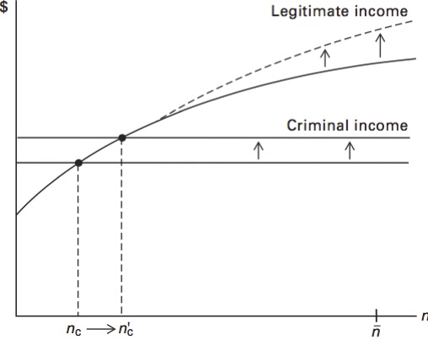
Income Increase for the Advantaged
Suppose income increases for the advantaged.
These individuals where not engaging in criminal activity anyways, and this does not change.
BUT the loot value is linked to the incomes of advantaged individuals.
So this income increase causes L to increase.

Slide 30
What do Economists Know About Crime?
A summary of key points in: Dills, Angela K., Jeffrey A. Miron, and Garrett Summers. 2010. “What Do Economists Know About Crime?” In The Economics of Crime, edited by Rafael Di Tella, Sebastian Edwards, and Ernesto Schargrodsky, 269–302. National Bureau of Economic Research.
Abstract: In this paper we evaluate what economists have learned [since about 2010] about the determinants of crime. We base our evaluation on two kinds of evidence: an examination of aggregate data over long time periods and across countries, and a critical review of the literature.
We argue that economists know little about the empirically relevant determinants of crime. Even hypotheses that find some support in U.S. data for recent decades are inconsistent with data over longer horizons or across countries. This conclusion applies both to policy variables like arrest rates or capital punishment and to less conventional factors such as abortion or gun laws.
The hypothesis that drug prohibition generates violence, however, is generally consistent with the long times-series and cross-country facts. This analysis is also consistent with a broader perspective in which government policies that affect the nature and amount of dispute resolution play an important role in determining violence.

Slide 31
Overview of Economics Research
Economists have devoted significant effort to determining to what extent the Becker model or crime (“rational criminal” model, from earlier) is empirical valid, and to what extent factors like policing, income levels, etc., affect crime rates.
Much research examines deterrence – which factors could reduce crime. This literature focuses especially on arrest and incarceration rates, policing levels, and punishments like longer sentences or the death penalty.

Slide 32
Overview of Economics Research
Other research done by economists studies the causal effects of crime related laws. I.e., can they isolate the actual effect of a law, beyond just a correlation?
Much of this work uses a difference-in-differences approach – comparing areas/people affected by a law change or event (e.g., change in state gun laws) to unaffected control group(s), before and after the law change or event.
Non-exhaustive examples of this work on the causal effect of laws:
Controversial and notable work on how abortion legalization affects crime rates.
Numerous studies on changes in gun laws, often at the state level.
E.g., increased or decreased barriers to gun access or public holding, gun bans, and related legislation like “stand your ground” laws.
Effects of lead exposure on crime (lots of work also in public health on lead).
Drug laws and drug prohibition.
E.g., lots of recent work on state legalization of marijuana and how it affects numerous outcomes, ranging from crime to health.

Slide 33
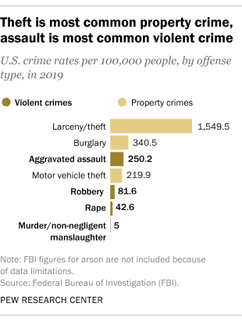
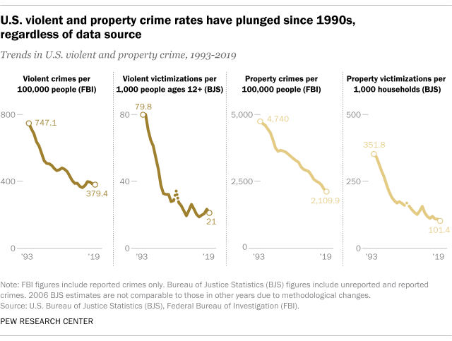
Stylized Facts about Crime in the US (from Pew)

Slide 34
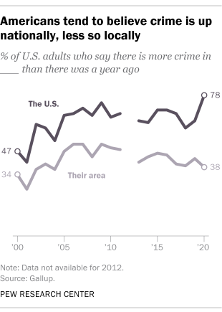
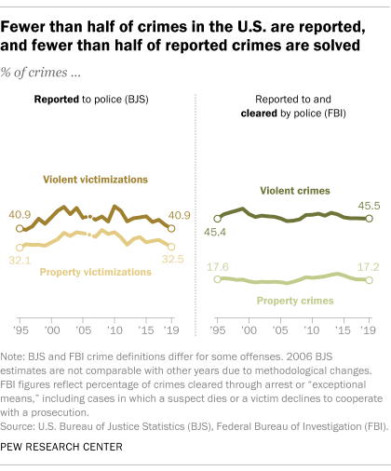
Stylized Facts about Crime in the US (from Pew)

Slide 35
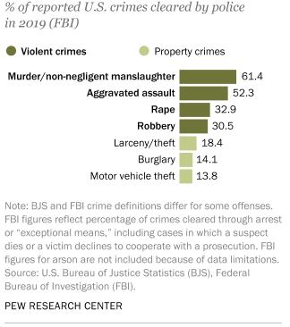
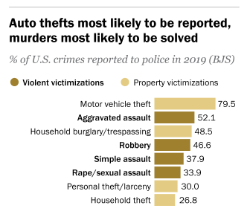
Stylized Facts about Crime in the US (from Pew)

Slide 36
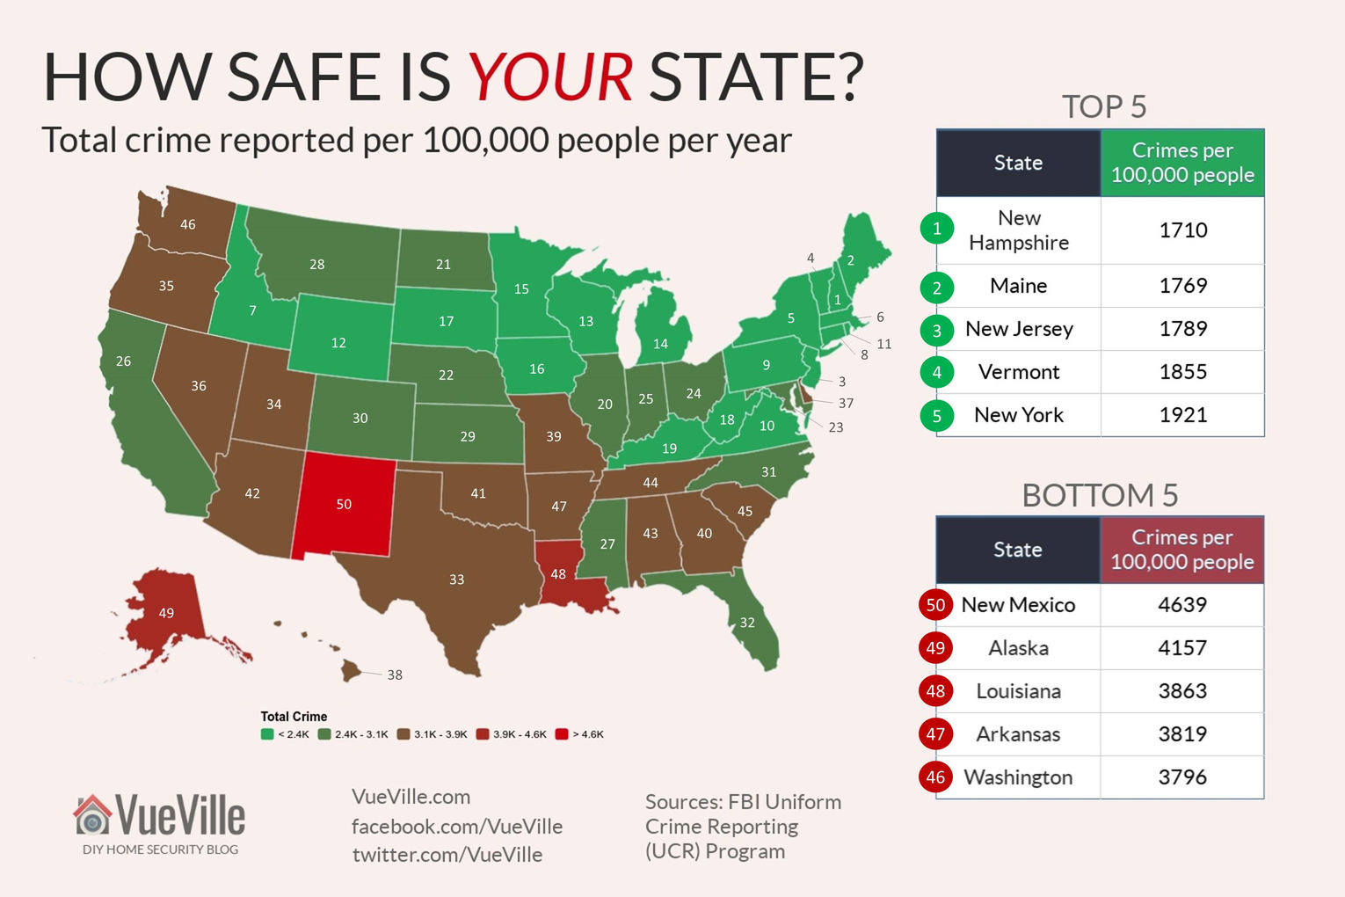

Slide 37
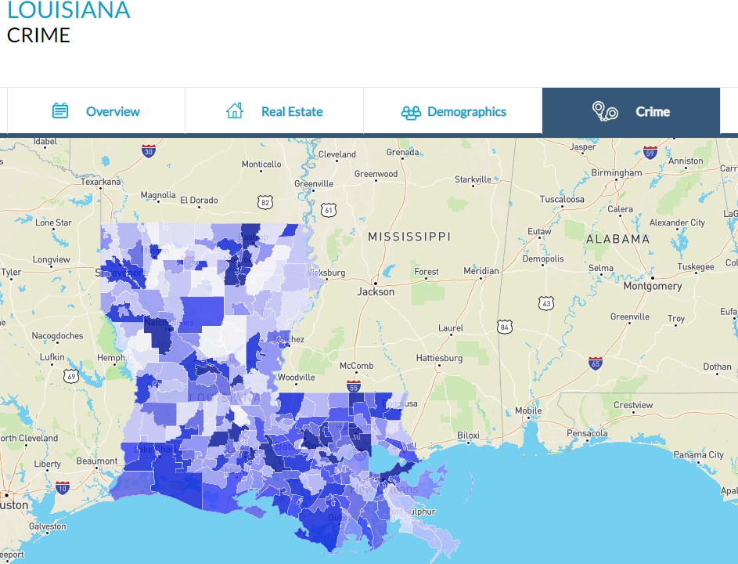
From: https://www.neighborhoodscout.com/la/crime

Slide 38
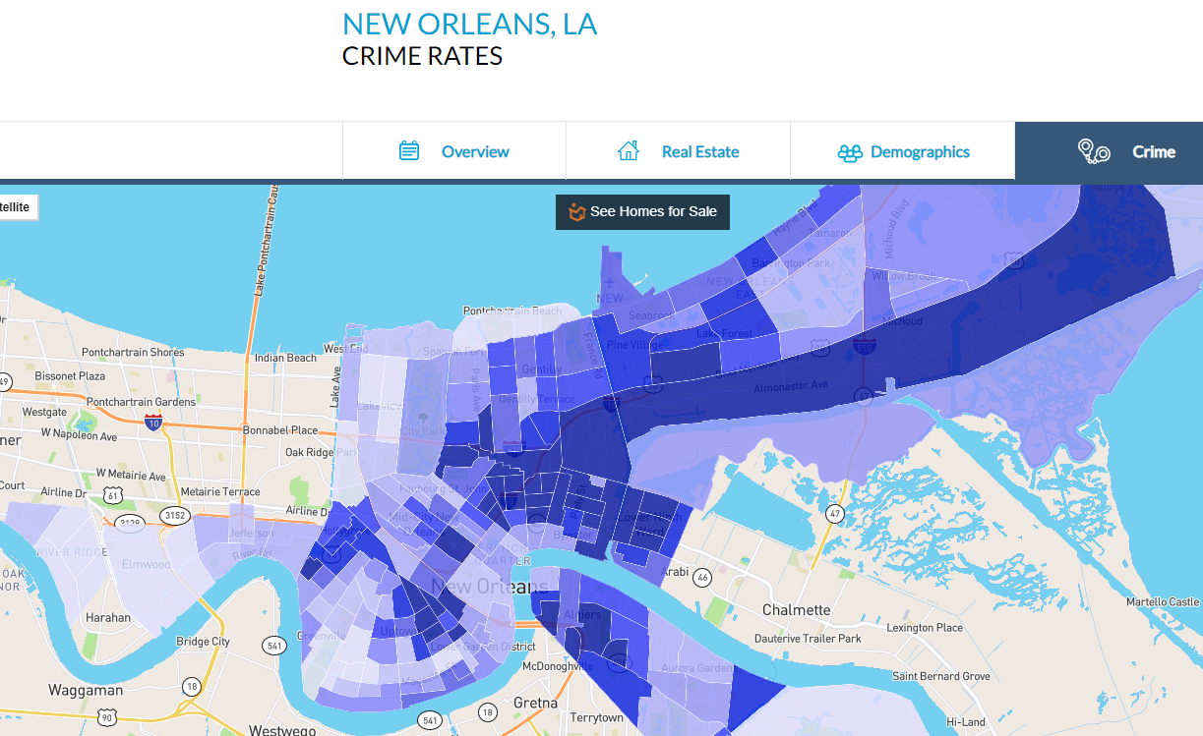

Slide 39
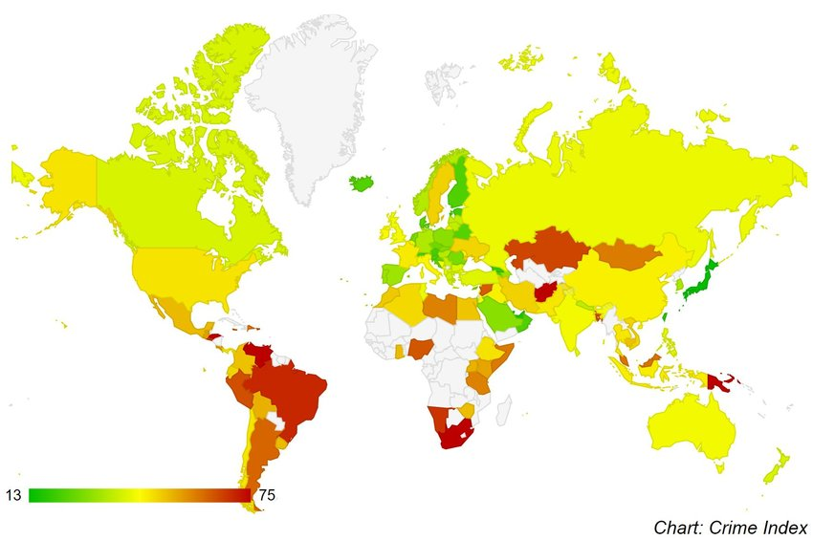
Crime Index by Country (2019)

Slide 40
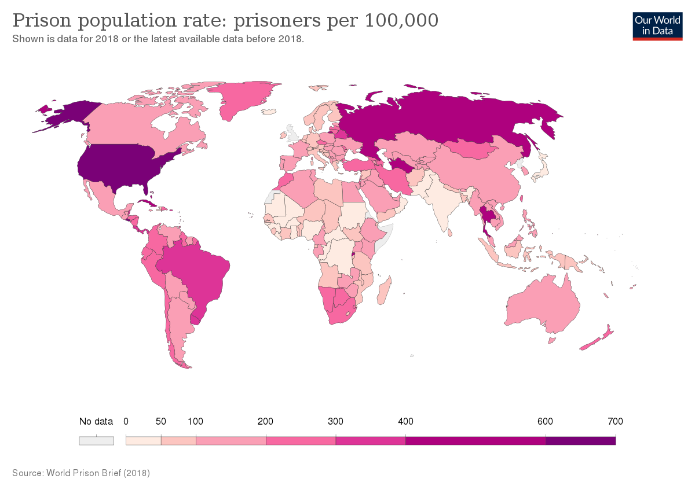
Data from World Prison Brief (2018 data)

Slide 41
Overview of Economics Research – Past Dills, Miron, and Summers (2010)
Since this Dills, Miron, and Summers (2010) article, there has been much work on measuring racial bias in policing and criminal justice in various contexts. We will see this come up in the next briefing note on racial bias, and in some other content later in the course.
There has also been better access to data since 2010. For example:
Crystal Yang, whose paper we will discuss later, leverages detailed sentencing data to study how economic circumstances affect recidivism (reoffending). (Yang, 2017)
Teams of economists have used administrative data (government-held data) in counties such as Norway that matches criminal justice records with other data like tax and program use data. They use this data and a “judge fixed effects” approach (discussed briefly in next slide, and later on in the course in more detail) to see how incarceration affects future criminal behavior. (Bhuller et al., 2020)

Slide 42
Past Dills, Miron, and Summers (2010) – Judge Fixed Effects
The other “hot” area of research by economists right now uses an approach called “judge fixed effects”.
While we will get into this in more detail, here is a quick summary.
The idea is to leverage the fact that many cases or situations in policing or criminal justice have random or conditional random assignment of judges/prosecuters/police to cases or incidents.

Slide 43
Past Dills, Miron, and Summers (2010) – Judge Fixed Effects
Sometimes judges are randomized to cases, leading to key characteristics such as strictness or race, to be randomized to cases.
Or maybe it’s police officers (white vs. black) being randomly assigned to incidents involving white or black individuals.
The idea is to exploit this “natural” randomization to see if it affects an outcome. This is usually better than difference-in-differences in getting us closer to a randomized control trial’s ability to estimate causal effects.

Slide 44





Defendant
This quasi-random assignment of cases to judges creates quasi-random variation that can be used to study the causal effect of a conviction (or other judicial decision) on causal outcomes (Bhuller et al., 2020; Eren and Mocan, 2021)
Lenient judge (less likely to convict)
Strict judge (more likely to convict)

Slide 45
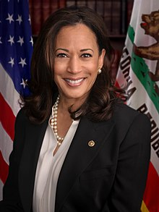




Defendant
Or random assignment to a judge/prosecutor of a particular race, to defendants, to study racial bias (Sloan, 2020)
Black prosecutor
White prosecutor

Slide 46
Past Dills, Miron, and Summers (2010) – Judge Fixed Effects
Examples of “judge fixed effects” or similar “fixed effects” approaches (most of which you will be exposed to later):
Random assignment of prosecutors (white vs. black) to cases of white vs. black defendants (Sloan, 2020).
Same as 1. but using bail judges (Arnold, Dobbie, and Yang, 2018)
Random assignment of police (white vs. black) to policing incidents that involve white vs. black people, and how this affects police use of force (Hoekstra and Sloan, 2020).
Random assignment of pickier judges (more likely to convict) to cases to see how this “random” variation in sentencing affects future criminal activity (Bhuller et al., 2020 using Norway data; Eren and Mocan, 2021, using Louisiana data).

