Slide 1

Urban Economics
Interpreting the results from GHM
Prof. Patrick Button

Slide 2
Plan for today
Brief overview of the GHM paper again (mostly to refresh memory)
Go over main tables and figures to explain the results
The parallel trends assumption – does it make sense in their case?
Discuss Quiz 2 on Wednesday

Slide 3
What do Greenstone et al. (2010) do?
Greenstone et al. (2010) compare other, existing manufacturing firms the winning county to existing manufacturing firms in the counties that just barely lost out on getting the MDP.
Firms in the winning county = “treated” group -> these firms gets the agglomeration spillovers from the large firm that moves in.
Firms in the losing counties = “control” group -> these firms do NOT get the spillovers.
Similar to a randomized trial (e.g., a study of the effects of a drug).

Slide 4
Are the “losers” a good control group?
A fundamental assumption is required to get a proper estimate of the actual (causal) effect of spillovers.
The treatment group (firms in winning county) must be as close as identical as possible to the control group (firms in losing counties).
Why might this not hold?
Winning counties might be better. Firms in winning counties might be more productive, independent of the spillover effect from the new firm.
For this reason they use a “difference-in-differences” methodology.

Slide 5
A Brief Intro to Difference-in-Differences
Also called “Diff-in-Diff” or just DD or DID or DiD.
This is a particular model used in regression analysis (more on what that is later).
Instead of just comparing the “treated” firms (firms in the winning county) to the “control” firms (firms in the losing counties), they make this comparison over time.
Compare the pre-period (the large firm hasn’t moved in yet, no firm is “treated”) to the post-period (the large firm has moved in, only firms in the winning county are “treated”)

Slide 6
Before MDP Enters
After MDP Enters
Pre-Period
Post-Period
Existing Firms in Winning County
Control
Treated
B
A
Existing Firms in Losing Counties
Control
Control
D
C

Slide 7
The Difference-Difference Estimate
The difference-in-differences estimate of the causal effect is:
(A – B) – (C – D)
That is, the before vs after in winning counties (A – B) compared to the before vs after in losing counties (C – D).
GHM do a more complicated calculation than this, but the intuitive idea behind their approach can be described this way, as a before vs. after for treatment group vs. a before vs. after for control group.

Slide 8
Does GHM’s parallel trends assumption make sense?
This assumption must be true for the DiD to provide an unbiased estimate of the causal effect.
Parallel trends assumption = The assumption that, had treatment not occurred (the MDP actually didn’t move in), then the treatment group and control group would have had the same changes in productivity over time (i.e. parallel changes).
So, do the control counties (“barely lost”) serve as a good control group? Does the general productivity trend for the existing firms in the “barely lost” counties match the existing general trend in the “winning” counties?

Slide 9
Violations of Parallel Paths
The parallel paths assumption can be violated (i.e. is it not realistic) under many circumstances:
The control group doesn’t provide a good estimate of the counterfactual. For example, maybe the treatment and control groups had different productivity trends leading up to the MDP moving in. In this case, we would expect those different existing trends to continue, so the change over time for the control group is not a realistic estimate of the counterfactual.
Something happens over time that is not controlled for that affects either the treatment of control group or affects one differently than the other.

Slide 10
Does GHM’s parallel trends assumption make sense?
There is never a way to actually test this parallel trends assumption.
There is no way to know exactly what would have happened had treatment not occurred. No way to know if the treated firms would have had a similar productive growth, in the absence of treatment as the control firms.
But some evidence can help suggest to what extent this assumption may be realistic or not.
1) Can look at pre-trends (time trends before treatment)
Do the treatment and control group seem parallel?
2) Knowing the context
Do we think the choice between the winning vs. runner up counties was close and kind of random, so those might be similar?

Slide 11
Investigating Parallel Trends
How would this work in Greenstone el al. (2010)?
1) Seems unlikely that something happened in the winning counties before firm entry, relative to the losing counties.
2) They look at the pre-trends and note that they are similar for the firms in winning and losing counties.
3) They argue that the decision between the winning and “barely lost” counties is more like a tie-breaker, so the control group is good (a bit of truth to this, but perhaps a stretch).
This generally seems to suggest that parallel trends holds.

Slide 12
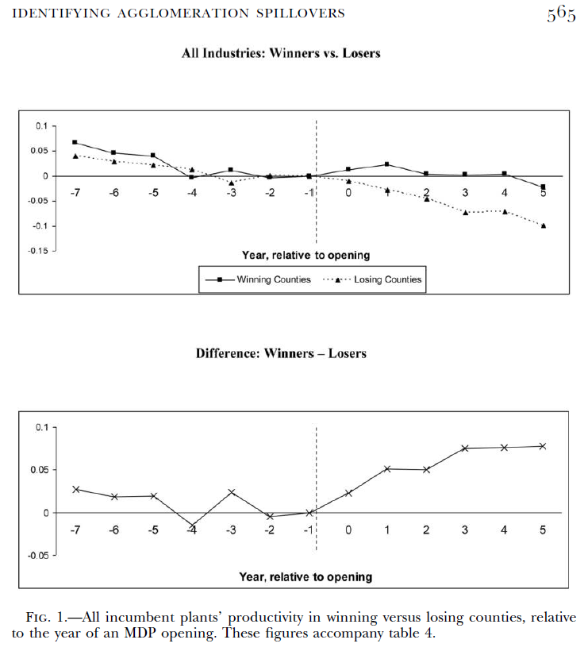
Looking at pre-trends
Top figure: shows the trend in productivity over time for treatment and control groups.
Bottom figure: shows winning – losing (i.e. shows the difference between both line)
Time = year relative to MDP opening (t = -1 is year before)
Effects are “normalized” to be relative to t = -1 (hence why t = -1 set at zero)

Slide 13
Ok, so what exactly do they do?
Greenstone el al. (2010) use the difference-in-differences strategy to measure productivity spillovers on existing firms when the new firms enter the winning counties.
They use “total factor productivity” to measure productivity of the existing firms.
What is this? I’ll try to explain both in a technical way but also a more intuitive way.

Slide 14
Total Factor Productivity and Production Functions
Here is a common function you will see in economics, a Cobb-Douglas Production Function…
Y = A K^{𝛼} L^{β}
Y = Output
K = Capital
L = Labor
A = Total Factor Productivity -> usually thought of as technology or production practices.
Measures how much you can get out of fixed inputs (K and L constant).
E.g., hold K and L fixed. Double A, then Y doubles. Making double output with the same inputs.

Slide 15
Total Factor Productivity and Production Functions
Y = A K^{𝛼} L^{β}
Y = Output, K = Capital, L = Labor, A = Total Factor Productivity
They can measure “A” by seeing how capital, and labor translate into output.
Intuitively, if they know K, L, and Y, they can “solve” for A to see how productive the firm is.
(More technically, they measure A as being the residual, the unexplained variation in Y, that is not explained in a regression of Y on K and L)

Slide 16
Summary statistics
These are tables that present summarizing statistics of the data.
I.e. it shows us what the data looks like so we can understand the context of the paper more.

Slide 17
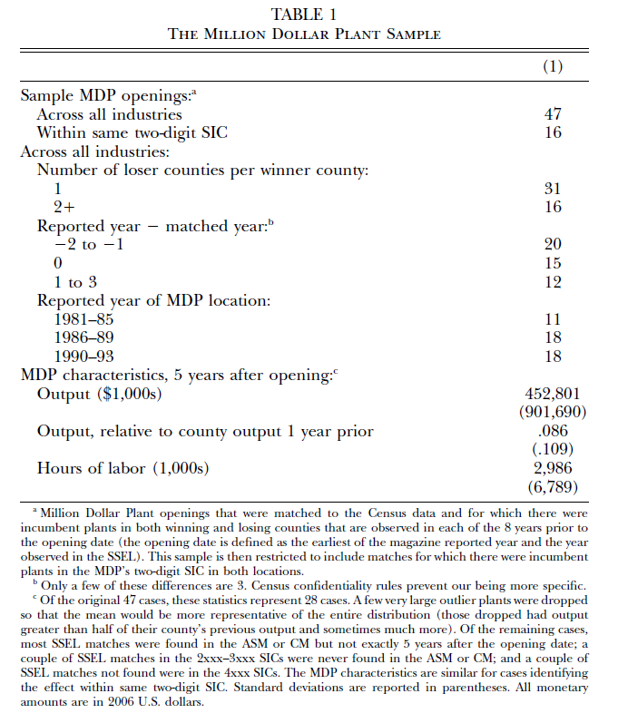
Summary Statistics for MDPs
This table shows us what the MDPs are like.
They have 47 MDPs in their sample.
Average output of the MDPs is about $452.8m dollars (2006 USD)
Average hours of labor is almost 3m hours per year.

Slide 18
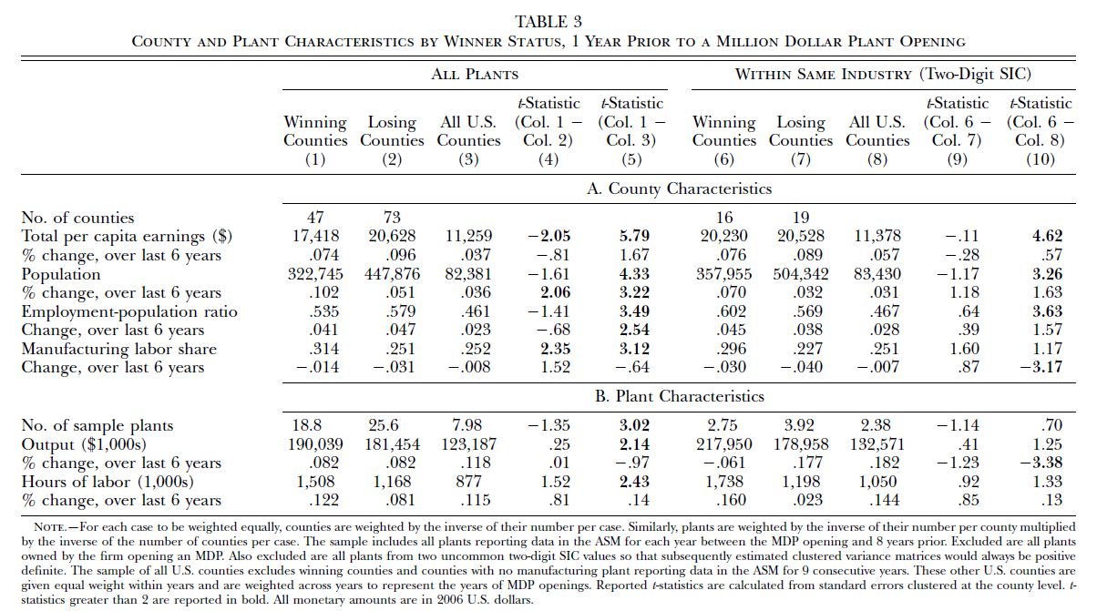
Summary statistics

Slide 19
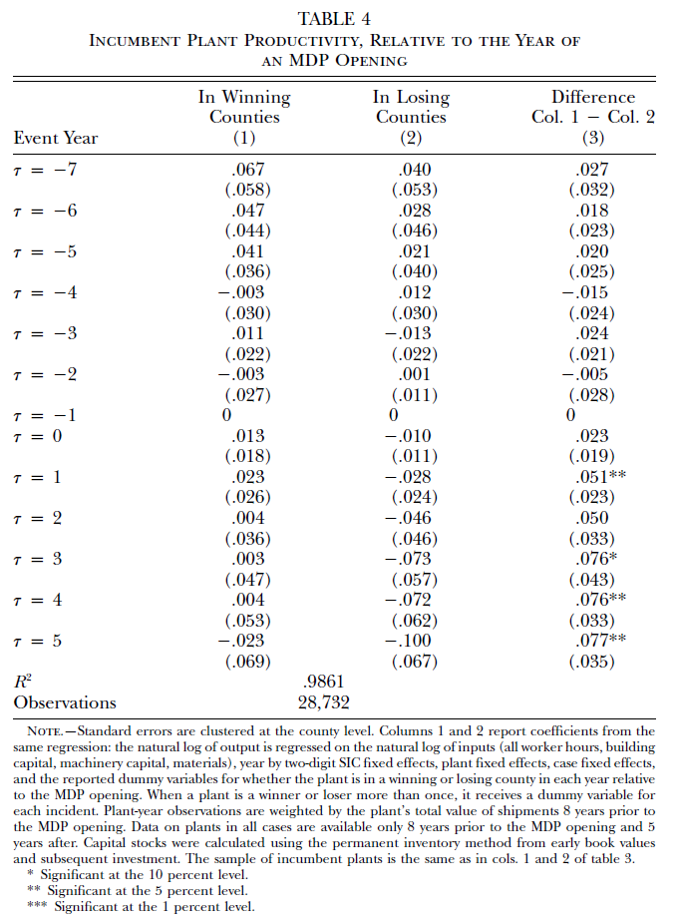
Results discussion
This table shows how productivity varies for each group, compared to that group’s productivity at time T = -1
T = -1 is the year before the MDP moves in.
The outcome variable is the natural logarithm of the productivity difference between that time period and T = -1
In English, the estimates reflect percent differences between that period and T = -1
E.g., for T = -7 for winning counties, the estimate is 0.067. This means that in that time period of seven years before the MDP plant moved in, productivity was about 6.7% higher than for those firms the year before the MDP moved in.

Slide 20
Results discussion
Positive values = higher productivity for that group, compared to that group’s productivity in time T = -1
What we see in this figure: both groups in the pre-period had declining productivity.
Productivity continues to decline for the control group, but stays pretty constant for the treatment group.
Column (3) shows us the difference, and we see that since the counterfactual (control group) predicted negative growth, but growth was flat for the treatment group, the net effect was an increase in productivity.
Estimates range from 2.3 to 7.7% increase in productivity due to MDP.
Effects increase over time.

Slide 21
Same thing but in a picture
Top figure: shows the trend in productivity over time for treatment and control groups.
Bottom figure: shows winning – losing (i.e. shows the difference between both line)
Time = year relative to MDP opening (t = -1 is year before)
Effects are “normalized” to be relative to t = -1 (hence why t = -1 set at zero)

Slide 22
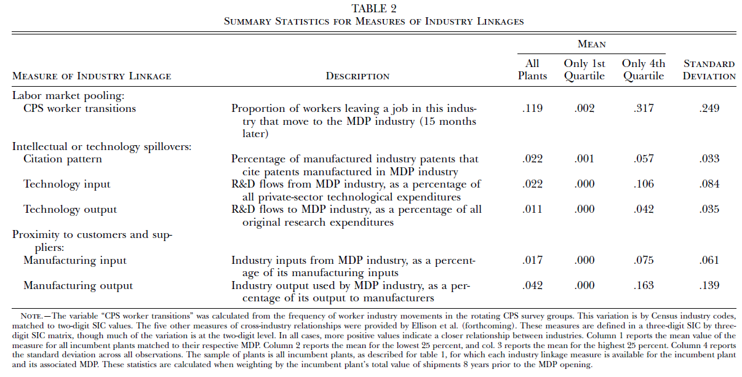

Slide 23
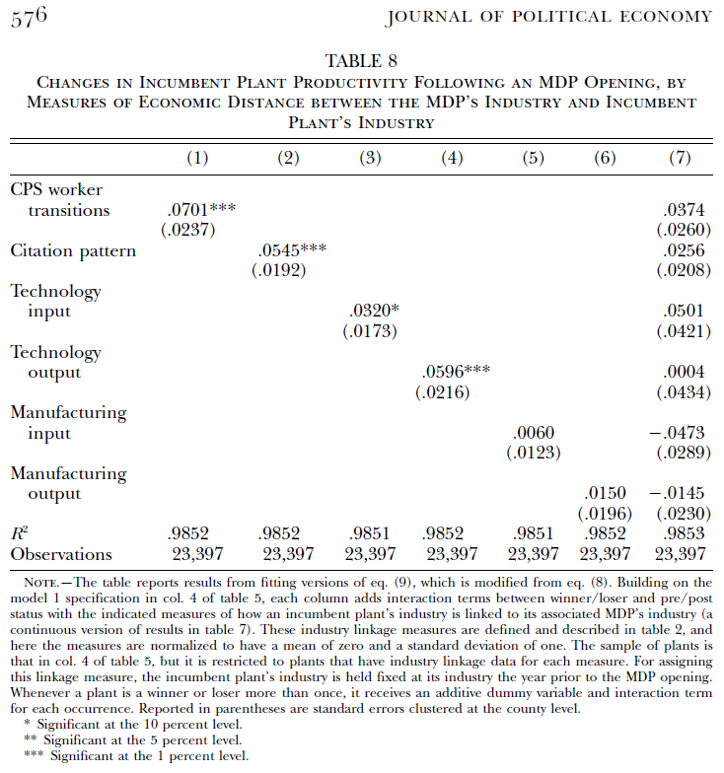
This table captures what moderates the spillover effects on productivity.
Which types of existing firms get the productivity boost?
I.e. how do spillover effects operate?
It seems that the “pollination” effect, i.e. worker mobility/transitions between firms, is the most important. More worker transitions between the MDP’s industry and existing firm’s industry predicts a larger productivity spillover.

Slide 24
“Citation pattern” also matters, meaning the spillover effects are larger with the MDP and existing firms cite similar patents.
i.e. they develop and apply similar technology.
Weak evidence that using the same technology inputs matters, it’s more about the technology output (as shown in the output and citation pattern results).
Doesn’t seem to matter if the existing firms and MDP use the same inputs and outputs, it comes down to making the same tech and using similar workers.

Slide 25
Results Summary
Five years after the new manufacturing plants open in the winning counties, total factor productivity (TFP) is 12 percent higher in winning counties (relative to before, relative to losing counties).
Pretty big effect!
Greenstone et al. (2010) also found that the spillover effect was larger for firms that shared similar labor and technology pools with the new plants. This makes sense.

Slide 26
Results Summary
But something else happens. Labor costs increase.
This makes sense. A big manufacturing plant moves into the country. Demand for manufacturing works goes up.
Labor demand curve shifts to the right.
The wage increase should be higher in the short term than in the long term.
In the long term, more workers can move to that country (supply shifts right).

Slide 27
Results Summary
Total Factor Productivity for existing firms increases by 12 percent over five years.
But labor costs also increase.
So part of the profit increase that would come from the TFP increase is eaten by labor costs.

Slide 28
Quiz 2 info
See the modules page for Quiz 2 on Canvas.

