Slide 1

Urban Economics
Interpreting Statistical Results Tables
Prof. Patrick Button

Slide 2
Overview of these slides
General layout of statistical results tables
Coefficients and standard errors – what they mean
Constructing confidence intervals: 90%, 95%, and 99%
Hypothesis testing: 10%, 5%, and 1% levels
What do the *s beside the estimates mean?

Slide 3
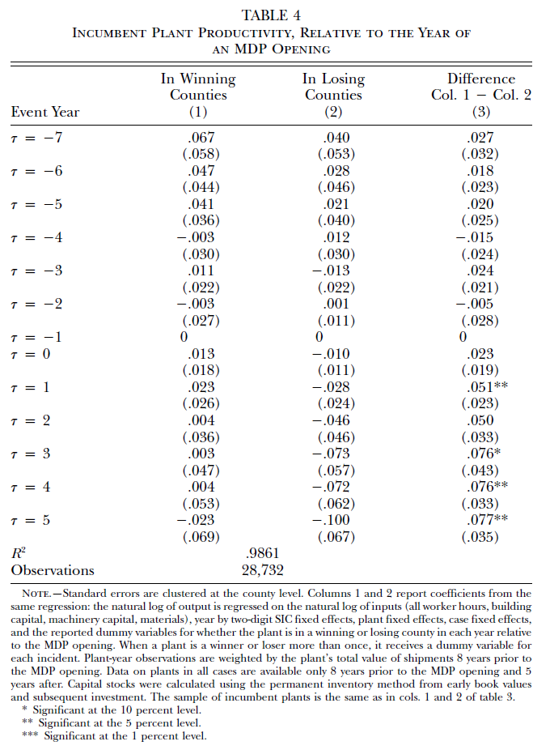
General layout of statistical results tables
Top numbers are the estimates.
Usually these are coefficient estimates from a regression, but sometimes they are just means or differences in means.
These tell you the estimated effect, difference, etc.
These tell you the magnitude of the effect or difference – was it small or large? Negative or positive?

Slide 4
General layout of statistical results tables
Under each estimate, in (), is the standard error (SE) of the estimate.
The SE tells us how precise the estimate is. How sure are we of this estimate?
Larger SE = less precise estimate, the estimate has a larger margin of error.
A confidence interval for this estimate would be wider (as we shall see).

Slide 5
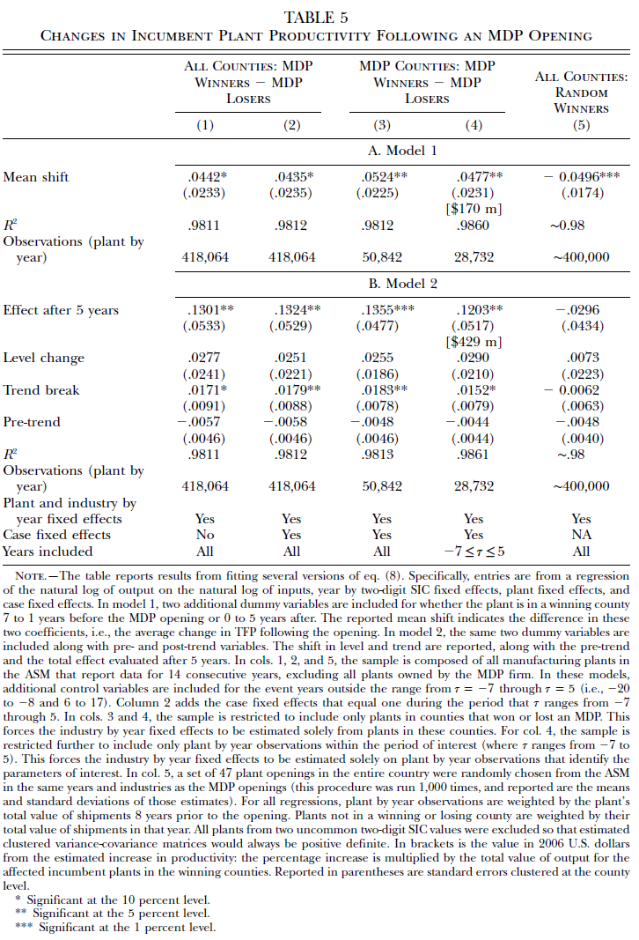
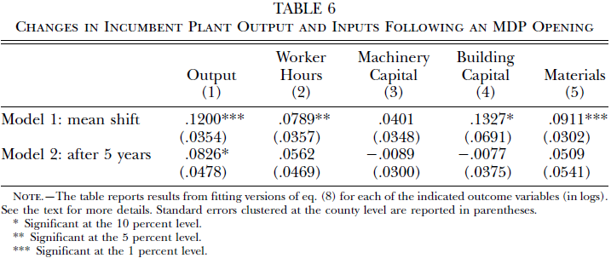
More Table examples
I will explain more about all these tables later, but for not just notice the
typical format: estimate with standard errors underneath it.
Also notice the use of *s, which I will explain shortly. These indicate how
statistically significant an estimate is.

Slide 6
Coefficients and standard errors – what they mean
Estimate (top number) tell us the effect that was estimated and what the magnitude of the effect was.
The standard error tells us how precise that estimate is (how much margin of error does it have?)
Here are some examples of coefficients that may make this easier to understand for those of you who haven’t taken econometrics or any statistics courses that use regression.

Slide 7
Coefficients and standard errors – what they mean
Suppose I estimated the mean (average) productivity of firms in county A and in county B. These are hypothetical numbers.
County A = 100, with a standard error of 10.
County B = 90, with a standard error of 12.
The difference (A – B) is 10, and suppose it has a standard error of 15.
Let’s focus on this estimate of 10, with a standard error of 15.

Slide 8
Coefficients and standard errors – what they mean
The estimate of 10 tells us that county A’s productivity is estimated to be 10 higher than county B’s productivity, on average.
The standard error is 15, which is fairly high.
How do we use this standard error to tell us how precise our estimate is?
The best way to do it is by using it to construct a confidence interval.

Slide 9
Constructing confidence intervals
There are usually three confidence intervals that (social) scientists create: 90%, 95%, and 99% confidence intervals.
The intuitive* way to understand these is:
The 90% (95%, 99%) confidence interval tells us that, under the assumption that our statistical model is correct, the true effect we are measuring lies within our confidence interval 90% (95%, 99%) of the time.
For example, suppose the 95% confidence interval of an estimate was (-0.3 to 0.1). Then we are 95% confident that the true effect, the thing we are estimating, lies between -0.3 and 0.1.
Thus, this confidence intervals tell us how sure we are of our estimates, since it’s impossible to be sure what they are exactly, given randomness and noise in the data.
*For those with more theoretical stats training, you’ll know that this intuitive explanation isn’t technically correct, but I am not looking to explain to beginners the difference between frequentist and Bayesian statistics or the repeated sampling nature of classical statistics.

Slide 10
Constructing confidence intervals
How do we make 90%, 95%, and 99% confidence intervals?
The general formula is:
Lower bound: Estimate – critical value * standard error
Upper bound: Estimate + critical value * standard error
Where the critical value is 1.645 for a 90% interval, 1.96 for 95%, and 2.576 for 99%.

Slide 11
Calculating confidence intervals
Going back to our original example, we had an estimate of 10 and a standard error of 15
Lower bound: 10 – critical value * 15
Upper bound: 10 + critical value * 15
Where the critical value is 1.645 for a 90% interval, 1.96 for 95%, and 2.576 for 99%.

Slide 12
Calculating confidence intervals – 90%
Lower bound: 10 – critical value * 15 = 10 – 1.645*15 = 10 – 24.675 = -14.675
Upper bound: 10 + critical value * 15 = 10 + 1.645*15 = 10 + 24.675 = 34.675
Therefore, the 90% confidence interval is (-14.675, 34.675).

Slide 13
Calculating confidence intervals – 95%
Lower bound: 10 – critical value * 15 = 10 – 1.96*15 = 10 – 29.4 = -19.4
Upper bound: 10 + critical value * 15 = 10 + 1.96*15 = 10 + 29.4 = 39.4
Therefore, the 95% confidence interval is (-19.4, 39.4).

Slide 14

Calculating confidence intervals – 95%
Lower bound: 10 – critical value * 15 = 10 – 1.96*15 = 10 – 29.4 = -19.4
Upper bound: 10 + critical value * 15 = 10 + 1.96*15 = 10 + 29.4 = 39.4
Therefore, the 95% confidence interval is (-19.4, 39.4).
1.96 is very close to 2, so you can calculate an “eye-ball” confidence interval (not a technical term) by using 2:
Lower = 10 – 2*15 = 10 – 30 = -20
Upper = 10 + 2*15 = 10 + 30 = 40

Slide 15
Calculating confidence intervals – 99%
Lower bound: 10 – critical value * 15 = 10 – 2.576*15 = 10 – 38.64 = -28.64
Upper bound: 10 + critical value * 15 = 10 + 2.576*15 = 10 + 38.64 = 48.64
Therefore, the 99% confidence interval is (-28.64, 48.64).

Slide 16
Comparing confidence intervals
For our example of an estimate of 10, with a standard error of 15, our confidence intervals are:
The 90% confidence interval is (-14.675, 34.675).
The 95% confidence interval is (-19.4, 39.4).
The 99% confidence interval is (-28.64, 48.64).
Notice how as we move higher in confidence, the confidence interval grows.
To be more sure that our interval contains the true value (higher % confidence), we have to increase the interval.

Slide 17

Activity break – Calculating confidence intervals
Let’s take a break from lecture to calculate some intervals.
For this, I’m going to have you calculate “eye-ball” 95% confidence intervals, i.e. using 2 instead of 1.96 for the critical value.
Therefore, the formula is:
Lower bound = estimate – 2*SE, Upper bound = estimate + 2*SE
Remember order of operations -> multiply SE by 2 first!
I’ll give you five minutes to do the short quiz “Confidence Interval Calculation” on Canvas. I’ll put you into breakout rooms so you can more easily ask each other or me (by summoning me) questions.

Slide 18
Hypothesis testing
In addition to calculating confidence intervals, we often do hypothesis testing.
Mostly, we test to see if our estimates are statistically significantly different from zero.
This is, are we reasonably sure that the true value, which we estimated, is different from zero?
Different from zero is useful to test because if it is different from zero, then it implies that there is likely an effect or a difference.
If an estimate is not statistically significantly different from zero, we don’t have enough statistical evidence to claim that there is an effect.

Slide 19
Hypothesis testing: 10%, 5%, and 1% levels
We typically test for statistical significance at the following levels:
10%, which corresponds to a 90% confidence interval,
5%, which corresponds to a 95% confidence interval,
1%, which corresponds to a 99% confidence interval.
The 10%, 5%, and 1% here refer to the amount of what is called “Type 1 error”, which can be interpreted as a false positive rate (finding an effect that does not exist).
Under 10% (5%, 1%), you will find an effect (difference from zero) that does not actually exist 10% (5%, 1%) of the time.

Slide 20
Balancing Type 1 and Type 2 Error
Statistics tries to balance to types of error:
Type 1 error -> “false positive”
E.g., finding an effect where there is actually no effect.
A positive test result when really the person is negative.
Type 2 error -> “false negative”
E.g., finding no effect (not statistically different from zero) when really there is an effect.
A negative test result when really the person is positive.

Slide 21


Balancing Type 1 and Type 2 Error
Actual Result↓|Estimated Result→ | There is an effect | There is no effect
There is an effect |  | Type 2 Error False Negative
There is no effect | Type 1 Error False Positive
If we decrease the level that we test at (e.g., from 5% to 1%, which would be the same as moving from a 95%
confidence interval to a 99% confidence interval) then we decrease the probability of making Type 1 Errors
(fewer false positives) but we increase the probability of making Type 2 Errors (more false negatives).

Slide 22
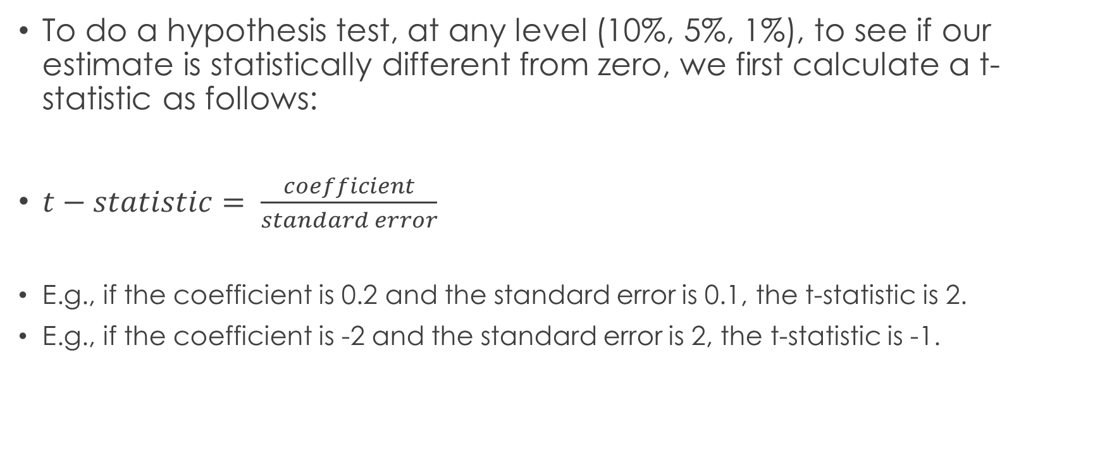
Hypothesis testing formula
To do a hypothesis test, at any level (10%, 5%, 1%), to see if our estimate is statistically different from zero, we first calculate a t-statistic as follows:
$t−statistic= \frac{coefficient}{standard error}$
E.g., if the coefficient is 0.2 and the standard error is 0.1, the t-statistic is 2.
E.g., if the coefficient is -2 and the standard error is 2, the t-statistic is -1.

Slide 23
Hypothesis testing formula
Once we have our t-statistic, we compare it to a critical value.
These are the same critical values used to create confidence intervals.
The critical values are…
1.645 for a test at the 10% level of significance (90% confidence interval)
1.96 for a test at the 5% level of significance (95% confidence interval)
2.576 for a test at the 1% level of significance (99% confidence interval)
If our critical value is, in absolute value, greater than that critical value, then it is at least significant at that level.

Slide 24
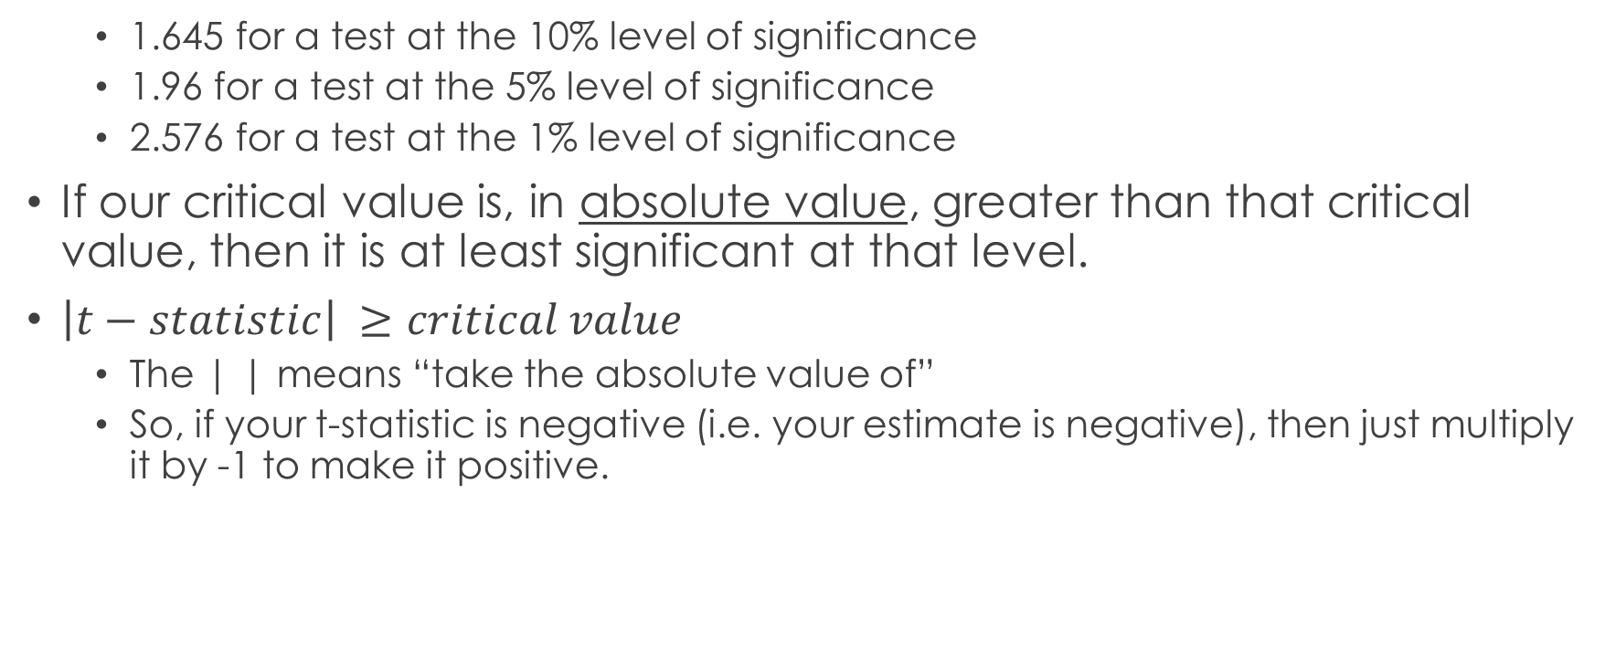
Hypothesis testing formula
1.645 for a test at the 10% level of significance
1.96 for a test at the 5% level of significance
2.576 for a test at the 1% level of significance
If our critical value is, in absolute value, greater than that critical value, then it is at least significant at that level.
$\left|t−statistic\right| ≥critical value$
The | | means “take the absolute value of”
So, if your t-statistic is negative (i.e. your estimate is negative), then just multiply it by -1 to make it positive.

Slide 25
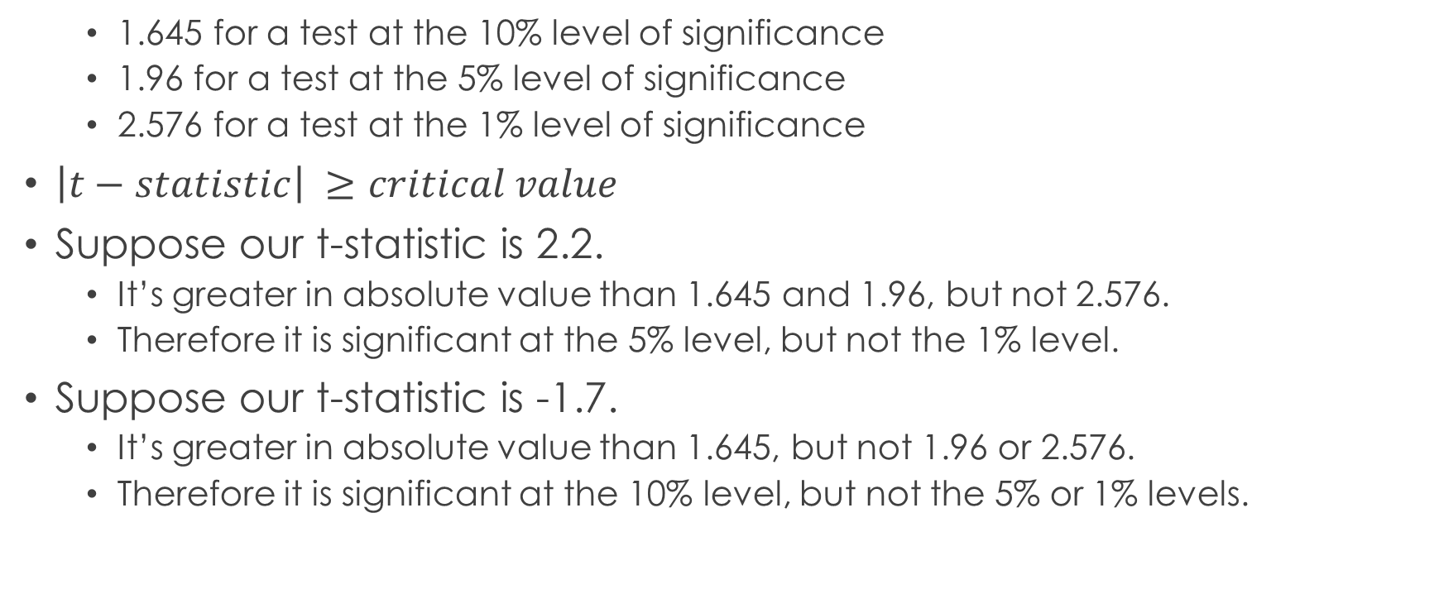
Hypothesis testing Example
1.645 for a test at the 10% level of significance
1.96 for a test at the 5% level of significance
2.576 for a test at the 1% level of significance
$\left|t−statistic\right| ≥critical value$
Suppose our t-statistic is 2.2.
It’s greater in absolute value than 1.645 and 1.96, but not 2.576.
Therefore it is significant at the 5% level, but not the 1% level.
Suppose our t-statistic is -1.7.
It’s greater in absolute value than 1.645, but not 1.96 or 2.576.
Therefore it is significant at the 10% level, but not the 5% or 1% levels.

Slide 26
Hypothesis testing Example
Instead of using 1.96 as the critical value to test at the 5% level, use 2.
The “eye-ball” t-test at the 5% level is just dividing the coefficient by the standard error and seeing if that t-statistic is greater than 2 in absolute value.
You can often do this just by looking at coefficient estimates with their standard errors in tables.
E.g., 0.038
(0.017)
I can see that that’s bigger than 2.

Slide 27
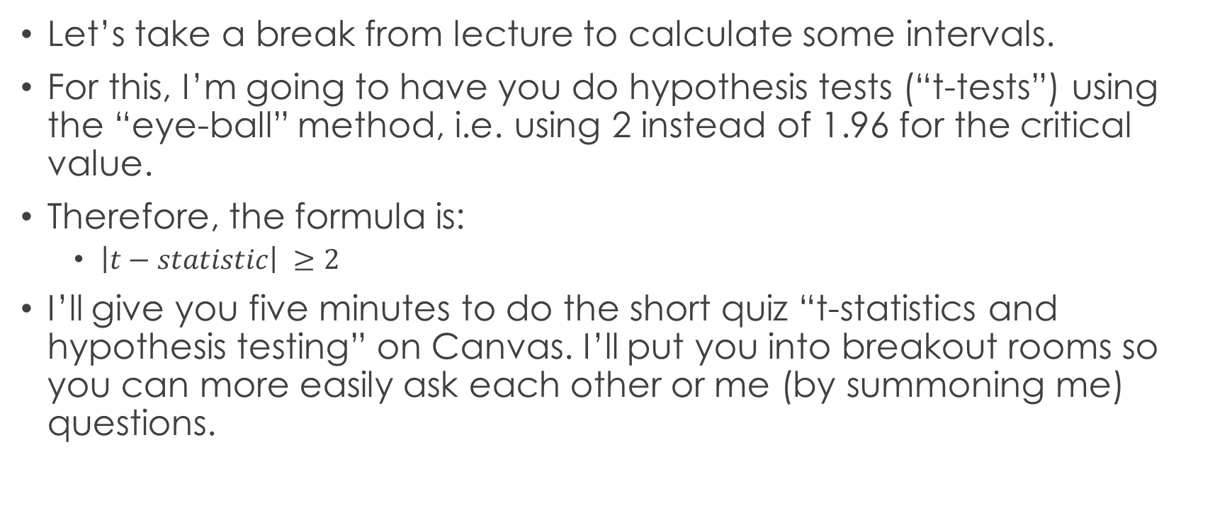
Activity break – t-statistics and hypothesis testing
Let’s take a break from lecture to calculate some intervals.
For this, I’m going to have you do hypothesis tests (“t-tests”) using the “eye-ball” method, i.e. using 2 instead of 1.96 for the critical value.
Therefore, the formula is:
$\left|t−statistic\right| ≥2$
I’ll give you five minutes to do the short quiz “t-statistics and hypothesis testing” on Canvas. I’ll put you into breakout rooms so you can more easily ask each other or me (by summoning me) questions.

Slide 28
What do the *s beside the estimates in tables mean?
Usually statistical tables have notes under them that detail what *, **, and *** mean.
More *s means more statistically significant -> we are even more sure that there is an effect (i.e. that the estimate is different). The risk of Type 1 error (false positive) is lower as significance increases.

Slide 29
What do the *s beside the estimates mean?
Most tables use the following convention, but check the table notes to be sure.
No *s means not statistically significant at the 10% level (or any more stringent levels: 5%, 1%, etc.).
* means statistically significantly different from zero at the 10% level.
Or, zero does not fall into the 90% confidence interval
** means statistically significantly different from zero at the 5% level.
Or, zero does not fall into the 95% confidence interval
*** means statistically significantly different from zero at the 1% level.
Or, zero does not fall into the 99% confidence interval

Slide 30
What do the *s beside the estimates mean?
Note: anything significant at the 1% level (***) is also significant at the 5% level (**) and the 10% level (*).
Similarly, anything significant at the 5% level (**) is also significant at the 10% level (*).
Testing at the 5% level is the most common benchmark of statistical significance used.
So, when researchers say something is statistically significant, they usually mean that it’s statistically significant at at least the 5% level.
The 1% level is the strongest conventional level, although you can test at any level (e.g., some researchers test at the 0.1% level).

Slide 31
What do the *s beside the estimates mean?
You can use the * system to quickly see how significant estimates are.
This avoids you having to do more time-intensive ways at gauging the statistical significant of the estimates, such as:
Calculating a t-statistic (coefficient divided by standard error) and seeing if it’s greater than two (which would mean its significant at the 5% level).
Calculating a confidence interval.
Again, just be sure to check the table notes to be sure you are interpreting the * system correctly.

Slide 32
Other table conventions – t-stats in ()
The majority of social sciences, outside of usually psychology, tend to present statistical results the way I detailed here:
Estimate, with standard errors in () underneath
However, some fields or older papers put t-statistics underneath the estimates.
So instead of 2.0 they would have: 2.0
(1.0) (2.0)
Check the table notes so you know what is in the ()!

Slide 33
Other table conventions – p-value in ()
The majority of social sciences, outside of usually psychology, tend to present statistical results the way I detailed here:
Estimate, with standard errors in () underneath
However, some fields or older papers put p-values underneath the estimates.
So instead of 1.96 they would have: 1.96 or 1.96
(1.00) (0.05) [0.05]
The p-value is significance level, so 0.05 means significant at the 5% level.
A p-value of 0.01 means significant at the 1% level, etc.

